Slide 1

Good Afternoon Year 6!
Let’s start our afternoon with a quick burst of energy!
Get your PE kit at the ready because at the start of each afternoon session we will be joining Joe Wicks for our daily workout.
Do as much as you can and over the week you should find you are getting fitter and finding it easier.
Let’s go!
Click the youtube link below and select today’s date from the videos listed.
https://www.youtube.com/channel/UCAxW1XT0iEJo0TYlRfn6rYQ

Slide 2
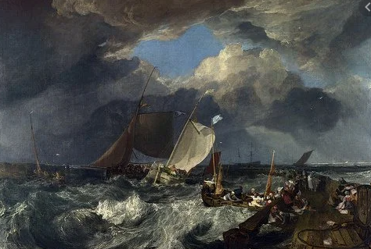
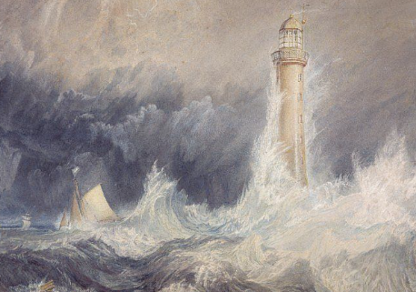
Art
Stormy seas
WALT: create a piece of artwork based on J. Turner’s Style using a range of techniques.

Slide 4
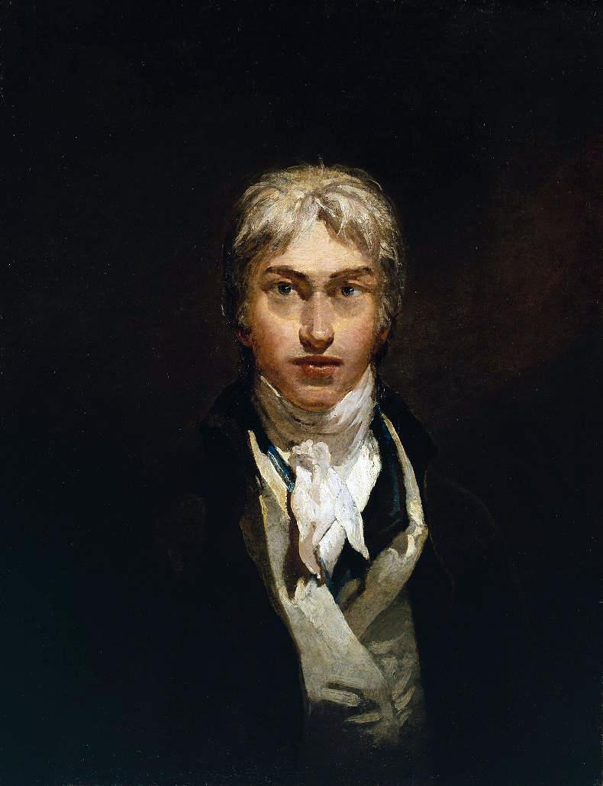
A Londoner
Joseph Mallord William Turner was born in April 1775 in Covent Garden, London. His father, William, was a barber and wigmaker and his mother was called Mary.
Joseph’s father was supportive of his artistic talent and would display his son’s early drawings in his shop.
Joseph Turner kept his Cockney accent
all his life.
Image courtesy of (@commons.wikimedia.org) under the creative commons license.

Slide 5
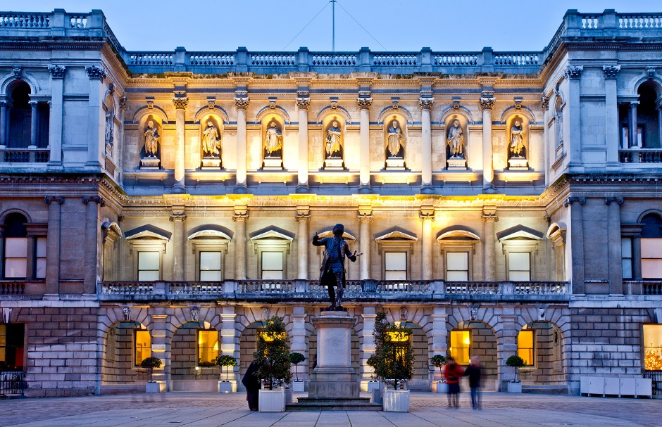

The Royal Academy of Arts
Joseph attended the Royal Academy of Arts school in 1789 and was accepted into the academy the following year.
Although Joseph was interested in architecture, he was advised to carry on painting watercolour pictures. He sold some of his watercolour paintings to help pay for his fees at the Academy.
Joseph Turner was only fourteen years old when he started studying at
the Academy.
Did You Know?
Image courtesy of Turner Bequest (@commons.wikimedia.org) under the creative commons license.

Slide 6
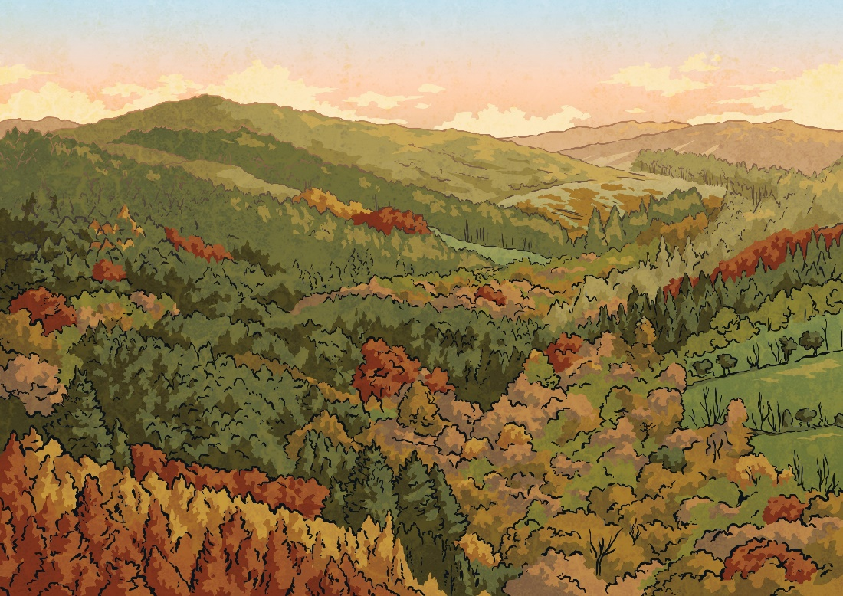
Capturing the Light
Joseph Turner began sketching outside, using these as a basis for his paintings, indoors. This led to him touring the country during the summer and working in the studio in the winter.
He became known as “The Painter
of Light”.
In 1796, he exhibited his first painting in oils: ‘Fishermen at Sea’.
As you look at the following paintings, think about why Turner was known as “The Painter of Light”.

Slide 7

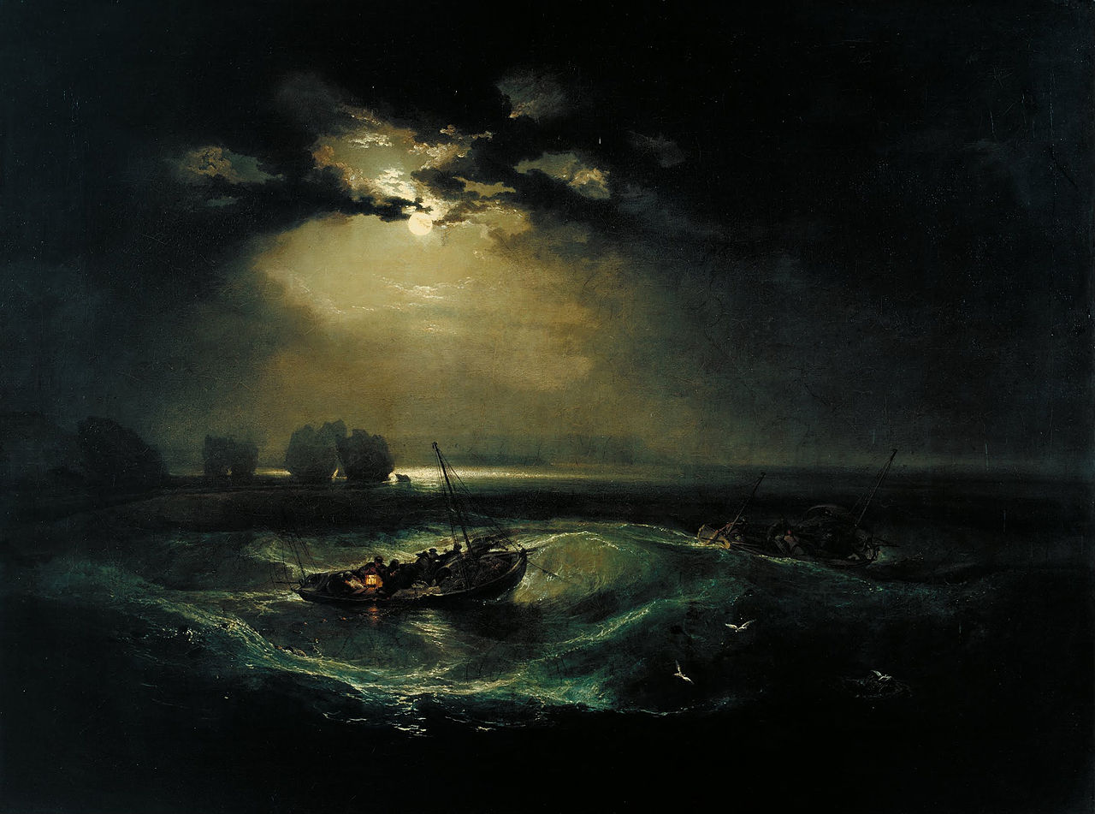
Fishermen at Sea
What are your thoughts about this painting?
Image courtesy of Jmw Turner (@commons.wikimedia.org) under the creative commons license.

Slide 8
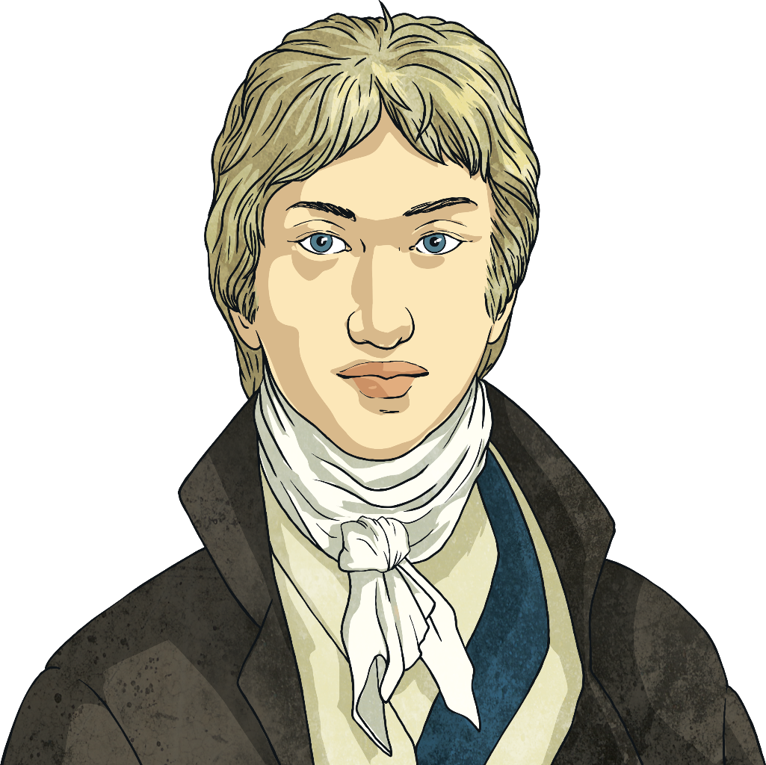
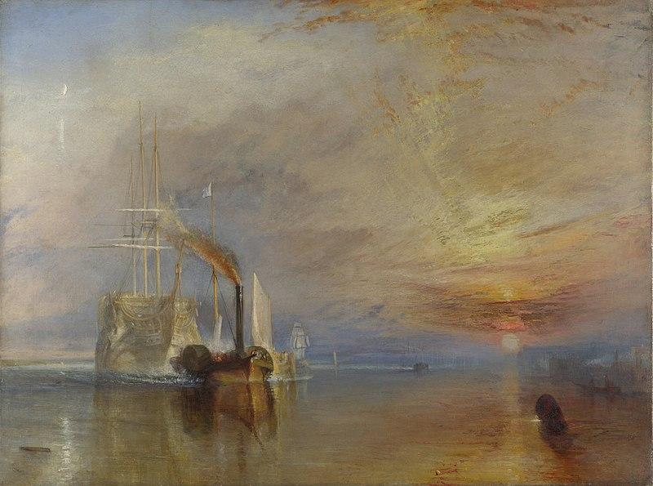
Painter of Light
One of Joseph Turner’s most famous paintings is called ‘The Fighting Temeraire Tugged to Her Last Berth to Be Broken Up’ and is on display at the National Gallery in London.
How would you describe
Turner’s painting technique?
Image courtesy of Tunrer jmw (@commons.wikimedia.org) under the creative commons license.

Slide 9
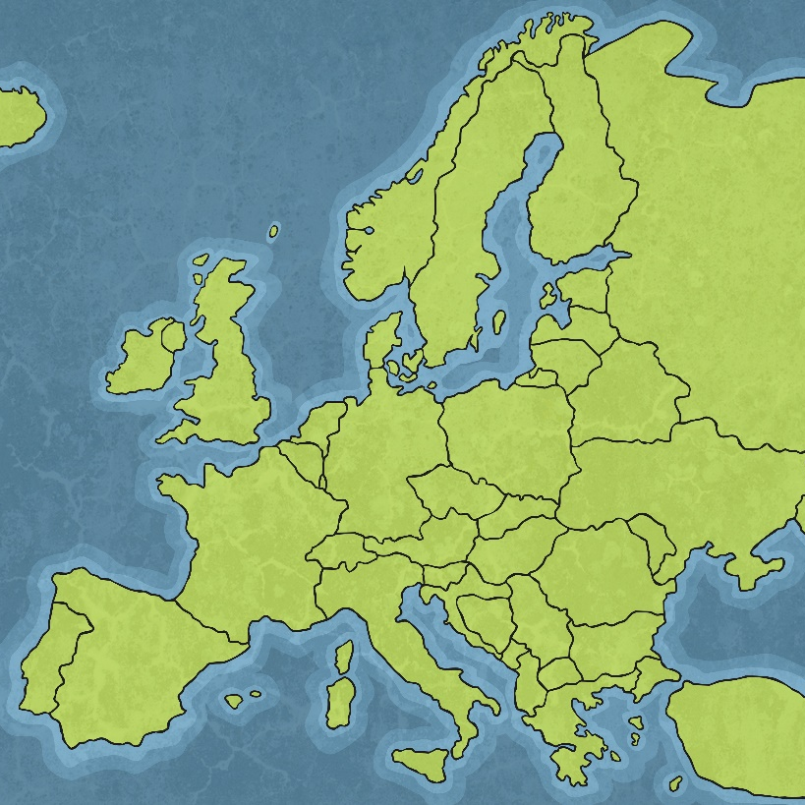
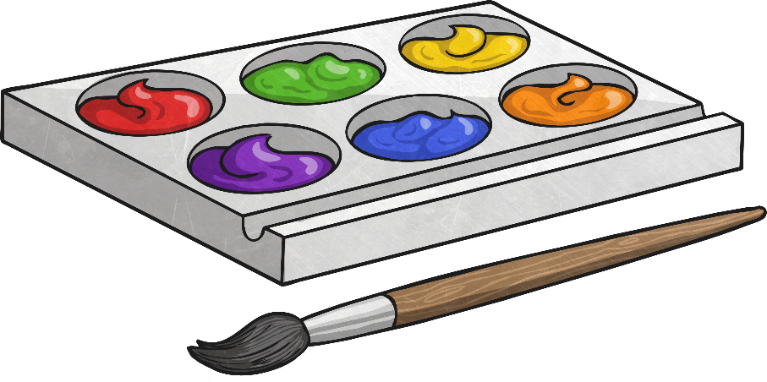
Travel
Turner began to travel around Europe, becoming known as one of the greatest masters of watercolour landscapes.
He travelled to Belgium and Holland to see the sight of the Battle of Trafalgar after receiving a royal commission to paint the battle.

Slide 10
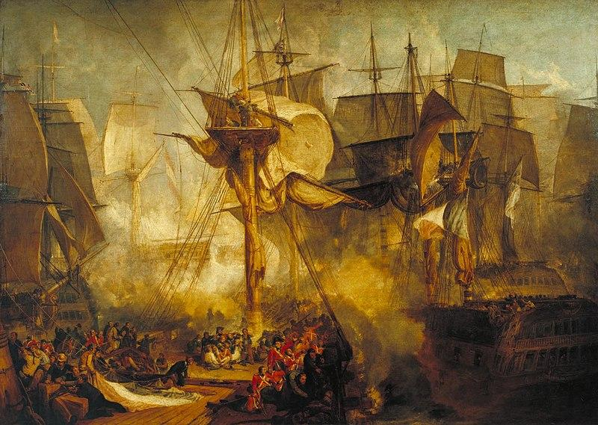
The Battle of Trafalgar 1806
This painting was a royal commission for Turner.
He travelled to Belgium and Holland to see where the battle took place.
Image courtesy of Tuner JMW (@commons.wikimedia.org) under the creative commons license.

Slide 11
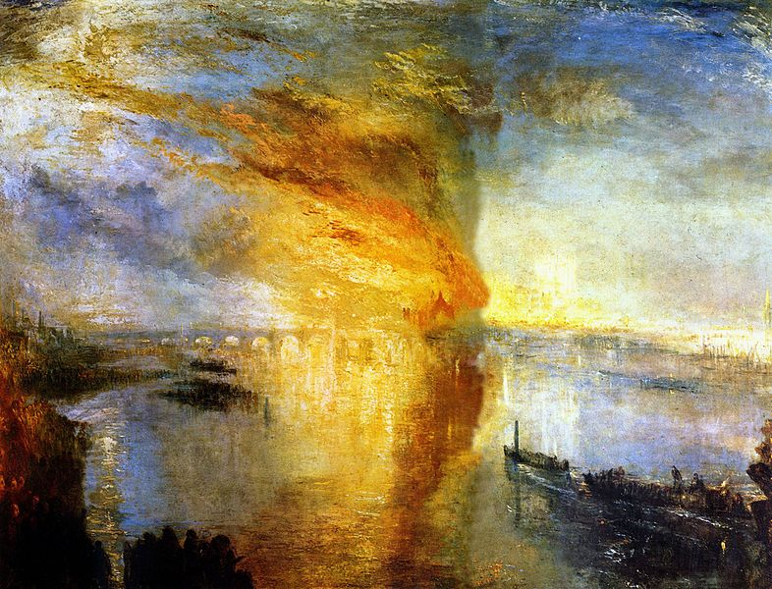
The Burning of the
Houses of Parliament 1835
On 16th October 1835, a fire broke out in the Houses of Parliament in London.
Turner sketched the scene at the spot and went on to paint some of his most famous masterpieces.
Image courtesy of jm Turner (@commons.wikimedia.org) under the creative commons license.

Slide 12
The Fighting Temeraire, Tugged to
Her Last Berth to Be Broken Up 1839
This ship was used in the Battle of Trafalgar but this painting documents when it was being tugged to be used for scrap.
Image courtesy of (@commons.wikimedia.org) under the creative commons license.

Slide 13
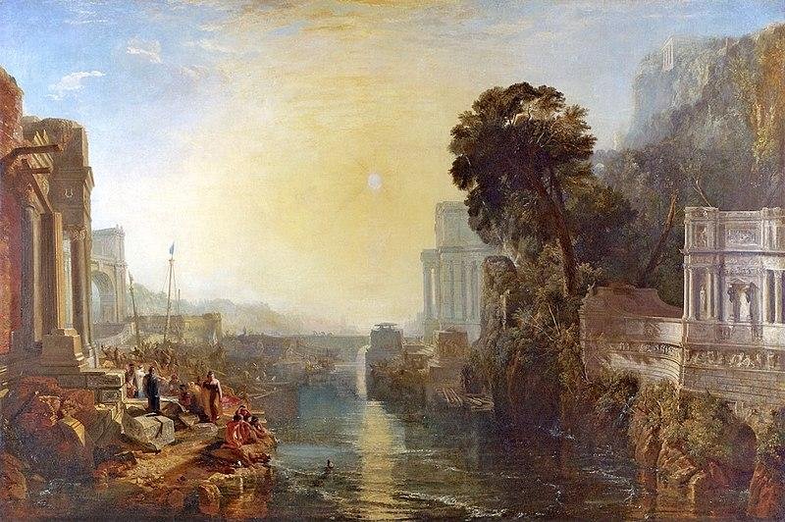
Dido Building Carthage 1815
Turner became influenced by Greek mythology.
This painting is one of his most famous from this period.
Image courtesy of Joe Turner Images (@commons.wikimedia.org) under the creative commons license.

Slide 14
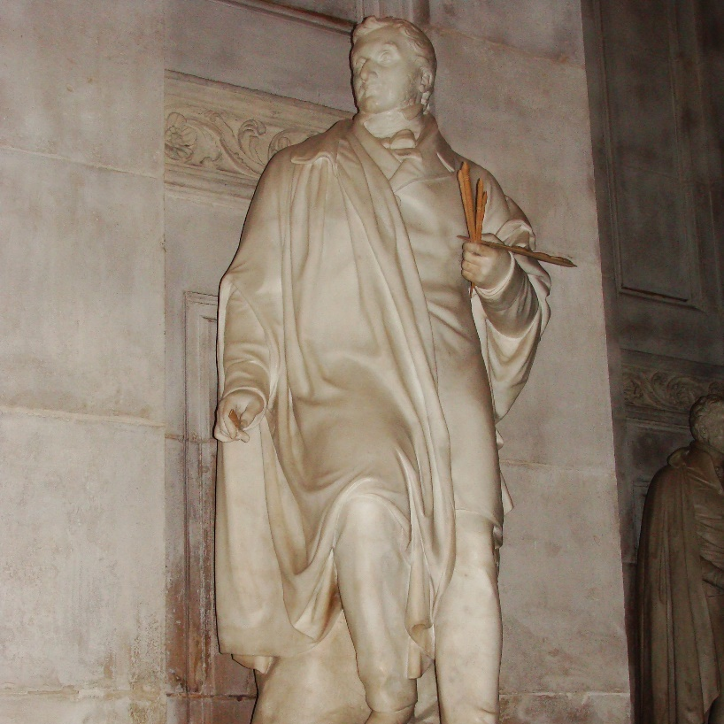
Towards the Light
On 19th December 1857, Joseph Mallord William Turner died after contracting cholera. He was buried in St Paul’s Cathedral, London, near two of his artist friends who had passed away years before.
He left money for an elaborate funeral and a monument to be built in his memory. This
resulted in a marble statue, sculpted by
Patrick MacDowell, being created in 1862,
which now stands in the nave of
the cathedral.
Image courtesy of Turner123 (@commons.Wikimedia.org) under the creative commons license.

Slide 15
Art
Stormy seas
Let’s have a closer look at how Turner painted the sea.

Slide 16
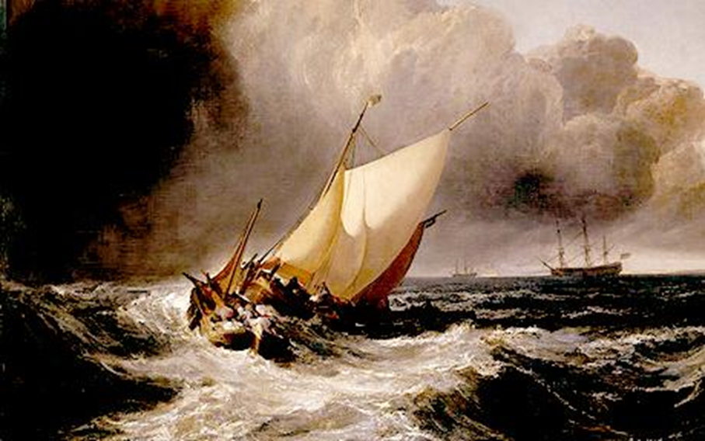

Slide 17
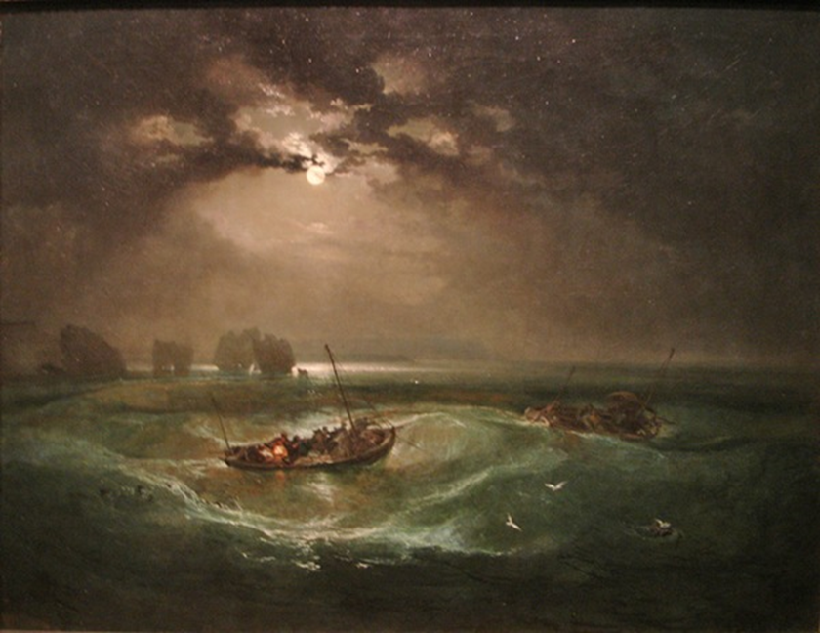

Slide 18
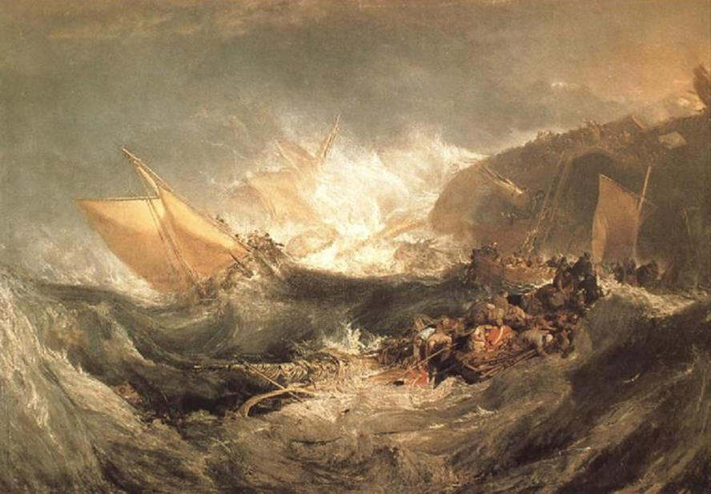

Slide 19
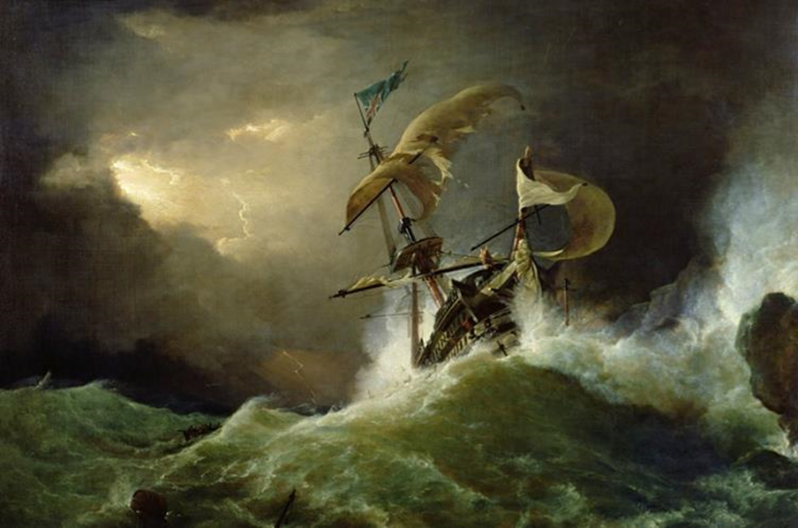

Slide 20
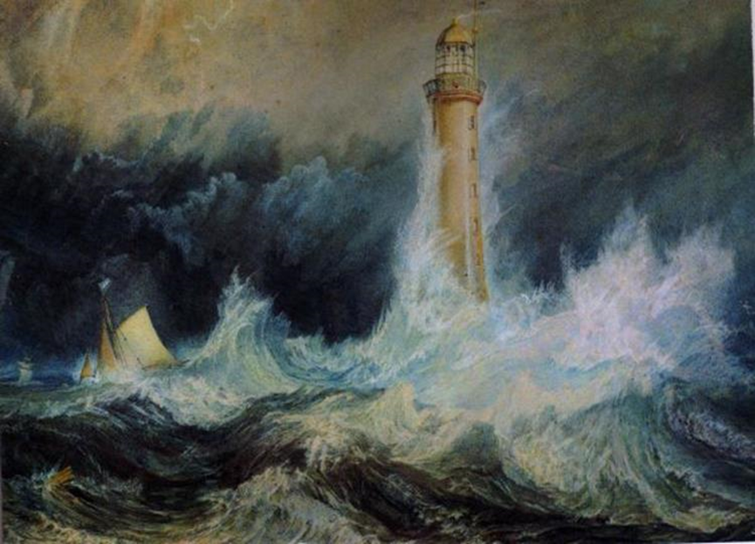

Slide 21
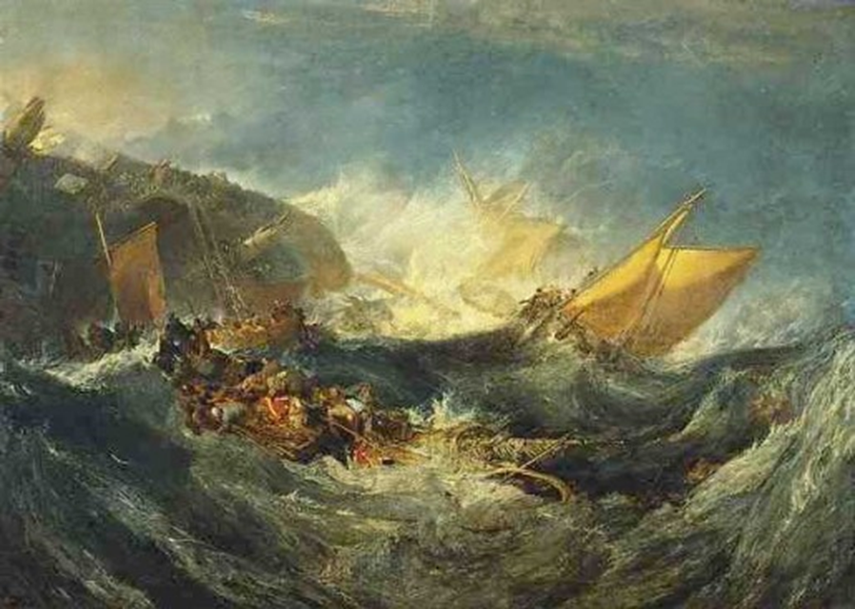

Slide 22
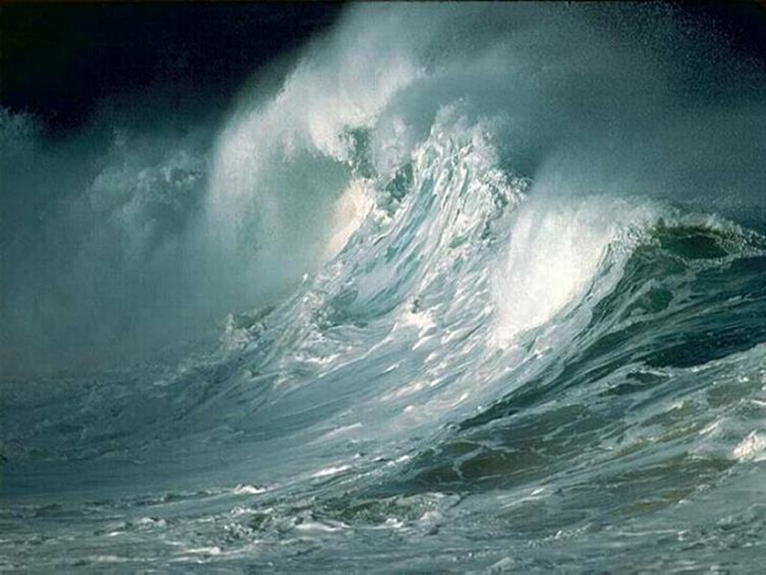
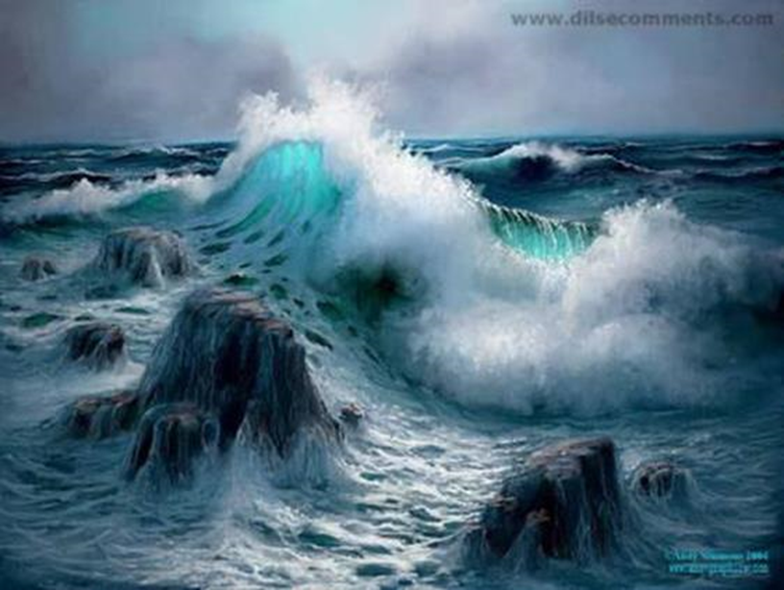
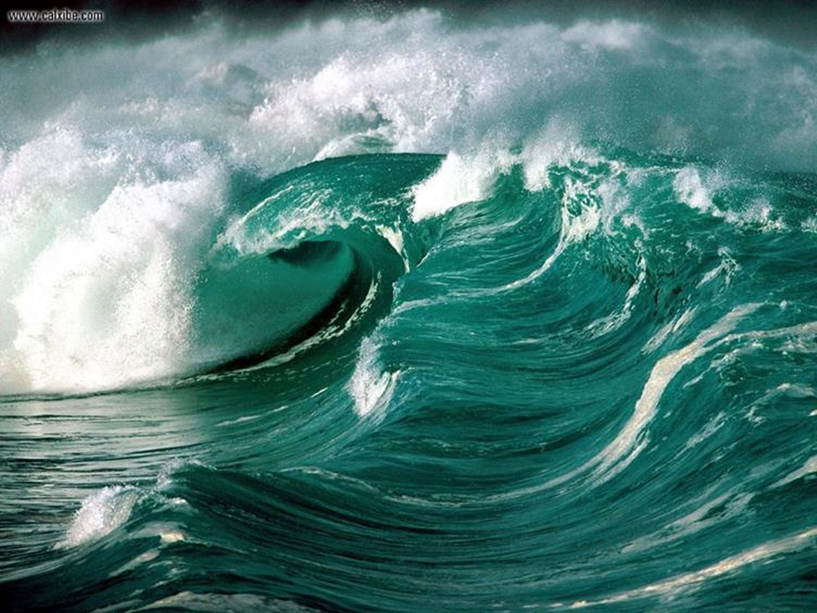
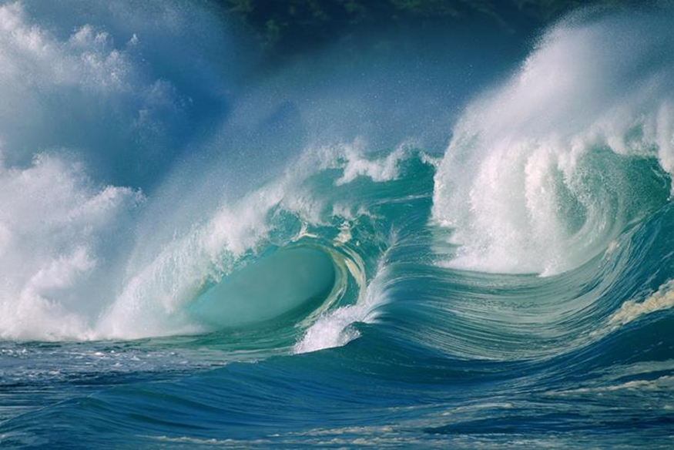
Let’s have a look at some photos of stormy seas so that we can see how accurate Turner was…
What do you notice about the colours and shapes?

Slide 23
Look at how the tips and crests have white on and there is sometimes spray coming from them too.
Look at how the colours change in certain parts with lighter and darker areas. Where do these occur?

Slide 24
We are going to use a range of brush strokes to create the sea.
Start at the crest of the wave with a base colour and bring it downwards then repeat bringing it down in different directions using a range of long and short brush strokes.
Go over the top of it in a lighter or darker colour to create a range of shades and effects.
Before it is dry use a fresh brush and then dab the crests lightly with white to create a sea spray effect.
Practice your waves! Once you have had some practice, create your own stormy seascape.
Notes:
Model the technique described.
Children use this technique to create waves and then put these together into a seascape.

Slide 25

Well done on a great day!
Enjoy your evening and be ready for more learning tomorrow...

