Slide 1
Good MoRning Year 6!
We hope you are enjoying the last week of term!
Please follow the instructions on each page to help you - we look forward to hear about how you have got on!
Mrs Jones and Miss Nolan

Slide 2


This week’s theme is
Football Project and Transition
Day 2 - 14.7.20

Slide 3
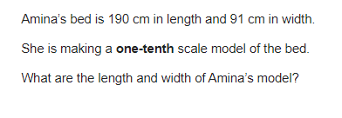

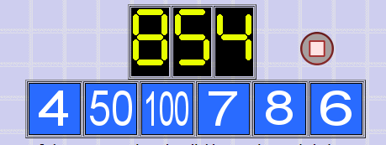
Morning Maths
8.
9. How many days in 2 years and 12 weeks?
10.
1755 ÷ 5 =
8³ =
67% of 2000 =
2/7 x 560 =
3036 ÷ 12 =
6.
7. It costs Mike 50p to send 8 texts on his phone. He spends £5 in one month. How many texts did he send?
Notes:
Children complete in maths book.
They have 15 minutes to complete independently.
Spend 10 minutes at the end of the session going through the answers and the children self mark.

Slide 4
ANSWERS
8.
9. How many days in 2 years and 12 weeks? 365 + 365 + (12 x 7) = 814
10.
1755 ÷ 5 = 351
8³ = 512
67% of 2000 = 1340
2/7 x 560 = 160
3036 ÷ 12 = 253
6.
7. It costs Mike 50p to send 8 texts on his phone. He spends £5 in one month. How many texts did he send? 80 texts
L = 19cm
W = 9.1cm
336
100 x 8 = 800
800 + 50 + 4 = 854

Slide 5
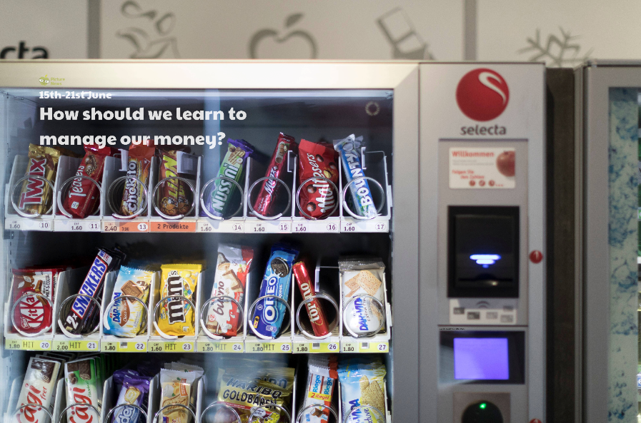
Daily Worship

Slide 6
Daily Worship
Do you think young people should receive pocket money?
What is pocket money? Do you receive pocket money or know anyone who does?
Explain that pocket money is a small amount of money, usually given weekly to children. Some children may have to complete weekly jobs to earn their pocket money; others will just receive it.

Slide 7
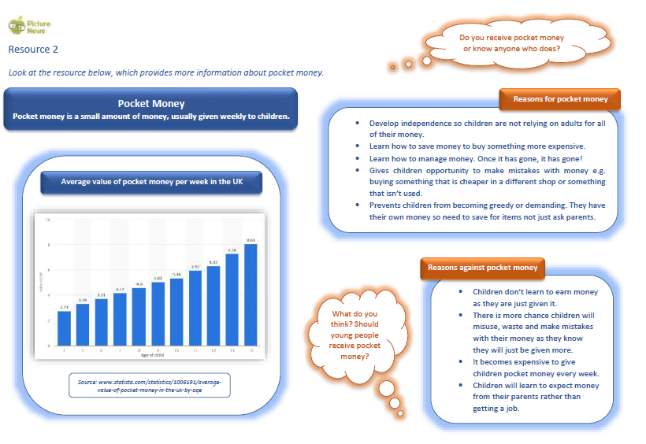

Slide 8
Daily Worship
Do you think it is important for young people to have money? Other than pocket money, how else do we receive money e.g. birthdays, for doing well in a test, for doing jobs at home, selling old toys or books etc?
Have you ever received money? What do you do with it? Do you spend it or save it? Do you have a bank account to save your money in?
In the UK, the youngest age you can get a job part-time is 13. Do you think you will want a job when you are 13? Why/why not?

Slide 9

Daily Worship
Reflection
Whether you think young people should receive pocket money or not, it is important to be aware of money because it will become something we need to manage as an adult.

Slide 10

Spellings

Slide 11
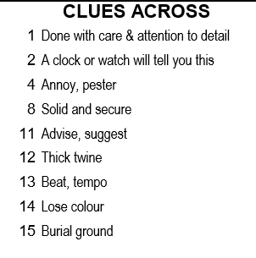
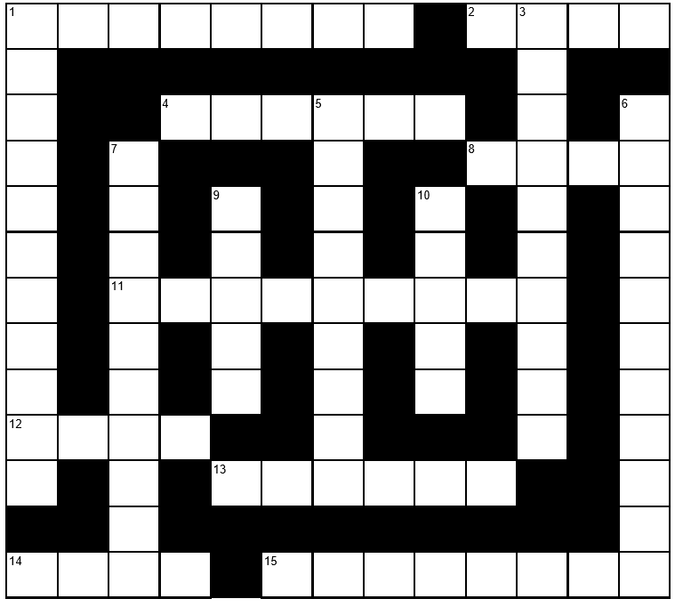
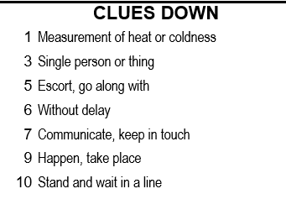
Tuesday - CrossWord
Words on next slide

Slide 12
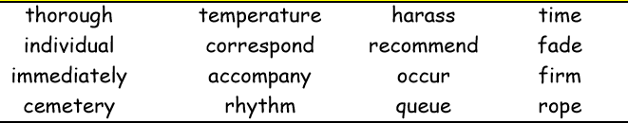
Tuesday- CrossWord

Slide 13
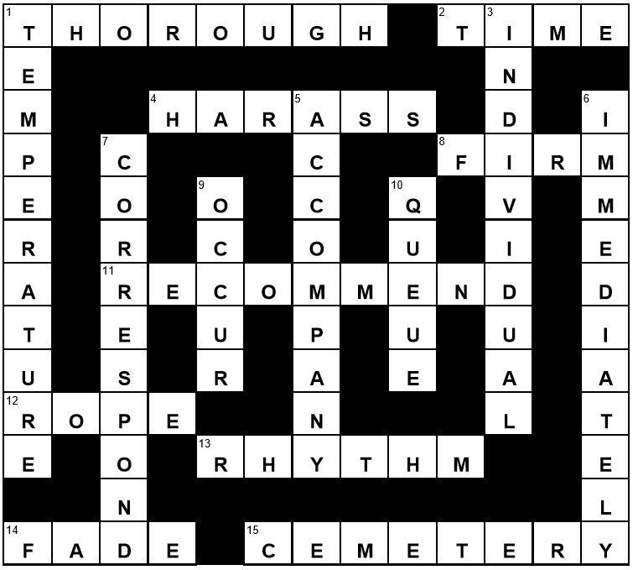
Tuesday - CrossWord Answers

Slide 14
A New Team In Town
Football Project

Slide 15
Money, Money, Money
You are the chairman of your new football team.
You have £200,000,000 to spend on setting the team up, buying players, creating your stadium, appointing a new manager and everything required for the team to run effectively.
Using the attached matrix, and list of costs. What will you spend your money on?
You will need:
16 players (at least 1 goalkeeper, at least 4 defenders, at least 4 midfielders and at least 2 strikers – the rest are up to you)
1 manager
1 coach
1 physio
1 doctor
1 stadium
When buying your players and staff, note their rating score. The higher the score, the better chance your team has of winning matches and trophies, but also the more expensive they are to buy.

Slide 16
Your Team & Staff
Player | Position | Rating | Price | Player | Position | Rating | Price
Manager | Rating | Price
Doctor | Rating | Price
Stadium | Capacity | Price
Coach | Rating | Price
Physio | Rating | Price
Notes:
You may want to print this slide or the next few slides for reference.

Slide 17
STAR PLAYERS
Name | Position | Rating (out of 20) | Price
Stevie Saves | Goalkeeper | 18 | £15,000,000
Billy Blocker | Defender | 19 | £16,000,000
Peter Passer | Midfielder | 20 | £20,000,000
Gary Goals | Striker | 19 | £17,000,000
Carrie Catch | Goalkeeper | 18 | £15,000,000
Tara Tackle | Defender | 19 | £16,000,000
Annie Assist | Midfielder | 20 | £20,000,000
Sheila Shooter | Striker | 19 | £17,000,000

Slide 18
GOOD PLAYERS
Name | Position | Rating (out of 20) | Price
Dave Dives | Goalkeeper | 15 | £12,000,000
Carl Clears | Defender | 14 | £10,000,000
Larry Longpass | Midfielder | 16 | £14,000,000
Sammy Skills | Striker | 14 | £11,000,000
Paula Parry | Goalkeeper | 14 | £11,000,000
Sally Slides | Defender | 16 | £14,000,000
Carly Corners | Midfielder | 15 | £12,000,000
Debbie Dribbles | Striker | 14 | £10,000,000

Slide 19
SQUAD PLAYERS
Name | Position | Rating (out of 20) | Price
Gordon Goalkick | Goalkeeper | 13 | £6,000,000
Barry Bookings | Defender | 12 | £8,000,000
Lenny Longshot | Midfielder | 11 | £7,000,000
Stanley Stepover | Striker | 12 | £9,000,000
Glenda Gloves | Goalkeeper | 13 | £9,000,000
Hayley Headers | Defender | 11 | £6,000,000
Pamela Playmaker | Midfielder | 12 | £8,000,000
Vera Volley | Striker | 12 | £7,000,000

Slide 20
YOUNG RESERVE PLAYERS
Name | Position | Rating (out of 20) | Price
Callum Cantcatch | Goalkeeper | 8 | £5,000,000
Simon Slips | Defender | 7 | £5,000,000
Timmy Trips | Midfielder | 8 | £5,000,000
Martin Misses | Striker | 6 | £5,000,000
Orla Owngoal | Goalkeeper | 8 | £5,000,000
Sarah Sentoff | Defender | 8 | £5,000,000
Fallon Falls | Midfielder | 6 | £5,000,000
Olive Offside | Striker | 7 | £5,000,000

Slide 21
MANAGER |  |  | COACH
Name | Rating (out of 20) | Price | Name | Rating (out of 20) | Price
Charlie Champion | 19 | £10,000,000 | Timmy Tactic | 18 | £7,500,000
Winnie Everything | 19 | £10,000,000 | Freya Formation | 18 | £7,500,000
Niall Nilnil | 12 | £6,000,000 | Ashley Attack | 13 | £3,500,000
Deidre Draws | 12 | £6,000,000 | Dani Defend | 13 | £3,500,000
PHYSIO |  |  | DOCTOR
Name | Rating (out of 20) | Price | Name | Rating (out of 20) | Price
Michael Massage | 18 | £1,500,000 | Dr. Doctor | 20 | £2,500,000
Wendy Warmup | 18 | £1,500,000 | Dr. Medicine | 17 | £1,500,000
Freddy Firstaid | 12 | £500,000 | Dr. Doolittle | 11 | £750,000
Sally Sling | 12 | £500,000 | Dr. Ouchee | 6 | £250,000

Slide 22
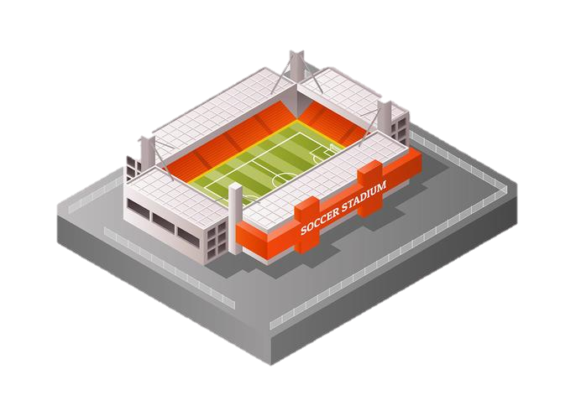
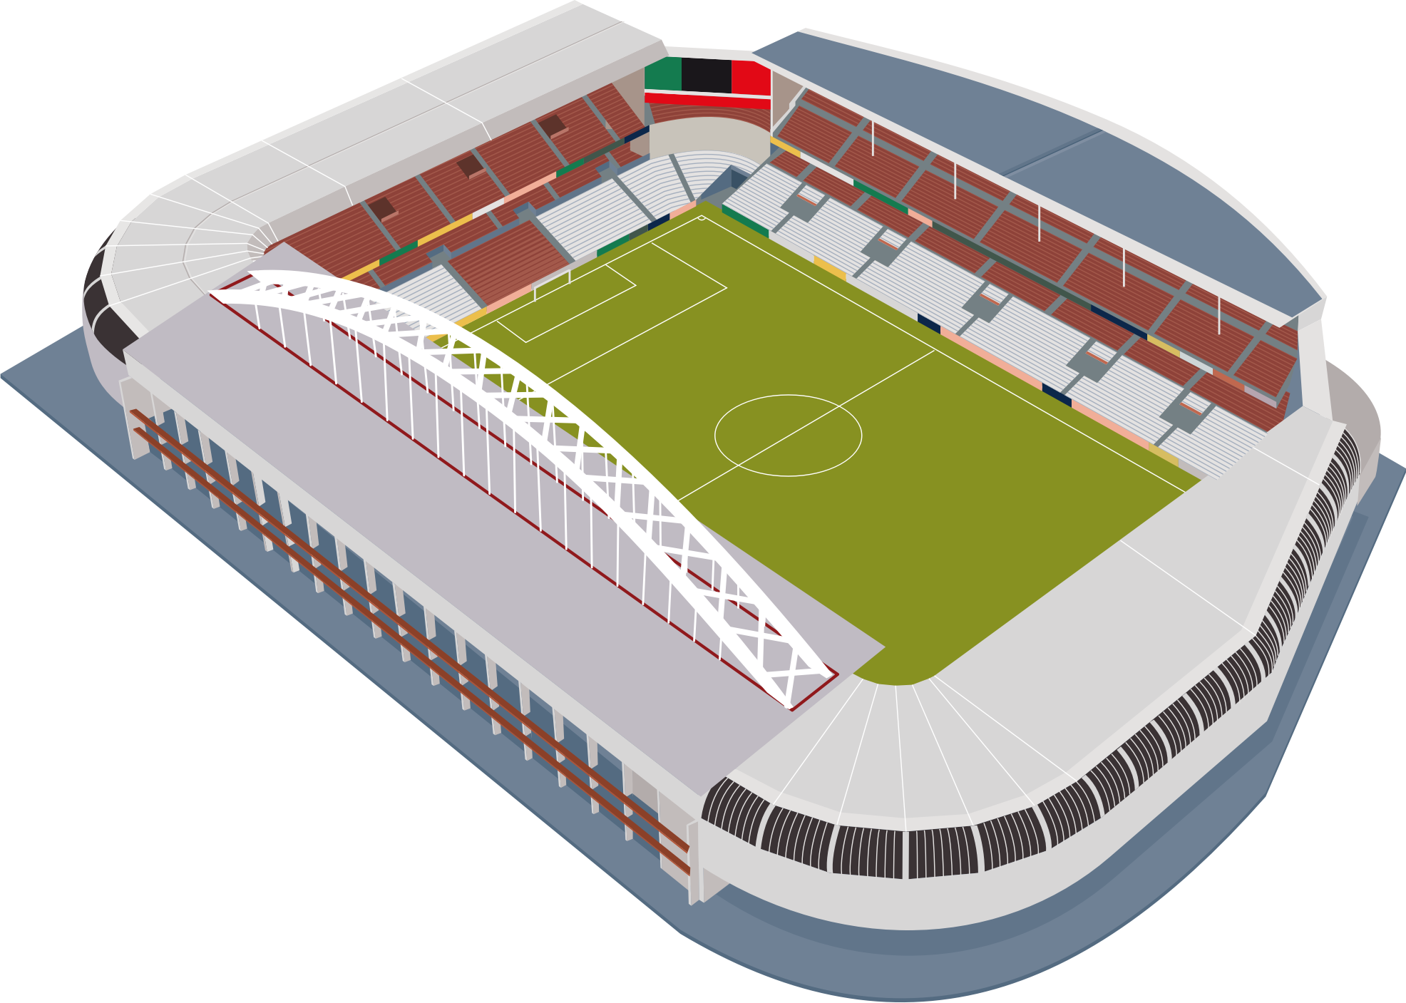
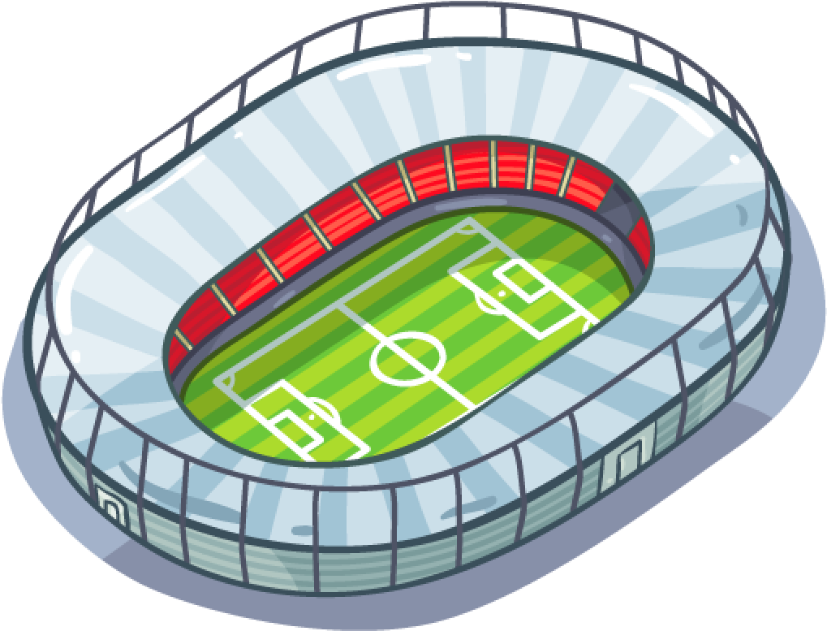
The People’s Stadium
Capacity: 25,000
Built: 1896
Cost: £4,000,000
City Park Stadium
Capacity: 55,000
Built: 2006
Cost: £9,000,000
Victory Road Stadium
Capacity: 89,000
Built: 2015
Cost: £15,000,000

Slide 23
NOTES:
I chose my staff because…
I chose this stadium because…

Slide 24

Good Afternoon Year 6!
Let’s start our afternoon with a quick burst of energy!
Get your PE kit at the ready because at the start of each afternoon session we will be joining Joe Wicks for our daily workout.
Do as much as you can and over the week you should find you are getting fitter and finding it easier.
Let’s go!
Click the youtube link below and select today’s date from the videos listed.
https://www.youtube.com/channel/UCAxW1XT0iEJo0TYlRfn6rYQ

Slide 25
Art
Transition Activity

Slide 26
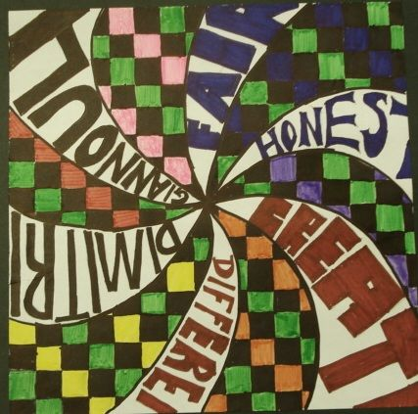
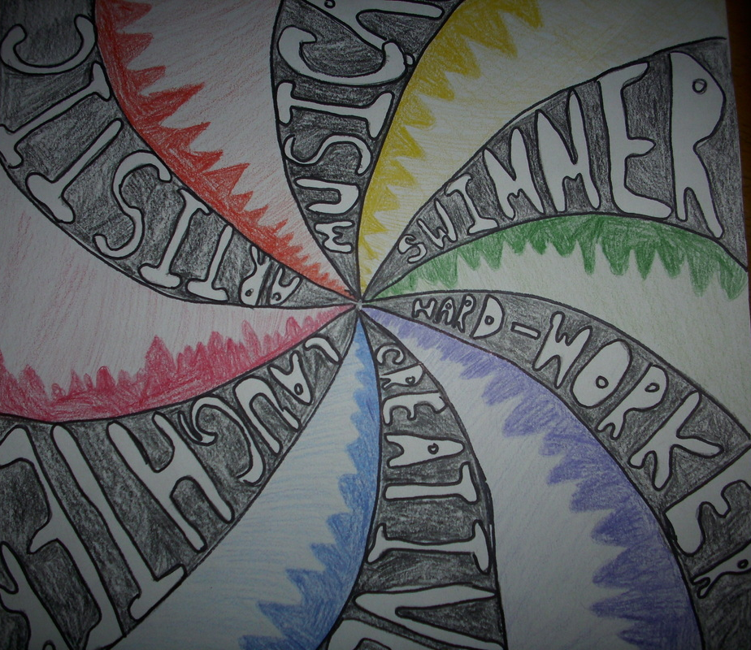
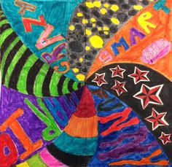
Art
Transition Activity
Today you are going to create some artwork to support transition to secondary.
You are going to express your characteristics and personality through art.
What would you like your secondary school to know about you?

Slide 27
Art - Transition Activity
Spend some time thinking about your characteristics and personality. Be Positive.
Mind map words to describe yourself. There are categories below but you can add others if you want. A good tip is to ask a friend for ideas!
Skills
Likes
Strengths
Hobbies

Slide 28
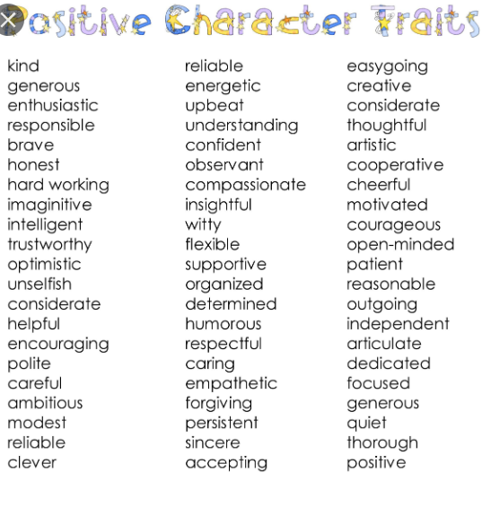
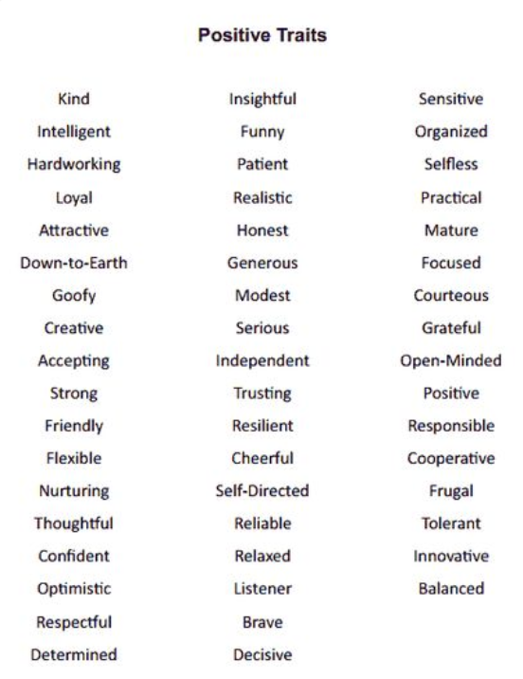
Art - Transition Activity
Positive Personality Traits

Slide 29


Art - Transition Activity
Create the Swirls

Slide 30

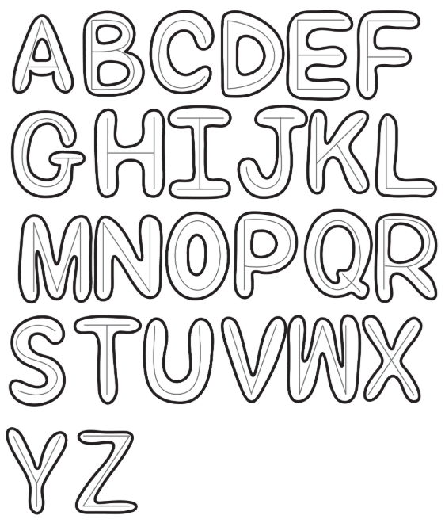
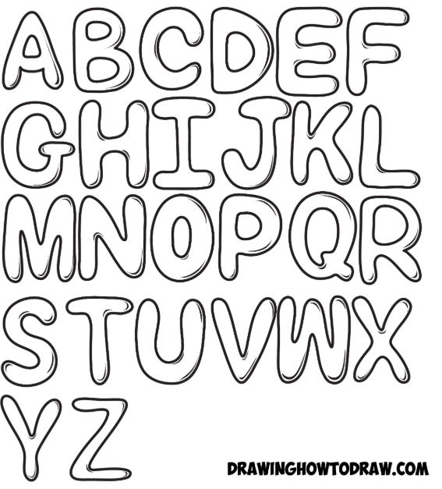
Art - Transition Activity
Bubble Writing in Steps
Step 1 Lightly draw your letters … draw them any way you like. If you want them to be perfect, you can use a ruler.
Step 2 Now just outline the letters with rounded edges. Have fun with it and don’t get stressed out trying to make it exactly like this.
Step 2 Now you could add shadow lines to the right side of the letters

Slide 31
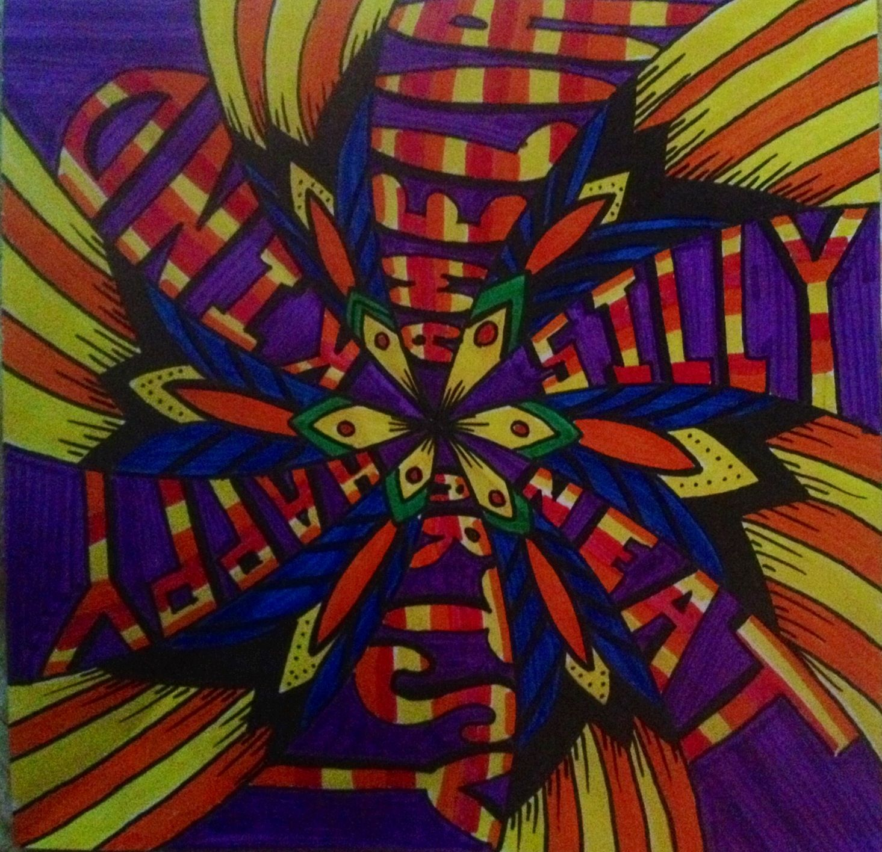

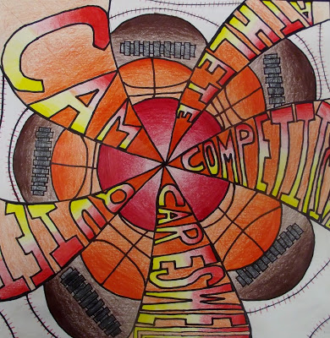
Art - Transition Activity
Add the colour and designs. Be creative. Here are some examples.

Slide 32

Well done on a great day!
Enjoy your evening and be ready for more learning tomorrow...

