Slide 1
Good MoRning Year 6!
Welcome to Tuesday’s home learning!
Please follow the instructions on each page to help you - we look forward to hear about how you have got on!
Mrs Jones and Miss Nolan

Slide 2
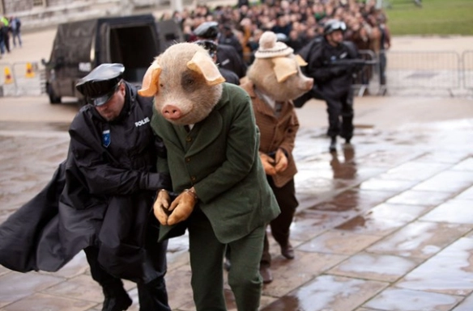
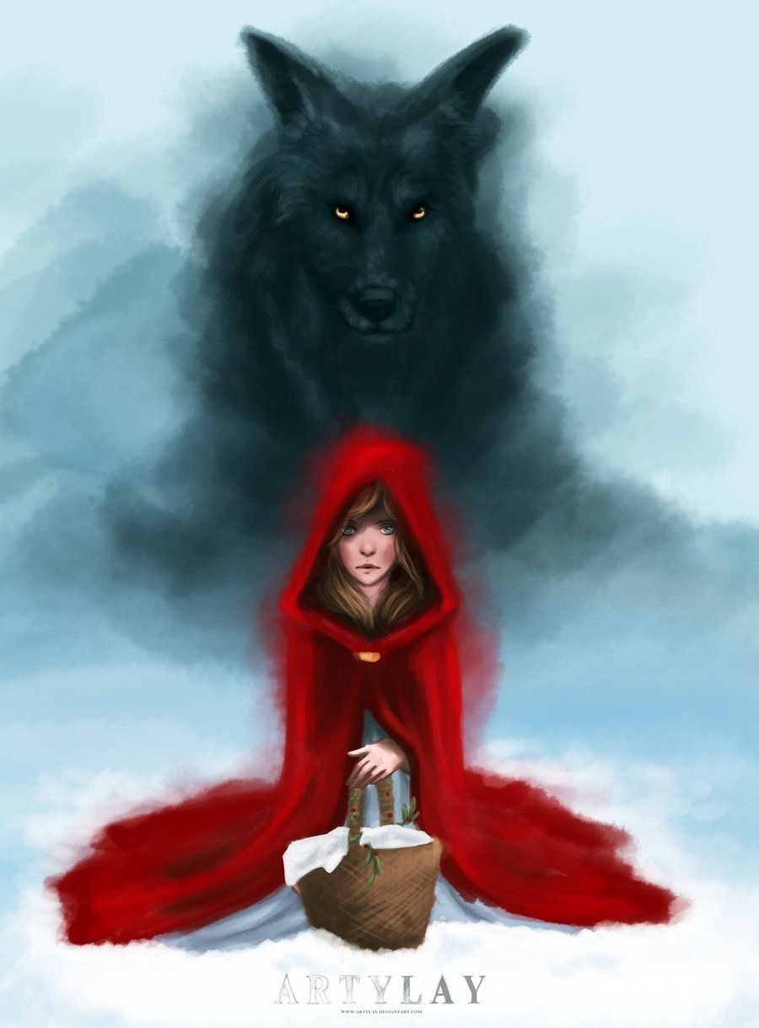
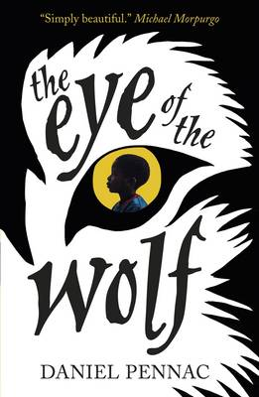
This week’s theme is
Wolves and Fairy Tales
Day 2 - 2.6.20

Slide 3
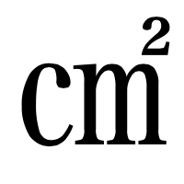
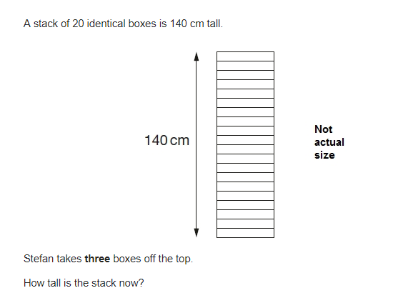

Morning Maths - Give yourself 15 - 20 minutes to complete these questions.
8. Draw a square with an area of 64
9.
987 + 100 =
46 + 304 =
56 + 9 x 4 =
4 + 5 =
7 7
20% of 1,800
6.
7. 15 x 6.1 =
10. 5,542 ÷ 17 = 326
Explain how you can use this fact to find the answer to 18 x 326

Slide 4
Now mark your work using these answers.
8. Draw a square with an area of 64
8 by 8
9.
987 + 100 = 1, 087
46 + 304 = 350
56 + (9 x 4) = 92
4 + 5 = 1 2
7 7 7
20% of 1,800 = 360
6. 6791
7. 15 x 6.1 = 91.5
140 - 21 = 119cm
10. 5,542 ÷ 17 = 326
Explain how you can use this fact to find the answer to 18 x 326 Discuss 326 x 17 = 5542

Slide 5

Daily Worship

Slide 6
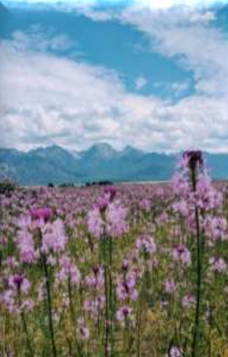
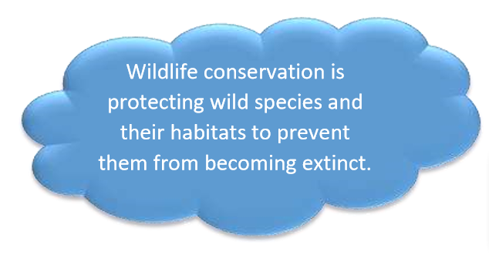
Daily Worship

Slide 7
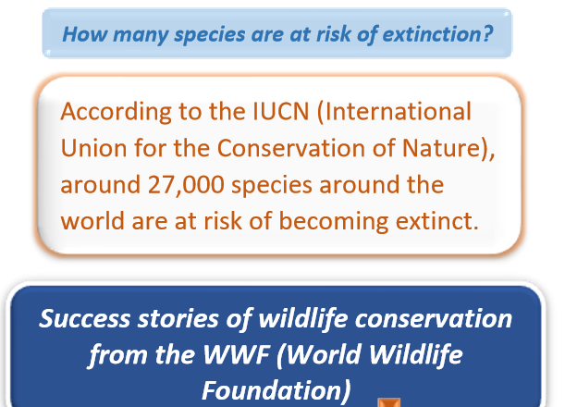
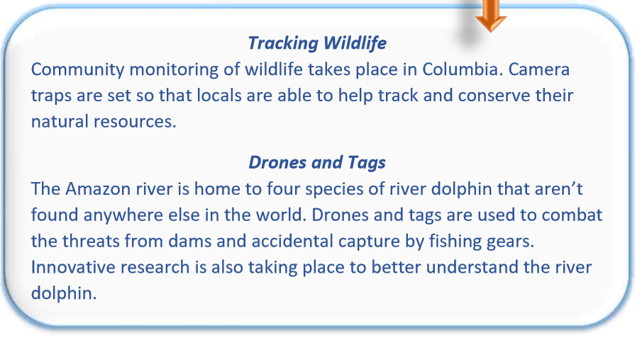
Daily Worship

Slide 8
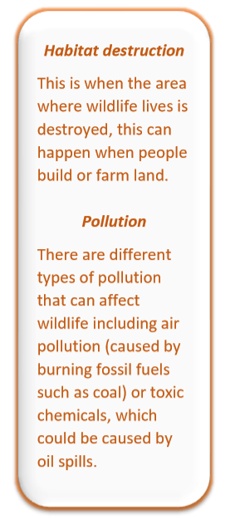
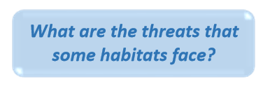
Daily Worship

Slide 9
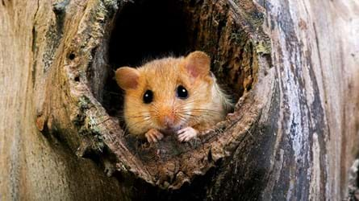
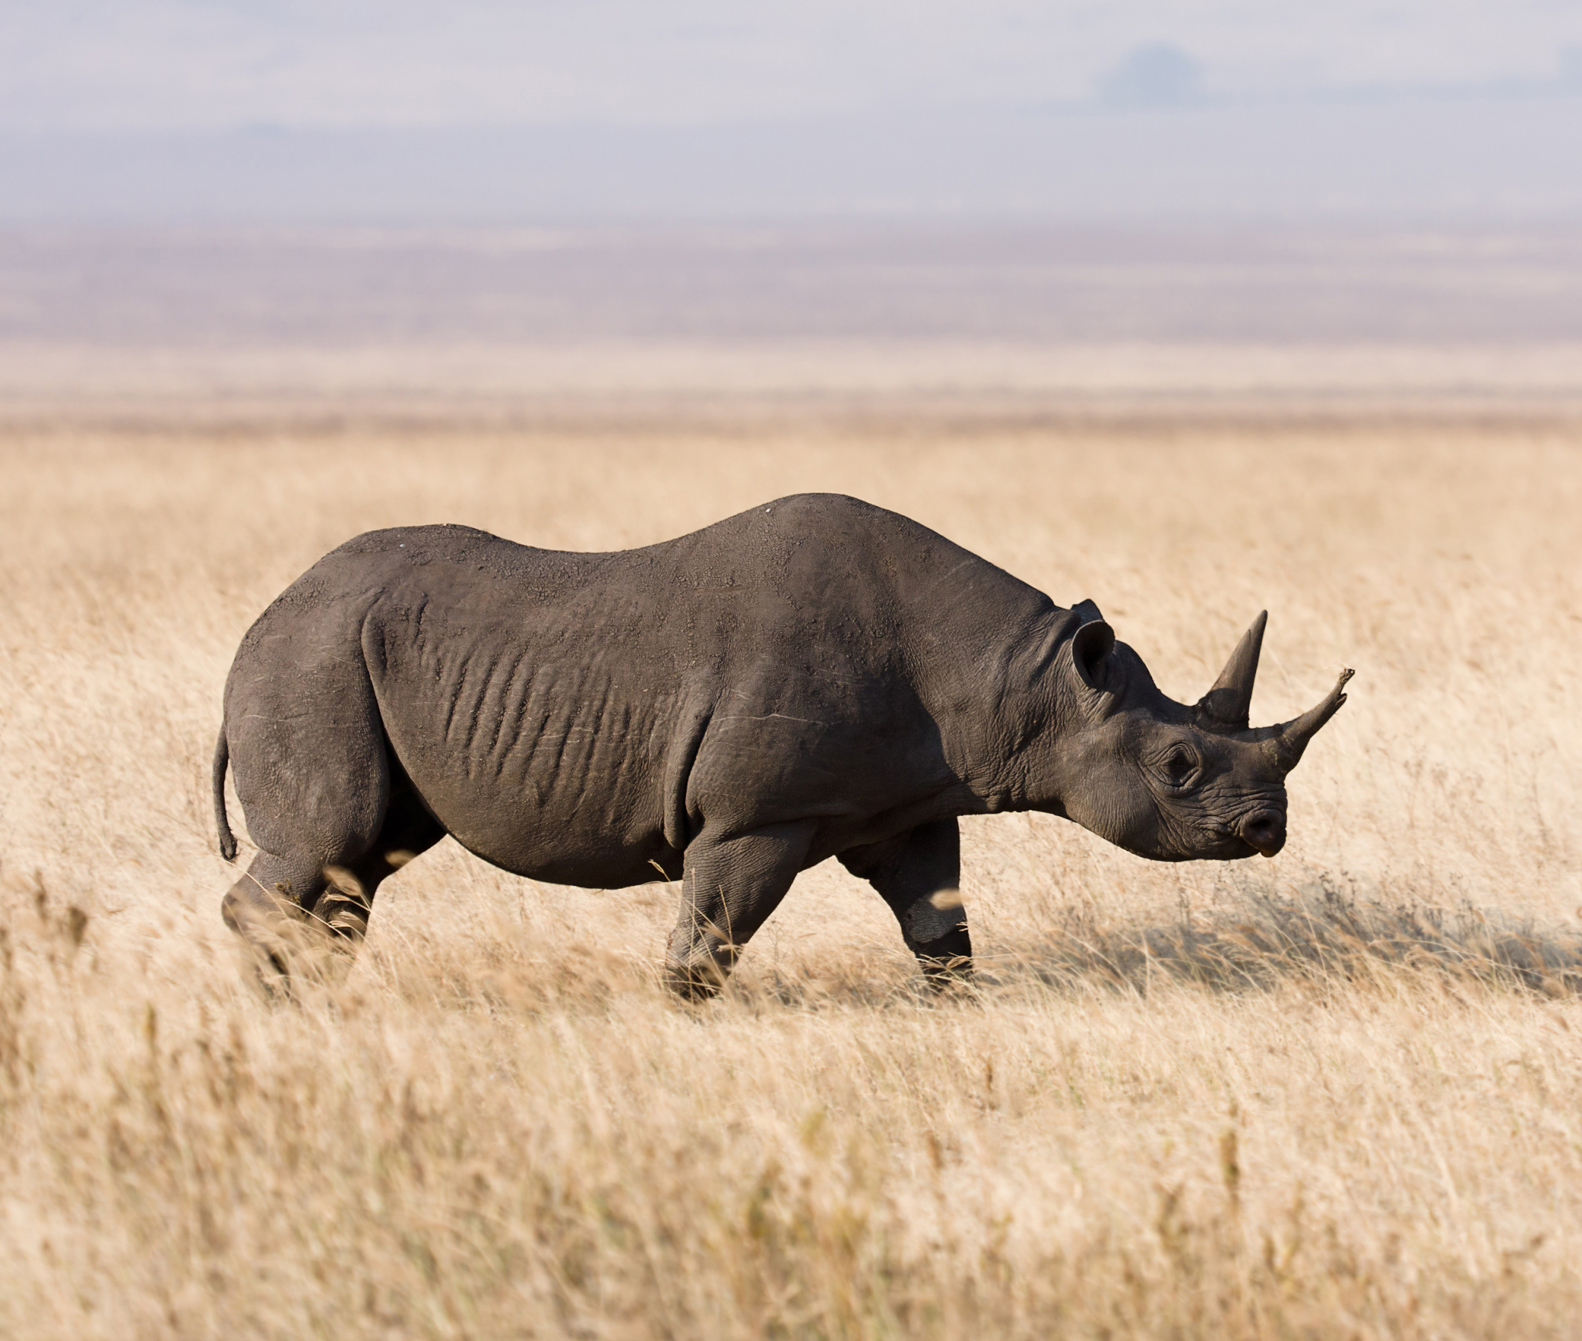
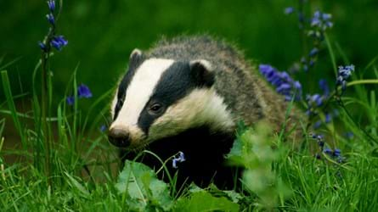
Daily Worship
Habitats
What are the habitats around where you live? Or close by? Is there any wildlife there?
Do you know where the closest nature reserve is? Are there birds, insects or are there bigger animals? Can you think of anything they could do to help protect wildlife?

Slide 10
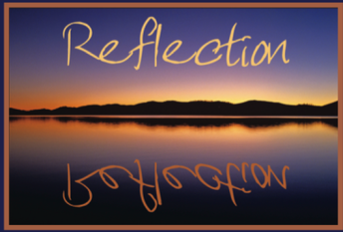
Daily Worship
We are very lucky to share our world with many fascinating creatures! There will be times when some of these need protection. We can all play a part in helping to protect our wildlife.
Can you think of anything you could do to protect our wildlife?

Slide 11

We may not be learning together in the classroom, but it is important to still remember our classroom beliefs.
WALT: develop problem solving and thinking skills.
In Maths today we will continue to design our theme park using the criteria we read about yesterday.

Slide 12


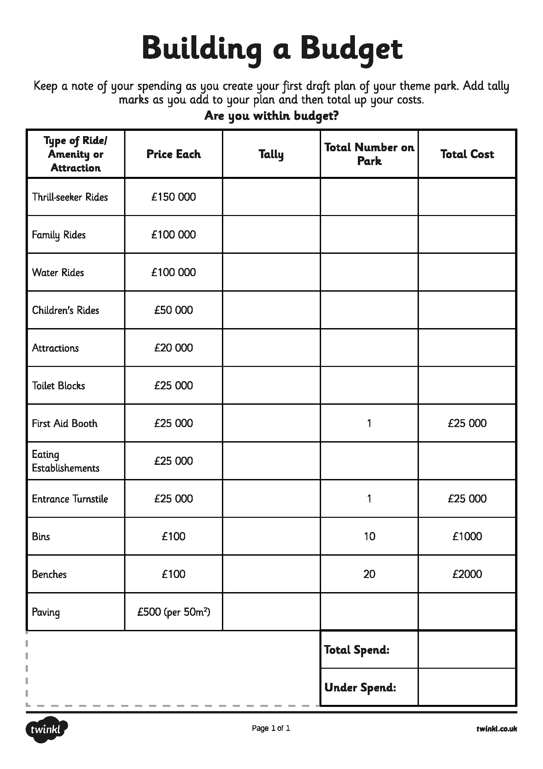
Continue your plan and budget from yesterday’s lesson - remember it must be in budget!
Now it’s time to get thinking and planning.
Use the key to remind you of costs, potential users for each type of ride, sizes and building regulations.

Slide 13

Spellings
Reading = Eye of the Wolf
Writing = create a brochure

Slide 14
Tuesday - Spelling and handwriting practice.
devise
device
practise
practice
guarantee
Spelling practice is extremely important.
Copy out these words out twice in your best joined handwriting.

Slide 15
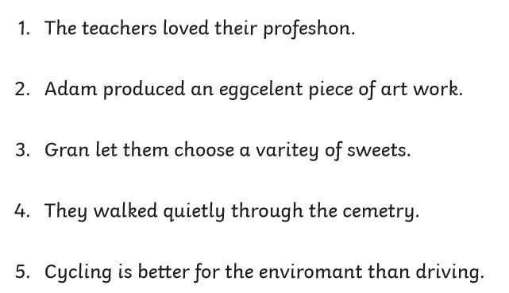
Tuesday - Spelling
Correct the spelling mistake. Can you find the incorrect spelling and rewrite it correctly?

Slide 16
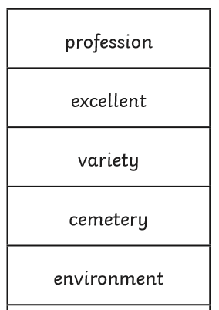
Tuesday - Spelling Answers
Correct the spelling mistake. Can you find the incorrect spelling and rewrite it correctly?

Slide 17
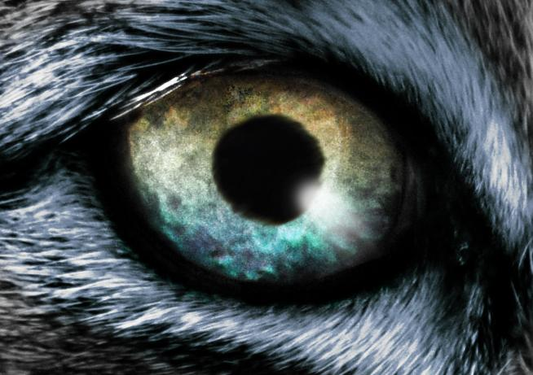
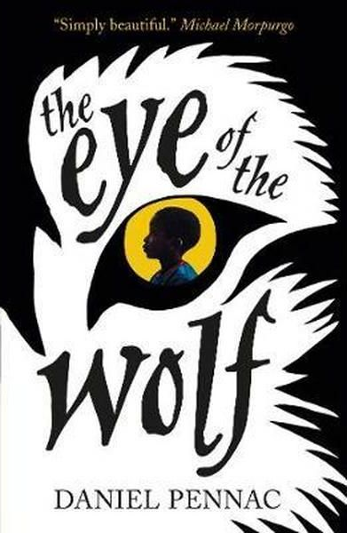
READING - Eye of The Wolf
WALT: Make inferences using evidence from the text.
Can you remember what happened in ‘the eye of the wolf’ extract from yesterday?

Slide 18
Reading Activity
Teacher Notes
The purpose of a close read activity is to gain an understanding of the text by reading it multiple times.
Close Read Instructions:
Look at the vocabulary. Do you know what the words mean? If you are unsure, note down the words and use a dictionary (this could be online) to find out their meaning.
Read the text to yourself and ask yourself the following questions:
What did I just read? What did it say? You can make notes or annotate the text.
Now read the text again (you could do this wit an adult) - this will help you gain a better understanding.
Read the questions and now reread the text again to find evidence that will support your answers.
Answer the questions in writing.
All close read texts are age appropriate.

Slide 19
READING - Eye of The Wolf
WALT: Make inferences using evidence from the text.
“The eye of the wolf” by Daniel Pennac
The wolf’s yellow eye is large and round, with a black pupil in the middle. And it never blinks. The boy could be watching a candle flame in the dark. All he can see is the eye: the trees, the zoo and the enclosure have disappeared. All that’s left is the eye of the wolf. It grows fatter and rounder, like a harvest moon in an empty sky. The pupil in the middle grows darker and he can make out small, coloured flecks in the yellow brown iris – a speck of blue here, like frozen water below the sky; a glimmer of gold there, shiny as straw.
But what really matters is the pupil. The black pupil. You wanted to stare at me, it seems to be saying, so go ahead, stare at me! It sparkles so brightly, it’s scary. Like a flame.
That’s what it is, thinks the boy, a black flame! Then he answers, “All right Black Flame, I’m staring at you and I’m not frightened.”

Slide 20
READING - Eye of The Wolf
WALT: Make inferences using evidence from the text.
“The eye of the wolf” by Daniel Pennac
The wolf’s yellow eye is large and round, with a black pupil in the middle. And it never blinks. The boy could be watching a candle flame in the dark. All he can see is the eye: the trees, the zoo and the enclosure have disappeared. All that’s left is the eye of the wolf. It grows fatter and rounder, like a harvest moon in an empty sky. The pupil in the middle grows darker and he can make out small, coloured flecks in the yellow brown iris – a speck of blue here, like frozen water below the sky; a glimmer of gold there, shiny as straw.
But what really matters is the pupil. The black pupil. You wanted to stare at me, it seems to be saying, so go ahead, stare at me! It sparkles so brightly, it’s scary. Like a flame.
That’s what it is, thinks the boy, a black flame! Then he answers, “All right Black Flame, I’m staring at you and I’m not frightened.”
Questions
1) What are the two things the writer compares the wolf’s eye to?
2) How do you think the boy is feeling about the wolf? Explain using evidence from the text.

Slide 21
READING - Eye of The Wolf - Answers
WALT: Make inferences using evidence from the text.
“The eye of the wolf” by Daniel Pennac The wolf’s yellow eye is large and round, with a black pupil in the middle. And it never blinks. The boy could be watching a candle flame in the dark. All he can see is the eye: the trees, the zoo and the enclosure have disappeared. All that’s left is the eye of the wolf. It grows fatter and rounder, like a harvest moon in an empty sky. The pupil in the middle grows darker and he can make out small, coloured flecks in the yellow brown iris – a speck of blue here, like frozen water below the sky; a glimmer of gold there, shiny as straw.
But what really matters is the pupil. The black pupil. You wanted to stare at me, it seems to be saying, so go ahead, stare at me! It sparkles so brightly, it’s scary. Like a flame.
That’s what it is, thinks the boy, a black flame! Then he answers, “All right Black Flame, I’m staring at you and I’m not frightened.”
Questions
1) What are the two things the writer compares the wolf’s eye to?
A harvest moon in an empty sky and a frozen water below the sky
2) How do you think the boy is feeling about the wolf? Explain using evidence from the text.
The boy is not intimidated or scared. He was challenging the wolf - I’m not frightened/go ahead stare.

