Slide 1
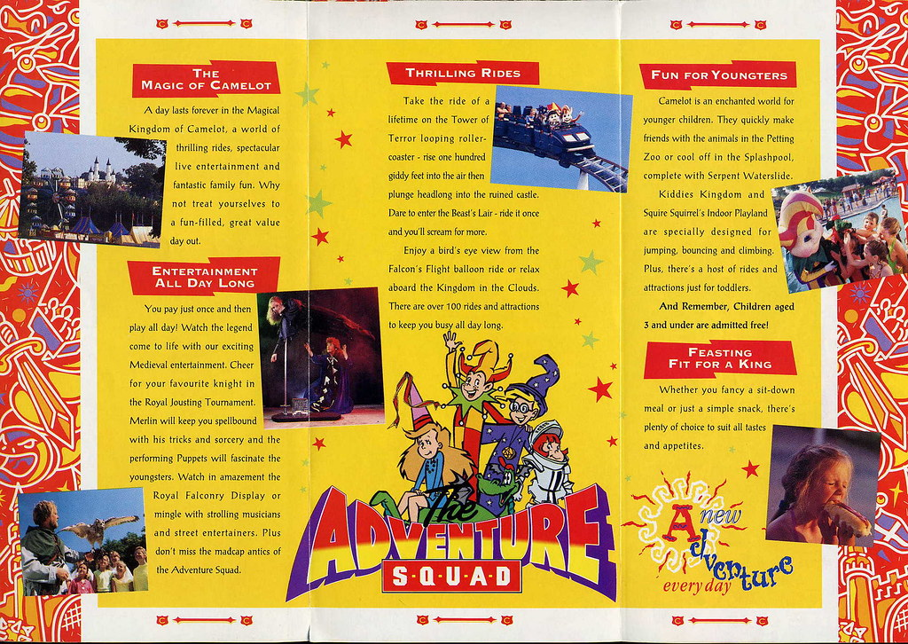
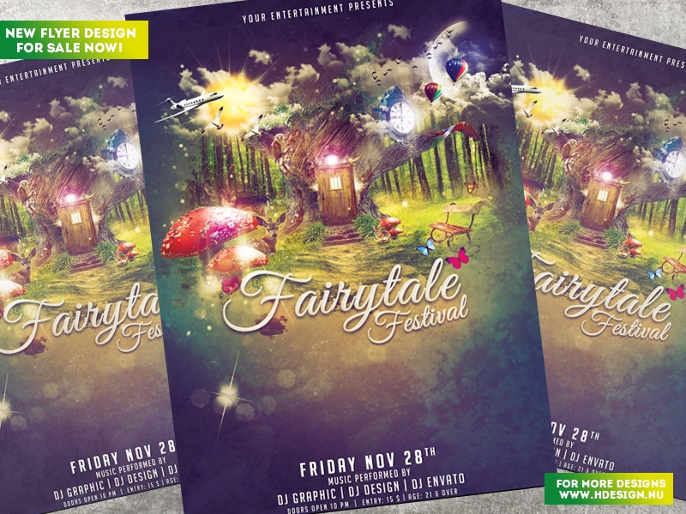
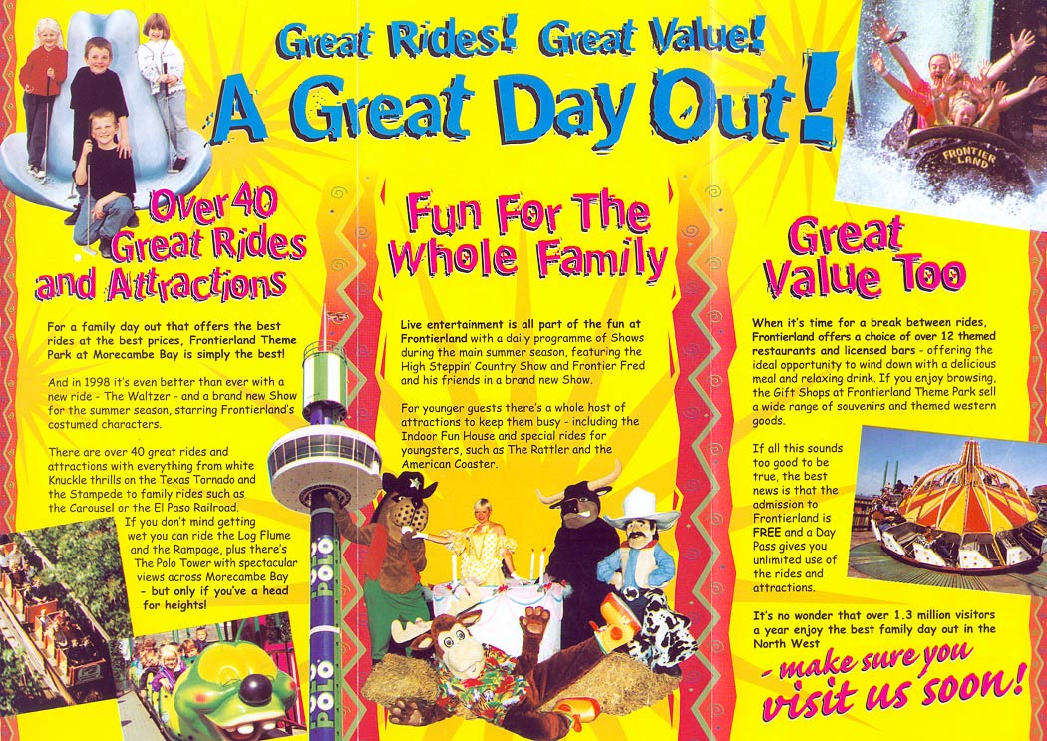
Create A Brochure
Today’s writing activity will be creating a brochure - this links with this weeks maths topic.
This activity will take two days. The slides will be repeated tomorrow so you can recap and then carry on with creating your brochures.

Slide 2
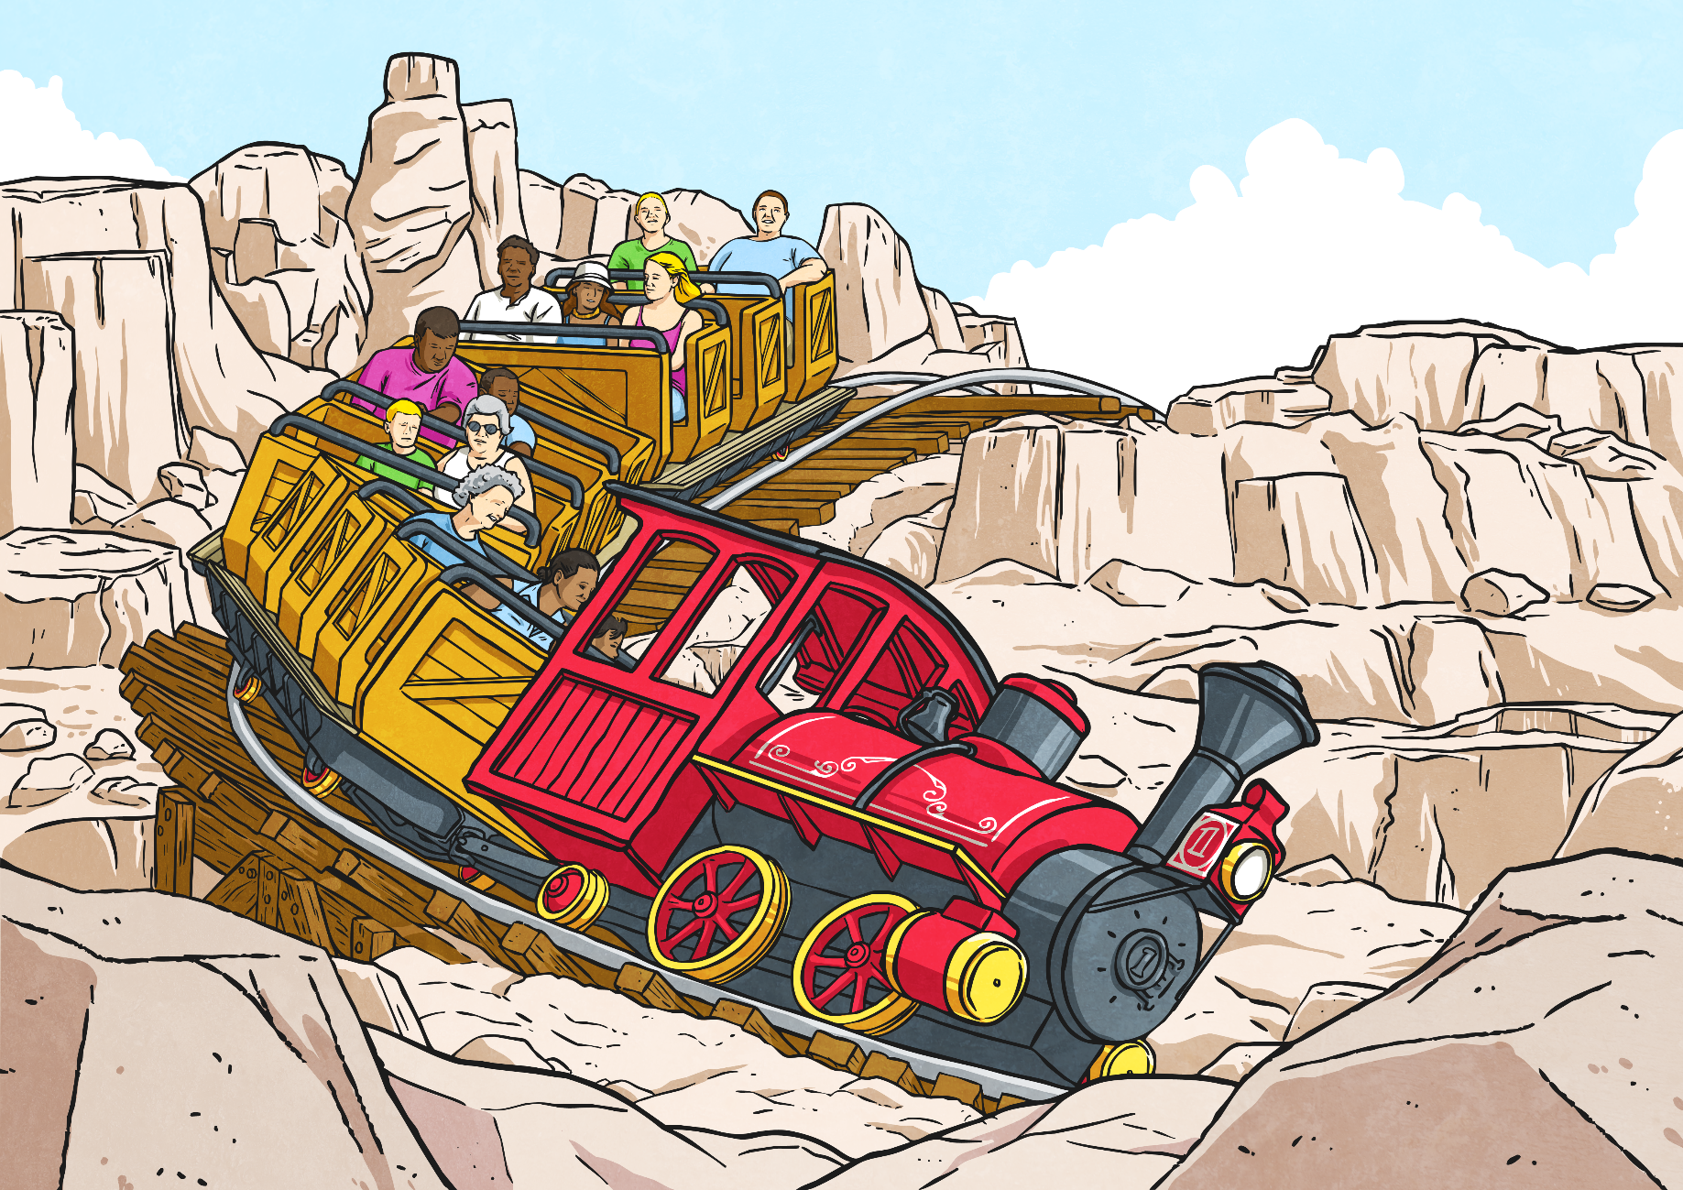
Fairy Tale Theme Park Brochure
Now that you have decided on a theme park name, themed areas and the rides, attractions and amenities within your park, it’s time to tell your customers about them in more detail.
In today’s lesson, you will start to create a brochure that will go on your website and be given to customers as they arrive at your park.
For this lesson today you will need:
Plain paper and colouring pencils
Your ideas from the maths sessions.

Slide 3
Fairy Tale Theme Park
Brochure Content
What will need to go in your brochure? How should it be written and illustrated?
What will a successful brochure do?
Inform customers (and potential customers if they are looking at it on the website) what is available to do while visiting.
Give details of the rides, attractions and food outlets in each of your three park areas.
Have an element of persuasion – if potential customers see it on the internet, will they be persuaded to visit?
Be bright, colourful and easy to read.

Slide 4

Brochure Content: Front Cover
Your brochure should have at least two pages; a front cover and a page for each themed area of your park.
Look at this front cover.
What’s been included?
What do you notice?
Theme park name
Alliteration
Introducing new rides and attractions
Rhetorical question
Indication of target customer

Slide 5

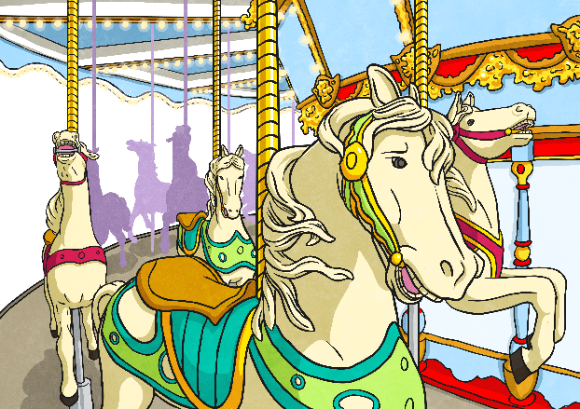

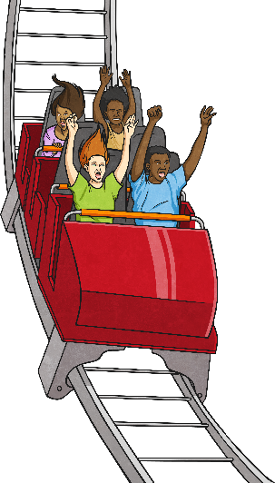
Brochure Content: Themed Areas
Pages should be headed with the names you have chosen for your themed areas. Look at some of these examples. What did you notice?
Adrenaline World
Are you brave enough to visit? Will you ever leave?
Kiddies Kingdom
Perfect for even the smallest thrill-seekers!
The Wicked Wild West
Yee Ha! A world of runaway mine trains, gold rush flumes and other Wild West fun!

Slide 6


Brochure Content:
Rides and Attractions
You don’t have to give details on every ride or attraction in your theme park, but your brochure pages need to introduce the main incentives for visiting each of your three areas.
Think of exciting and intriguing names for some of your main rides and attractions. Do they relate to the themes of your park areas?
Could you draw pictures of them?
Do you want to introduce a rating system for each ride you discuss?
Ride Name: | The Rush
Thrill Factor * = Tame / ***** = Extreme! | ***** You need to have nerves of steel to ride the Rush!
Suitable for: | Only suitable for adults and children aged 12+
Other Restrictions: | Do not ride if you suffer with any heart condition.

Slide 7
Brochure: Get Designing!
Now it’s time to get designing:
Remember the criteria for a successful brochure. Does your brochure:
Inform customers (and potential customers if they are looking at it on the website) what is available to do while visiting?
Give details of the rides, attractions and foot outlets in each of your three park areas?
Have an element of persuasion – if potential customers see it on the internet, will they be persuaded to visit?
Catch people’s eyes by being bright, colourful and easy to read?

Slide 8

Good Afternoon Year 6!
Let’s start our afternoon with a quick burst of energy!
Get your PE kit at the ready because at the start of each afternoon session we will be joining Joe Wicks for our daily workout.
Do as much as you can and over the week you should find you are getting fitter and finding it easier.
Let’s go!
Click the youtube link below and select today’s date from the videos listed.
https://www.youtube.com/channel/UCAxW1XT0iEJo0TYlRfn6rYQ

Slide 9
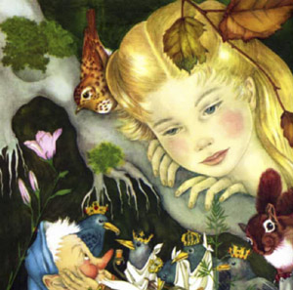
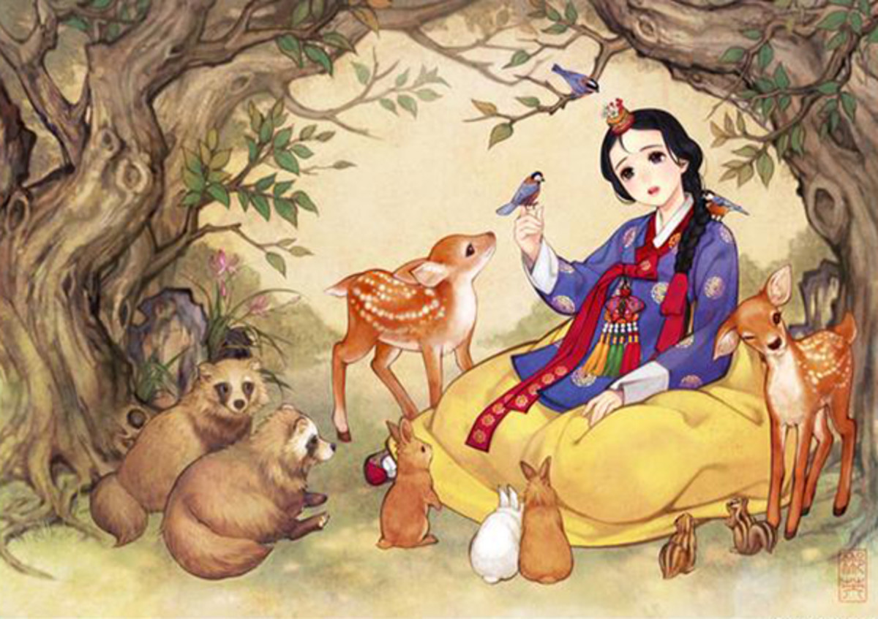
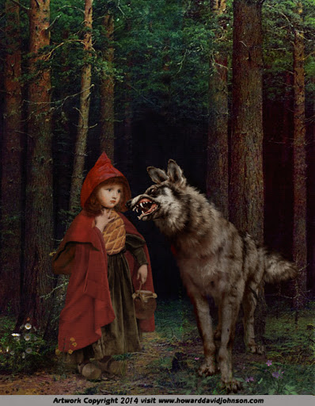
Art
This week’s art will focus on portraits and will continue our theme of fairy tales.

Slide 10
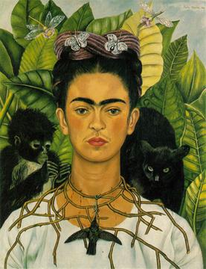
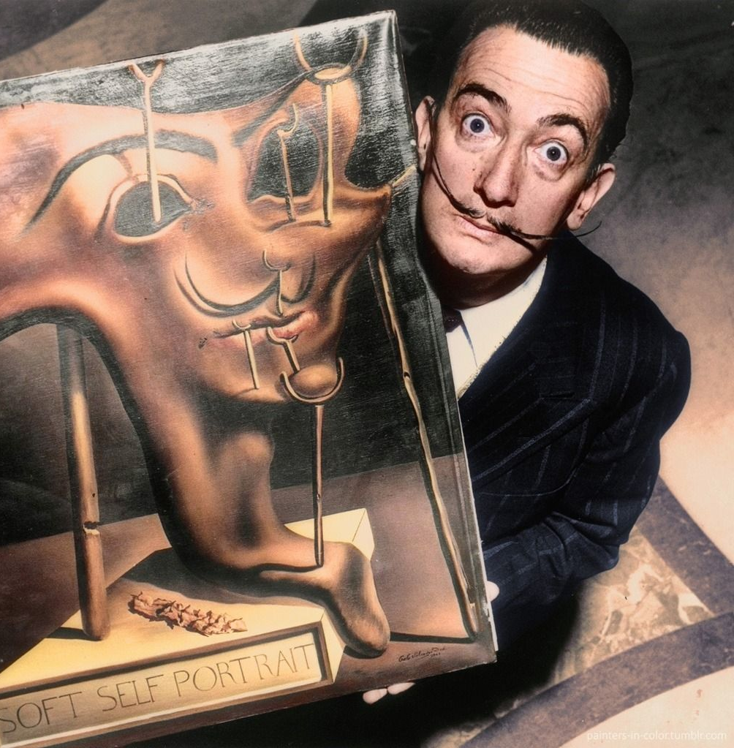
Yesterday afternoon we looked at some iconic self-portraits.
Frida Kahlo
Salvador Dali

Slide 11
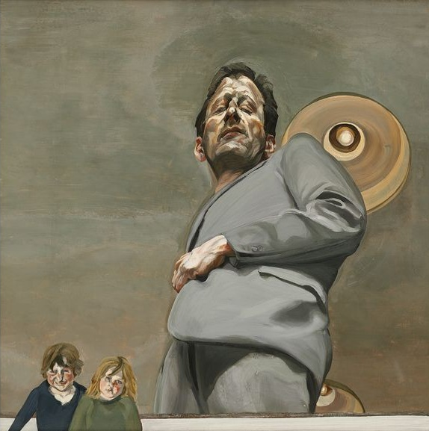
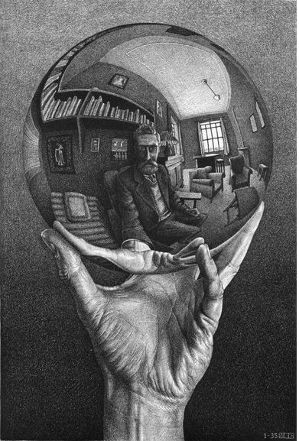
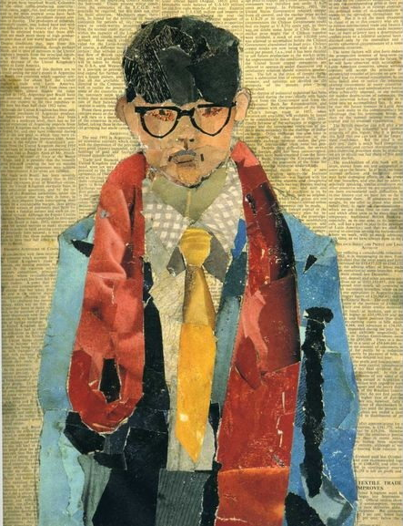
Lucian Freud
M C Escher
David Hockney

Slide 12
Art Activity
Which self portrait interested you the most? Which style of painting made you feel most excited?
Choose one of the artists’ self-portraits to recreate.
Consider which tools they used when you decide which painting to recreate.
(You are copying their portrait, rather than painting a picture of yourself).

