Slide 1
Good MoRning Year 6!
Happy Monday morning year 6!
Welcome to another week of home learning. Well done for all your efforts so far. Remember to just try your best!
Please follow the instructions on each page to help you - we look forward to hear about how you have got on!
Mrs Jones, Miss Nolan and Mrs Crane.

Slide 2
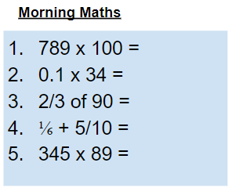
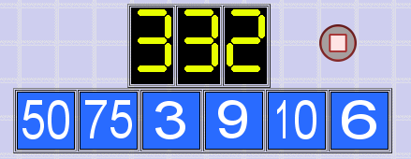
As always, our day will start with Morning Maths.
Give yourself 10 minutes to complete these questions and then try and tackle today’s countdown. If you finish within 10 minutes, check your work and see how many ways you can find to solve the countdown.
After 10 minutes, check your answers using the next slide and the countdown solver (linked below) to see how to solve today’s problem.
Click the link below and type in the numbers and target to see how the countdown could be solved!
http://www.maths-resources.com/countdown/

Slide 3
Answers
78900
3.4
60
5/30 + 15/30 = 20/30 = ⅔
30,705

Slide 4


Maths today will be focusing on continuing to look at angles in a triangle.
We may not be learning together in the classroom, but it is important to still remember our classroom beliefs.
WALT: use properties of triangles to reason about angles.
Today we will not be using My Maths, but instead some White Rose videos and questions to help us to learn and then to test our understanding.

Slide 5
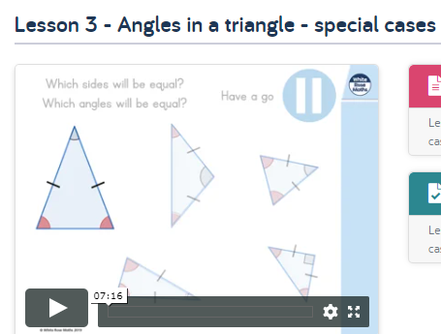
WALT: use properties of triangles to reason about angles.
To start the lesson, click on the image to the left of the screen. This will take you to the White Rose home learning website.
Click on:
Then scroll down to Lesson 3 - Angles in a triangle - special cases and click play on the video. This will be a short video lesson.
Watch the video, pausing where necessary to have a go at the mini quizzes throughout.

Slide 6
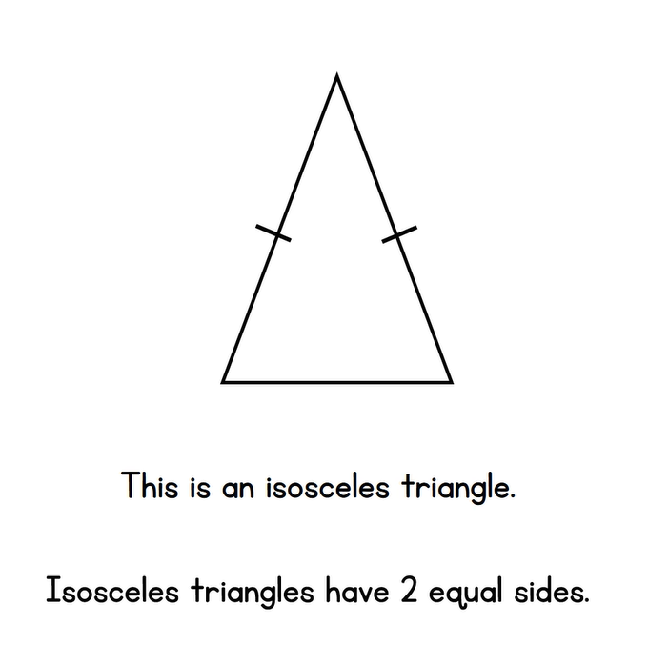
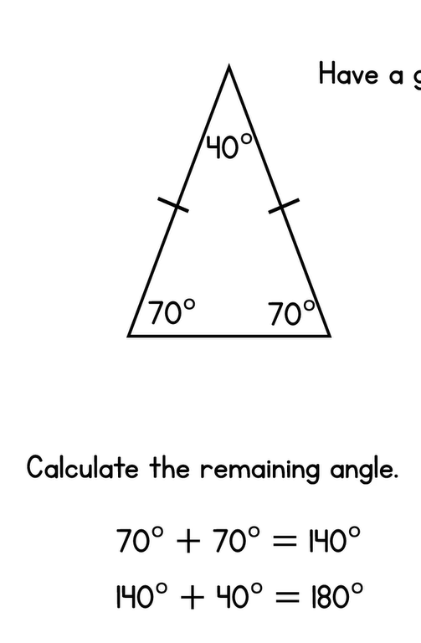
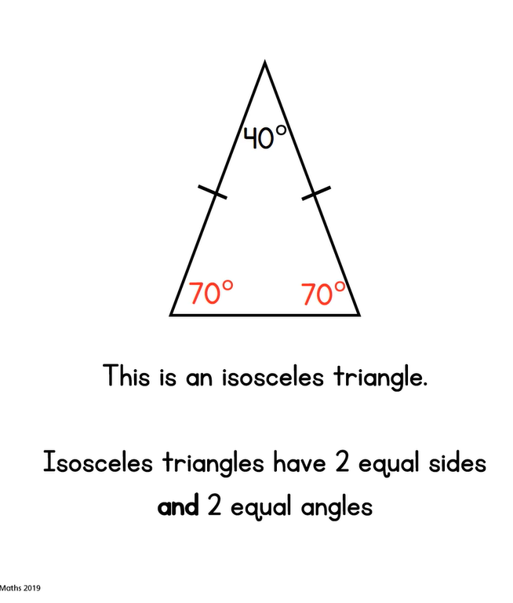
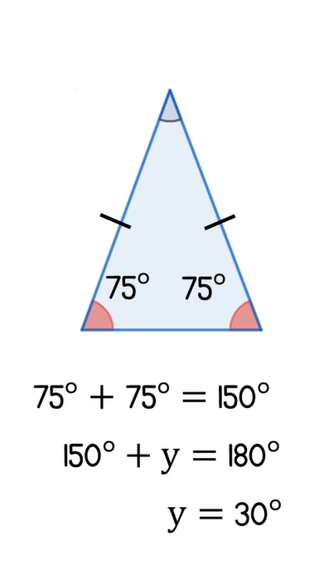
WALT: use properties of triangles to reason about angles.
A quick recap...

Slide 7
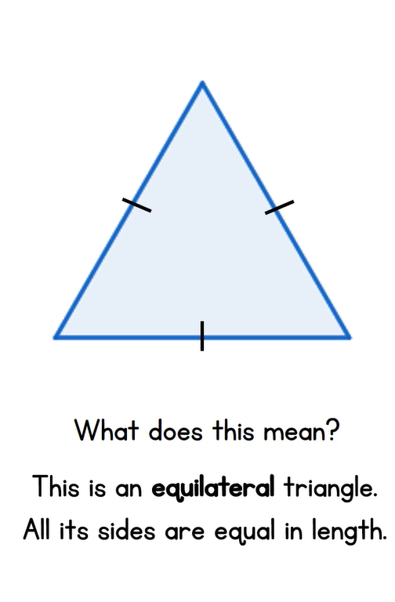
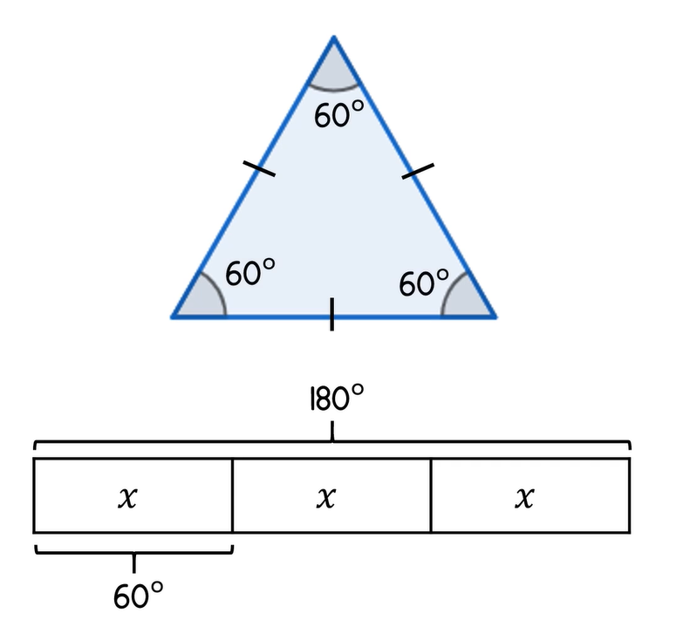
WALT: use properties of triangles to reason about angles.
A quick recap...
All angles are equal in size in an equilateral triangle.

Slide 8
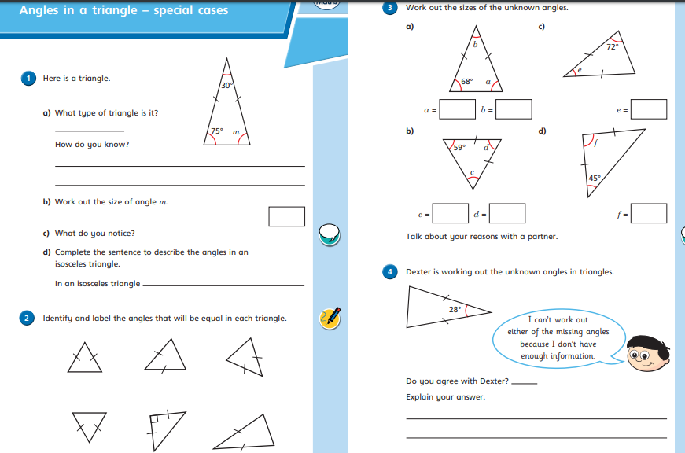

WALT: use properties of triangles to reason about angles.
Now click the image on the left of the screen, this will take you to a short test where you can test your understanding.
Have a go at the questions, writing down your answers on some paper. If you have a paper pack, the questions are on the next few slides.
Once you have completed, click the link below to mark your work against the answers.

Slide 9
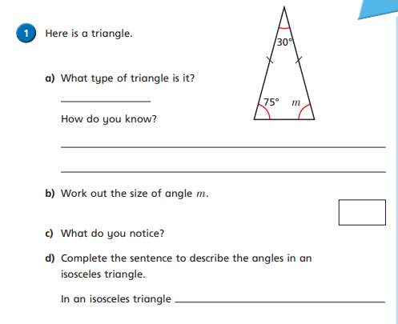
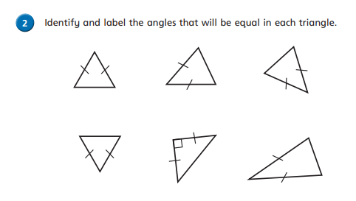
WALT: use properties of triangles to reason about angles.

Slide 10
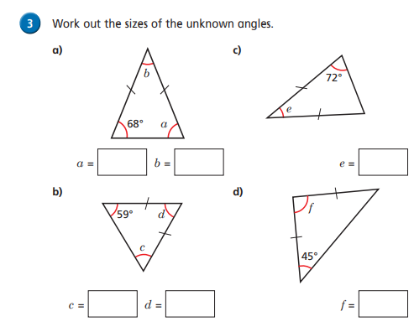
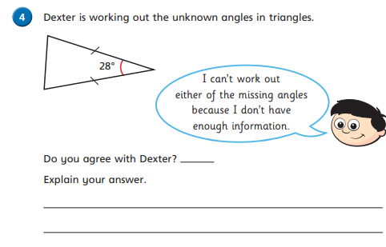
WALT: use properties of triangles to reason about angles.

Slide 11
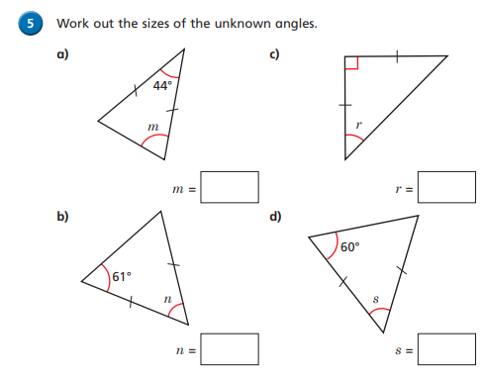
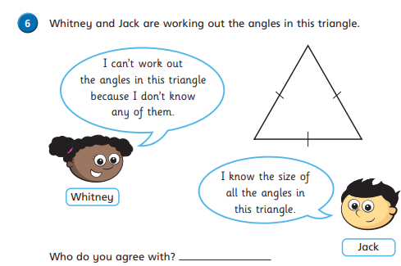
WALT: use properties of triangles to reason about angles.

Slide 12
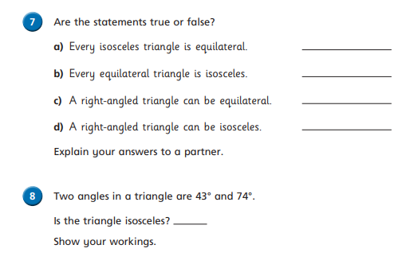
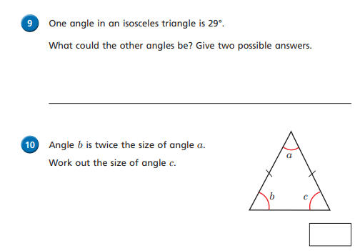
WALT: use properties of triangles to reason about angles.

Slide 13
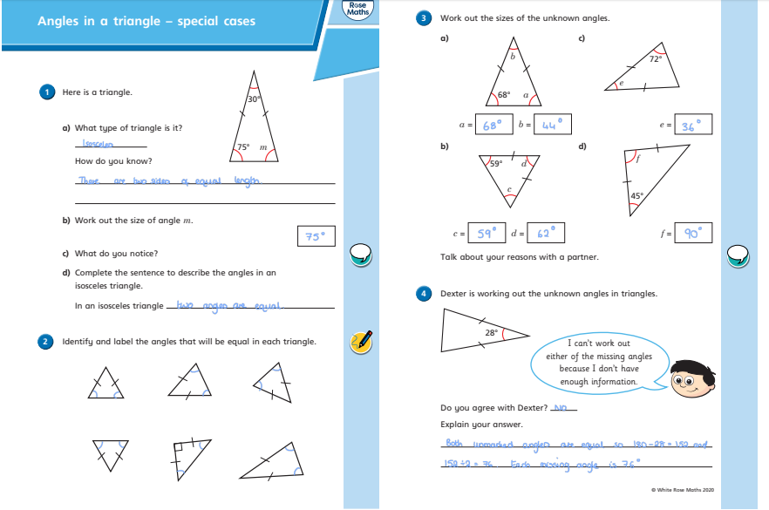
WALT: use properties of triangles to reason about angles.
Answers

Slide 14
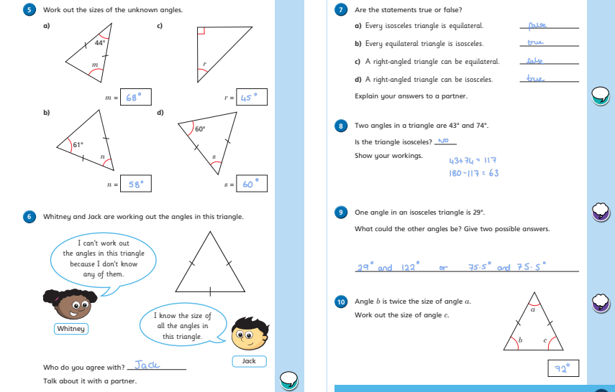
WALT: use properties of triangles to reason about angles.
Answers

Slide 15
Now you have completed the maths (and had a short break), it’s time for spellings.
Monday - Spelling and handwriting practice.
Copy out these words out twice in your best joined handwriting.
draught/draft
dissent/descent
precede/proceed
wary/ weary
Since Billy didn't shut the glass door completely, his mom could feel a small draught.

Slide 16
Spelling - Lesson 3 Homophones
draught | draft
dissent | descent
precede | proceed
wary | weary
Teacher Notes
Can you think of some clever ways to remember which word is which? Find the meaning of the words and see if you can come up with your own way to help you remember which is which.

Slide 17


English - Writing
Lesson 3
© Jamie Thomas for Talk for Writing

Slide 18
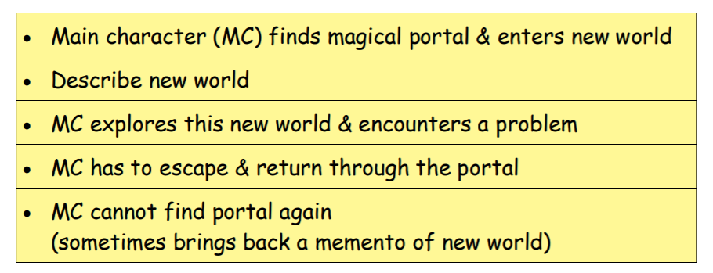
Planning a portal story
Teacher Notes
Nearly all portal stories follow a similar pattern:
Teacher Notes
Once you have identified the pattern of the story, the possibilities are endless.
Let your imagination run free. Mindmap lots of ideas and then decide which captures your interest as a writer.
© Talk for Writing

Slide 19
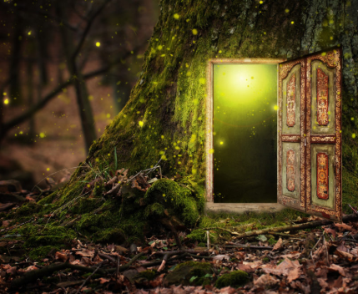
Planning a portal story
Teacher Notes
Before you start, take a look at some top tips.
Top tips for story writing:
• Start in a world/a setting that you know well – it is far easier to describe something familiar to you, e.g. a garden, your school, your local town, etc.
• Use a stimulus (e.g. picture) for the new world – an image will help you focus in on the detail and describe what is there.
• Let your ideas flow – don’t worry about spelling, handwriting or presentation … you can go back and edit this later.

Slide 20
Planning a portal story
Teacher Notes
Here are a couple of ideas to open your mind to the world of possibility:
Underlying Pattern | Story idea 1 | Story idea 2
Main character (MC) finds magical portal and enters new world | Elif is playing in her Grandmother’s garden and notices a small fairy door. Touches door and shrinks/ enters. | Josh and Archie playing hide and seek in their house. Archie opens hatch in the roof and discovers new world.
Describe new world | Arrives in an underground world full of caves, giant toadstools and magical creatures. | Transported to life onboard an enormous sailing ship in Tudor England.
MC explores new world and encounters a problem | Elif explores new world and enters an area strictly forbidden. Picks magical flower. | Ship is thrown into battle.
© Talk for Writing

Slide 21
Planning a portal story
Underlying Pattern | Story idea 1 | Story idea 2
MC has to escape and return through the portal | Alarms sound and Elif runs. She is chased through the magical world by unknown threat and escapes. | Archie desperately searches for portal and way back to own world.
MC cannot find portal again (sometimes has brought back a memento of new world) | Elif cannot find fairy door again, but the cut flower lives on forever reminding her of her journey | Archie escapes with small pouch of gunpowder in his pocket.
© Talk for Writing
Teacher Notes
Using this underlying pattern, plan a few portal stories of your own. You may like to draw upon your own personal experience as well as your wider reading and imagination. There are some images on the next slide to help you create ideas.

Slide 22

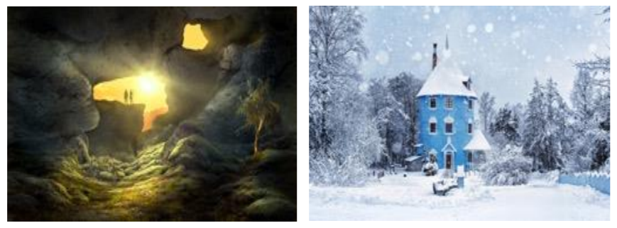
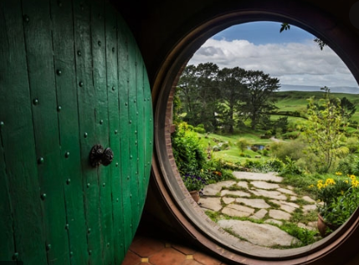

Planning a portal story

Slide 23

Good Afternoon Year 6!
Let’s start our afternoon with a quick burst of energy!
Get your PE kit at the ready because at the start of each afternoon session we will be joining Joe Wicks for our daily workout.
Do as much as you can and over the week you should find you are getting fitter and finding it easier.
Let’s go!
Click the youtube link below and select today’s date from the videos listed.
https://www.youtube.com/channel/UCAxW1XT0iEJo0TYlRfn6rYQ

Slide 24
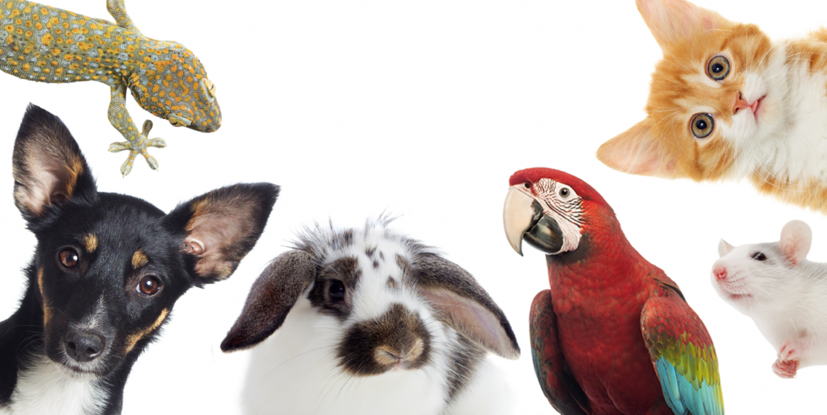
Buenos días 6N and 6J. I hope that you are all well and are enjoying the sunshine!
This week the first task is a vocabulary revision and the second task is devised to help you to use adjectives accurately.
I hope that you enjoy them!
Miss Wheeler.

Slide 25
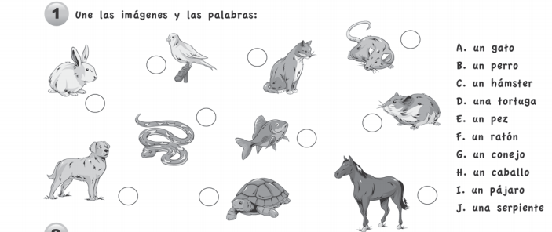
Task 1 – vocab revision
Match the animal to the correct word.

Slide 26

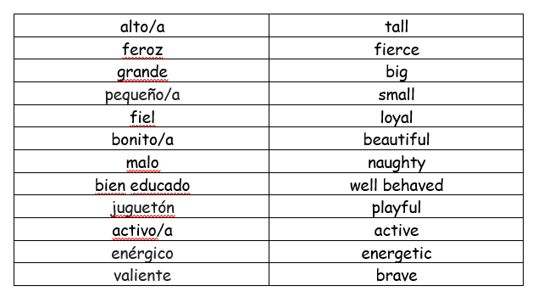
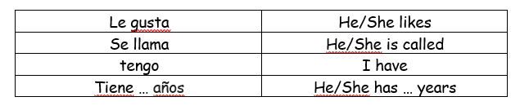
Task 2 - Describing animals
Write 4-5 accurate sentences describing your pets.
Remember that in Spanish the adjective comes after the noun.
Eg/ Tengo una tortuga feroz pero no tengo un gato fiel. También tengo un perro se llama Bertie. Bertie es alto y bonito. Tiene seis años.
Conjunctions
(to add detail to your sentences)
También = also
Pero = but
Y = and
*Remember that if you don’t have a pet it’s ok to write about an imaginary one!

Slide 27

Well done on a great day!
See you tomorrow!

