Slide 1
Good MoRning Year 6!
You are all working so hard this half term - keep it up! We are very proud of you :)
Please follow the instructions on each page to help you - we look forward to hear about how you have got on!
Mrs Jones, Miss Nolan and Mrs Crane.

Slide 2
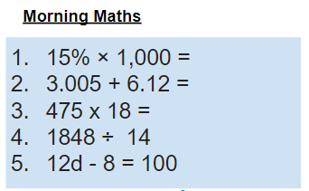
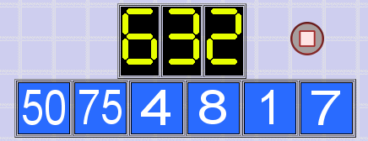
As always, our day will start with Morning Maths.
Give yourself 10 minutes to complete these questions and then try and tackle today’s countdown. If you finish within 10 minutes, check your work and see how many ways you can find to solve the countdown.
After 10 minutes, check your answers using the next slide and the countdown solver (linked below) to see how to solve today’s problem.
Click the link below and type in the numbers and target to see how the countdown could be solved!
http://www.maths-resources.com/countdown/

Slide 3
Answers
150
9.612
8550
132
12d= 100+8
12d = 108
D = 108 ÷ 12
D = 9

Slide 4


Maths today will focus on parts of a circle.
We may not be learning together in the classroom, but it is important to still remember our classroom beliefs.
WALT: name and label parts of a circle.
Before we start, get your My Maths log in details ready. These were provided in your first work pack.

Slide 5
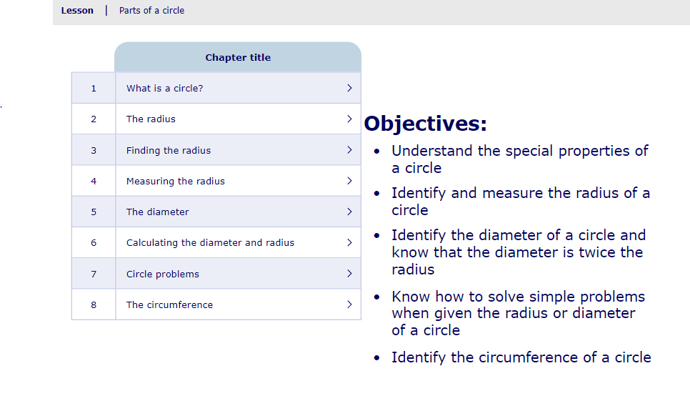
WALT: name and label parts of a circle.
To start the lesson, click on the image to the left of the screen. This will take you to an interactive lesson. This lesson will teach you how how to name and label parts of a circle.
Click on the next buttons at the bottom of the page to move your learning on and take part in the mini-quizzes along the way to check your understanding.

Slide 6
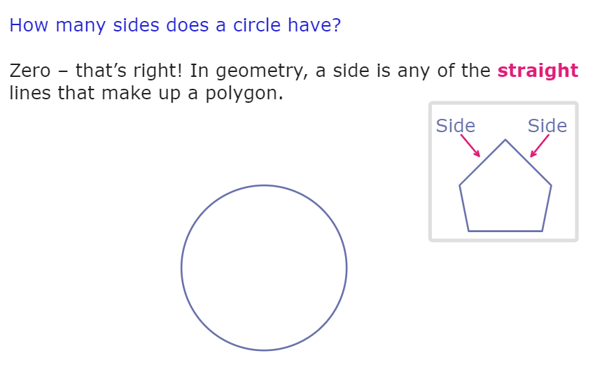
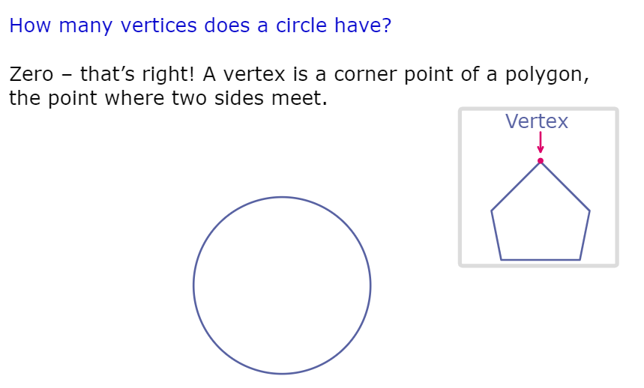
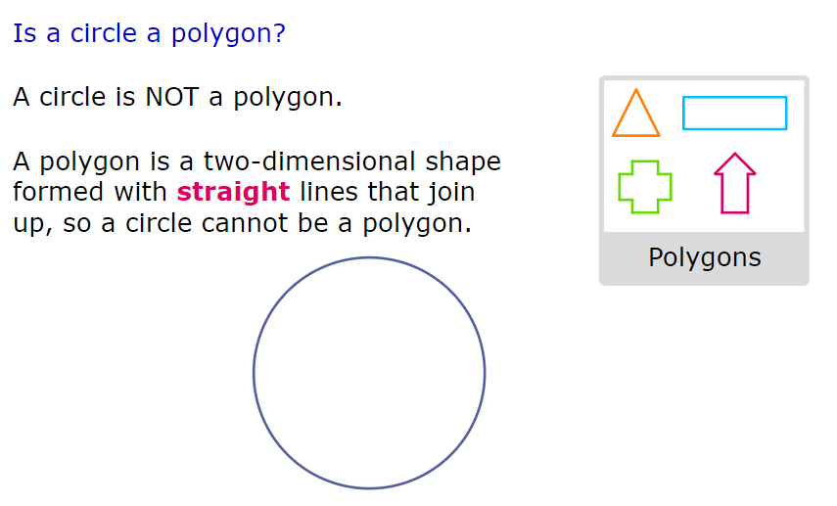
WALT: name and label parts of a circle.
A quick recap...

Slide 7
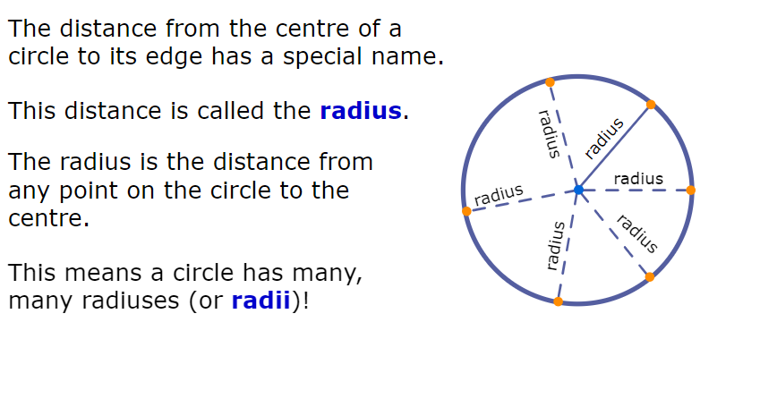
WALT: name and label parts of a circle.
A quick recap...

Slide 8
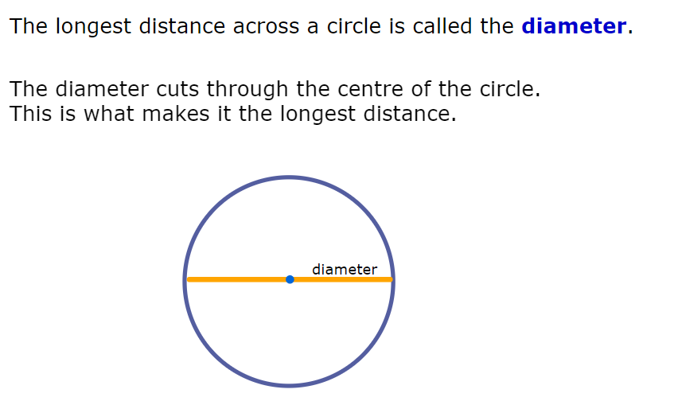
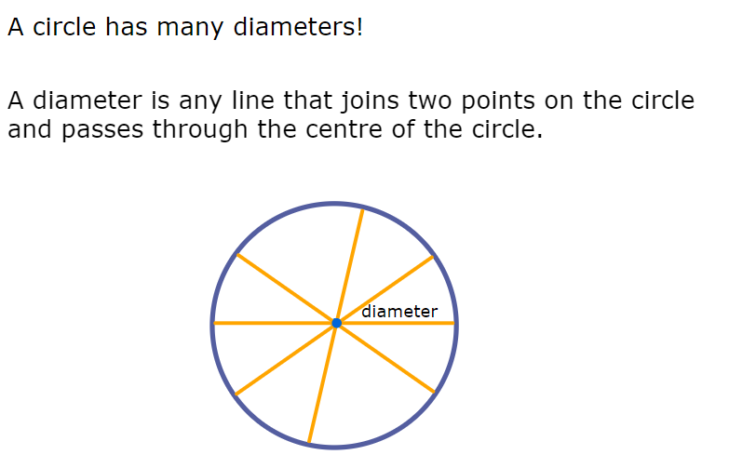
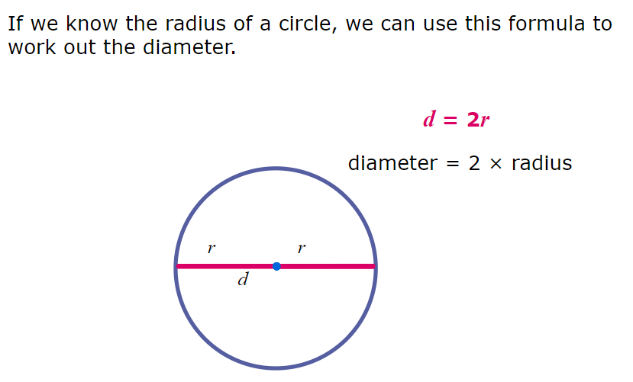
WALT: name and label parts of a circle.
A quick recap...

Slide 9
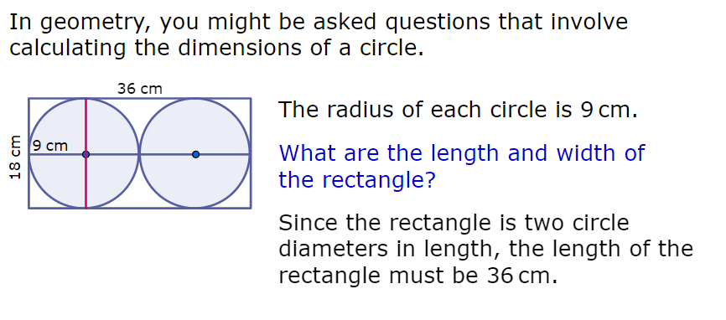
WALT: name and label parts of a circle.
A quick recap...

Slide 10
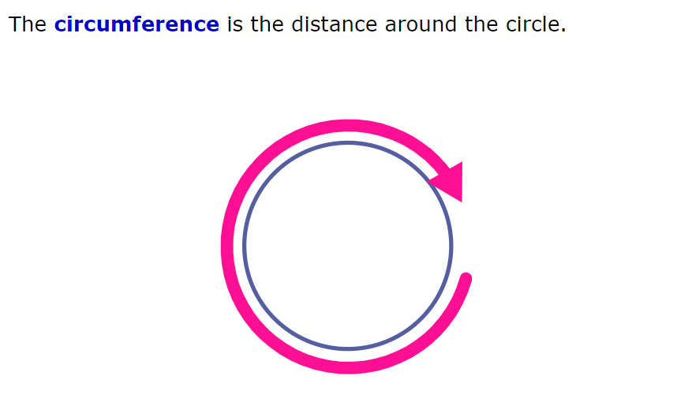
WALT: name and label parts of a circle.
A quick recap...

Slide 11
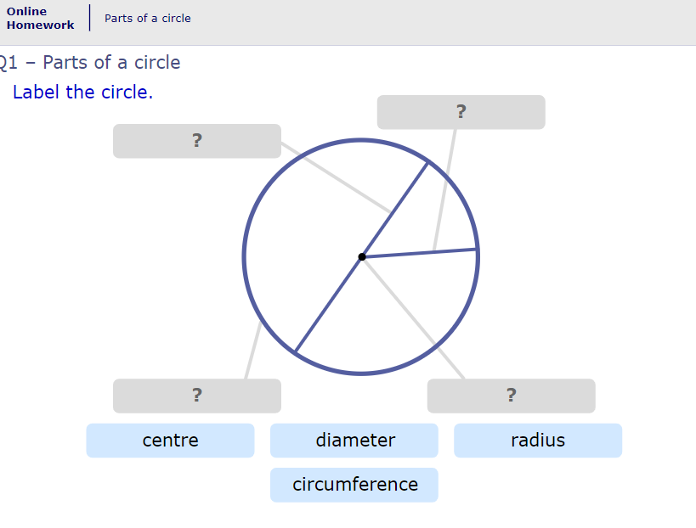
WALT: name and label parts of a circle.
Now click the image on the left of the screen, this will take you to an online homework where you can test your understanding.
Have a go at the questions and then click ‘Mark it’ to see how you have go on.
Your login details for My Maths were sent home in your first work pack - make sure you log in so we can see how you are getting on.

Slide 12
Now you have completed the maths (and had a short break), it’s time for spellings.
Wednesday - Spelling and handwriting practice.
gracious
ambitious
infectious
superstitious
repetitious
The ambitious athlete sometimes found it difficult to be gracious in defeat.
Copy out these words out twice in your best joined handwriting.

Slide 13
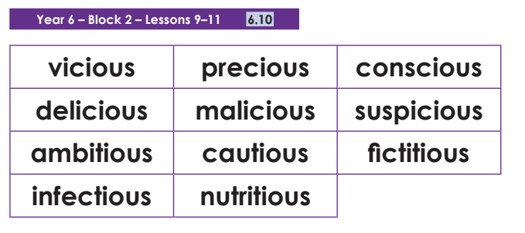
Spelling - Lesson 2
Write a paragraph using as many cious and tious words as you can! Try and make it as silly as possible!
________________________________________________________________________________________________________________________________________________________________________________________________________________________________________________________________________________________________________________________________________________________________________________________________________________________________________________________________________

Slide 14

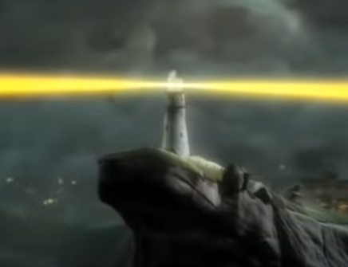
English - Writing
Lesson 2

Slide 15
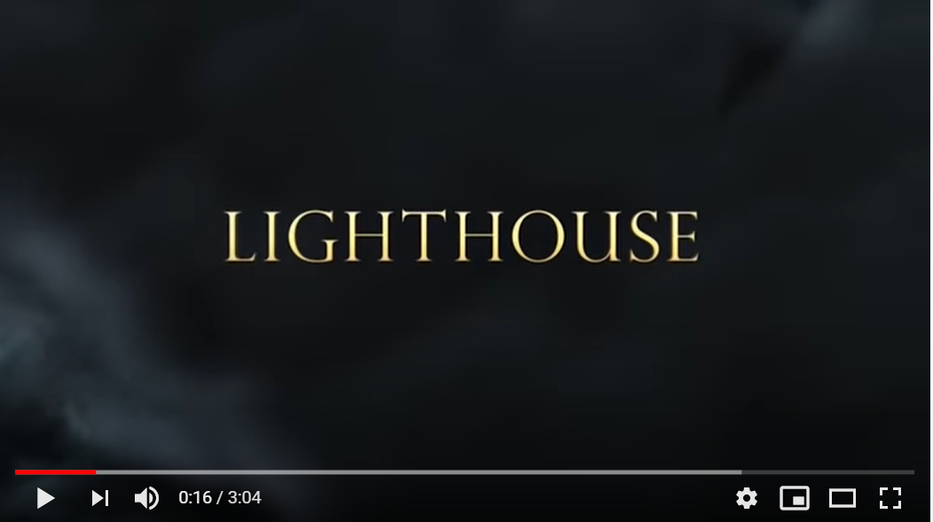
The Lighthouse - Poetry
Teacher Notes
Watch the film to remind yourself about what our English sessions are all about this week.
Click on the image or the link below to watch the short film.
https://www.youtube.com/watch?v=6HfBbSUORvo

Slide 16
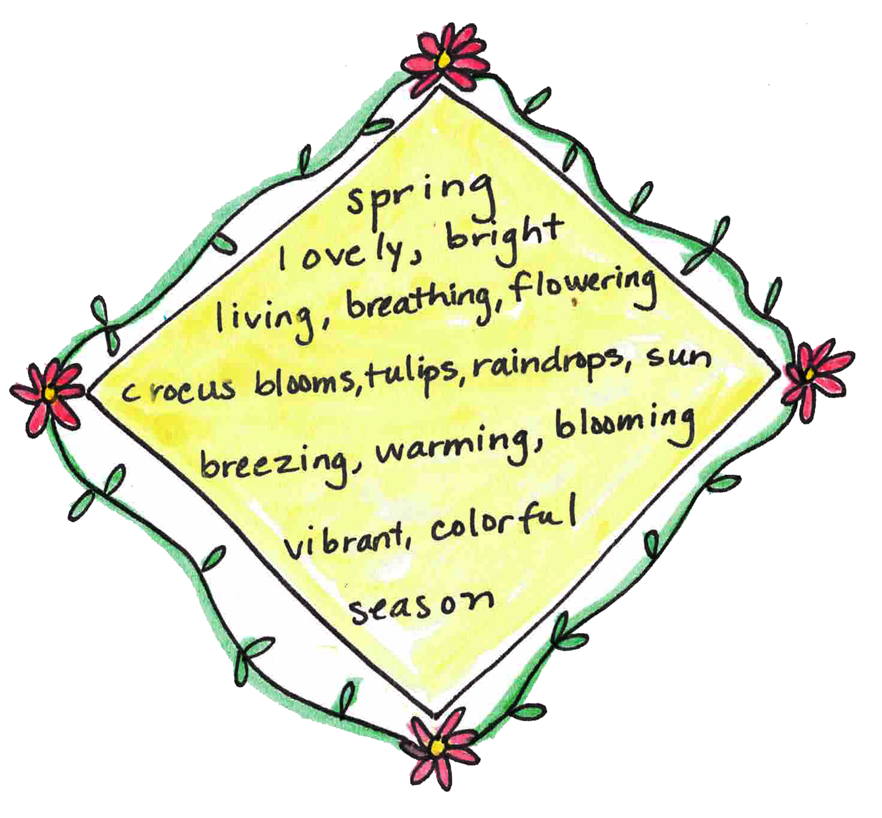
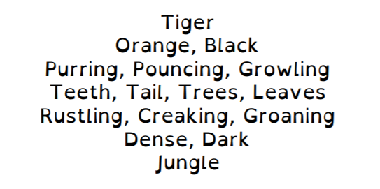
The Lighthouse - Poetry
A diamante poem has 7 lines

Slide 17
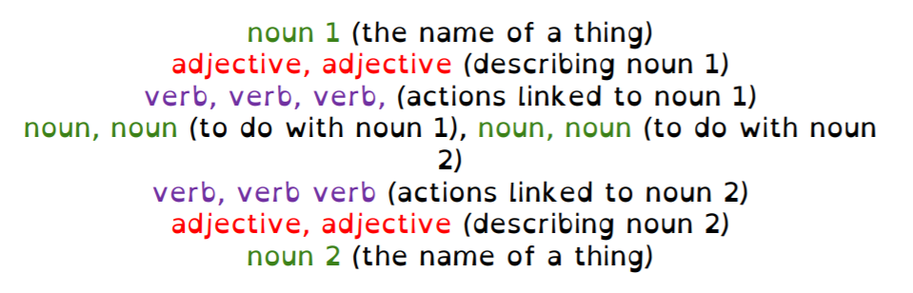
The Lighthouse - Poetry
It follows this pattern…

Slide 18
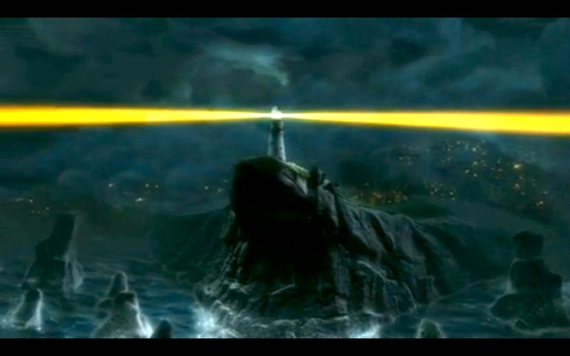
The Lighthouse - Poetry
Now create a diamante poem for the lighthouse and the sea. You can use some of the ideas below to help you.
Lighthouse: tall, bold, bright, magnificent, huge, lonely, solitary, remote, striped, guiding, shining, standing, looming, glowing, illuminating, warning, leading, directing, light, tower, lamp, lens, steps, rocks, coast.
Sea: choppy, angry, deep, dangerous, turbulent, restless, grey, wild, mighty, cold, raging, surging, swaying, crashing, rushing, engulfing, swallowing, rolling, sweeping, wave, crest, boat, water, breaker, surf, foam.

Slide 19

Good Afternoon Year 6!
Let’s start our afternoon with a quick burst of energy!
Get your PE kit at the ready because at the start of each afternoon session we will be joining Joe Wicks for our daily workout.
Do as much as you can and over the week you should find you are getting fitter and finding it easier.
Let’s go!
Click the youtube link below and select today’s date from the videos listed.
https://www.youtube.com/channel/UCAxW1XT0iEJo0TYlRfn6rYQ

Slide 20
Heartsmart

Slide 21

Heartsmart
Watch this video:
https://vimeo.com/354778034

Slide 22

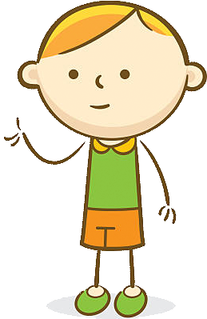
Heartsmart
You should tell the truth at all costs.
Sometimes, lying can be a good thing.
Who do you agree with and why?

Slide 23
Heartsmart
Agreement isn’t the goal, understanding is.
We don’t always have to agree, but we do seek to understand.
Jaoquin was right about using an iPad to fix Boris’s tummy. Does that mean he was right to mention it?
Jude was creative in trying to conceal the truth about Boris. Is what he did wrong?
Is it ever right to tell a lie and if so when?

Slide 24

Well done on a great day!
See you tomorrow!

