Slide 1
Good MoRning Year 6!
Another day of learning - we hope you are enjoying it!
Please follow the instructions on each page to help you - we look forward to hear about how you have got on!
Mrs Jones and Miss Nolan

Slide 2
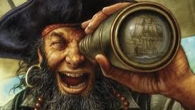
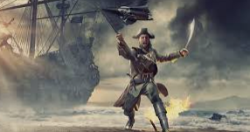
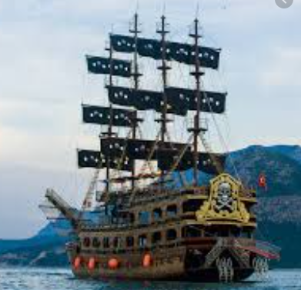
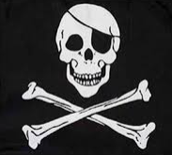
This week’s theme is
Pirates!
Day 4 - 25.6.20

Slide 3
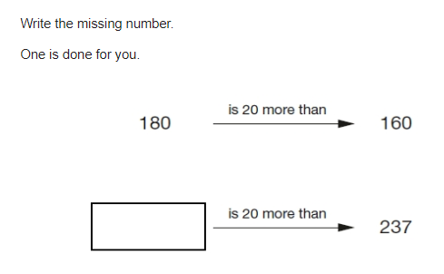
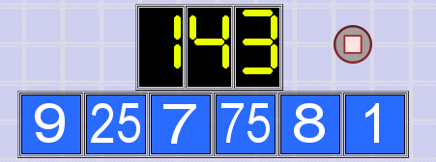
Morning Maths - Give yourself 15 - 20 minutes to complete these questions and then try and tackle today’s countdown.
8.
9. 67894 x 36 =
10.
0.125 = ___% = ?/?
45% x 600
0.6 x 30 =
4578.798 ÷ 1000
Find the area of a rectangle measuring 13.5cm x 6cm.
Find n if 5n + 12 = 65 - 3
A farmer has 4 sheep for every 7 cows. If she has 24 sheep, how many cows does she have?

Slide 4
Now mark your work using these answers.
7. A farmer has 4 sheep for every 7 cows. If she has 24 sheep, how many cows does she have? 42 cows
8.
9. 67894 x 36 = 2,444,184
10.
0.125 = 12.5% = 1/8
45% x 600 = 270
0.6 x 30 = 18
4578.798 ÷ 1000 = 4.578798
Find the area of a rectangle measuring 13.5cm x 6cm.
81cm2
Find n if 5n + 12 = 65 - 3
5n + 12 = 62
5n = 62 - 12
5n = 50
N = 50 / 5
N = 10
257
My answer : 143
9 + 25 = 34
8 - 7 = 1
1 + 1 = 2
2 x 34 = 68
68 + 75 = 143

Slide 5


Assembly Click on title or image below to access the weekly assemblies
Thursday Collective Worship 11am
Live Stream

Slide 6

St Catherine’s Classroom Beliefs
Mistakes are valuable.
Everyone can learn maths to the highest level.
Questions are really important.
Depth is more important than speed.
Maths is about making connections.

Slide 7
25.6.20
WALT: create a range of problems using mathematical knowledge.
Success Criteria:
Four operations
FDP
shape , space and measure
Statistics.
Notes:
Notes:

Slide 8
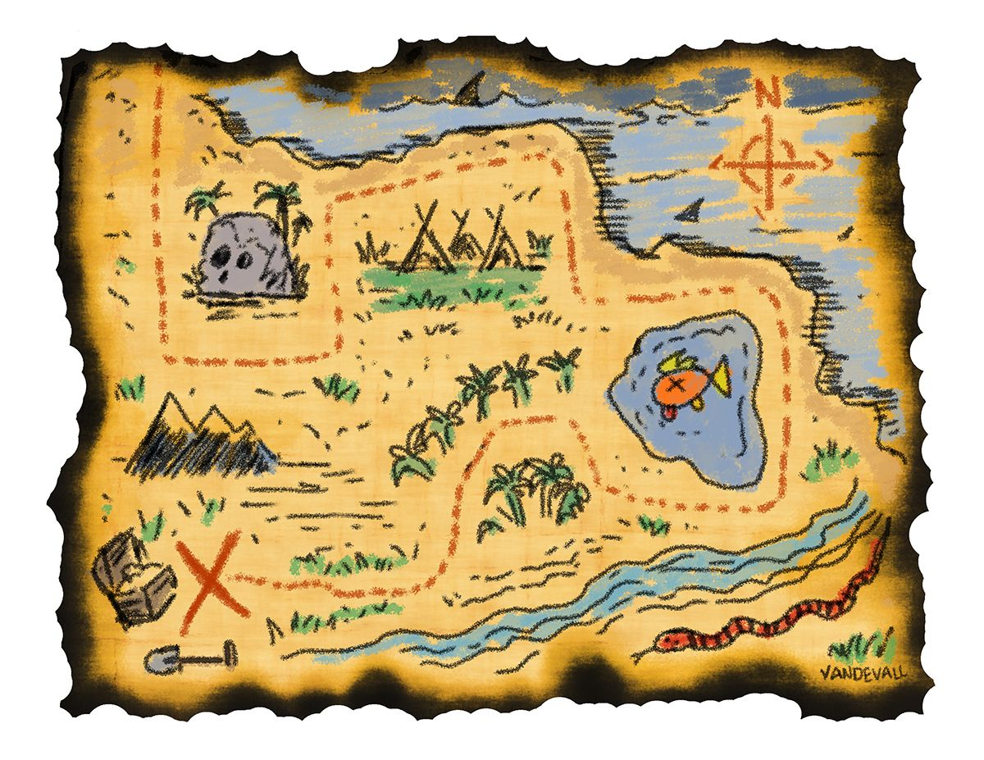
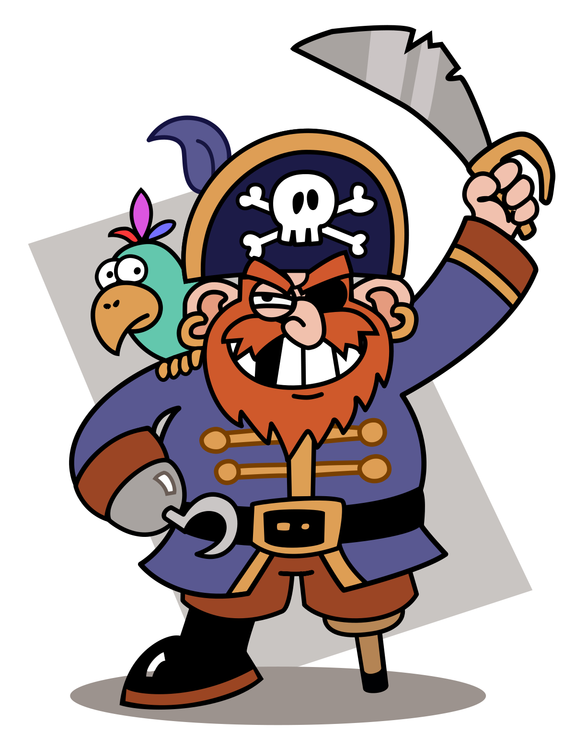
25.6.20
WALT: create a range of problems using mathematical knowledge.
Our final Pirate challenge!
Your task today is to create your own pirate maths problem to solve.
You may choose to use one of the ideas from this week or think of your own innovative idea!
Here are some ideas to help you get started:
a mosaic but rather than decimals could you use times tables
create maths clues that someone has to solve in order to find the buried treasure.
create your own pirate map and use coordinates and directions to help the problem solver find the treasure or abandoned ship.
Draw a pirate ship and the problem solver has to calculate the area or perimeter of different parts.
Can you think of other ideas? Discuss.

Slide 9

Spellings
Reading = World Oceans

Slide 10
Thursday - Spelling and handwriting practice.
luckily
nasty
normally
nosy
rosy
Luckily, I managed to watch them win the football match.
Copy out these words out twice in your best joined handwriting.

Slide 11
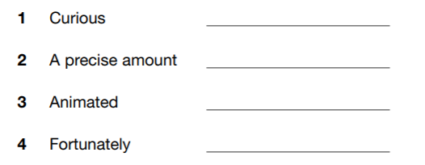
Thursday- Spelling
angrily
costly
dingy
exactly excitedly floury
forty
guilty
lively
lonely
lovely
luckily
nasty normally
nosy
rosy
Which of the words fit these definitions?

Slide 12
Thursday- Spelling
angrily
costly
dingy
exactly excitedly floury
forty
guilty
lively
lonely
lovely
luckily
nasty normally
nosy
rosy
Which of your words fit these definitions? Check the answers below and see if you got it correct.

Slide 13
Reading Activity
Teacher Notes
The purpose of a close read activity is to gain an understanding of the text by reading it multiple times.
Close Read Instructions:
Look at the vocabulary. Do you know what the words mean? If you are unsure, note down the words and use a dictionary (this could be online) to find out their meaning.
Read the text to yourself and ask yourself the following questions:
What did I just read? What did it say? You can make notes or annotate the text.
Now read the text again (you could do this wit an adult) - this will help you gain a better understanding.
Read the questions and now reread the text again to find evidence that will support your answers.
Answer the questions in writing.
All close read texts are age appropriate.

Slide 14
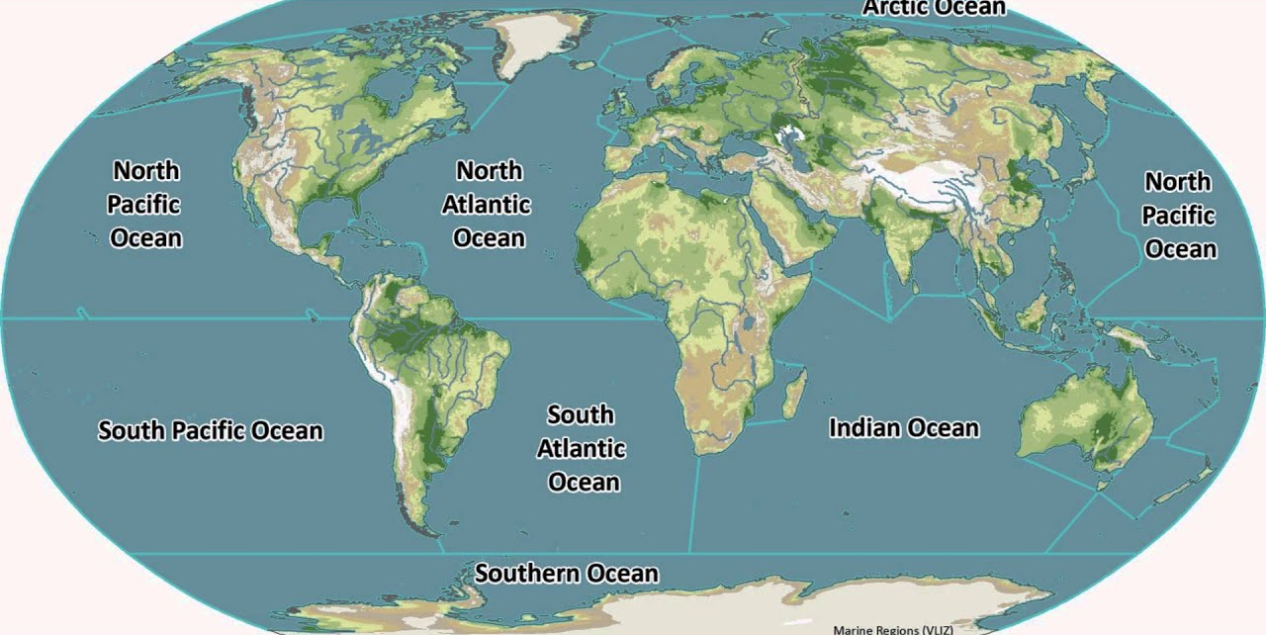
READING - World Oceans
WALT: Make inferences using evidence from the text.

Slide 15
READING - World Oceans
WALT: Make inferences using evidence from the text.
As a result of human action, our oceans are struggling to function as they should. Increasing levels of carbon dioxide in the ocean has led to an increase in the acidity in the ocean. Many sea creatures cannot adapt to this change and therefore die. Sea temperatures are rising with some areas of the ocean seeing a temperature rise of 2°C in the last one hundred years. This causes living things, such as coral, to die. Pollution, both plastic and chemical, is causing major damage to oceans. Oil spills from tankers, fertilisers from agriculture, and litter from land all pollute our oceans. This pollution kills marine life and damages plant life. One of the other biggest problems facing the oceans of the world is overfishing. This means too many sea creatures are being caught in relation to the number that are born. Some species of sea creatures are in danger of becoming extinct because of it and the balance of the ocean is under threat. As countries increasingly view the ocean as a potential source of economic growth, governments must address the challenge of balancing the financial benefits of the ocean while protecting it for the future.

Slide 16
READING - World Oceans
WALT: Make inferences using evidence from the text.
The focus of World Oceans Day changes each year and this year, the theme is ‘Innovation for a Sustainable Ocean’. This theme focuses on ideas and innovations that will help protect the ocean and all life that depend on it. It will highlight technological advances, scientific research and solutions-focused programmes that will help to protect the ocean and sustain it for the future. Scientists and environmentalists are trying to find innovative ways to stem the flow of plastics into the ocean and are developing holistic waste management systems. Other innovations include finding ways to repurpose plastic waste to prevent it from ending up in the ocean. For example, in some countries, plastic is being used to make new products such as roads, clothes and even mattresses!

Slide 17
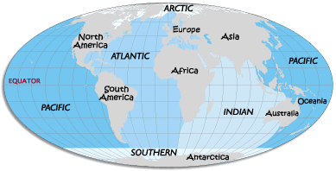
READING - World Oceans
WALT: Make inferences using evidence from the text.
Although governments, businesses and multinational organisations are mostly responsible for making progress towards ocean sustainability, we can all play our part in caring for it. We can all reduce our carbon footprint by using the car less and walking or cycling more. We can strive to use less plastic and recycle more. If living near the coast, we can go on organised beach cleans, collecting and recycling plastic waste. We can research and support charities and innovations that aim to raise awareness about the importance of caring for our oceans.

Slide 18
READING - World Oceans
WALT: Make inferences using evidence from the text.
Explain why there is more carbon dioxide in the ocean. Use evidence from the text to support your answer.
Explain why overfishing is a problem and why it is a difficult problem to solve.
Who do you think is most responsible for caring for the oceans and why? Explain your answer fully using evidence from the text to support your answer.

Slide 19
READING - World Oceans Answers
WALT: Make inferences using evidence from the text.
Explain why there is more carbon dioxide in the ocean. Use evidence from the text to support your answer.
Own responses, such as: There is more carbon dioxide in the ocean because it says in the text that humans create it when they burn fossil fuels such as oil, coal and natural gas. We are more polluted and are burning more fuels than ever which the ocean then absorbs to help the planet to breathe.
Explain why overfishing is a problem and why it is a difficult problem to solve.
Own responses, such as: Overfishing is a problem because more fish are being caught than being born which means that some species of fish are in danger of becoming extinct. It is a difficult problem to solve because some people need to fish to make a living and to help their country’s economy grow but this can be at the expense of the ocean and the creatures that live within it.
Who do you think is most responsible for caring for the oceans and why? Explain your answer fully using evidence from the text to support your answer.
Own responses, such as: I think that governments are the most responsible for caring for the oceans. This is because they have the power and the money to fund the research and innovations that are needed to clean up the oceans. They also have the power to stop things such as overfishing or factories from polluting the ocean.

