Slide 1

Good Afternoon Year 6!
Let’s start our afternoon with a quick burst of energy!
Get your PE kit at the ready because at the start of each afternoon session we will be joining Joe Wicks for our daily workout.
Do as much as you can and over the week you should find you are getting fitter and finding it easier.
Let’s go!
Click the youtube link below and select today’s date from the videos listed.
https://www.youtube.com/channel/UCAxW1XT0iEJo0TYlRfn6rYQ

Slide 2
Religious Education
WALT: show knowledge of gods and goddesses in Hinduism.
Copy these words twice into your book.
Hinduism God Goddess

Slide 3
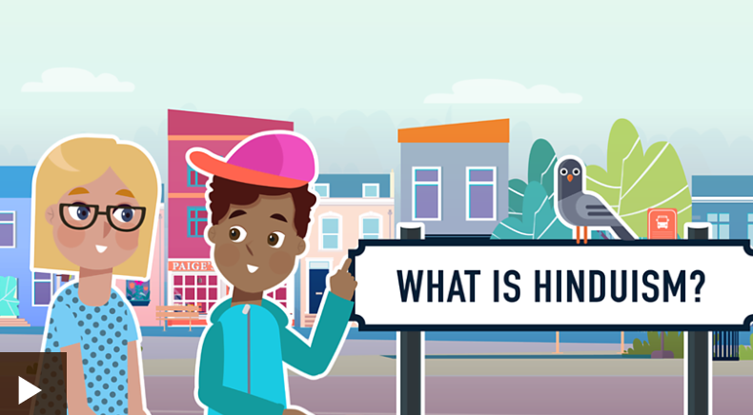
Watch the video linked below and read the accompanying text.
After watching, list 5 things you have learnt about Hinduism.
https://www.bbc.co.uk/bitesize/topics/zh86n39/articles/zmpp92p
Notes:
https://www.bbc.co.uk/bitesize/topics/zh86n39/articles/zmpp92p

Slide 4
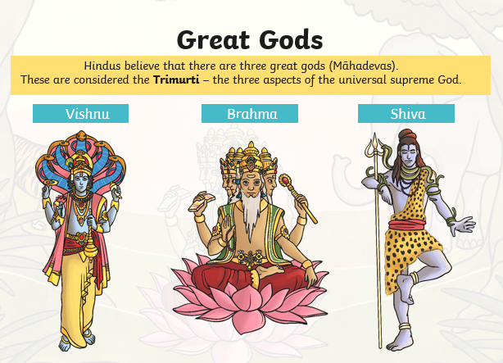
Notes:
Read through the slides - you may want to print the slides off in note form to support learners with the activity.

Slide 5
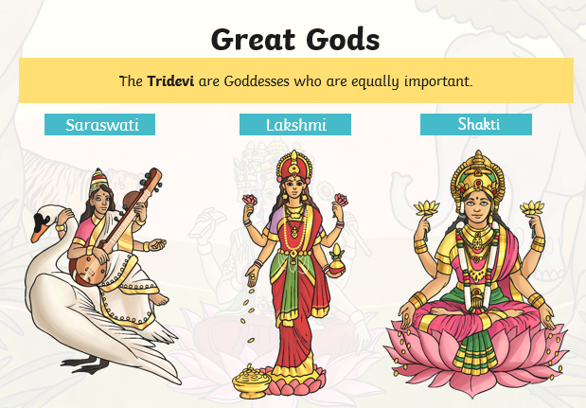

Slide 6
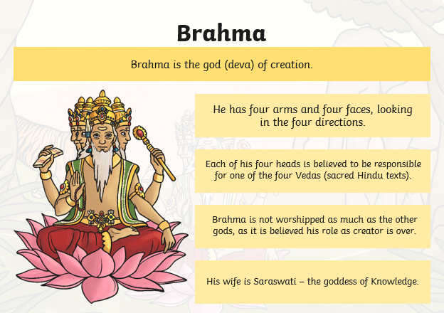

Slide 7
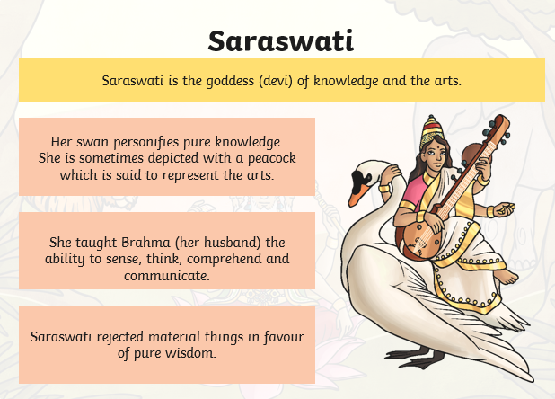

Slide 8
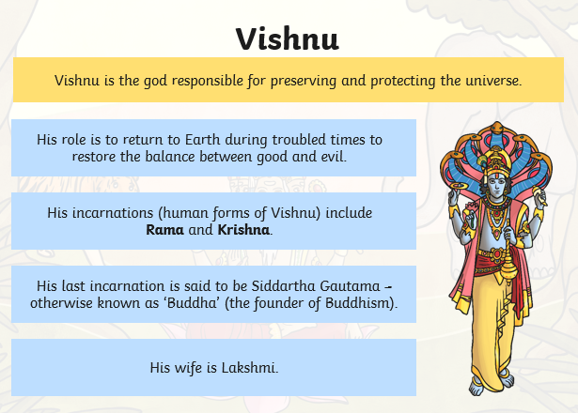

Slide 9
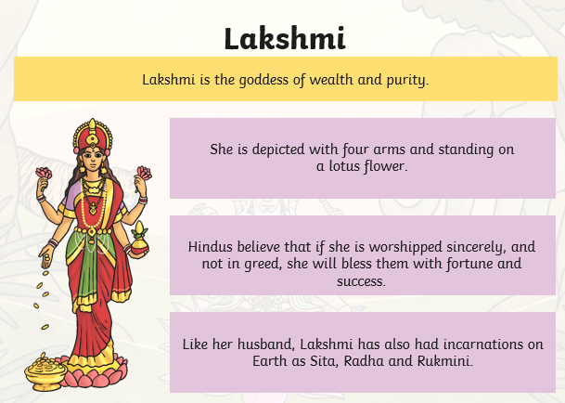

Slide 10
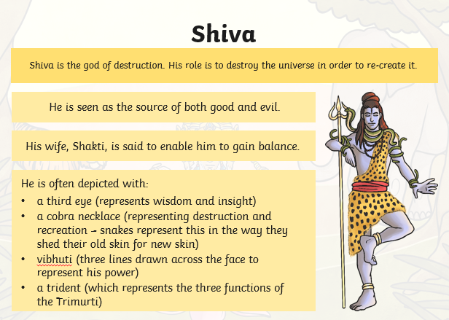

Slide 11
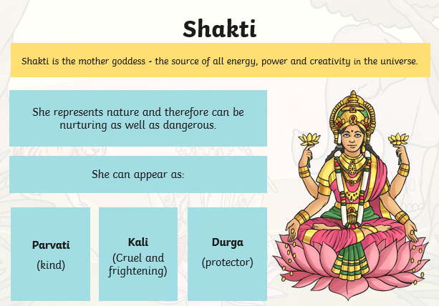

Slide 12
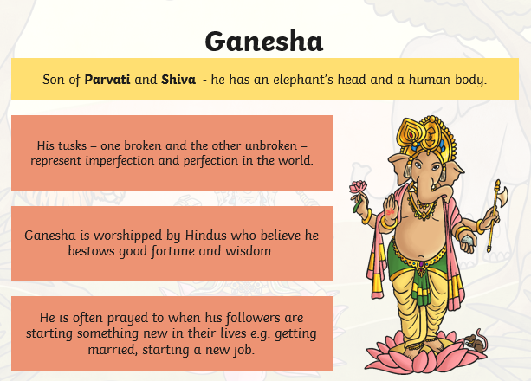

Slide 13
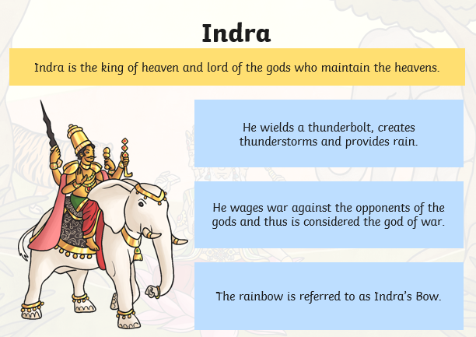

Slide 14
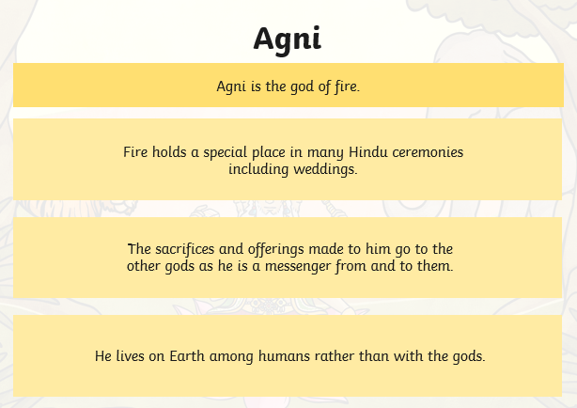

Slide 15
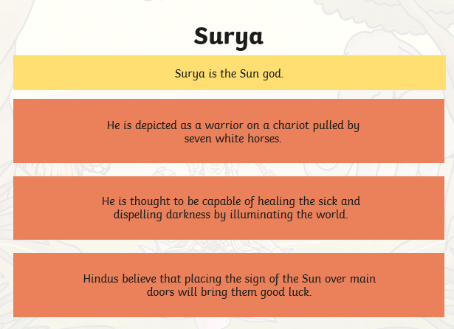

Slide 16
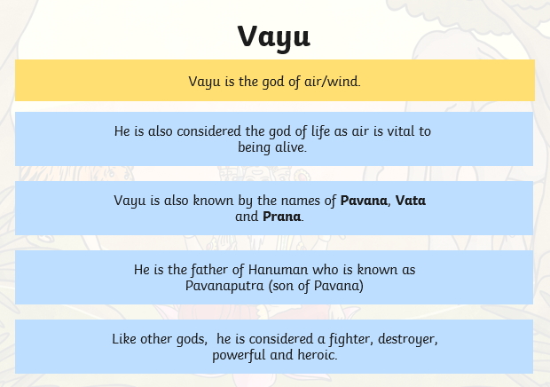

Slide 17
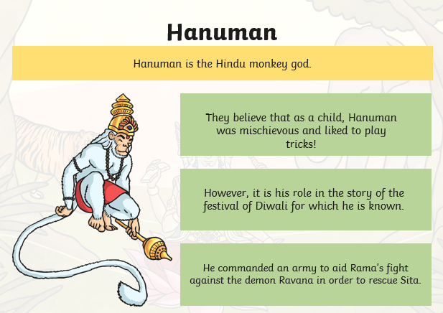

Slide 18
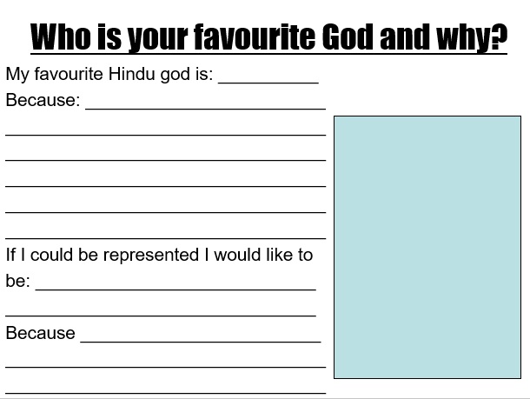
Now you have some information about the different Hindu Gods and Goddesses think about which is your favourite and why?
Use the questions stems to record your thoughts.
Draw an image of the God or Goddess.

Slide 19

Well done on a great day!
Enjoy your evening and be ready for more learning tomorrow...

