Slide 1
Good MoRning Year 6!
Happy Monday morning year 6!
Welcome to another week of home learning. Well done for all your efforts so far. Remember to just try your best!
Please follow the instructions on each page to help you - we look forward to hear about how you have got on!
Mrs Jones, Miss Nolan and Mrs Crane.

Slide 2
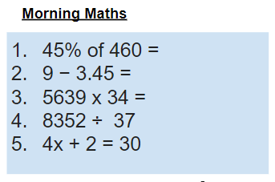
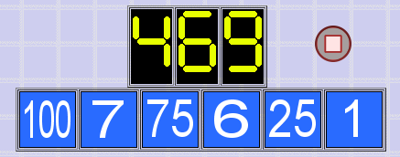
As always, our day will start with Morning Maths.
Give yourself 10 minutes to complete these questions and then try and tackle today’s countdown. If you finish within 10 minutes, check your work and see how many ways you can find to solve the countdown.
After 10 minutes, check your answers using the next slide and the countdown solver (linked below) to see how to solve today’s problem.
Click the link below and type in the numbers and target to see how the countdown could be solved!
http://www.maths-resources.com/countdown/

Slide 3
Answers
207
5.55
191,726
225 r 27
4x = 30-2
4x = 28
X = 28 ÷ 4 = 7

Slide 4


Maths today will focus on line graphs.
We may not be learning together in the classroom, but it is important to still remember our classroom beliefs.
WALT: read and interpret line graphs.
Before we start, get your My Maths log in details ready. These were provided in your first work pack.

Slide 5
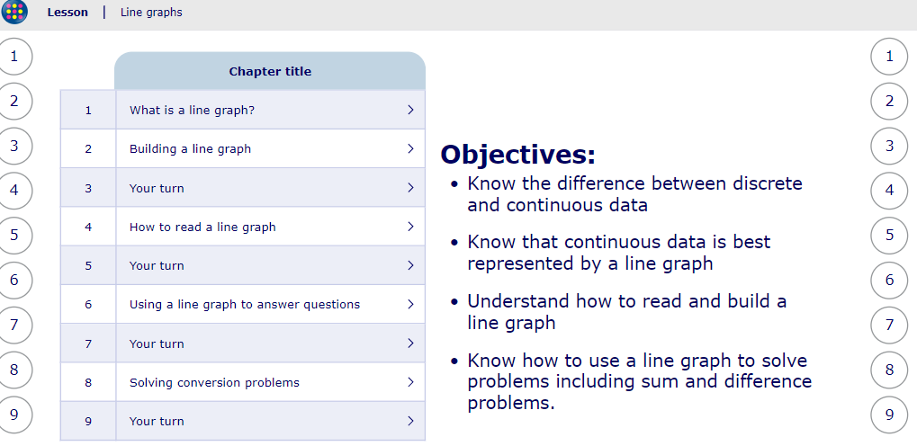
WALT: read and interpret line graphs.
To start the lesson, click on the image to the left of the screen. This will take you to an interactive lesson. This lesson will teach you how to read and interpret line graphs.
Click on the next buttons at the bottom of the page to move your learning on and take part in the mini-quizzes along the way to check your understanding.

Slide 6
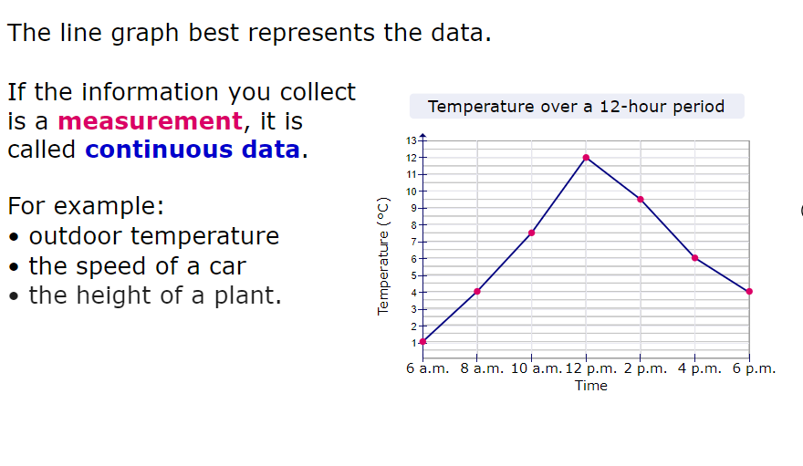
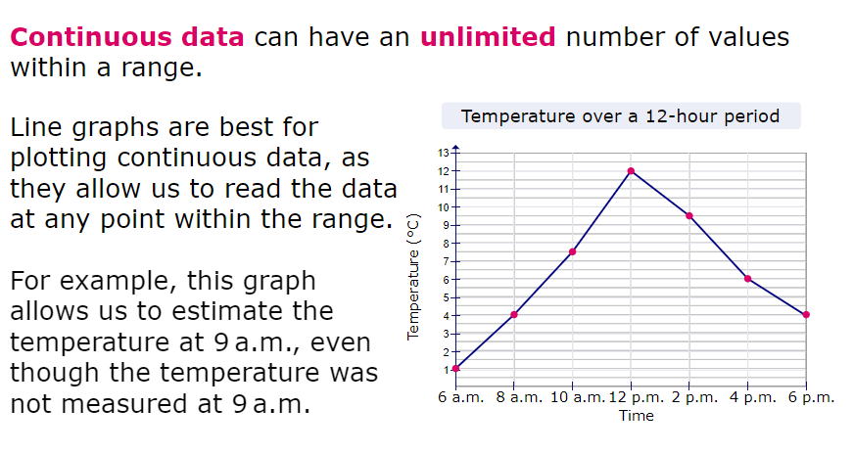
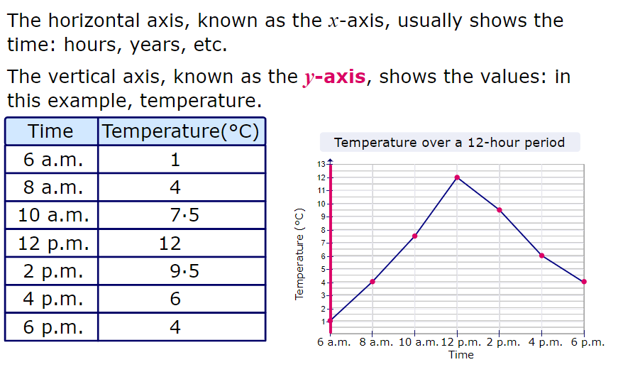
WALT: read and interpret line graphs.
A quick recap...

Slide 7
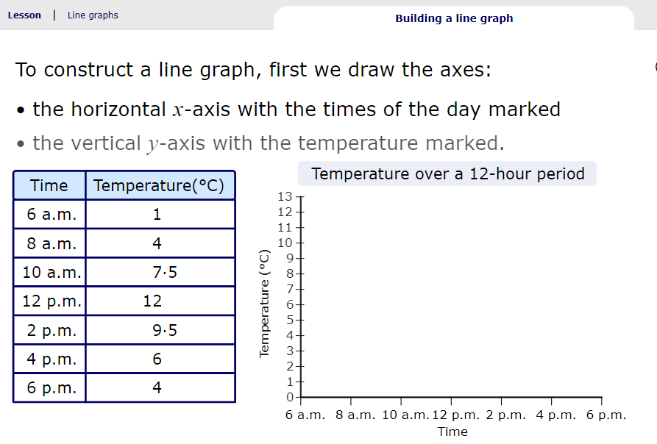
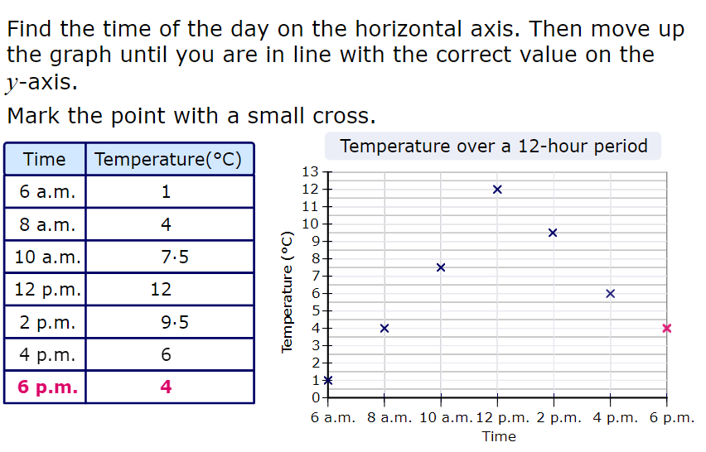
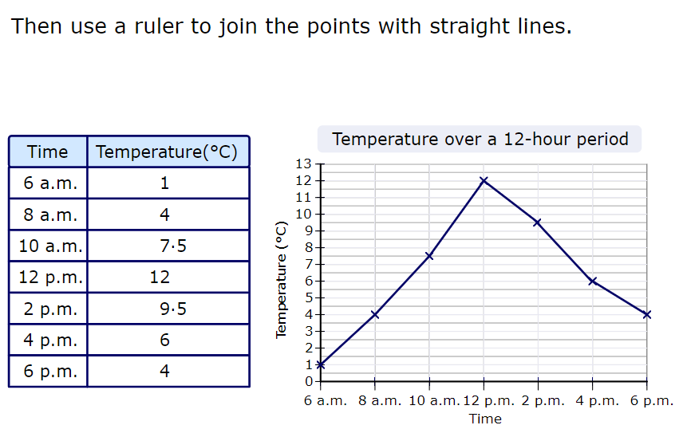
WALT: read and interpret line graphs.
A quick recap...

Slide 8
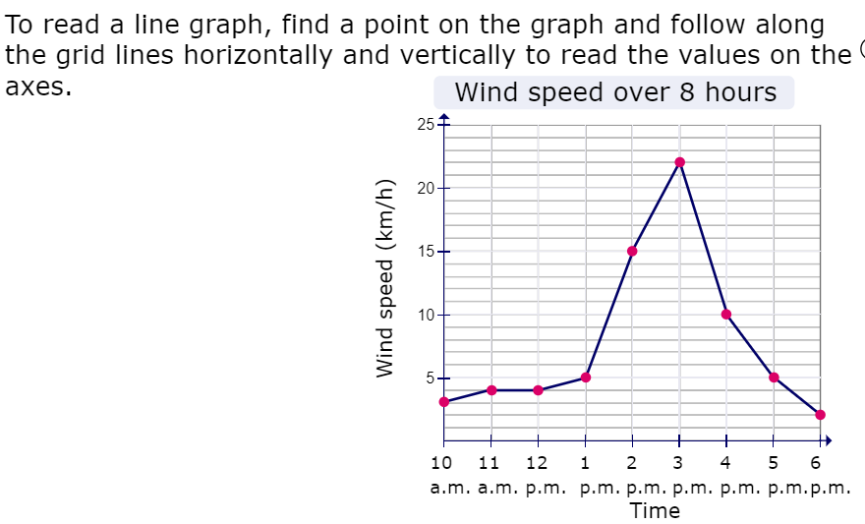
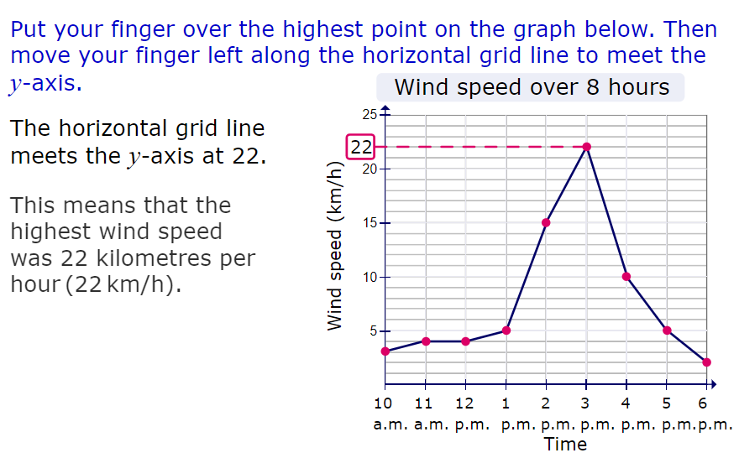
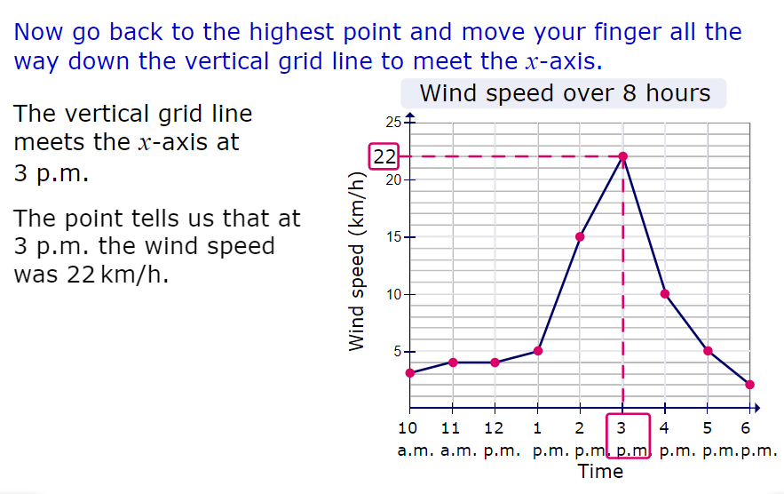
WALT: read and interpret line graphs.
A quick recap...

Slide 9
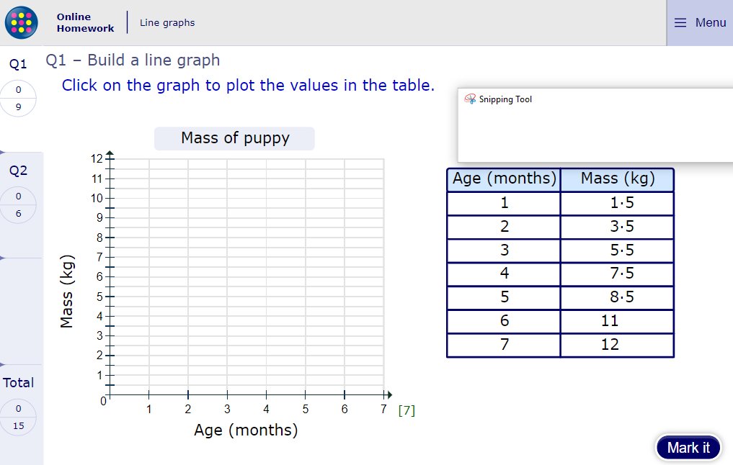
WALT: read and interpret line graphs.
Now click the image on the left of the screen, this will take you to an online homework where you can test your understanding.
Have a go at the questions and then click ‘Mark it’ to see how you have go on.
Your login details for My Maths were sent home in your first work pack - make sure you log in so we can see how you are getting on.

Slide 10
Now you have completed the maths (and had a short break), it’s time for spellings.
Monday - Spelling and handwriting practice.
fictitious
vicious
cautious
malicious
precious
It was important to be cautious around the animal, he was known to be vicious.
Copy out these words out twice in your best joined handwriting.

Slide 11
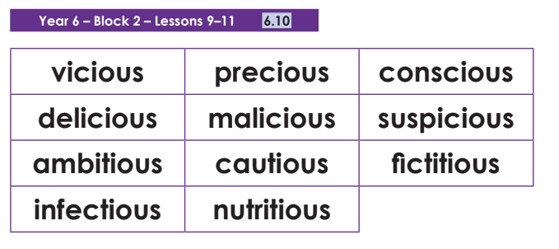
Spelling - Lesson 1
Teacher Notes
Can you identify the root word for some of these words? Write the root word next to the ‘-tious’/‘-cious’ word:
For example:
fiction fictitious
vice vicious
caution cautious
What do they notice about the words that take ‘-cious’?
Teacher Notes
• Not many common words end like this.
• If the root word ends in ‘-ce’, the ending is usually spelt with ‘c’, for
example: vice/vicious, grace/gracious.
• Exceptions: anxious and suspicious.

Slide 12
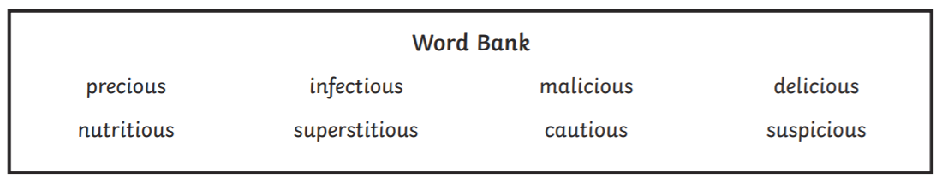
Spelling - Lesson 1
Teacher Notes
Add the correct -cious and -tious words to the sentences using the word bank below to help you.
1. The bully was very mean and ________________________ .
2. Mum was ________________________that the deal was too good to be true.
3. You need to be _________________________ when you are crossing the road.
4. Mrs Bryan thought that the chocolate cake was _____________________________ .
5. My aunty is very _____________________________and will not walk under a ladder.
6. Some diseases can be highly ______________________________ .
7. Fruit and vegetables are very __________________________.
8. The ___________________________ jewels were kept under lock and key.

Slide 13
Spelling - Lesson 1 Answers
Teacher Notes
Add the correct -cious and -tious words to the sentences using the word bank below to help you.
1. The bully was very mean and malicious.
2. Mum was suspicious that the deal was too good to be true.
3. You need to be cautious when you are crossing the road.
4. Mrs Bryan thought that the chocolate cake was delicious.
5. My aunty is very superstitious and will not walk under a ladder.
6. Some diseases can be highly infectious.
7. Fruit and vegetables are very nutritious.
8. The precious jewels were kept under lock and key.

Slide 14

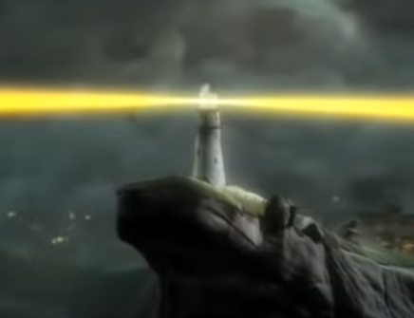
English - Writing
Lesson 1

Slide 15
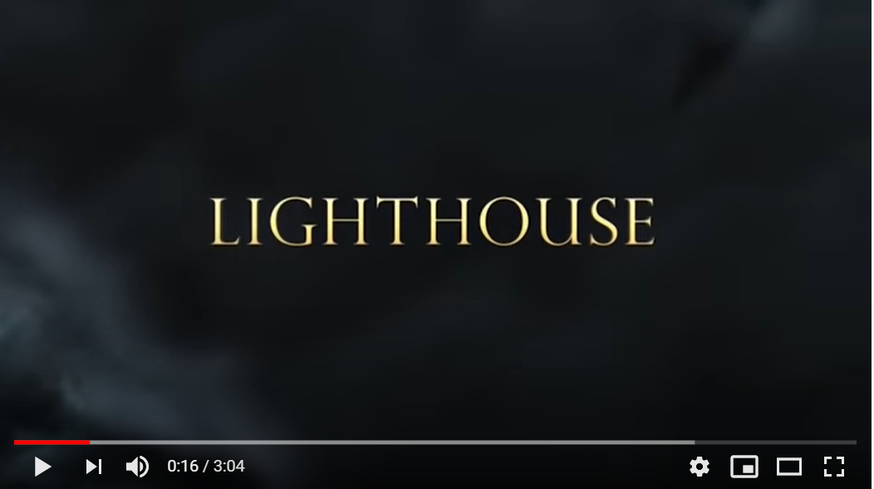
The Lighthouse - Comic strip
Teacher Notes
This week all of the writing sessions will be based on the short film - The Lighthouse.
Watch the film a few times and think about the questions on the next slide. They will help to focus you on the key themes of the film.
Click on the image or the link below to watch the short film.
https://www.youtube.com/watch?v=6HfBbSUORvo

Slide 16

The Lighthouse - Comic strip
Teacher Notes
Questions to think about. You can discuss these with an adult or sibling if you want to.
Note: there are no answers for these discussion questions.
Pause the film after 40 seconds when we first see the lighthouse keeper at his desk.
Why is this scene included in the film? Can we describe the setting in 3 sentences? When do you think the story is set?
Pause the film after the candle blows out.
Does the lighthouse keeper like his neighbours? How does the director build the tension in this scene? What words do you think the lighthouse keeper would use to describe the people of the village? What do you think the lighthouse keeper would be saying to himself when the lantern at the top of the lighthouse goes out?

Slide 17
The Lighthouse - Comic strip
Teacher Notes - Questions to think about continued.
Pause the film after the lighthouse keeper sees the ship.
How do you think he feels when he sees the ship? The lighthouse keeper begins to panic – how can we show through his actions or feelings this sense of panic?
Pause the film when the lighthouse keeper gets to the bottom of the steps. Where do you think he is going? Do you think the villagers will help him? Predict what you think will happen in the rest of the film. Watch the film until the end. How does the lighthouse keeper feel at the end? Do you think he feels differently about his neighbours now? What do you think will happen next time there is a party in the village?
Note: there are no answers for these discussion questions.

Slide 18
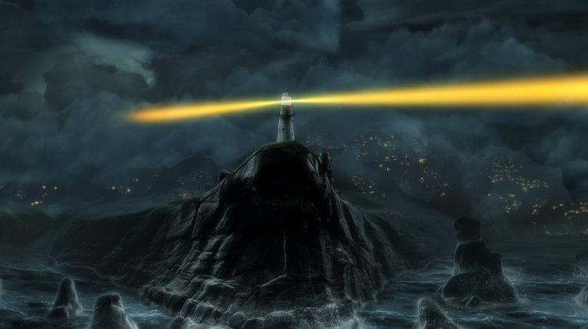

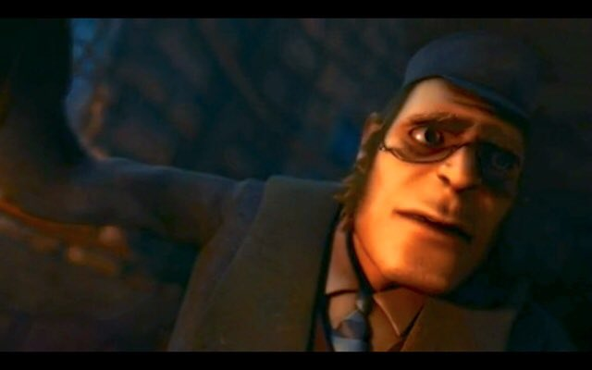

The Lighthouse - Comic strip
Teacher Notes -
Create your own comic strip based on the Lighthouse.
Here are some steps to help you create your comic strip:
Step 1: Write your ideas for your comic - A comic strip is no different from writing a short story. It still needs a beginning, middle and ending. Break your story down into parts. Write down your ideas for the characters, settings, expressions and even speech.
Step 2: Draw the frames - On a new piece of plain paper, draw your frames using a pencil and a ruler. Make sure each frame is equal size. You can even put small light marks on the paper to mark out where the speech bubbles will go. As a bonus tip, you might want to make your frames twice as big as you want them to be, so you don’t run out of space.

Slide 19


The Lighthouse - Comic strip
Teacher Notes -
Create your own comic strip based on the Lighthouse.
Step 3: Use basic shapes to draw - One of the hardest parts of creating a comic strip is drawing out your characters. We recommend you use basic shapes to draw out your characters. Also, sketch in the speech bubbles and any starbursts for sound effects. Oh and don’t forget, please use a pencil at this stage, so you can erase any mistakes.
Step 4: Add in the speech and lettering - Now add in the lettering for your speech into your speech bubbles and don’t forget to double-check your spelling. Remember the size of your lettering could show whether a character is shouting or whispering. For example, lettering in full capitals shows that your character is shouting.

Slide 20
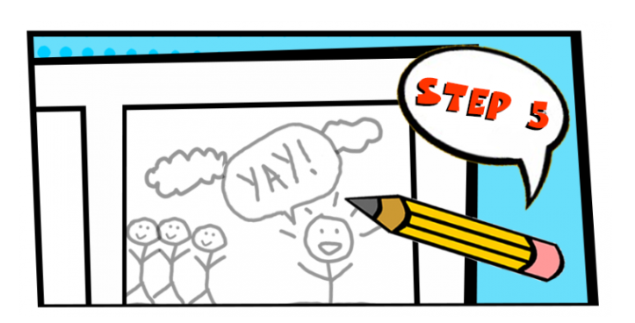

The Lighthouse - Comic strip
Teacher Notes -
Create your own comic strip based on the Lighthouse.
Step 5: Add detail to your cartoon - Now go back to your characters and add any extra details, such as facial expression, movement lines, shadowing on the floor. And also draw in the background for each frame.
Step 6: Go over your comic in pen - Now, you can finally use a felt-tip pen to go over your pencil drawings and rub out any pencil lines. Your comic strip is now complete – well done! You can leave it as it is or even add some colour.

Slide 21

Good Afternoon Year 6!
Let’s start our afternoon with a quick burst of energy!
Get your PE kit at the ready because at the start of each afternoon session we will be joining Joe Wicks for our daily workout.
Do as much as you can and over the week you should find you are getting fitter and finding it easier.
Let’s go!
Click the youtube link below and select today’s date from the videos listed.
https://www.youtube.com/channel/UCAxW1XT0iEJo0TYlRfn6rYQ

Slide 22
Computing
Word Processing

Slide 23
Word Processing
*If you do not have access to a computer or tablet with a word processor (Microsoft Word, Pages, Google Docs), please use the website “Hour of Code” to further practise your coding skills. The coding game that you choose is up to you.

Slide 24
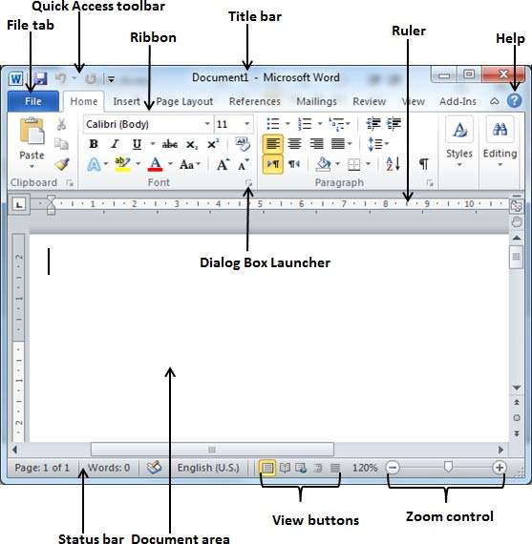

Word Processing Tools

Slide 25
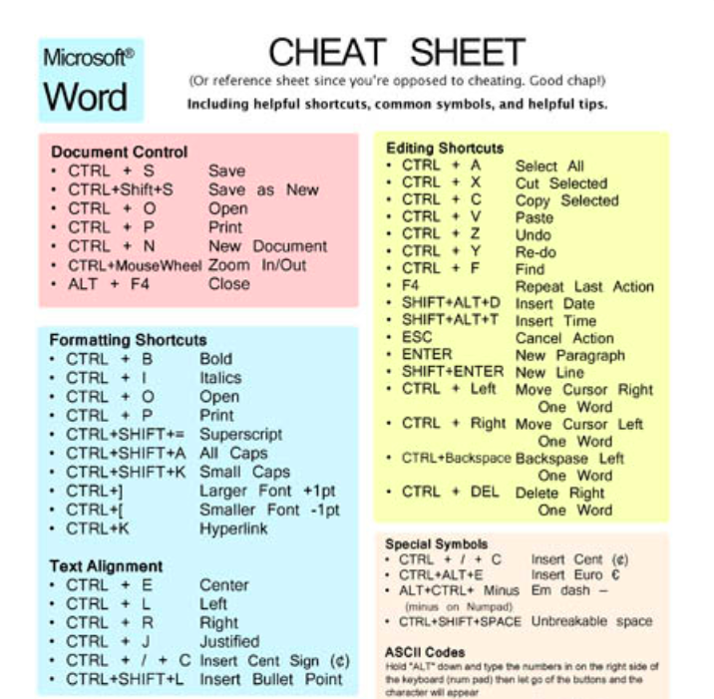
Useful Shortcuts
Save time by using these easy keyboard shortcuts.
Try some of them out now to see how they work!

Slide 26
Activity
Try to recreate the following document using a word processor.
You will need to use:
Different fonts
Different text sizes and colours
Bold and italics
Text boxes
Justifying text centre and to the left
Copy and paste images from the internet
Aligning text around the image
Bullet points

Slide 27
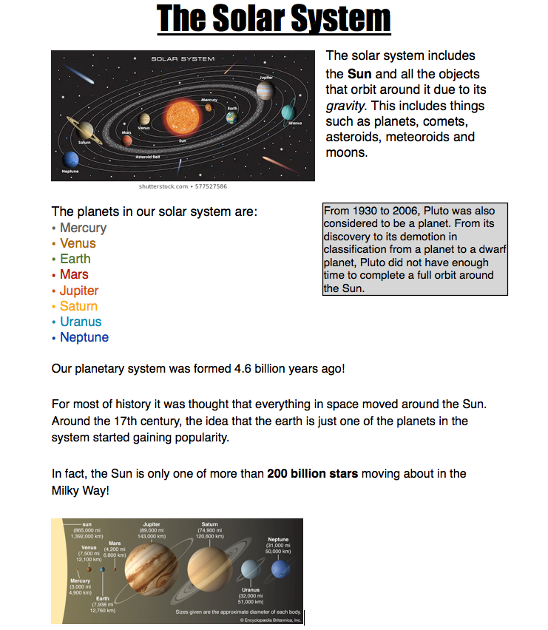
1
WRAP text “tight” around image.
1
2
Text box. Filled with colour with a black outline.
2

Slide 28

Well done on a great day!
See you tomorrow!

