Slide 1
Good MoRning Year 6!
We hope you are all keeping safe and well and enjoying the routine and structure this home learning is providing.
Please follow the instructions on each page to help you - we look forward to hear about how you have got on!
Mrs Jones, Miss Nolan and Mrs Crane

Slide 2
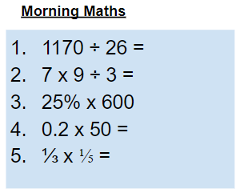
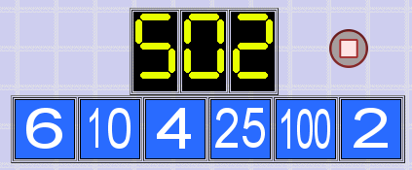
As always, our day will start with Morning Maths.
Give yourself 10 minutes to complete these questions and then try and tackle today’s countdown. If you finish within 10 minutes, check your work and see how many ways you can find to solve the countdown.
After 10 minutes, check your answers using the next slide and the countdown solver (linked below) to see how to solve today’s problem.
Click the link below and type in the numbers and target to see how the countdown could be solved!
http://www.maths-resources.com/countdown/

Slide 3
Answers
45
21
150
10
1/15

Slide 4

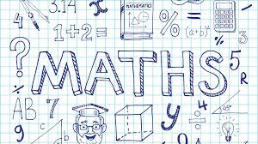
Maths today will be learning about angles in quadrilaterals.
We may not be learning together in the classroom, but it is important to still remember our classroom beliefs.
WALT: use knowledge of properties of quadrilaterals to solve problems.
Today we will not be using My Maths, but instead some White Rose videos and questions to help us to learn and then to test our understanding.

Slide 5
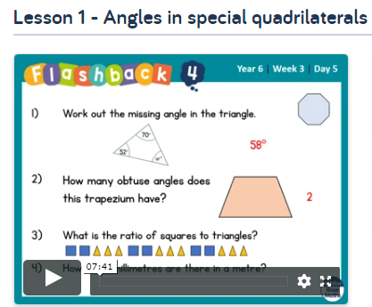

WALT: use knowledge of properties of quadrilaterals to solve problems.
To start the lesson, click on the image to the left of the screen. This will take you to the White Rose home learning website.
Click on:
Then scroll down to Lesson 1 - Angles in special quadrilaterals and click play on the video. This will be a short video lesson.
Watch the video, pausing where necessary to have a go at the mini quizzes throughout.

Slide 6
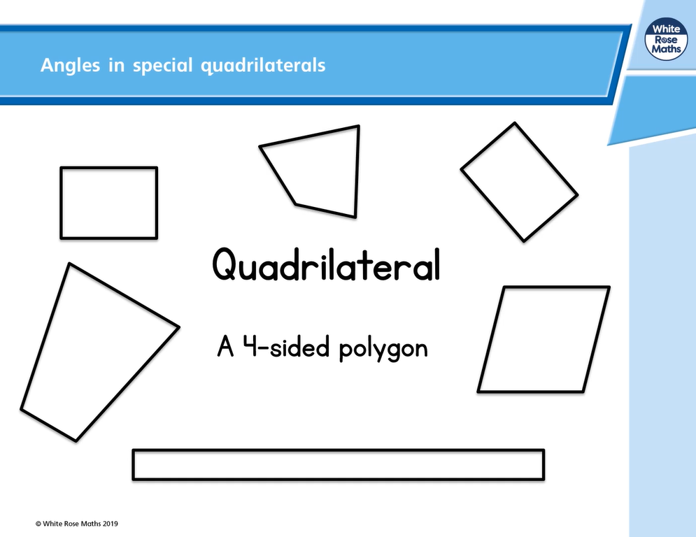
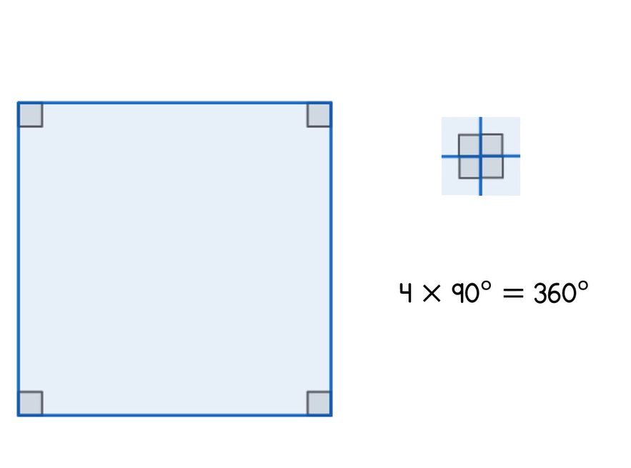
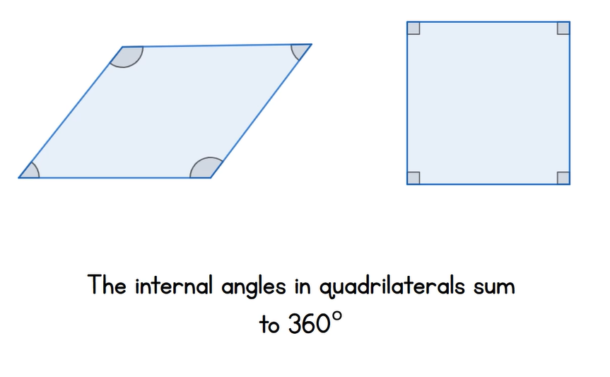
WALT: use knowledge of properties of quadrilaterals to solve problems.
A quick recap...

Slide 7
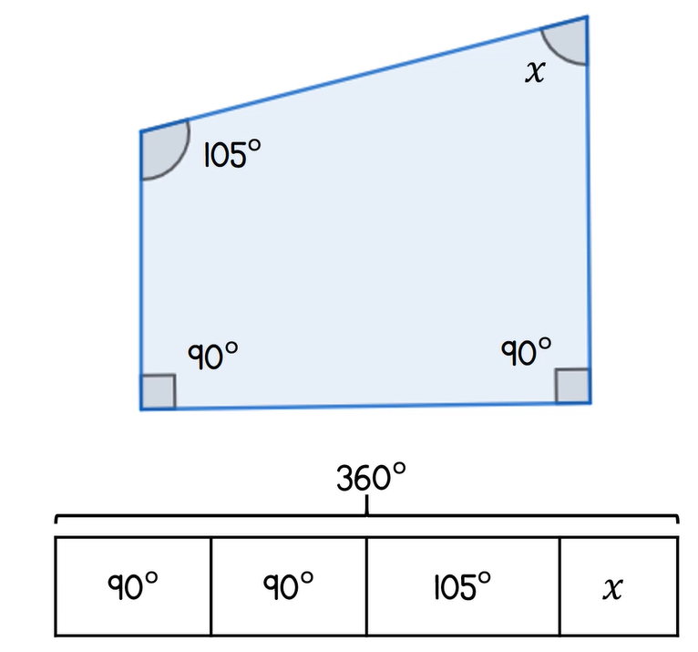
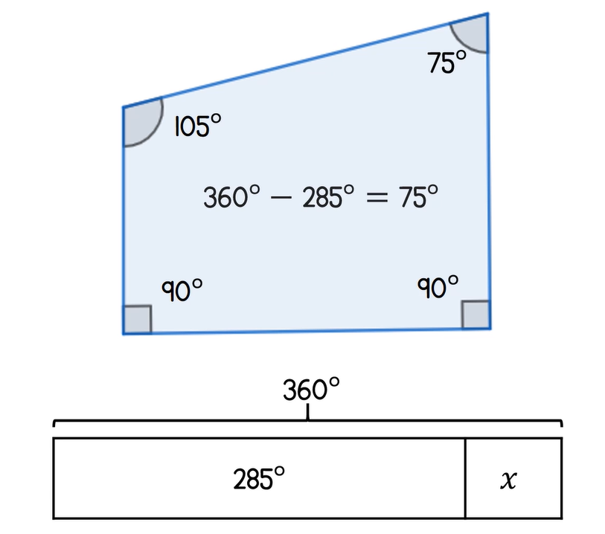
WALT: use knowledge of properties of quadrilaterals to solve problems.
A quick recap...

Slide 8
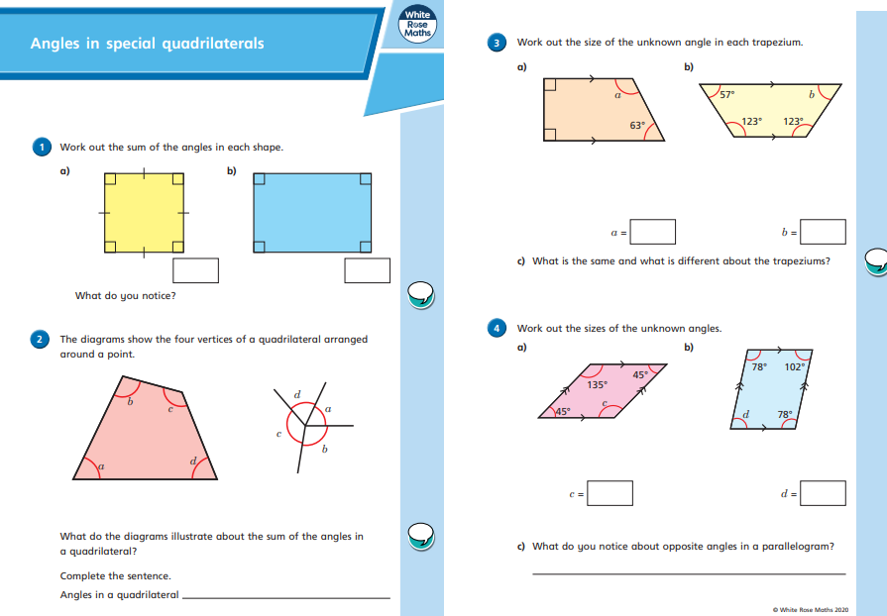

WALT: use knowledge of properties of quadrilaterals to solve problems.
Now click the image on the left of the screen, this will take you to a short test where you can test your understanding.
Have a go at the questions, writing down your answers on some paper. If you have a paper pack, the questions are on the next few slides.
Once you have completed, click the link below to mark your work against the answers.

Slide 9
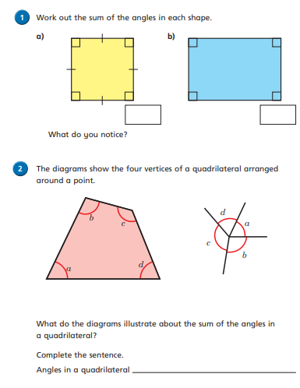
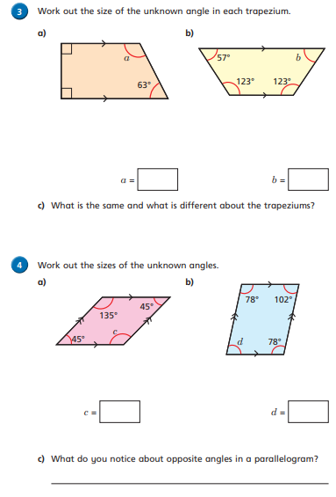
WALT: use knowledge of properties of quadrilaterals to solve problems.

Slide 10
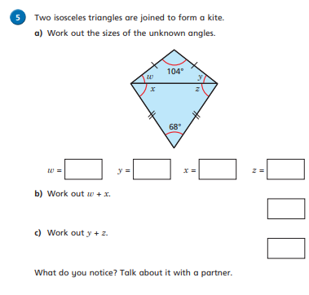
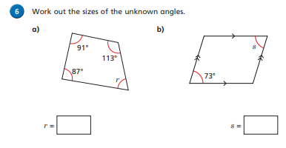
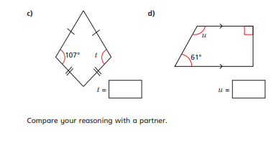
WALT: use knowledge of properties of quadrilaterals to solve problems.

Slide 11
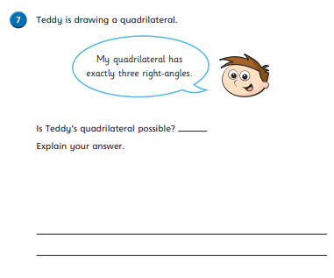
WALT: use knowledge of properties of quadrilaterals to solve problems.

Slide 12
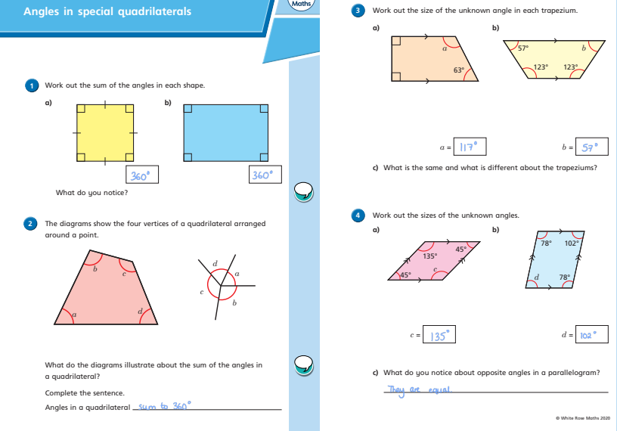
WALT: use knowledge of properties of quadrilaterals to solve problems.
Answers

Slide 13
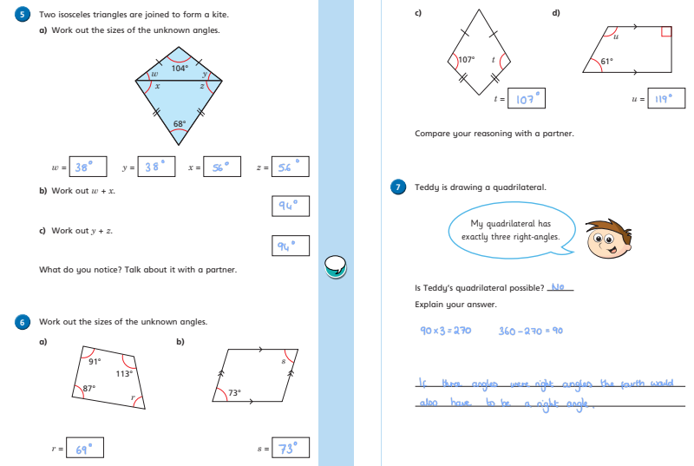
WALT: use knowledge of properties of quadrilaterals to solve problems.
Answers

Slide 14
Now you have completed the maths (and had a short break), it’s time for spellings.
Wednesday - Spelling and handwriting practice.
Copy out these words out twice in your best joined handwriting.
male/mail
past/passed
missed/mist
mourning/morning
meat/meet
The colour black is traditionally associated with mourning.

Slide 15
Spelling - Lesson 1 Homophones
1 The person who delivered the ______________ was a young _____________.
2 The butcher went to ___________ the farmer from whom he buys his _____________.
3 The driver ____________ the road he was supposed to turn down as the ______________meant he couldn’t see the road sign.
4 The family was still in ______________ the _______________after the funeral.
5 The truck driver ____________ a couple of cyclists before driving _______________ a parked car.
Teacher Notes
These sentences contain homophones from the spelling list on the previous slide. Choose which homophones go in the sentences. Make sure you put them in the right order.

Slide 16
Spelling - Lesson 1 Homophones
1 The person who delivered the mail was a young male.
2 The butcher went to meet the farmer from whom he buys his meat.
3 The driver missed the road he was supposed to turn down as the mist meant he couldn’t see the road sign.
4 The family was still in mourning the morning after the funeral.
5 The truck driver passed a couple of cyclists before driving past a parked car.
Teacher Notes
Here are the answers. How many did you get right?

Slide 17


English - Writing
Lesson 4
© Jamie Thomas for Talk for Writing

Slide 18
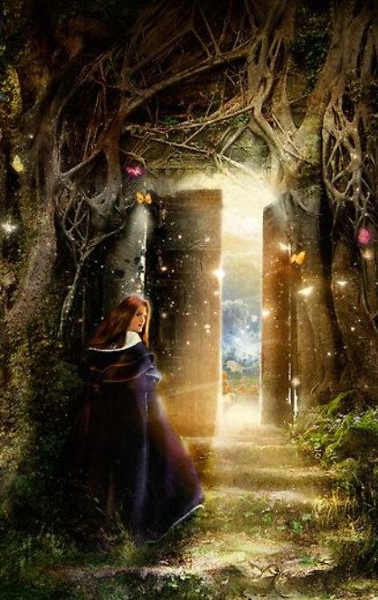
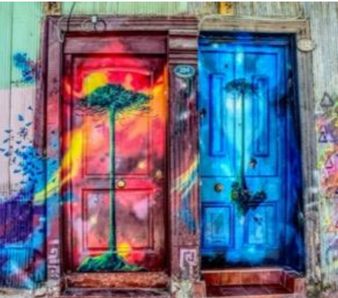
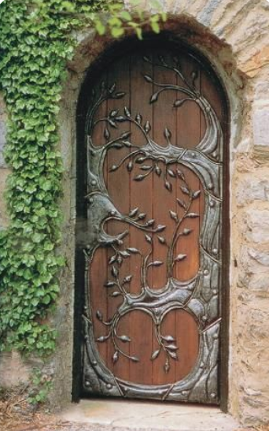
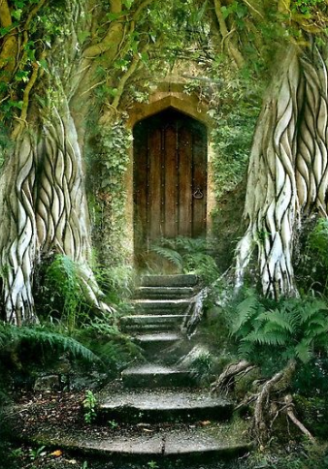
Writing your own story
Teacher Notes
You now have all of the tools required to write your own portal story. You may like to write about a more traditional portal that leads you to a magical world, or you may prefer to draw upon your personal experiences, as we have explored throughout this unit.

Slide 19
Writing your own story
Teacher Notes
To recap on all the key points we’ve been learning:
a. Describe the portal in detail. You may want to show the portal through the eyes of the main character.
b. Think about what lies on the other side of the door. Allow yourself the opportunity to write about what interests you and what is important to you.
c. Great writers steal ideas (‘magpie’) from other great writers. Reflect upon the portal stories that you have loved reading and consider what made these so engaging. Try to bring in some of these skills and techniques into your own work.
d. Enjoy it. Writing is all about sharing a passion for words, stories and the world of possibility. If you love the story you are writing – so too will your reader.
© Talk for Writing

Slide 20
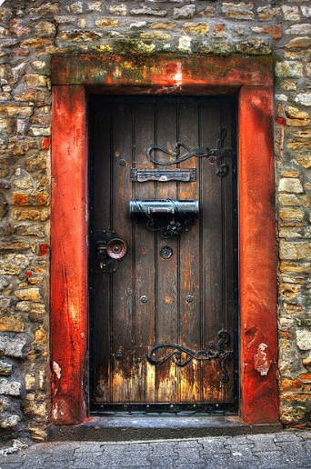
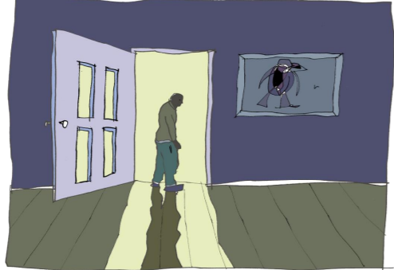
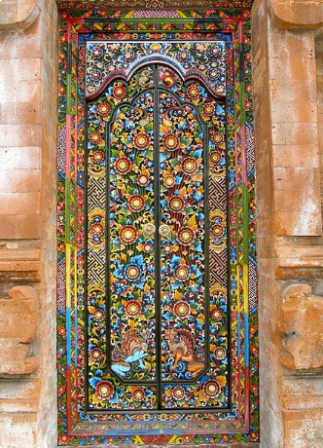
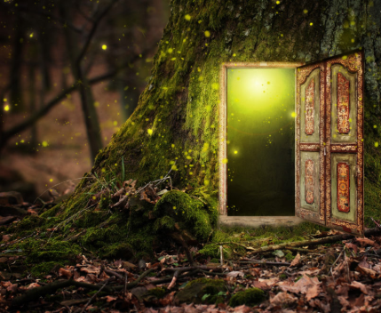
Writing your own story
Teacher Notes
Now write your portal story, drawing on all that you have learned. Don’t forget to share or publish your work – great writing deserves an audience!
© Jamie Thomas for Talk for Writing

Slide 21

Good Afternoon Year 6!
Let’s start our afternoon with a quick burst of energy!
Get your PE kit at the ready because at the start of each afternoon session we will be joining Joe Wicks for our daily workout.
Do as much as you can and over the week you should find you are getting fitter and finding it easier.
Let’s go!
Click the youtube link below and select today’s date from the videos listed.
https://www.youtube.com/channel/UCAxW1XT0iEJo0TYlRfn6rYQ

Slide 22
Computing
Coding
Coding is what makes computer software, apps and websites work.
Behind every animation or activity we use on computers, there is a set of instructions which tell the computer what to do.
Just like any instructions, computer code has to be clear and straightforward.

Slide 23
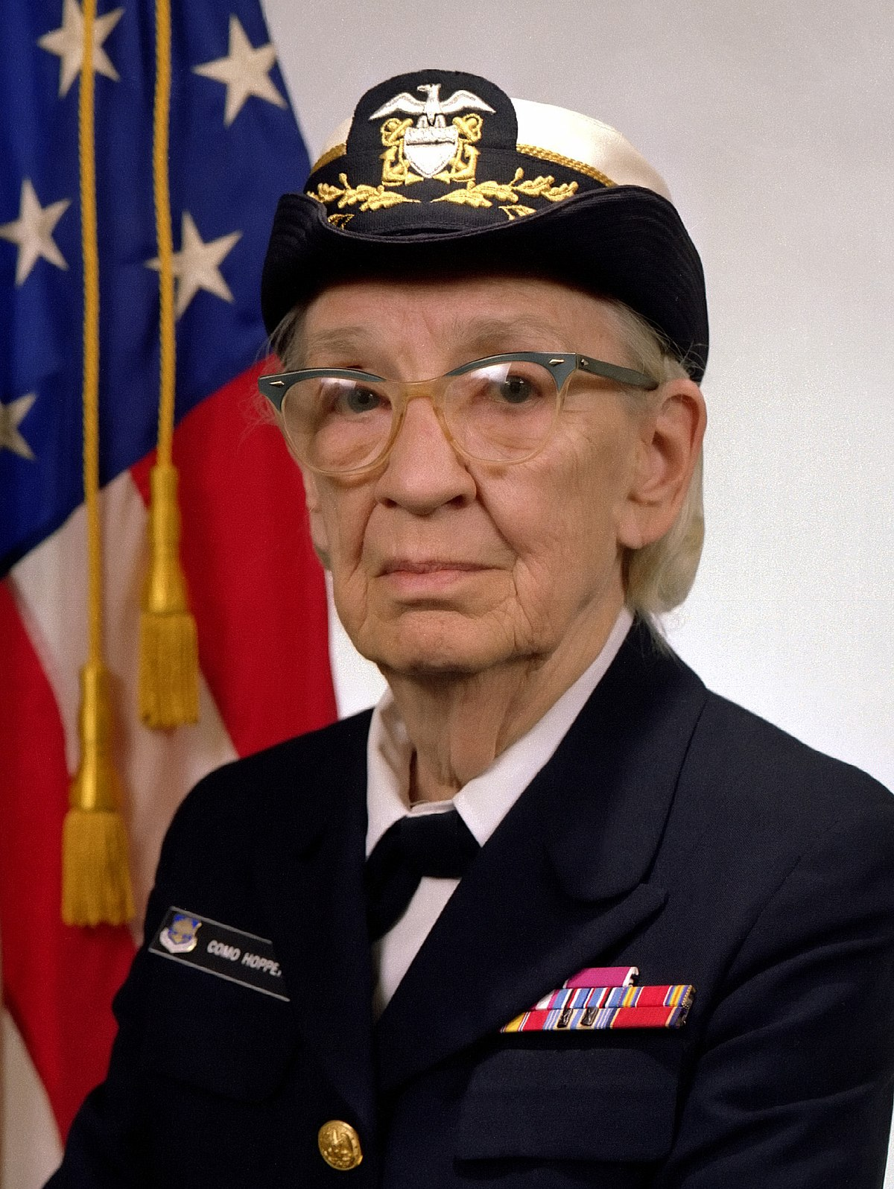
Computing: Coding
There are a number of different code languages. They are all based on English, but the language is simplified to make it clear and direct.
Computers use a range of mathematical symbols put together to make an algorithm (a sequence of instructions).
Grace Hopper, a pioneering computer scientist, developed the use of code written in English to make it more easy to write new code. She developed something called a compiler which translates English code into machine code.

Slide 24
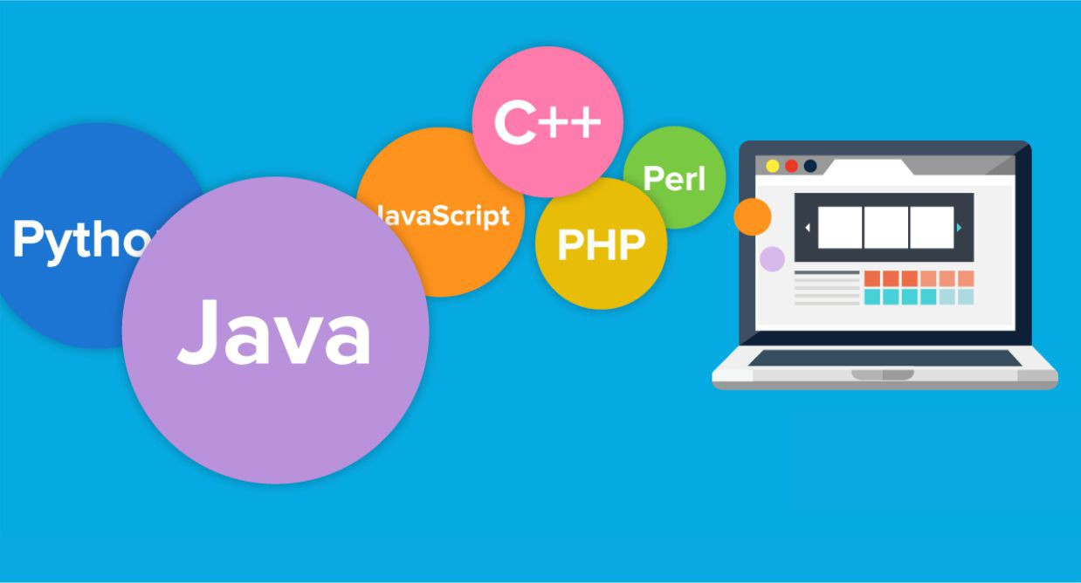
Coding Languages
There are thousands of different coding languages in use today.
Different languages are used for different purposes.
HTML is used for building websites
Ladder Logic is used in manufacturing
Java is used in many things like apps and video gaming
Python can be used for pretty much everything. Instagram was built using Python!

Slide 25

Coding Languages
There are common terms in most coding languages such as:
If… then… else
For… next
Repeat - until
The way these terms are organised looks different in each language.

Slide 26
Why does coding matter?
Coding makes computers work.
Computers are involved in almost every part of our lives today. From microwaves and washing machines, to smartphones and supercomputers, all of these things rely on code in order to work.
Not enough people are able to write code to keep up with the demand for technology today.
It is important that more computer scientists are trained to keep up with demand.

Slide 27
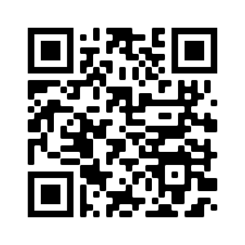
Hour of Code
Hour of code is a website that was launched in 2013 in order to introduce school children to coding.
Use the link to create a Flappy Bird game. Use a smartphone or tablet camera to find the link through the QR code, or type in the link below:
https://studio.code.org/flappy/1

Slide 28

Well done on a great day!
Enjoy your evening and be ready for more learning tomorrow...

