Slide 1
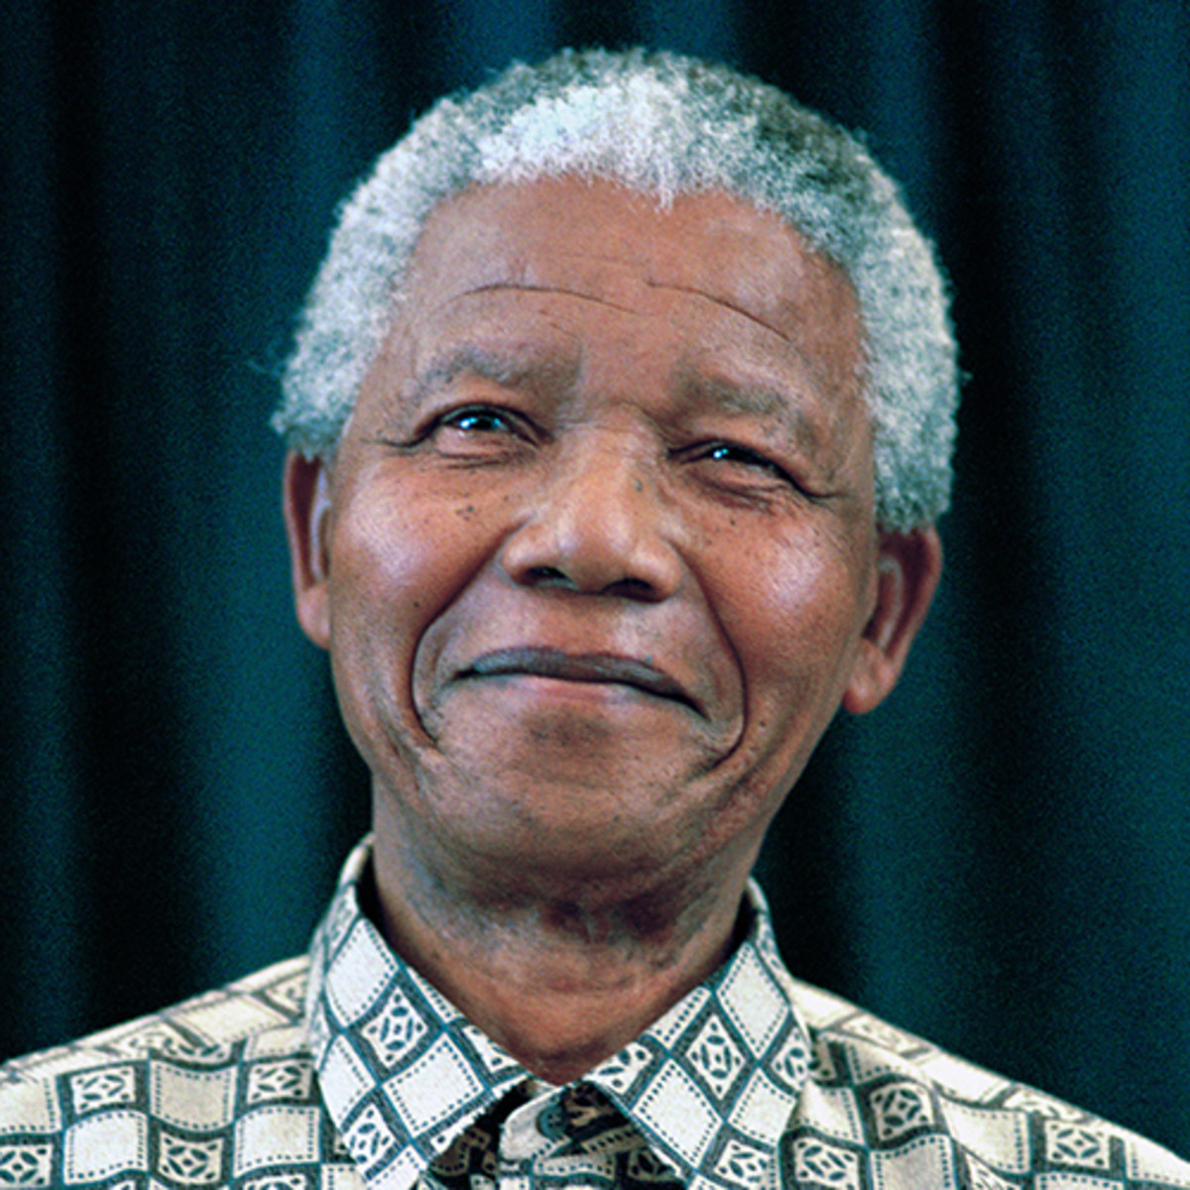
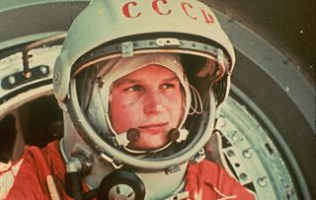
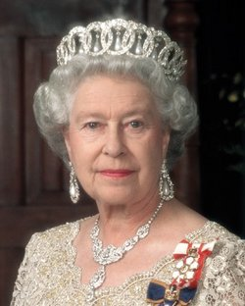

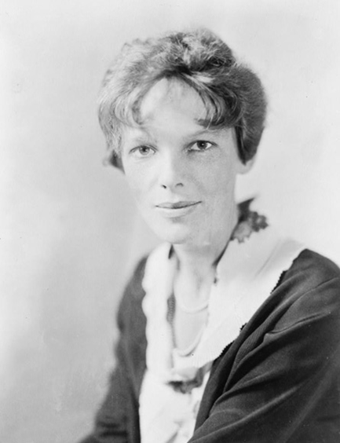
This week’s theme is
Inspirational People
Day 5 - 19.6.20

Slide 2

Spellings
Reading = Valentina Tereshkova

Slide 3
Friday - Spelling and handwriting practice.
national
official
original
parcel
personal
Government officials expect the minister to make an announcement this afternoon.
Copy out these words out twice in your best joined handwriting.
Notes:
Long date and title underlined.
Children copy the words twice in their books and then write the sentence. This is handwriting and spelling.
10 min activity

Slide 4
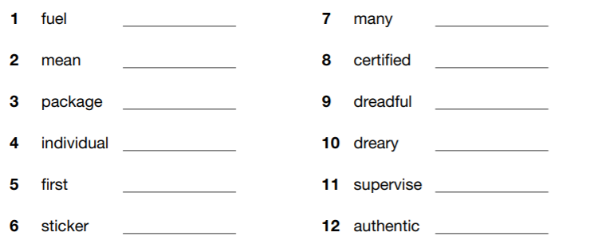
Friday- Spelling
awful
control decimal dismal
hostel
initial
label
national official original
parcel personal petrol removal several spiteful
Which of your words are synonyms for these words?

Slide 5

Friday- Spelling Answers
Which of your words are synonyms for these words? Check the answers below and see how many you got correct.

Slide 6
Reading Activity
Teacher Notes
The purpose of a close read activity is to gain an understanding of the text by reading it multiple times.
Close Read Instructions:
Look at the vocabulary. Do you know what the words mean? If you are unsure, note down the words and use a dictionary (this could be online) to find out their meaning.
Read the text to yourself and ask yourself the following questions:
What did I just read? What did it say? You can make notes or annotate the text.
Now read the text again (you could do this wit an adult) - this will help you gain a better understanding.
Read the questions and now reread the text again to find evidence that will support your answers.
Answer the questions in writing.
All close read texts are age appropriate.

Slide 7
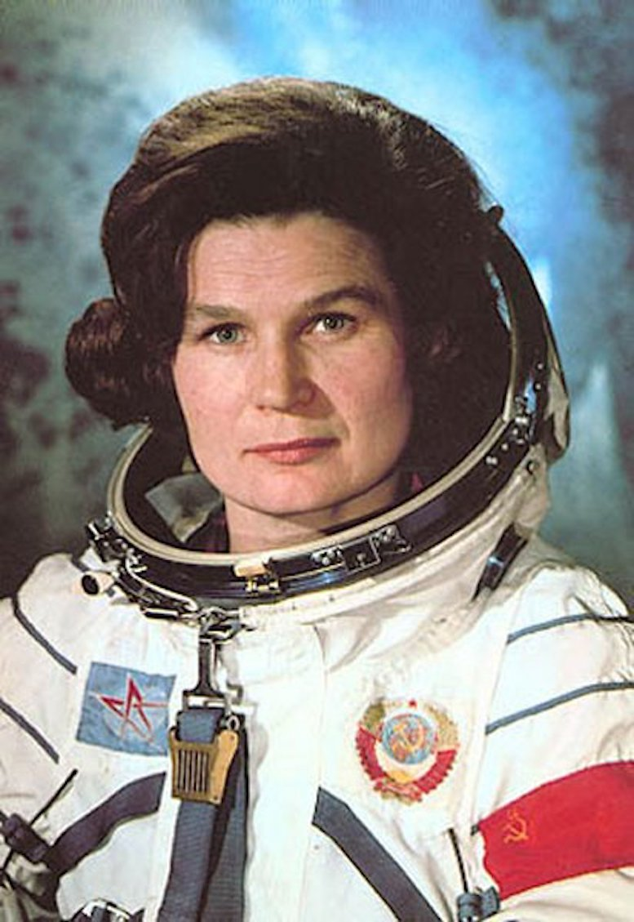
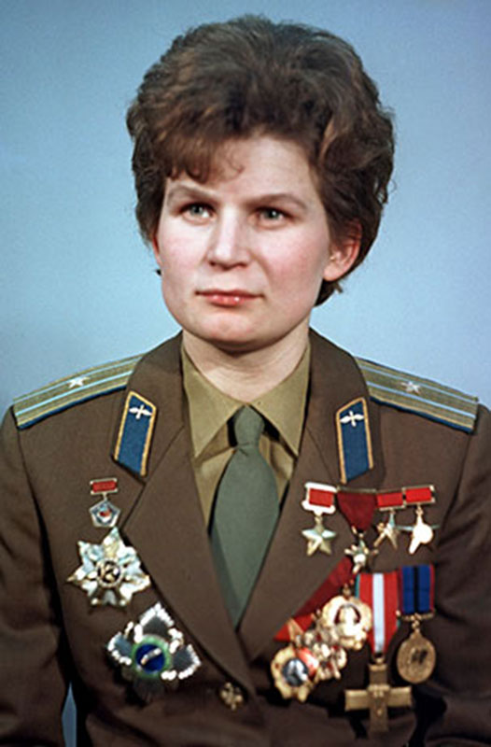
READING - Valentina Tereshkova
WALT: Make inferences using evidence from the text.

Slide 8
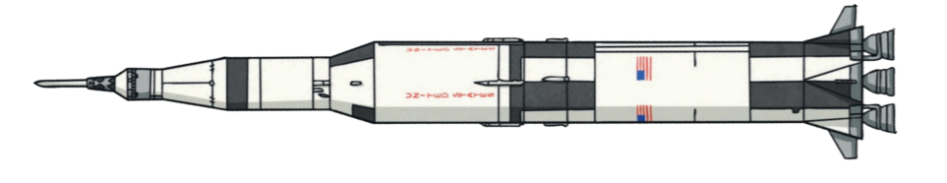
READING - Valentina Tereshkova
WALT: Make inferences using evidence from the text.
Valentina Tereshkova is a famous Russian engineer and cosmonaut. She is best known for being the first woman to fly in space.
Valentina’s Early Life
Valentina was born on 6th March in 1937 in the country that is now called Russia but was then called the USSR. She grew up in a poor family but she dreamt of a more exciting life. Valentina left school at just 16 and worked in a factory but she never gave up on her dreams. In her spare time, Valentina joined a skydiving club and soon learnt that she was a natural, making her first skydiving jump in 1959.
Notes:
All children whisper read text independently first.
Choral read the text together - read aloud with the children
Discuss any vocabulary they are unsure about - children can annotate the text if needed.

Slide 9
READING - Valentina Tereshkova
WALT: Make inferences using evidence from the text.
Spaceflight Training
At this time, a woman had never travelled in space and people wanted to know if women would react differently to spaceflight. The USSR wanted to be the first country to send a woman into space and they were in a race against the United States. Valentina applied to be in a space programme and was chosen because of her skydiving skills.
Five women were picked to train to be cosmonauts but only one of them would be selected to go to space. Valentina was determined that it would be her and worked extremely hard to secure a place. The training was very challenging – they had to perform weightless tests in zero gravity and spend long periods of time alone. The women had to keep their training a secret – even from their own families. After many difficult exams, only two of the women passed the programme and one of them was Valentina. Finally, Valentina achieved her dream and was chosen as the only one to go into space.
Notes:
4. Read the questions with the children
5. Reread the text together and children underline any answers they can find to support the questions. See next slide for teachers notes and annotations.
6. Children write the answers to the questions in their books.

Slide 10
READING - Valentina Tereshkova
WALT: Make inferences using evidence from the text.
The Vostok VI Mission
One month later, on 16th June 1963, Valentina was launched alone into space on a shuttle called Vostok VI, which made her the first woman ever in space. She orbited the Earth 48 times, setting a new world record. She also took incredible photographs in space that helped scientists understand the Earth’s atmosphere much better.
After three days in space, she returned to Earth but her journey home nearly ended in disaster! There were problems with the ship’s programming, which meant that it nearly crashed. Nauseous and disorientated from the change in pressure, Valentina managed to correct the problem before passing out. She had remembered her training and survived with only a few bruises on her face. She proved that women were more than capable of reacting every bit as well as men to the challenges of spaceflight.
Following her flight, Valentina became an engineer and later a doctor. She has worked closely with the cosmonaut programme to help to train many more cosmonauts. She now works for world peace and has a moon crater named after her. Now retired, she remains an inspiration to men and women throughout the world and dreams of going to Mars one day.

Slide 11
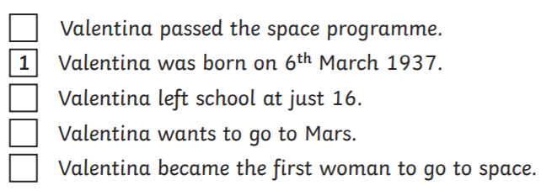
READING - Valentina Tereshkova
WALT: Make inferences using evidence from the text.
Questions
What did Valentina become after she was a cosmonaut? Tick two
Doctor
Scientist
Engineer
Teacher
Number the events below to show the order in which they happened in Valentina’s life.

Slide 12
READING - Valentina Tereshkova
WALT: Make inferences using evidence from the text.
Questions
3. What does the word atmosphere mean?
4. Find and copy one phrase that tells you that Valentina did not feel well when correcting the problem on Vostok VI.
5. What did Valentina prove in her first flight?
6. Why do you think Valentina applied to be in the space programme? Explain your answer.

Slide 13
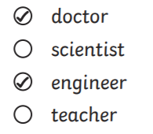
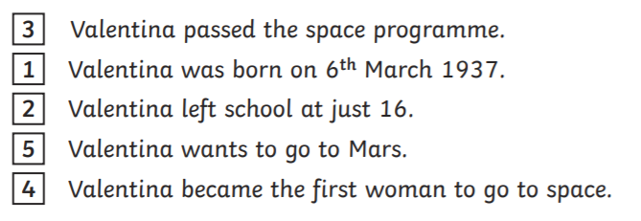
READING - Valentina Tereshkova Answers
WALT: Make inferences using evidence from the text.
What did Valentina become after she was a cosmonaut? Tick two
Number the events below to show the order in which they happened in Valentina’s life.
Notes:
For Teacher guidance

Slide 14
READING - Valentina Tereshkova Answers
WALT: Make inferences using evidence from the text.
3. What does the word atmosphere mean?
The word atmosphere means the gasses that surround the Earth or other planets.
4. Find and copy one phrase that tells you that Valentina did not feel well when correcting the problem on Vostok VI.
Nauseous and disorientated from the change in pressure
5. What did Valentina prove in her first flight?
In her first flight, Valentina proved that women were more than capable of reacting every bit as well as men to the challenges of spaceflight.
6. Why do you think Valentina applied to be in the space programme? Explain your answer.
Responses such as: I think Valentina applied to be in the space programme because she had always dreamt of a more exciting life and she saw a life in space as the most exciting life imaginable. She also loved flying as a skydiver and thought that her skydiving skills would make her good at flying a space shuttle.
Notes:
For Teacher guidance

