Slide 1

Good Afternoon Year 6!
Let’s start our afternoon with a quick burst of energy!
Get your PE kit at the ready because at the start of each afternoon session we will be joining Joe Wicks for our daily workout.
Do as much as you can and over the week you should find you are getting fitter and finding it easier.
Let’s go!
Click the youtube link below and select today’s date from the videos listed.
https://www.youtube.com/channel/UCAxW1XT0iEJo0TYlRfn6rYQ

Slide 2
Heartsmart

Slide 3
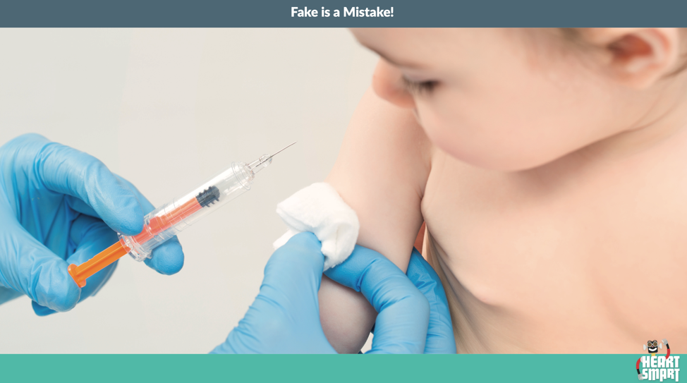
Heartsmart
Lesson 5 : Vaccines: facts vs fake news!
What is happening in this picture?
Why is it happening?

Slide 4
Heartsmart
Vaccinations prevent infectious diseases.
Before vaccinations were introduced it was very common for young children to die of infectious diseases such as diphtheria, and polio.
Thanks to vaccinations this is now very rare.
Can you remember having a vaccination? What can you remember about it?

Slide 5
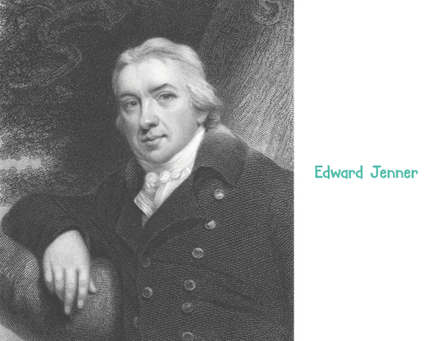
Heartsmart
Vaccines were invented by an English scientist in 1796 named Edward Jenner.
He discovered that injecting a child with a harmless disease protected them from a more serious deadly one.
Click the image to watch a short video.
Notes:
https://www.bbc.co.uk/bitesize/clips/zgj8q6f

Slide 6

Heartsmart
Since Edward Jenner’s discovery, vaccinations against many other infectious diseases have been invented and have saved lives - up to 3 million per year!
However, since the rise in social media there have been many fake news stories about vaccinations that have made parents cautious about vaccinating their children. This has led to a lower uptake in vaccinations and a worldwide increase in cases of diseases like measles, a highly infectious and unpleasant disease.
What is ‘fake news’?

Slide 7

Heartsmart
Fake news can be a deliberate spreading of mis-information or it can be that facts are not properly checked before they shared and mistakes are made. Bad news travels fast so fake news can often be shared more widely than the truth. It is believed that this is what has happened regarding information about vaccinations and has had a significant negative impact on the numbers of children being vaccinated.

Slide 8
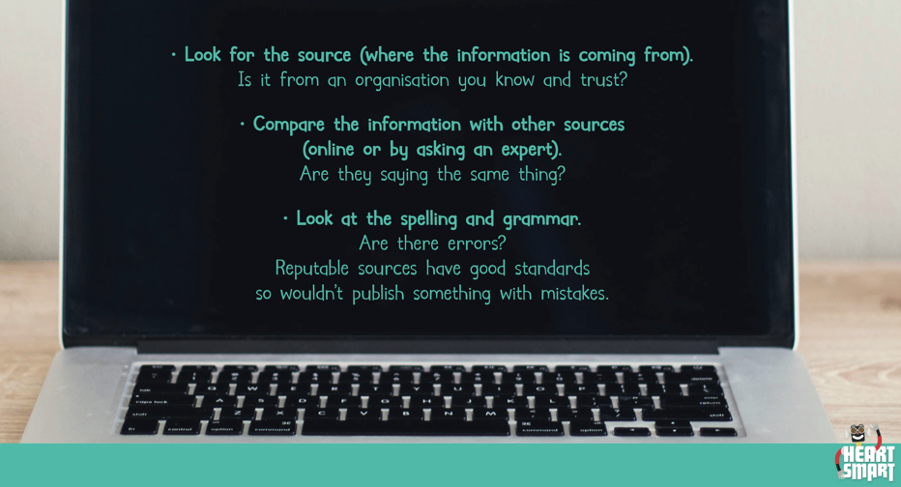
Heartsmart
How do you discern if a news source is credible?
Where might you get credible information about health issues and vaccinations from?
Notes:
Ask the children to suggest a credible source of information online about vaccinations (NHS, Government site, World Health Organisation).

Slide 9
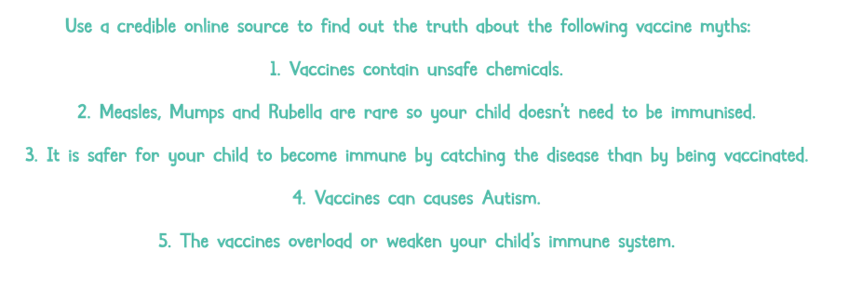
Heartsmart
Notes:
You may have to do this as a class if the children do not have internet access through the ipads. There is a worksheet they can complete this on in the resources document.

Slide 10
Heartsmart
Always check what they are reading or looking at online to avoid being taken in by fake news.
After all Fake is a Mistake!

Slide 11

Well done on a great week!
Enjoy your weekend!

