Slide 1
Good MoRning Year 6!
Welcome to Thursday’s lessons. We are excited to share today's learning with you.
Please follow the instructions on each page to help you - we look forward to hear about how you have got on!
Mrs Jones and Miss Nolan

Slide 2
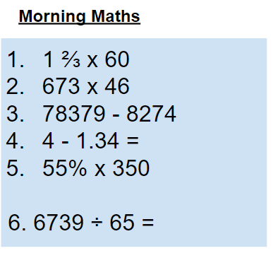
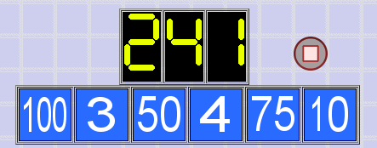
As always, our day will start with Morning Maths.
Give yourself 10 minutes to complete these questions and then try and tackle today’s countdown. If you finish within 10 minutes, check your work and see how many ways you can find to solve the countdown.
After 10 minutes, use a calculator to check your answers and the countdown solver (linked below) to see how to solve today’s problem.
Click the link below and type in the numbers and target to see how the countdown could be solved!
http://www.maths-resources.com/countdown/

Slide 3

Maths today will focus on enlarging shapes using scale factors.
We may not be learning together in the classroom, but it is important to still remember our classroom beliefs.
WALT: enlarge shapes using scale factors.
Before we start, get your My Maths log in details ready. These were provided in your first work pack.
You will need a ruler, pencil and paper.

Slide 4
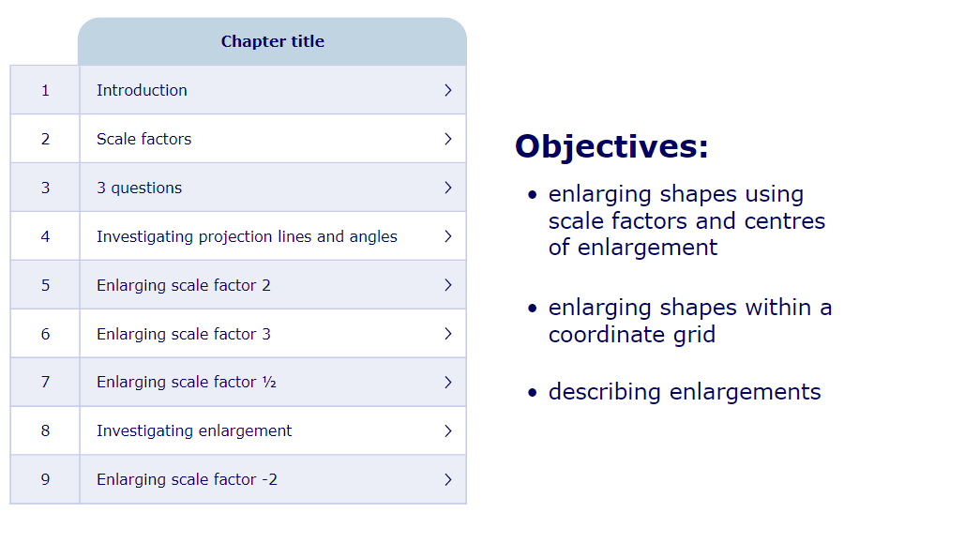
WALT: enlarge shapes using scale factors.
To start the lesson, click on the image to the left of the screen. This will take you to an interactive lesson. This lesson will show you how to enlarge shapes using scale factors.
Click on the next buttons at the bottom of the page to move your learning on and take part in the mini-quizzes along the way to check your understanding.

Slide 5
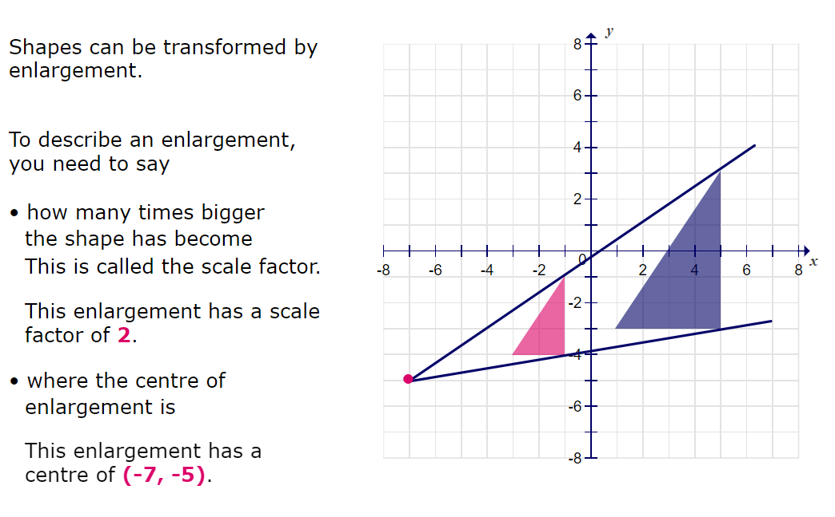
WALT: enlarge shapes using scale factors.
A quick recap...

Slide 6
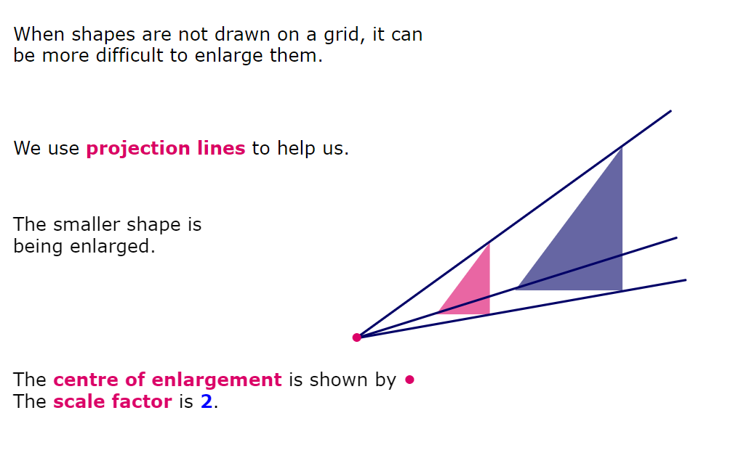
WALT: enlarge shapes using scale factors.
A quick recap...

Slide 7
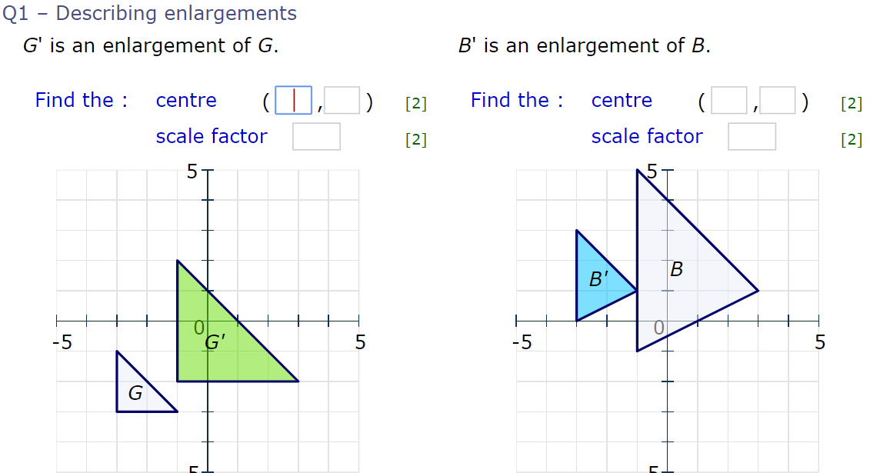
WALT: enlarge shapes using scale factors.
Now click the image on the left of the screen, this will take you to an online homework where you can test your understanding.
Have a go at the questions and then click ‘Mark it’ to see how you have go on.
Your login details for My Maths were sent home in your first work pack - make sure you log in so we can see how you are getting on.

Slide 8
Now you have completed the maths (and had a short break), it’s time for spellings.
Thursday - Spelling and handwriting practice.
ancient
agent
decent
confidence
emergency
The secret agent needed to act with confidence.
Copy out these words out twice in your best joined handwriting.

Slide 9
Thursday - Spelling and handwriting practice.
RULES
‘ent’, ‘ence’ and ‘ency’ are normally used when the preceding letter is either a soft c (decent), soft g (regent) or qu (frequent)
As with any other rules, there are always exceptions which just need to be learnt. Try emphasising the e or a when reading the words to help you recall the correct spelling.
ent and ency
As with any other rules, there are always exceptions which just need to be learnt. Try emphasising the e or a when reading the words to help you recall the correct spelling.

Slide 10
Thursday - Spelling and handwriting practice.
Exceptions
Teacher Notes
There are exceptions to many spelling rules - here are a few examples of exceptions to the ent and ency rule.
assistant
assistance
ent ant ence ancy
benevolent
benevolence

Slide 11

Spelling - letter string challenge
Teacher Notes
How many words can you write with the letter string ent in them?
Challenge:
Can you beat an adult or sibling at writing ‘ent’ words?
ent

Slide 12
Close Read
Today’s English Lesson will be a close read activity based on The Lion, the Witch and the Wardrobe by C.S Lewis
Teacher Notes
The purpose of a close read activity is to gain an understanding of the text by reading it multiple times.
Close Read Instructions:
Read the blurb about the text to gain an idea of the context. Share your thoughts with an adult or sibling.
Do you know what all the words mean? If you are unsure, note down the words and use a dictionary (this could be online) to find out its meaning.
Read the text to yourself and ask yourself the following questions:
What did I just read? What did it say? You can make notes or annotate the text.
Now read the text again with an adult - this will help you gain a better understanding.
Read the questions and now reread the text again to find evidence that will support your answers.
Answer the questions in writing.
All close read texts are age appropriate.

Slide 13
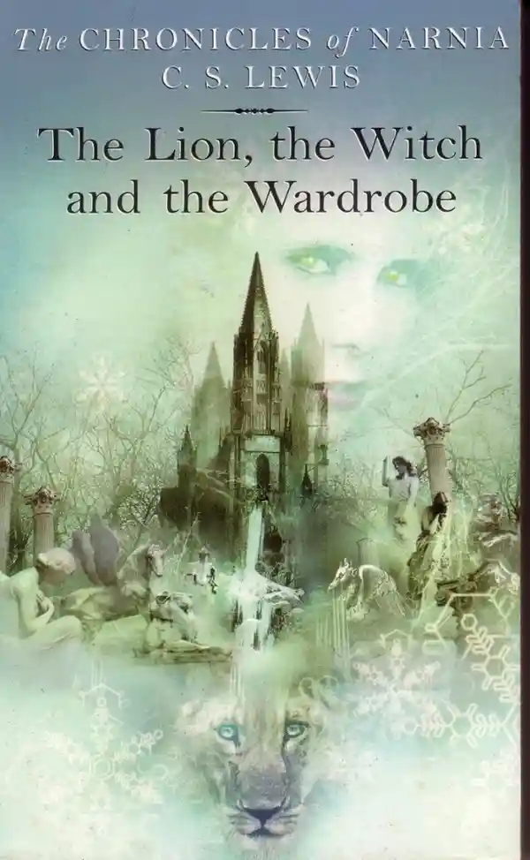
Close read - The Lion, The Witch and The Wardrobe
WALT: identify figurative language and discuss its impact on the reader
Blurb
We are going to read an extract from The Lion, the Witch and the Wardrobe by C. S. Lewis.
In this extract, Edmund has been captured by a witch and a dwarf and is being made to walk through a forest.
As they walk, the snow covering all of Narnia begins to melt because Aslan, representing the force of good, is returning.

Slide 14
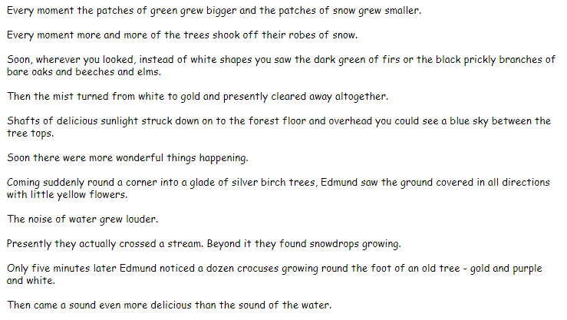
Close read - The Lion, The Witch and The Wardrobe Text
WALT: identify figurative language and discuss its impact on the reader.

Slide 15
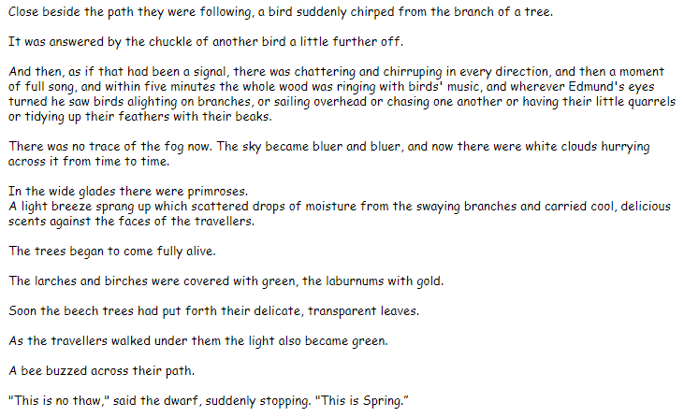
Close read - The Lion, The Witch and The Wardrobe Text
WALT: identify figurative language and discuss its impact on the reader

Slide 16

Close read - The Lion, The Witch and The Wardrobe Questions
WALT: identify figurative language and discuss its impact on the reader
Q1 - Find and copy an example of personification.
Q2 - Why has the author chosen to use personification to create a detailed description of Spring?

Slide 17
Close read - The Lion, The Witch and The Wardrobe Answers
WALT: identify figurative language and discuss its impact on the reader
Q1 - Find and copy an example of personification.
There are a few - here is an example: White clouds hurrying across it
Q2 - Why has the author chosen to use personification to create a detailed description of Spring?
Personification helps the reader connect with the text and create an image in their minds. It helps the reader to understand and gain an emotional connection to the description of spring, which was a clear contrast to the winters they had experienced for many years.

Slide 18

Good Afternoon Year 6!
Let’s start our afternoon with a quick burst of energy!
Get your PE kit at the ready because at the start of each afternoon session we will be joining Joe Wicks for our daily workout.
Do as much as you can and over the week you should find you are getting fitter and finding it easier.
Let’s go!
Click the youtube link below and select today’s date from the videos listed.
https://www.youtube.com/channel/UCAxW1XT0iEJo0TYlRfn6rYQ

Slide 19
We hope you enjoyed a lunch break and had something delicious to eat!
Now time for our afternoon session of Art. Today will be your last art session on drawing and sketching. We know that you will have produced some excellent drawings over this week - well done!
Art

Slide 20
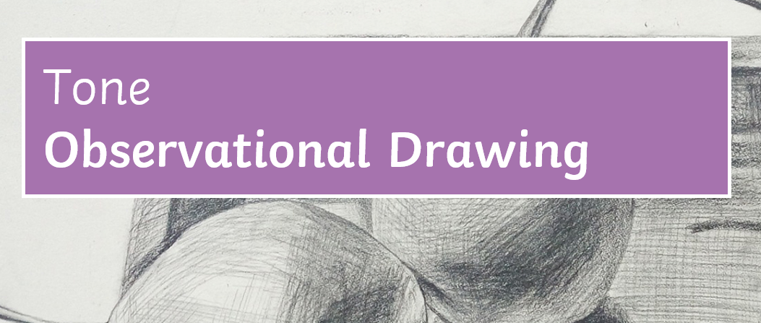

Slide 21
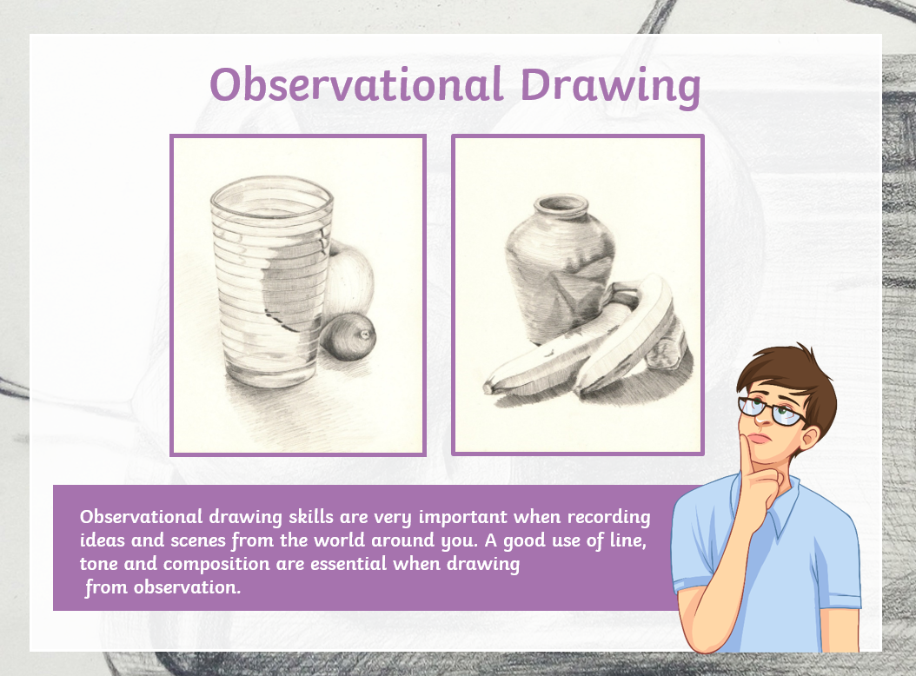
Teaching Notes:
Start to gather up a few objects you would like to draw. Look carefully at them
Size
Proportions
Light
Dark
shadow

Slide 22
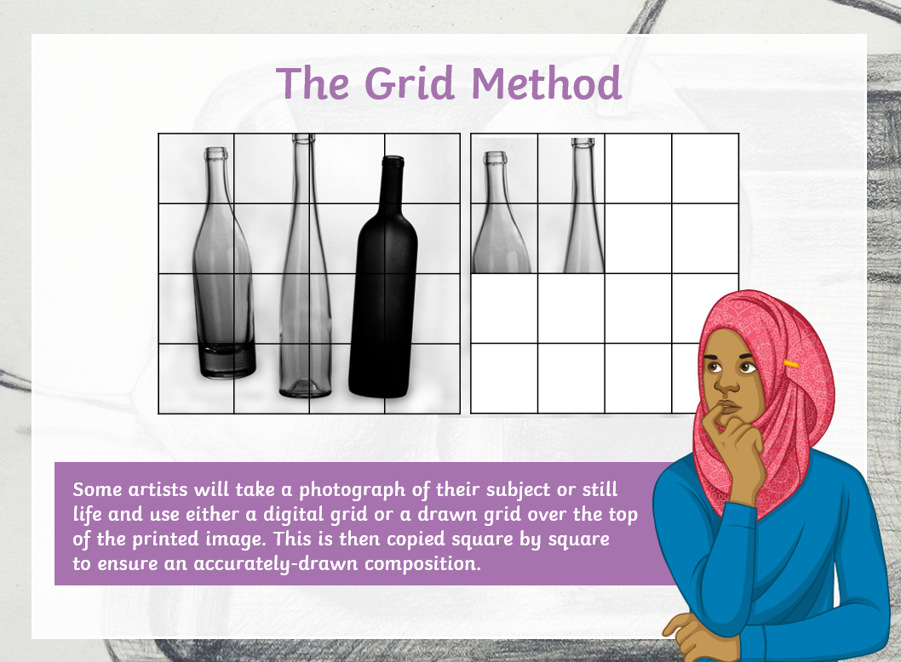
Teaching Notes:
Different artist use different techniques.
Some use photography and take a photo of the object they would like to draw.

Slide 23
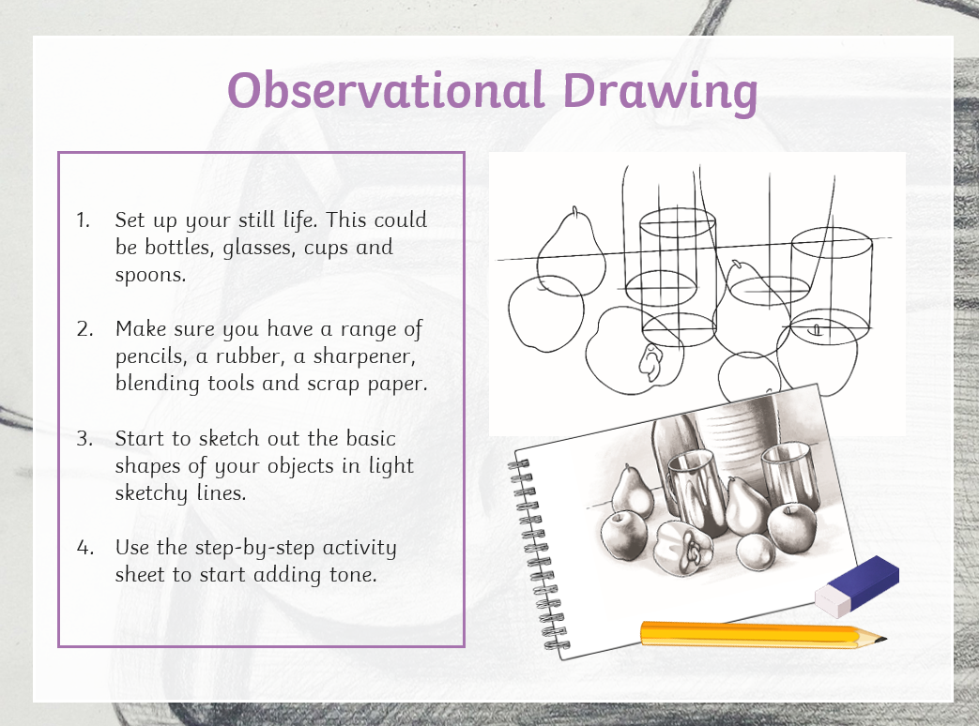
Teaching Notes:
Now it is your turn to have a go.
Set up your still life. This could be bottles, glasses, cups and spoons.
You will need a pencil and some paper.
Start to sketch out the basic shapes of your objects in light sketchy lines.
Add tone and shading
If you are still unsure how to start or what to do, then there are some video clips on the next slide that could help you.

Slide 24
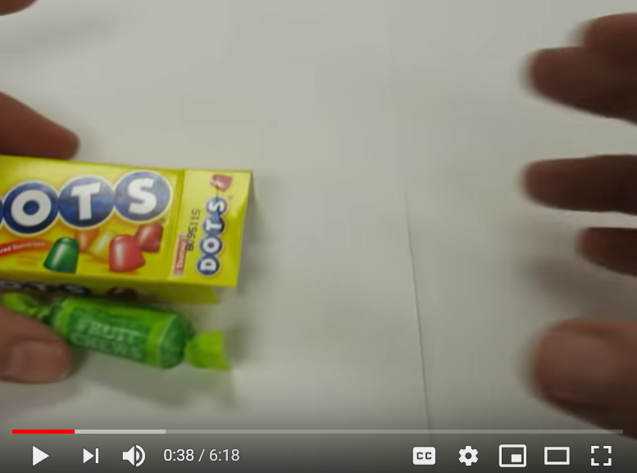
Teaching Notes:
Click on the video image or the link below to learn more about contour lines when drawing.
https://www.youtube.com/watch?v=RpZ1TwGaugM
Videos that offer extra help, if needed.

Slide 25
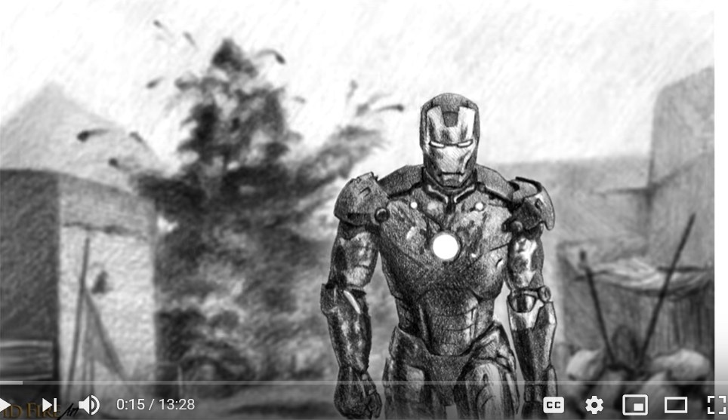
Teaching Notes:
This video is longer than the others we have looked at. If you want more guidance on shading and tone before having a go, then you can get some hints and tips from this video. Otherwise get drawing and have some fun.
Click on the video image or the link below to learn more about shading when drawing.
https://www.youtube.com/watch?v=-WR-FyUQc6I
Videos that offer extra help, if needed.

Slide 26

Thursday complete!
Well done on a great day!
Enjoy your evening and be ready for more learning tomorrow...

