Slide 1

Good Afternoon Year 6!
Let’s start our afternoon with a quick burst of energy!
Get your PE kit at the ready because at the start of each afternoon session we will be joining Joe Wicks for our daily workout.
Do as much as you can and over the week you should find you are getting fitter and finding it easier.
Let’s go!
Click the youtube link below and select today’s date from the videos listed.
https://www.youtube.com/channel/UCAxW1XT0iEJo0TYlRfn6rYQ

Slide 2
Heartsmart

Slide 3
Heartsmart
Lesson 3: HeartSmart Self-talk!
We are learning to catch negative self-talk and replace it with positive self-talk.
Imagine you see an adult saying unkind things to another - how would it make the other person feel if they were having to hear negative things said to them?

Slide 4
Heartsmart
Think about/discuss:
How do you think the other person felt hearing those unkind things?
Do you think it is ever ok to talk to your friend in a way that is unkind?

Slide 5
Heartsmart
What if I told you that this unkind voice is often the way we talk to ourselves?
We talk to ourselves at the rate of 150-300 words a minute, or nearly 50,000 thoughts per day. Of those words, 70% are negative and 70% of your negative self talk words are unconscious (which means you don’t even know that you are thinking them). AND 95% of the negative thoughts you think each day will be repeated again the next day…Sometimes the person who is the most unkind to us is...us!

Slide 6
Heartsmart
Why do we have negative self-talk?
Sometimes we think we deserve it. Sometimes we are unkind to ourselves because we think it is helping us to ‘be better’- to be funnier, be a better friend, be a better athlete, etc.
When you think back to the role-play, do you think speaking to anyone like that is going to help them ‘be better’?
No. Hearing those words will only ever make a person feel worse.

Slide 7
Heartsmart
What do you think the result is of talking to ourselves like that is?
What we put in, we get out. If we put negative and unkind thoughts into our hearts and minds on a daily basis our words and actions will be negative and unkind. If instead we choose to put positive and loving thoughts into our hearts and minds, our words and actions will be kind and loving. It is our job to catch negative thoughts and replace them with loving self-talk

Slide 8
Heartsmart
Now we are going to talk to ourselves in a positive way!
These can be called ‘positive affirmations’.

Slide 9
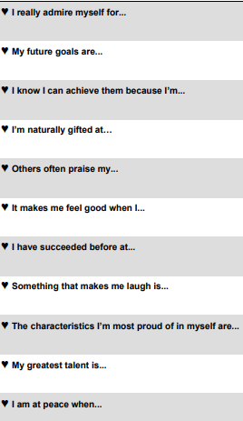

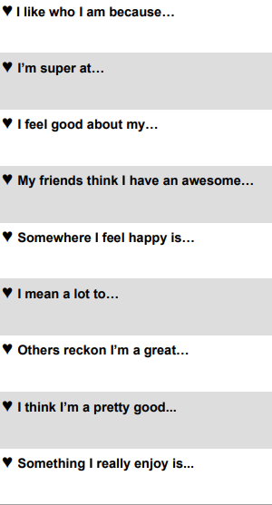
Use these sentence stems to either list positive affirmations to yourself or create a poster or image to support these affirmations.

Slide 10

Well done on a great week!
Enjoy your weekend!

