Slide 1
Good MoRning Year 6!
We hope you have had a lovely weekend with your families and are keeping safe!
Please follow the instructions on each page to help you - we look forward to hear about how you have got on!
Mrs Jones and Miss Nolan

Slide 2


This fortnight’s theme is
Transition
Day 1 - 6.7.20

Slide 3
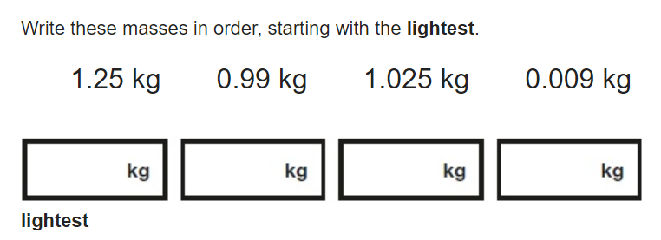
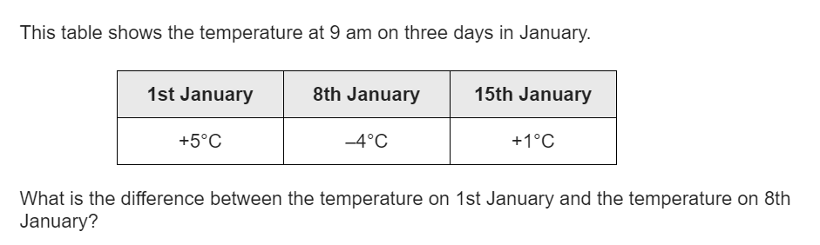
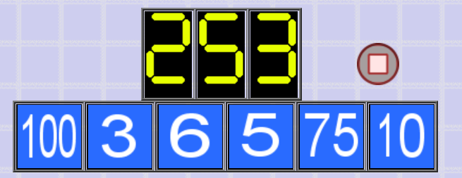
Morning Maths
8.
9.
10.
5.87 + 3.123 =
60 ÷ (30 − 24) =
836 x 27
⅔ ÷ 3
7,064 − 502 =
6. Put these numbers in order from largest to smallest.
314 729 314 228 341 617
7. 4kg of wool can make 60 pairs of socks. How many pairs of socks can be made with 12kg of wool?
Notes:
Children complete in maths book.
They have 15 minutes to complete independently.
Spend 10 minutes at the end of the session going through the answers and the children self mark.

Slide 4
ANSWERS
8.
9.
10.
5.87 + 3.123 = 8.993
60 ÷ (30 − 24) =10
836 x 27 = 22,572
⅔ ÷ 3 = 2/9
7,064 − 502 = 6562
6. Put these numbers in order from largest to smallest.
341 617 314 729 314 228
7. 4kg of wool can make 60 pairs of socks. How many pairs of socks can be made with 12kg of wool?
4 x 3 = 12
60 x 3 = 180 pairs
0.009kg 0.99kg 1.025kg 1.25kg
9 degrees.
100 - 75 = 25
25 x 10 = 250
250 + 3 = 253

Slide 5
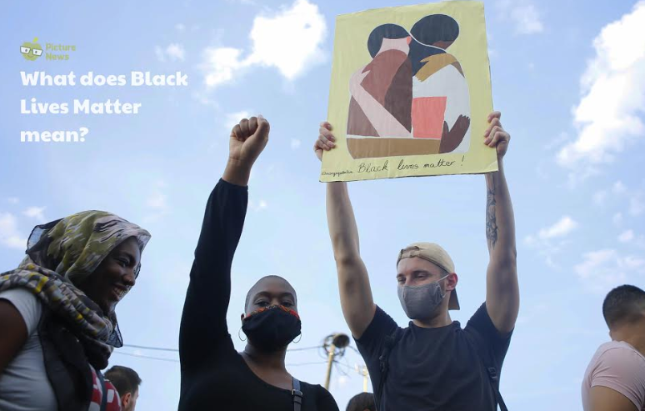
Class Based Worship

Slide 6
Class Based Worship
There have been several nights of protests and violent clashes between police and protestors as demonstrations have swept across cities in the US and other cities around the world. The protests in Minneapolis began in reaction to the death of a man named George Floyd after he was stopped by police officers. The protests have now spread across the country to cities including New York, LA, Chicago and Philadelphia. While many protests have been peaceful, many places have seen rioting, looting and violence and President Trump has said he will call in the army if things aren't brought back under control.
What does Black Lives Matter mean?

Slide 7
Class Based Worship
Are you aware of the protests currently taking place in America and in other cities around the world?
Many people are angry about the unfairness and mistreatment of how black African American citizens are treated by the police and in other situations within their lives. They want to raise awareness of racism and are trying to change the opinions and actions of others. As some of the protests have turned violent, they have caused divided opinion. Some people believe that more peaceful methods should be used to help educate and initiate change.
Many people in America feel the police and the justice system treat black people unfairly compared to how they treat white people. African Americans are five times more likely to be sent to jail than white Americans. Does this surprise us? Have we head of the Black Lives Matters movement?
The recent protests have brought the ongoing movement to the forefront of peoples’ attention all around the world. The movement campaigns against violence and racism and fights for equality for black people around the world, starting in 2013

Slide 8
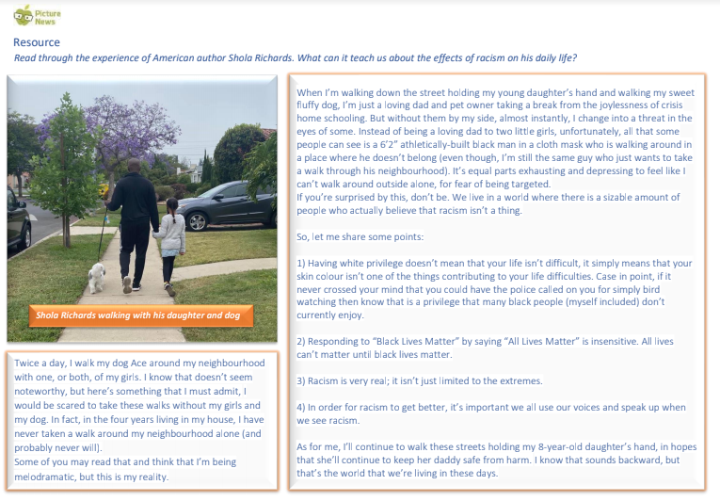

Slide 9
Class Based Worship
What does the experience of American author Shola Richards teach us about the effects of racism on his daily life? Does any of his experience surprise us? Why do you think he wanted to share his story at this time?
On Tuesday 2nd June, millions of people around the world shared a plain black image as part of ‘Black Tuesday’, a global event to protest against racial inequality. Organisers behind the movement asked people to, post a picture of a black square on their social media account, mute their account for the day and use the time they would otherwise be on social media to educate themselves on Black Lives Matter.
Watch the video (www.bbc.co.uk/newsround/52893017). Do we think Blackout Tuesday was an effective way to raise awareness? What do you think the benefits are for pausing and using the time to learn? Can you think of any other ways to raise awareness about an issue we care about?

Slide 10
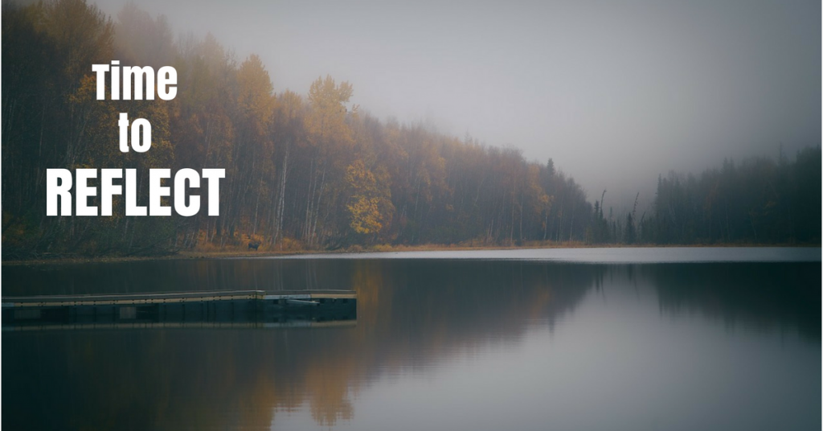
Class Based Worship
Reflection
Black Lives Matter and Blackout Tuesday are movements to both raise awareness and educate people about racial inequalities around the world. Racism is something we can all learn about and find out ways that we can support and promote equality for all.

Slide 11

St Catherine’s Classroom Beliefs
Mistakes are valuable.
Everyone can learn maths to the highest level.
Questions are really important.
Depth is more important than speed.
Maths is about making connections.

Slide 12

6.7.20
WALT: apply our mathematical knowledge to a variety of questions.
As part of the transition to high school, your new schools have sent some work for you to complete.
They will be having a look at this to see how you get on so remember to try your best!
Today’s task is a skills check...
Notes:
Notes: If the child is going to Wolverley, please ask them not to stick it in their book. Instead can they name the sheet and then put them in a pile please in case they want to collect them back.

Slide 13
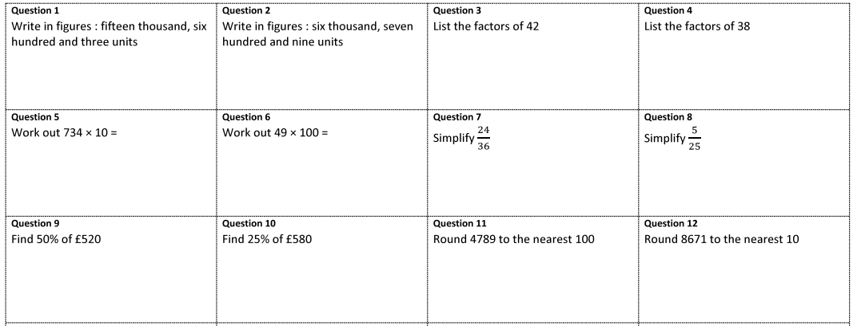
6.7.20
WALT: apply our mathematical knowledge to a variety of questions.
Notes:
Notes:

Slide 14
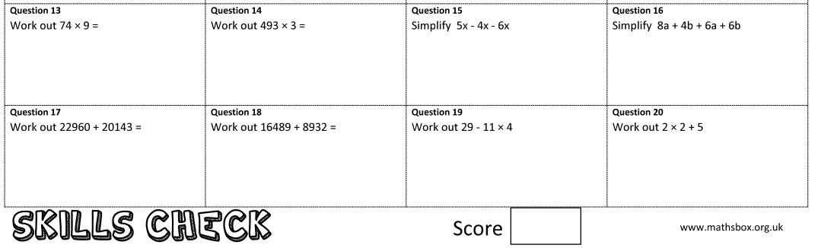
6.7.20
WALT: apply our mathematical knowledge to a variety of questions.
Notes:
Notes:

Slide 15
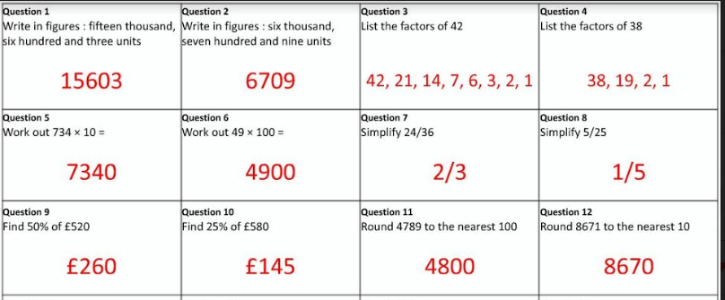
6.7.20
WALT: apply our mathematical knowledge to a variety of questions.
Answers
Notes:
Notes:

Slide 16
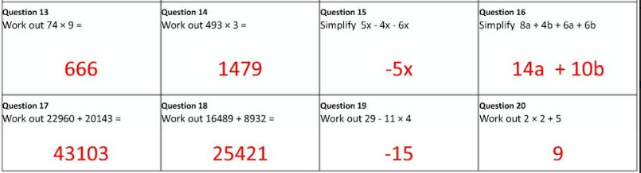
6.7.20
WALT: apply our mathematical knowledge to a variety of questions.
Answers
Notes:
Notes:

Slide 17

Grammar
Writing = Transition

Slide 18
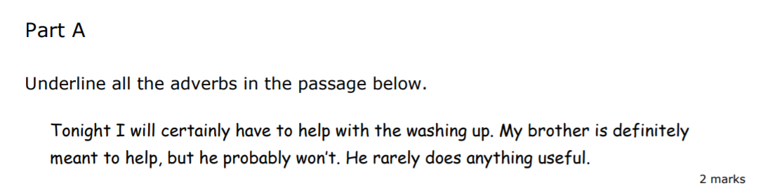
Monday - Grammar

Slide 19
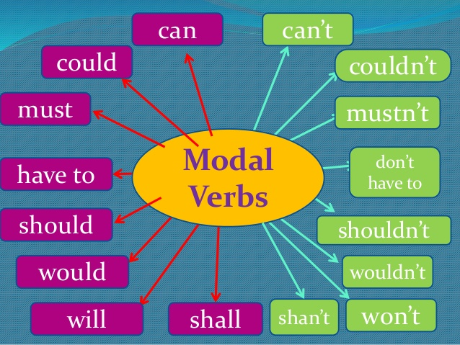
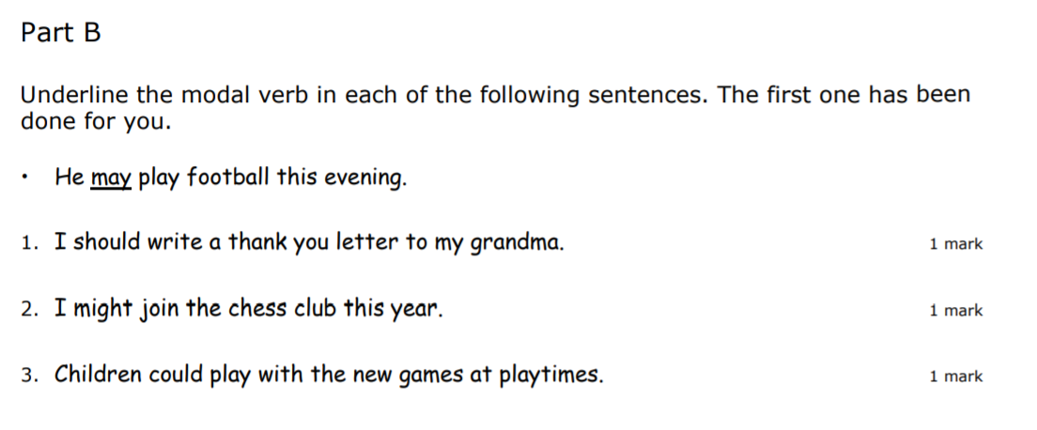
Grammar

Slide 20
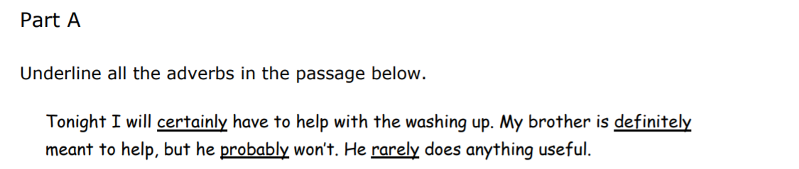
Grammar
Answers

Slide 21
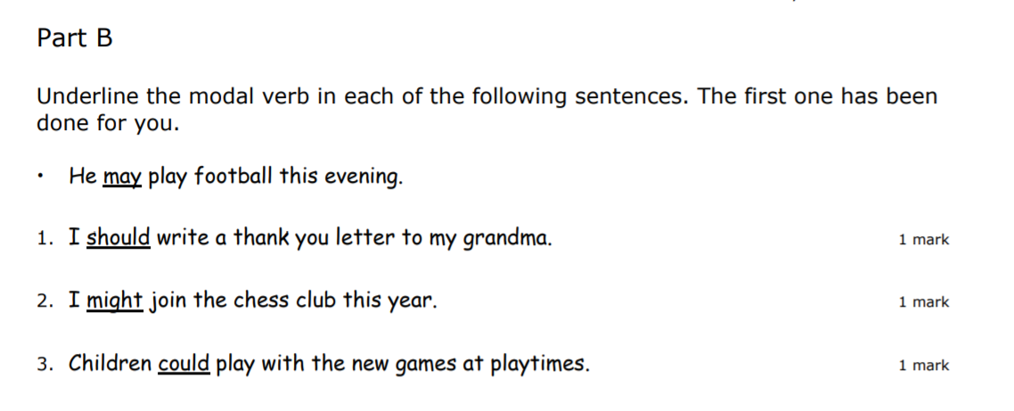
Grammar
Answers

Slide 22
Transition Writing Task
This English Task has been set by your secondary school. Please write up your task on named paper.
They will be having a look at this to see how you get on, so remember to try your best!

Slide 23
Transition Writing Task
Year 6 Transition – English
The Mystery of the Aurora Borealis
Starter:
All – How do you feel towards the idea of winter? What do you most look forward to? Challenge – Can you think of a time you have been uncomfortably cold? Why did you feel like that? How did it change your behaviour?
Expert – What is the coldest thing you can think of? The more ambitious and creative the better! Can you make this into a simile or metaphor?

Slide 24
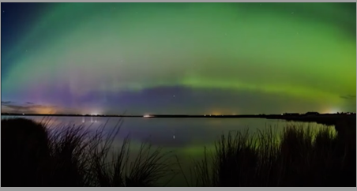
Transition Writing Task
The Wonder of the Aurora Borealis
The Aurora Borealis, more commonly known as the Northern Lights, is created when a burst of solar energy ejects gas onto the surface of the sun! The science behind the Northern Lights is complicated, but the simplest explanation explains that the natural phenomenon is the result of a collision of particles that produce dazzling auroral light when they collide.
Seeing the Northern Lights is on many people’s bucket lists; it is a rare and exceptionally special event to see and usually only in specific parts of the world during very specific dates.
The Lights can only be viewed in their full glory in remote and unpolluted parts of the world. These places are usually some of the coldest and Northernly regions of our globe, where humans are closest to undisturbed natural beauty.

Slide 25
Transition Writing Task
If you can, there are some awe-inspiring videos on Youtube which show the intrinsic and sublime patterns in the night sky.
https://www.youtube.com/watch?v=fVsONlc3OUY https://www.youtube.com/watch?v=T75IKSXVXlc
As you watch, list and name as many colours as you can see in the clip. Can you describe how they move with ambitious vocabulary? Can you create a creative and effective metaphor for the movement of the lights?

Slide 26
Transition Writing Task
Your task this week will be to create a first-person narrative piece of extended, descriptive creative writing. You will be imagining that you are there watching the Northern Lights in person.
Today come up with some vocabulary and phrases that you could use.

Slide 27

Good Afternoon Year 6!
Let’s start our afternoon with a quick burst of energy!
Get your PE kit at the ready because at the start of each afternoon session we will be joining Joe Wicks for our daily workout.
Do as much as you can and over the week you should find you are getting fitter and finding it easier.
Let’s go!
Click the youtube link below and select today’s date from the videos listed.
https://www.youtube.com/channel/UCAxW1XT0iEJo0TYlRfn6rYQ

Slide 28

History - Transition Work
Your high schools have sent over some History transition work they would like you to complete.
Have a go at the following activities....

Slide 29
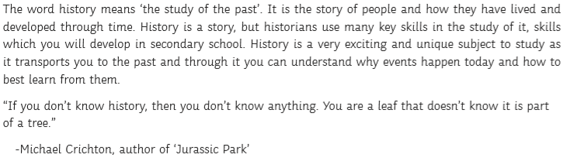
History - Transition Work

Slide 30
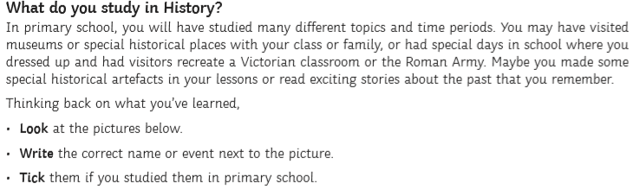
History - Transition Work

Slide 31
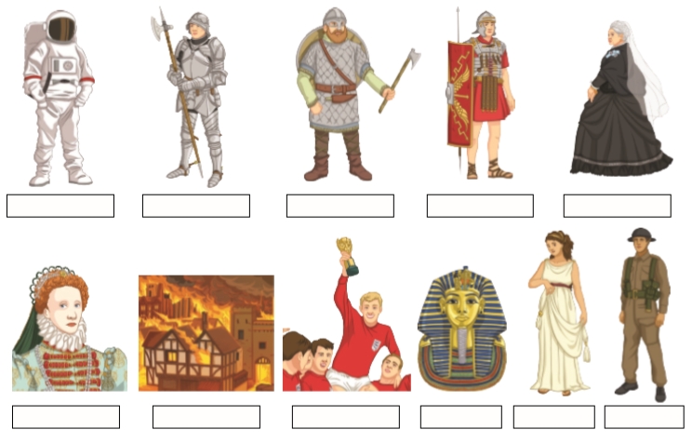
History - Transition Work

Slide 32
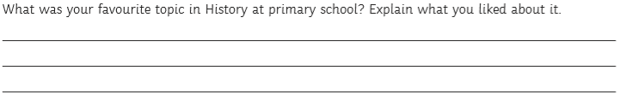
History - Transition Work

Slide 33
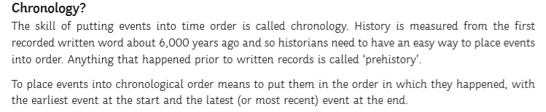
History - Transition Work

Slide 34
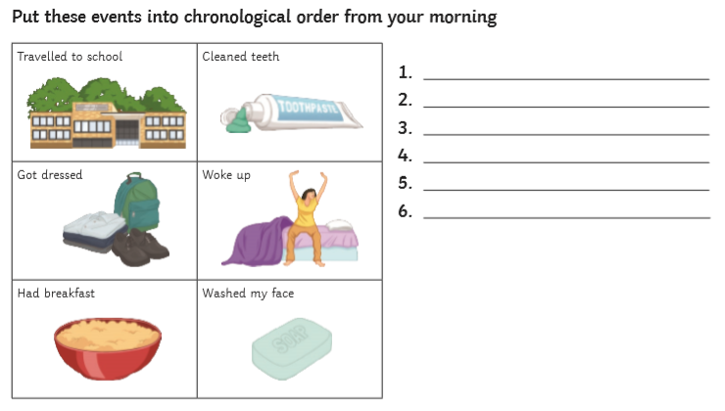
History - Transition Work

Slide 35
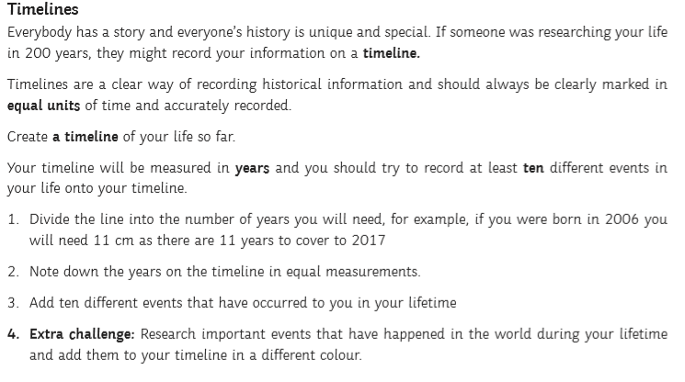
History - Transition Work

Slide 36

Well done on a great day!
Enjoy your evening and be ready for more learning tomorrow...

