Slide 1
Good MoRning Year 6!
Happy Tuesday! Keep up the good work!
Please follow the instructions on each page to help you - we look forward to hear about how you have got on!
Mrs Jones and Miss Nolan

Slide 2
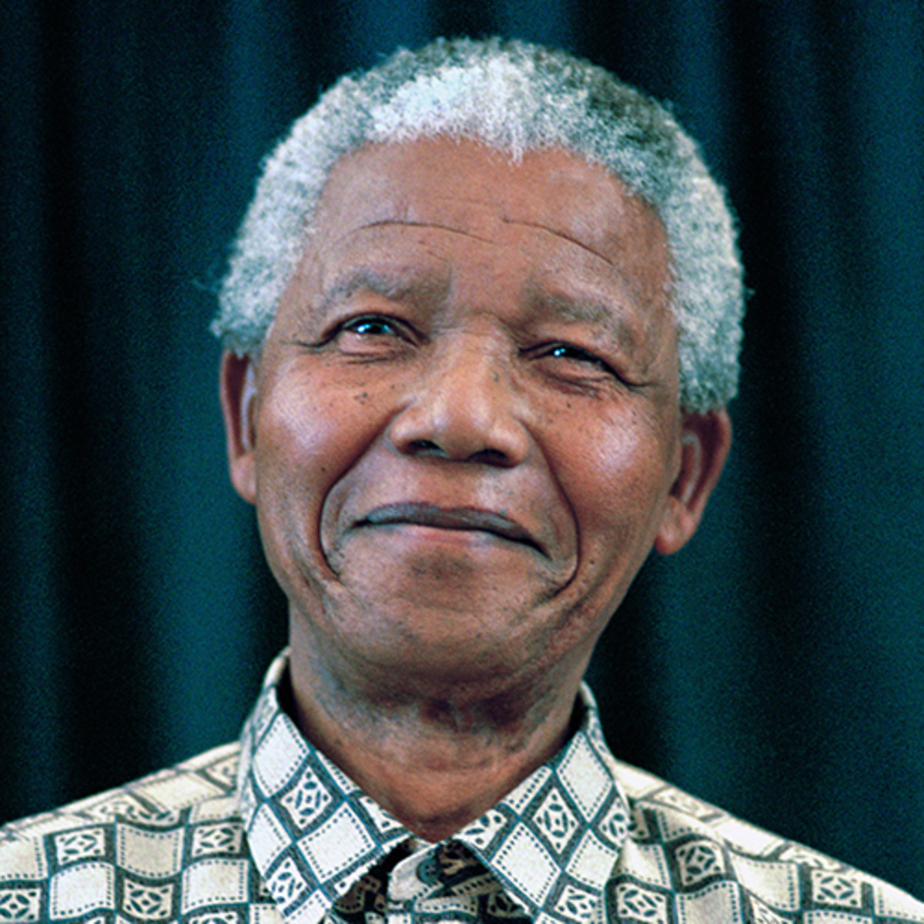
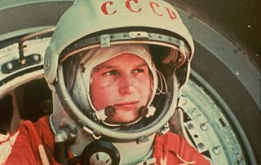
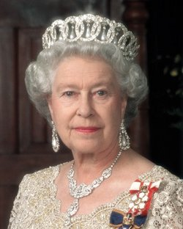

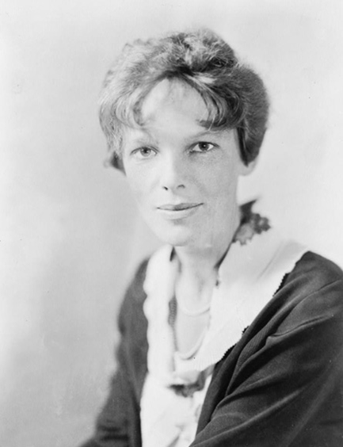
This week’s theme is
Inspirational People
Day 2 - 16.6.20

Slide 3

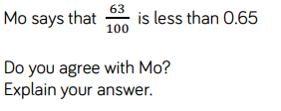
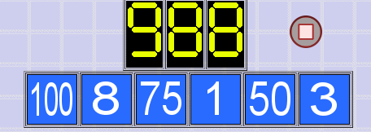
Morning Maths - Give yourself 15 - 20 minutes to complete these questions and then try and tackle today’s countdown.
8.
9.
10.
1.73957 + 8293 =
2. 7.89 x 100 =
3. ⅛ = 0.______
4. ⅕ ÷ 4 =
5. 25% x 740 =
6. ⅘ x 6/7 =
7. Write a definition of acute,obtuse and reflex angles.Draw an example of each.

Slide 4
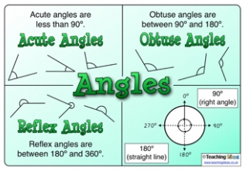
Now mark your work using these answers.
8.
9.
10.
1.73957 + 8293 =
82250
2. 7.89 x 100 = 789
3. ⅛ = 0.125
4. ⅕ ÷ 4 = 1/20
5. 25% x 740 = 185
6. ⅘ x 6/7 = 24/35
7.
Sam ate ¼, Mark ate 3/10 and Jill ate 35/100
There is 1/10 of the pizza left.
Yes 0.65 = 65/100. Therefore 63/100 is 2/100 less than 0.65.
OR 63/100 = 0.63. Therefore 0.63 is 0.02 less than 0.05.
Closest answer = 980 (8 away)
100 - 8 = 92
92 - 75 = 17
17 + 3 = 20
50 - 1 = 49
49 x 20 = 980

Slide 5
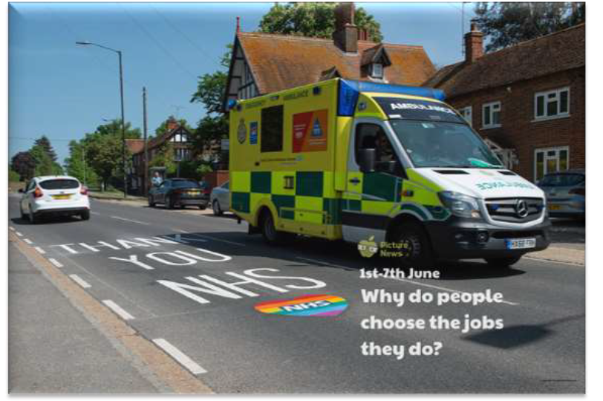
Daily Worship
Yesterday we discussed the NHS and the following fact:
The number of people seeking to start a career in the healthcare sector has risen during the
pandemic, official figures reveal. Health leaders said the wish shown by thousands of people to
help them to fight illness was “truly humbling”.
The NHS Health Careers website has seen a 220% rise in people expressing an interest in becoming
a nurse.

Slide 6
Daily Worship
Recap:
Why do you think that lots of people want to work in healthcare at the moment?
Do you have any idea what you would like to do or be when you are older?

Slide 7
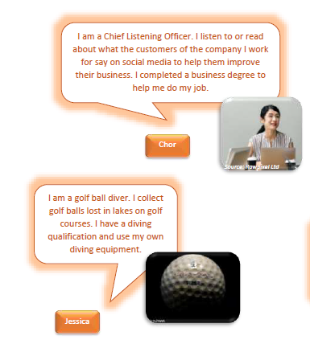
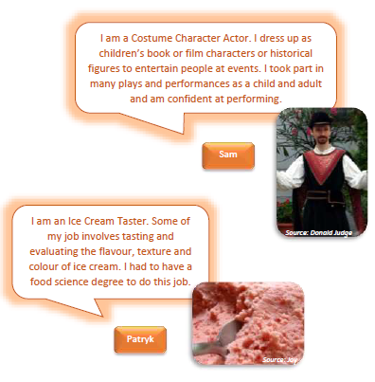
Daily Worship

Slide 8

Daily Worship

Slide 9
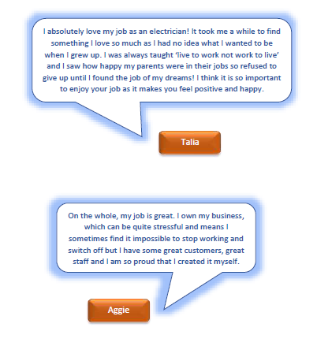
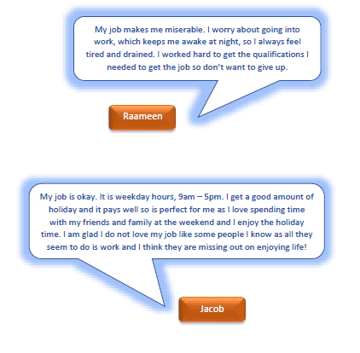
Daily Worship
Here some people explain how they feel about their job...

Slide 10
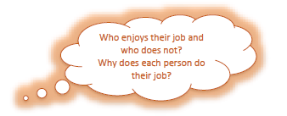
Daily Worship
Reflection - What is more important - to enjoy your job? Or to earn lots of money? Discuss.

Slide 11

St Catherine’s Classroom Beliefs
Mistakes are valuable.
Everyone can learn maths to the highest level.
Questions are really important.
Depth is more important than speed.
Maths is about making connections.

Slide 12

16.6.20
WALT: use exchange rates.
Success Criteria:
Foreign Currency
Exchange rates
Pound sterling

Slide 13
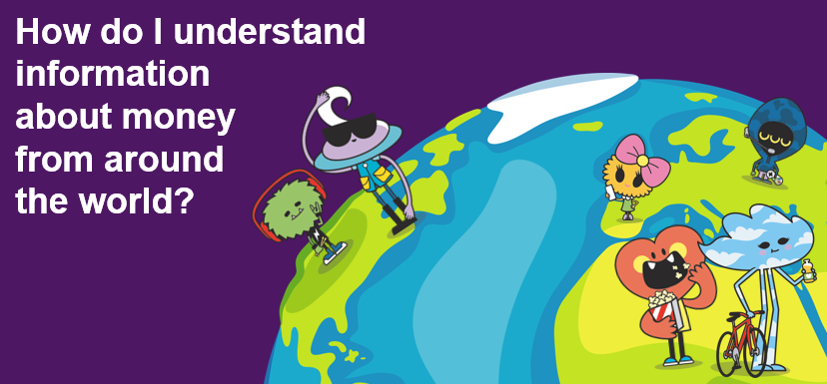
16.6.20
WALT: use exchange rates.

Slide 14
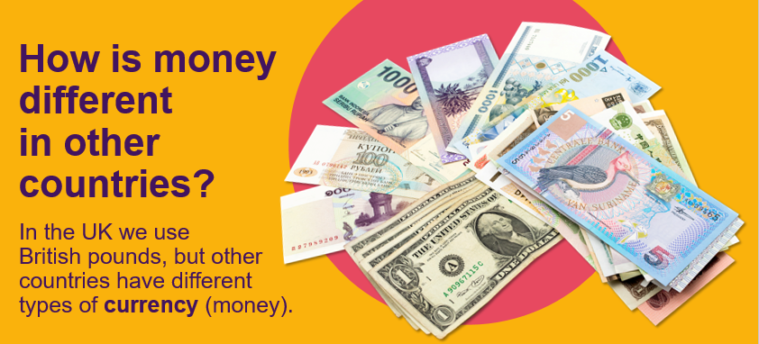
16.6.20
WALT: use exchange rates.

Slide 15
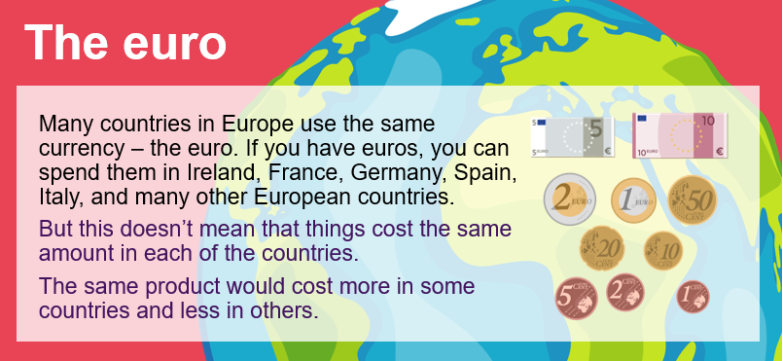
16.6.20
WALT: use exchange rates.

Slide 16
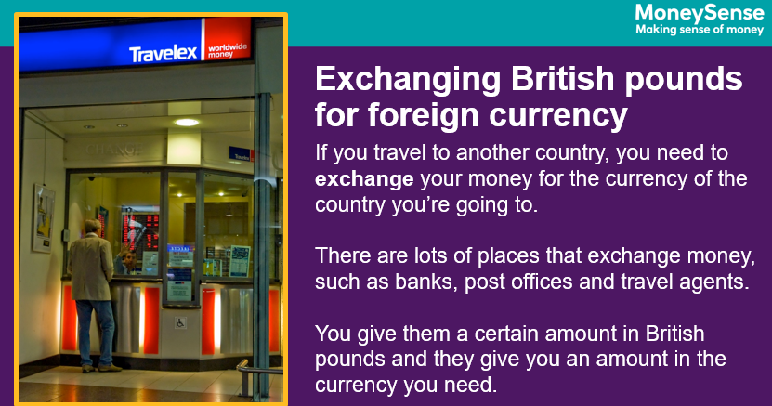
16.6.20
WALT: use exchange rates.

Slide 17
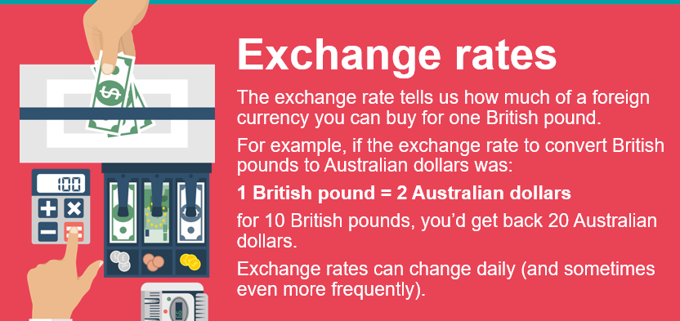
16.6.20
WALT: use exchange rates.

Slide 18
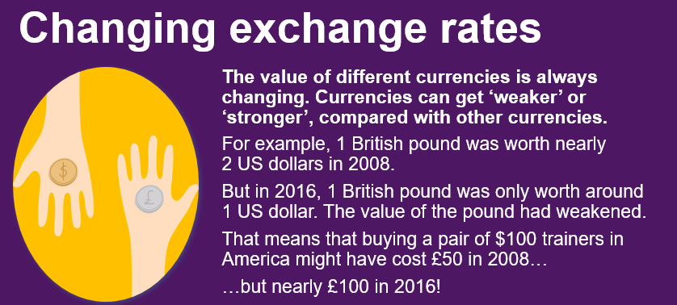
16.6.20
WALT: use exchange rates.

Slide 19
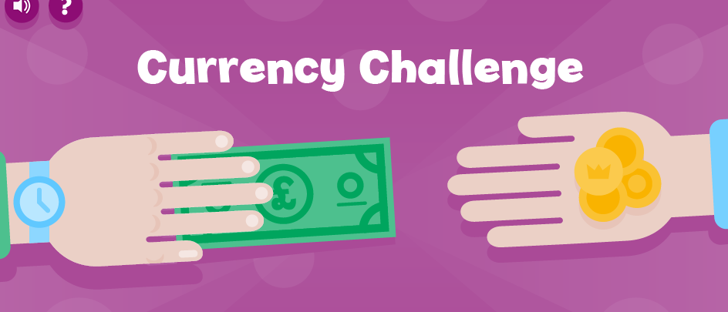
16.6.20
WALT: use exchange rates.
Click on the image above to have a go at the ‘Currency Challenge’.
https://natwest.mymoneysense.com/challenge/currency-challenge-uk/

Slide 20
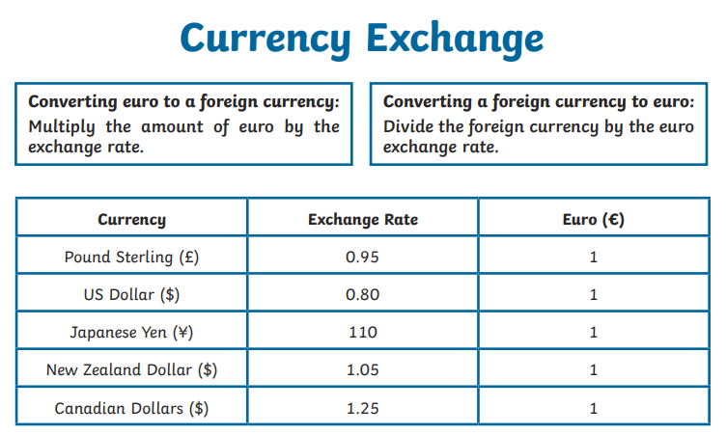
16.6.20
WALT: use exchange rates.
Now let’s have a go at using these exchange rates to convert currency.
Remember exchange rates change so these may not be as they are today.
You can find the sheet on the separate word document or on the next slides.
Notes:
Children use activity sheet to convert exchange rates.

Slide 21
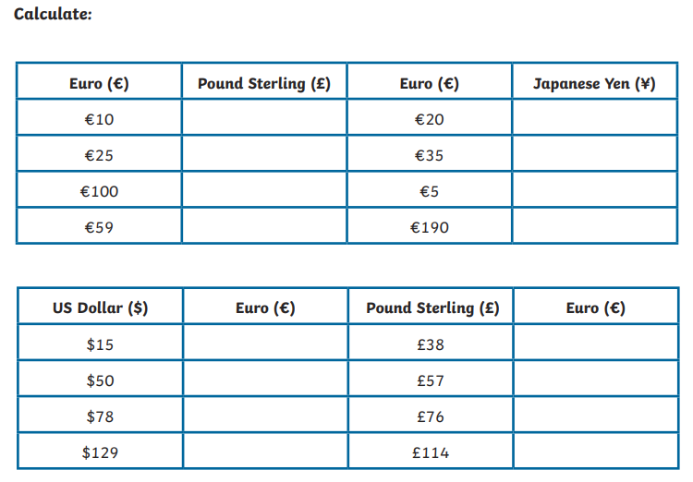
16.6.20
WALT: use exchange rates.

Slide 22
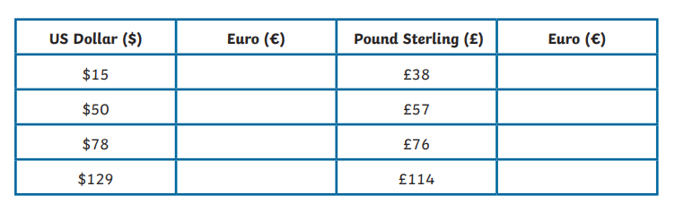
16.6.20
WALT: use exchange rates.

Slide 23
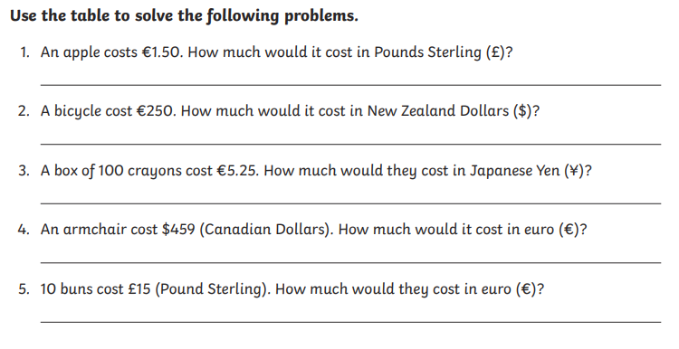
16.6.20
WALT: use exchange rates.

Slide 24

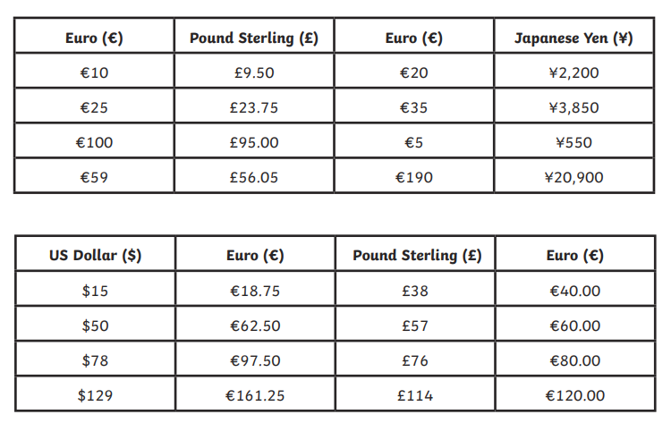
16.6.20
WALT: use exhange rates.

Slide 25
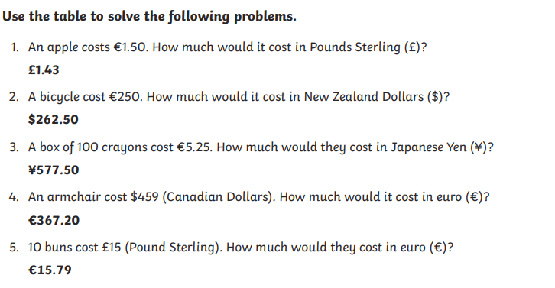
16.6.20
WALT: use exhange rates.

Slide 26
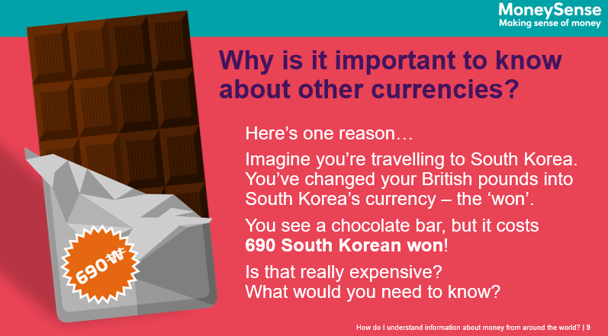
16.6.20
WALT: use exchange rates.

Slide 27
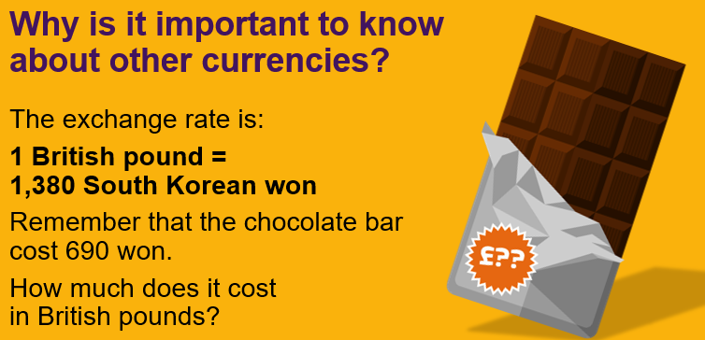
16.6.20
WALT: use exchange rates.
690/1,380 = 0.5, so the chocolate bar actually only cost 50p

