Slide 1

Good Afternoon Year 6!
Let’s start our afternoon with a quick burst of energy!
Get your PE kit at the ready because at the start of each afternoon session we will be joining Joe Wicks for our daily workout.
Do as much as you can and over the week you should find you are getting fitter and finding it easier.
Let’s go!
Click the youtube link below and select today’s date from the videos listed.
https://www.youtube.com/channel/UCAxW1XT0iEJo0TYlRfn6rYQ

Slide 2
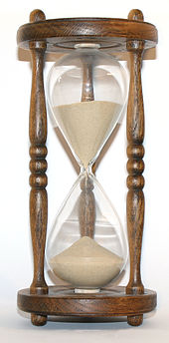
History
Today’s history lesson will focus on Queen Elizabeth II

Slide 3
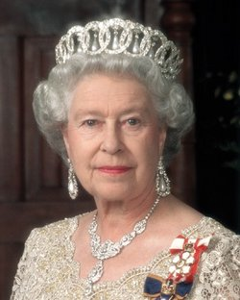
Modern History Queen Elizabeth II

Slide 4
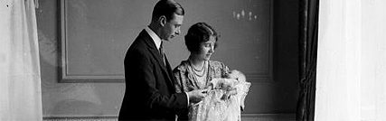
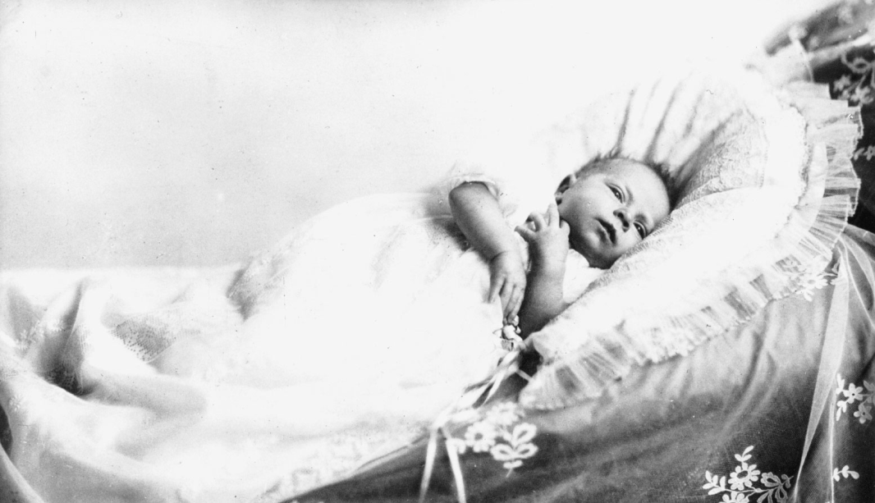
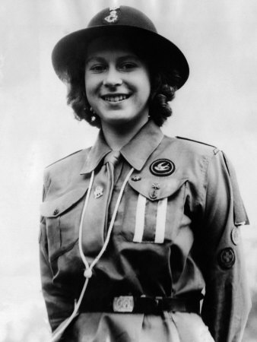
The Queen’s Early Life
The Queen was born at 2.40am on 21 April 1926 at 17 Bruton Street in Mayfair, London.
She was the first child of The Duke and Duchess of York.
She became a girl guide when she was 11.

Slide 5
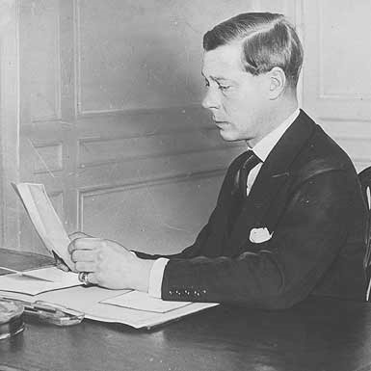
The Abdication
Elizabeth was never meant to be queen – but her uncle became the first king to give up being king – to abdicate, so her father, George VI became king.

Slide 6
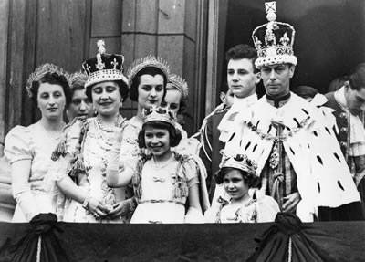
Her father becoming king
The Queen’s father became King in 1937. She was now the next person in line to be queen.

Slide 7
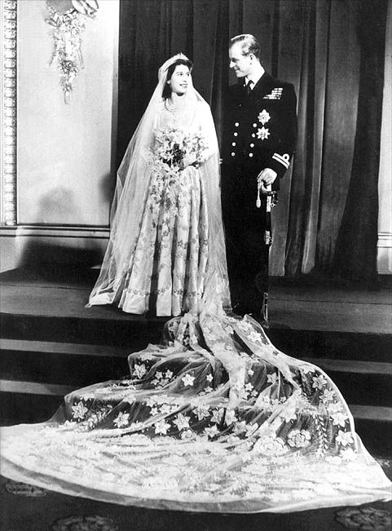
Wedding Day
In November 1947, she married Prince Philip of Greece and Denmark, who was created duke of Edinburgh.

Slide 8
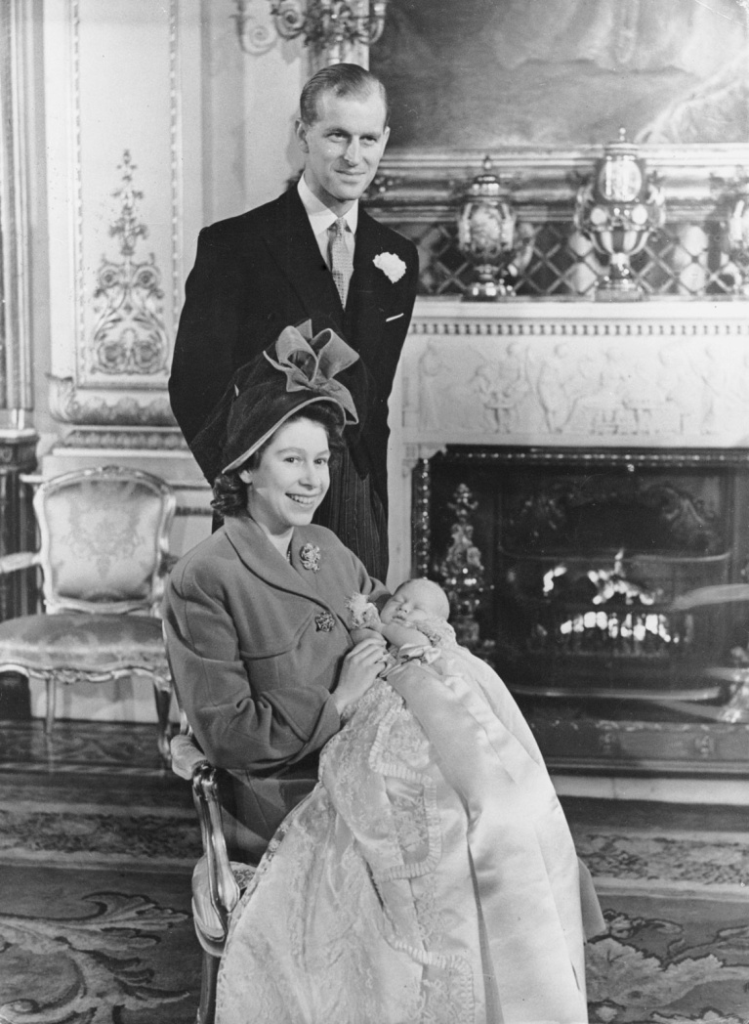
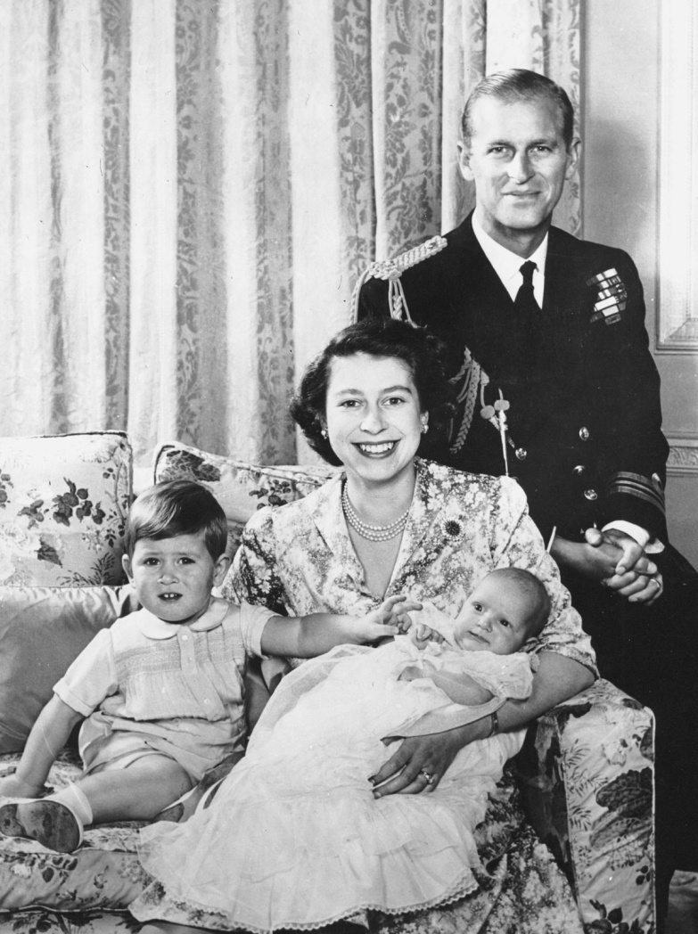
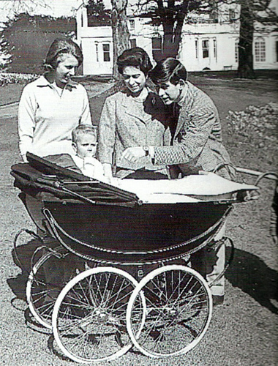
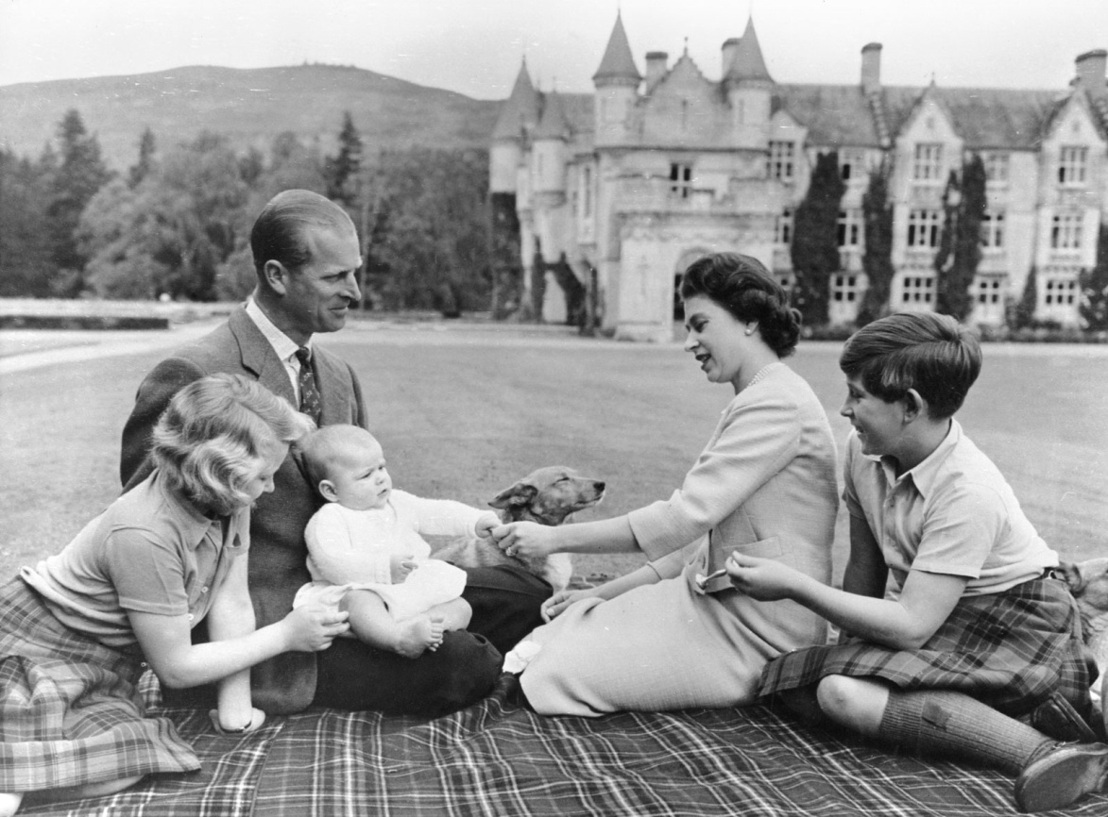
The Queen’s Family
The Queen has four children
Prince Charles
Born in 1948
Princess Anne
Born in 1950
Prince Andrew
Born in 1960
Princess Edward
Born in 1964

Slide 9
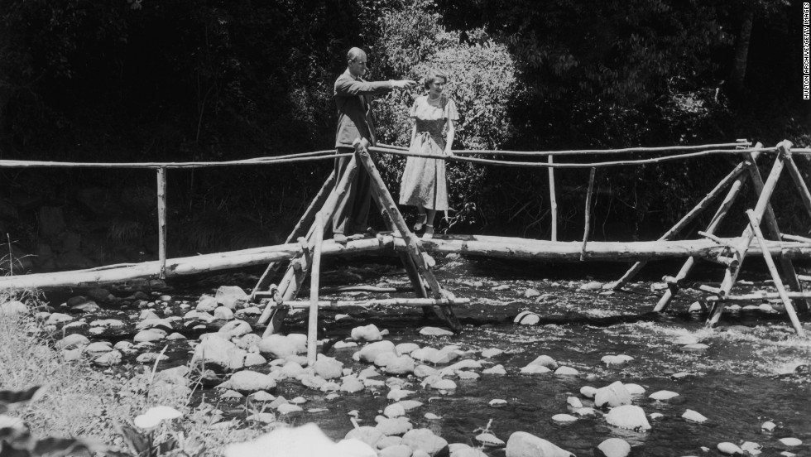
Becoming Queen
On Wednesday, 6 February 1952, Princess Elizabeth received the news of her father's death while staying in Kenya with Prince Philip.

Slide 10
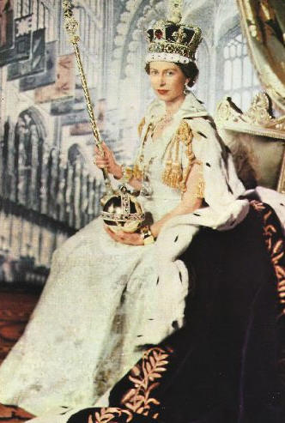
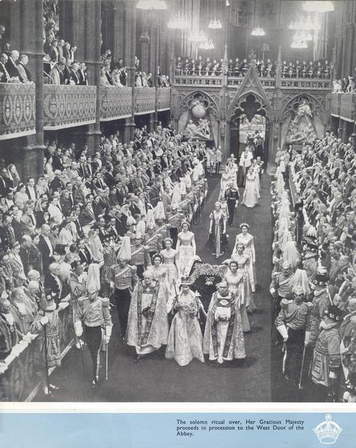
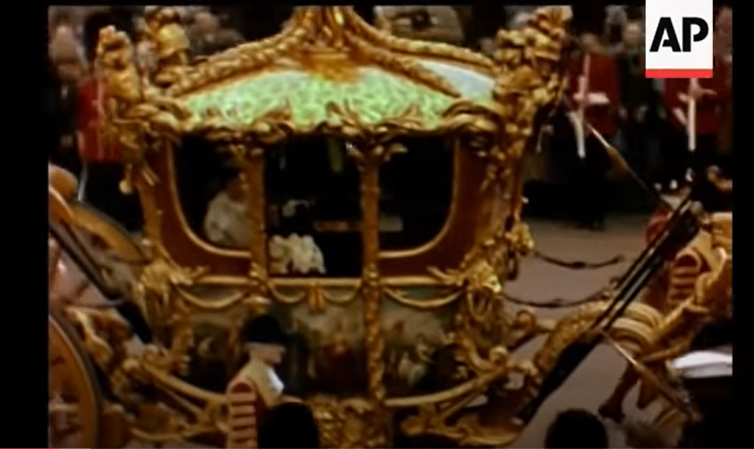
Coronation Day
The Coronation took place in Westminster Abbey on 2 June 1953
Click on image for clip

Slide 11
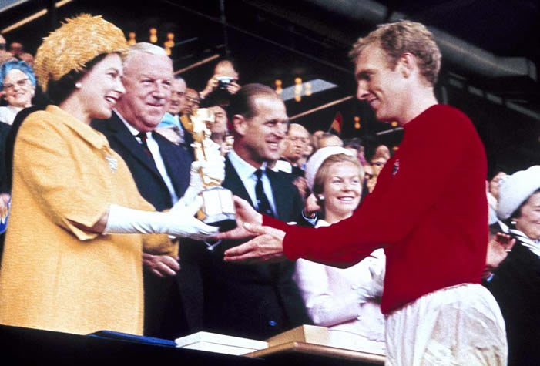
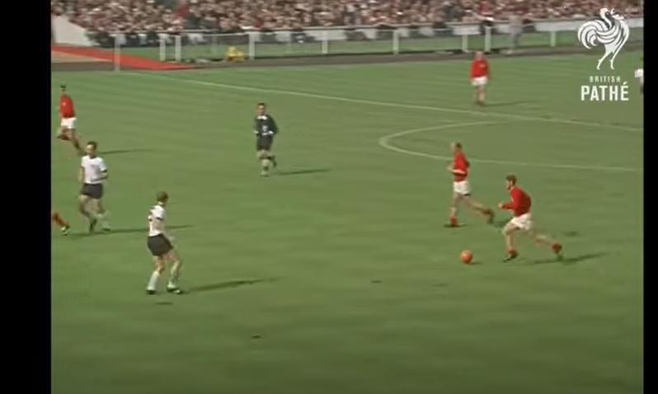
World Cup 1966
In 1966 Queen Elizabeth watched England win the world cup!
Click on image for clip

Slide 12
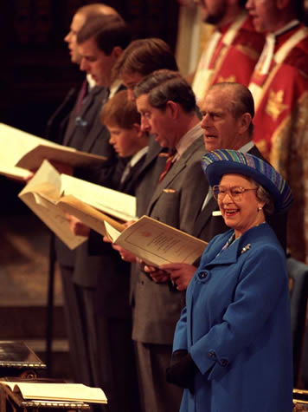
Golden Wedding Anniversary
In 1997 Queen Elizabeth and Prince Philip celebrated 50 years of marriage.

Slide 13
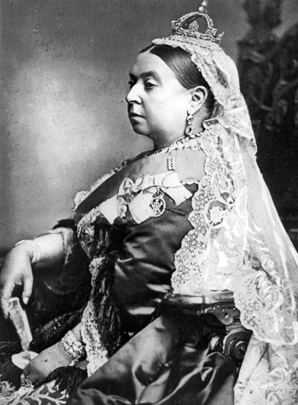
A Special Date
On 9th September 2015, The Queen will became the longest reigning king or queen.
Queen Victoria was queen for 63 years and 216 days
On September 9th , the queen reigned for 63 years and 217 days.
Can you work out how long she has reigned for now?

Slide 14
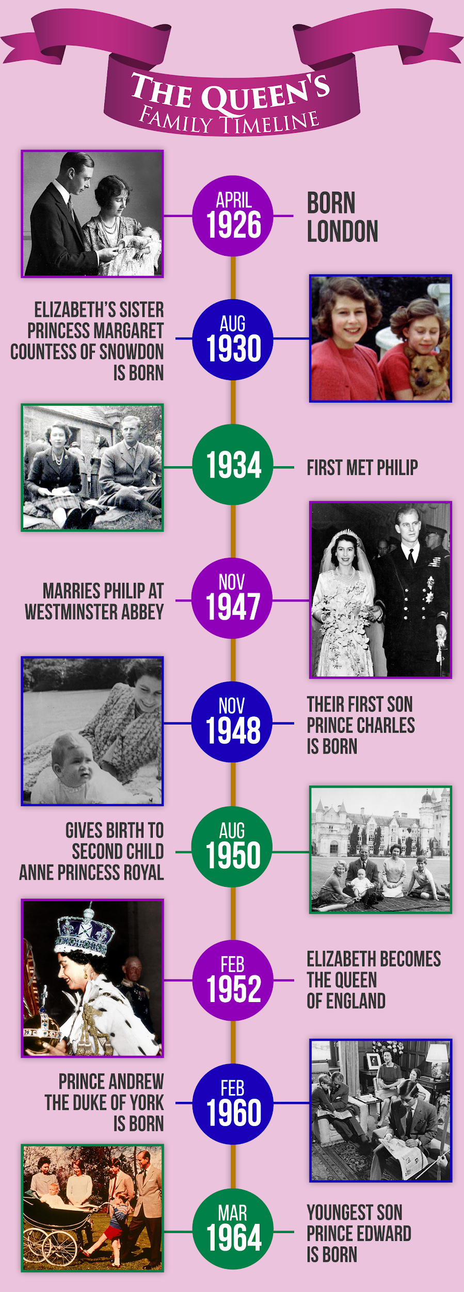
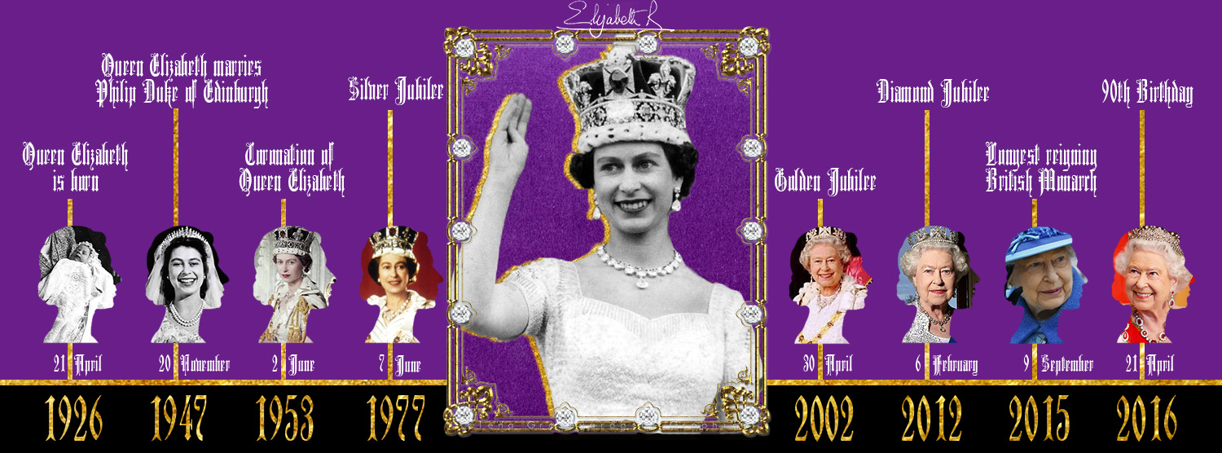
Create your own timeline
Can you create your own timeline of Queen Elizabeth II’s life? You can use the information on these slides and/or explore further if you want to. Include key facts and draw images on the timeline to add more detail.

Slide 15
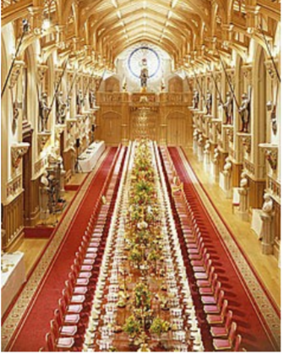
Extension Activity :
Dinner for the Inspirational
One of The Queen’s jobs is to host special dinner parties for important guests from around the world. Imagine you have been invited to a grand dinner at Windsor Castle. Who would you invite to the dinner party? Choose the people that inspire you the most? Think carefully.
Now plan the menu. Think carefully about the courses. Research ideas if you are not sure.
Finally you need to deliver a speech to your guests – what would you say?

Slide 16

Well done on a great day!
Enjoy your evening and be ready for more learning tomorrow...

