Slide 1
Good MoRning Year 6!
Half way through the week - keep it up!
Please follow the instructions on each page to help you - we look forward to hear about how you have got on!
Mrs Jones and Miss Nolan

Slide 2
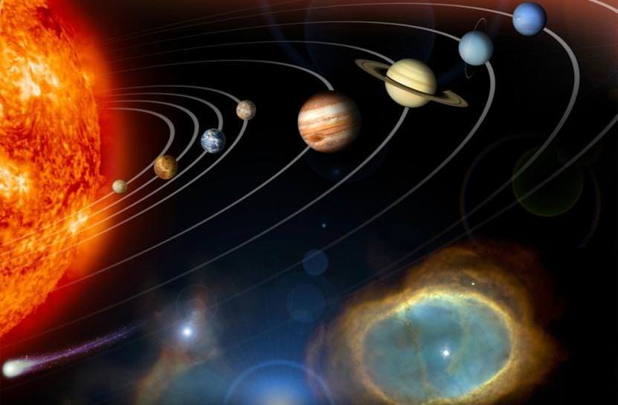
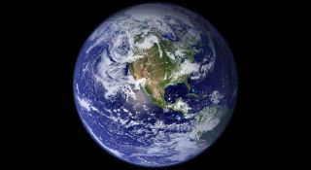
This week’s theme is
Space
Day 3 - 1.7.20

Slide 3
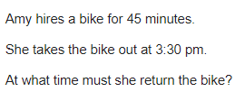
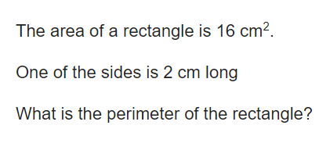
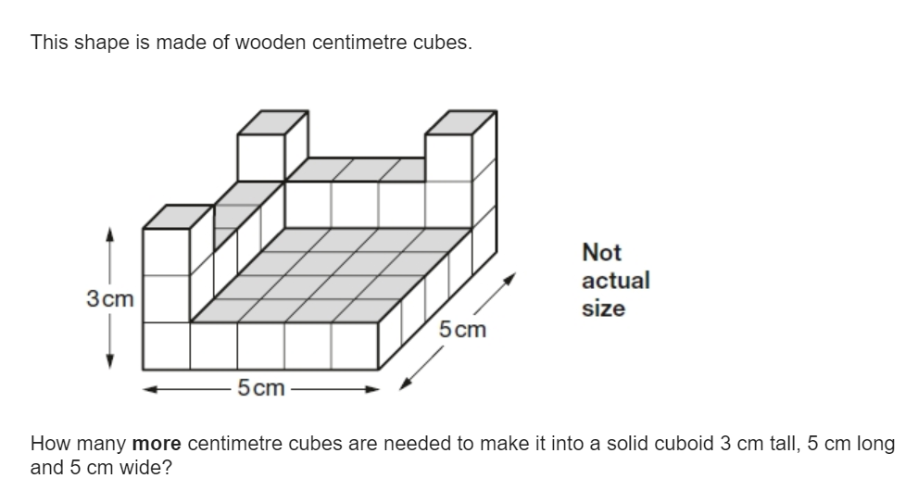
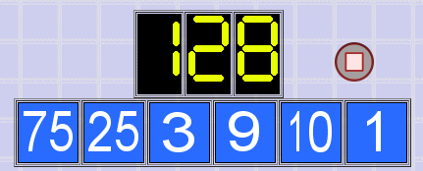
Morning Maths
8.
9.
10.
789 x 34 =
82749 + 8273.2
67820 - 23451 =
⅙ x 2/4 =
2/12 x 144
6. 8x - 6 + 2x = 14 + 5x
7.
Notes:
Children complete in maths book.
They have 15 minutes to complete independently.
Spend 10 minutes at the end of the session going through the answers and the children self mark.

Slide 4
ANSWERS
4:15 pm
8.
9.
10.
789 x 34 = 26,826
82749 + 8273.2 = 91,022.2
67820 - 23451 = 44,369
⅙ x 2/4 = 2/24
2/12 x 144 = 24
6. 8x - 6 + 2x = 14 + 5x
10x - 6 = 14 + 5x
10x = 14 + 5x + 6
10x = 20 + 5x
10x - 5x = 20
5x = 20
X = 20 / 5
X = 4
7.
2 + 2 + 8 + 8 = 20cm
3 - 1 = 2
10 - 2 = 8
25 - 9 = 16
16 x 8 = 128
16 + 16 + 6 = 38 cubes

Slide 5

Class Based Worship
Click the image to view today’s Newsround.
https://www.bbc.co.uk/newsround/news/watch_newsround
Notes:
Teacher notes:
https://www.bbc.co.uk/newsround/news/watch_newsround
Watch today’s newsround as a class.
Discuss topics featured on today’s show.

Slide 6

St Catherine’s Classroom Beliefs
Mistakes are valuable.
Everyone can learn maths to the highest level.
Questions are really important.
Depth is more important than speed.
Maths is about making connections.

Slide 7
1.7.20
WALT: identify parts of a circle.
Success Criteria:
Diameter
Radius
circumference
Notes:
Notes:

Slide 8
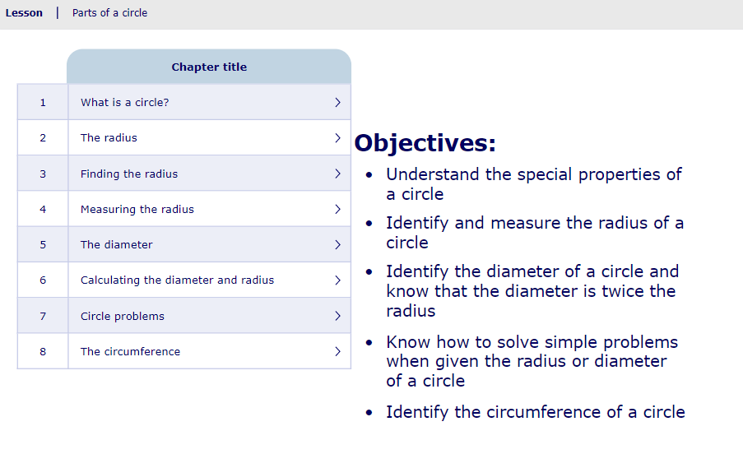
1.7.20
WALT: identify parts of a circle.
Click on the image to take on the online lesson on MyMaths which focuses on parts of a circle.
https://app.mymaths.co.uk/6009-lesson/parts-of-a-circle
Notes:
Notes: https://app.mymaths.co.uk/6009-lesson/parts-of-a-circle

Slide 9
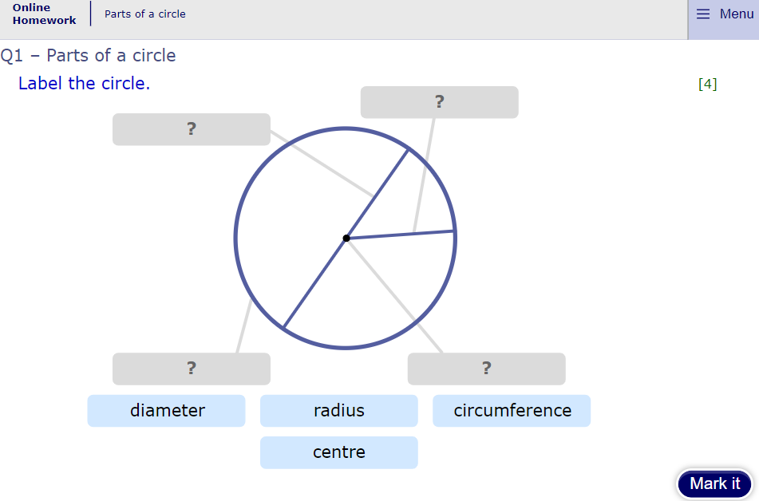
1.7.20
WALT: identify parts of a circle.
Click on the image to take on the online homework on MyMaths which focuses on parts of a circle.
https://app.mymaths.co.uk/6009-homework/parts-of-a-circle
Notes:
Notes: https://app.mymaths.co.uk/6009-homework/parts-of-a-circle
You may chose to do this as a class or move on to the questions in their book.

Slide 10
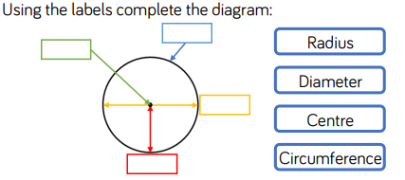
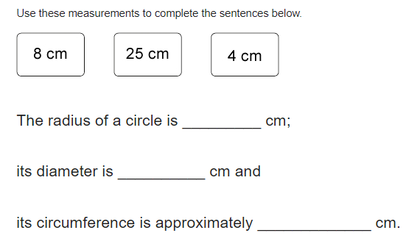
1.7.20
WALT: identify parts of a circle.
Q1
Q2

Slide 11
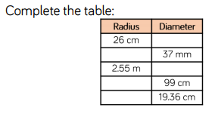
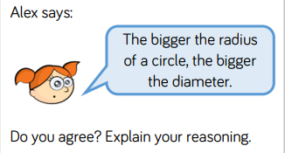
1.7.20
WALT: identify parts of a circle.
Q3
Q4

Slide 12
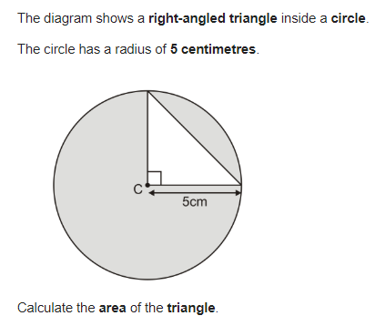
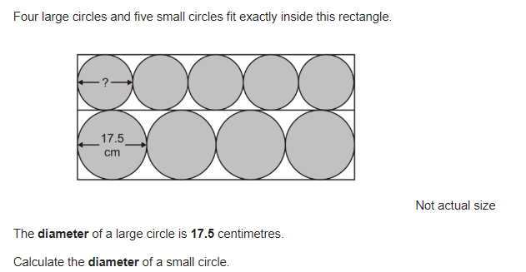
1.7.20
WALT: identify parts of a circle.
Q5
Q6

Slide 13
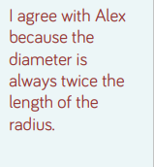
ANSWERS
Q1
Q2
4
8
25
Q3
Q4
52cm
18.5mm
5.1m
49.5cm
9.68cm

Slide 14
ANSWERS
Q5
Q6
17.5 x 4 = 70cm
70cm / 5 = 14cm
Small circle has a diameter of 14cm.
Base x height divided by 2 = area of a triangle.
5 x 5 / 2 = 12.5cm2

