Slide 1
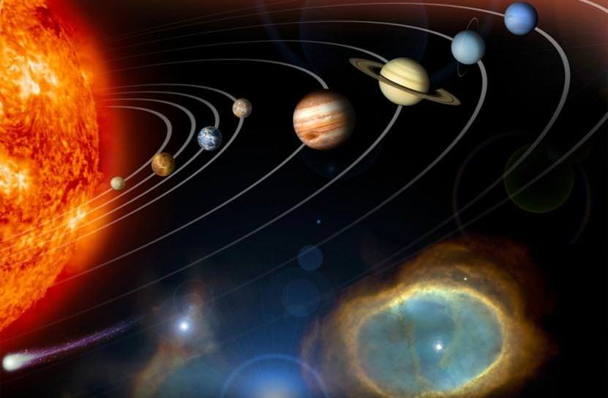
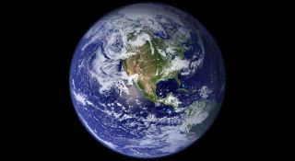
This week’s theme is
Space
Day 3 - 1.7.20

Slide 2

Spellings
Writing =

Slide 3
Wednesday - Spelling and handwriting practice.
brought
caught
enough
plough
coughed
The goalie caught the ball as he leapt into the air.
Copy out these words out twice in your best joined handwriting.

Slide 4
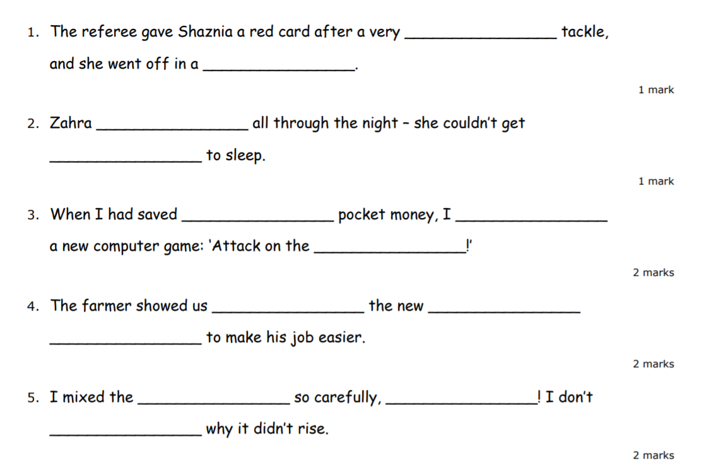
Wednesday - Spelling
ough
Can you write the missing spelling words in the sentence below.
ought
bought
rough
huff
though
plough
cough
off
dough
enough
know
fort
how

Slide 5
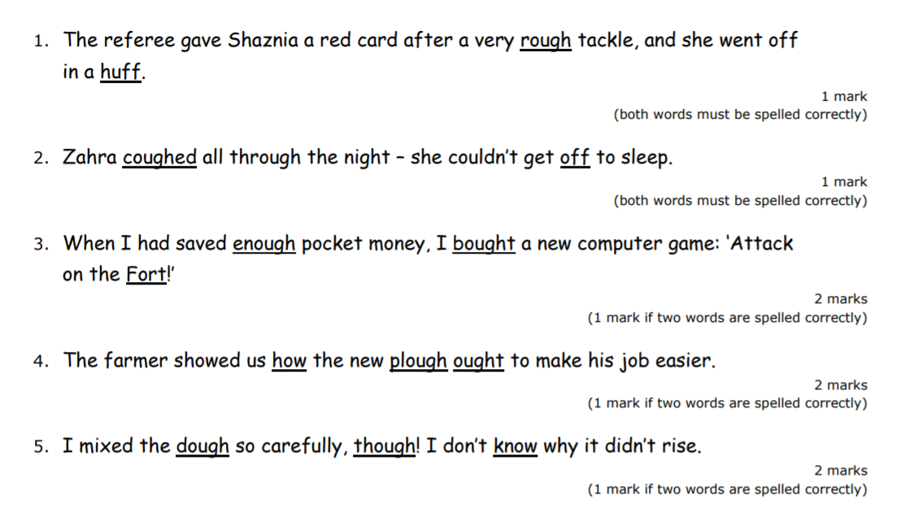
Wednesday - Spelling
ough
Can you write the missing spelling words in the sentence below.
Look at the answers below and check how many you got right.

Slide 6
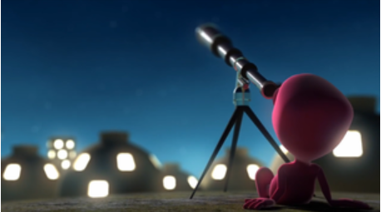
Writing - session 2
Thinking Points
Who is this?
What is it?
What are they doing?
Where are they from?
What are they looking at?

Slide 7
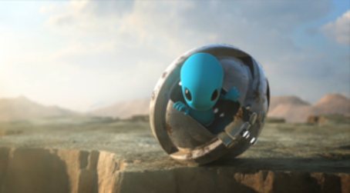
Writing - Corresponding with a Friend
If these two aliens were friends, what would they say to each other? What adventures have they had? What are they looking at? What have they discovered?

Slide 8
Writing - Corresponding with a Friend
Write some emails between the blue and pink aliens. What would they say to each other. What discoveries would they share?

Slide 9
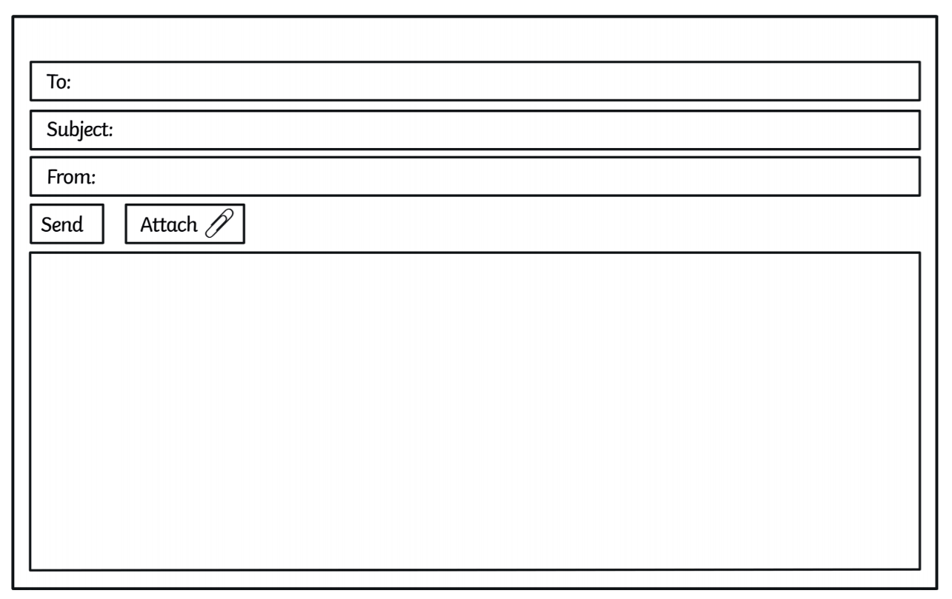
Writing - Corresponding with a Friend
Write some emails between the blue and pink aliens.

