Slide 1
Good MoRning Year 6!
Well done on another fantastic week!
Please follow the instructions on each page to help you - we look forward to hear about how you have got on!
Mrs Jones and Miss Nolan

Slide 2
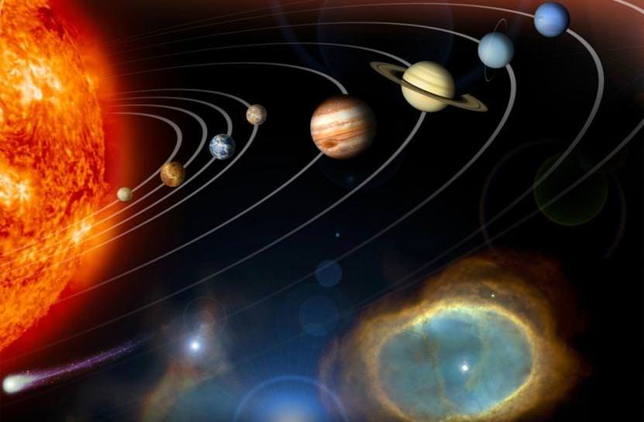
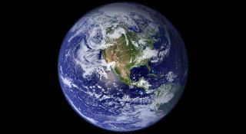
This week’s theme is
Space
Day 5 - 3.7.20

Slide 3
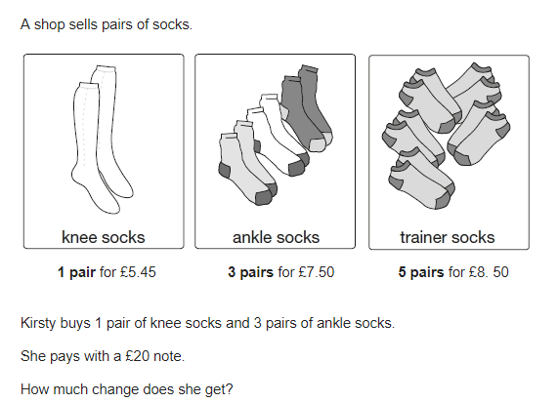
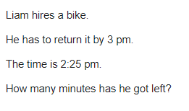
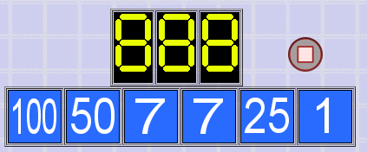
Morning Maths
8.
9. If n is 16, what is 4n + 12 x 2
10.
1342 x 34 =
¼ x ⅜ =
94829.34 - 29472.1
3 - 2.04
37.5% x 200
6. 5x + 7 = 19 + 3x
7.
Notes:
Children complete in maths book.
They have 15 minutes to complete independently.
Spend 10 minutes at the end of the session going through the answers and the children self mark.

Slide 4
ANSWERS
8.
9. If n is 16, what is 4n + 12 x 2
4 x 16 + 12 x 2
64 + 24 = 88
10.
£7.05
1342 x 34 = 45,628
¼ x ⅜ = 3/32
94829.34 - 29472.1 = 65,357.24
3 - 2.04 = 0.96
37.5% x 200 = 75
6. 5x + 7 = 19 + 3x
5x = 19 - 7 + 3x
5x = 12 + 3x
5x - 3x = 12
2x = 12
X = 12/2
X = 6
7.
50 - 1 = 49
25 - 7 = 18
49 * 18 = 882
882 + 7 = 889
(off by 1)
35 minutes

Slide 5


Class Based Worship
What are your worries? You can share if you want or ponder. Let’s clear our minds.
Notes:
Teacher Notes -
Discuss daily worries with children

Slide 6
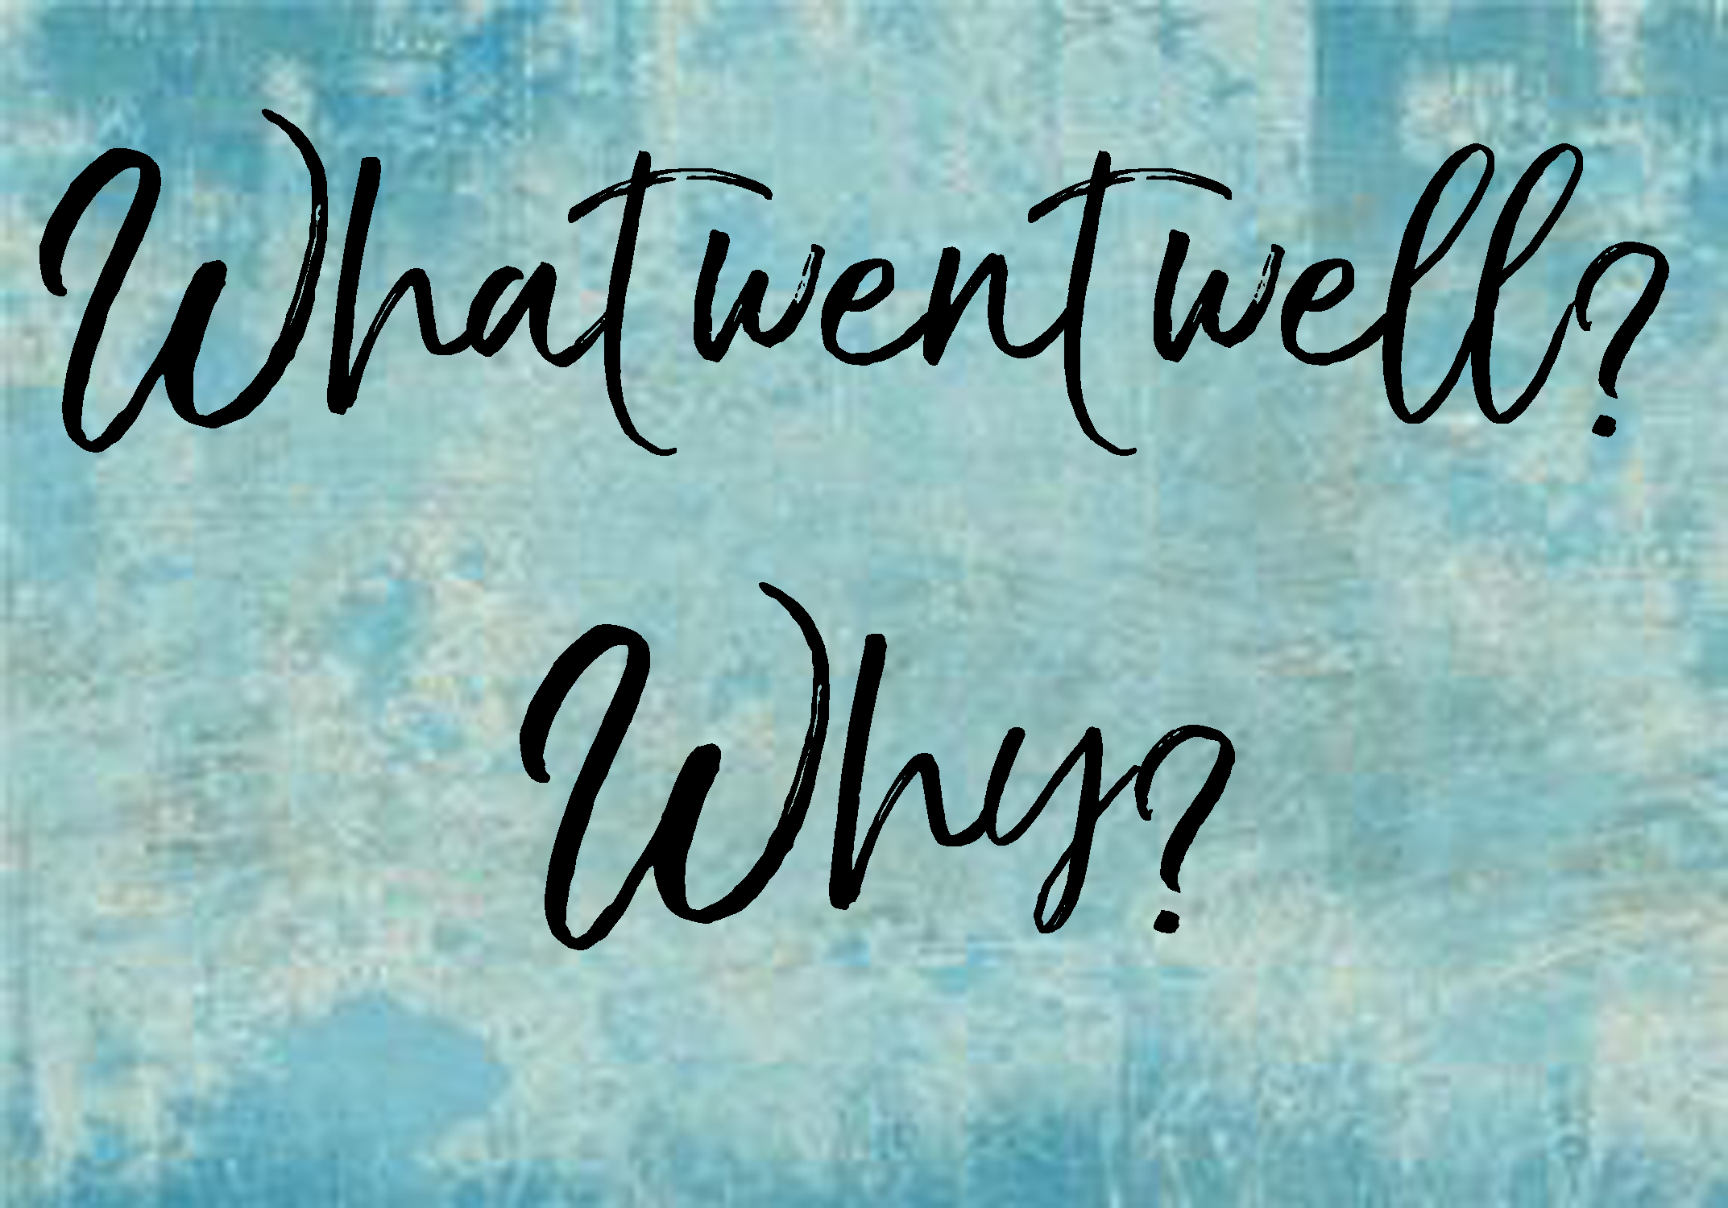


Class Based Worship
What has gone well! Let’s celebrate our achievements and things that have made us happy.
Notes:
Teacher Notes -
Discuss and celebrate what has gone well for the children this week.

Slide 7

Class Based Worship
Compliment Others - What kind things can you say?
Notes:
Teacher Notes -
Discuss and share

Slide 8

St Catherine’s Classroom Beliefs
Mistakes are valuable.
Everyone can learn maths to the highest level.
Questions are really important.
Depth is more important than speed.
Maths is about making connections.

Slide 9
3.7.20
WALT: apply our maths knowldge to a variety of questions within a time limit.
Success Criteria:
Four operations
Fractions
Decimals
Percentages
Place value
Notes:
Notes:

Slide 10
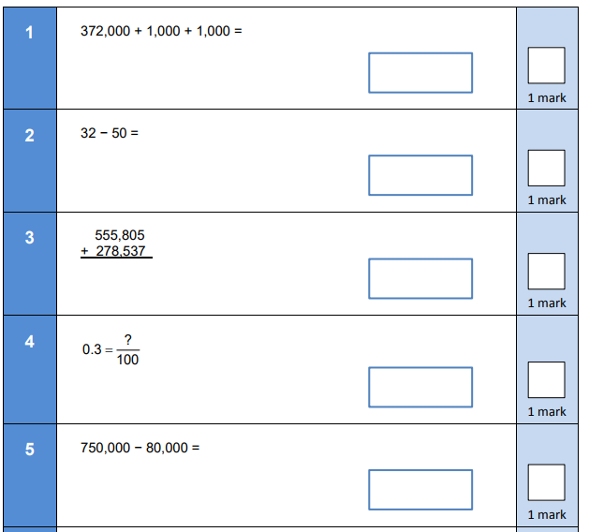
3.7.20
WALT: apply our maths knowldge to a variety of questions within a time limit.
Notes:
Notes:

Slide 11
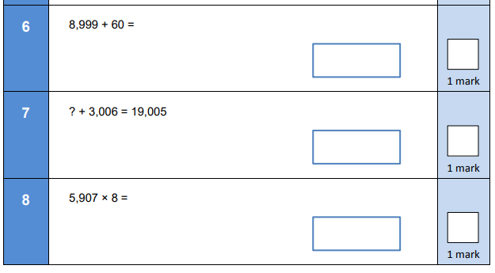
3.7.20
WALT: apply our maths knowldge to a variety of questions within a time limit.
Notes:
Notes:

Slide 12
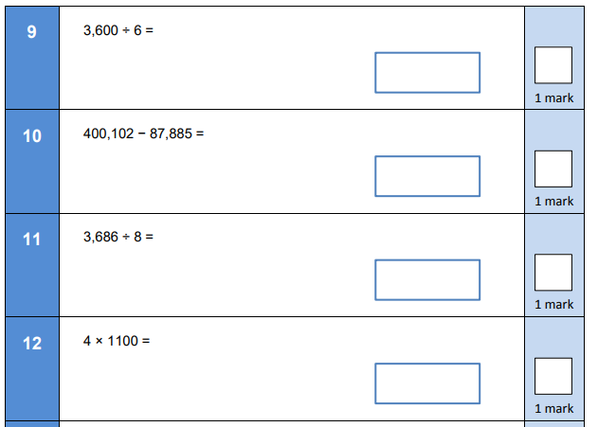
3.7.20
WALT: apply our maths knowldge to a variety of questions within a time limit.
Notes:
Notes:

Slide 13
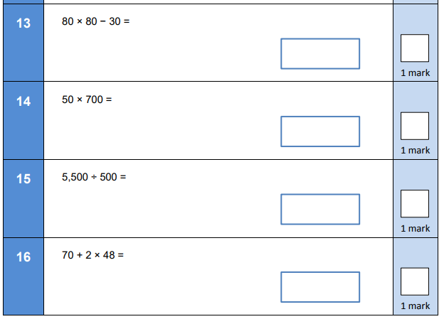
3.7.20
WALT: apply our maths knowldge to a variety of questions within a time limit.
Notes:
Notes:

Slide 14
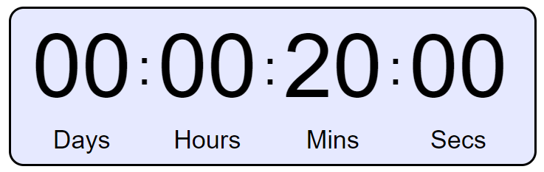
WALT: apply our maths knowledge to a variety of questions within a time limit.
Notes:
Once the children are clear they have 20 minutes to complete the questions independently.
https://www.online-stopwatch.com/timer/20minutes/

Slide 15
3.7.20
WALT: apply our maths knowldge to a variety of questions within a time limit.
Answers
1.374,000
2. - 18
3. 834,342
4. 30/100
5. 670,000
Notes:
Notes:

Slide 16
3.7.20
WALT: apply our maths knowldge to a variety of questions within a time limit.
Answers
6. 9059
7. 15,999
8. 47, 256
Notes:
Notes:

Slide 17
3.7.20
WALT: apply our maths knowldge to a variety of questions within a time limit.
Answers
9.600
10. 312,217
11. 460.75
12. 4400
Notes:
Notes:

Slide 18
3.7.20
WALT: apply our maths knowldge to a variety of questions within a time limit.
Answers
13. 6370
14. 35,000
15. 11
16. 166
Notes:
Notes:

