Slide 1
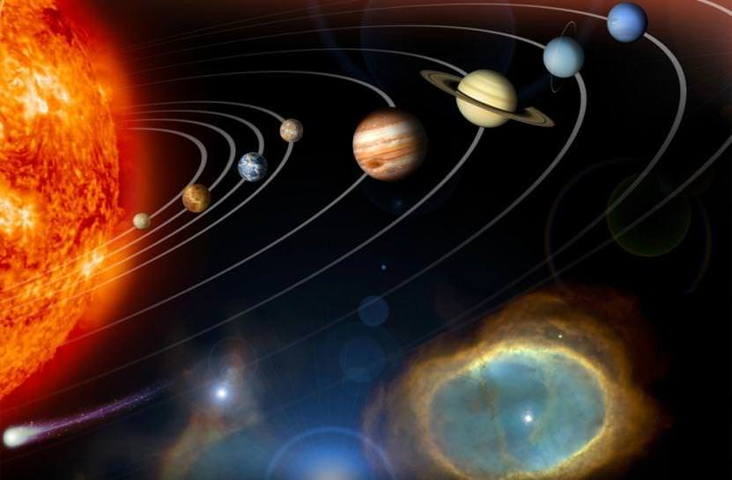
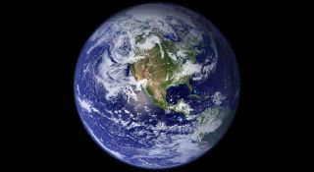
This week’s theme is
Space
Day 5 - 3.7.20

Slide 2

Spellings
Writing = Advertising Earth

Slide 3
Friday - Spelling and handwriting practice.
though
through
thorough
throughout
thought
It would take a thorough search.
Copy out these words out twice in your best joined handwriting.

Slide 4
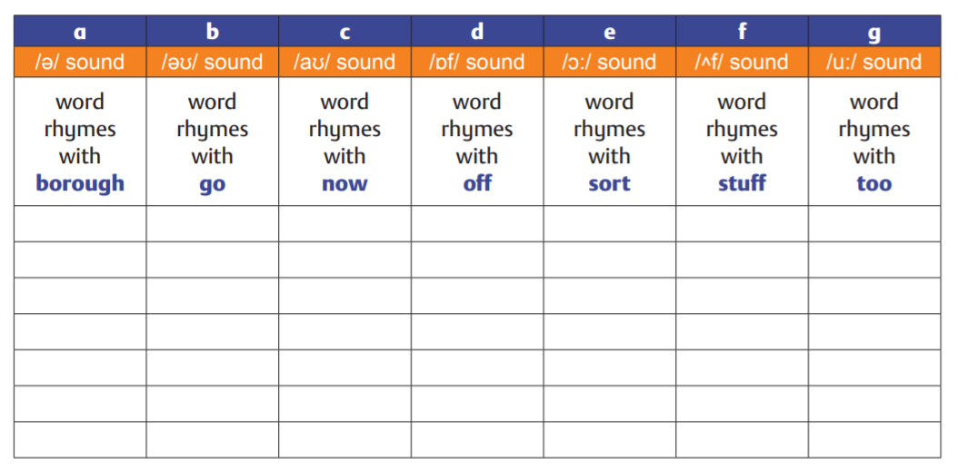
Friday- Spelling
Write some –ough– words in the correct columns in the table below.

Slide 5
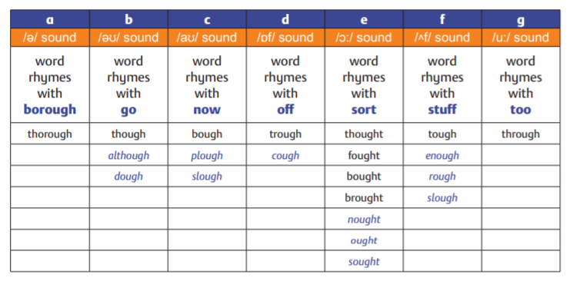
Friday- Spelling answers
Possible answers

Slide 6
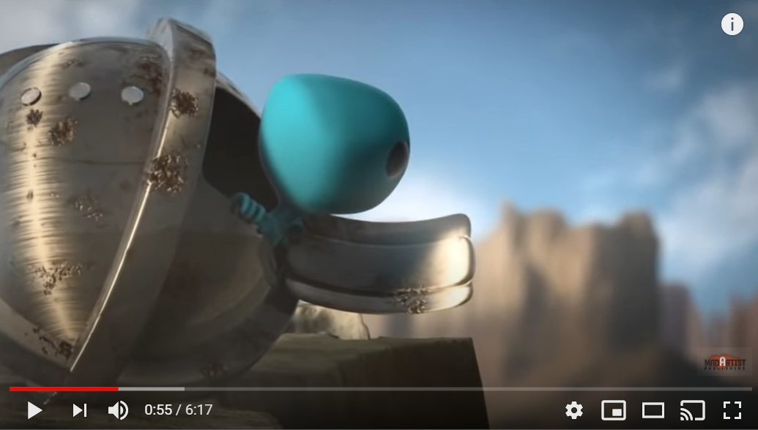
Writing - Session 3
Why are aliens visiting our planet? This enchanting animated short film follows a visitor from another world as it starts its journey on Earth.
Click on the image or the link to watch the short film about the Blue Alien:
https://www.youtube.com/watch?v=g1071nvLmgY

Slide 7
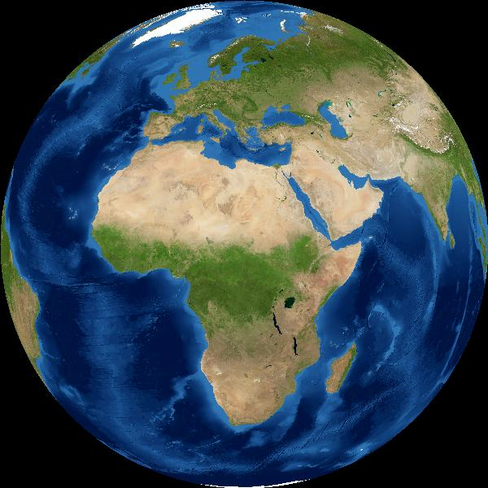
Writing - Why would aliens visit our planet?
Why would aliens visit our planet?
Think about the blue alien. Why did he visit? Why would other aliens visit?
How would you advertise the Earth to encourage aliens to visit?
Come up with a list of positive things about planet Earth that would encourage an alien to visit.

Slide 8
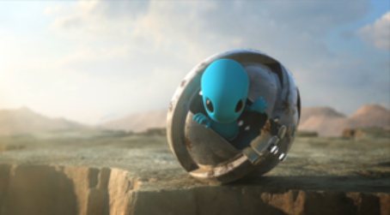
Writing - Why would aliens visit our planet?
Why would aliens visit our planet?
Make your own poster advertising Earth. Why would aliens visit our planet? Can you create a poster that encourages them to visit?

