Slide 1

Good Afternoon Year 6!
Let’s start our afternoon with a quick burst of energy!
Get your PE kit at the ready because at the start of each afternoon session we will be joining Joe Wicks for our daily workout.
Do as much as you can and over the week you should find you are getting fitter and finding it easier.
Let’s go!
Click the youtube link below and select today’s date from the videos listed.
https://www.youtube.com/channel/UCAxW1XT0iEJo0TYlRfn6rYQ

Slide 2
Heartsmart

Slide 3

Heartsmart
Lesson 1: No way through isn’t true!
Today we are learning to think about how to persevere when we get stuck!

Slide 4
Heartsmart
As a class, list situations where you sometimes feel it is too hard or there is no way through. Let’s think of an example from the film as a starting point.

Slide 5
Heartsmart
Now think about and suggest ways you can overcome some of the difficulties mentioned. Let’s list our ideas on the board.
Remember...
When we don’t believe there is a way through, we give up and stay stuck. But when we believe there’s a solution for every problem, we keep working at it until we find it.

Slide 6
Heartsmart
Being HeartSmart means knowing ‘No Way Through’ isn’t True!’
Encourage each other throughout the week to keep going in all situations and find a way through.

Slide 7
Heartsmart
Lesson 2: The Bridge to Yet.
Today we are learning to describe the impact of changing our thinking from ‘I can’t do it’ to ‘I can't do it yet’?

Slide 8
Heartsmart
A group of students at a High School in Chicago, if they didn’t pass a course got the grade ‘not yet.’
Let’s think about….
Why did the teachers do this?
What can we learn from this?

Slide 9
Heartsmart
Why did the teachers do this?
Although the children hadn’t passed ‘yet’, the teachers wanted the children to know that if they keep learning and keep trying they can pass in the future and build a bridge to yet.
What can we learn from this?
Even if you don’t know how to do it ‘now’, you can change your thinking to I don’t know how to do it ‘yet.’ Believing this helps you to keep learning until you can meet your goals. It gives you a bridge to yet.

Slide 10
Heartsmart
The truth is, becoming really good at something takes a lot of practise. The difference between people that succeed and those that don’t is their ability to not give up and to know that ‘I can’t yet, but I will’. Successful people do things every day that the average person doesn’t want to do - practise!

Slide 11
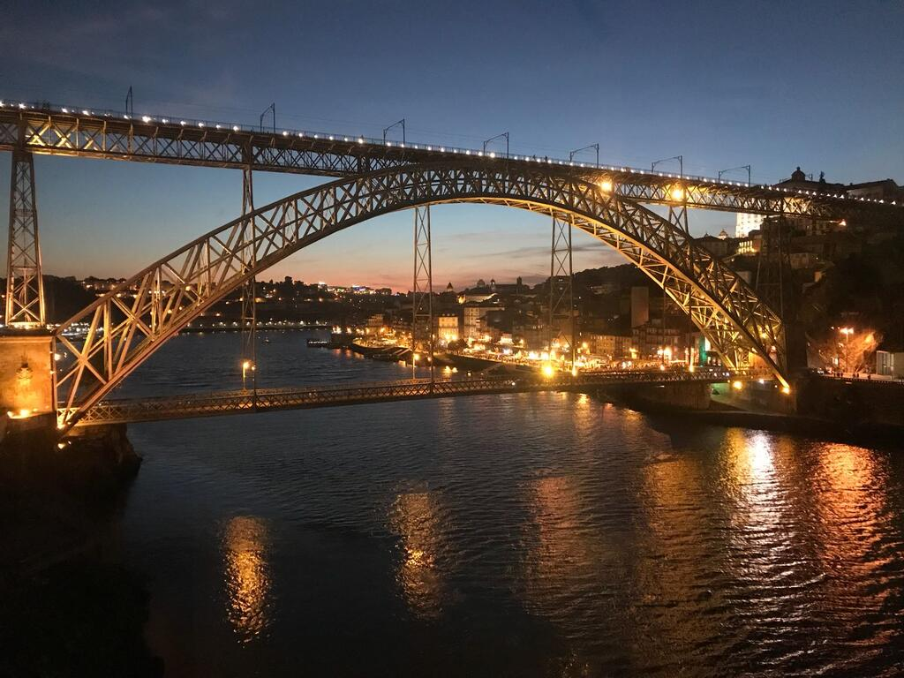
Heartsmart
How can we build the bridge to yet?
Get yourself some newspaper and sellotape and without instruction make a bridge. Take 5 minutes then come back together and we will look at the results.
The first attempt may not have gone well but that’s ok. Think about how you could improve your bridge and then try again. Take another 5 minutes. Come back together and look at the results the second time around. The bridges will have improved.
When there is something that we can’t do, we can grow, learn from our mistakes and build the bridge to yet!

Slide 12

Heartsmart
How might the learning this afternoon link with our transition to secondary school?
Can we think of any way that taking this positive attitude of ‘No way through isn’t true’ could help us with transition?

Slide 13

Well done on a great day!
Enjoy your evening and be ready for more learning tomorrow...

