Slide 1
Good MoRning Year 6!
It’s Wednesday! You are a now half way through the week. We hope you are continuing to enjoy your lessons. We know you will be applying yourselves and trying hard. Well Done!
Please follow the instructions on each page to help you - we look forward to hear about how you have got on!
Mrs Jones and Miss Nolan

Slide 2
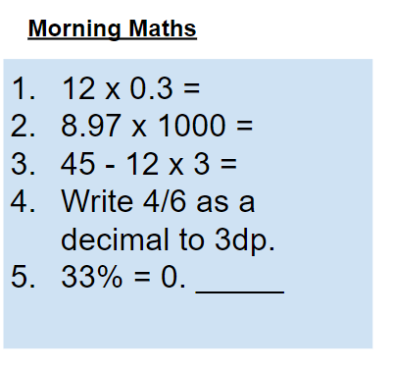
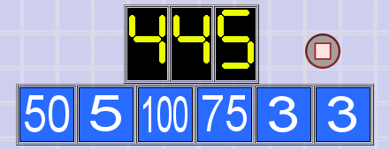
As always, our day will start with Morning Maths.
Give yourself 10 minutes to complete these questions and then try and tackle today’s countdown. If you finish within 10 minutes, check your work and see how many ways you can find to solve the countdown.
After 10 minutes, use a calculator to check your answers and the countdown solver (linked below) to see how to solve today’s problem.
Click the link below and type in the numbers and target to see how the countdown could be solved!
http://www.maths-resources.com/countdown/

Slide 3


Maths today will focus on using ratio to read scales on maps.
We may not be learning together in the classroom, but it is important to still remember our classroom beliefs.
WALT: use ratio to read map scales.
Before we start, get your My Maths log in details ready. These were provided in your first work pack.

Slide 4
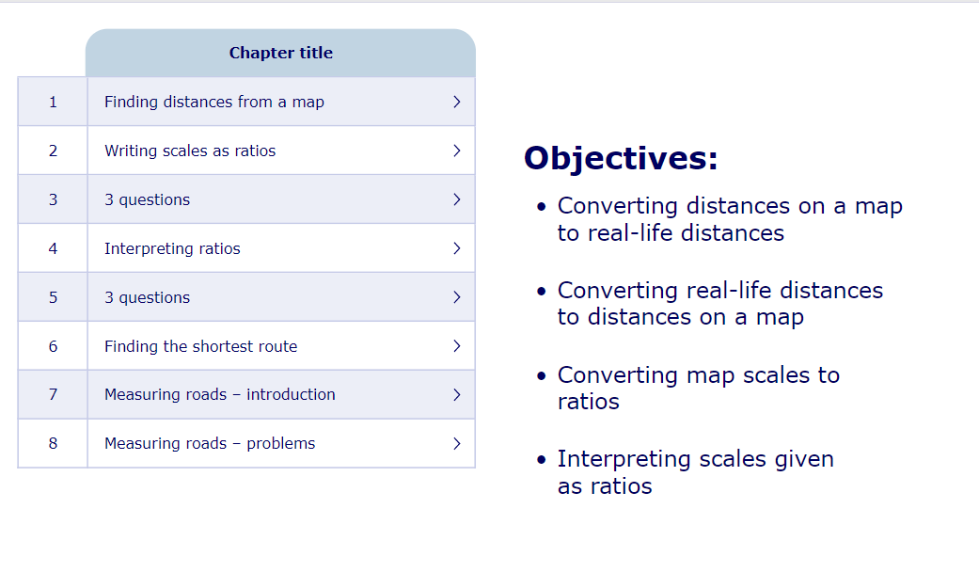
WALT: use ratio to read map scales.
To start the lesson, click on the image to the left of the screen. This will take you to an interactive lesson. This lesson will show you how to use ratio to convert distances on maps to real-life distances.
Click on the next buttons at the bottom of the page to move your learning on and take part in the mini-quizzes along the way to check your understanding.

Slide 5
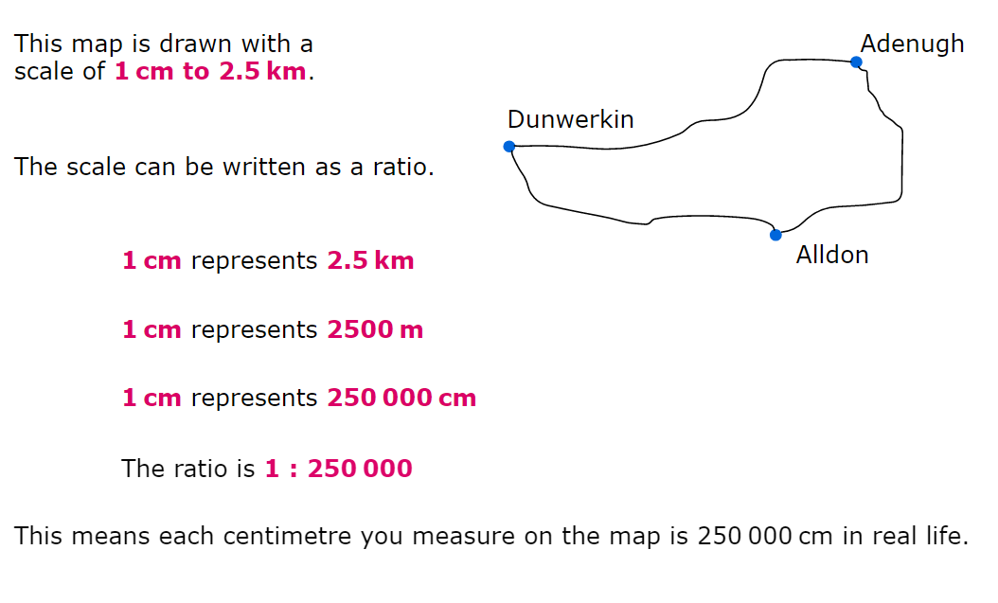
WALT: use ratio to read map scales.
A quick recap...

Slide 6
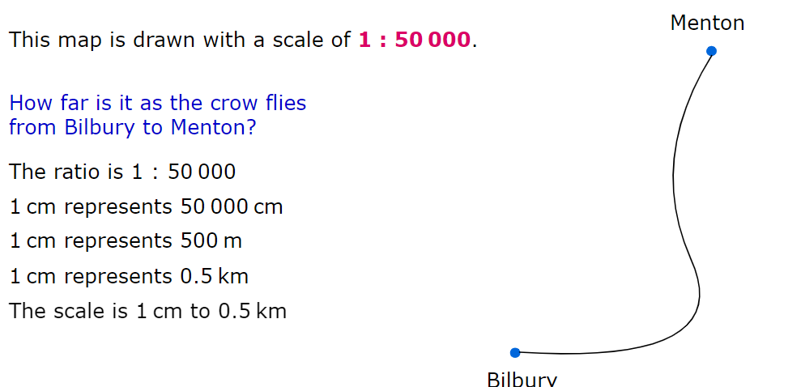
WALT: use ratio to read map scales.
A quick recap...

Slide 7
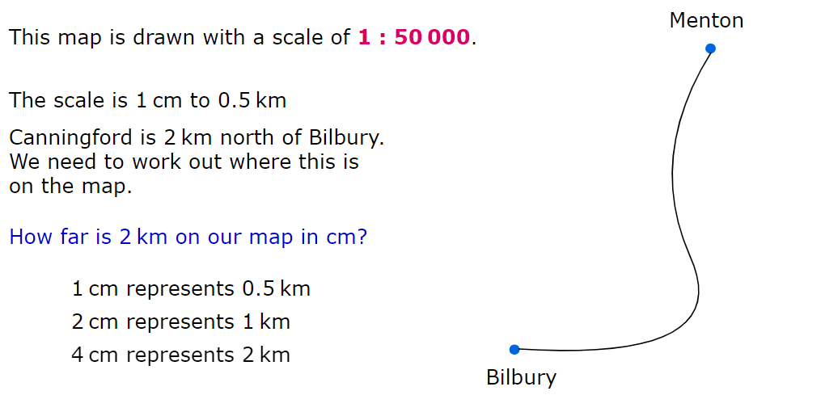
WALT: use ratio to read map scales.
A quick recap...

Slide 8
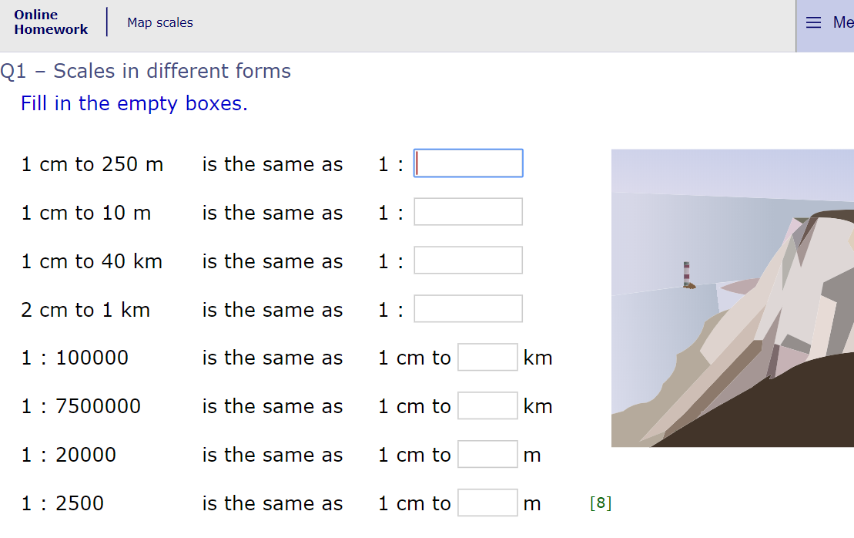
WALT: use ratio to read map scales.
Now click the image on the left of the screen, this will take you to an online homework where you can test your understanding.
Have a go at the questions and then click ‘Mark it’ to see how you have go on.
Your login details for My Maths were sent home in your first work pack - make sure you log in so we can see how you are getting on.

Slide 9
Grammar
Teacher Notes
Today we will be learning about formal and informal register.
Study the slides to make sure you have a clear understanding of formal and informal register. If you are still unsure, have a go at the formal and informal activities on Achieve Online.

Slide 10
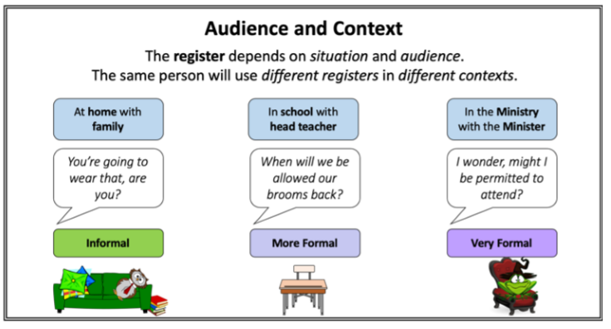
Grammar

Slide 11
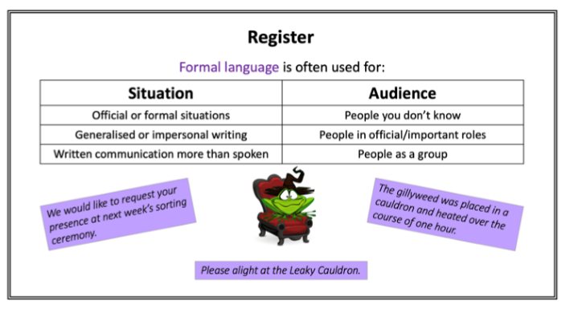
Grammar

Slide 12
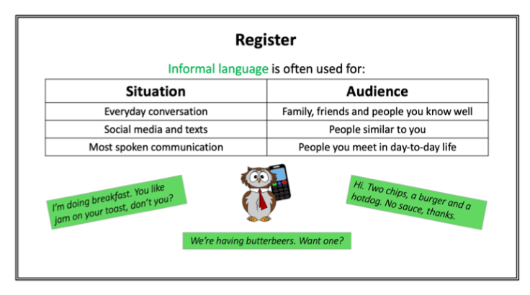
Grammar

Slide 13
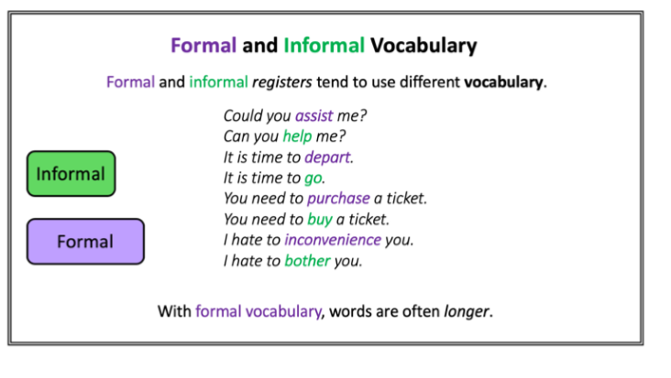
Grammar

Slide 14
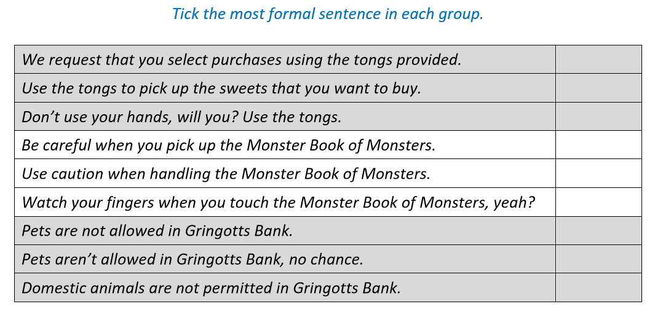
Grammar
Teacher Notes:
Now try and answer the question.

Slide 15
Grammar - Answers

Slide 16
Creative Writing Lesson 2
Today we will be continuing to develop our creative writing skills. Remember to keep our 4 key writing targets in mind.
Vocabulary
Range of punctuation and sentence types
Cohesion
Awareness of Reader - Show not tell

Slide 17
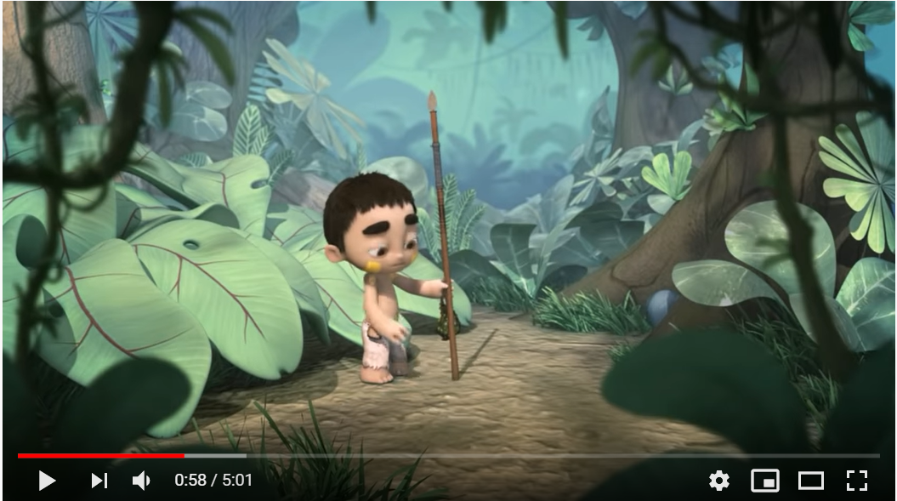
Creative Writing Lesson 2
Teacher Notes
Watch the video to remind yourself of the content - Ride of Passage.
Click on the image and you should be directed to a Youtube video.
Otherwise click on the URL below:
https://www.youtube.com/watch?v=29fIGIr0cuQ&t=102s

Slide 18
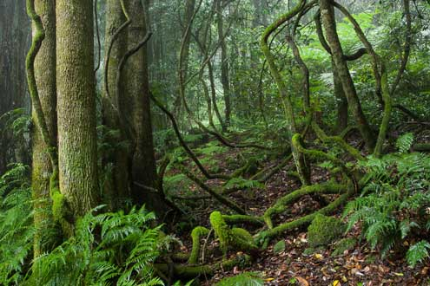
Creative Writing Lesson 2
Teacher Notes
Last lesson you looked at this image of a rainforest and started describing what you could see. We are going to take it further today and develop our use of vocabulary.

Slide 19
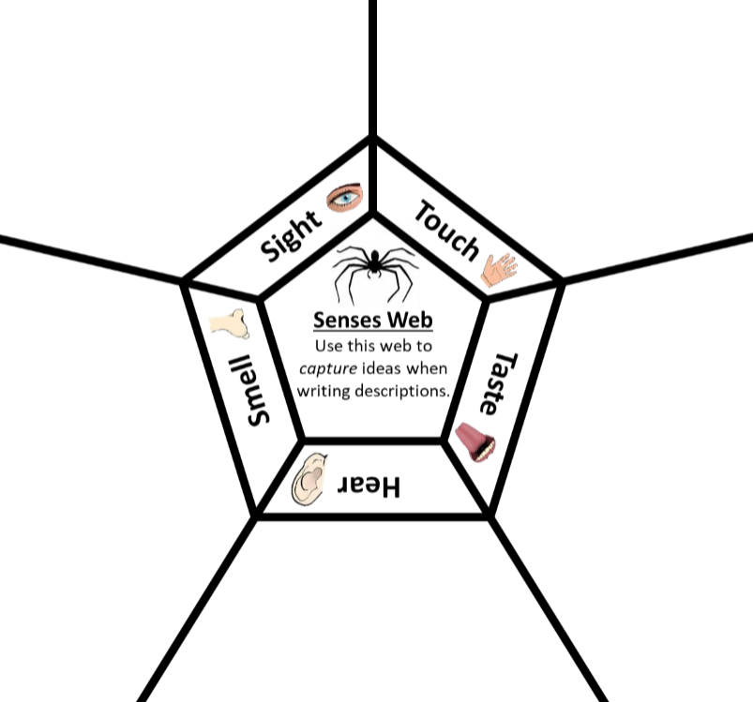
Creative Writing Lesson 2
Teacher Notes
Use your notes from the previous writing lesson and start to add more detail by using the senses web. Try to get at least 5 ideas for each section.

Slide 20
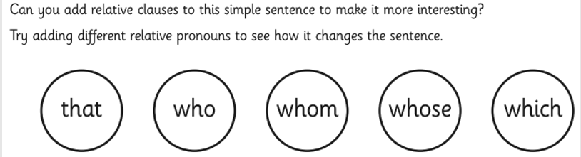
Creative Writing Lesson 2
Teacher Notes
Relative Clauses:
Simple Sentence:
The flowers were amethyst-pink.

Slide 21
Creative Writing Lesson 2
Teacher Notes
Relative Clauses:
Simple Sentence:
The flowers were amethyst-pink.
Improved sentence with a Relative Clause:
The flowers, which smelled sweeter than honey, were amethyst-pink.
Now try adding a relative clause to this sentence:
Simple sentence: The vines hung from the canopy like streamers.

Slide 22
Creative Writing Lesson 2
Teacher Notes
Using what we have learned so far, write a setting description to describe a rainforest setting. Use the image to start your imagination, or watch the video ‘Ride of Passage’ as your inspiration.
Try to write at least 2 different paragraphs. Each one should be about a different feature of the setting. Challenge yourself to use a relative clause in each paragraph.

Slide 23

Good Afternoon Year 6!
Let’s start our afternoon with a quick burst of energy!
Get your PE kit at the ready because at the start of each afternoon session we will be joining Joe Wicks for our daily workout.
Do as much as you can and over the week you should find you are getting fitter and finding it easier.
Let’s go!
Click the youtube link below and select today’s date from the videos listed.
https://www.youtube.com/channel/UCAxW1XT0iEJo0TYlRfn6rYQ

Slide 24
We hope you enjoyed a lunch break and had something delicious to eat!
Now time for our afternoon session of Art. Today’s art lesson will follow on from Monday’s session.
Art

Slide 25
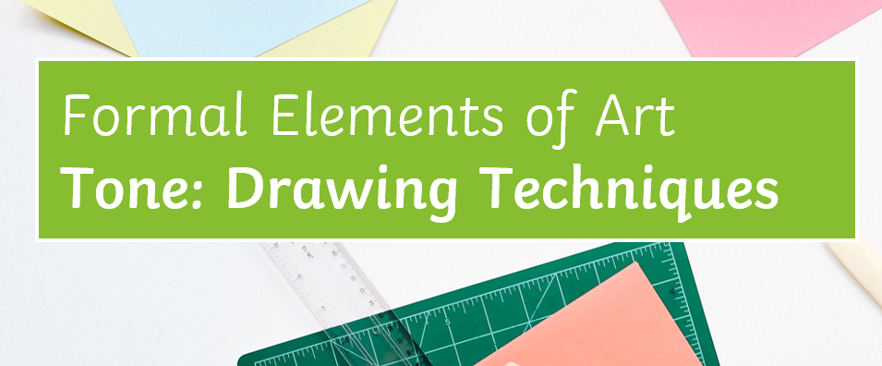

Slide 26
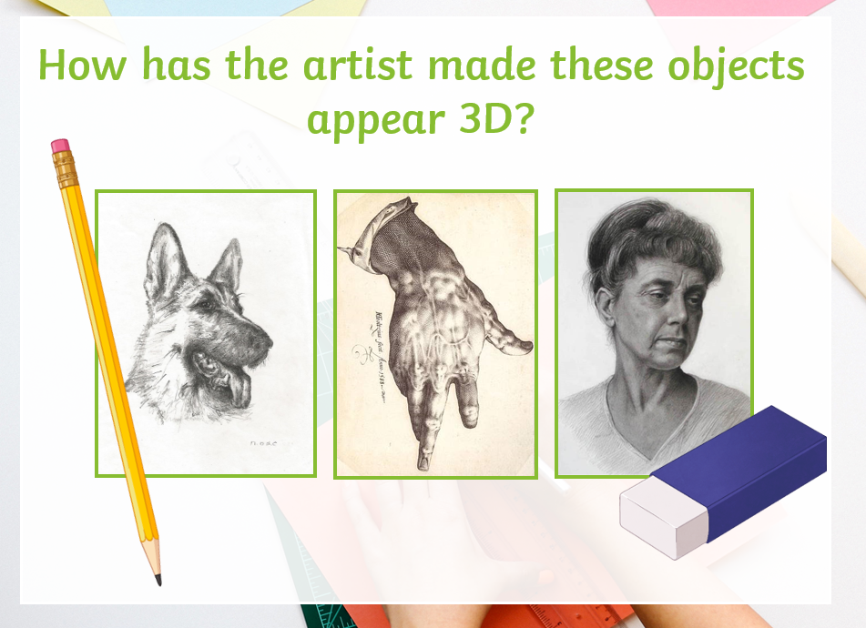
Teacher notes
How has the artist made these pencil drawings look 3D?
Think about our learning in Art yesterday and the different techniques used to create tone.

Slide 27
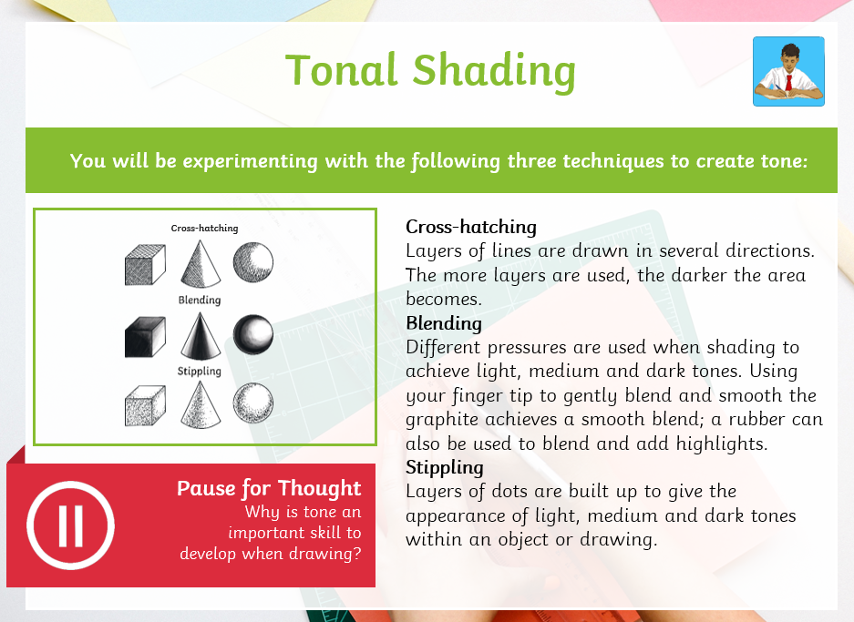
Teacher notes
Think - Why is tone an important skill to develop when drawing?

Slide 28
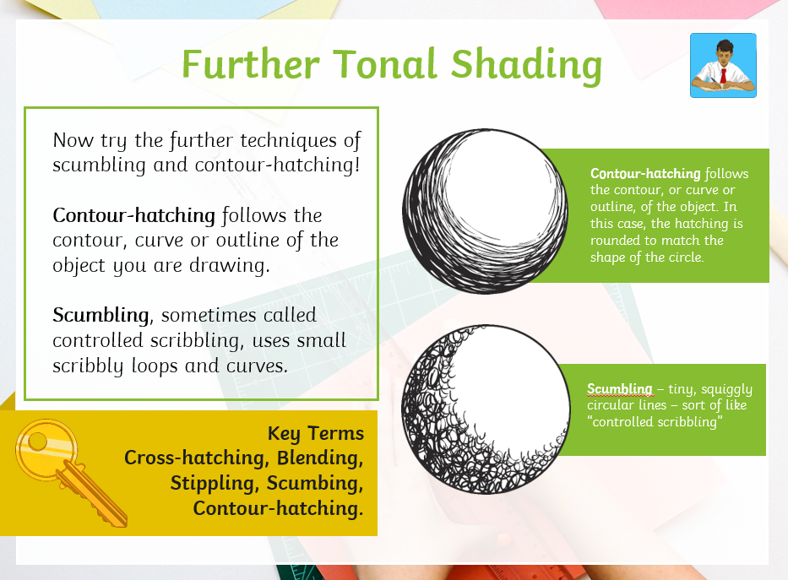
Teacher notes
Now try using all the different tonal shading techniques we have explored.
Experiment with creating light, medium and dark tones.

Slide 29


Slide 30
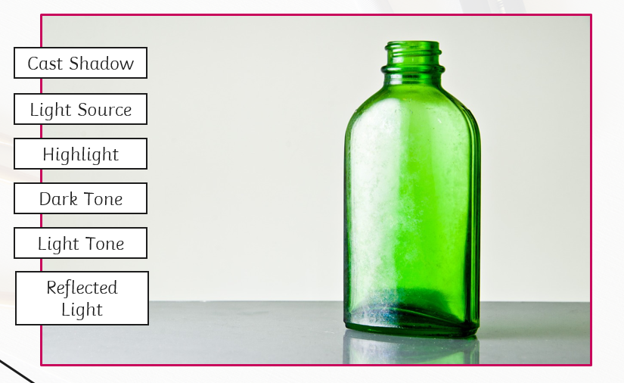
Teacher notes
Look at the bottle and labels and see if you can identify the areas of light, shadow and tone.

Slide 31
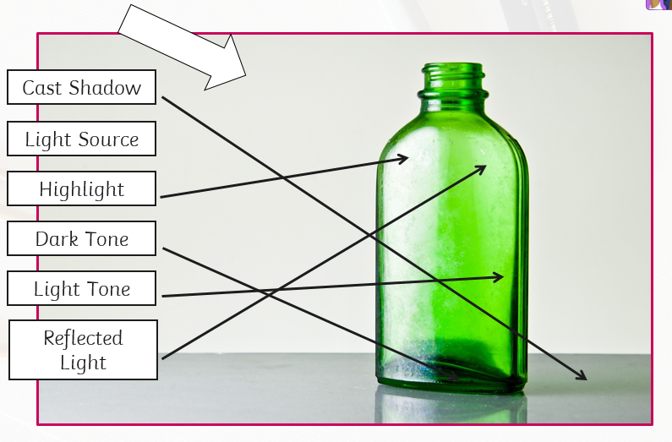
Teacher notes
Answers are shown on this image.

Slide 32
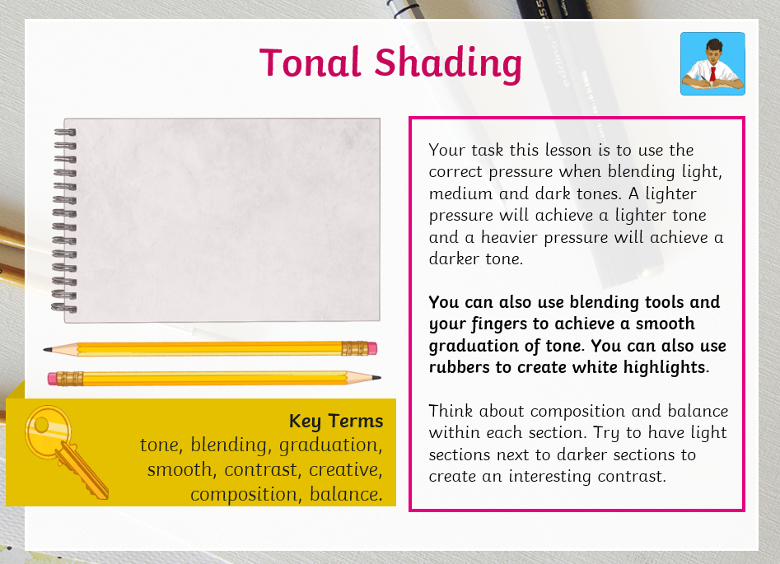
TASK

Slide 33

Wednesday complete!
Well done on a great day!
Enjoy your evening and be ready for more learning tomorrow...

