Slide 1
Good MoRning Year 6!
We hope you have had a lovely Easter break with your families and are keeping safe!
We have set up your learning for the next two weeks as daily powerpoints for you to follow in the same structure as our school day in Year 6.
Please follow the instructions on each page to help you - we look forward to hear about how you have got on!
Mrs Jones and Miss Nolan

Slide 2
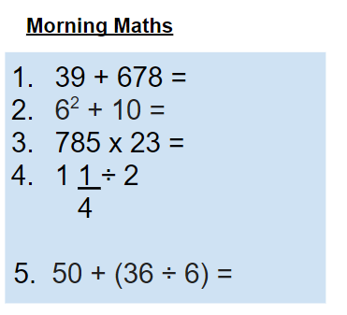
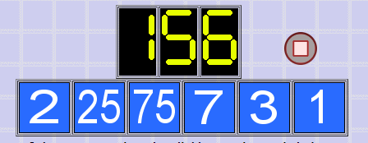
As always, our day will start with Morning Maths.
Give yourself 10 minutes to complete these questions and then try and tackle today’s countdown. If you finish within 10 minutes, check your work and see how many ways you can find to solve the countdown.
After 10 minutes, use a calculator to check your answers and the countdown solver (linked below) to see how to solve today’s problem.
Click the link below and type in the numbers and target to see how the countdown could be solved!
http://www.maths-resources.com/countdown/

Slide 3

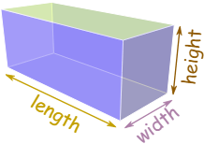
Maths today will focus on finding the volume of a cuboid.
We may not be learning together in the classroom, but it is important to still remember our classroom beliefs.
WALT: find the volume of a cuboid.
Before we start, get your My Maths log in details ready. These were provided in your first work pack.

Slide 4
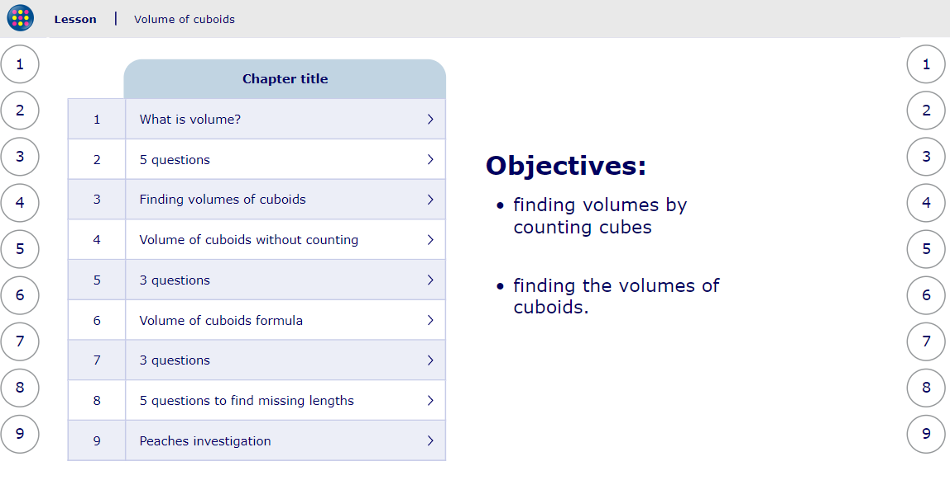
WALT: find the volume of a cuboid.
To start the lesson, click on the image to the left of the screen. This will take you to an interactive lesson. This lesson will teach how to find volume, firstly by counting 1 cm cubes and then how to find the volume of cuboids.
Click on the next buttons at the bottom of the page to move your learning on and take part in the mini-quizzes along the way to check your understanding.

Slide 5
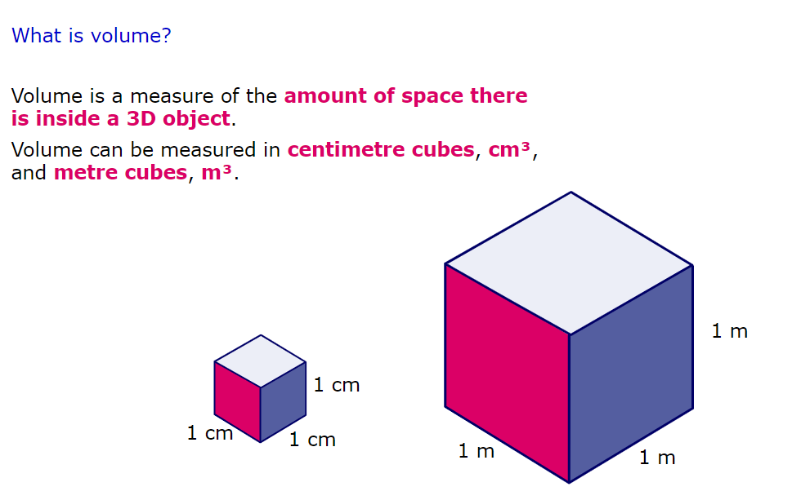
WALT: find the volume of a cuboid.
A quick recap...

Slide 6
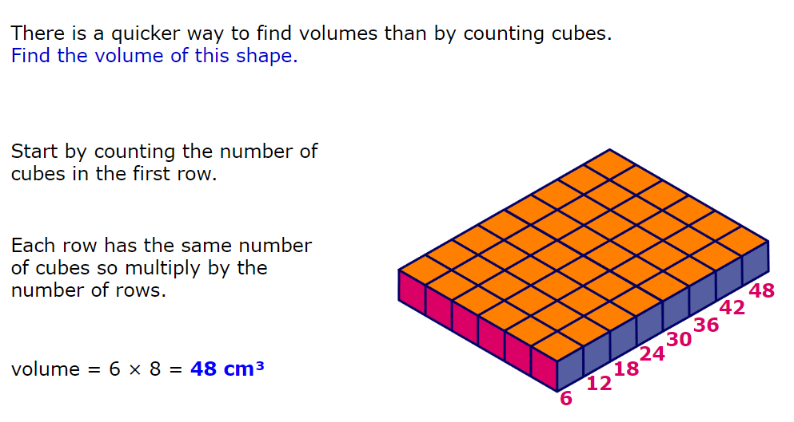
WALT: find the volume of a cuboid.
A quick recap...

Slide 7
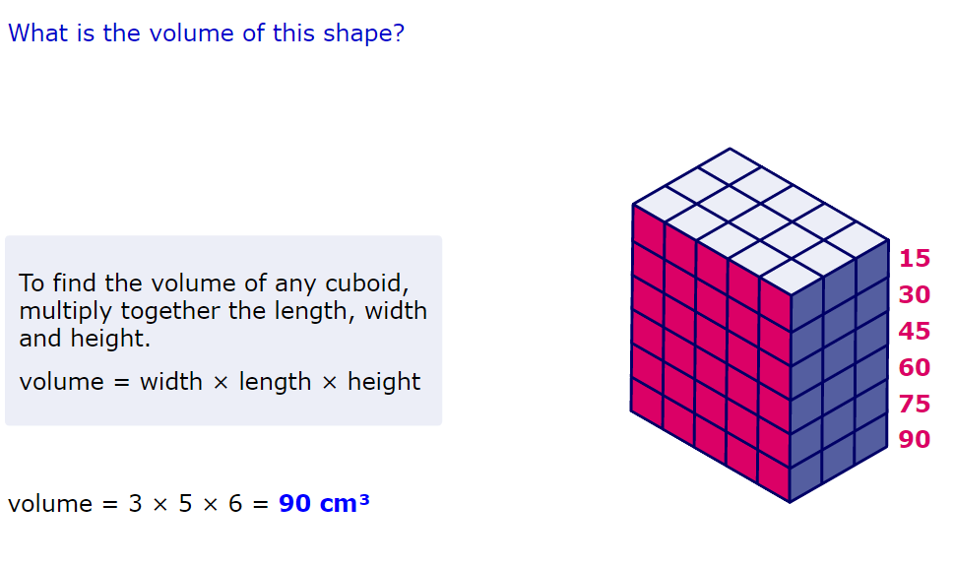
WALT: find the volume of a cuboid.
A quick recap...

Slide 8
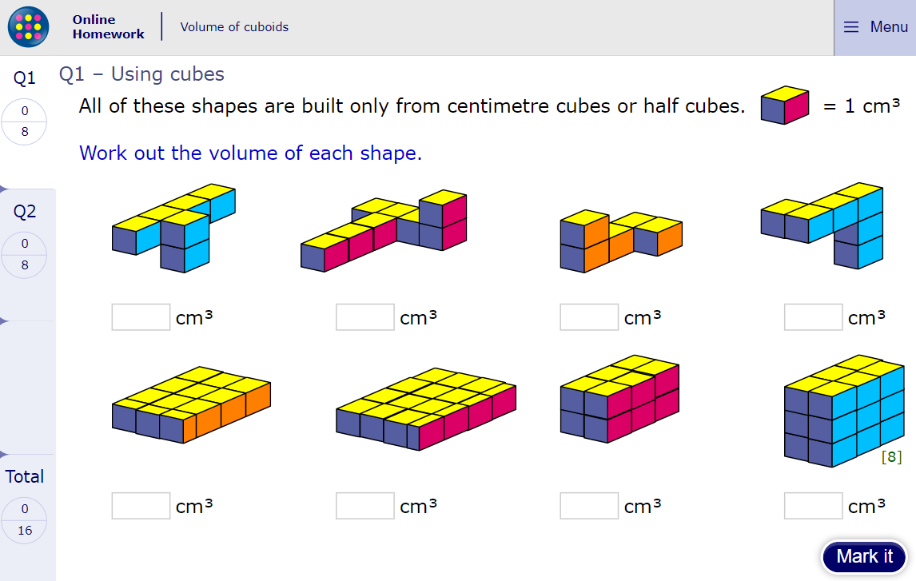
WALT: find the volume of a cuboid.
Now click the image on the left of the screen, this will take you to an online homework where you can test your understanding.
Have a go at the questions and then click ‘Mark it’ to see how you have go on.
Your login details for My Maths were sent home in your first work pack - make sure you log in so we can see how you are getting on.

Slide 9
Now you have completed the maths (and had a short break), it’s time for spellings.
Monday - Spelling and handwriting practice.
partial
official
confidential
preferential
facial
The discussions at the official meeting were confidential.
Copy out these words out twice in your best joined handwriting.

Slide 10
Spelling - Lesson 1
Financial = The root word of finance comes from the french word ‘finer’ meaning settle a debt.
Social = The root word of social comes from the Latin word ‘socius’ meaning "friend."
ial =
relating to
a kind of
connected with
Teacher Notes
Knowing the meaning of the root word can help you when you try and spell. Have a look at words social, glacial and finance. Discuss with an adult the root word meaning and the difference ‘ial’ makes to the word.
glacial = The root word of glacial comes from the Latin word ‘glacies’ meaning ice.

Slide 11
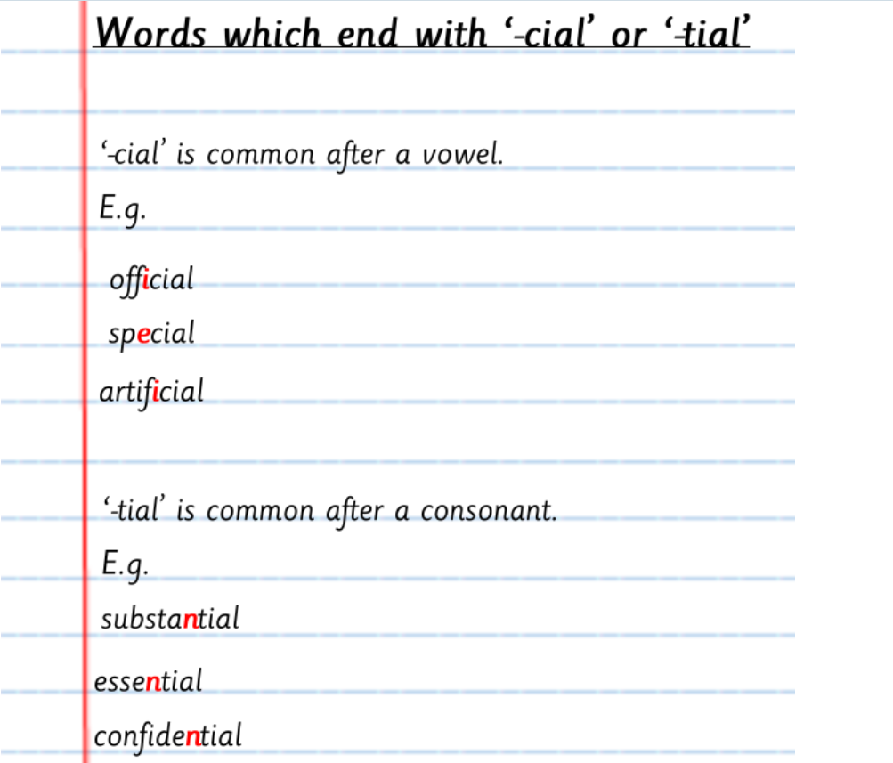
Spelling - Lesson 1
Teacher Notes
Look at the spelling rule. Can you think of any other words that match the rule?
Do you know any exceptions to the rule?

Slide 12
Spelling - Lesson 1
eviden
-tial
-cial
deferen
so
offi
substan
spe
residen
essen
Teacher Notes
Match the letter string with the correct suffix - can you work out what the root word is from the letter string and therefore, the meaning of your new word?

Slide 13
Close Read
Today’s English Lesson will be a close read activity based on the Falcon’s Malteser by Anthony Horowitz.
Teacher Notes
The purpose of a close read activity is to gain an understanding of the text by reading it multiple times.
Close Read Instructions:
Read the blurb about the text to gain an idea of the context. Share your thoughts with an adult or sibling.
Look at the vocabulary highlighted. Do you know what the words mean? If you are unsure, read the vocabulary slide to gain a better understanding.
Read the text to yourself and ask yourself the following questions:
What did I just read? What did it say? You can make notes or annotate the text.
Now read the text again with an adult - this will help you gain a better understanding.
Read the questions and now reread the text again to find evidence that will support your answers.
Answer the questions in writing.
All close read texts are age appropriate.

Slide 14

Close read - Falcon’s Malteser
WALT: make inferences and deductions using evidence from the text.
Blurb
When a dwarf comes into the office and leaves a package, Tim Diamond, the world's worst private-detective, is faced with his toughest case yet. The office is ransacked and the package is found to contain simply a box of Maltesers. Who was the dwarf ...and why was he murdered shortly after his visit?

Slide 15
Close read - Falcon’s Malteser - Text
WALT: make inferences and deductions using evidence from the text.
Before the bus had even arrived to take us back to Fulham, we both knew that we were going to have to open the dwarf’s package. We hadn’t had it twenty-four hours but already our flat had been ransacked and we’d attracted the poisonous attention of the biggest crook in the country. OK – so Johnny Naples had paid us two hundred pounds. He made us promise not to open the envelope. But promises are easily broken. So are necks. I knew which I wanted to see get broken first.
There was a woman waiting at the door when the bus dropped us off. What with the dwarf and the Fat Man, I figured I’d already seen enough weird people for one day, but it seemed that today, like buses and musketeers, they were coming in threes.
She was an old woman with grey, curling hair that stuck out like someone had just electrocuted her. Her lipstick, a vivid shade of crimson, was pretty electrifying too. Her skin was a mass of wrinkles, hanging on her like an old coat. An old coat hung on her too, a sort of seaweed green with artificial fur trimmings. She had a hat like a tea cosy on her head and bulging carpetbag in her hand. Although this was a high street in the middle of Fulham, her feet were lost in blue fluffy slippers.
We assumed that she had drifted out of the local lunatic asylum and let ourselves into the flat, ignoring her. It was only when we got into the office and found her still behind us that we realized she had been waiting to see us. Now she took one look at the wreckage and whistled, smacking her lips together afterwards as if she had swallowed a toffee.

Slide 16
Close read - Falcon’s Malteser Text
WALT: make inferences and deductions using evidence from the text.
“Cor blimey!” she exclaimed. “Luv-a-duck! What a blooming mess!”
“Who are you?” Herbert demanded.
“Charlady,” she replied. She gave us a big crimson smile. “I saw your ad in the newsagent.”
With everything that had happened, we’d quite forgotten about our advertisement for a cleaner, but here a cleaner was.
“Oh yes,” Herbert muttered. “What’s your name?”
“Charlady.”
“Yes. I know.” He frowned. I shrugged. Maybe she didn’t understand English. Maybe somebody had dropped her when she was a baby. Herbert tried again, more slowly. “What – is – your – name?”
“Charlady!” she said for a third time. “Betty Charlady. That’s my name. But you can call me Betty.”
Without waiting for an invitation, she stepped further into the room, waving a feather duster which she had produced out of nowhere like a demented magician. Herbert and I looked at each other as she brushed it lightly across the remains of a shelf. The shelf fell off the wall. The cleaning lady scowled. “Crikey!” she said. “Wot a disaster. You don’t need a blooming cleaner ‘ere, luv. You need a master carpenter!”

Slide 17
Close read - Falcon’s Malteser - Vocabulary
WALT: make inferences and deductions using evidence from the text.
Meaning of words:
Ransacked - go through (a place) stealing things and causing damage.
Electrocuted - injure (someone) by electric shock.
Electrifying - a sudden sense of great excitement; thrilling.
Artificial - made or produced by human beings rather than occurring naturally
Demented - behaving irrationally due to anger, distress, or excitement.

Slide 18
Close read - Falcon’s Malteser Questions
WALT: make inferences and deductions using evidence from the text.
What does the woman say that suggests that a lot of furniture has been broken?
What does the narrator say that shows he thinks the woman is mentally ill?
Below are statements which summarise the extract – put them in the correct order by numbering them from 1-4.
4. Do you think the narrator is respectful of other people? Use evidence from the text to justify your answer.
There is confusion about the woman’s name. The narrator enters the flat. The narrator notices a weird looking woman. The narrator realises that they have to open a package.·

Slide 19
Answers
Close read - Falcon’s Malteser
What does the woman say that suggests that a lot of furniture has been broken?
You don’t need a blooming cleaner ‘ere, luv. You need a master carpenter
2. What does the narrator say that shows he thinks the woman is mentally ill?
We assumed that she had drifted out of the local lunatic asylum
3. Below are statements which summarise the extract – put them in the correct order by numbering them from 1-4.
4. Do you think the narrator is respectful of other people? Use evidence from the text to justify your answer.
Your answer can be yes or no, but you must use evidence from the text and explain how this proves your point e.g. No because the narrator judged the woman based on her appearance. In the text it says “She was an old woman with grey, curling hair that stuck out like someone had just electrocuted her.” This is unkind and shows a lack of respect just because she looked different.
4
3
2
1
There is confusion about the woman’s name. The narrator enters the flat. The narrator notices a weird looking woman. The narrator realises that they have to open a package.·

Slide 20

Good Afternoon Year 6!
Let’s start our afternoon with a quick burst of energy!
Get your PE kit at the ready because at the start of each afternoon session we will be joining Joe Wicks for our daily workout.
Do as much as you can and over the week you should find you are getting fitter and finding it easier.
Let’s go!
Click the youtube link below and select today’s date from the videos listed.
https://www.youtube.com/channel/UCAxW1XT0iEJo0TYlRfn6rYQ

Slide 21

History - World War Two
Now time for our afternoon session of History.
Over the past few weeks, we have been learning all about WW2 and we didn’t want to leave it there!
This week we will be continuing to study this period of history and complete the learning we started together in the classroom.

Slide 22

History - World War Two
Let’s start with Rose.
What can you remember about Rose’s life before the war? What about during the war?

Slide 23
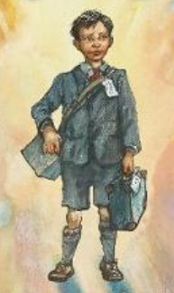
History - World War Two
Let’s start with Leo (our British Evacuee).
What can you remember about Leo’s life before the war? What about during the war?

Slide 24
History - World War Two
Each lesson for the next few days, you will complete a comparison activity.
We have learnt lots about Rose, our German school girl and our English evacuee, Leo.
Today your task is to compare what life was like for children before WW2 in Britain and in Germany.

Slide 25

History - World War Two
Draw a basic head outline - remember this is history not art, don’t worry about making it perfect!
Add the title ‘Children’s lives before WW2’
Label one side ‘Rose’ and the other ‘Leo’. You can add hair if you wish!
On each side, we would like you to make notes about what their life was like before WW2 began.
These can be notes, rather than full sentences.
4. Use the information we learnt in lesson and the internet or books to help. Maybe you have a relative who lived before the war who could tell you first hand what it was like.
5. Use the questions on the next slide to support your research and thinking.

Slide 26
History - World War Two
Questions to think about
Did they attend school? If they did, what type of lessons did they learn?
Who might they have lived with at home?
What did they do in their spare time?
Did we get any specific information about their friends or life from our class research? Add this to your image.
Think about Germany before the War - how did the reparations they had to repay impact their lives?
What might they have used in their homes? Think back to the resources we looked at in the classroom - the toys, iron, radio etc.
Were girls and boys treated differently in those times?
Finish with the question - Which child had the most challenging life pre-WW2?
Write this conclusion at the bottom of the page.

Slide 27

Monday complete!
Well done on a great day!
Enjoy your evening and be ready for more learning tomorrow...

