Slide 1
Good MoRning Year 6!
Happy Tuesday! Keep up the good work!
Please follow the instructions on each page to help you - we look forward to hear about how you have got on!
Mrs Jones and Miss Nolan

Slide 2
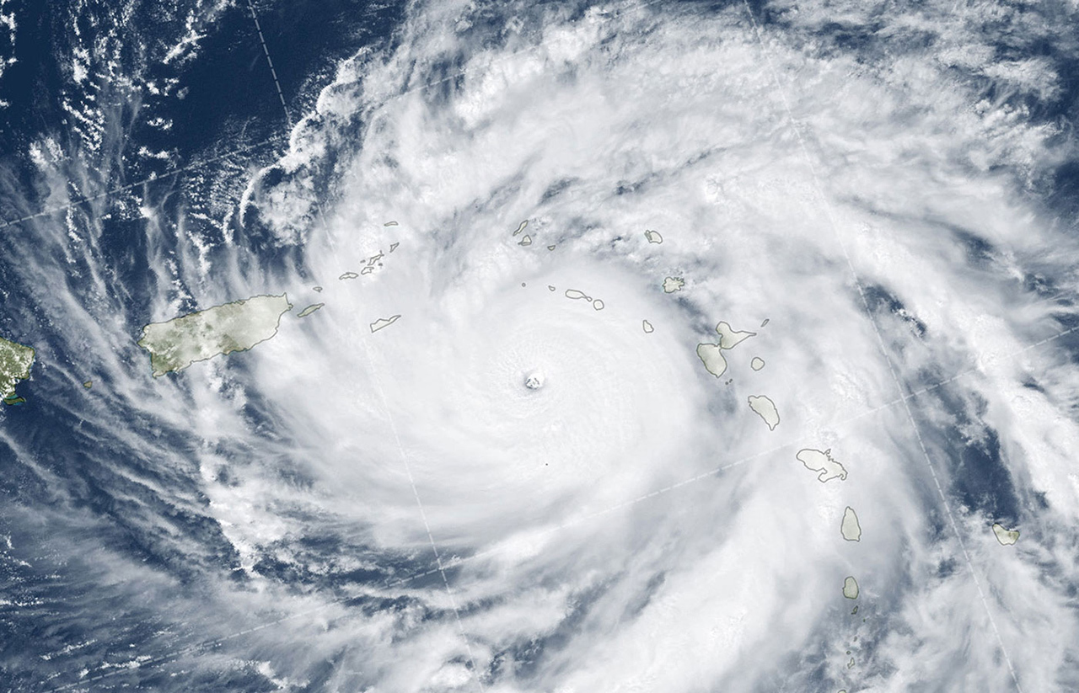
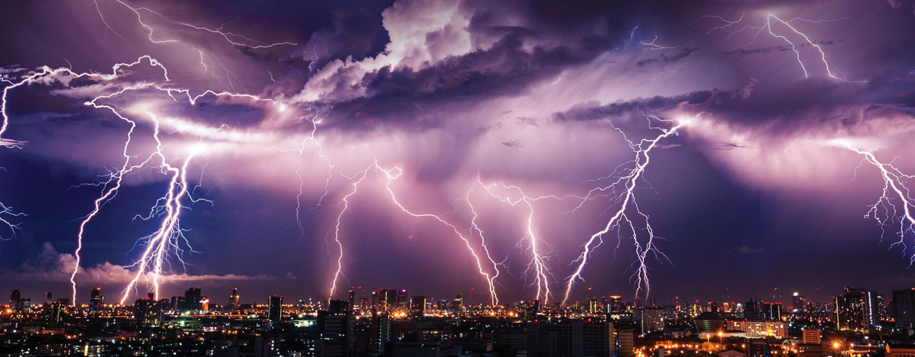
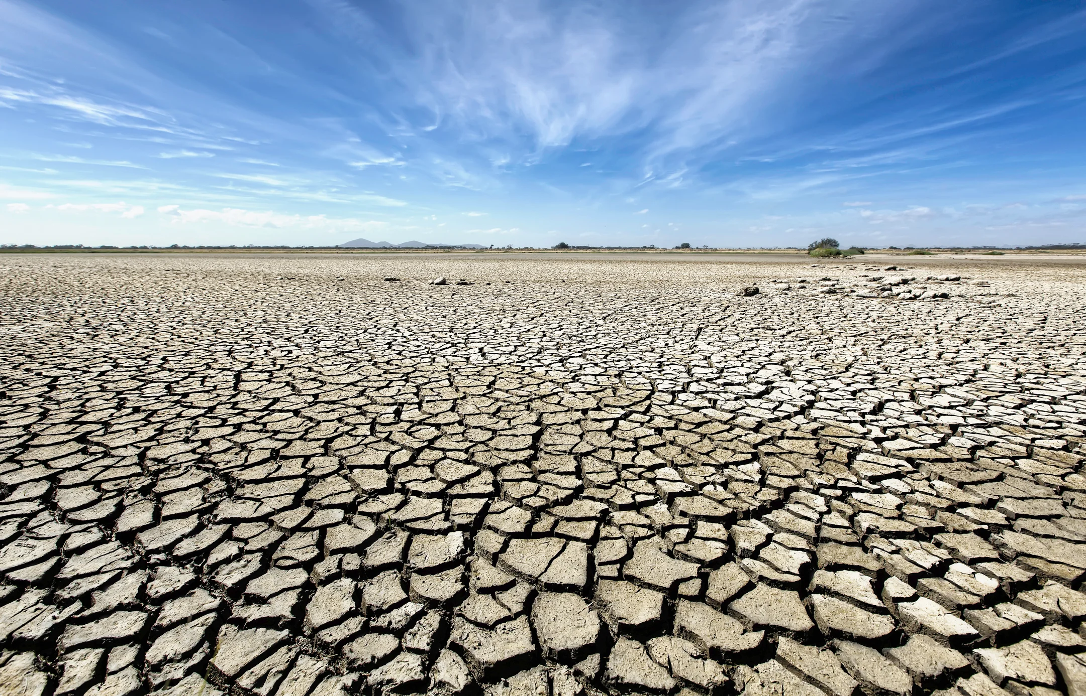
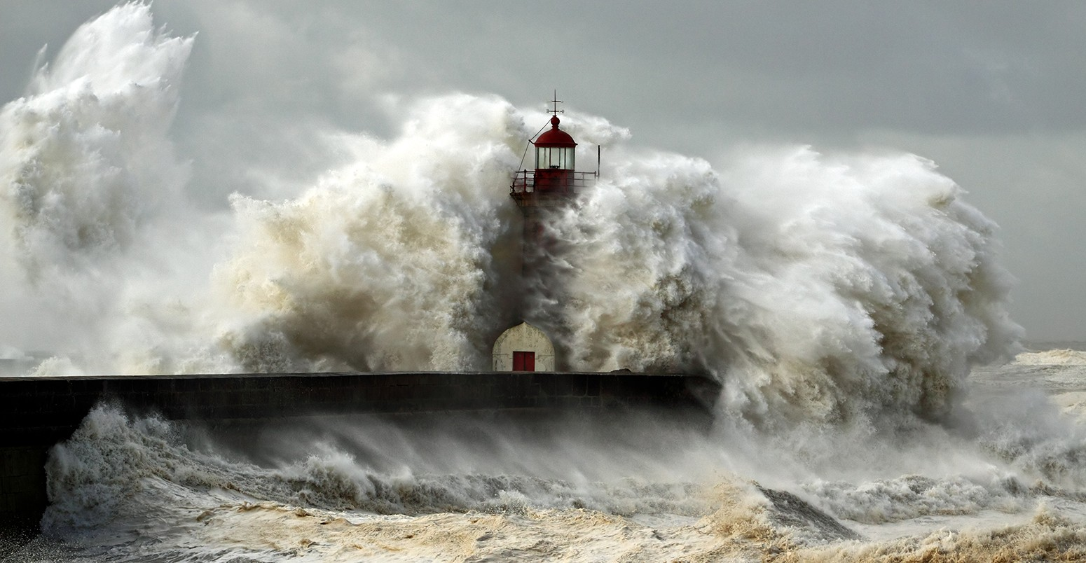
This week’s theme is
Extreme Weather
Day 2 - 9.6.20

Slide 3
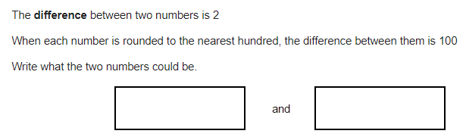

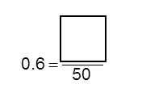

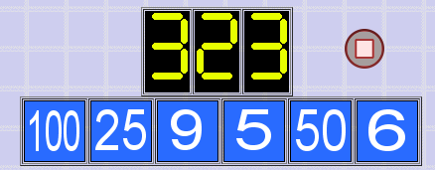
Morning Maths - Give yourself 15 - 20 minutes to complete these questions and then try and tackle today’s countdown.
7.
8.
9.
½ + 1/10 =
98 x 6 =
0.67 x 12 =
⅚ - 2/12 =
686465 - 43522 =
6.
10.

Slide 4
Now mark your work using these answers.
7.
8.
9.
½ + 1/10 = 6/10
98 x 6 = 588
0.67 x 12 = 8.04
⅚ - 2/12 = 8/12
686465 - 43522 = 642,943
6.
49 51
182
30
Countdown Answer
25 x 6 = 150
150 + 9 = 159
100 ÷ 50 = 2
159 x 2 = 318
318 + 5 = 323
18/21
10.

Slide 5
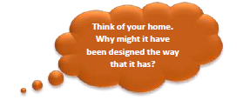
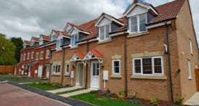
Daily Worship
Think about...

Slide 6
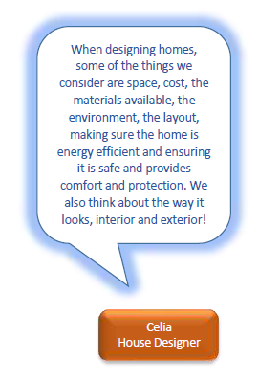
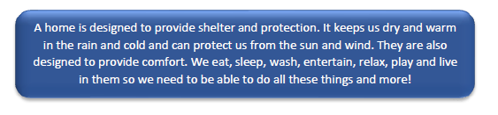
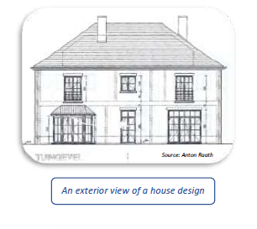
Daily Worship

Slide 7
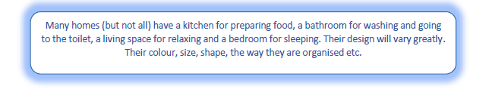
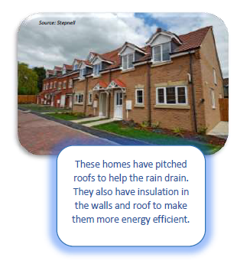
Daily Worship
Can you think of anything else that might be considered? Think of your home. Why might it have been designed the way that it has?
When thinking about the design of a home, which do you think is most important: the way it looks or how functional it is, or do you think they are both important?
Is it possible to alter the design of your home? Think about things such as having a new kitchen designed and fitted, altering outside space, decorating, moving furniture. Has your home ever had its design altered?
Have you ever visited a home that you didn’t like the design of? Or one that you loved so much you wished your home could look more like it?
Notes:
•

Slide 8

Daily Worship
Homes come in many different forms. We are all different so one person’s dream home design may be very different to another. Whatever the design, a home should provide us with shelter and comfort.

Slide 9


We may not be learning together in the classroom, but it is important to still remember our classroom beliefs.
WALT: describe different jobs people do to earn money.
This week we will be looking at money and how banks work.
This will help you gain an understanding of maths in adulthood and the decisions you will have to make.

Slide 10
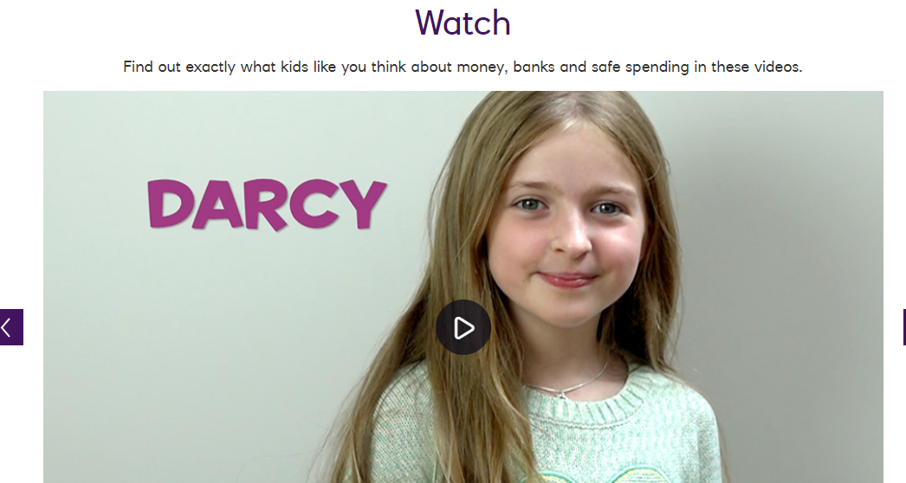
9.6.20
WALT: use bank accounts.
https://natwest.mymoneysense.com/students/students-8-12/
Click the link, scroll down to Watch and then click the second video ‘How can I use a bank account’.
List the services you think banks offer their customers.

Slide 11
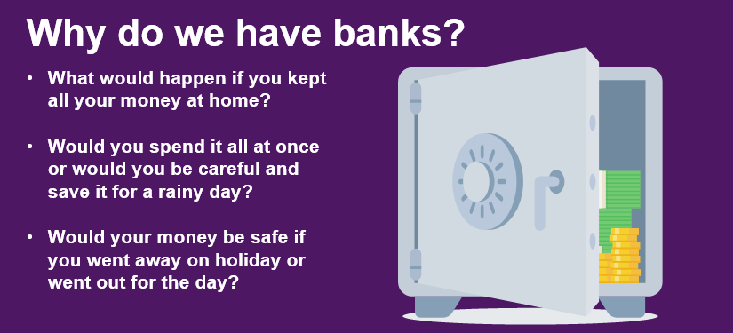
9.6.20
WALT: use bank accounts.

Slide 12
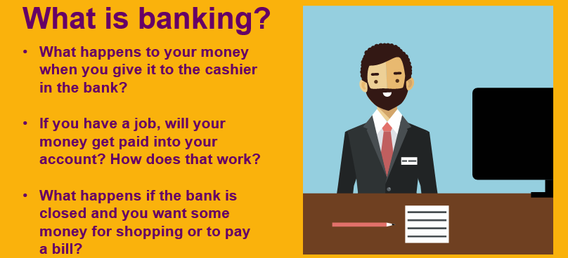
9.6.20
WALT: use bank accounts.

Slide 13
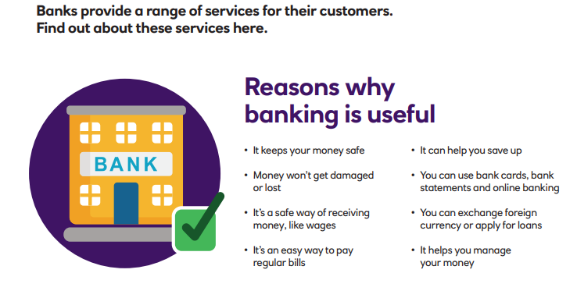
9.6.20
WALT: use bank accounts.
What do banks do?

Slide 14
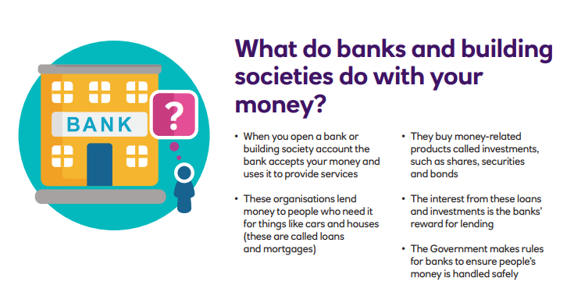
9.6.20
WALT: use bank accounts.

Slide 15
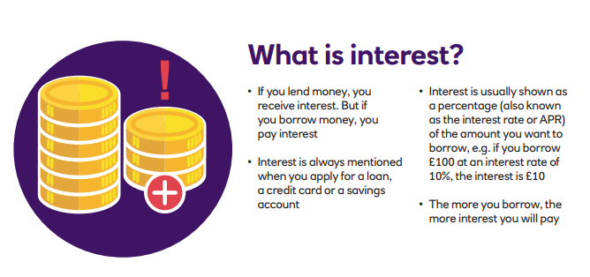
9.6.20
WALT: use bank accounts.

Slide 16
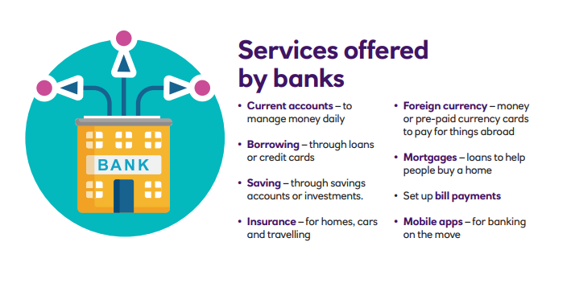
9.6.20
WALT: use bank accounts.
Did you list all of the services earlier? Which ones did you miss?

Slide 17
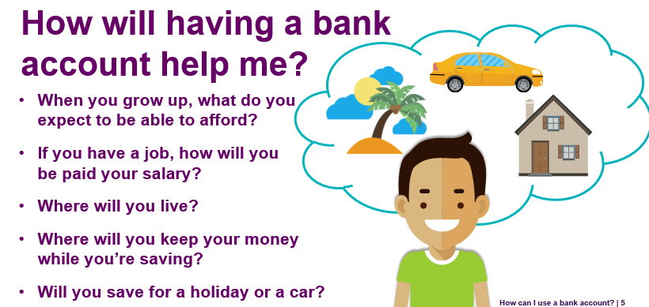
9.6.20
WALT: use bank accounts.
Do you have a bank account?
What do you use it for?
Banks offer lots of different types of account and you need to choose what is right for you and what you want to do with the money. There are lots of different accounts for different things with different banks

Slide 18
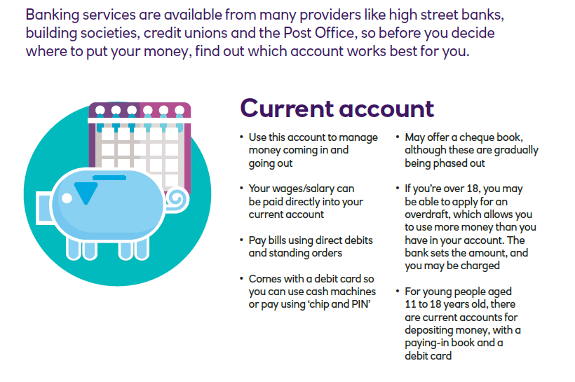
9.6.20
WALT: use bank accounts.

Slide 19
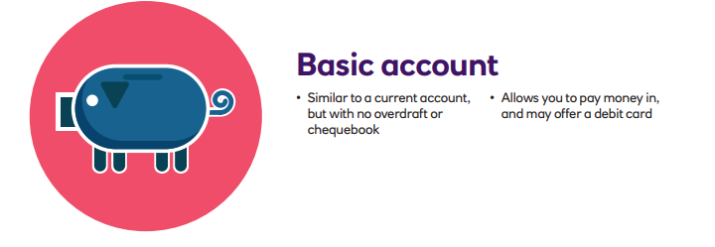
9.6.20
WALT: use bank accounts.

Slide 20
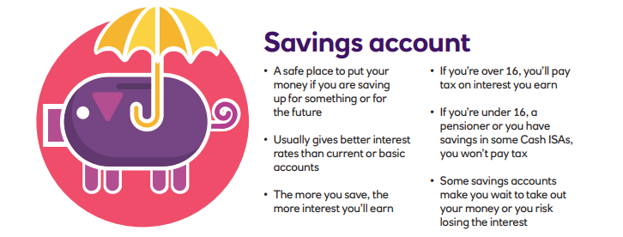
9.6.20
WALT: use bank accounts.

Slide 21
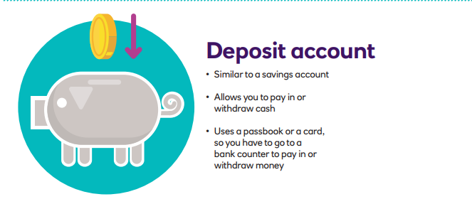
9.6.20
WALT: use bank accounts.

Slide 22
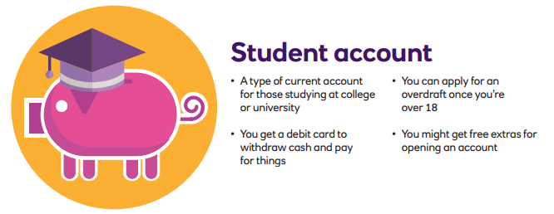
9.6.20
WALT: use bank accounts.

Slide 23
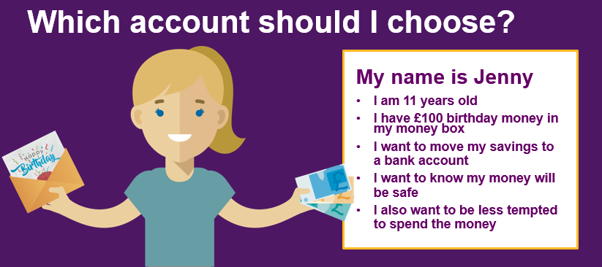
9.6.20
WALT: use bank accounts.
What account should Jenny chose and why?

Slide 24
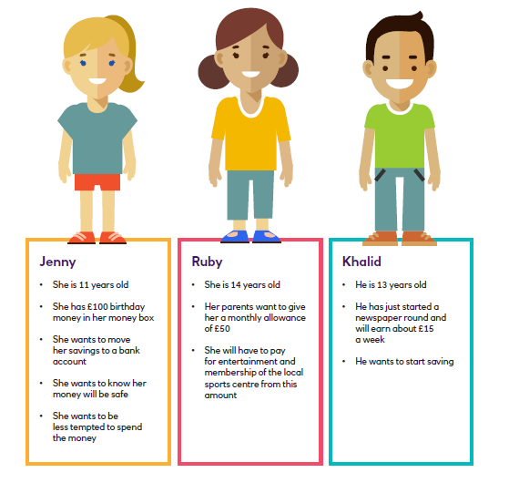
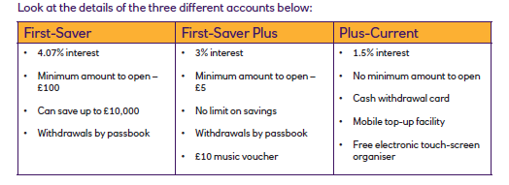



9.6.20
WALT: use bank accounts.

Slide 25
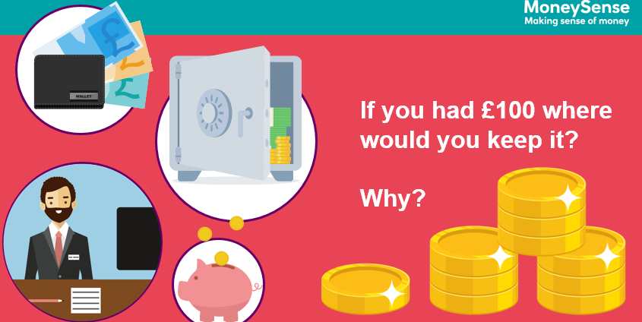
9.6.20
WALT: use bank accounts.
Design a poster promoting a new bank account to be featured in the new money magazine. Your poster should explain the benefits of having a bank account and include a list of services offered by the bank.

