Slide 1

Spellings
Reading = Earthquakes
Writing = Volcano Disaster Story Build up

Slide 2
Tuesday - Spelling and handwriting practice.
cemetery
existence
conscience
preference
transference
A beautiful smile without any reason is the smile of existence!
Copy out these words out twice in your best joined handwriting.

Slide 3
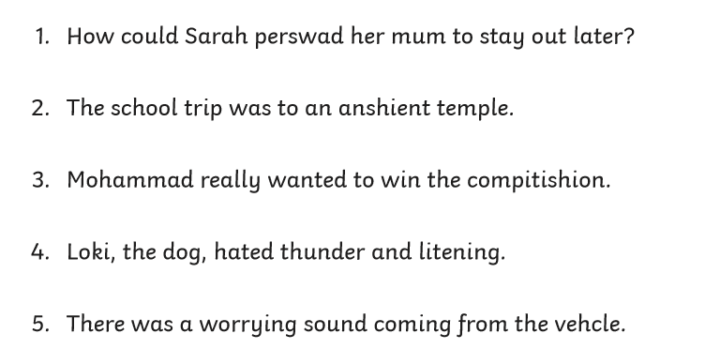
Tuesday - Spelling
Correct the spelling mistake. Can you find the incorrect spelling and rewrite it correctly?

Slide 4
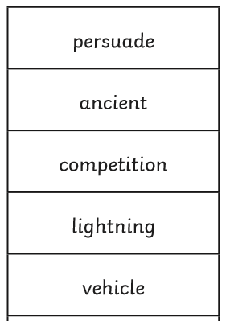
Tuesday - Spelling Answers
Correct the spelling mistake. Can you find the incorrect spelling and rewrite it correctly?

Slide 5
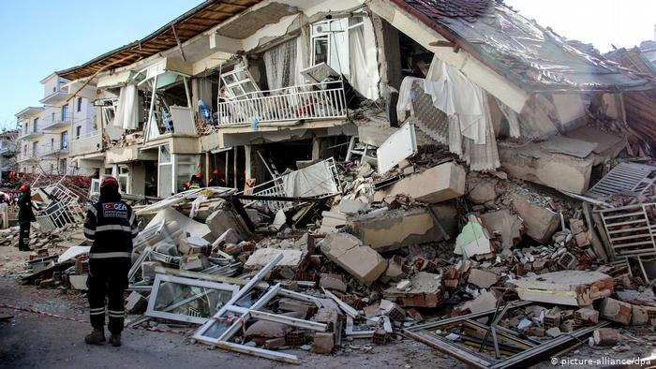
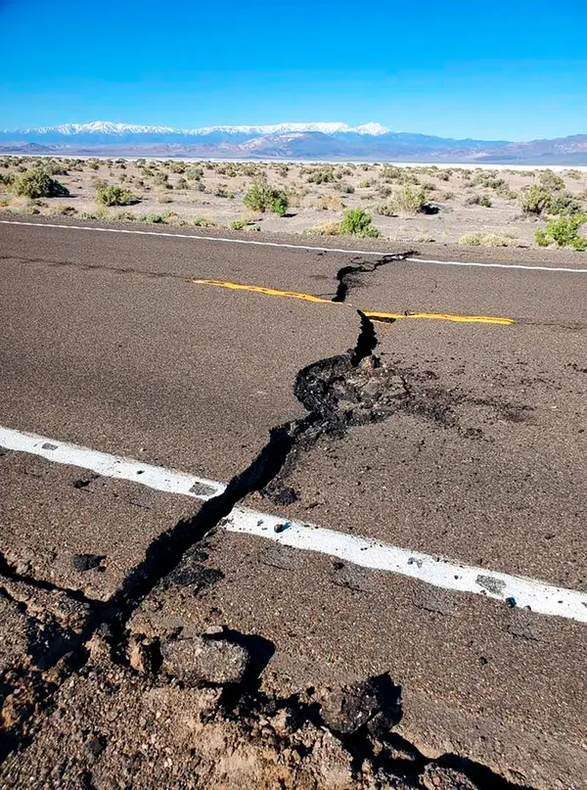
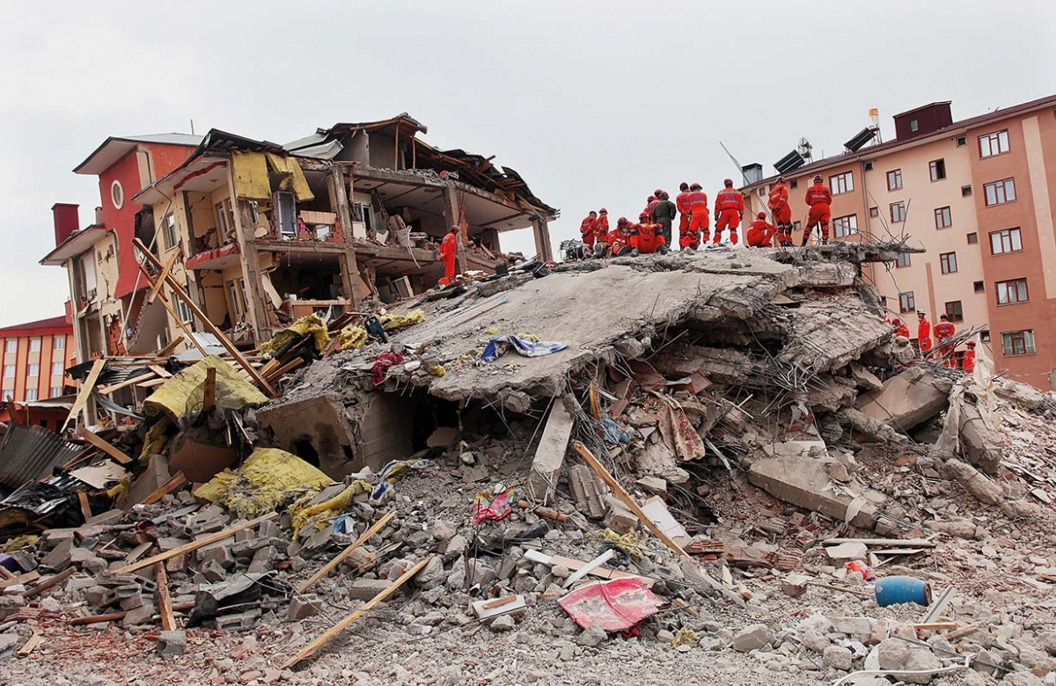
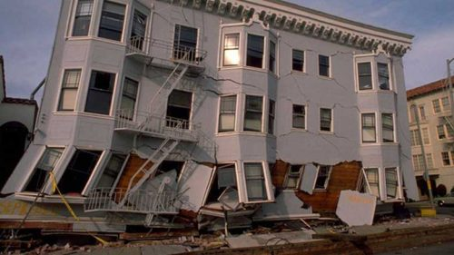
READING - Earthquakes
WALT: Make inferences using evidence from the text.
Take a look at the images on the next few slides. Discuss what you think has happened? Where do you think it is?

Slide 6
Reading Activity
Teacher Notes
The purpose of a close read activity is to gain an understanding of the text by reading it multiple times.
Close Read Instructions:
Look at the vocabulary. Do you know what the words mean? If you are unsure, note down the words and use a dictionary (this could be online) to find out their meaning.
Read the text to yourself and ask yourself the following questions:
What did I just read? What did it say? You can make notes or annotate the text.
Now read the text again (you could do this wit an adult) - this will help you gain a better understanding.
Read the questions and now reread the text again to find evidence that will support your answers.
Answer the questions in writing.
All close read texts are age appropriate.

Slide 7
READING - Earthquake
WALT: Make inferences using evidence from the text.
The Earth’s Crust
The Earth’s crust and the top of the mantle have about twenty tectonic plates, which are like jigsaw pieces covering the Earth. These plates are always moving and bumping into each other. The edges of the plates are called ‘plate boundaries’, which are made up of faults. These faults are where most of the world’s earthquakes occur. As the plates move, the edges get stuck because they are not smooth, but the rest of the plate keeps moving. When the force is too much, it slips and bumps and that causes an earthquake. A bit like when you pull something which gets caught, you pull it some more until it comes free with a big force.

Slide 8
READING - Earthquake
WALT: Make inferences using evidence from the text.
The Earth’s Crust
The Earth’s crust and the top of the mantle have about twenty tectonic plates, which are like jigsaw pieces covering the Earth. These plates are always moving and bumping into each other. The edges of the plates are called ‘plate boundaries’, which are made up of faults. These faults are where most of the world’s earthquakes occur. As the plates move, the edges get stuck because they are not smooth, but the rest of the plate keeps moving. When the force is too much, it slips and bumps and that causes an earthquake. A bit like when you pull something which gets caught, you pull it some more until it comes free with a big force.
Questions
What do the tectonic plates float on and how many tectonic plates are there?
What can plate boundaries do when they are near each other?
What is a ‘fault’?

Slide 9
READING - Earthquake Answers
WALT: Make inferences using evidence from the text.
The Earth’s Crust
The Earth’s crust and the top of the mantle have about twenty tectonic plates, which are like jigsaw pieces covering the Earth. These plates are always moving and bumping into each other. The edges of the plates are called ‘plate boundaries’, which are made up of faults. These faults are where most of the world’s earthquakes occur. As the plates move, the edges get stuck because they are not smooth, but the rest of the plate keeps moving. When the force is too much, it slips and bumps and that causes an earthquake. A bit like when you pull something which gets caught, you pull it some more until it comes free with a big force.
Questions
What do the tectonic plates float on and how many tectonic plates are there?
The Mantle and there are about twenty.
What can plate boundaries do when they are near each other?
Any answer from: • Crash into each other • Rub against each other • Move further apart • Get caught and stuck • One moves under the other
What is a ‘fault’?
Any answer that suggests: The line/crack/gap between plates.

Slide 10
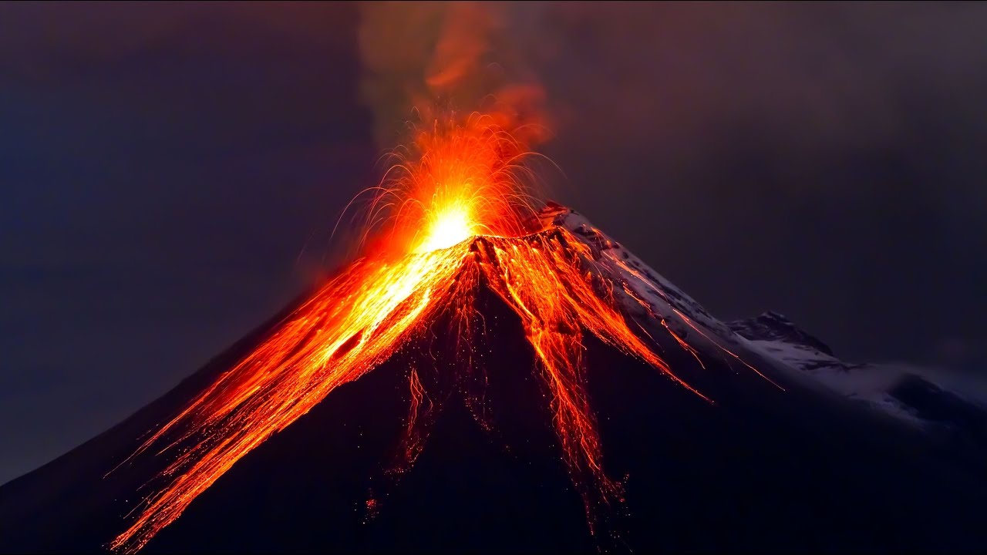
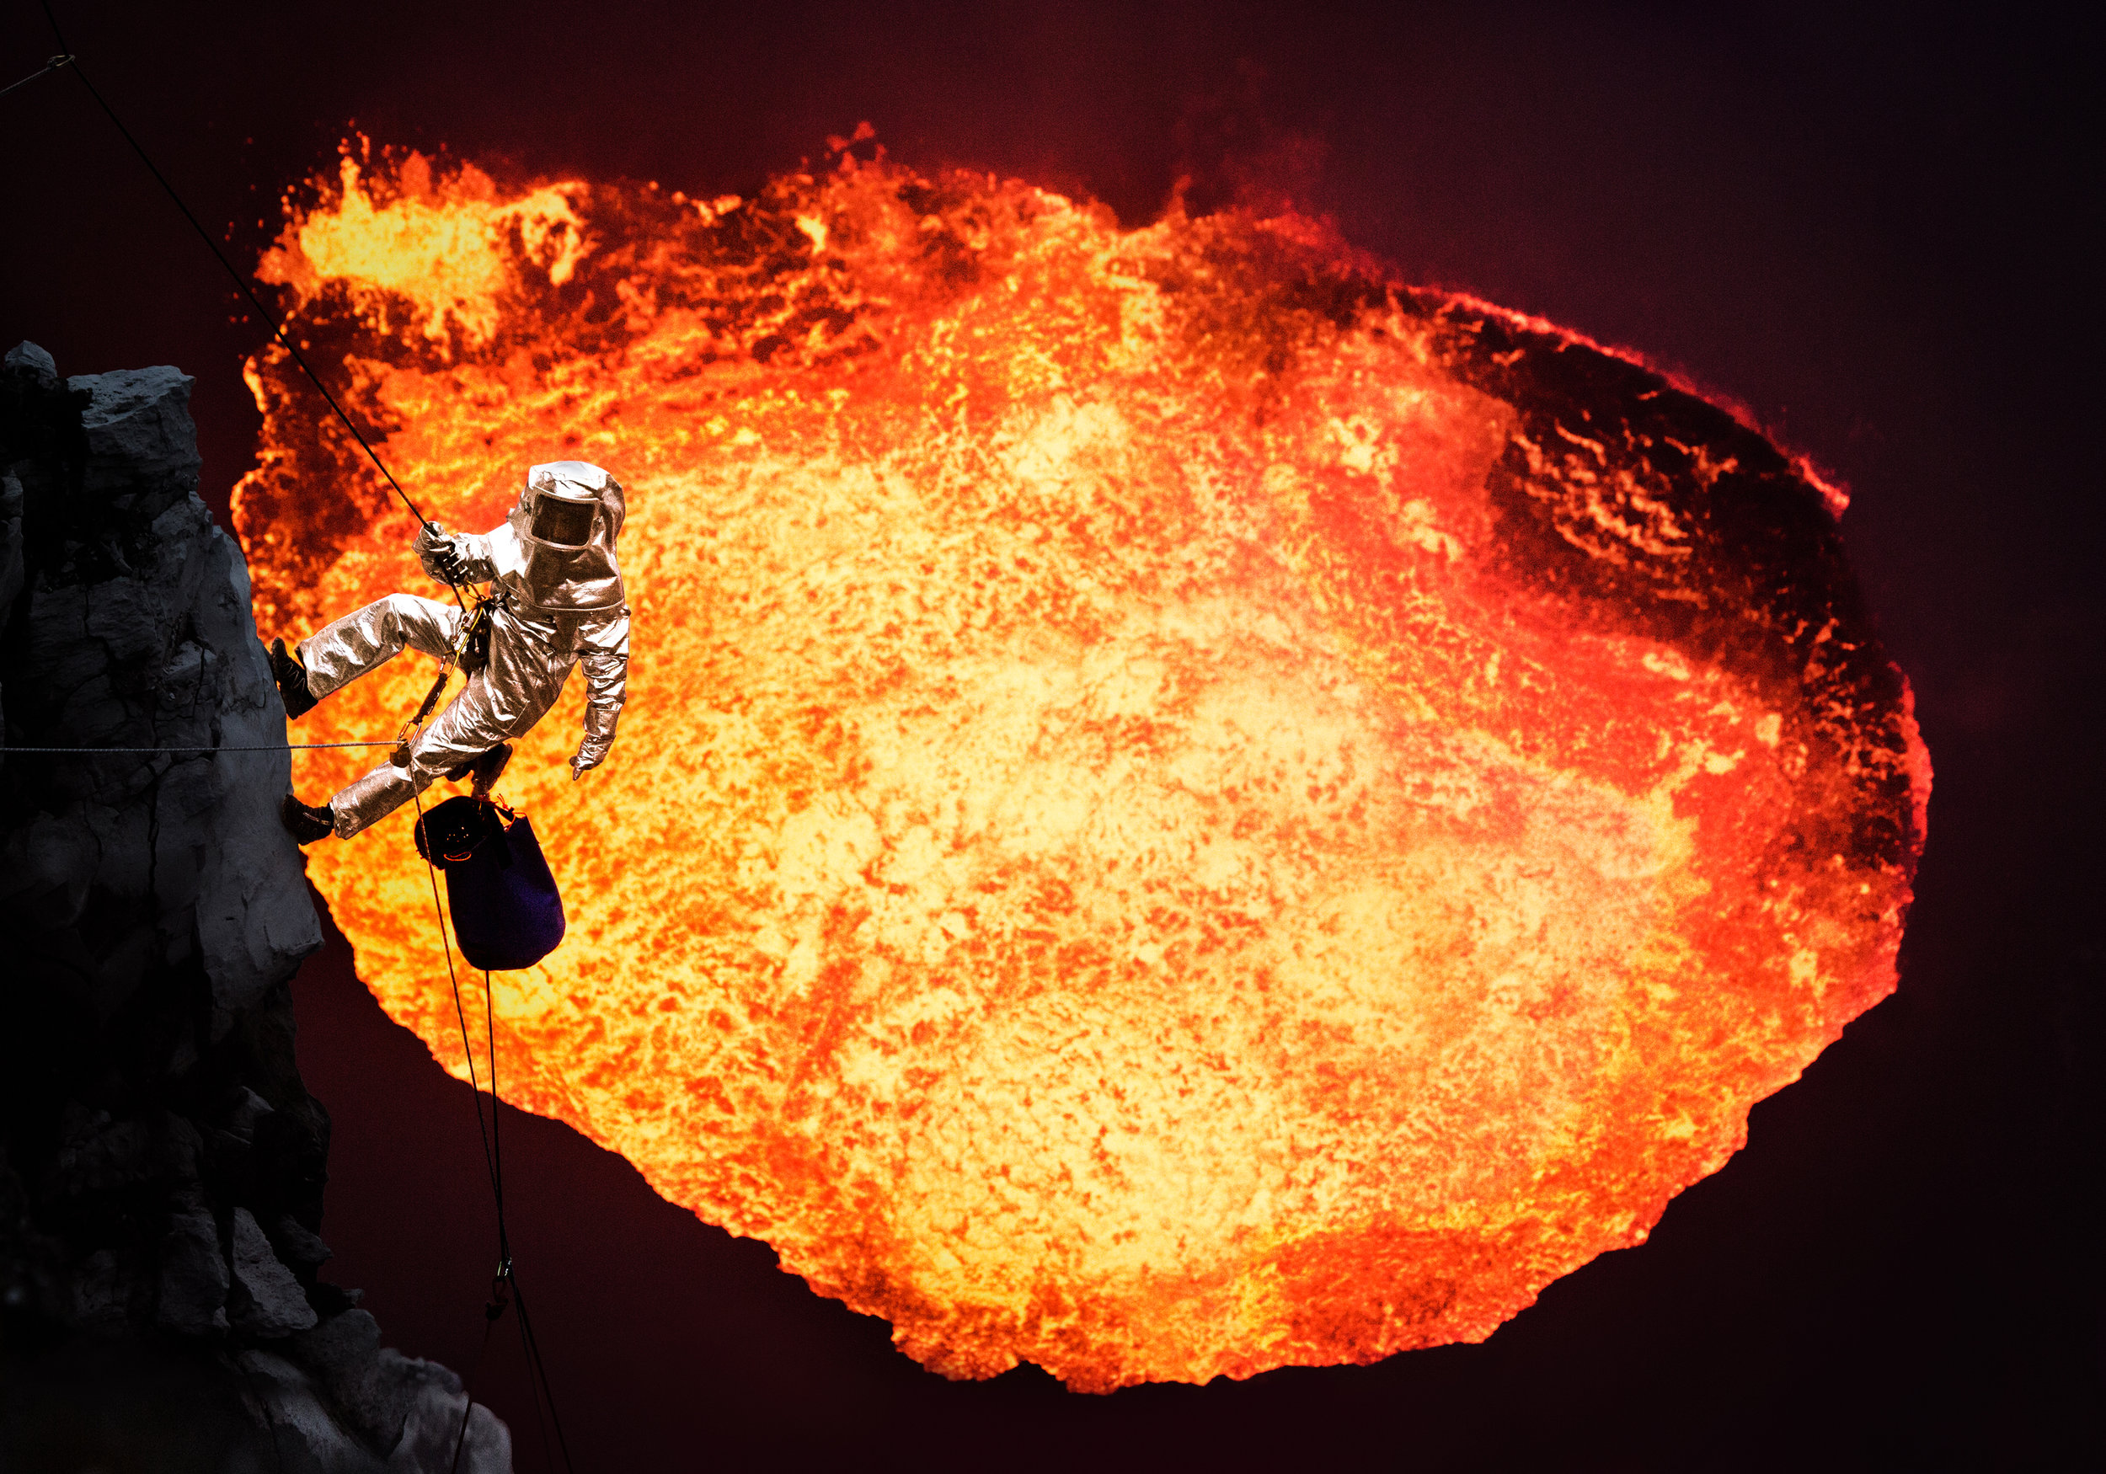
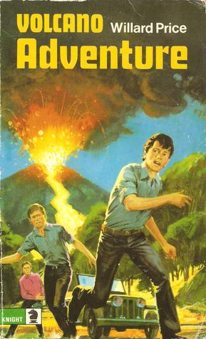
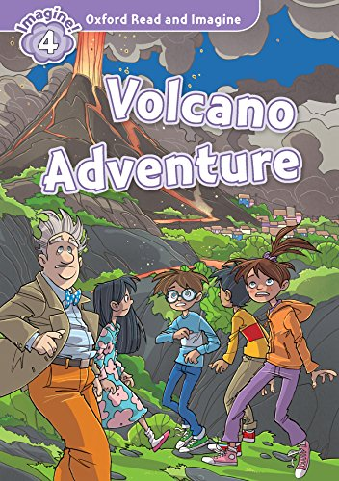
Writing - Volcano Disaster Story Build Up
Think back to yesterday’s story opener. You started with a sensory description and some of you may have started to introduce characters. Today we are going to introduce some characters and the build-up to our story.

Slide 11
Writing - Volcano Disaster Story Build Up
What Makes a Good Build-Up?
So far, we have written the opener to our disaster stories. In our opener, we introduced a setting and some of us also may have introduced characters. The next part of a story is the build-up. What is a build-up?

Slide 12
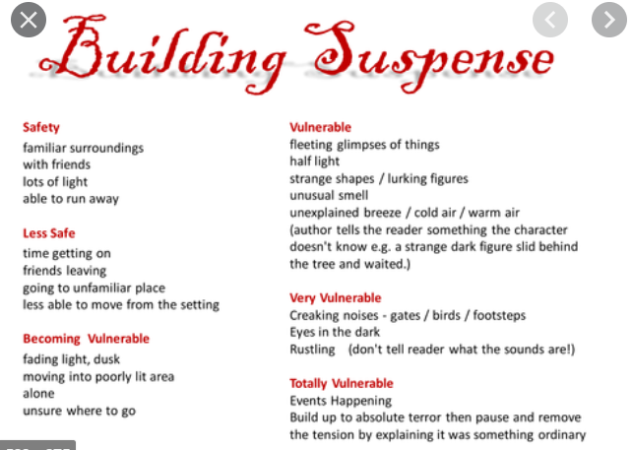
Writing - Volcano Disaster Story Build Up
What Makes a Good Build-Up?
In a build-up, we start to build tension by hinting at the complication that will come later in the story. We also develop our characters so that the reader can get to know them more

Slide 13
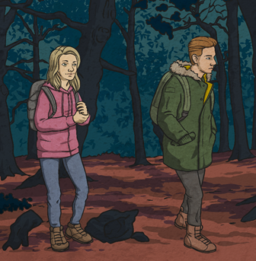
Writing - Volcano Disaster Story Build Up
How might this look in your disaster story?
Characters and settings are developed with more detail.
Clues hint at the complication to come.

Slide 14
Writing - Volcano Disaster Story Build Up
What Makes a Good Build-Up?
Feeling tired and hungry, Jade stopped and reached into her backpack. She rummaged around for a while before her hand removed a small, glistening parcel accusingly. Jade glanced angrily at her brother and hissed, “Why did you make jam sandwiches? You know I only eat cheese!” She stomped off into the forest.
Birds rustled in the trees. Ben froze in disbelief. This day was getting worse and worse. Jade’s mood had taken a turn for the worse. “How am I supposed to remember everything?” called Ben hurriedly as he chased after his frightened, angry sister.
The mist was descending quickly now and the temperature was falling rapidly. Jade halted. Silently, Ben watched for his sister’s reaction.

Slide 15
Writing - Volcano Disaster Story Build Up
What Makes a Good Build-Up?
“Let’s just camp here, Ben…this isn’t fun anymore. I don’t even care about the sandwich. I’m tired and we’ve gone too far already,” she complained bitterly thrusting her hand onto her hip.
“Jade, this ground is too cluttered.
I’m still looking for a clearing to pitch our tent on. It shouldn’t be much longer now. Trust me,” he asked kindly while he gently touched his tired sister on
the arm.
Reluctantly, Jade continued on as the night time mist descended eerily onto the woodland like a blanket.

Slide 16
Writing - Volcano Disaster Story Build Up
Let’s Get Writing!
Today, you are going to write a build-up for your disaster story.
Your build-up should include descriptive dialogue that helps the reader get to know the characters more. Remember to hint at the
complication that will come later in the story.

