Slide 1
Good MoRning Year 6!
Happy fake Friday! Due to the bank holiday tomorrow, today is our last day of home learning this week. Well done on working so hard! Enjoy the long weekend staying safe with your family.
Mrs Jones, Miss Nolan and Mrs Crane

Slide 2
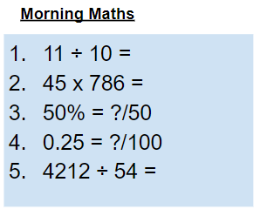
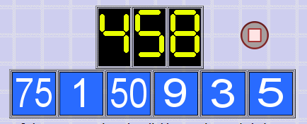
As always, our day will start with Morning Maths.
Give yourself 10 minutes to complete these questions and then try and tackle today’s countdown. If you finish within 10 minutes, check your work and see how many ways you can find to solve the countdown.
After 10 minutes, check your answers using the next slide and the countdown solver (linked below) to see how to solve today’s problem.
Click the link below and type in the numbers and target to see how the countdown could be solved!
http://www.maths-resources.com/countdown/

Slide 3
Answers
1.1
35,370
25/50
25/100
78

Slide 4

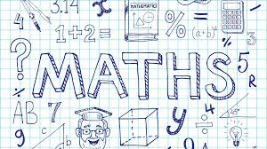
Maths today will be calculating angles in a triangle.
We may not be learning together in the classroom, but it is important to still remember our classroom beliefs.
WALT: calculate interior angles of a triangle.
Today we will not be using My Maths, but instead some White Rose videos and questions to help us to learn and then to test our understanding.

Slide 5
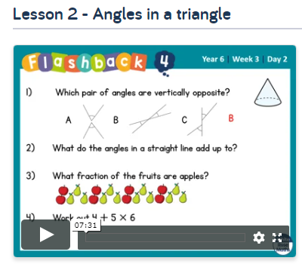
WALT: calculate interior angles of a triangle.
To start the lesson, click on the image to the left of the screen. This will take you to the White Rose home learning website.
Click on:
Then scroll down to Lesson 2 - angles in a triangle and click play on the video. This will be a short video lesson.
Watch the video, pausing where necessary to have a go at the mini quizzes throughout.

Slide 6
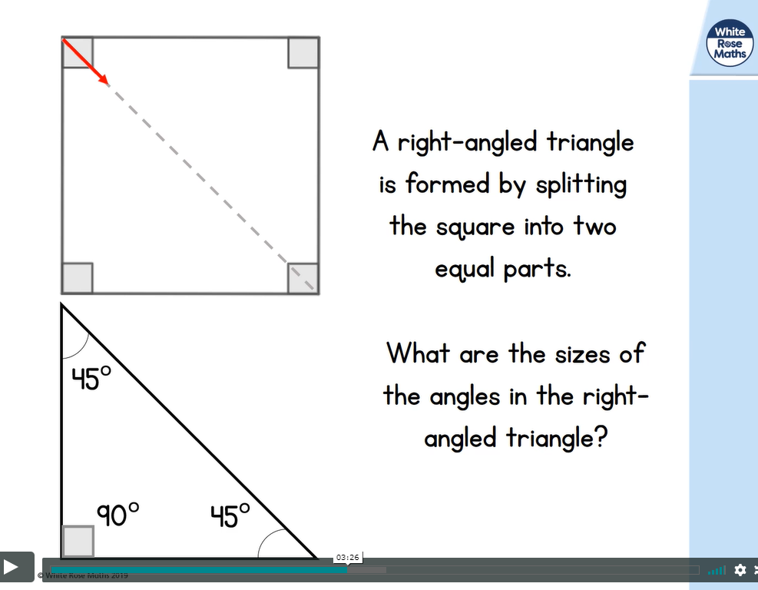
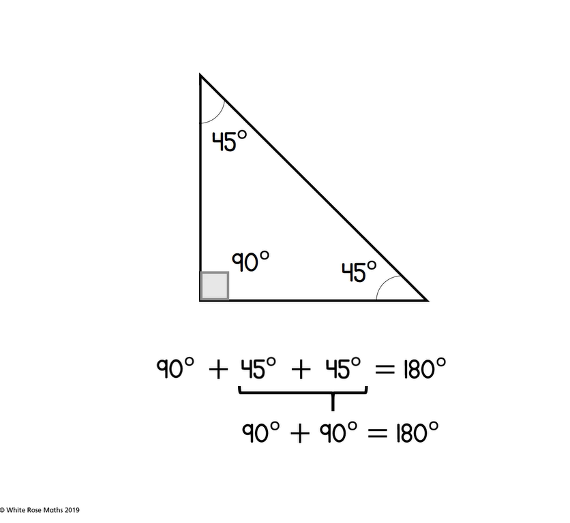
WALT: calculate interior angles of a triangle.
A quick recap...

Slide 7
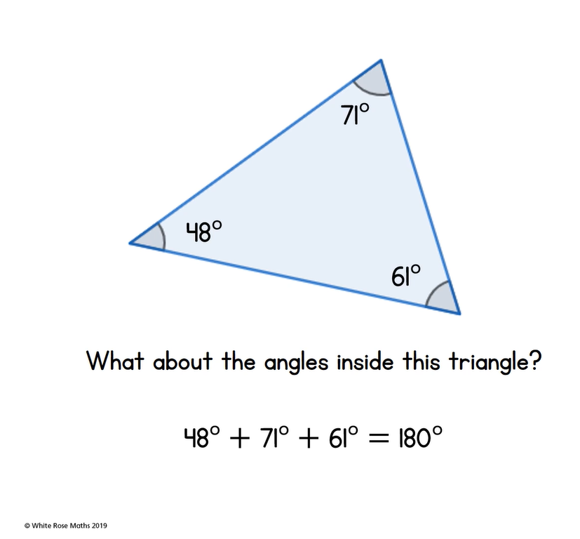
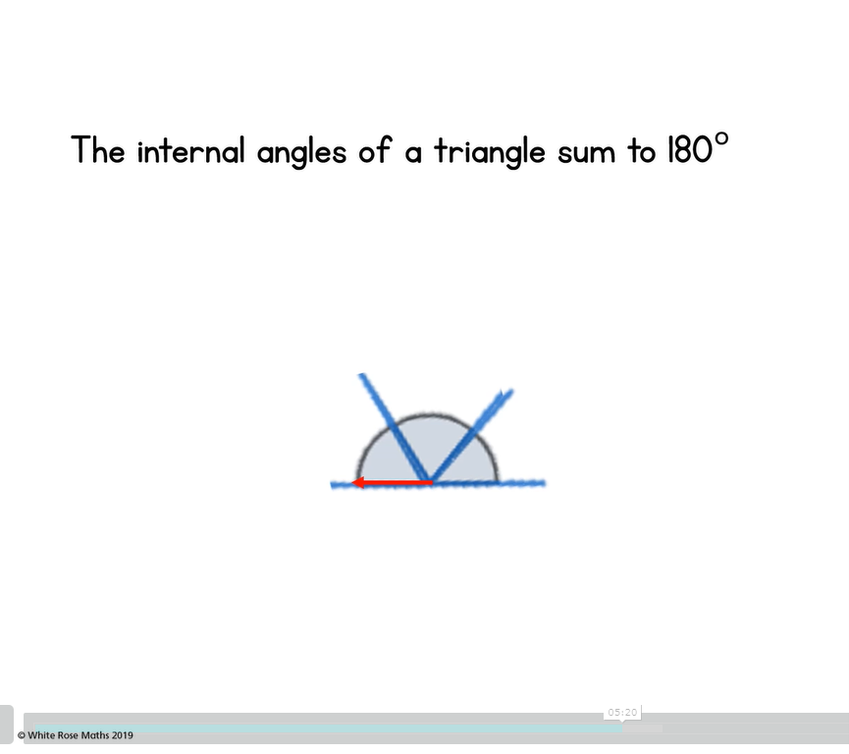
WALT: calculate interior angles of a triangle.
A quick recap...

Slide 8
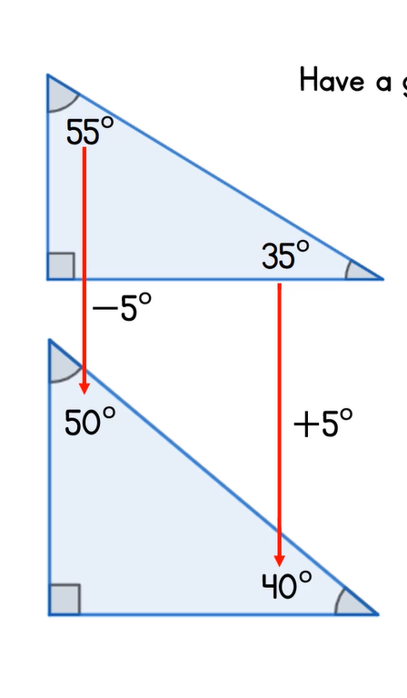
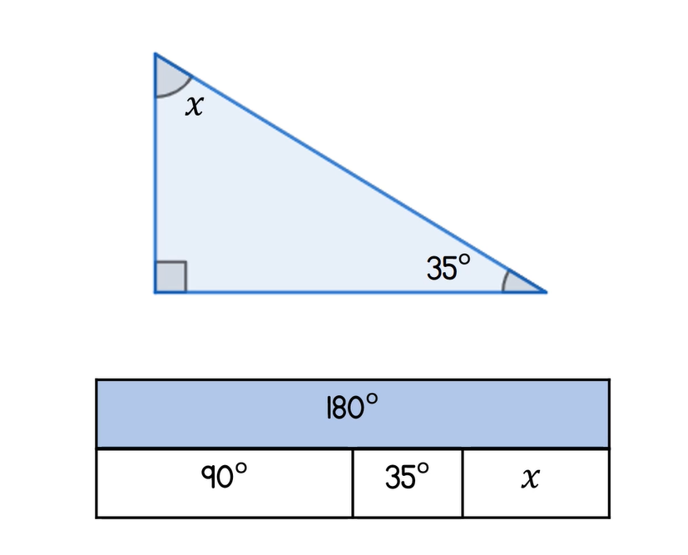
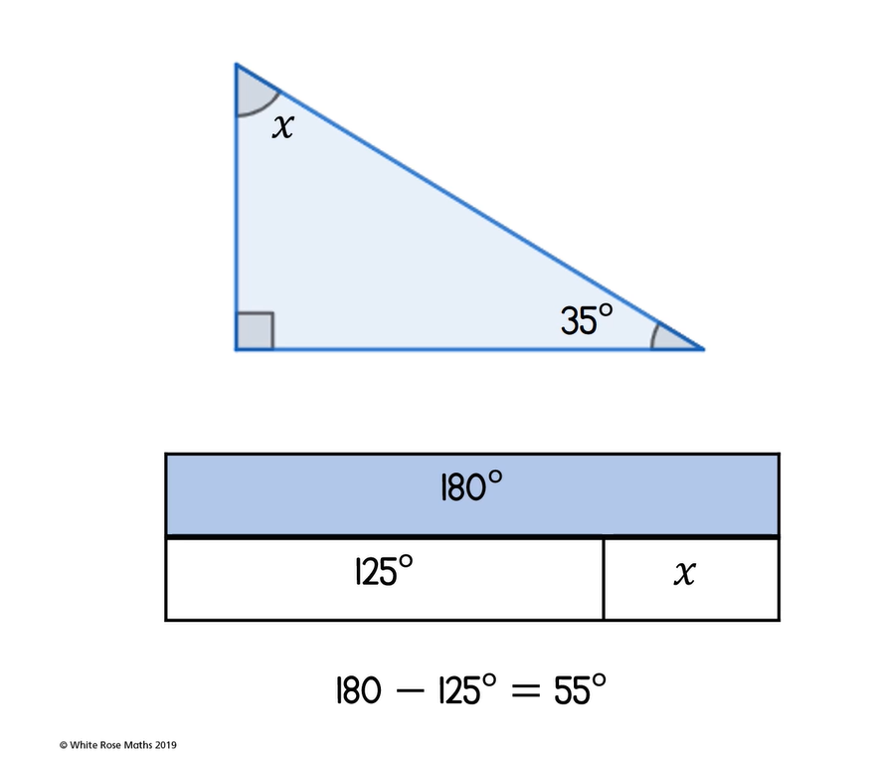
WALT: calculate interior angles of a triangle.
A quick recap...

Slide 9
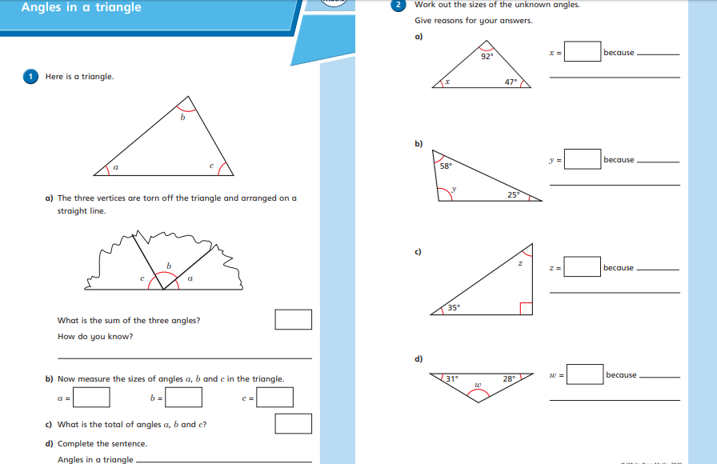
WALT: calculate interior angles of a triangle.
Now click the image on the left of the screen, this will take you to a short test where you can test your understanding.
Have a go at the questions, writing down your answers on some paper. If you have a paper pack, the questions are on the next few slides.
Once you have completed, click the link below to mark your work against the answers.

Slide 10
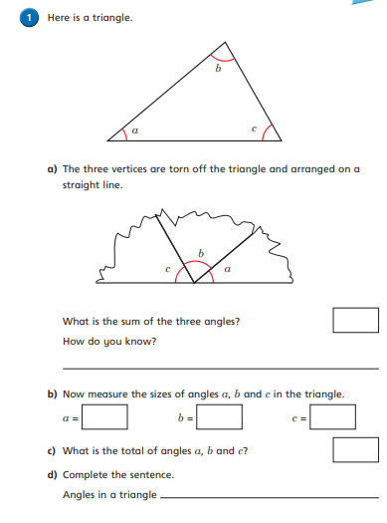
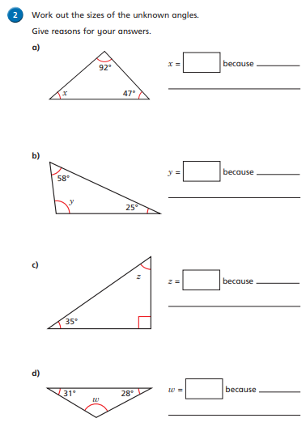
WALT: calculate interior angles of a triangle.

Slide 11
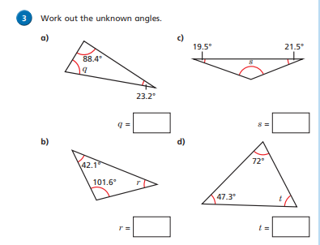
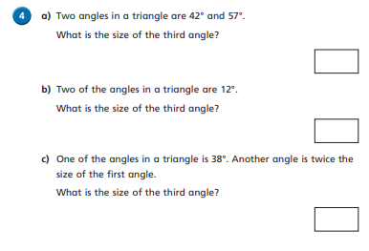
WALT: calculate interior angles of a triangle.

Slide 12
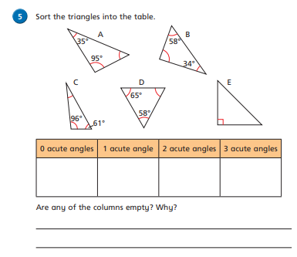
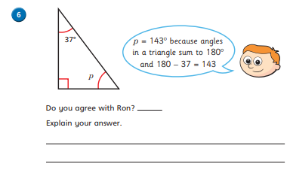
WALT: calculate interior angles of a triangle.

Slide 13
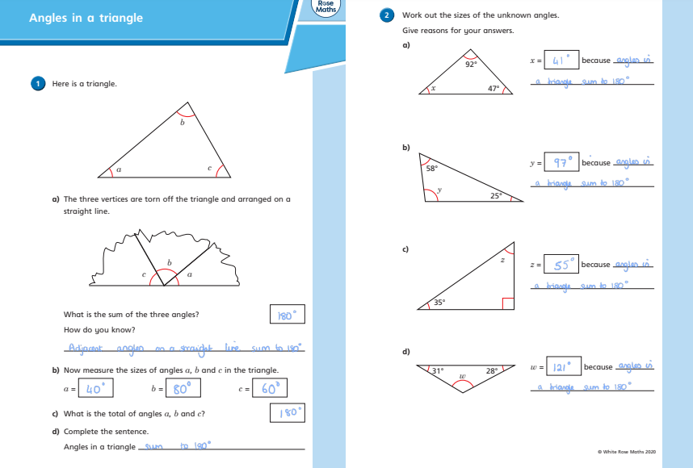
WALT: calculate interior angles of a triangle.
Answers

Slide 14
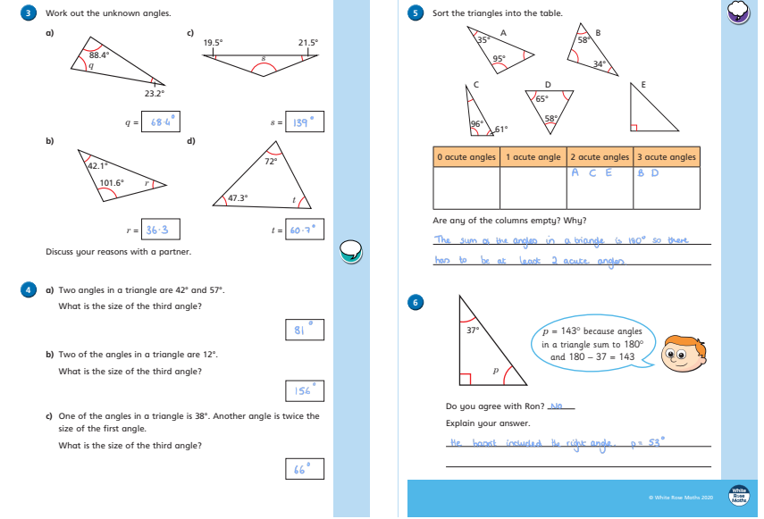
WALT: calculate interior angles of a triangle.
Answers

Slide 15
Grammar
Modal Verbs
Today we will be learning about modal verbs and reminding ourselves of what they are.
Please read through the next 4 slides and then try the challenges.

Slide 16
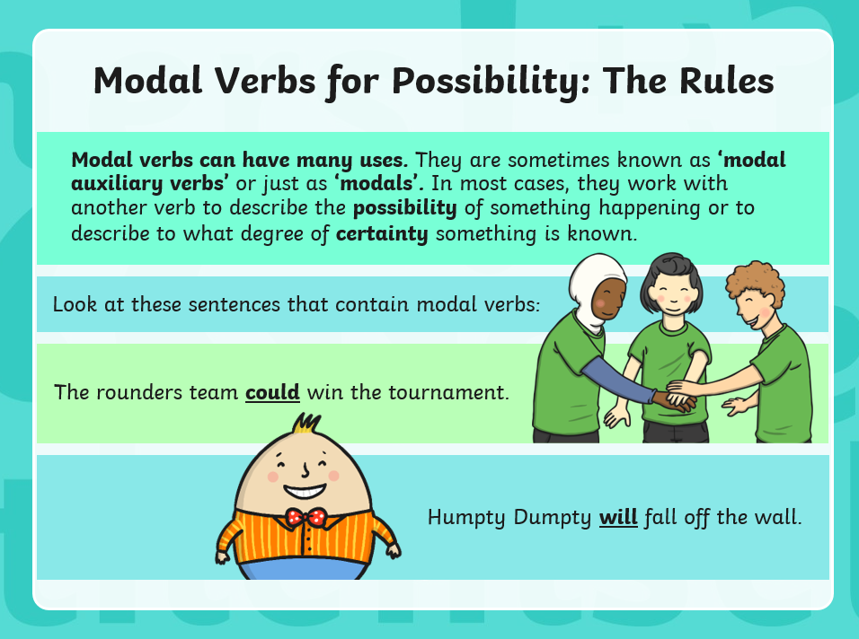
Twinkl

Slide 17
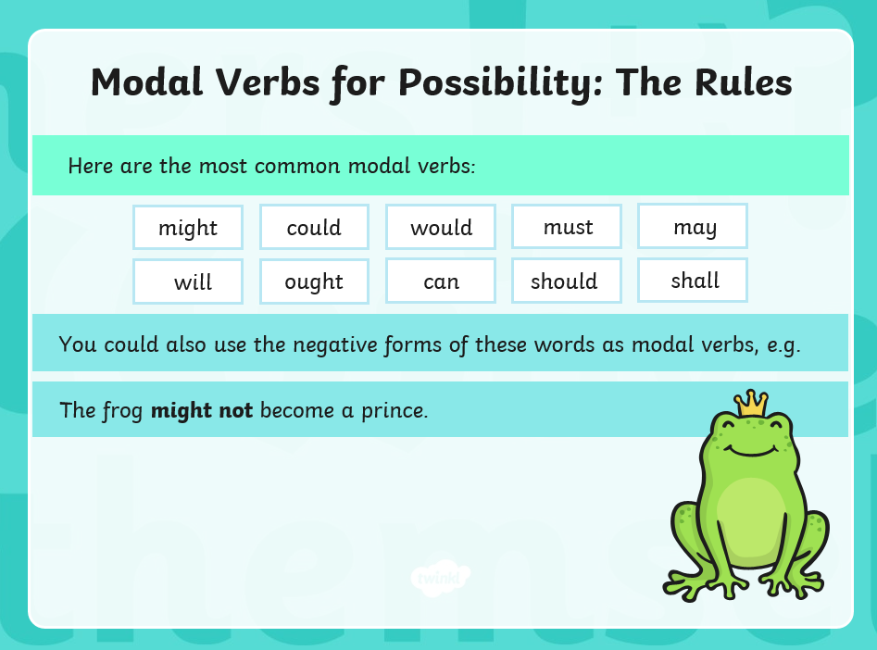

Slide 18
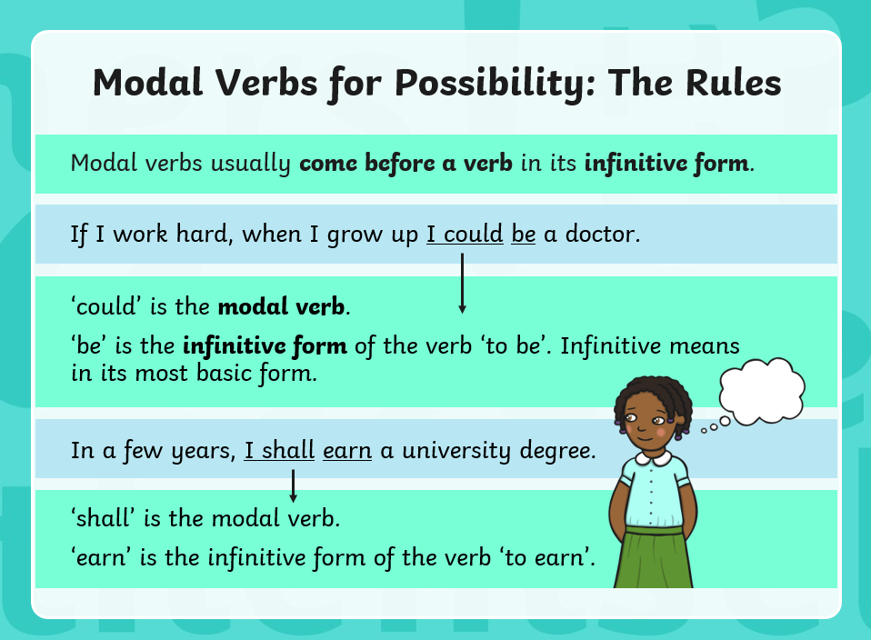

Slide 19
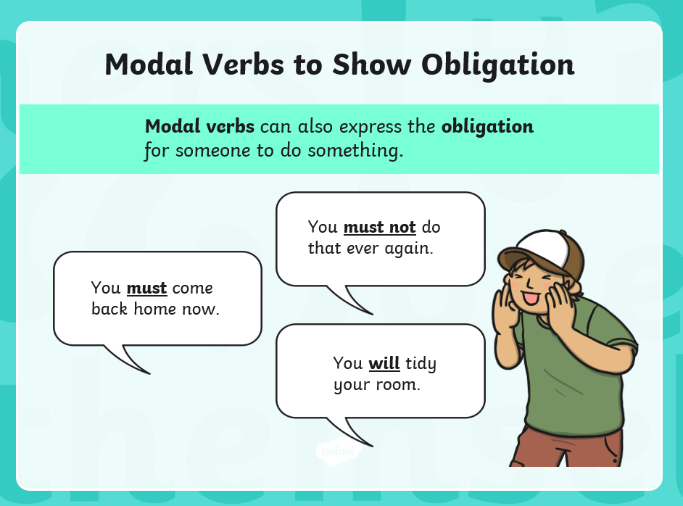

Slide 20
Modal Verbs
Activity One:
Identify the modal verb in each sentence below.
1) Steve could get some chicken.
2) Aaron ought to go home.
3) Barry won’t be having chips tonight.
4) Harry may go to the cinema later.
Activity Two:
Rewrite each sentence, changing the modal verb so that the possibility/ probability in the sentence is different.
1) Steve could get some chicken.
2) Aaron ought to go home.
3) Barry won’t be having chips tonight.
4) Harry may go to the cinema later.

Slide 21
Modal Verbs - Answers
Activity One:
Identify the modal verb in each sentence below.
1) Steve could get some chicken.
2) Aaron ought to go home.
3) Barry won’t be having chips tonight.
4) Harry may go to the cinema later.
Activity Two:
Rewrite each sentence, changing the modal verb so that the possibility/ probability in the sentence is different. There are many options - these answers are just examples.
1) Steve will get some chicken.
2) Aaron must go home.
3) Barry will be having chips tonight.
4) Harry can go to the cinema later.

Slide 22
Close Read
Today’s English Lesson will be a close read activity based on The Tailor of Gloucester by Beatrix Potter
Teacher Notes
The purpose of a close read activity is to gain an understanding of the text by reading it multiple times.
Close Read Instructions:
Read the blurb about the text to gain an idea of the context. Share your thoughts with an adult or sibling.
Look at the vocabulary highlighted. Do you know what the words mean? If you are unsure, read the vocabulary slide to gain a better understanding.
Read the text to yourself and ask yourself the following questions:
What did I just read? What did it say? You can make notes or annotate the text.
Now read the text again with an adult - this will help you gain a better understanding.
Read the questions and now reread the text again to find evidence that will support your answers.
Answer the questions in writing.
All close read texts are age appropriate.

Slide 23

Close read - The Tailor of Gloucester by Beatrix Potter
WALT: make inferences and deductions using evidence from the text.
Blurb
Beatrix Potter loved the countryside and she spent much of her otherwise conventional Victorian childhood drawing and studying animals. Her passion for the natural world lay behind the creation of her famous series of little books. A particular source of inspiration was the English Lake District where she lived for the last thirty years of her life as a farmer and land conservationist, working with the National Trust.
She described The Tailor of Gloucester as her own favourite among her books. It was based on the true story of a tailor who left the unsewn pieces of a coat in his shop and found that the garment had been mysteriously finished for him in the night. It turned out that the real tailor's assistants were his apprentices, but in Beatrix Potter's version of the story the secret helpers are skilful little brown mice.

Slide 24
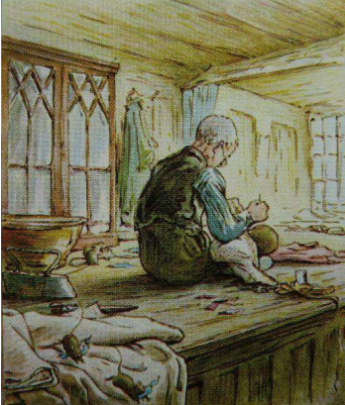
Close read - The Tailor of Gloucester Text
WALT: make inferences and deductions using evidence from the text.
‘In the time of swords and periwigs and full-skirted coats with flowered lappets – when gentlemen wore ruffles, and gold-laced waistcoats of paduasoy [luxurious strong corded silk] and taffeta – there lived a tailor in Gloucester.
He sat in the window of a little shop in Westgate Street, cross legged on a table, from morning till dark. All day long while the light lasted he sewed and snippeted, piecing out his satin and pompadour, and lustring; stuffs had strange names, and were very expensive in the days of the Tailor of Gloucester.
But although he sewed fine silk for his neighbours, he himself was very, very poor –
a little old man in spectacles, with a pinched face, old crooked fingers, and a suit of
thread-bare clothes. He cut his coats without waste, according to his embroidered
cloth; they were very small ends and snippets that lay about upon the table –
“Too narrow breadths for nought – except waistcoats for mice,” said the tailor.
One bitter cold day near Christmas-time the tailor began to make a coat – a coat of cherry-coloured corded silk embroidered with pansies and roses, and a cream coloured satin waistcoat – trimmed with gauze and green worsted chenille – for the Mayor of Gloucester.

Slide 25
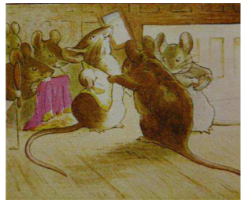
Close read - The Tailor of Gloucester Text
WALT: make inferences and deductions using evidence from the text.
The tailor worked and worked, and he talked to himself. He measured the silk, and
turned it into shape with his shears; the table was all littered with cherry-coloured
snippets. “No breadth at all, and cut on the cross; it is no breadth at all; tippets for
mice and ribbons for mobs! for mice!” said the Tailor of Gloucester.
When the snow-flakes came down against the small leaded window-panes and shut
out the light, the tailor had done his day’s work; all the silk and satin lay cut out upon
the table. There were twelve pieces for the coat and four pieces for the waistcoat; and there were pocket flaps and cuffs, and buttons all in order. For the lining of the coat there was a fine yellow taffeta; and for the button-holes of the waistcoat, there was cherry-coloured twist. And everything was ready to sew together in the morning, all measured and sufficient – except that there was wanting just one single skein of cherry-coloured twisted silk.
The tailor came out of his shop at dark, for he did not sleep there at nights; he fastened the window and locked the door, and took away the key. No one lived there at night but little brown mice, and they run in and out without any keys!’

Slide 26
Close read - The Tailor of Gloucester - Vocabulary
WALT: make inferences and deductions using evidence from the text.
Meaning of words:
ruffles - ornament with or gather into a frill.
luxurious - extremely comfortable or elegant, especially when involving great expense.
Snippeted cut a small piece or a brief extract.
embroidered - decorated with patterns sewn on with thread.
Shears - a cutting instrument in which two blades move past each other, like scissors but typically larger.
Sufficient - enough; adequate.

Slide 27
Close read - The Tailor of Gloucester Questions
WALT: make inferences and deductions using evidence from the text.
1. In which position did the tailor sit to do his work?
2. What do you think Beatrix Potter meant when she used the word ‘snippeted’?
3. How did the Tailor of Gloucester’s attire differ from those of his neighbours?
4. “Too narrow breadths for nought – except waistcoats for mice.” What do you think this means?
5. Why do you think the tailor cut out fabric for his coats without waste?
Use a dictionary to help find the meanings of the following words as used in the passage:
periwig
lappet
threadbare
chenille

Slide 28
Close read - The Tailor of Gloucester Answers
WALT: make inferences and deductions using evidence from the text.
1. In which position did the tailor sit to do his work?
The tailor sat cross legged on his table to do his work.
2. What do you think Beatrix Potter meant when she used the word ‘snippeted’?
An answer that suggests Beatrix Potter was describing the tailor cutting out pieces of cloth.
3. How did the Tailor of Gloucester’s attire differ from those of his neighbours?
The tailor’s attire was that of thread-bare clothes whereas his neighbours wore fine silks.
4. “Too narrow breadths for nought – except waistcoats for mice.” What do you think this means?
An answer to suggest that it means the tiny offcuts are too small for him to use.
5. Why do you think the tailor cut out fabric for his coats without waste?
An answer that suggests the tailor cut out fabric for his coats without waste so that he could make as many coats as possible out of the fabric to save him money.
Use a dictionary to help find the meanings of the
following words as used in the passage:
periwig
lappet
threadbare
chenille
periwig: a wig
lappet: a decorative flap, fold or overhanging part of a garment
threadbare: material or clothes which have become worn out and are frayed and thin with age.
chenille: a thick, soft material. Chenille is French for caterpillar and the fabric is supposed to look like caterpillars

Slide 29

Good Afternoon Year 6!
Let’s start our afternoon with a quick burst of energy!
Get your PE kit at the ready because at the start of each afternoon session we will be joining Joe Wicks for our daily workout.
Do as much as you can and over the week you should find you are getting fitter and finding it easier.
Let’s go!
Click the youtube link below and select today’s date from the videos listed.
https://www.youtube.com/channel/UCAxW1XT0iEJo0TYlRfn6rYQ

Slide 30
Design and Technology
Cooking
Aims of the week for DT:
To understand that fruit and vegetables are seasonal
To apply our knowledge of healthy eating
To design, prepare and evaluate a healthy meal

Slide 31
Design and Technology
Activity
Use your meal planner to create a recipe
Choose from the following options:
With the permission and help of an adult, use your recipe to create your meal
Use your recipe to create a labelled picture or collage of your meal

Slide 32

Recipe
What I will make
Use paper to create a recipe for your chosen seasonal, balanced meal.
Feel free to illustrate your recipe. Ideas for how you could present your recipe are on the following slide.
Why I have chosen this meal
Ingredients
Equipment
Instructions

Slide 33
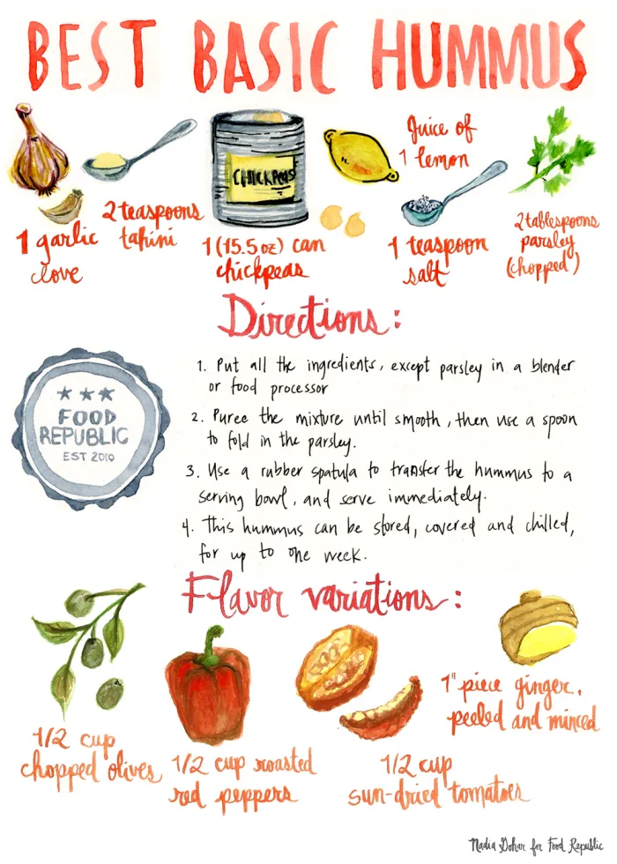
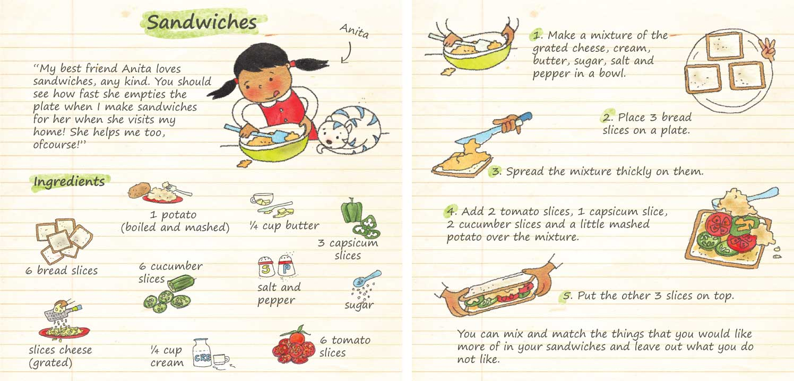

Slide 34
Evaluation
Skills I used:
Write an evaluation using the following subheadings.
What went well:
What I would do differently next time:
What I learnt:

Slide 35

Well done on another great week!
Enjoy your long weekend with your family and stay safe!

