Slide 1
Good MoRning Year 6!
We hope you have had a lovely weekend with your families and are keeping safe!
Please follow the instructions on each page to help you - we look forward to hear about how you have got on!
Mrs Jones and Miss Nolan

Slide 2
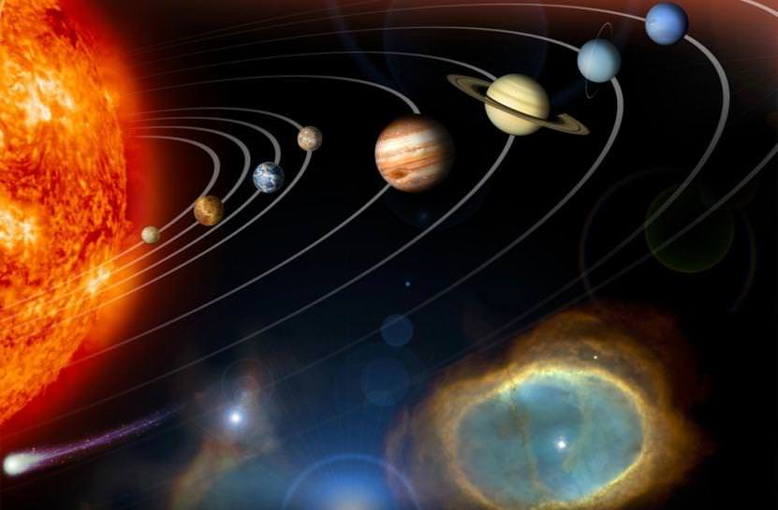
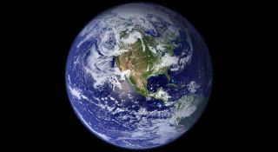
This week’s theme is
Space
Day 1 - 29.6.20

Slide 3
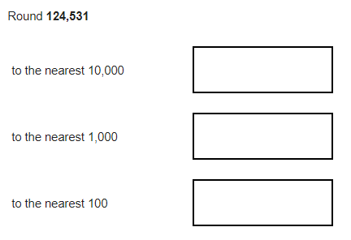
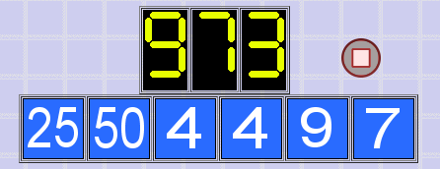
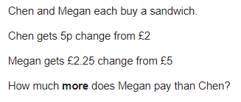
Morning Maths
8.
9. 8x + 5 = 2x + 29
10.
67 x 12
0.8 x 32
⅖ x 75
12.5% x 80
789 ÷ 9
6. 67457 + 748858 =
7.
Notes:
Children complete in maths book.
They have 15 minutes to complete independently.
Spend 10 minutes at the end of the session going through the answers and the children self mark.

Slide 4
ANSWERS
8.
9. 8x + 5 = 2x + 29
8x = 2x + 29 - 5
8x = 2x - 24
8x - 2x = 24
6x = 24
X = 24 ÷ 6
X = 4
10.
67 x 12 = 804
0.8 x 32 = 25.6
⅖ x 75 = 30
12.5% x 80 = 10
789 ÷ 9 = 87.66
6. 67457 + 748858 = 816,315
7.
C = £1.95 M = £2.75 80p
120,000
125,000
124,500
9 - 4 = 5
5 x 4 = 20
20 + 7 = 27
50 x 20 = 1000
1000 - 27 = 973

Slide 5
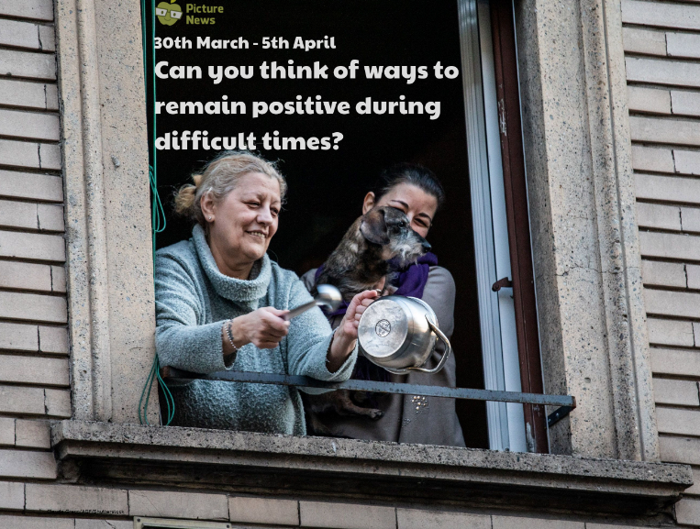
Class Based Worship

Slide 6
Class Based Worship
Many countries across the world have been asked or have chosen to remain at home during the COVID-19 outbreak. Thousands of Italians, in several cities, clapped from their windows and balconies as healthcare workers went to work, raising spirits with a flashmob, during the lockdown period (where most people remain at home). Families and neighbours also sang and crashed pots and pans together for the performers in cities across the country.
Can you think of ways to remain positive during difficult times?

Slide 7
Class Based Worship
Does anyone know where it’s taking place?
It’s in Italy. People there have been remaining at home to help prevent the spread of coronavirus. Healthcare workers raised spirits by performing a flashmob on their way to work whilst people clapped, crashed pots and pans together and sang from their balconies.
Watch this week’s useful video (www.bbc.co.uk/newsround/51904789) and talk about the actions of the people in Italy. How do you think them all coming together in this way will have improved their situation?

Slide 8
Class Based Worship
Can you think of any times when the actions of others have made you feel positive or cheered you up? Talk about how even very small things can make us feel better. Talk about the things that make us happy. These could be things like, watching our favourite TV show, spending time with our pets.
Can you think of ways you can help bring joy to others? E.g. writing letters to elderly relatives, placing rainbows in windows.

Slide 9

Class Based Worship
Reflection
Sometimes, things will happen that affect us that we have no control over. It is important to focus on the positives and help to support each other as much as we can.

Slide 10

St Catherine’s Classroom Beliefs
Mistakes are valuable.
Everyone can learn maths to the highest level.
Questions are really important.
Depth is more important than speed.
Maths is about making connections.

Slide 11
29.6.20
WALT: read and interpret line graphs.
Success Criteria:
Data
X and y axis
Line graphs
Interpret
Notes:
Notes:

Slide 12
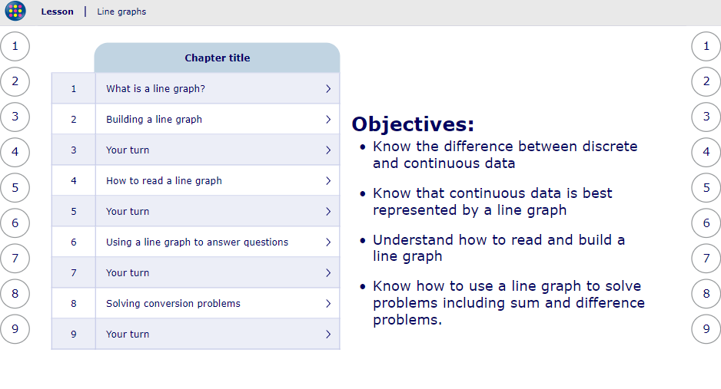
29.6.20
WALT: read and interpret line graphs.
https://app.mymaths.co.uk/6007-lesson/line-graphs
Click on the image to take you to the lesson on Line graphs.
Go through this together as a class.
Notes:
Notes:

Slide 13
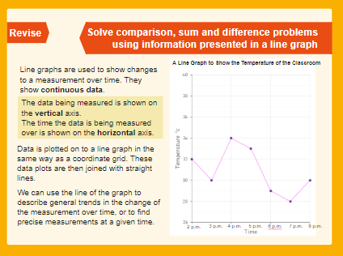
29.6.20
WALT: read and interpret line graphs.
Let’s recap...
Notes:
Notes:

Slide 14
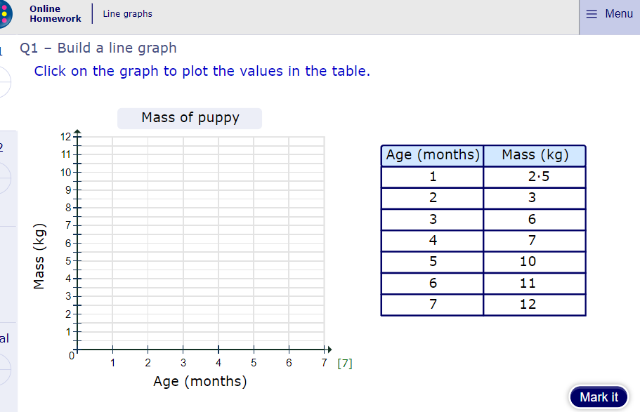
29.6.20
WALT: read and interpret line graphs.
Test your understanding!
Now click the image to have a go at the online homework and see how you get on.
Notes:
Notes: https://app.mymaths.co.uk/6007-homework/line-graphs
You may choose to do this as a class or not to take part in this activity as this is predominately for the home learning.

Slide 15
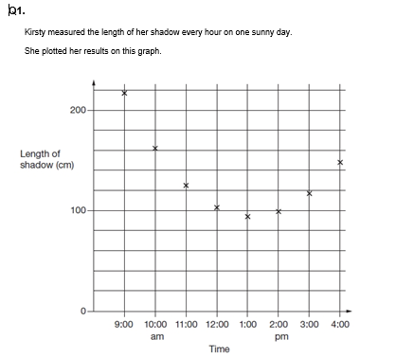
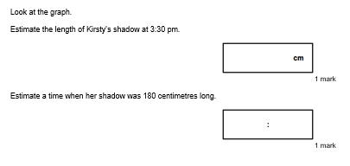
29.6.20
WALT: read and interpret line graphs.
Notes:
Notes: See worksheet with question in today’s word resources document.

Slide 16
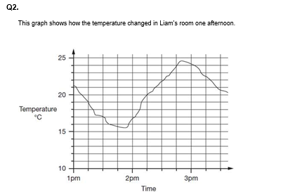
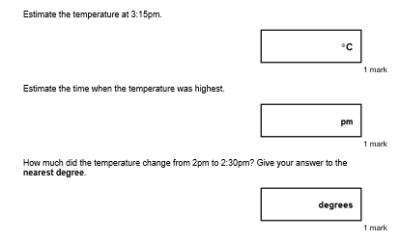
29.6.20
WALT: read and interpret line graphs.
Notes:
Notes:

Slide 17
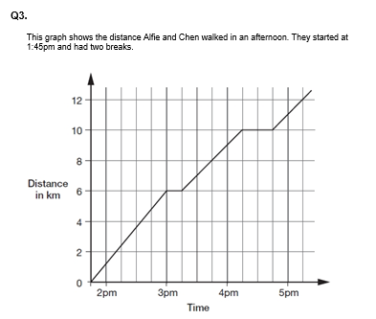
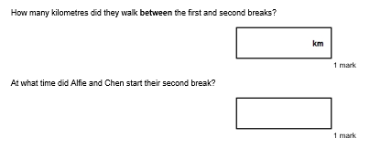
29.6.20
WALT: read and interpret line graphs.
Notes:
Notes:

Slide 18
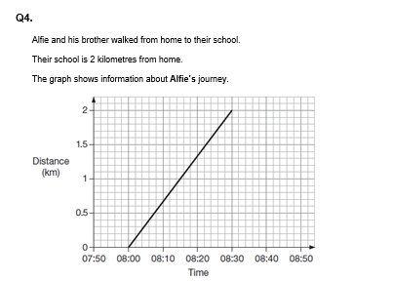
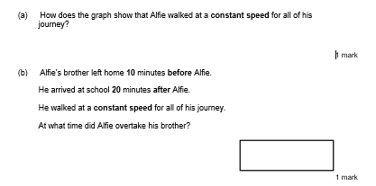
29.6.20
WALT: read and interpret line graphs.
Notes:
Notes:

Slide 19
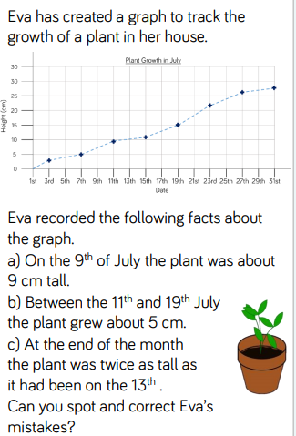
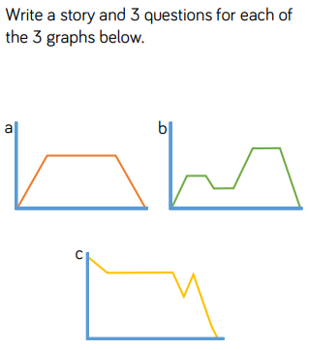
29.6.20
WALT: read and interpret line graphs.
Discussion Question...
Notes:
Notes:

Slide 20
Answers
Q1.
(a) Answer in the range 125 cm inclusive to 140 cm exclusive
Do not accept 140 cm.
(b) Answer in the range 9:30 am to 9:50 am inclusive
Accept an answer in the range 4:30 pm to 4:50 pm inclusive.
Q2.
(a) Accept answers in the range 22.2 to 22.8 exclusive.
Do not accept 22.2 or 22.8
(b) Accept answers in the range 2:48pm to 2:52pm inclusive.
The answer is a specific time.
(c) 5
Q3.
(a) 4 km
(b) 4:15pm
Notes:
Notes:

Slide 21
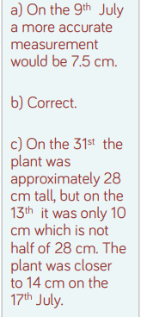
Q4.
Gives a correct interpretation of the graph, eg:
• It is a straight line
• It goes up steadily
• The angle of the line stays the same
• The gradient of the line is constant
Accept minimally acceptable explanation, eg:
• It is straight
• It doesn’t bend
• It is a diagonal
Q5.
Notes:
Notes:

Slide 22
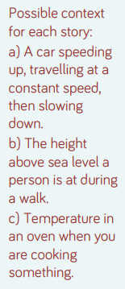
Discussion Question answer...
Notes:
Notes:

