Slide 1
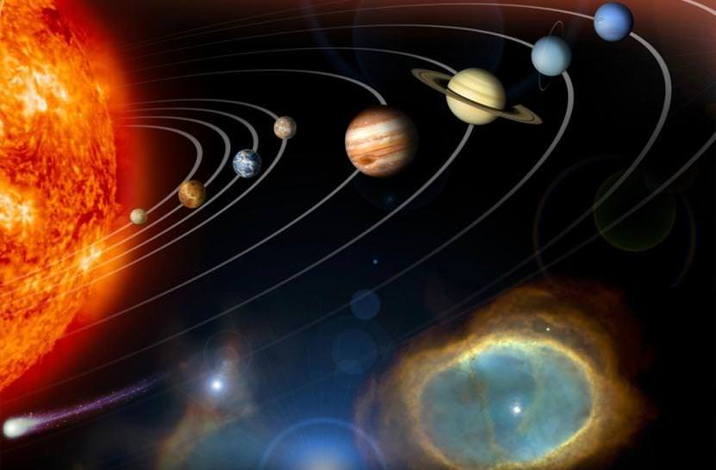
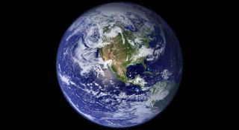
This week’s theme is
Space
Day 1 - 29.6.20

Slide 2

Spellings
Writing = A Day in the Life of an Alien

Slide 3
Monday - Spelling and handwriting practice.
knowledge
doubtful
knuckle
gnome
environment
He had no knowledge about the missing gnome.
Copy out these words out twice in your best joined handwriting.

Slide 4
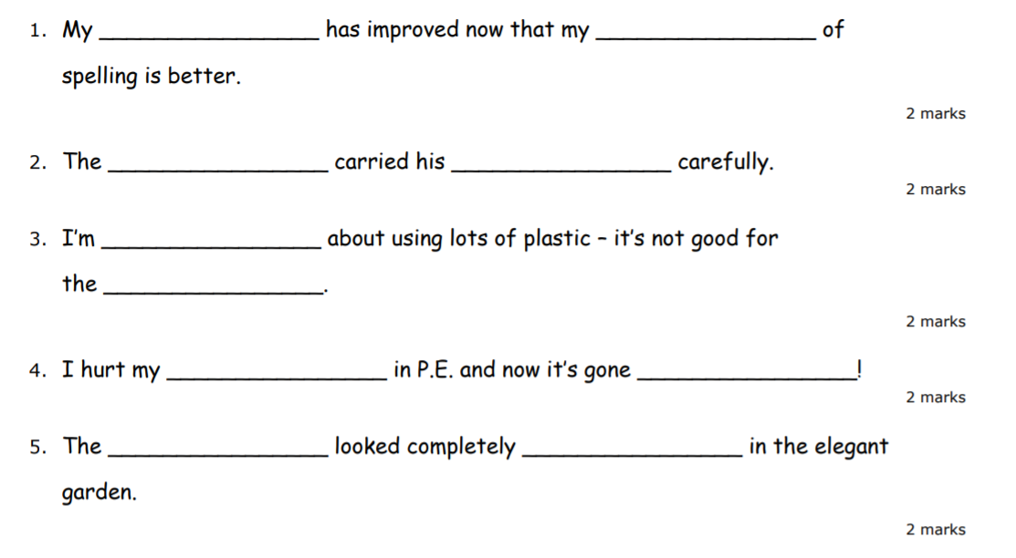
Monday - Spelling
Silent Letters
Can you write the missing spelling words in the sentence below.
sword
knowledge
gnome
doubtful
writing
knuckle
wrong
numb
Environment
knight

Slide 5
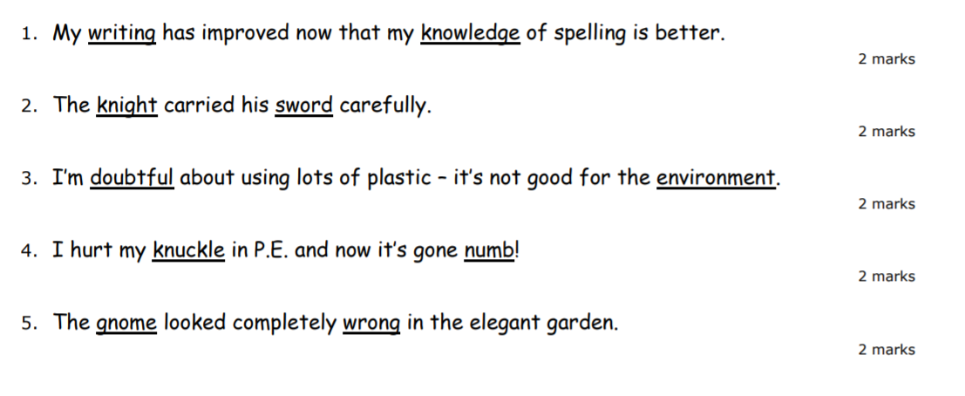
Monday - Answers
Silent Letters
Can you write the missing spelling words in the sentence below.
Look at the answers below and check how many you got right.

Slide 6
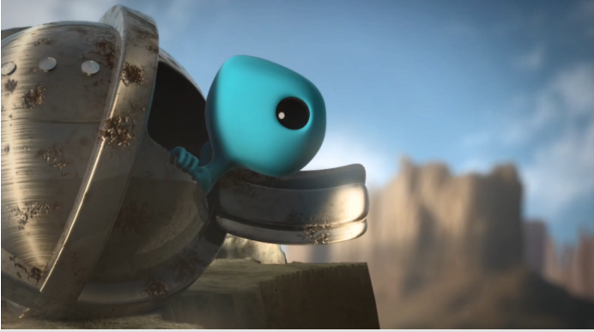
Writing - Session 1
Thinking Points
Who is this?
What is it?
What are they doing?
Where are they from? Where have they landed?

Slide 7
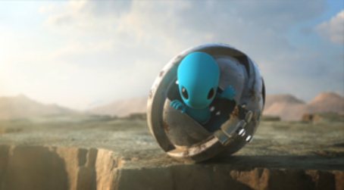
Writing - A Day in the Life of an Alien
Humans have five senses. What senses does the alien have? Write down a list of ideas about what senses this alien may have.

Slide 8
Writing - A Day in the Life of an Alien
What has the alien discovered? What do you think the alien is looking at? Write down some ideas about what he has discovered.

Slide 9
Writing - A Day in the Life of an Alien
Ship’s Log - Use the table to help prompt ideas
Where are they visiting? What places have they passed? What did they see? What does it look like? | Did anything exciting happen? What did they do? What did they experience? | How did they feel?

Slide 10
Writing - A Day in the Life of an Alien
A Ship’s Log
The captain of a ship keeps a detailed log of their daily discoveries and events.
Write the ship's log for the blue alien recording his discoveries.

