Slide 1

Good Afternoon Year 6!
Let’s start our afternoon with a quick burst of energy!
Get your PE kit at the ready because at the start of each afternoon session we will be joining Joe Wicks for our daily workout.
Do as much as you can and over the week you should find you are getting fitter and finding it easier.
Let’s go!
Click the youtube link below and select today’s date from the videos listed.
https://www.youtube.com/channel/UCAxW1XT0iEJo0TYlRfn6rYQ

Slide 2
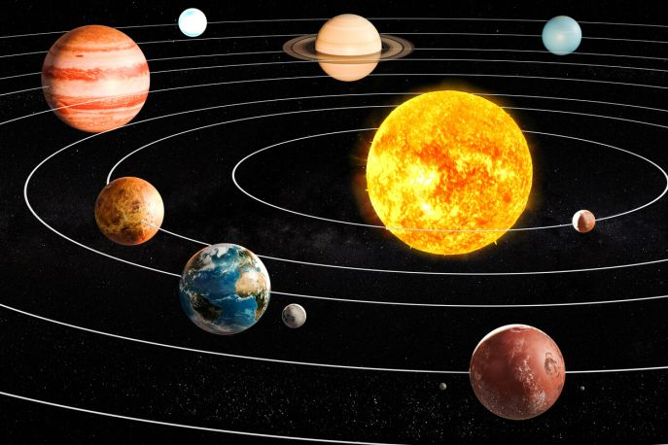
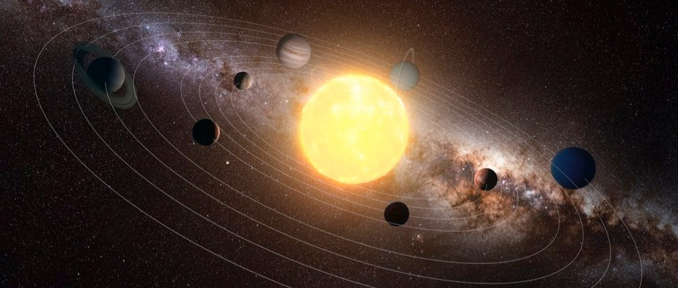
Space
What is the solar system?

Slide 3
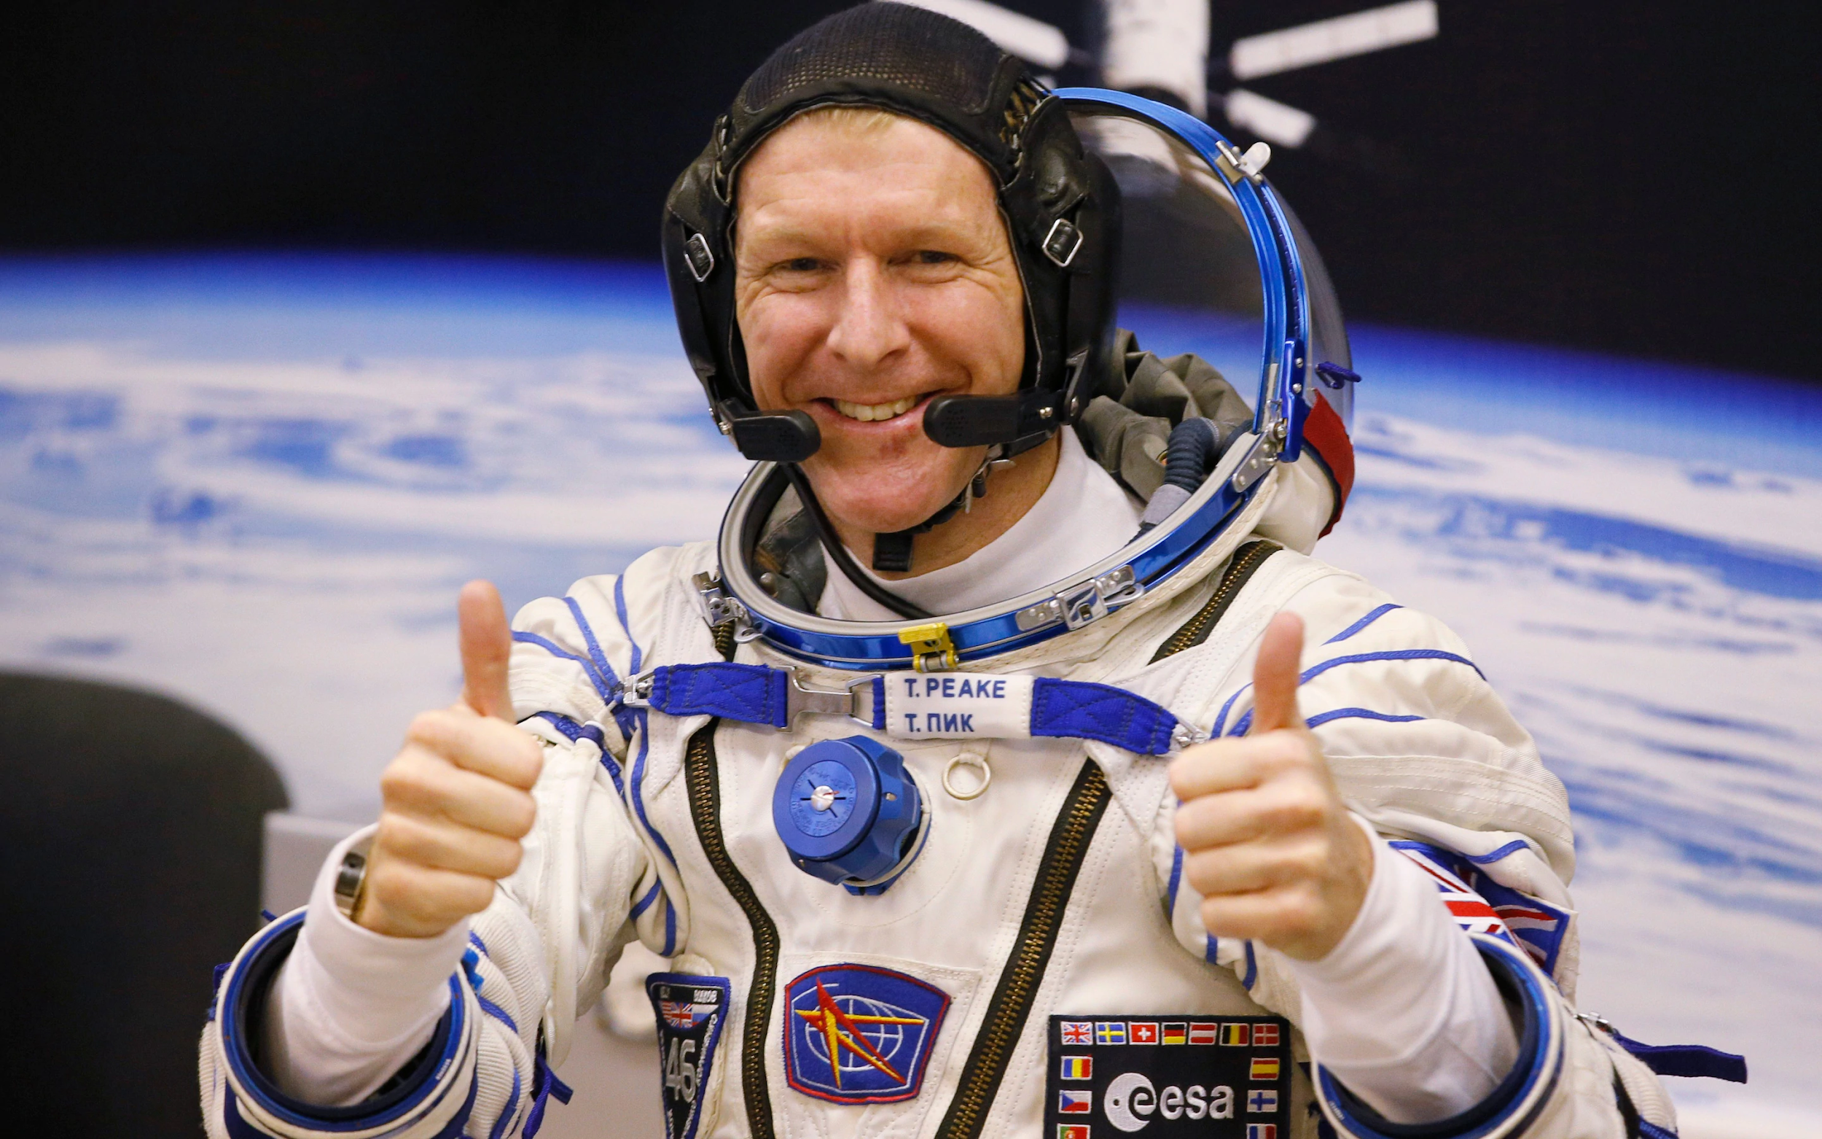
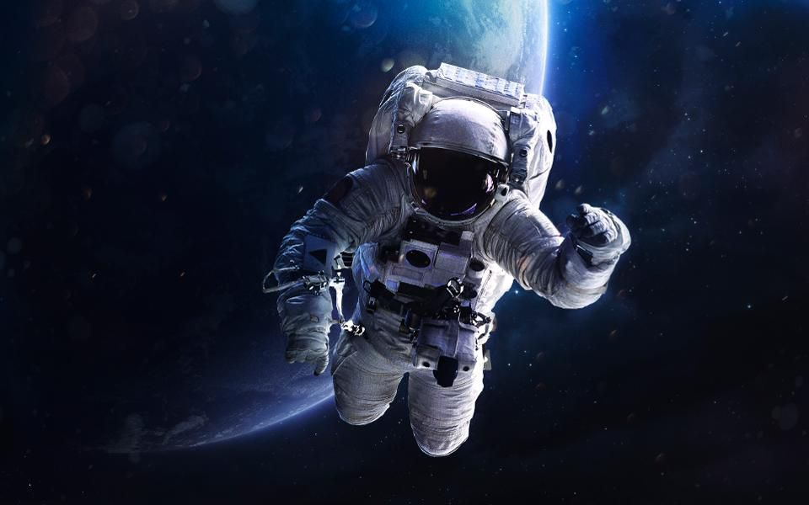
Space - What is the solar system?
Tim Peake - If Tim Peake was trying to locate you from space, what would your full address be?

Slide 4

Space - What is the solar system?
Tim Peake - If Tim Peake was trying to locate you from space, what would your full address be?
Year 6 Room
Upstairs
St Catherine’s Primary School
Marlpool Lane
Kidderminster
Worcestershire
England
United Kingdom
Europe
Northern Hemisphere
Earth
Solar System
Milky way galaxy
Virgo Supercluster
Universe

Slide 5
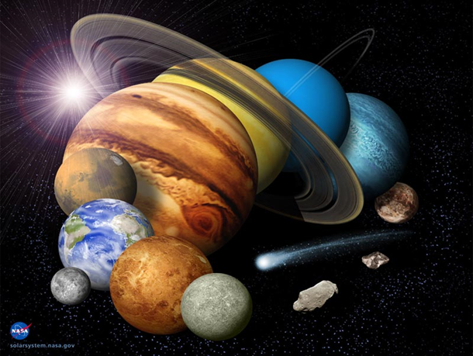
Space - What is the solar system?
How many planets and dwarf planets are there in our solar system?
Can you name all the planets and dwarf planets?
Hint: There are 8 planets and 5 Dwarf planets

Slide 6
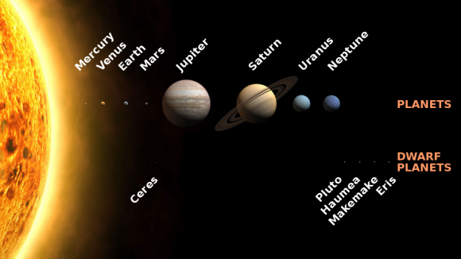
Space - What is the solar system?
Can you name the planets and dwarf planets?

Slide 7
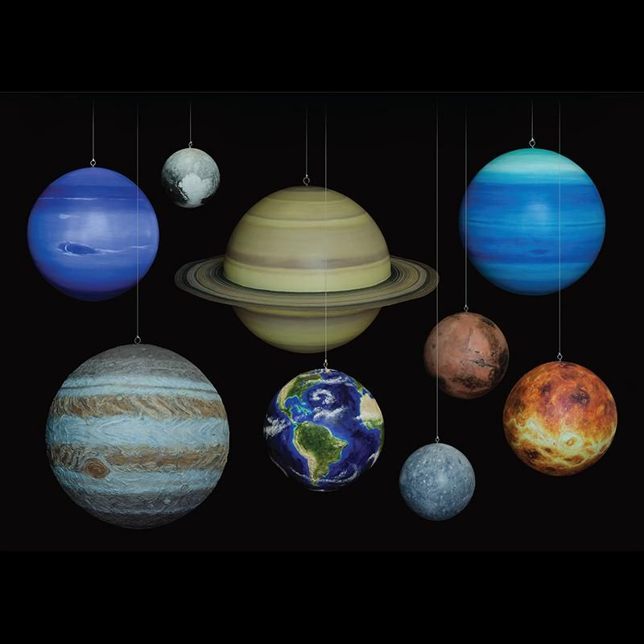
Space - What is the solar system?
Can you come up with your own mnemonic for remembering the planets.
The sillier the better!
M
V
E
M
J
S
U
N
Examples:
My very eager mother just served us noodles
Remember Pluto is a dwarf planet.

Slide 8
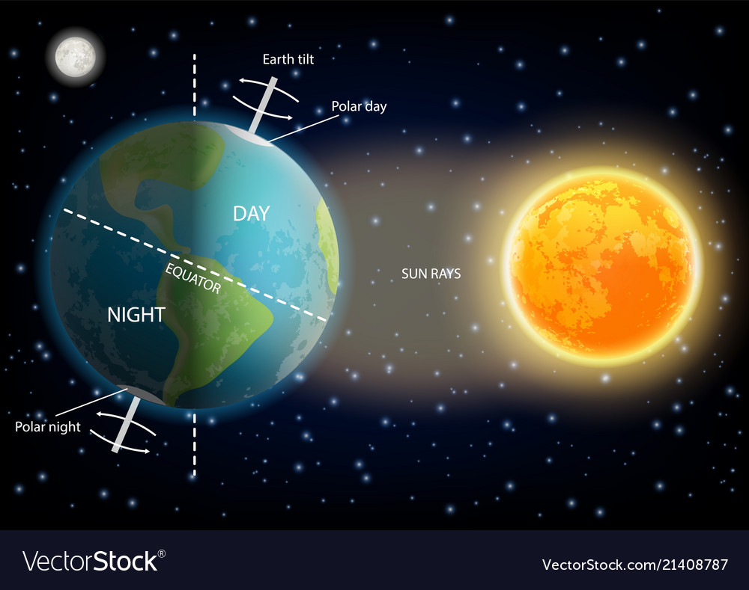
Space
Day and Night
Seasons

Slide 9
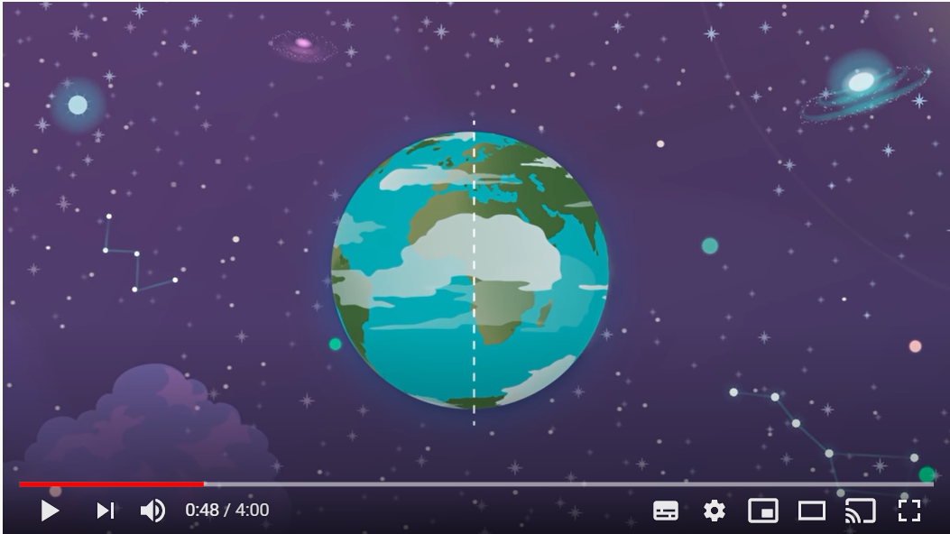
Space - Day and Night, Seasons
Click on the image to learn about the Earth’s rotations

Slide 10
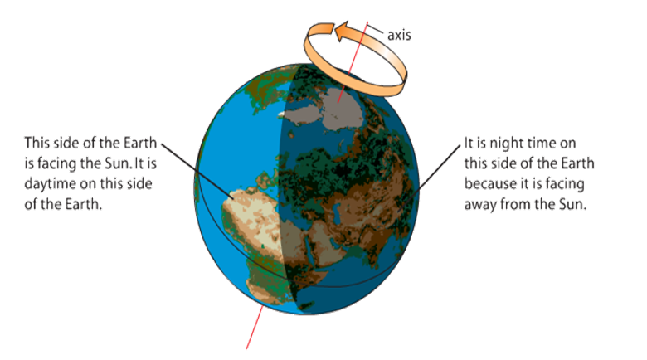
Space - Day and Night, Seasons
Days, Nights and Years
Questions
1) What does the earth get from the sun?
2) How long does the earth take to spin around once on its axis? What is this known as to us?
3) Explain why we have night and day using the key terms: daytime, night time, facing, sun
4) Where does the sun rise?
5) Where does the sun set?

Slide 11
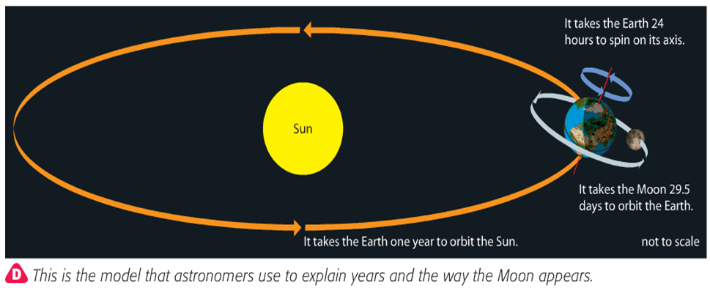
Space - Day and Night, Seasons
Days, Nights and Years
The Earth orbits the sun every 365.25 days. This is known as a year.

Slide 12
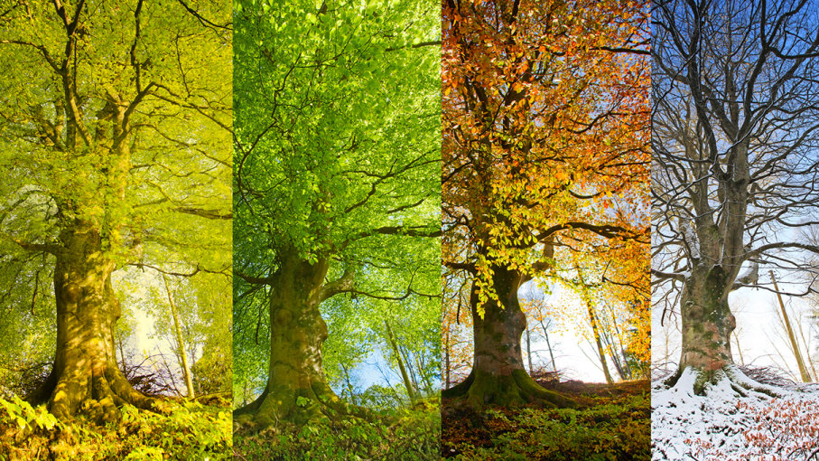
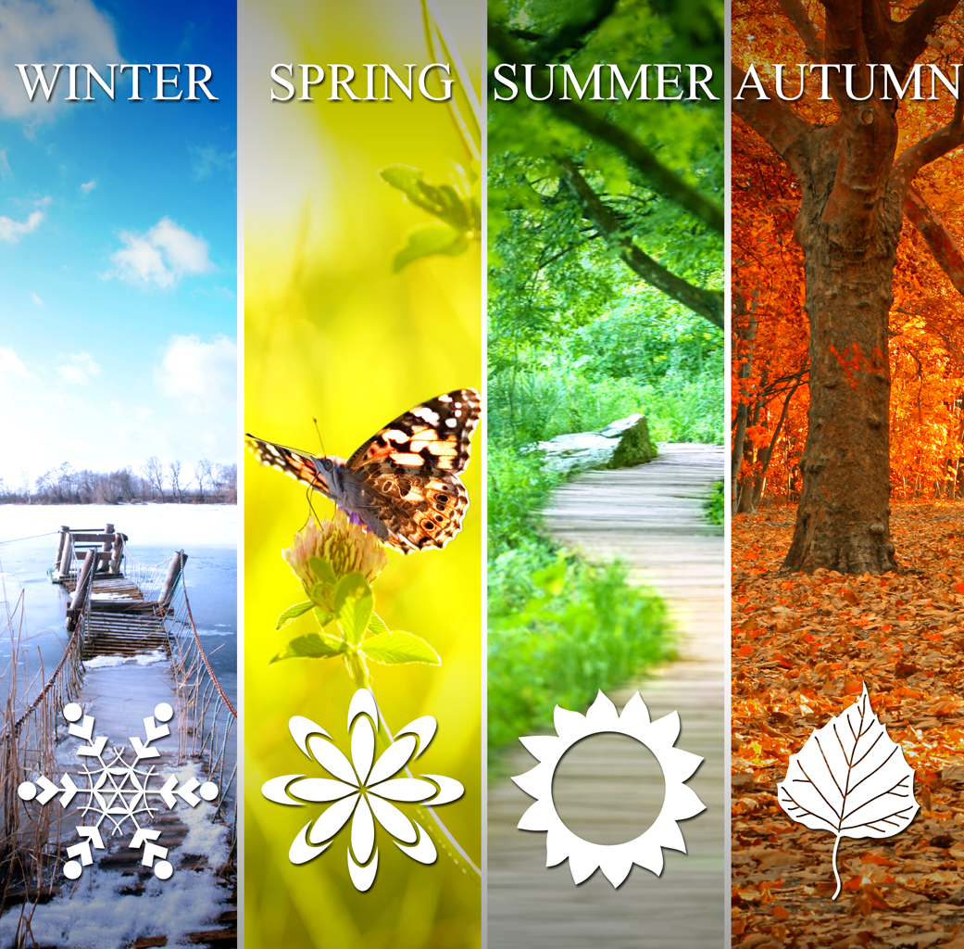
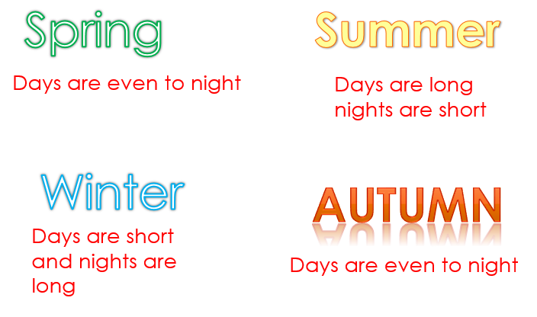
Space - Day and Night, Seasons
Seasons - Why do we have seasons?

Slide 13

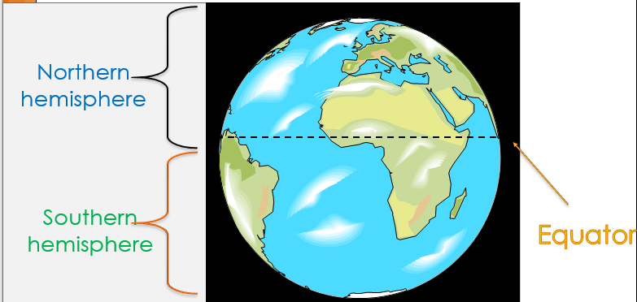
Space - Day and Night, Seasons
Seasons - Why do we have seasons?
What hemisphere is the UK in?

Slide 14
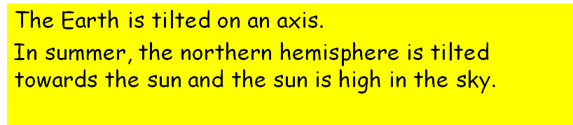
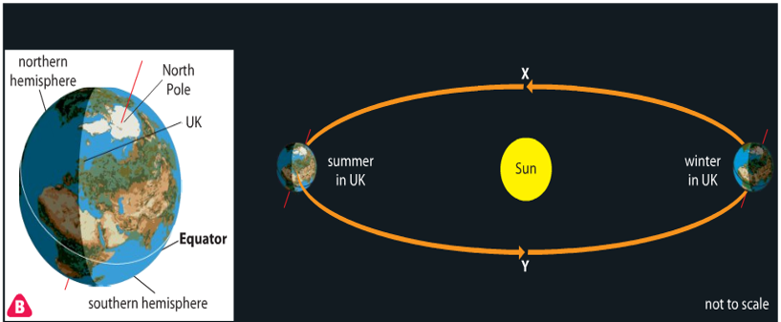
Space - Day and Night, Seasons
Seasons - Why do we have seasons?

Slide 15
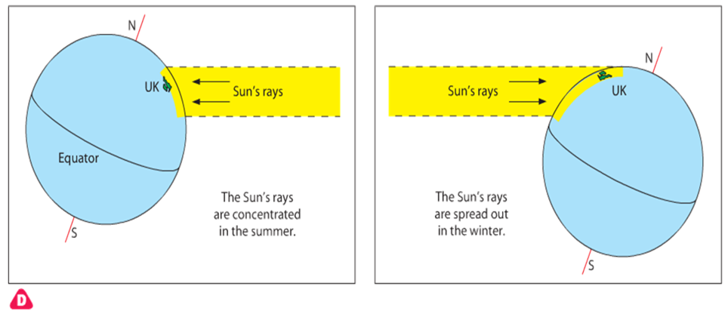
Space - Day and Night, Seasons
Seasons - Why is it hotter in summer?

Slide 16
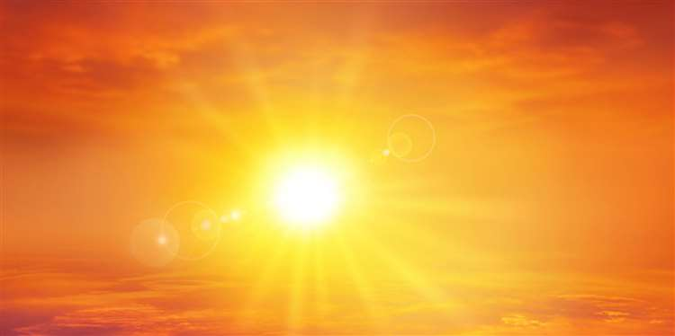
Space - Day and Night, Seasons
Seasons
Draw you own diagram to explain why it is hotter in summer in the UK.

Slide 17

Well done on a great day!
Enjoy your evening and be ready for more learning tomorrow...

