Slide 1
Good MoRning Year 6!
We hope you have had a lovely half term break with your families and are keeping safe!
The home learning will continue in the same format as before half term.
Please follow the instructions on each page to help you - we look forward to hear about how you have got on!
Mrs Jones and Miss Nolan

Slide 2
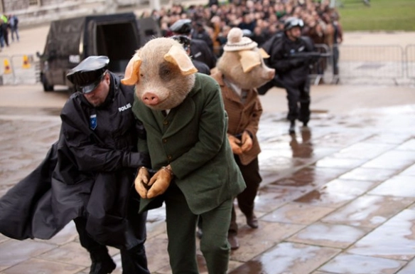
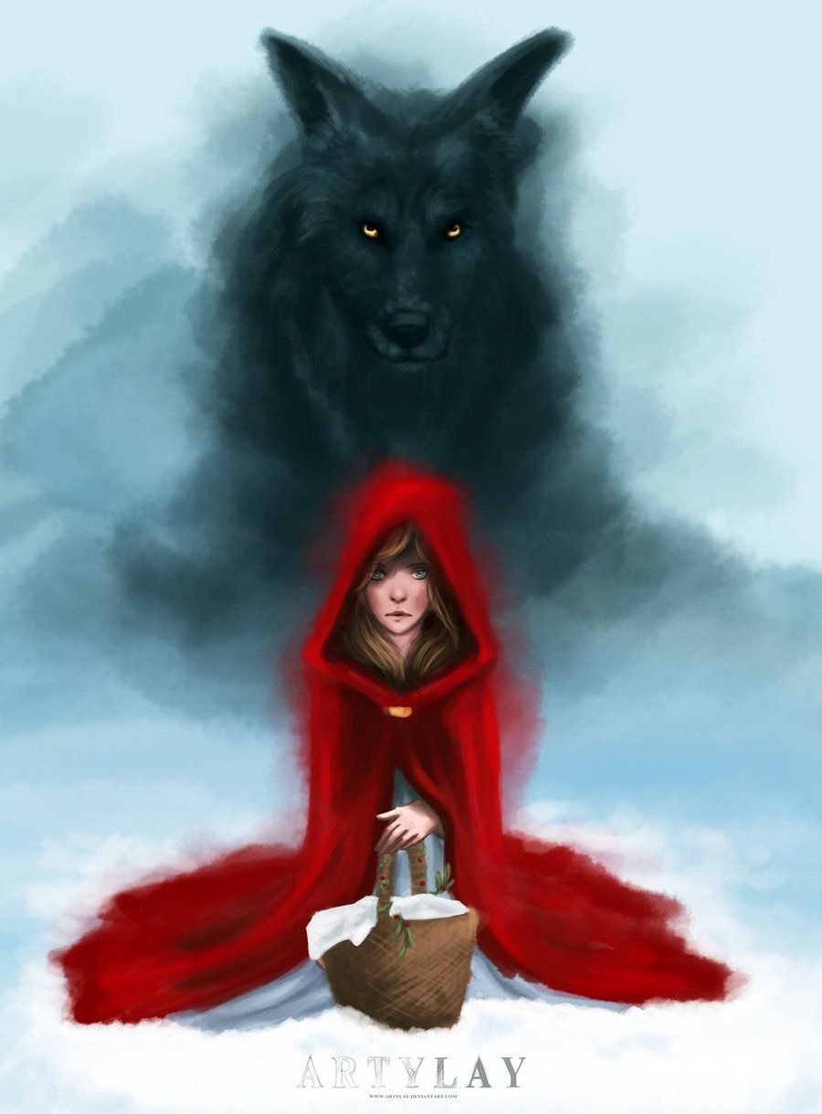

This week’s theme is
Wolves and Fairy Tales
Day 1 - 1.6.20

Slide 3
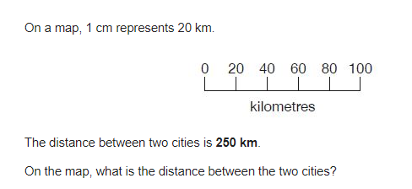

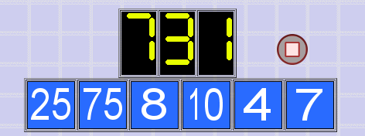
7. 122,456 - 11,999
8. 82 96 124 138
9.
Morning Maths - Give yourself 15 - 20 minutes to complete these questions and then try and tackle today’s countdown.
326 ÷ 1 =
468 - 9 =
100 x 412=
486 ÷ 3 =
71 x 46 =
6.
10.

Slide 4
7. 122,456 - 11,999 = 110,457
8. 82 96 124 138
9.
Now mark your work using these answers.
326 ÷ 1 = 326
468 - 9 = 459
100 x 412= 41200
486 ÷ 3 = 162
71 x 46 = 3266
6.
68
110
152
12.5
124
10.
Countdown Answer
8 + 7 + 4 = 19
75 x 10 = 750
750 - 19 = 731

Slide 5
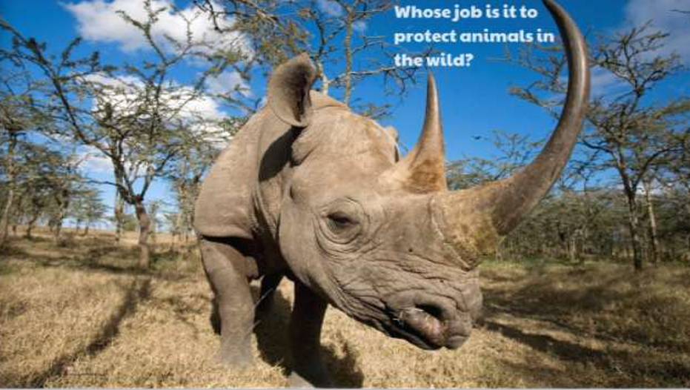
Daily Worship
This is a black rhino. It was announced last month that the numbers of the animal are increasing!
However, black rhinos are still classed as critically endangered (which means they are at a high risk of extinction).
Think about the differences between animals kept in our care or at zoos and animals who live freely in the wild.
Animals kept in zoos or in our homes are completely reliant on us, animals in the wild generally take care of themselves. Wildlife conservation is about protecting the area where the animals or wildlife live (the habitat).

Slide 6

Daily Worship
Which facts did you find the most interesting?
Click on the image or use the link below to view video -
https://www.youtube.com/watch?v=ST_83Hkrbk4&feature=youtu.be

Slide 7
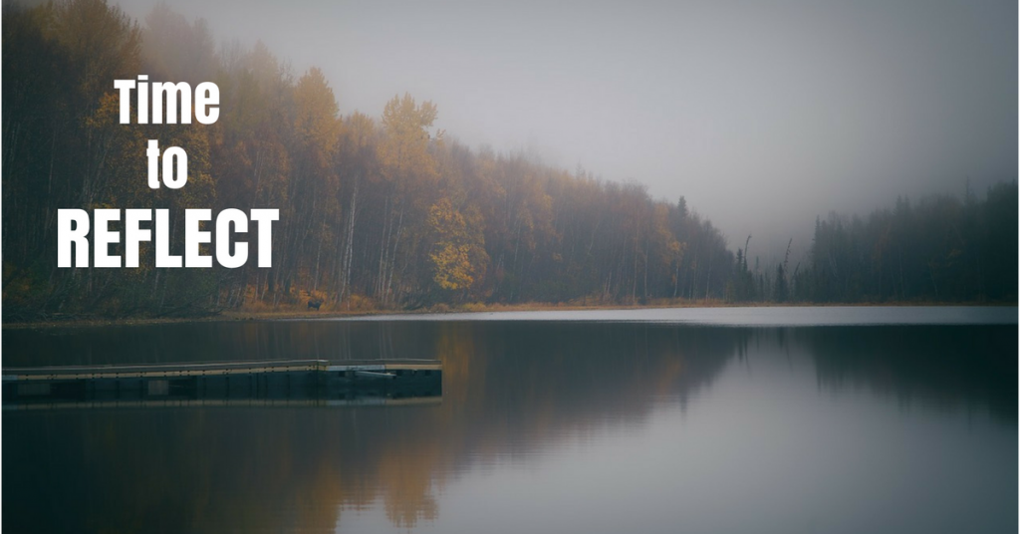
Daily Worship
Think about:
whose job is it to protect animals in the wild?

