Slide 1

We may not be learning together in the classroom, but it is important to still remember our classroom beliefs.
WALT: develop problem solving and thinking skills.
This lesson will be our maths learning for today and tomorrow, so do not worry if you do not finish in the time. Leave it and come back to it in Maths tomorrow.

Slide 2
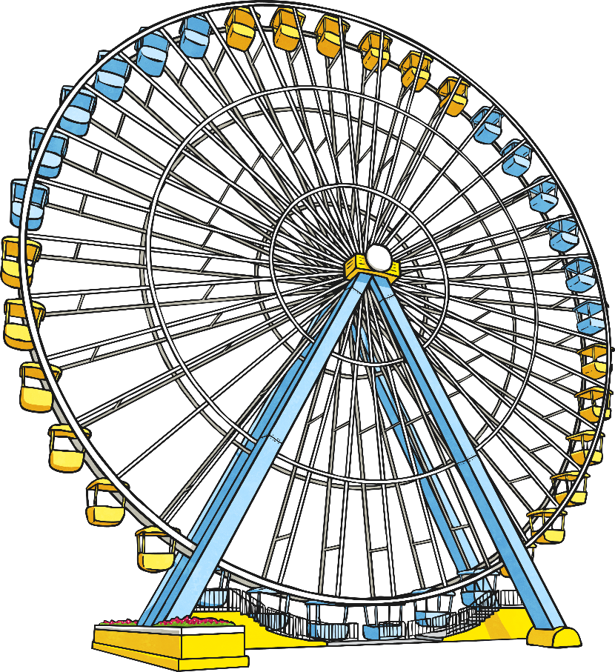
Year 6 Maths Project Pack:
Fairy Tale Theme Park
During this project, you will design your own theme park! You will:
Develop your problem-solving and thinking skills.
Make decisions and choices.
Strengthen your ability to independently to develop ideas.
Use a range of mathematical and literacy skills.
Have fun!

Slide 3
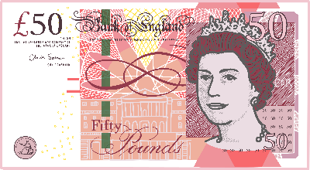

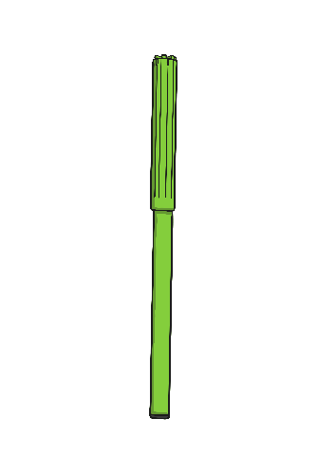
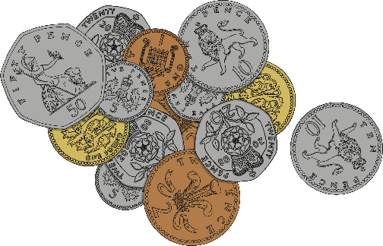
Lesson 1: The Brief
You have bought a plot of land.
You have recently been granted planning and permission to build a theme park as the local council feel the attraction would bring income and jobs within the local area.
You have been granted a substantial business loan of £5 million for building and start-up costs.

Slide 4
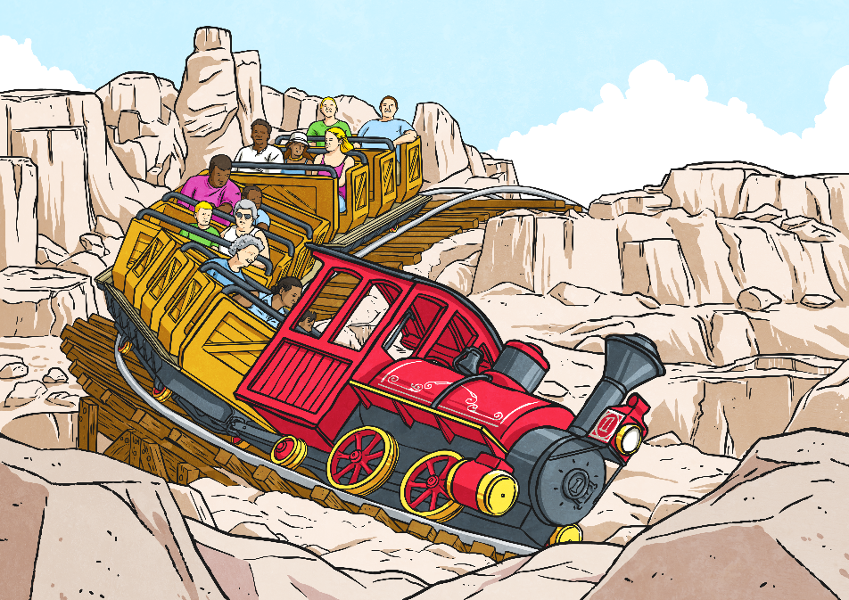
Business Ideas:
Target Market
You now need to think about the following business ideas.
At each stage make notes on some paper or in a word document.
Think about…
A Potential Name For Your Theme Park
Your name may depend on your ‘target market’ (the main people you hope will visit your theme park).
Will your park just be for thrill-seeking adults? Will it be a place suitable for a family of all ages? Or are you just going to create an attraction for children?

Slide 5
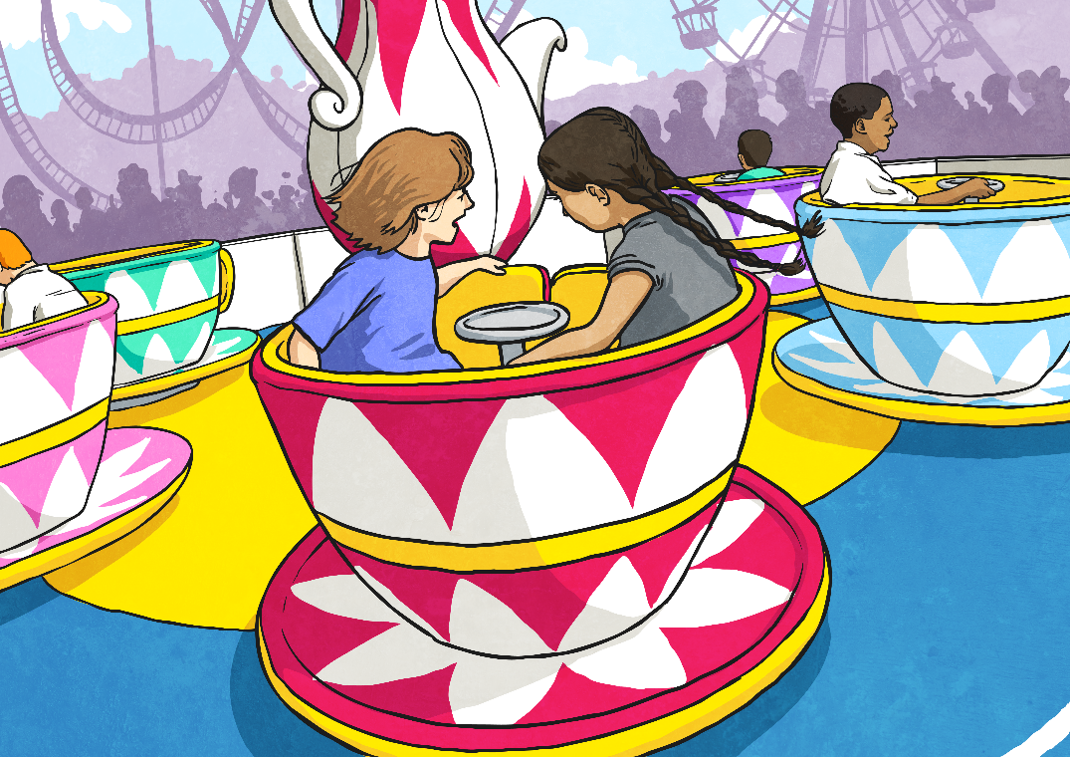
Discussing Business Ideas:
Park Layout
Your theme park will need to have three separate and distinct areas.
How will these areas be ‘themed’?
Maybe you’ll have an area relating to a different fairy tale character or story.
Or maybe the areas will be themed by the rides within them e.g. a thrill-seekers area full of rides for daredevils, a water world with only water rides where you’ll receive a soaking, a children’s world for under 8s only etc.

Slide 6

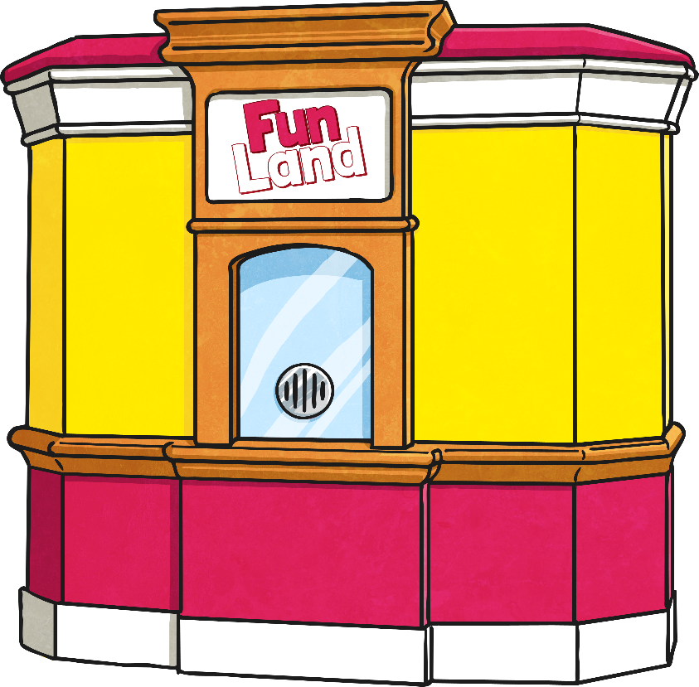
Discussing Business Ideas:
Budget
You need to budget for your build costs, but still leave at least £1 million in the bank for start-up and launch costs.
This means £4 million of your business loan can be spent on build costs. You must not go over budget and remember: every pound you save can go towards your big launch!
Your different rides, amenities and attractions will all vary in build costs and running costs.
You need to start to draw up a first draft plan of your theme park.

Slide 7
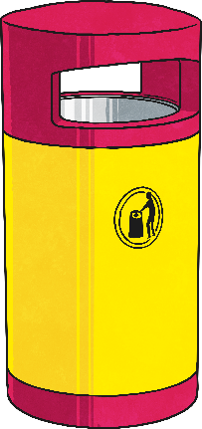
First Draft Plan:
Planning Build Costs
In the separate word document you have a copy of a draft planning sheet. You could also use some squared paper.
You’ll need to start to plan out your park and label your initial ideas. Remember:
Your park needs three distinct areas (so customers can walk between them and avoid becoming bored).
Each square on your map represents 50m². different rides, amenities and attractions take up different areas (but all need a one square wide perimeter around them for health and safety reasons).
There must legally be certain amenities within the theme park.
Every square not filled must be paved (at a cost of £500 for every 50m²).

Slide 8
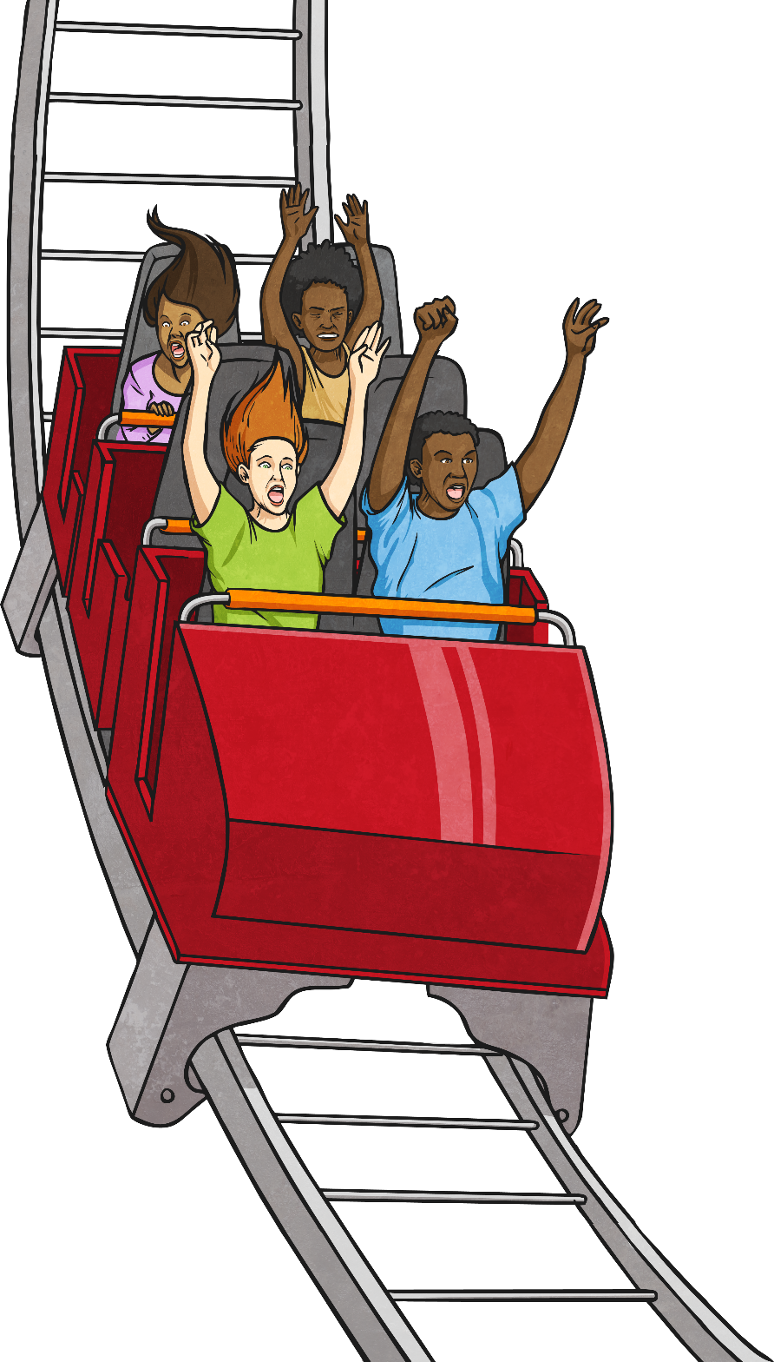
First Draft Plan:
Thrill-Seeker Rides
The most expensive rides to build, staff and run.
Only suitable for your dare-devil customers!
Cost to Build: £150 000
Area Taken Up: 300m²
Suitable For: All adults and children aged 12+
Colour on Map: red

Slide 9
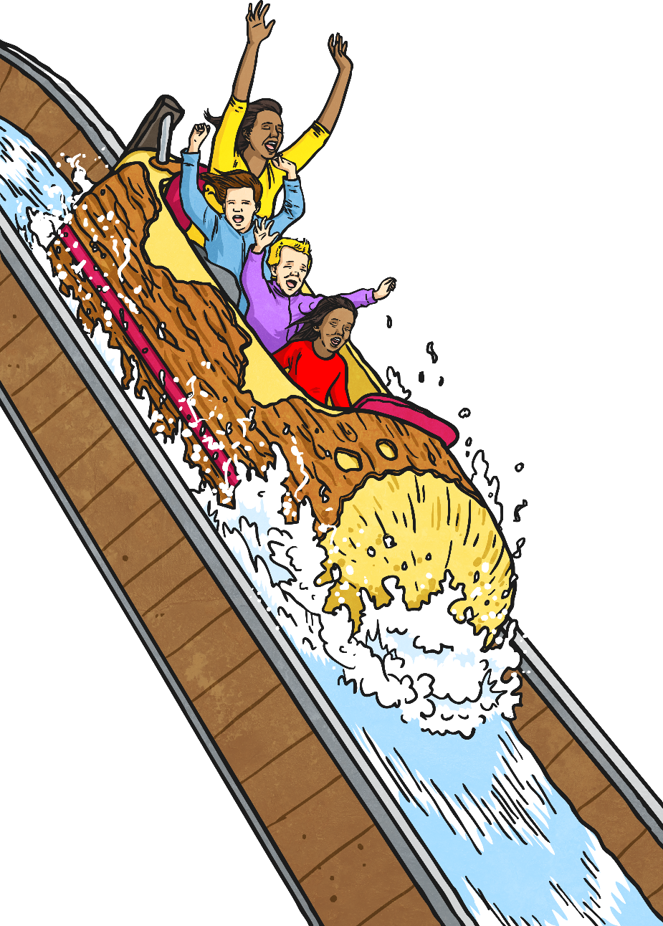
First Draft Plan:
Water Rides
Suitable for many customers aged 7+
Who feel like taking a splash!
Cost to Build: £100 000
Area Taken Up: 150m²
Suitable For: All adults and children aged 7+
Colour on Map: blue

Slide 10

First Draft Plan:
Family Rides
Quite expensive to build and run.
Suitable for many potential customers aged 7+
Cost to Build: £100 000
Area Taken Up: 200m²
Suitable For: All adults and children aged 7+
Colour on Map: green

Slide 11

First Draft Plan:
Children’s Rides
Cheaper to build and maintain.
Only suitable for children aged 3-8 years (and their parent or guardians).
Cost to Build: £50 000
Area Taken Up: 100m²
Suitable For: All children aged 3-8 years
Colour on Map: yellow

Slide 12
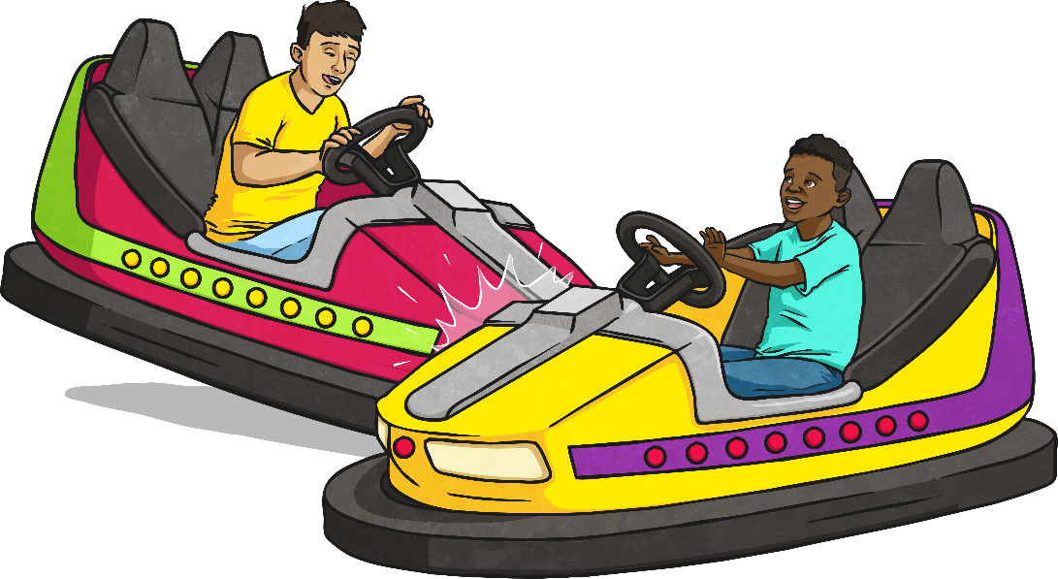
First Draft Plan:
Attractions
You have managed to strike an agreement with the developers to build other attractions at the bargain price of £20 000 each.
These attractions are suitable for all ages.
Cost to Build: £20 000
Area Taken Up: 100m²
Suitable For: All ages
Colour on Map: orange
Examples are: dodgems, amusements, fun house, bouncing pillow etc.

Slide 13
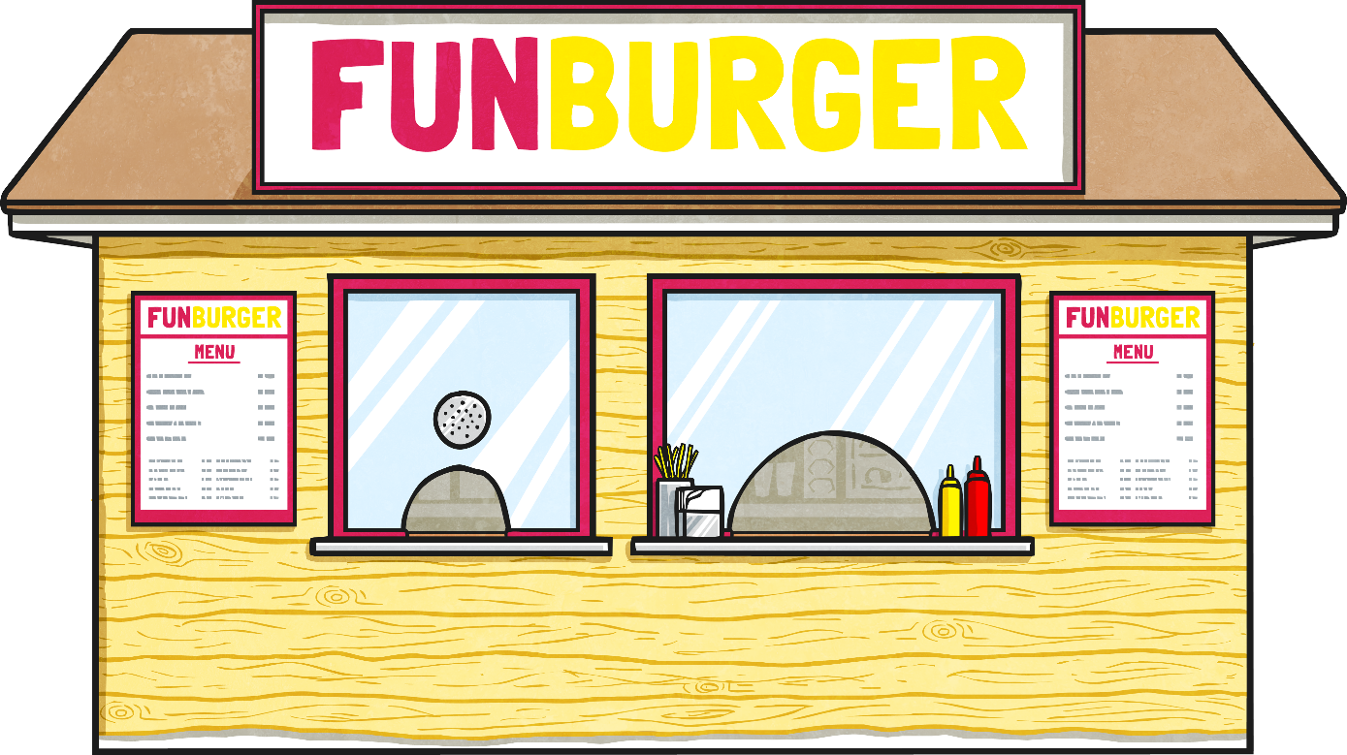
First Draft Plan:
Amenities
Some other amenities are essential within the park:
Cost to Build: £25 000
Area Taken Up: 100m²
Colour on Map: purple
Each of the three areas must have one eating establishment.
These can be family cafes, burger bars, pizza palaces, sandwich huts, ice cream parlours – whatever fits in with your themes.
These will hopefully help you to raise income for your business.

Slide 14
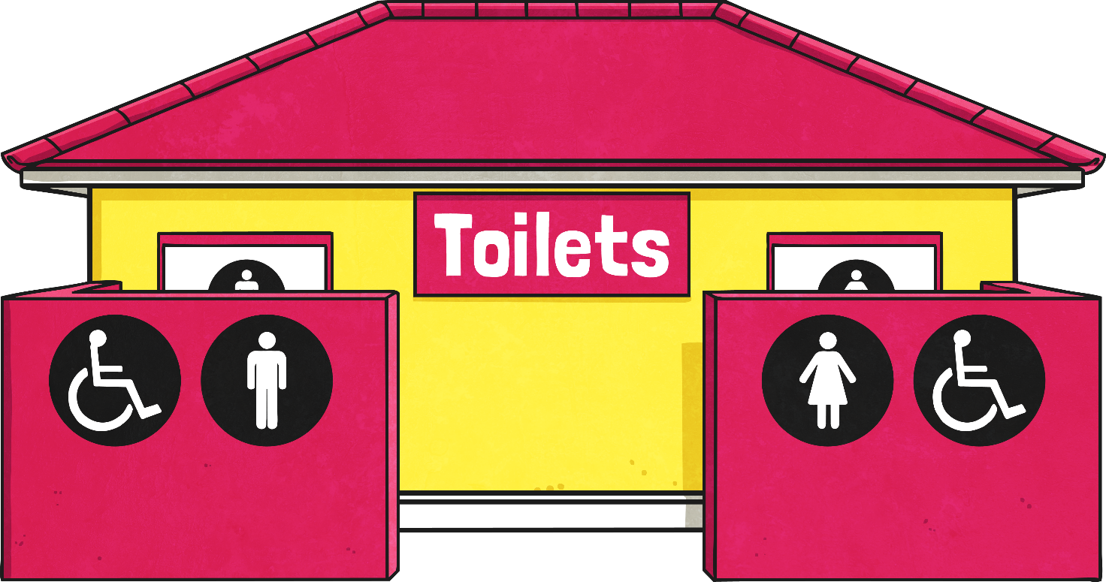
First Draft Plan:
Amenities
Some other amenities are essential within the park:
Cost to Build: £25 000
Area Taken Up: 100m²
Colour on Map: purple
Each of the three areas must have one toilet block.
There must be one first-aid block somewhere on the park.
On the border of the park, there must be one entrance turnstile and ticket booth to admit your customers.

Slide 15

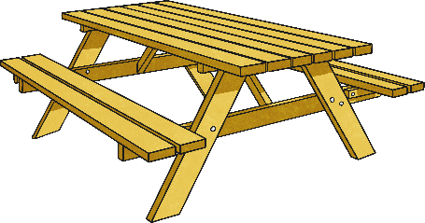
First Draft Plan:
Amenities
To help create a clean, welcoming atmosphere:
You need to provide ten bins for litter (which will hopefully cut down your cleaning costs).
Each bin costs £100. Mark these on your map with a small brown circle.
You also need to provide twenty picnic benches (for customers to rest, wait for others or eat a picnic lunch).
Each bench costs £100. Mark these on your map with a small pink circle.
=
=
Benches and bins can be within the 50m perimeter of rides, attractions and amenities.

Slide 16
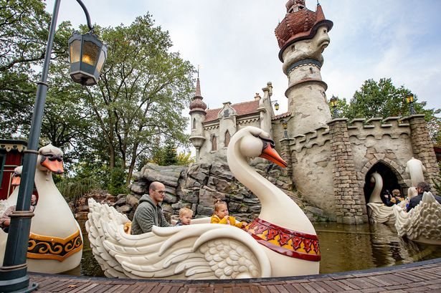


First Draft Plan:
Get Planning!
Now it’s time to get thinking and planning.
Use the key to remind you of costs, potential users for each type of ride, sizes and building regulations.

Slide 17
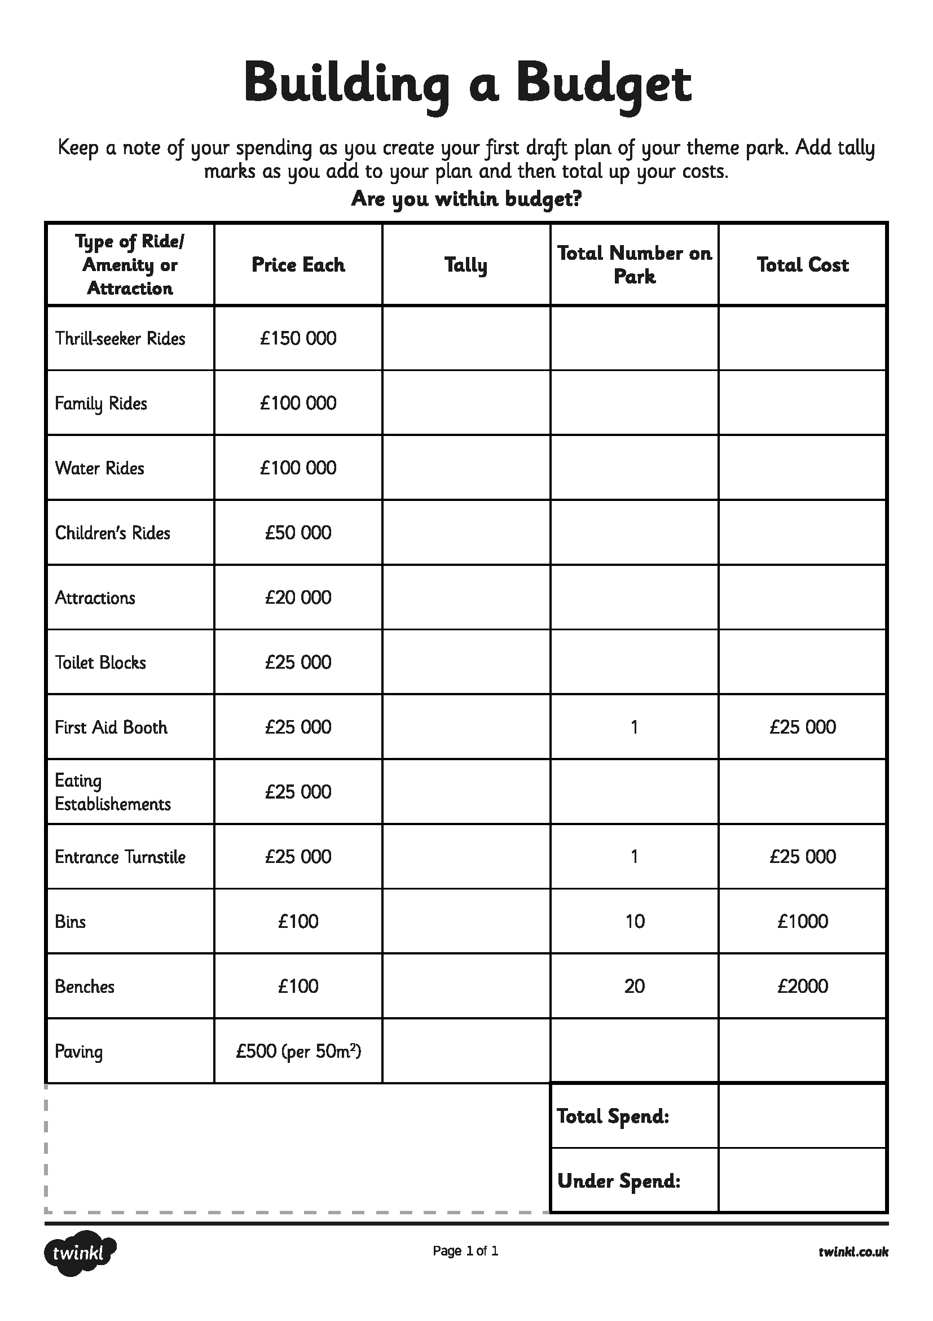
Building Cost Budget
As you go along, add your build costs to your budget sheet to keep a total of your spending. Don’t go over-budget… remember you have £4 million!
Every pound you under-spend can go towards your big launch!
You will find the ‘Building a Budget’ sheet in the separate word document for today’s learning on the website. You can choose to print this off and complete or work online or on some paper.
Also make sure you use the key to help you ensure your design meets the specification.

Slide 18

Spellings
Reading = Eye of the Wolf
Writing = Free Write

Slide 19
Monday - Spelling and handwriting practice.
advice
advise
practice
practise
particular
Please turn off that device, it is very distracting.
Copy out these words out twice in your best joined handwriting.

Slide 20
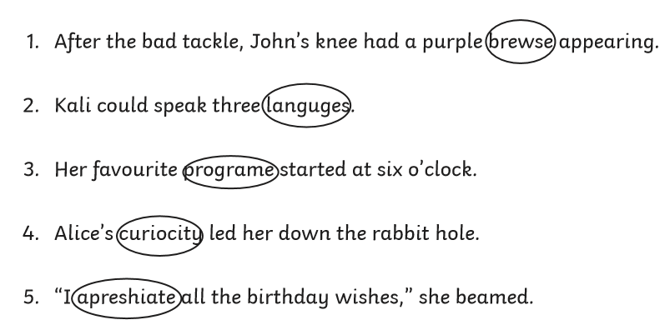
Monday - Spelling
Correct the spelling mistake. The circled word is spelt incorrectly. Can you record the right spelling of the word?

Slide 21
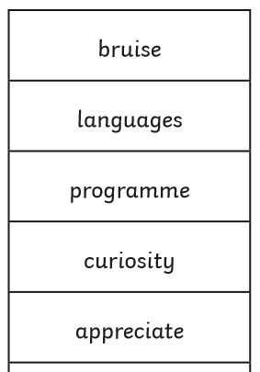
Monday - Answers
Correct the spelling mistake. The circled word is spelt incorrectly. Can you record the right spelling of the word?

Slide 22
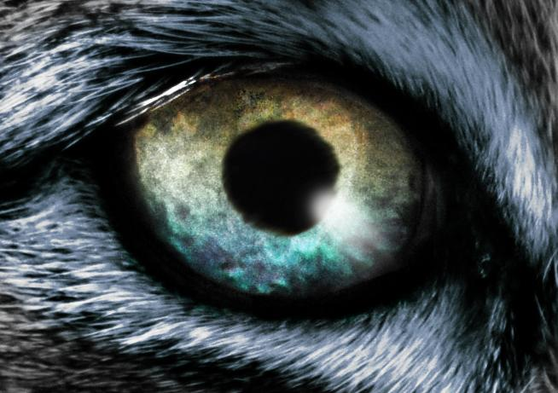

READING - Eye of The Wolf
WALT: Make inferences using evidence from the text.
This week all the reading is based around the book ‘the eye of the wolf’ by Daniel Pennac:
A young boy, a wolf in a zoo - what's the connection?

Slide 23
Reading Activity
Teacher Notes
The purpose of a close read activity is to gain an understanding of the text by reading it multiple times.
Close Read Instructions:
Look at the vocabulary. Do you know what the words mean? If you are unsure, note down the words and use a dictionary (this could be online) to find out their meaning.
Read the text to yourself and ask yourself the following questions:
What did I just read? What did it say? You can make notes or annotate the text.
Now read the text again (you could do this wit an adult) - this will help you gain a better understanding.
Read the questions and now reread the text again to find evidence that will support your answers.
Answer the questions in writing.
All close read texts are age appropriate.

Slide 24
READING - Eye of The Wolf
WALT: Make inferences using evidence from the text.
“The eye of the wolf” by Daniel Pennac
The boy standing in front of the wolf’s cage doesn’t move a muscle. The wolf paces backwards and forwards. He walks the length of the enclosure and back again without stopping.
He’s starting to get on my nerves, the wolf thinks to himself. For the last two hours the boy has been standing in front of the wire fencing, as still as a frozen tree, watching the wolf walking.
What does he want from me? The wolf wonders. The boy makes him feel curious. He’s not worried, (because wolves aren’t afraid of anything), just curious. What does he want?

Slide 25
READING - Eye of The Wolf
WALT: Make inferences using evidence from the text.
“The eye of the wolf” by Daniel Pennac
The boy standing in front of the wolf’s cage doesn’t move a muscle. The wolf paces backwards and forwards. He walks the length of the enclosure and back again without stopping.
He’s starting to get on my nerves, the wolf thinks to himself. For the last two hours the boy has been standing in front of the wire fencing, as still as a frozen tree, watching the wolf walking.
What does he want from me? The wolf wonders. The boy makes him feel curious. He’s not worried, (because wolves aren’t afraid of anything), just curious. What does he want?
Questions
1) How do you think the wolf is feeling in the first paragraph? Explain your answer using evidence from the text.
2) What does the description, “As still as a frozen tree,” suggest to you about the boy who is watching the wolf?

Slide 26
READING - Eye of The Wolf - Answers
WALT: Make inferences using evidence from the text.
“The eye of the wolf” by Daniel Pennac
The boy standing in front of the wolf’s cage doesn’t move a muscle. The wolf paces backwards and forwards. He walks the length of the enclosure and back again without stopping.
He’s starting to get on my nerves, the wolf thinks to himself. For the last two hours the boy has been standing in front of the wire fencing, as still as a frozen tree, watching the wolf walking.
What does he want from me? The wolf wonders. The boy makes him feel curious. He’s not worried, (because wolves aren’t afraid of anything), just curious. What does he want?
1) How do you think the wolf is feeling in the first paragraph? Explain your answer using evidence from the text. The wolf is pacing backwards and forwards without stopping this tells me that he is either anxious or impatient.
2) What does the description, “As still as a frozen tree,” suggest to you about the boy who is watching the wolf? This suggests that he is not moving, and that he is fixed in one position possibly trying not to draw attention to himself.

Slide 27
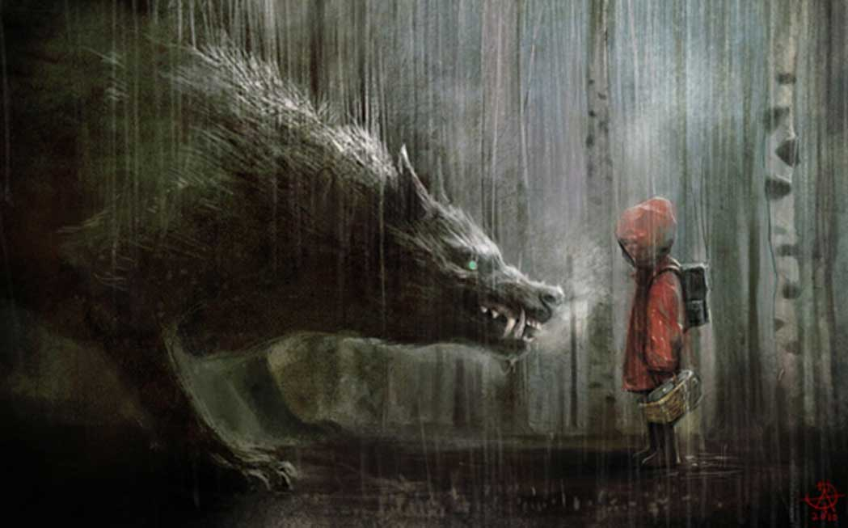
Your free writing can be fiction or non-fiction.
Free Write - Use the Image to Write!
1.Look at image and explore all the possibilities - be creative and imaginative.
2. Create your own mind map of ideas.
3. Spend rest of session free writing using the image as guidance.

