Slide 1

Good Afternoon Year 6!
Let’s start our afternoon with a quick burst of energy!
Get your PE kit at the ready because at the start of each afternoon session we will be joining Joe Wicks for our daily workout.
Do as much as you can and over the week you should find you are getting fitter and finding it easier.
Let’s go!
Click the youtube link below and select today’s date from the videos listed.
https://www.youtube.com/channel/UCAxW1XT0iEJo0TYlRfn6rYQ

Slide 2
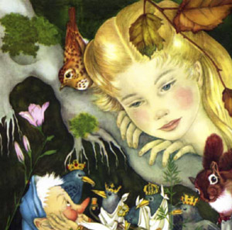
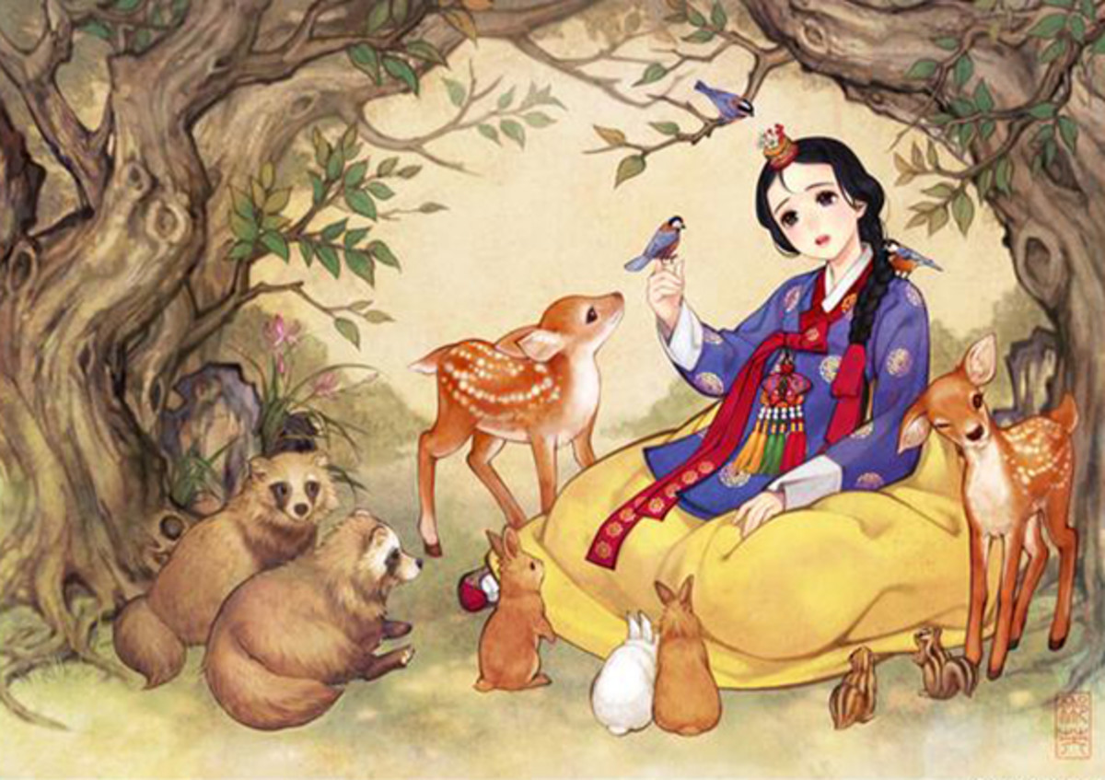
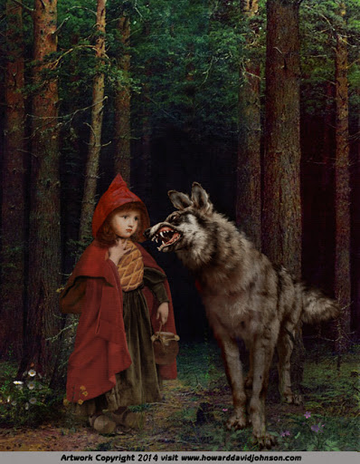
Art
This week’s art will focus on portraits and will continue our theme of fairy tales.

Slide 3
Art
Self Portraits
Throughout the course of art history, self-portraiture has remained a constant practice among leading artists. Self-portraits feature in every major movement, from the Italian Renaissance, to the Post-Modern and Contemporary period.
Art isn’t about making a painting look like the real thing. Art is an expression of something. From the background to the colour palette, the brush strokes to the composition, each choice has been made deliberately. The artists asks themselves: “What am I trying to tell the world through this piece of work?”, and so, each choice is made to further convey the emotion, message or story.

Slide 4
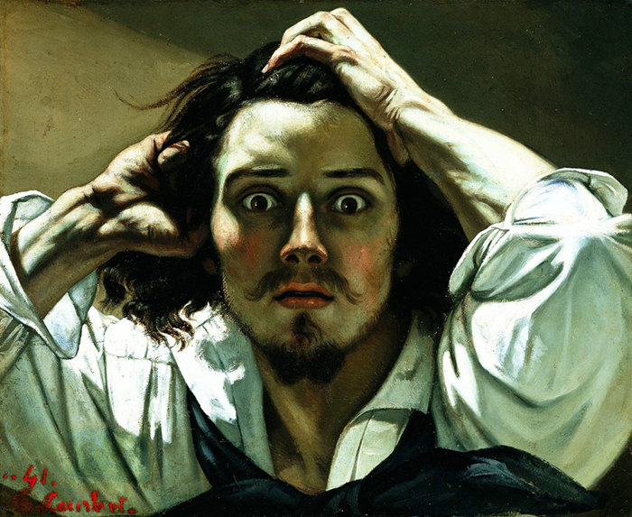
How to look at portraits
Let’s start by looking at this self portrait by Gustave Courbet.
On the following slide, there are a list of questions to ask yourself. Record your answers to each question in your book as you look at this self portrait.

Slide 5
What is your first reaction?
Does your opinion of this artwork change the longer you look at it?
Describe the colours in this portrait.
Which area of the painting is emphasised by the artist?
How does the artist use space? Which parts of the painting are empty? Why?
How does your eye move over the artwork? How does the artist draw your eye to different parts?
Describe this artwork to a person who has never seen it.
What is mysterious about it?
Describe this artist’s personality
What emotion is the artist feeling in this painting?

Slide 6
Art
Self Portraits
So, Year 6, from answering those questions, we can learn that artists do not paint self portraits to show others what they look like.
Artists are much deeper than that, you see. Everything they record on their canvas is a deliberate choice, designed to tell you, the viewer, something about themselves.
Artists paint self portraits to demonstrate to others who they truly are. Despite the fact that artists often concern themselves with things of beauty, it is the emotion and message of the painting that are important, not how the artist appears physically.

Slide 7
Art
Self Portraits
Let us now look at some other portraits of famous artists.
While you look at each one, ask yourself some of the questions from the previous slides so that you can better enjoy and understand the paintings.

Slide 8
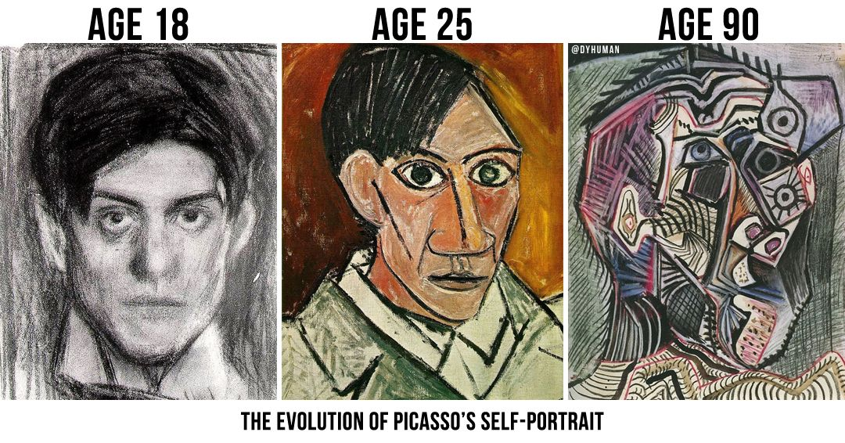
Art
Self Portraits

Slide 9
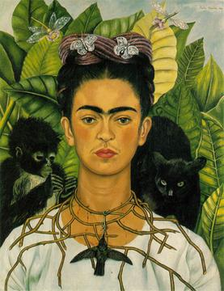
Frida Kahlo
Frida is famous for her self portraits. Some people may look at Frida and raise their eyebrows at her unique style and her facial hair, but Frida was proud of who she was and would never change herself to please others.
Frida was a strong and intelligent artist who did not care about the opinions of others. She was proud of who she was, and used her self proclaimed ‘strangeness’ to become one of the most famous female artists in history.

Slide 10
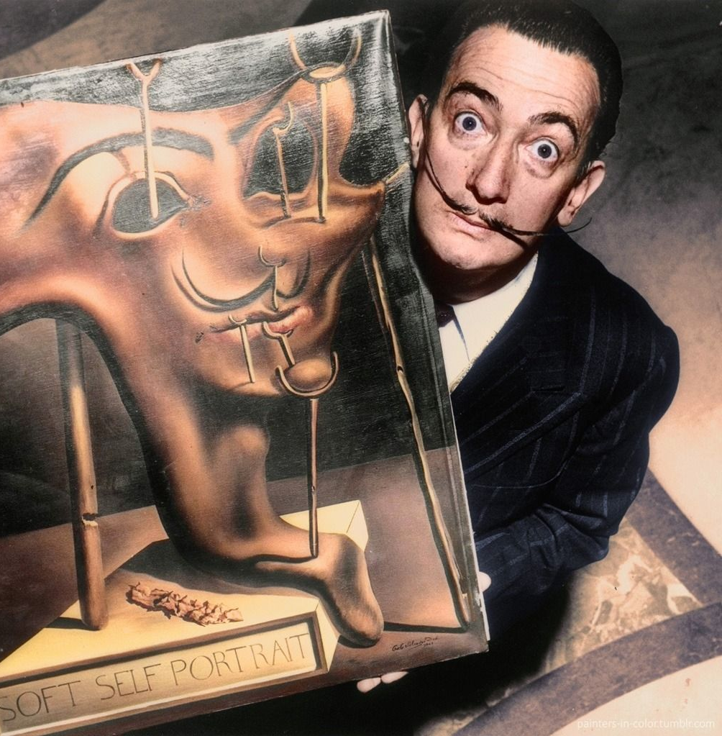
Salvador Dali
Dali is one of the most famous surrealist painters (and Mrs Crane’s personal favourite artist!). Dali’s paintings are characterised by their utterly dream-like and bizarre subjects, while being painted in a comparatively realistic style.
Did you know that Salvador Dali and Walt Disney were friends and created a surrealist animated film together? They first met during a dinner party at the house of Jack Warner (a creator of Warner Bros.)

Slide 11
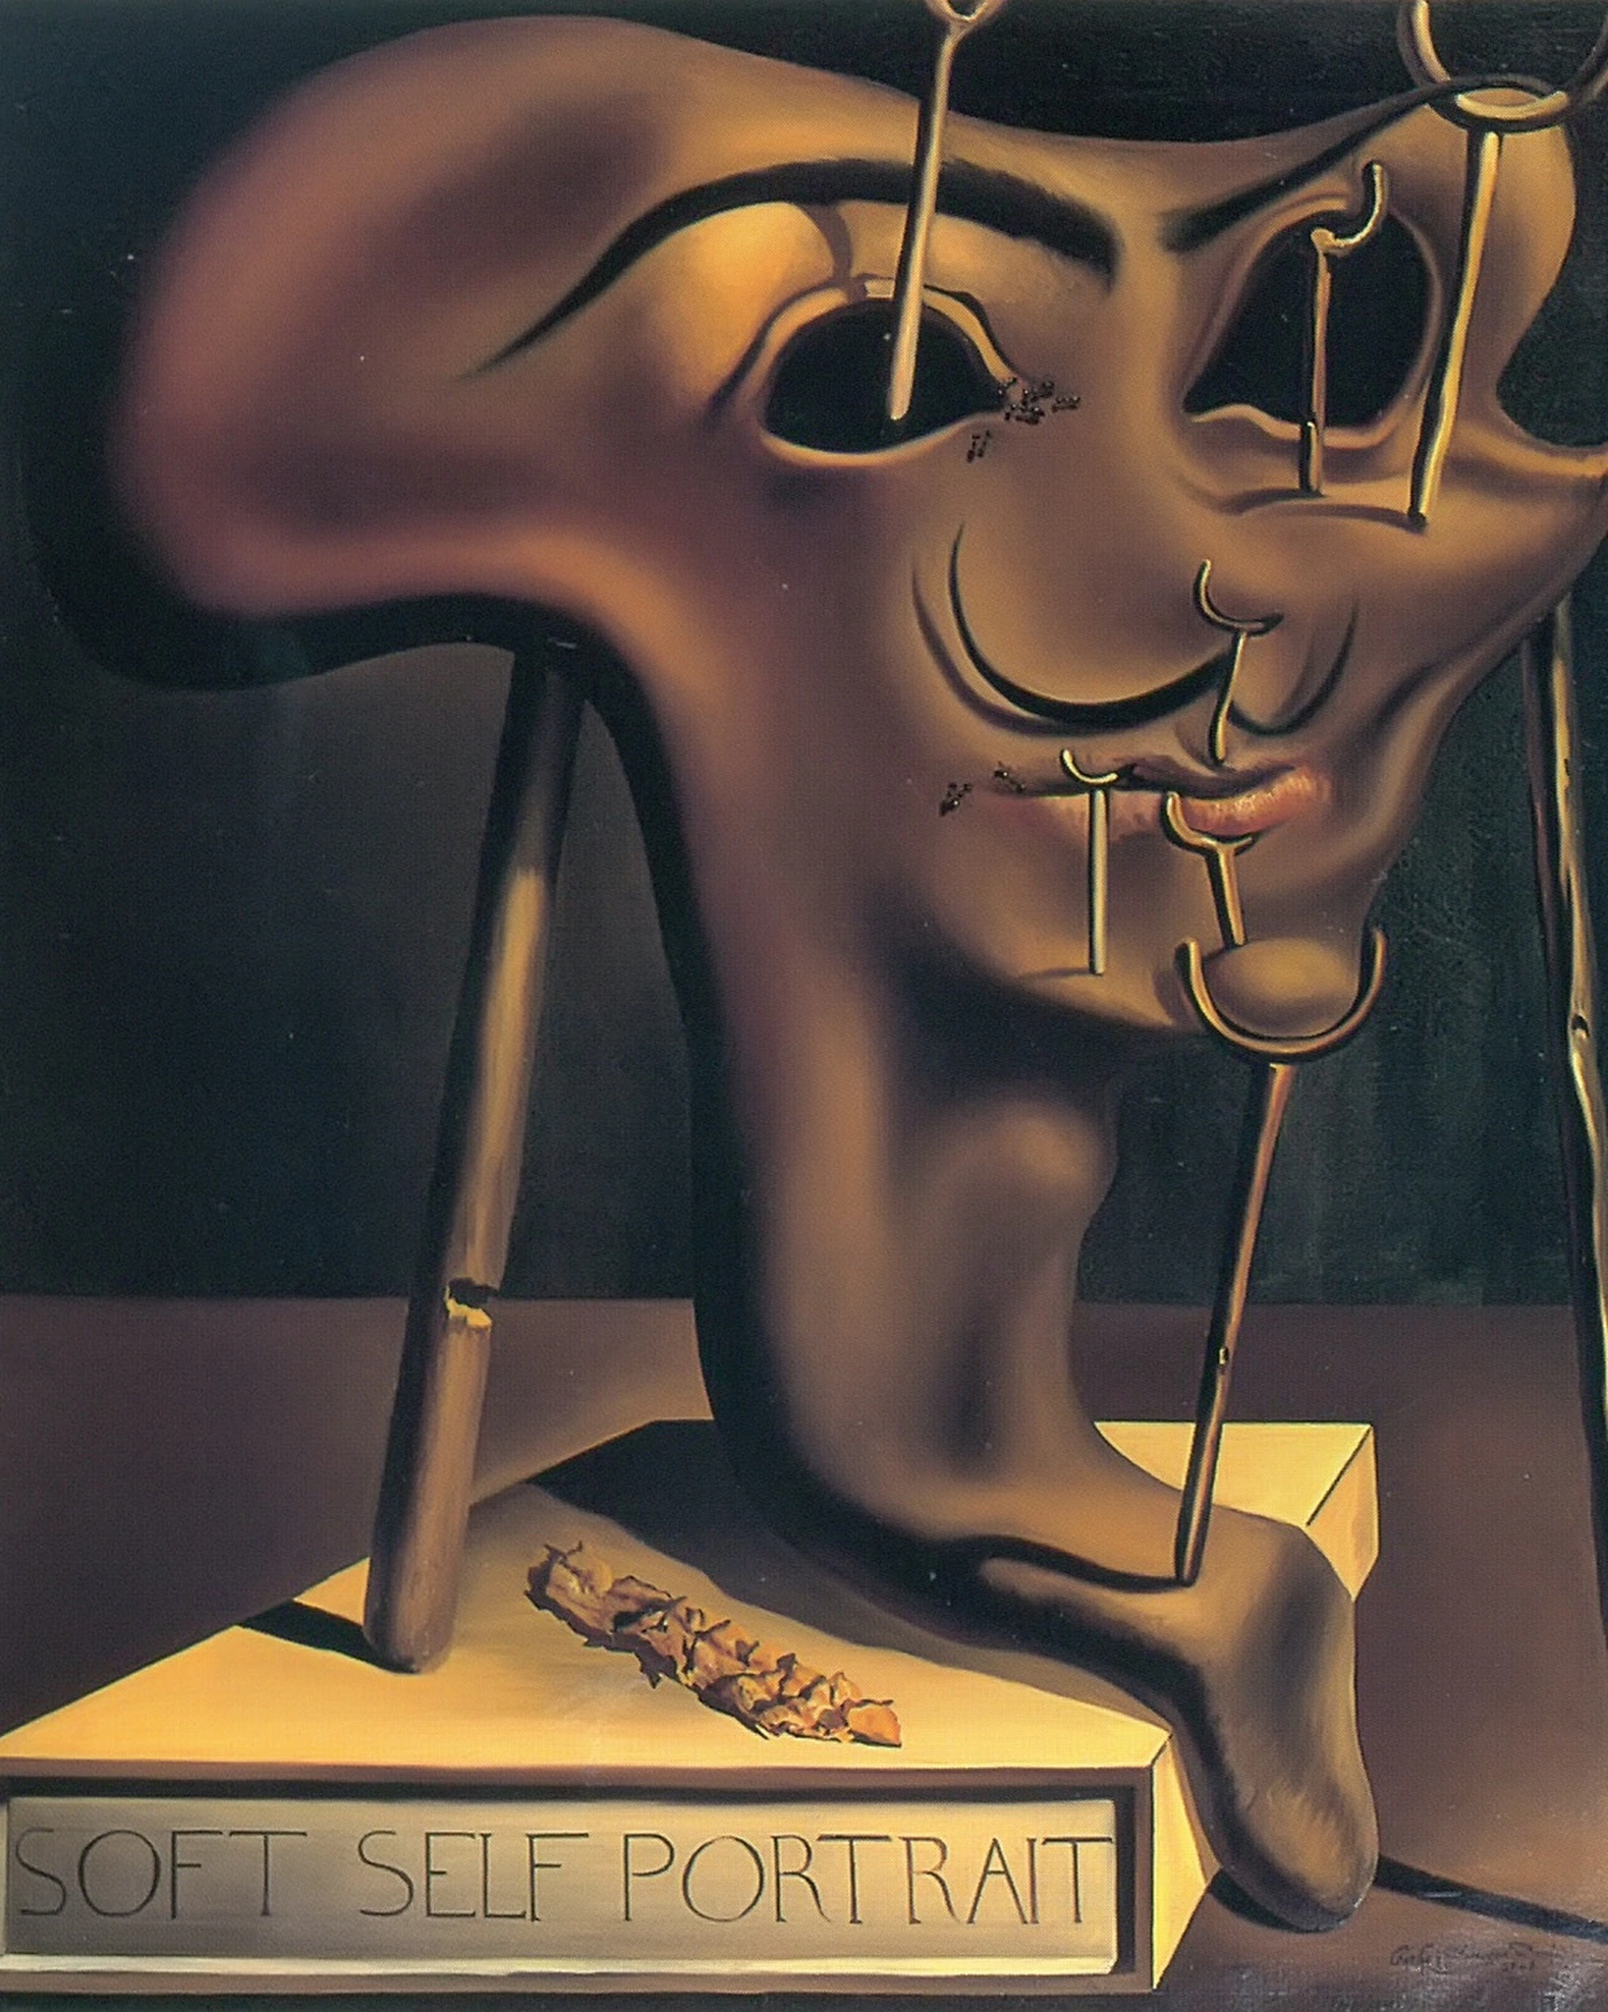
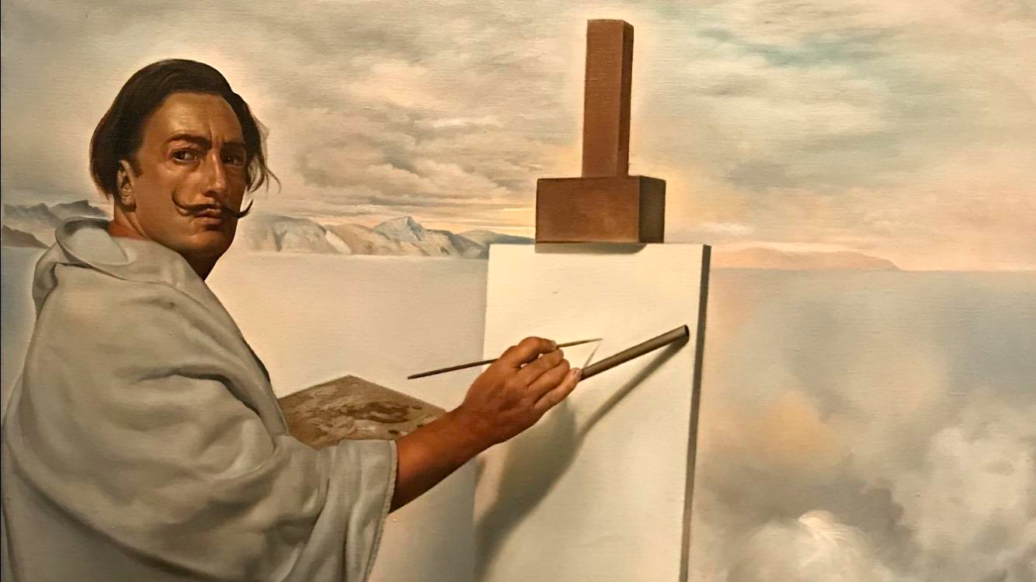
Two of Dali’s Self Portraits
Consider each painting separately using the ten questions. Then compare these two portraits. Why has he depicted himself in such different ways? What is he trying to tell you in each?

Slide 12
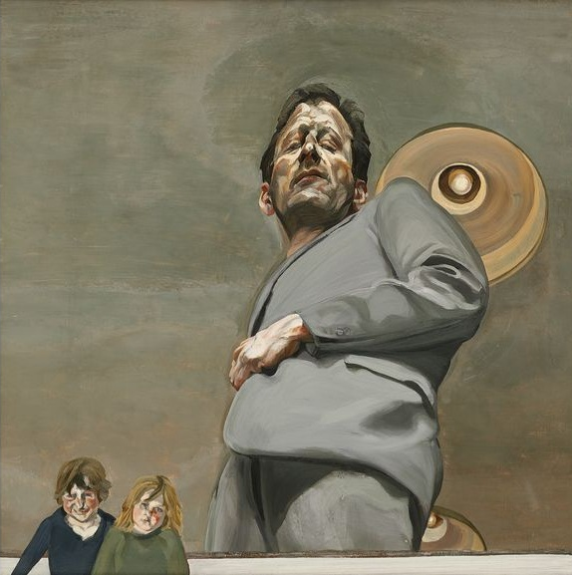
Have a look at this image.
Record your answers to the questions on some paper or you can word process.
What is your first reaction?
Does your opinion of this artwork change the longer you look at it?
Describe the colours in this portrait.
Which area of the painting is emphasised by the artist?
How does the artist use space? Which parts of the painting are empty? Why?
How does your eye move over the artwork? How does the artist draw your eye to different parts?
Describe this artwork to a person who has never seen it.
What is mysterious about it?
Describe this artist’s personality
What emotion is the artist feeling in this painting?
Lucian Freud

Slide 13

Well done on a great day!
Enjoy your evening and be ready for more learning tomorrow...

