Slide 1
Good MoRning Year 6!
Happy Monday morning Year 6! We hope you have had a good weekend with your families. We are looking forward to sharing another week of learning with you.
Please follow the instructions on each page to help you - we look forward to hear about how you have got on!
Mrs Jones, Miss Nolan and Mrs Crane

Slide 2
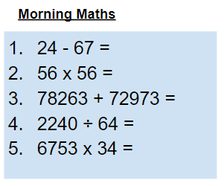
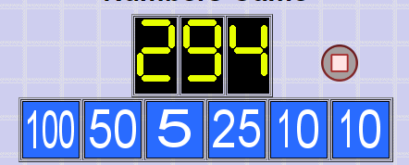
As always, our day will start with Morning Maths.
Give yourself 10 minutes to complete these questions and then try and tackle today’s countdown. If you finish within 10 minutes, check your work and see how many ways you can find to solve the countdown.
After 10 minutes, use the next slide to check your answers and the countdown solver (linked below) to see how to solve today’s problem.
Click the link below and type in the numbers and target to see how the countdown could be solved!
http://www.maths-resources.com/countdown/

Slide 3
Answers
-43
3136
151,236
35
229,602

Slide 4

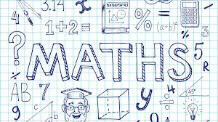
Maths today will be our first lesson on angles.
We may not be learning together in the classroom, but it is important to still remember our classroom beliefs.
WALT: use key angle facts to solve problems.
Today we will not be using My Maths, but instead some White Rose videos and questions to help us to learn and then to test our understanding.

Slide 5
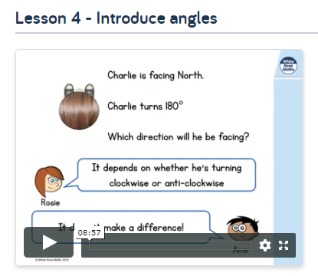

WALT: use key angle facts to solve problems.
To start the lesson, click on the image to the left of the screen. This will take you to the White Rose home learning website.
Click on
Then scroll down to Lesson 4 - introduce angles and click play on the video. This will be a short lesson introducing angles.
Watch the video, pausing where necessary to have a go at the mini quizzes throughout.

Slide 6
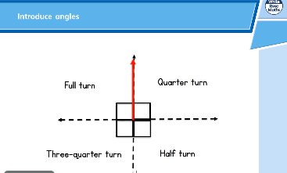
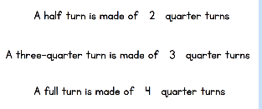
WALT: use key angle facts to solve problems.
A quick recap...

Slide 7
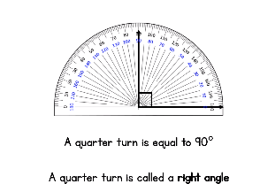
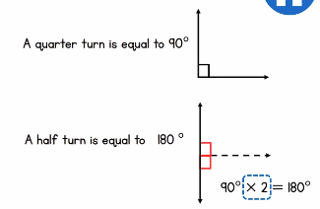
WALT: use key angle facts to solve problems.
A quick recap...

Slide 8
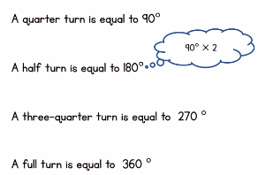
WALT: use key angle facts to solve problems.
A quick recap...

Slide 9
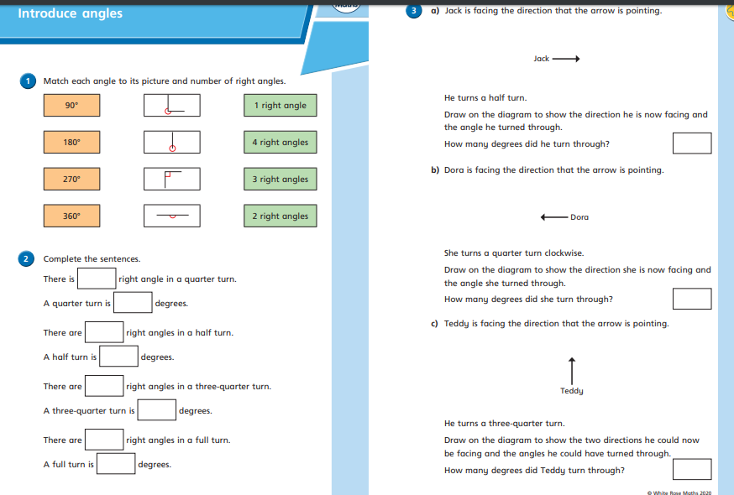

WALT: use key angle facts to solve problems.
Now click the image on the left of the screen, this will take you to a short test where you can test your understanding.
Have a go at the questions, writing down your answers on some paper. If you have a paper pack the questions are on the next few slides.
Once you have completed, click the link below to mark your work against the answers.

Slide 10
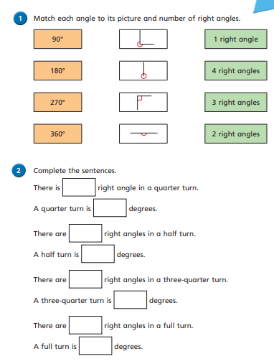
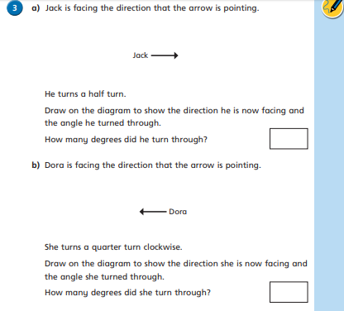
WALT: use key angle facts to solve problems.

Slide 11
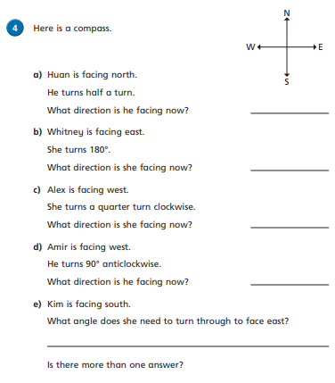
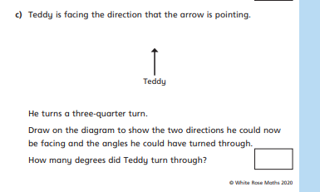
WALT: use key angle facts to solve problems.

Slide 12
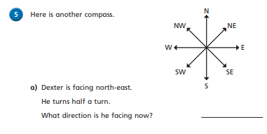
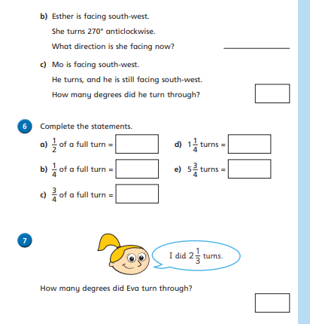
WALT: use key angle facts to solve problems.

Slide 13
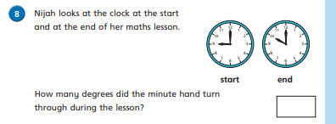
WALT: use key angle facts to solve problems.

Slide 14
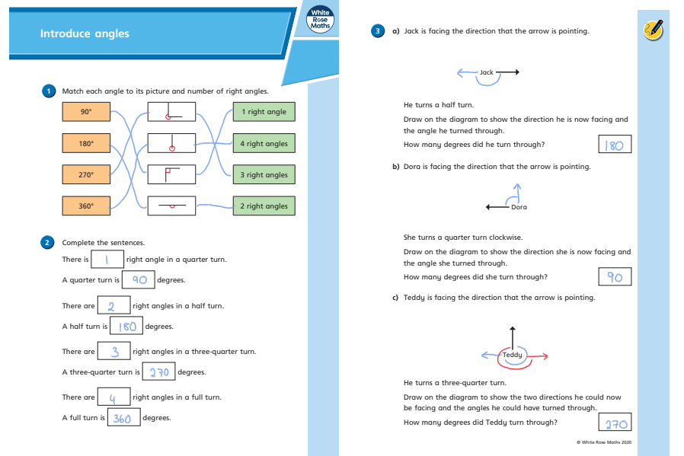
WALT: use key angle facts to solve problems.
Answers

Slide 15
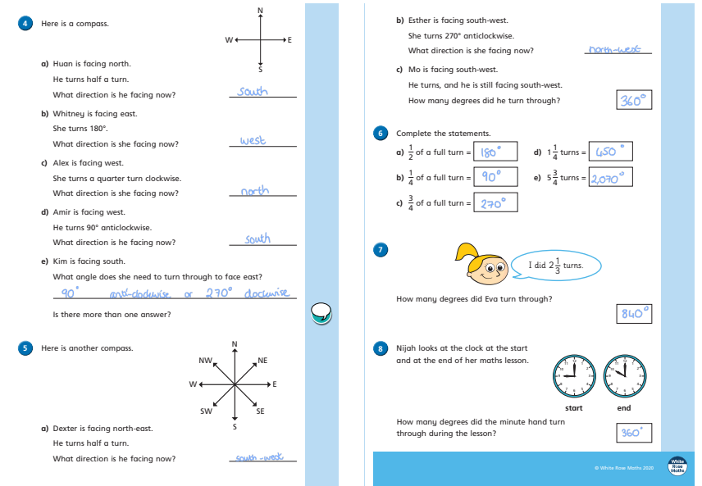
WALT: use key angle facts to solve problems.
Answers

Slide 16
Now you have completed the maths (and had a short break), it’s time for spellings.
Monday - Spelling and handwriting practice.
Copy out these words out twice in your best joined handwriting.
dessert/desert
stationery/stationary
complement/compliment
principle/principal
prophet/profit
We had ice cream and apple pie for dessert.

Slide 17
Spelling - Lesson 1 Homophones
dessert | desert
stationery | stationary
complement | compliment
principle | principal
prophet | profit
Teacher Notes
Can you think of some clever ways to remember which word is which? Find the meaning of the words and see if you can come up with your own way to help you remember which is which.
Note:
stationery/stationary: These words are commonly confused but there is a fun and simple trick to stop you doing the same. Whenever you mean the paper or writing supplies, think about the word paper, which ends in ‘er’. The word you want is also spelt with ‘er’, not ‘ar’, like the word paper.

Slide 18


English - Writing
Lesson 1
© Jamie Thomas for Talk for Writing

Slide 19
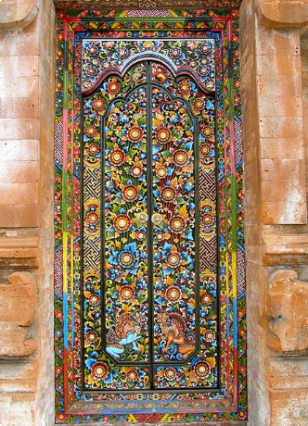
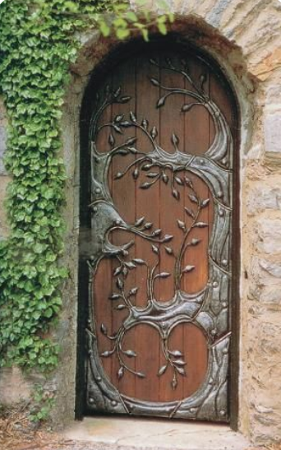
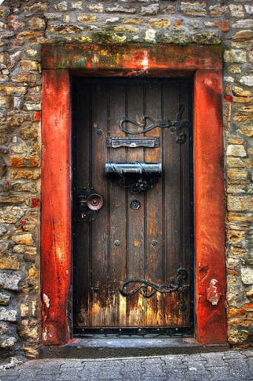
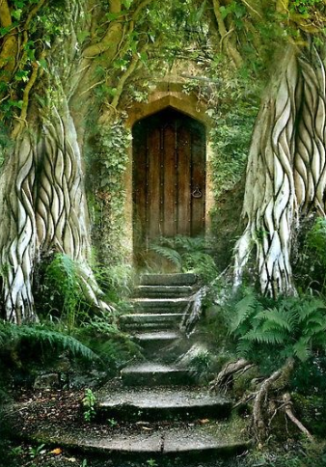
What’s behind the door?

Slide 20
What’s behind the door?
Teacher Notes
Have you ever looked at a door and wondered what might be on the other side? Where may it lead? What may be hiding within? At first glance, a door is just a piece of wood, glass or metal that is opened and closed so that people can get in and out of a room, a vehicle or a space. But in the hands of a writer, a door represents a world of possibility, a world where things are not only hidden but often closed off and restricted.

Slide 21
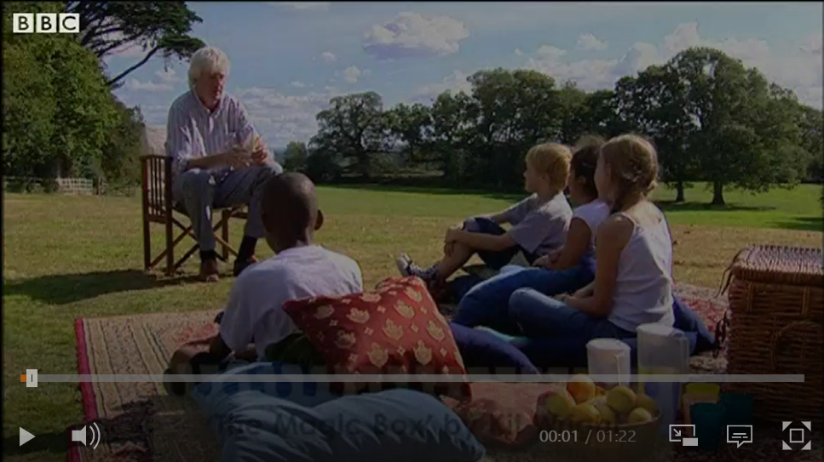
What’s behind the door?
Kit Wright’s poem ‘The Magic Box’
Teacher Notes
In the poem, Kit imagines what may be contained inside a magical box. We can use this idea to connect to what could be behind the magical door.
https://www.bbc.co.uk/bitesize/clips/zkpmhyc
Click on the image or the link to hear the poem

Slide 22
What’s behind the door?
Teacher Notes
We are going to be writing a poem today. Before you begin, create a mind map of ideas for what might be behind the door. Let your imagination run wild as there is no wrong answer.

Slide 23
What’s behind the door?
Here’s an example to help you get going:
I opened the magical door and saw shadows dancing.
I opened the magical door and saw a rainbow leading to another world.
I opened the magical door and saw people crying.
I opened the magical door and saw a magical fairground flooded in lights.
Teacher Notes
Once you have your ideas, have a go at writing a poem, using the repeating opener: I opened the magical door and saw …

Slide 24
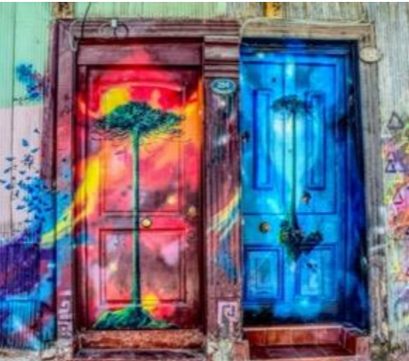
What’s behind the door?
Teacher Notes
Once you have created your poem, go back and see if you can add to it. You could add more description or bring the thing to life through action,
e.g. I opened the magical door and saw a shoal of hungry shadows, tangoing through busy streets.
Have fun adding to your ideas and let your imagination run wild.

Slide 25
What’s behind the door?
The Magical Door
I opened the magical door and saw … a world turned upside down: the sea, now a floating ceiling, the clouds, an inviting carpet.
I opened the magical door and saw … the reflection of myself: standing, searching, staring, questioning how this was possible.
I opened the magical door and saw … a sweet-treat paradise: clouds of candy floss, drifting across a bubble gum sky.
I opened the magical door and saw … a field of waves: blue potatoes were leaping, playing in white foam, as puzzled farmers watched from sunny shores.
I opened the magical door and saw … The image of a street I used to know, But as I entered, everything changed; As I reached out, everything had gone.
I opened the magical door and saw … A forest of mirrors, surrounding me in dazzling white light, leading me into a world of mystery.
I opened the magical door and saw… A feast of my favourite foods Guarded by monster chips Waiting to fight off all invaders.
I opened the magical door and saw … Monstrous mobile phones Herding people into little houses And laughing, laughing, laughing.
I opened the magical door and saw… The future.
Teacher Notes
Here is an example of a poem to help you get ideas.
© Talk for Writing

Slide 26

Good Afternoon Year 6!
Let’s start our afternoon with a quick burst of energy!
Get your PE kit at the ready because at the start of each afternoon session we will be joining Joe Wicks for our daily workout.
Do as much as you can and over the week you should find you are getting fitter and finding it easier.
Let’s go!
Click the youtube link below and select today’s date from the videos listed.
https://www.youtube.com/channel/UCAxW1XT0iEJo0TYlRfn6rYQ

Slide 27
Design and Technology
Cooking
Aims of the week for DT:
To understand that fruit and vegetables are seasonal
To apply our knowledge of healthy eating
To design, prepare and evaluate a healthy meal

Slide 28
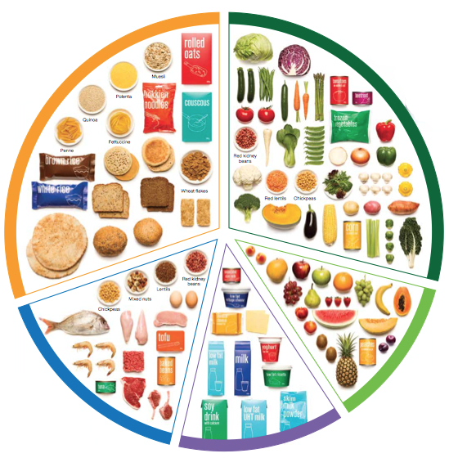
Design and Technology
Can you remember the different components of a healthy diet?
Why is it important to have a balanced diet?

Slide 29
Vegetables and fruits are full of fiber, antioxidants and vitamins. They keep your digestive system healthy. Fruits contain sugar, so make sure you eat a variety of both vegetables and fruits.
Carbohydrates give you energy.
Proteins are the building blocks of the body. They help the body to grow and repair itself.
Dairy products are full of calcium, protein, and vitamins A and D. They keep our teeth and bones healthy.

Slide 30
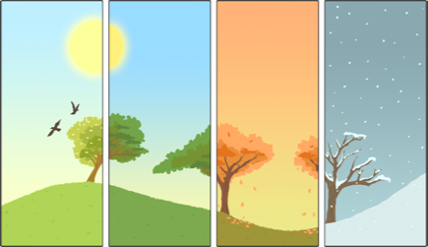
Seasonality
In the UK, different fruits and vegetables are ripe and ready to eat at different times of the year.
This is called seasonality.

Slide 31
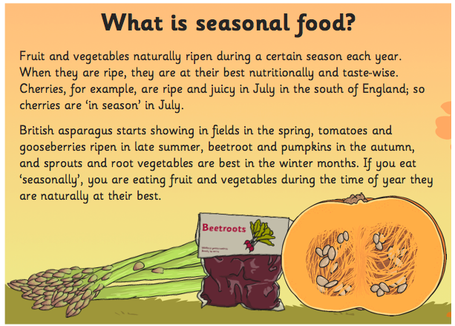

Slide 32
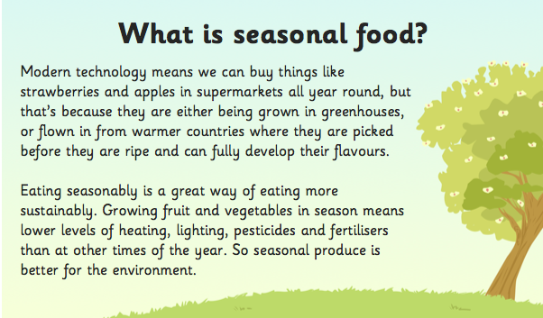

Slide 33
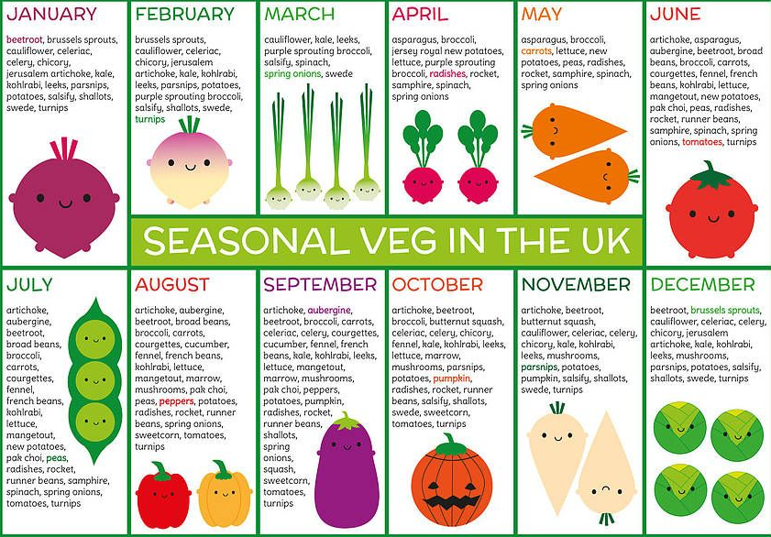
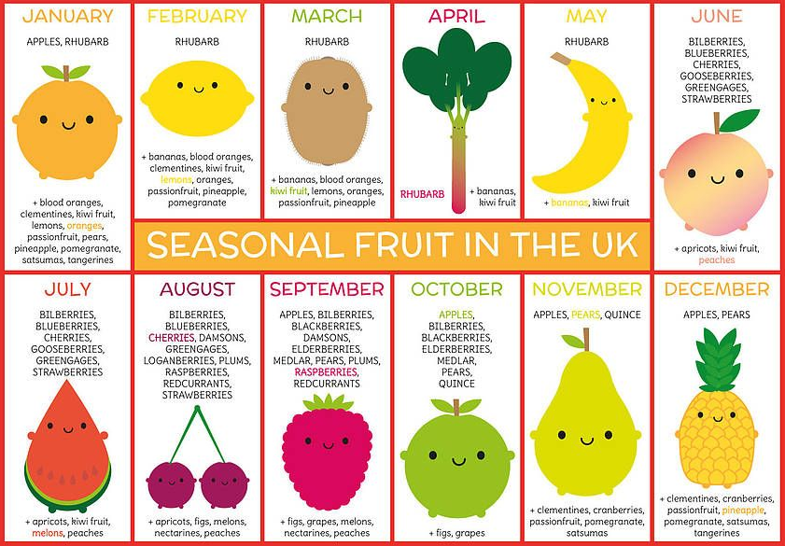
UK Seasonality Chart
The following charts show which fruits and vegetables are seasonal at what times of year.
Please note: All vegetables listed are grown in the UK.
Many fruits cannot be grown in the UK due to our climate. The UK grown seasonal fruits are in UPPERCASE.
Seasonal imported fruits are in lowercase.

Slide 36
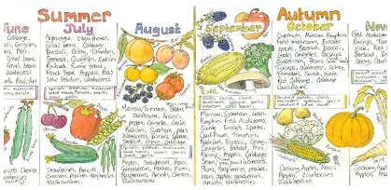
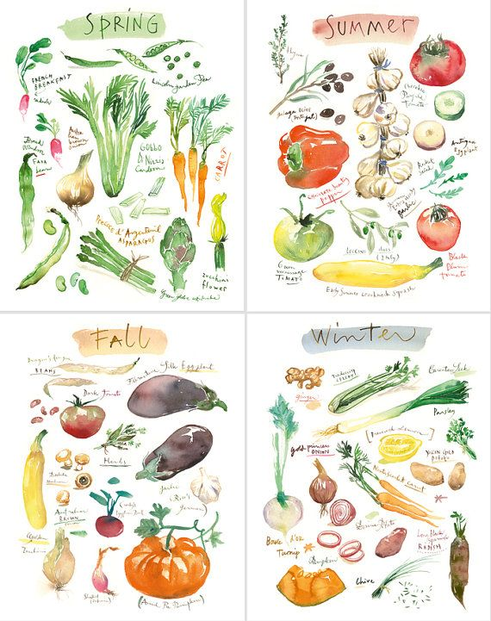
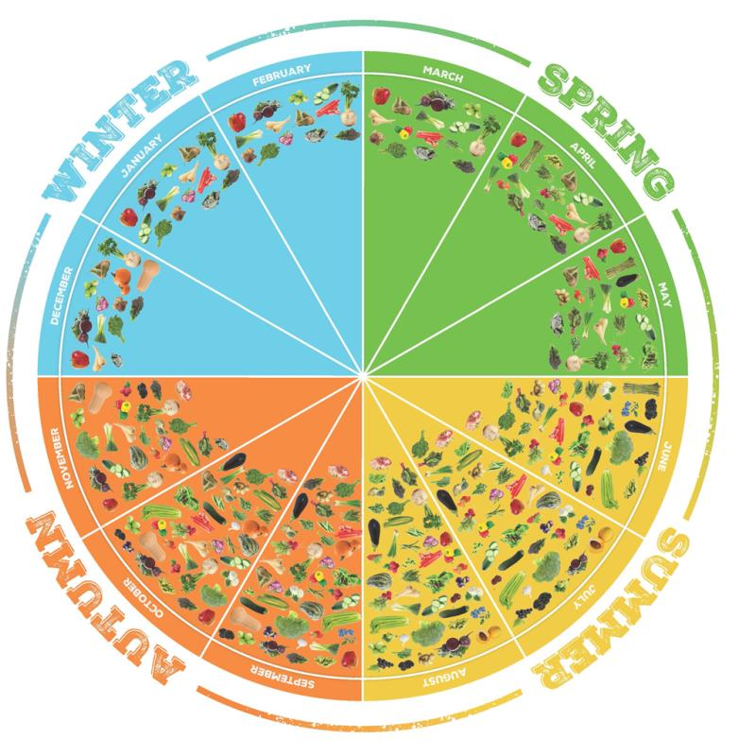
Seasonality Activity
Create a poster displaying seasonal fruit and vegetables in the United Kingdom. Ideas for your poster are shown below.

Slide 37

Monday complete!
Well done on a great day!
Enjoy your evening and be ready for more learning tomorrow...

