Slide 1
Good MoRning Year 6!
We are really proud of how hard you are working! Keep it up!
Please follow the instructions on each page to help you - we look forward to hear about how you have got on!
Mrs Jones and Miss Nolan

Slide 2
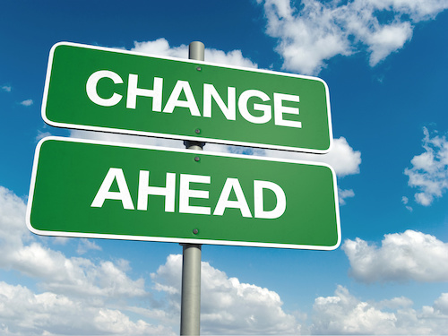

This fortnight’s theme is
Transition
Day 3 - 9.7.20

Slide 3
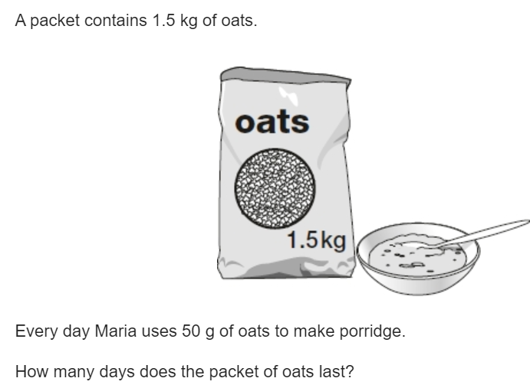

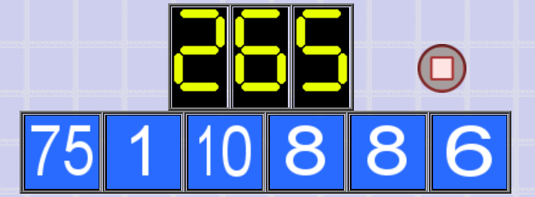
Morning Maths
8.
9. What is 444 minutes in hours and minutes?
10.
1,210 ÷ 11 =
20% of 3,000 =
6² + 10 =
56.38 + 24.7 =
785 x 23
6.
7. Which calculation does not equal 10?
4 x 3 - 2 2 + 3 x 2 (15 + 5 ) ÷ 2
Notes:
Children complete in maths book.
They have 15 minutes to complete independently.
Spend 10 minutes at the end of the session going through the answers and the children self mark.

Slide 4
ANSWERS
8.
9. What is 444 minutes in hours and minutes? 7 hours and 24 minutes
10.
1,210 ÷ 11 = 110
20% of 3,000 = 600
6² + 10 = 46
56.38 + 24.7 = 81.08
785 x 23 = 18,055
6.
7. Which calculation does not equal 10?
4 x 3 - 2 2 + 3 x 2 (15 + 5 ) ÷ 2
30
10/7 - 4/7 = 6/7
8 - 1 = 7
7 x 6 = 42
42 - 8 = 34
34 * 10 = 340
340 - 75 = 265

Slide 5

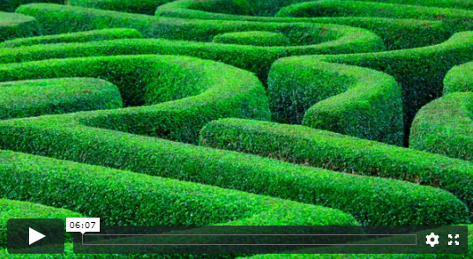
Meditation Time
Click the image to begin today’s guided meditation.
Notes:
Teacher notes:
https://church.heartsmartresource.com/heartfulnessc8480e16
Play the Audio meditation ‘No way through isn’t true’’
Children to remain at tables.
If any problems logging in, see details below:
Go to:
https://church.heartsmartresource.com/
Log in as office@stcatherines.worcs.sch.uk (everyone must use this login NOT their personal email address)
The password is Borisboris.
Click on Year 6, then Heartfulness to access the guided meditations.

Slide 6

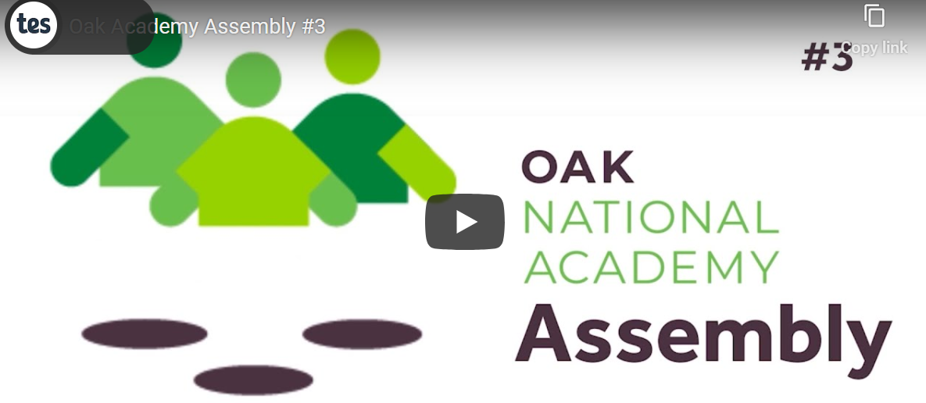
Assembly Click on title or image below to access the weekly assemblies
Thursday Collective Worship 11am
Live Stream

Slide 7

St Catherine’s Classroom Beliefs
Mistakes are valuable.
Everyone can learn maths to the highest level.
Questions are really important.
Depth is more important than speed.
Maths is about making connections.

Slide 8
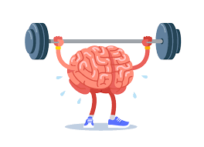
9.7.20
WALT: apply our mathematical knowledge to a variety of questions.
Today we will continue to have a go at solving a range of mathematical problems - they may get tricky but don’t give up! Get that brain working!
Notes:
Notes:

Slide 9
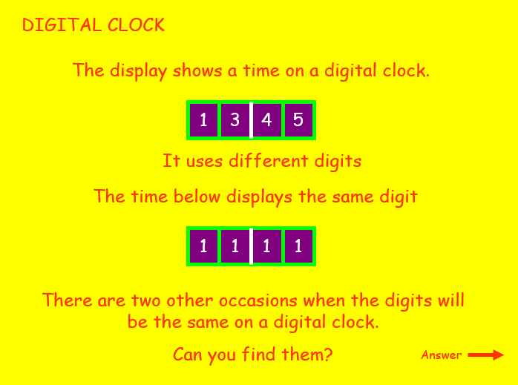
9.7.20
Challenge 1
Notes:
Notes:

Slide 10
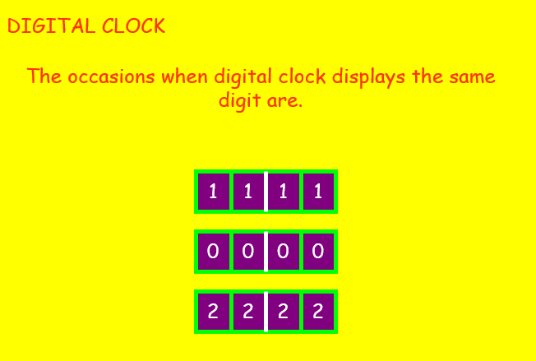
9.7.20
Challenge 1 - Solution
Notes:
Notes:

Slide 11
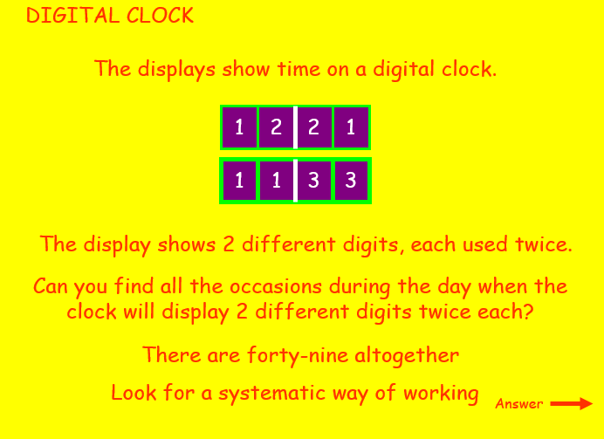
9.7.20
Challenge 2
Notes:
Notes:

Slide 12
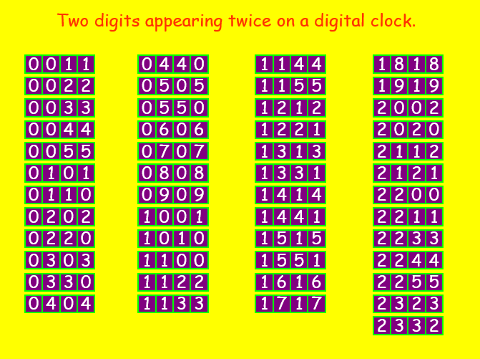
9.7.20
Challenge 2 - Solution
Notes:
Notes:

Slide 13
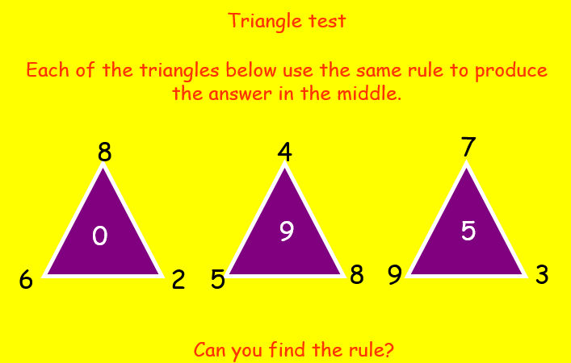
9.7.20
Challenge 3
Notes:
Notes:

Slide 14
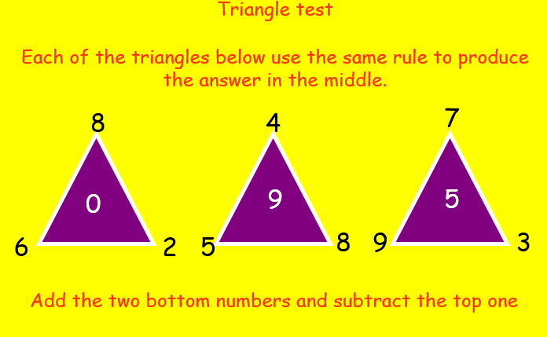
9.7.20
Challenge 3- Solution
Notes:
Notes:

Slide 15
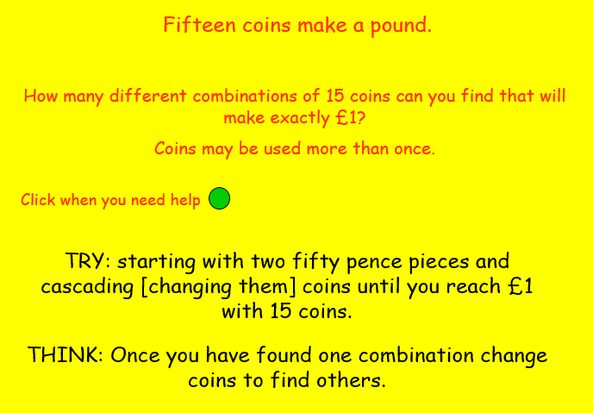
9.7.20
Challenge 4
Notes:
Notes:

Slide 16
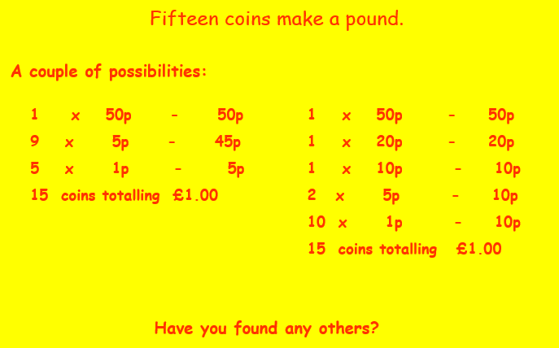
9.7.20
Challenge 4 - Solution
Notes:
Notes:

Slide 17
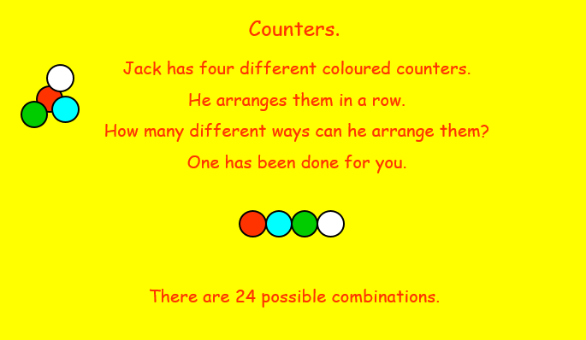
9.7.20
Challenge 5
Notes:
Notes:

Slide 18
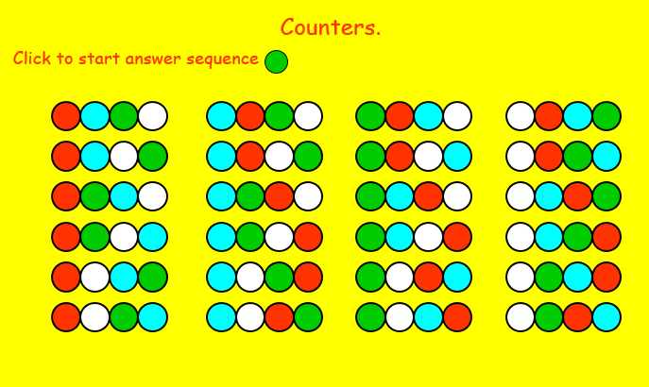
9.7.20
Challenge 5 - Solution
Notes:
Notes:

Slide 19
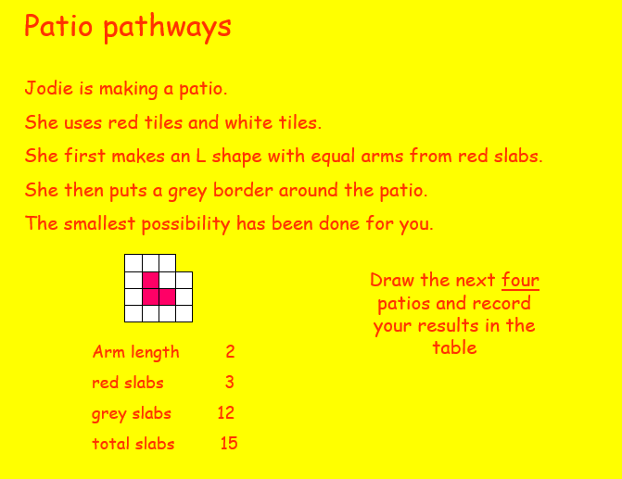
9.7.20
Challenge 6
Notes:
Notes:

Slide 20
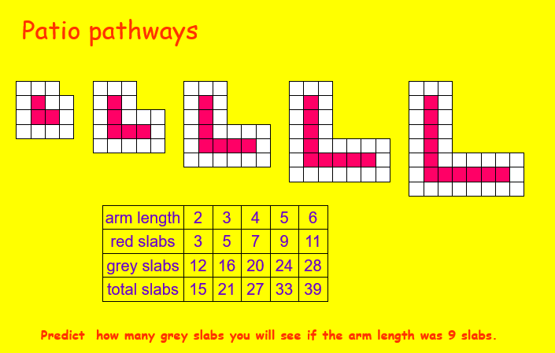
9.7.20
Challenge 6 - Solution
Notes:
Notes:

Slide 21

Grammar
Reading = Rainforest Calling

Slide 22
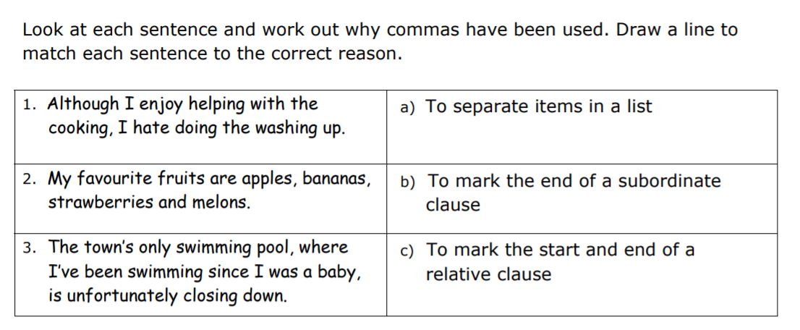
Thursday Grammar

Slide 23
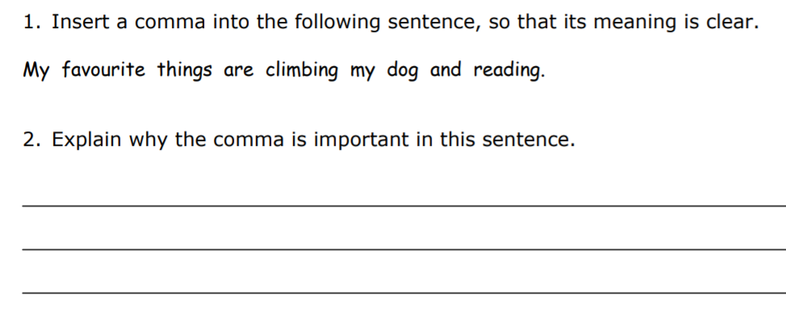
Grammar

Slide 24
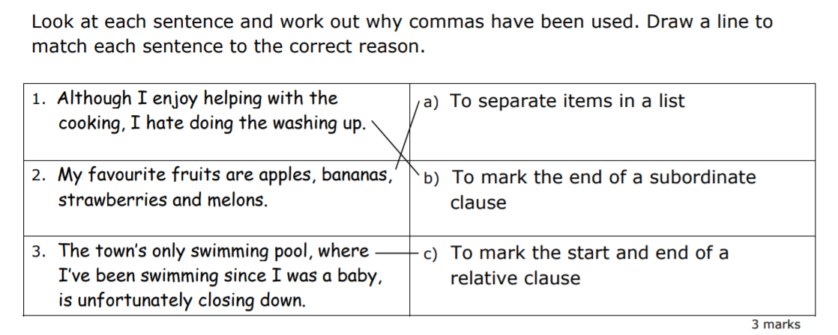
Grammar
Answers

Slide 25
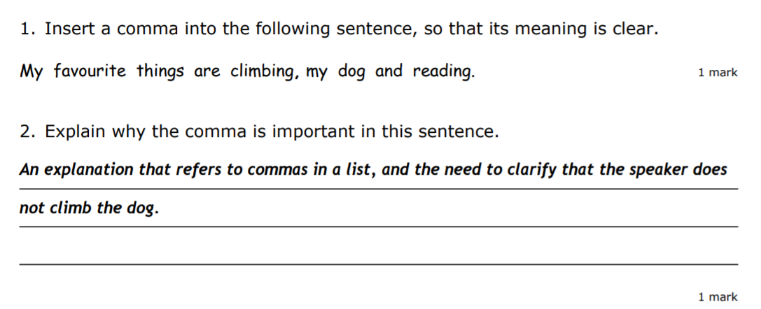
Grammar
Answers

Slide 26
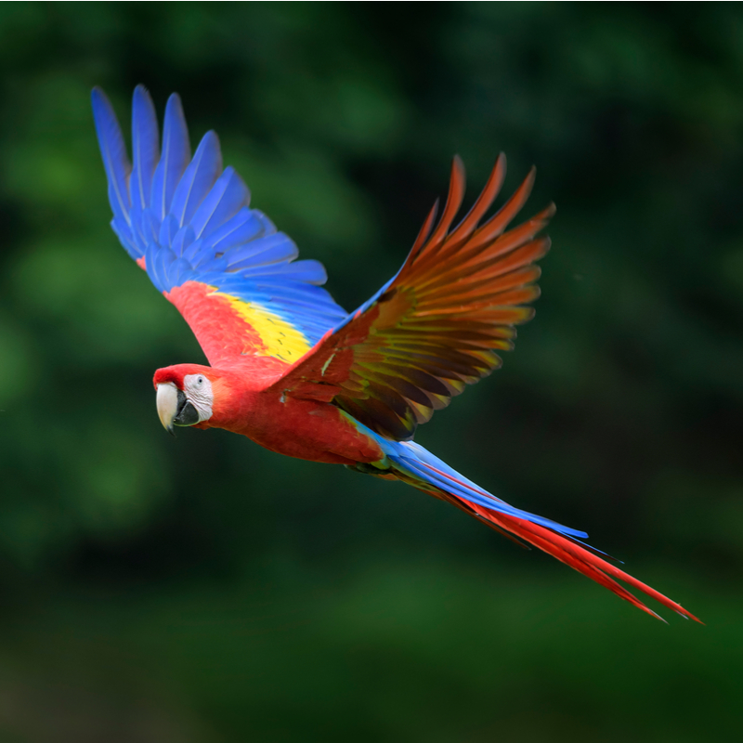
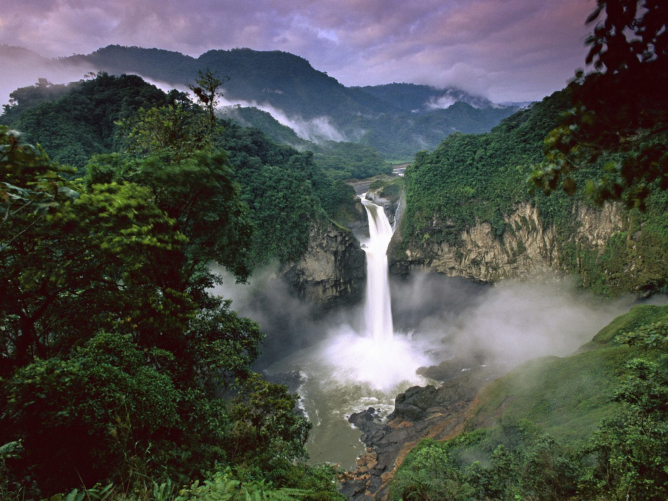
READING - Rainforest Calling
WALT: Make inferences using evidence from the text.

Slide 27
READING - Rainforest Calling
WALT: Make inferences using evidence from the text.
9:50 a.m.
I wonder if the person who gave the rainforest its name had ever actually been there. Surely, if they had, they’d have called it the ‘plant forest’ instead. Mrs Curtis, my teacher, told us that more than two thirds of the world’s plant species live in rainforest environments. That’s more than 80,000 different plants! There’s no way that I’m telling my Grandma Wilkins that! She’d be on the first plane to Brazil with her lucky gardening gloves because she really loves plants. Do you know, she once told me that she might love plants even more than she loves my mum! Don’t worry, I haven’t told my mum that.
That’s one of the reasons why I volunteered for this project – so that I could tell my grandma about all the plants. Mrs Curtis wanted one of us to spend a whole week looking at some webcams in the Amazonian rainforest.
I put my hand straight up. My best friend, Millie, said that the last time she’d seen anything move as fast as my arm was when someone told her daft brother that the bank was giving away free money. Who wouldn’t volunteer to spend the whole week looking at the Amazon? I think that I’d be really good at spotting all the different plants and animals.
Notes:
All children whisper read text independently first.
Choral read the text together - read aloud with the children
Discuss any vocabulary they are unsure about - children can annotate the text if needed.

Slide 28
READING - Rainforest Calling
WALT: Make inferences using evidence from the text.
As soon as Mrs Curtis looked at me, I knew that I hadn’t been picked. She had the same expression on her face that she uses to tell us that we’ve got a maths question wrong as she said, "Maybe next time, Daisy." Jack Walters got picked instead, but he changed his mind when he found out that we’re only allowed to look at the webcams during our breaks and at lunchtime. He said that there was no way that he was going to miss playing football in the playground. So Mrs Curtis ended up choosing me anyway! I don’t mind having to do normal lessons I got nine out of ten on my spellings last week. Still can’t spell rhinnosoraus, though.
Mrs Curtis said that I have to write a journal entry to tell the rest of the class what I’ve seen on the webcams. I haven’t written a journal before. The only things I write at home are lists of my favourite songs and the things I want for Christmas, but Mrs Curtis said not to worry and to just write as I like to speak. I think that should make it easier!
Notes:
4. Read the questions with the children
5. Reread the text together and children underline any answers they can find to support the questions. See next slide for teachers notes and annotations.
6. Children write the answers to the questions in their books.

Slide 29
READING - Rainforest Calling
WALT: Make inferences using evidence from the text.
A ‘green conversation’ charity set the webcams up a few years ago (I’m not actually sure what a green conversation is, or a red or yellow or pink conversation either) and when Mrs Curtis logged on with her laptop, she showed me that we can move the webcams with the arrows on the keyboard. If I want to move left or right, up or down, I just press the arrows. I can even move from camera to camera so that I can explore each layer of the rainforest! Mrs Curtis also said that the Amazon rainforest is over 5,000 miles away from our school, yet I can still move the lens in any direction I want. Sometimes, technology is amazing!
I’d love to spend all my time looking for the monkeys, or even a Bigfoot! My dad says that scientists claim there are still over five million animal species waiting to be discovered in the world, and most of those probably live in the rainforest. He wants me to keep my eyes peeled for a Bigfoot because he says, “Daisy, that’ll be like winning the lottery!”
Anyway, my dad thinks that he knows lots about the rainforest. I think that he might have read the same books as Mrs Curtis because they both said that lots of what we all take for granted comes from the rainforest. Those beans that they use to make chocolate come from there, and pineapples, too, plus the ginger that goes into yummy biscuits... even rubber for the soles of my trainers.

Slide 30
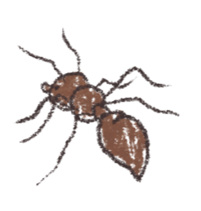
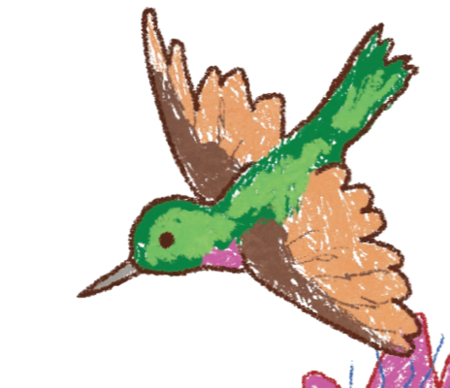
READING - Rainforest Calling
WALT: Make inferences using evidence from the text.
Millie says that her uncle has an important job at the city museum and he reckons that more than twenty-five percent (that’s a quarter) of all medicines use plants from the rainforest. So if you stay up too late and have a headache, or get an iffy tummy after you’ve eaten one of your dad’s home-made curries, the medicine that you are given could be made from rainforest plants. How amazing is that?
What I’d really like to find, though, is a new kind of flower - maybe one of those beautiful orchids. When you find something new like that, those clever people you see on the documentary channels sometimes let you name them. I’d call mine the Wilkins orchid, after Grandma Wilkins. That would make her feel very important, and she tells me that she’s always wanted to be a VIP!

Slide 31
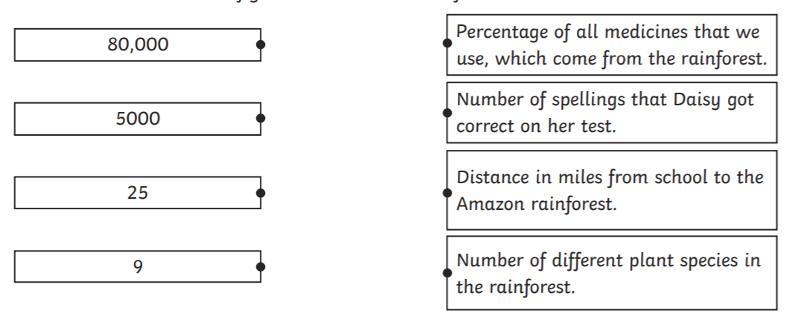
READING - Rainforest Calling
WALT: Make inferences using evidence from the text.
Questions:
1. What is the meaning of the word ‘volunteered’?
2. Draw lines to match these figures with the correct information.

Slide 32
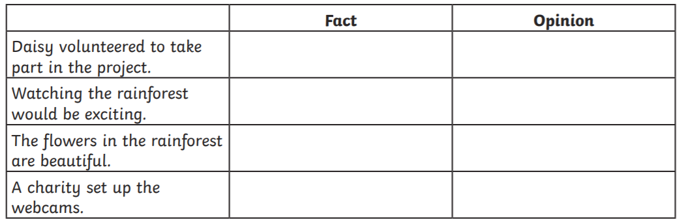
READING - Rainforest Calling
WALT: Make inferences using evidence from the text.
Questions:
3. Complete the table by showing whether each statement is a fact or an opinion.
4. How do you think Daisy feels about being chosen to take part in the project? Give evidence for your answer.
5. What kind of relationship do you think Daisy has with her grandma? Use evidence from the text to support your answer.

Slide 33
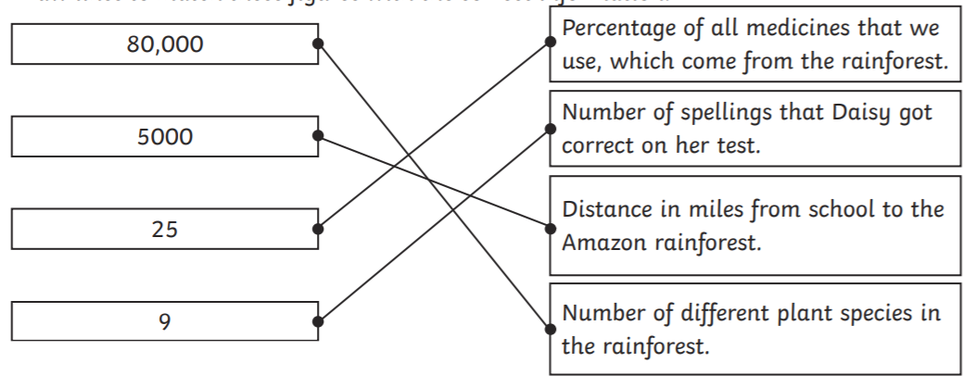
READING - Rainforest Calling Answers
WALT: Make inferences using evidence from the text.
Questions:
1. What is the meaning of the word ‘volunteered’?
offered freely and willingly/was not told to do it/put herself forward
2. Draw lines to match these figures with the correct information.

Slide 34
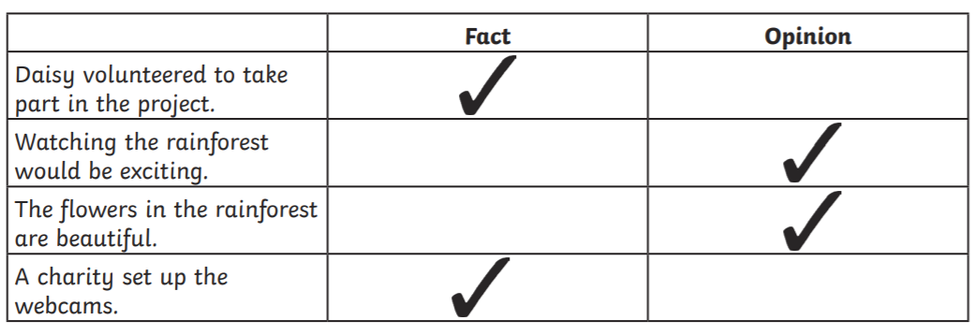
READING - Rainforest Calling Answers
WALT: Make inferences using evidence from the text.
Questions:
3. Complete the table by showing whether each statement is a fact or an opinion.
4. How do you think Daisy feels about being chosen to take part in the project? Give evidence for your answer.
Accept a response that explains that Daisy is happy/pleased/delighted to be chosen because she volunteered/she really wanted to take part. Accept evidence to show Daisy’s reasons or enthusiasm, e.g. she could tell her grandma about the plants/she could look for a new kind of flower. Also accept answers indicating Daisy is relieved as she was not picked first/annoyed because Jack was picked first.

Slide 35
READING - Rainforest Calling Answers
WALT: Make inferences using evidence from the text.
Questions:
5. What kind of relationship do you think Daisy has with her grandma? Use evidence from the text to support your answer.
Accept an answer that shows Daisy’s relationship with her grandma is good/close/ Rainforest Calling 9 25 5000 80,000 Percentage of all medicines that we use, which come from the rainforest. Number of spellings that Daisy got correct on her test. Distance in miles from school to the Amazon rainforest. Number of different plant species in the rainforest.
Accept evidence, such as: she wants to name a flower after her/she thinks of her grandma instantly/she talks a lot about her grandma. Do not accept answers which just state things that her grandma likes, such as gardening or plants, without reference to Daisy’s bond with her grandma.

Slide 36

Good Afternoon Year 6!
Let’s start our afternoon with a quick burst of energy!
Get your PE kit at the ready because at the start of each afternoon session we will be joining Joe Wicks for our daily workout.
Do as much as you can and over the week you should find you are getting fitter and finding it easier.
Let’s go!
Click the youtube link below and select today’s date from the videos listed.
https://www.youtube.com/channel/UCAxW1XT0iEJo0TYlRfn6rYQ

Slide 37
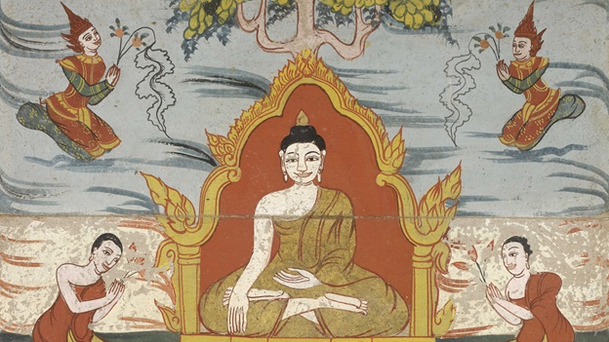
Religious Education
WALT: understand that Buddhists follow the Eightfold Path and know the rules involved.

Slide 38
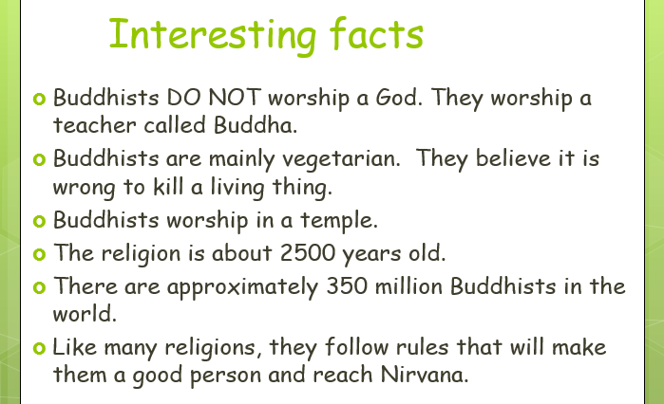
What can you remember about Buddhism from last week?
Here are some interesting facts about the religion....

Slide 39

Discussion
Do we need rules?
What rules do you have at home and school?

Slide 40
Like many religions Buddhists have rules that they are expected to follow.
Following the rules will help Buddhists reach Nirvana (perfect peace).
What are the rules of Buddhism?

Slide 41

This is the wheel of Dharma - it helps Buddhists remember the 8 rules of Buddhism.

Slide 42
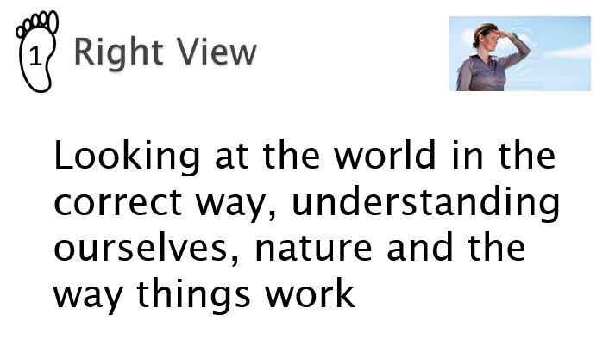

Slide 43
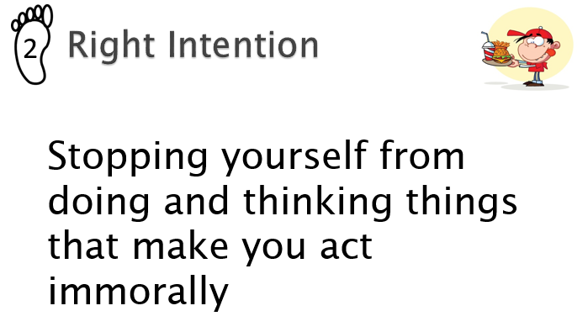

Slide 44
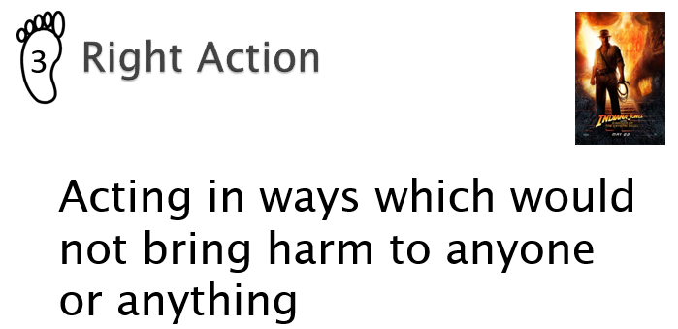

Slide 45
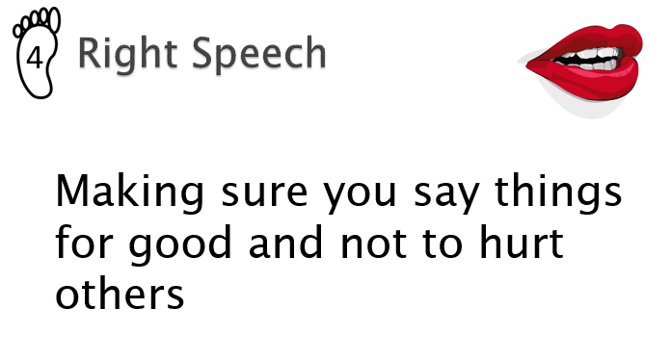

Slide 46
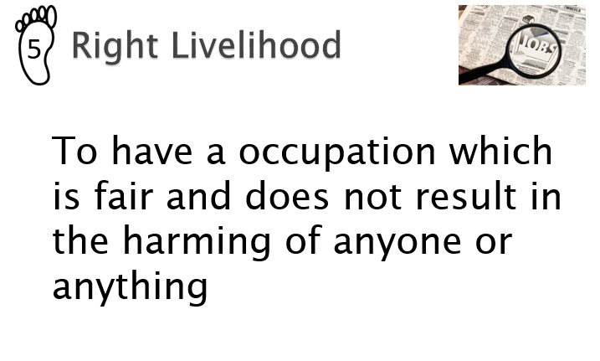

Slide 47
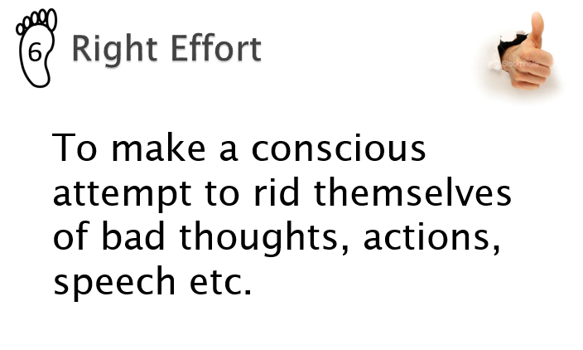

Slide 48
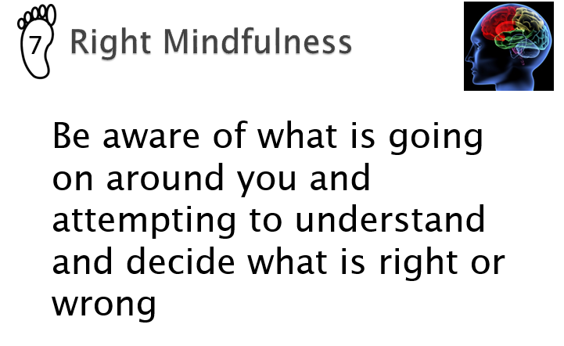

Slide 49
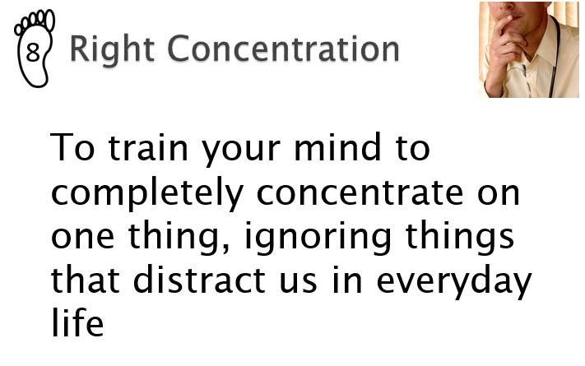

Slide 50
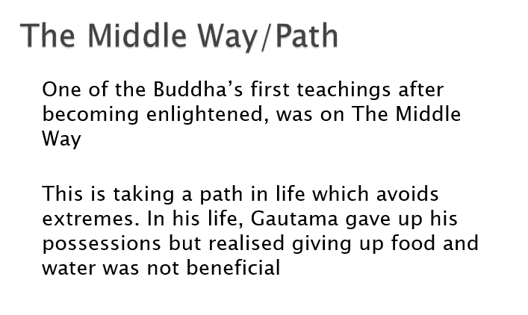

Slide 51
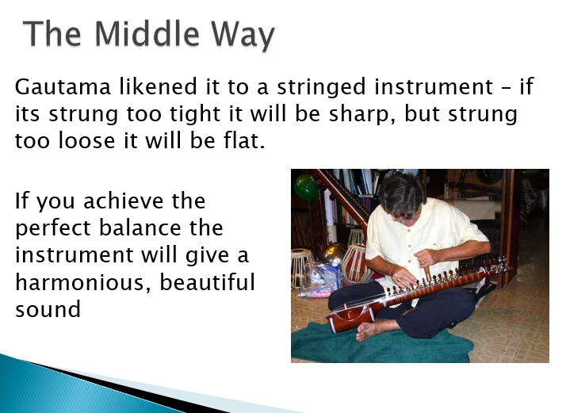

Slide 52
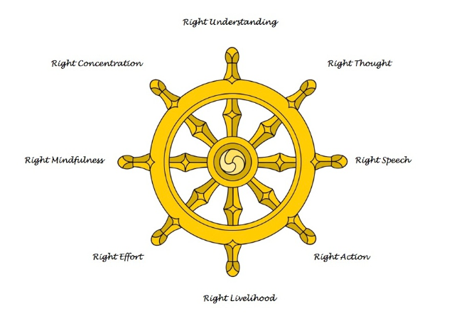

Your Task
Give an example of how you would act to follow the way set down by Buddha in their own search for enlightenment.
Then evaluate whether Buddha’s teachings are helpful in modern life.
I could show the Right Speech by paying my friends a compliment for no reason!

Slide 53

Well done on a great day!
Enjoy your evening and be ready for more learning tomorrow...

