Slide 1
Good MoRning Year 6!
Well Done Year 6, you have worked hard this week and we couldn’t be more proud of you. Have a wonderful weekend with your family.
Please follow the instructions on each page to help you - we look forward to hear about how you have got on!
Mrs Jones and Miss Nolan

Slide 2
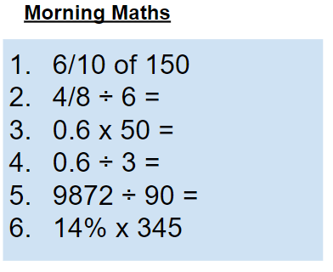
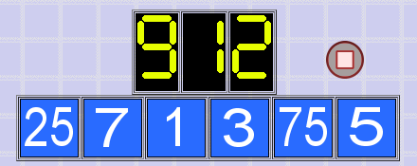
As always, our day will start with Morning Maths.
Give yourself 10 minutes to complete these questions and then try and tackle today’s countdown. If you finish within 10 minutes, check your work and see how many ways you can find to solve the countdown.
After 10 minutes, use a calculator to check your answers and the countdown solver (linked below) to see how to solve today’s problem.
Click the link below and type in the numbers and target to see how the countdown could be solved!
http://www.maths-resources.com/countdown/

Slide 3

We may not be learning together in the classroom, but it is important to still remember our classroom beliefs.
WALT: consolidate our understanding of ratio.
Today we will be completing an end of unit check for ratio and proportion.
It would be a good idea to perhaps spend 10 minutes or so looking through the My Maths lessons from the last two weeks if you need a refresh. There is also some revision material on the next two slides to have a read through.
Once you are ready the questions are on the following slides. There are optional additional questions for you to answer if you want an extra challenge!
The answers are on the final maths slides for today - use them only to check your learning - there is no point in cheating.

Slide 4
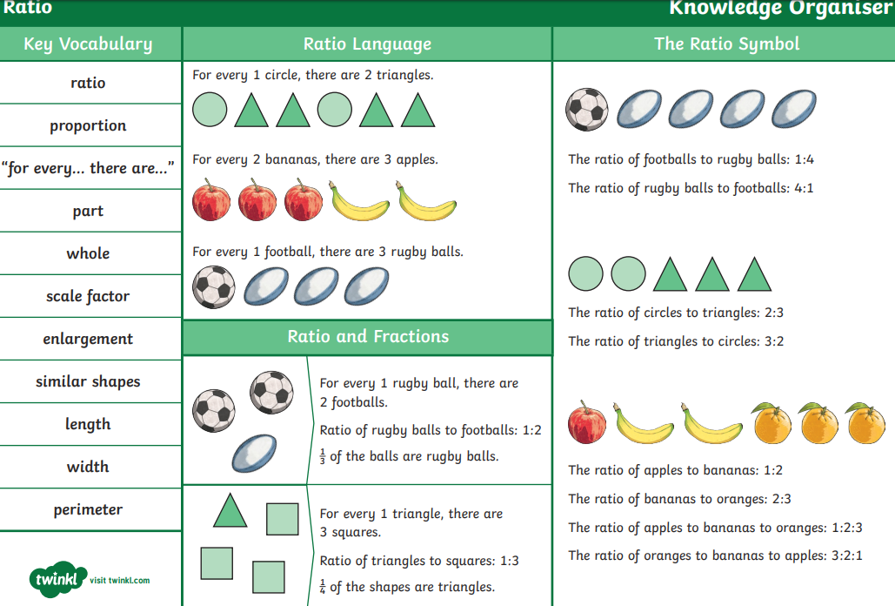
Ratio and proportion end of unit revision

Slide 5
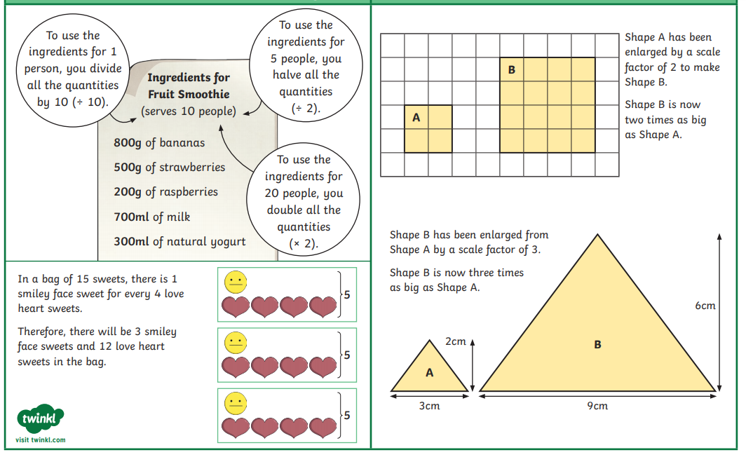
Ratio and proportion end of unit revision

Slide 6
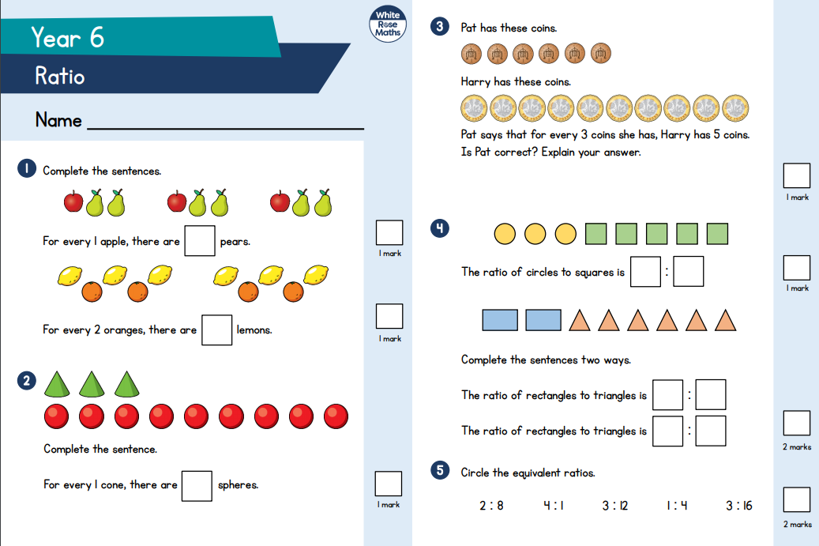
Ratio and proportion end of unit assessment

Slide 7
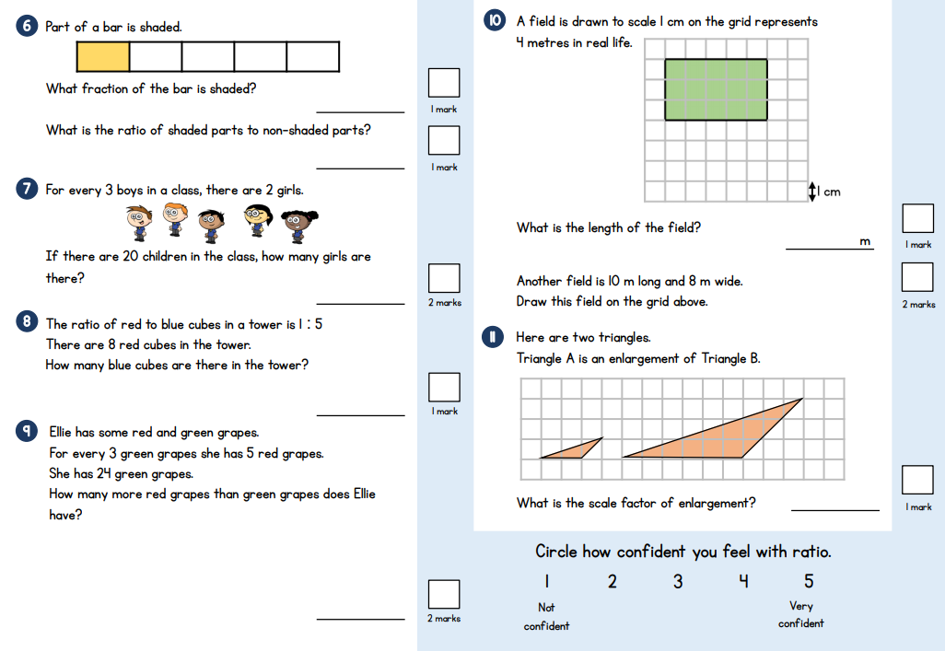
Ratio and proportion end of unit assessment

Slide 8
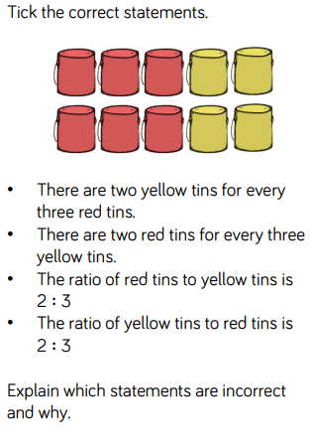
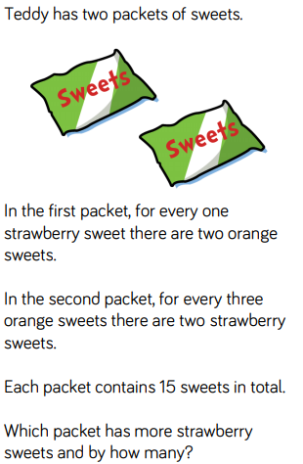
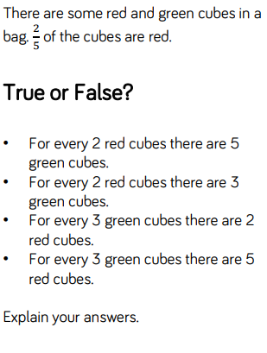
Extension Reasoning Questions (optional)
2.
3.

Slide 9
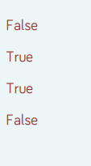
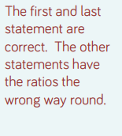
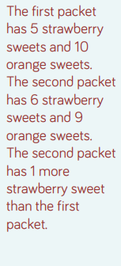
Extension Reasoning Questions (optional) - Answers
2.
3.

Slide 10
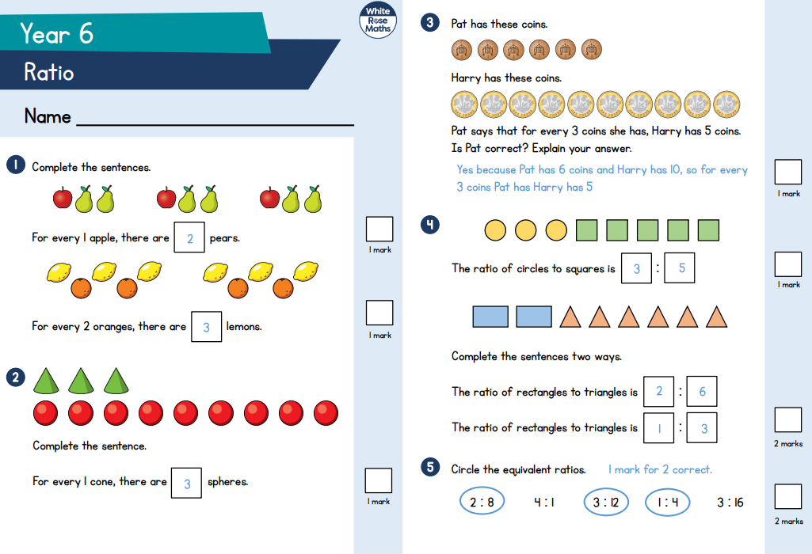
End of unit check - Answers

Slide 11
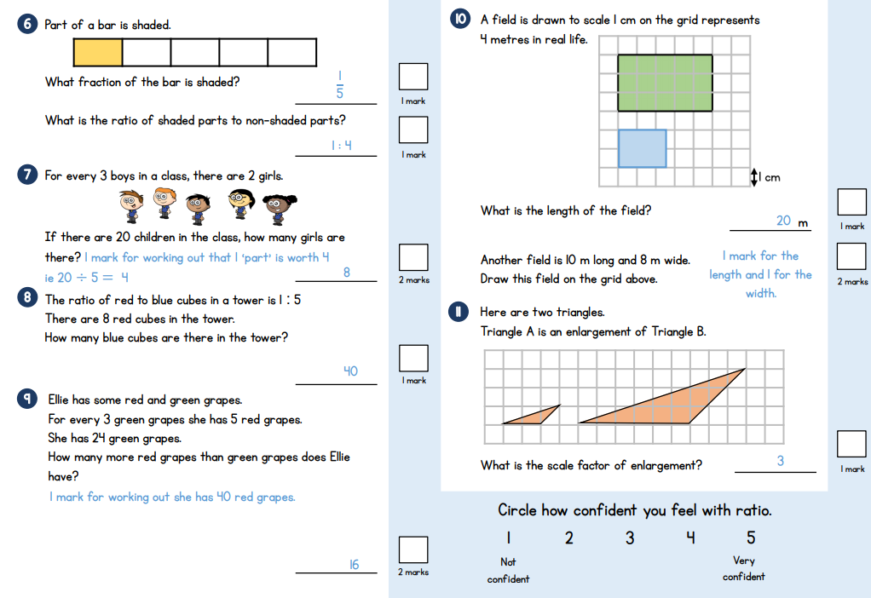
End of unit check - Answers

Slide 12
End of unit check - Answers
How did you get on?
Well done if you got even just one of the questions right! Learning from home can be tricky as you can’t ask all the questions we know you would love to!
If you would like more support on ratio and proportion follow this link:
https://whiterosemaths.com/homelearning/year-6/
There are videos to watch and other activities to complete along with the answers so you can check how you are getting on.
You are doing really well and we are very proud of all your efforts!

Slide 13
Grammar
Teacher Notes
Continuing on from Wednesday's grammar, we will be learning about formal and informal register.
Use the following three slides to recap and then have go at today’s grammar challenge.

Slide 14
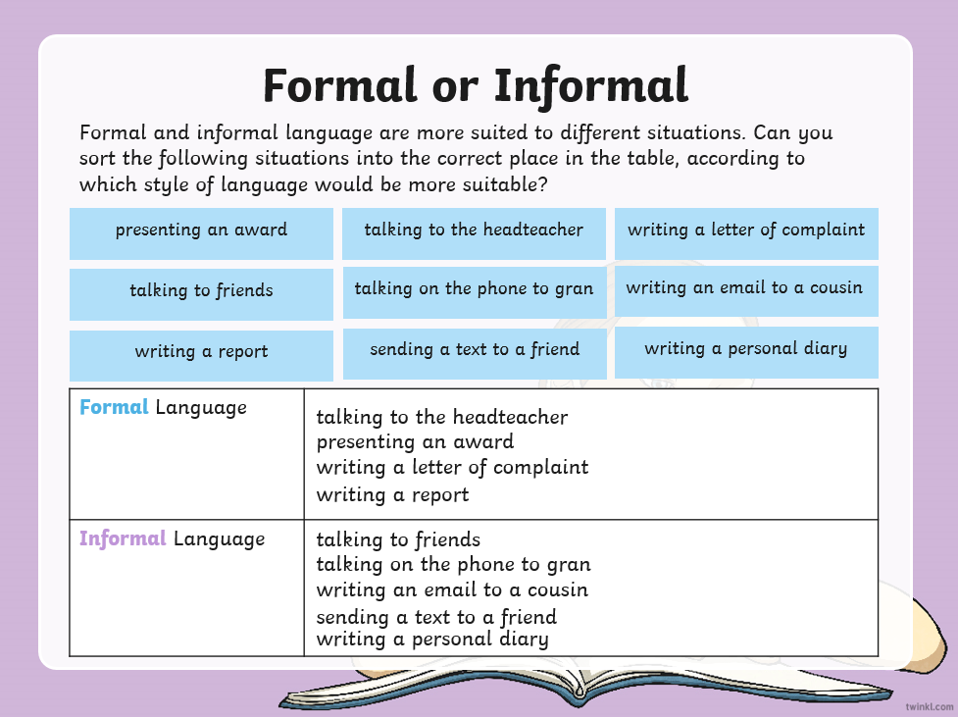
Grammar

Slide 15
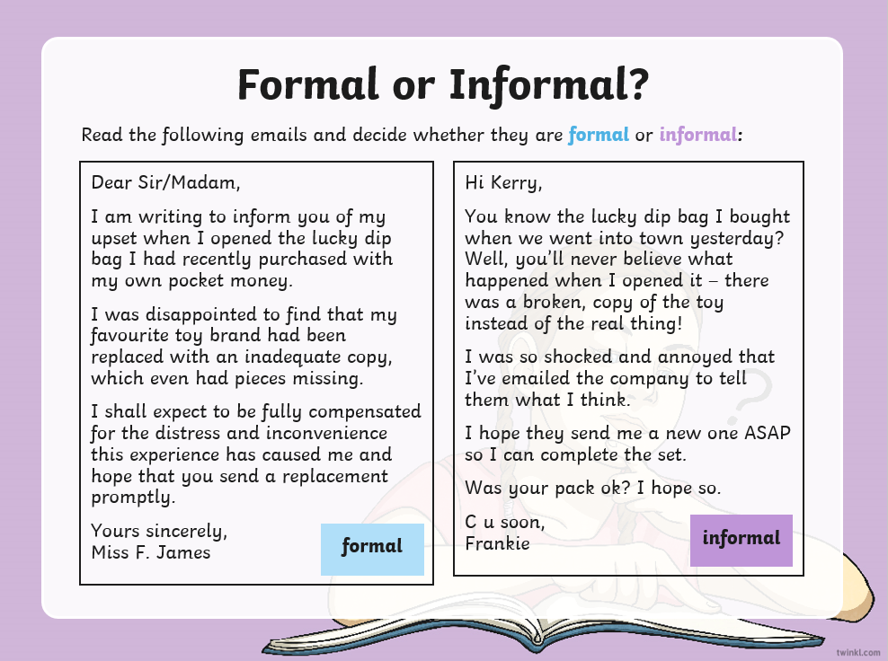
Grammar

Slide 16
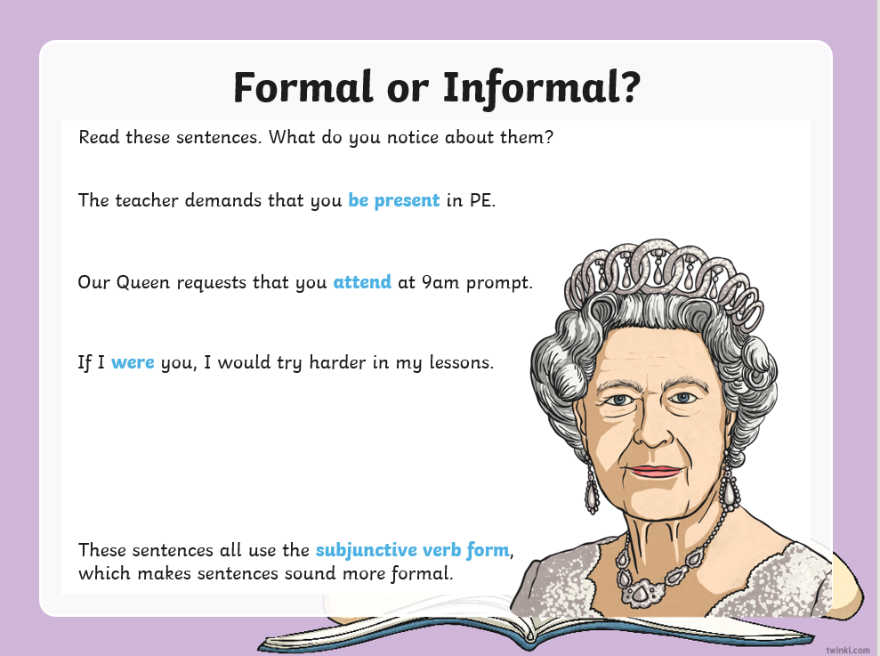
Grammar

Slide 17
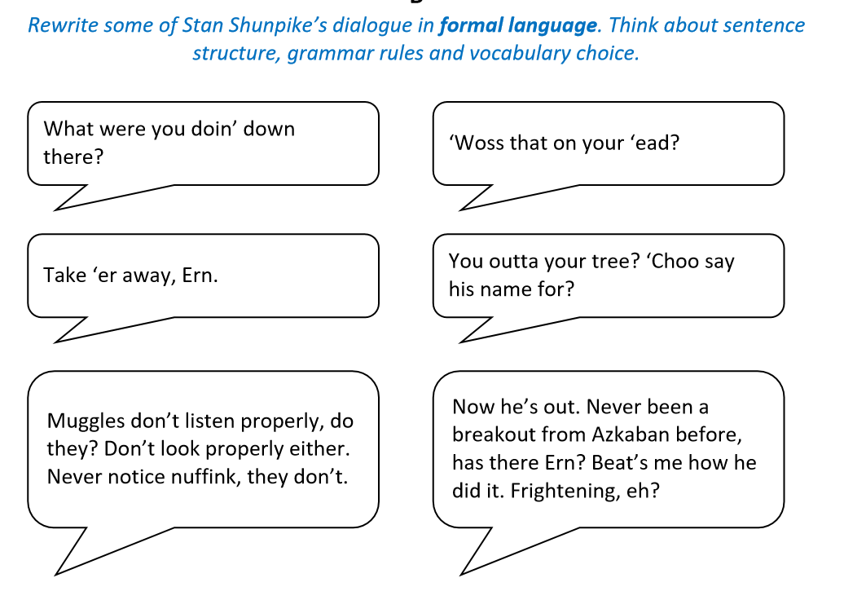
Grammar
Teacher Notes:
Now see if you can do today's grammar challenge.

Slide 18
Creative Writing Lesson 3
Today we will be our last creative writing session for this week. I hope you have enjoyed it so far. As we begin this lesson, remember our writing targets:
Vocabulary
Range of punctuation and sentence types
Cohesion
Awareness of Reader - Show not tell

Slide 19
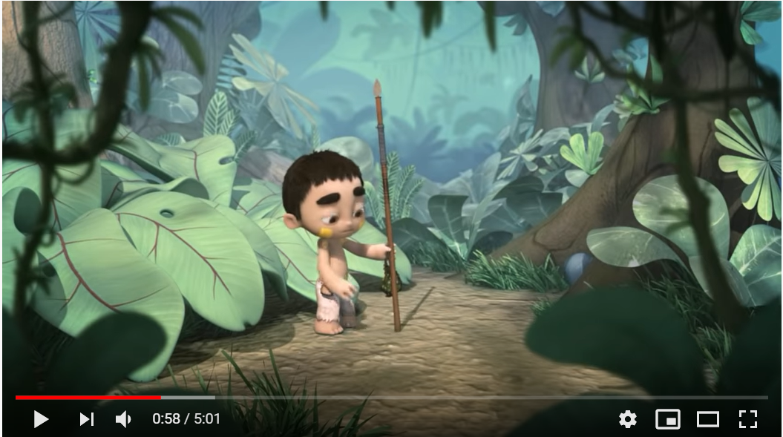
Creative Writing Lesson 3
Teacher Notes
Watch the video to remind yourself of the content - Ride of Passage.
Click on the image and you should be directed to a Youtube video.
Otherwise click on the URL below:
https://www.youtube.com/watch?v=29fIGIr0cuQ&t=102s

Slide 20
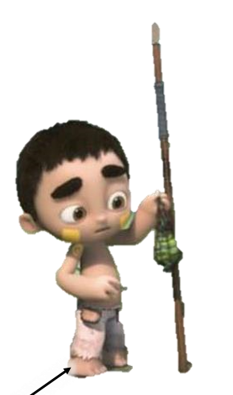
Creative Writing Lesson 3
Teacher Notes
Look at the image of the main character. Your task is to write down everything you can see in this picture.
Where possible, try to use high-level vocabulary and figurative language.
Calloused feet, that are stained with dirt.

Slide 21
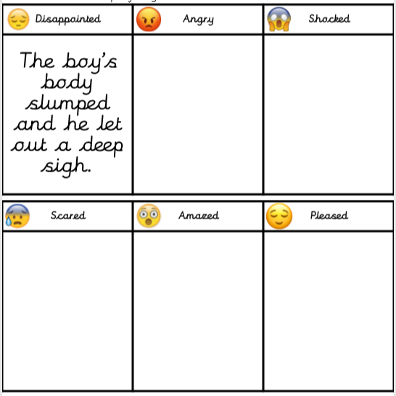
Creative Writing Lesson 3
Teacher Notes
Using the table as support, can you come up with one idea of how the main character may act that could show the reader how he is feeling, rather than telling them.
Think about their body language and movements. One example is done for you.
The boys body slumped and he let out a sigh.

Slide 22
Creative Writing Lesson 3
Teacher Notes
Character Description: Similes
Similes use the words “Like” or “As” (Or in some cases, “More… than…” or “Less… than…”
Look at the different features you have labelled on your image of the boy. Can you write similes to describe the different features?
Example: Simple Sentence:
His hair was brown and shaggy.
Improved with a simile: His hair was as brown and shaggy as a lion’s mane

Slide 23
Creative Writing Lesson 3
Teacher Notes:
Ride of Passage Narrative Writing
Now we have looked into writing setting descriptions and started to describe the character, let’s write the story in more detail.
You may want to use the comic strip you created earlier in the week to help support you with this.
Try and use some of the skills we have been developing throughout this writing sequence. These include the use of high level vocabulary, relative clauses and similes.
On the next slide, there is a story map that may help you with your narrative writing. Remember be creative.

Slide 24
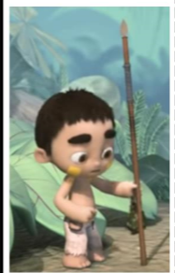
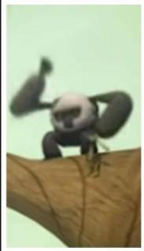
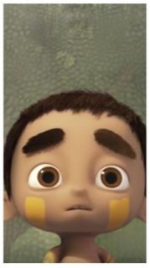
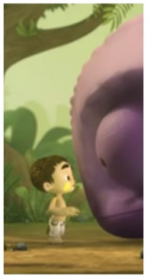
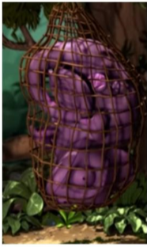
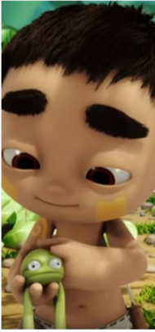
Creative Writing Lesson 3
Teacher Notes
It is time to write the story. Try and remember our Year 6 targets and sprinkle the skills taught in this unit throughout all of your story.

Slide 25

Good Afternoon Year 6!
Let’s start our afternoon with a quick burst of energy!
Get your PE kit at the ready because at the start of each afternoon session we will be joining Joe Wicks for our daily workout.
Do as much as you can and over the week you should find you are getting fitter and finding it easier.
Let’s go!
Click the youtube link below and select today’s date from the videos listed.
https://www.youtube.com/channel/UCAxW1XT0iEJo0TYlRfn6rYQ

Slide 26

Buenos días 6N and 6J. I hope that you are all well, I really miss teaching you all. I have devised 3 tasks to help you to practise the Spanish skills that we started learning at the beginning of the term. I hope that you enjoy them.
Miss Wheeler

Slide 27

Task 1
Go to the Linguascope web page (https://www.linguascope.com/)
User name: spanstcath
Password: simoned2
1) Go to the section ‘Beginner’ and then click on the Spanish flag.
2) Go to the section called ‘Mi familia y yo’ (My family and me)
3) Click on the square that says ‘Mis animales’ (My animals)
4) Choose 3 different games that will help you to learn the vocabulary. You can play any of the games on your own or with a member of your family. This is a great opportunity to teach your family some Spanish!

Slide 28
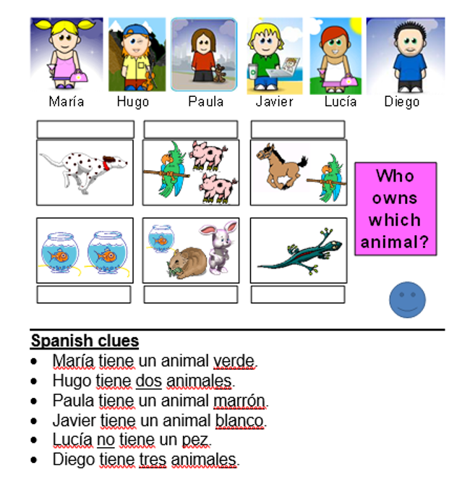
Task 2
Who owns which animal?
Read the clues to solve the mystery.

Slide 29
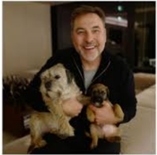
Task 3
Read and translate the text below. Check that your translation makes sense then identify if the statement is true or false. You should recognise our key phrases, but if you are unsure, use google translate to help you.
Hola me llamo Señor Walliams y vivo en Inglaterra. Tengo dos perros. Mis perros se llaman Bert y Ernie. Bert tiene once años y Ernie tiene dos años. Bert tiene su cumpleaños en el dos de agosto. Bert le gusta corer pero no le gustan las naranjas. También tengo un gato pequeño pero no tengo un caballo.
True or false - ¿Verdadero o falso?
1) David Walliams has a big cat. verdadero / falso
2) Bert is 11 years old. verdadero / falso
3) Bert’s birthday is the 3rd September verdadero / falso
4) David Walliams has a horse verdadero / falso
Translate the following words:
me llamo = vivo = pequeño = no le gusta =

Slide 30

Friday complete!
Well done on another great week!
Enjoy your weekend and relax spending time with your family.

