Slide 1

Good Afternoon Year 6!
Let’s start our afternoon with a quick burst of energy!
Get your PE kit at the ready because at the start of each afternoon session we will be joining Joe Wicks for our daily workout.
Do as much as you can and over the week you should find you are getting fitter and finding it easier.
Let’s go!
Click the youtube link below and select today’s date from the videos listed.
https://www.youtube.com/channel/UCAxW1XT0iEJo0TYlRfn6rYQ

Slide 2

Geography
Today’s geography lesson will focus on Volcanoes- a suitable home?

Slide 3
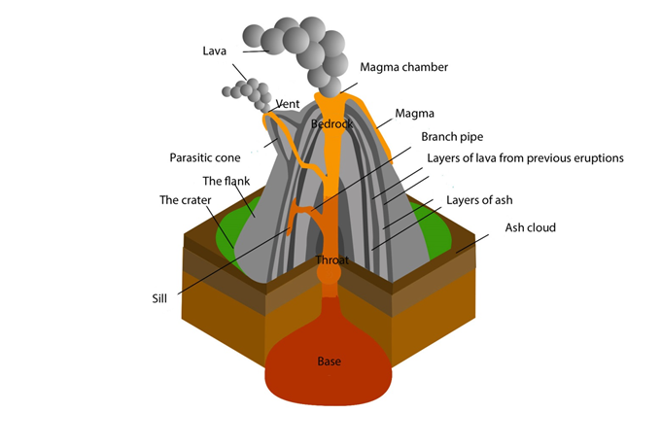
Geography
Spot my mistakes?
Look at the mislabeled diagram of a cross section of a composite volcano.
Note: not all of the labels are incorrect.

Slide 4
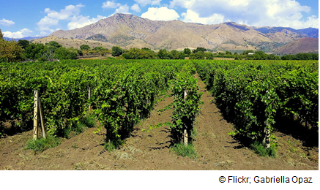
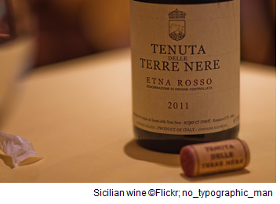
Geography
Fertile soil - Wine from the slopes of Mount Etna
In the foothills of Mount Etna, Sicily, the fertile volcanic soils support more than ninety vineyards. In Naples, Italy in an area that includes Mount Vesuvius, the soil is rich because of two large eruptions
35 000 and 12 000 years ago. The area is intensively cultivated and produces grapes, citrus trees, herbs and flowers. It is also a major tomato growing region.

Slide 5
Key Information
There are 500 active volcanoes in the world and on average 25 volcanoes erupt every year. Some active volcanoes are erupting lava, ash and noxious gases on a continual basis. However, 600 million people live on, or near to, active volcanoes: that is one in ten of the world’s population.
The question remains: why?
People choose to live near volcanoes because they consider the advantages outweigh the disadvantages. Most volcanoes are safe for long periods of time in between eruptions and those that erupt frequently are usually considered, by the people who live nearby, as being predictable.
The advantages:
Fertile soil that is good for agriculture.
The presence of minerals. Geothermal energy to produce electricity.
Tourism: volcanoes attract millions of visitors every year.
Fertile soil: Volcanic rocks are rich in minerals. However, when the lava is newly cooled these minerals are not available to plants. The rocks need thousands of years to become weathered and broken down before they form rich soils- some of the richest on Earth.

Slide 6
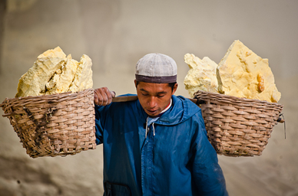
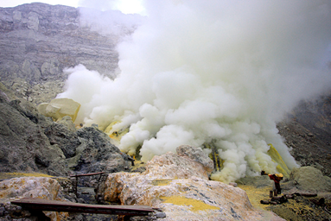
Geography
Sulphur Mining in Ijen Volcano, Java
Sulphur: Explain that sulphur is used to make a wide range of products and can be extracted from the vents of active volcanoes. In East Java, the Ijen volcano supports a sulphur mine. It is a dangerous job for the mine workers. Poisonous gas can burn the eyes and the throat and rot teeth. Mine workers’ lungs can also be permanently damaged. The water inside the crater’s lake has a pH similar to battery acid and can easily burn through clothes and skin. Luckily most of the world’s sulphur is no longer produced in this way.

Slide 7
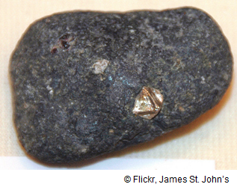
Geography
Sulphur Mining in Ijen Volcano, Java
For an image of the Yubileyny diamond mine visit: http://www.mining-technology.com/features/feature-the-worlds-top-10-biggest-diamond-mines/feature-the-worlds-top-10-biggest-diamond-mines-2.html
Magma rising deep from inside the earth contains a large range of precious metals and minerals. Tin, lead, copper, gold, silver and diamonds can all be found in volcanic rocks. The world’s largest diamond mine, the Jubilee diamond mine, also known as the Yubileyny diamond mine is located in northern Russia.

Slide 8
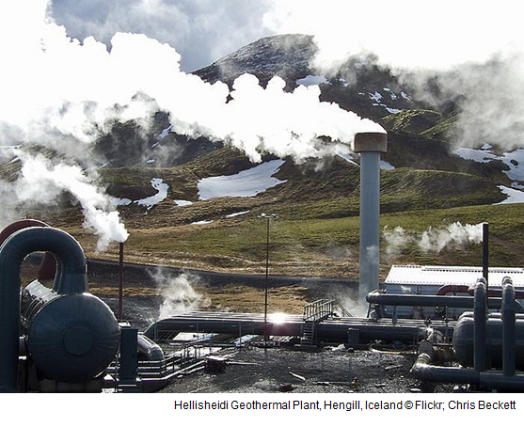
Geography
Geothermal energy in Iceland
Geo means ‘of the earth’ and ‘thermal’ means heat.
Geothermal energy is therefore the heat that naturally occurs underground in volcanic areas.
In many cases this geothermal energy is evident in the form of hot springs and geysers- fountains of hot water that shoot out intermittently from the spring.
In other cases this hot water is stored deep underground and is used in power plants to make electricity.
Iceland has five geothermal plants supplying about a fifth of the country’s energy supply and 85% of all heating and hot water to buildings in the country.
The photograph shows Hellisheidi geothermal power plant. Located on Hengill volcano in the south of Iceland, Hellisheidi power plant is the largest in Iceland and the second largest geothermal power station in the world. It was built to provide electricity to the capital city, Reykjavik. The Hengill volcano, from which the power plant extracts its energy, is still active, although the volcano last erupted 2 000 years ago.

Slide 9
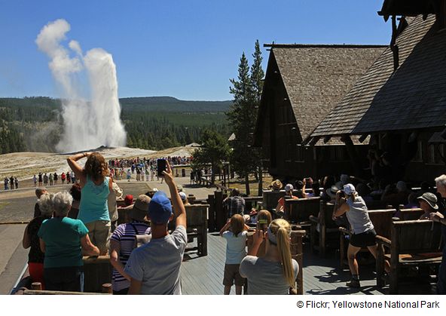
Geography
Tourism - Yellowstone National Park
The Yellowstone National Park is located primarily in Wyoming, North America. It covers an area of over 9000km2 . Three million tourists visit the National Park each year. There are 300 active geysers in Yellowstone (the largest concentration of geysers in the world). Of all the geysers in Yellowstone Old Faithful erupts the most regularly. Every 14-125 minutes water shoots 56 metres into the air for up to five minutes at a time.To see what Old Faithful is doing live, visit the National Park Service website:
http://www.nps.gov/features/yell/webcam/oldFaithfulStreaming.html
Yellowstone is a supervolcano.

Slide 10
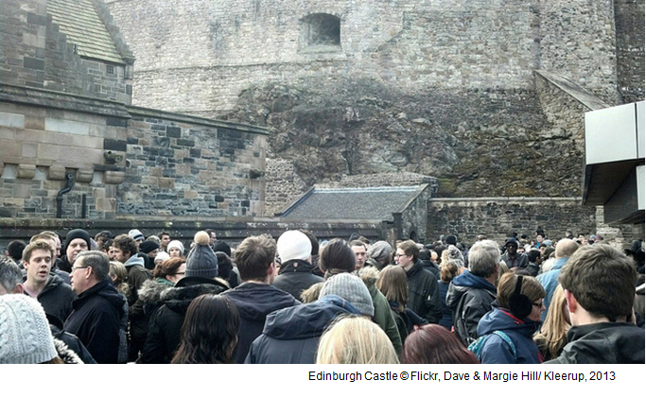
Geography
Tourism- Edinburgh Castle
Edinburgh Castle is Scotland’s most popular tourist attraction and 1.4 million visitors were recorded in 2013. The photograph shows the castle busy with tourists, as the photographers said, “It feels a bit like Disneyland.” Edinburgh Castle is built on a volcanic plug.

Slide 11
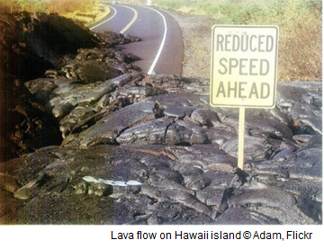
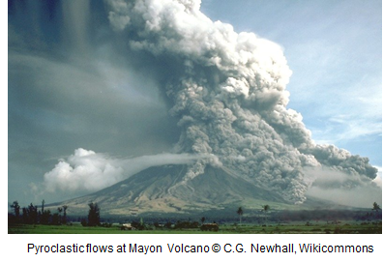
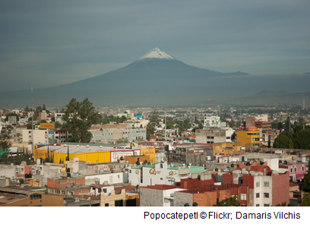
Geography
What do you think the disadvantages are to living near a volcano?
The Disadvantages: Volcanoes are dangerous and destructive. Volcanoes produce lava. Volcanoes produce ash clouds and poisonous gas. Volcanoes produce lahars (mud flows).

Slide 12
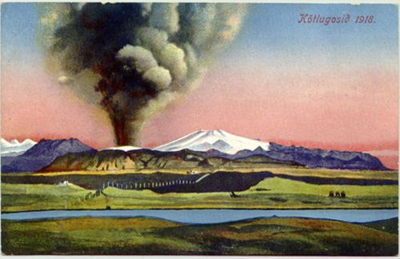
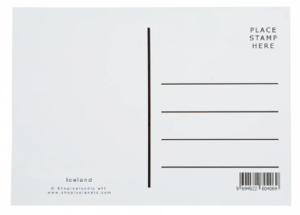
Geography
Postcard Home
Write a postcard home having visited a volcanic locality.
Draw the picture on the front of the postcard.
Include the geographical detail specific to the chosen volcano in their writing.
The design for the front of the postcard should be relatively complex.
It might include a picture of the volcano and the surrounding landscape, a map showing the volcano’s location, and/or the benefits of volcanic activity for the region.

Slide 13

Well done on a great day!
Enjoy your evening and be ready for more learning tomorrow...

