Slide 1
Good MoRning Year 6!
It is your last day! We hope you have enjoyed the home learning and we will miss you a great deal!
Please follow the instructions on each page to help you - we look forward to hear about how you have got on!
Mrs Jones and Miss Nolan

Slide 2


This week’s theme is
Football Project and Transition
Day 5 - 17.7.20
Last day of term!

Slide 3
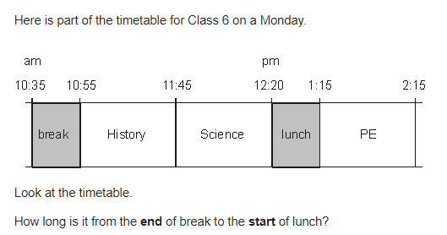
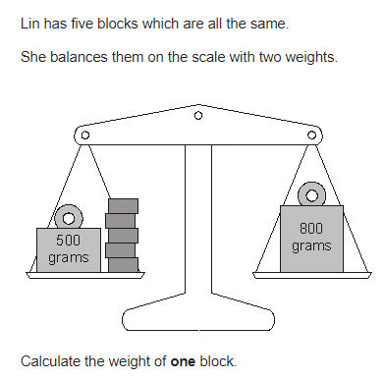
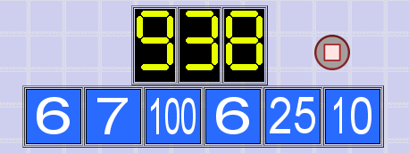
Morning Maths
7.
8. 45.5% x 250 =
9. 7895 ÷ 32 =
10.
6739 x 67 =
23% x 789 =
234 x 2 ½ =
List the first 10 prime numbers.
56 + x = 3x - 4
6.
Notes:
Children complete in maths book.
They have 15 minutes to complete independently.
Spend 10 minutes at the end of the session going through the answers and the children self mark.

Slide 4
ANSWERS
7.
8. 45.5% x 250 =
9. 7895 ÷ 32 = 246 r 23
10.
6739 x 67 = 451,513
23% x 789 =181.47
234 x 2 ½ = 585
List the first 10 prime numbers. 2, 3, 5, 7, 11, 13, 17, 19, 23, 29
56 + x = 3x - 4
56 + 4 + x = 3x
60 = 3x - x
60 = 2x
60/2 = x x = 30
6.
1 hour 25 minutes
113.75
100 x 7 = 700
25 x 10 = 250
700 + 250 = 950
6 + 6 = 12
950 - 12 = 938
60

Slide 5


Daily Worship
Reflect on your time at St Catherine’s…
What are your worries? You can share if you want or ponder. Let’s clear our minds.
Notes:
Teacher Notes -
Discuss daily worries with children

Slide 6



Daily Worship
What has gone well! Let’s celebrate our achievements and things that have made us happy.
Notes:
Teacher Notes -
Discuss and celebrate what has gone well for the children this week.

Slide 7

Daily Worship
Compliment Others - What kind things can you say?
Notes:
Teacher Notes -
Discuss and share

Slide 8

Spellings

Slide 9
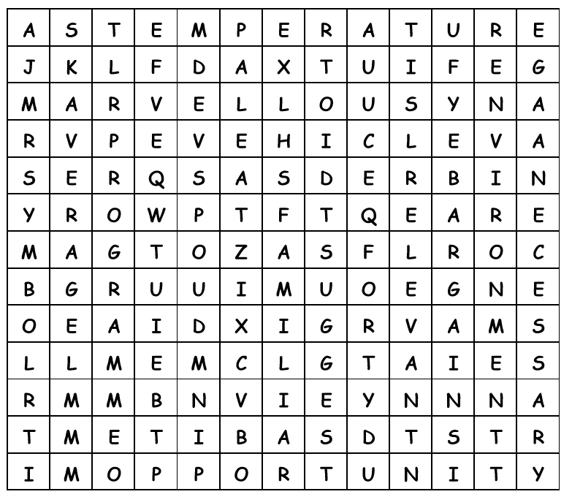
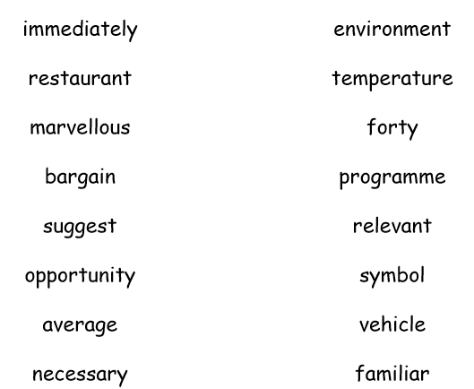
Friday - Spelling Word Search

Slide 10
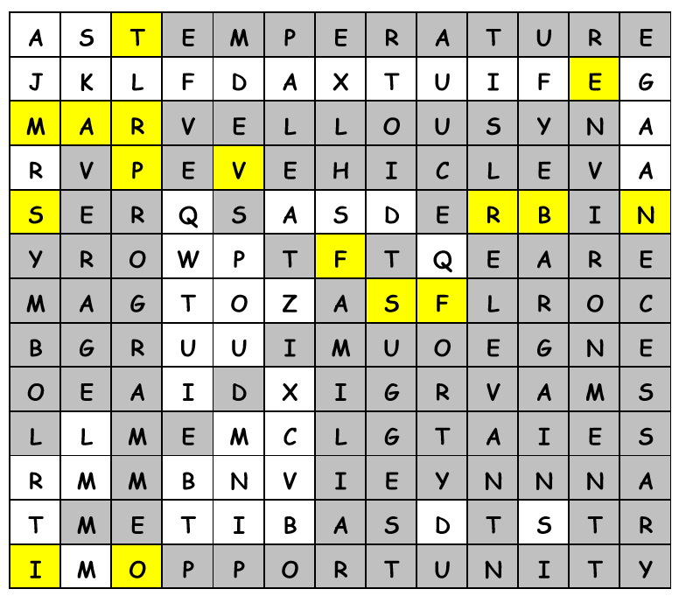
Friday - Answers

Slide 11
A New Team In Town
Football Project

Slide 12
The Final Task
Your season has come to an end…
You know how many points the team got, how much money they made and spent, the players and staff name as well as the team’s stadium name.
Using all the information you know about your new club, as well as the information you researched about the city your club is based in, we want you to write a short story about your club’s season.
You can choose to display this creative writing in ANY way you wish.
Don’t forget to be descriptive.

Slide 13
SENTENCE STARTERS
If you get stuck whilst writing your story, come back to this slide for some ideas about how to start a sentence or the next part of your story…
At the start of the season…
In the middle of the season…
At the end of the season…
The trickiest part of the season was…
Our best player this season was… because…
The fans thought…
The manager said…
Also, use your notes pages throughout to remind you of things, skim back through the slides – what decisions did you make throughout the project that might make an interesting addition to the story?

Slide 14

Good Afternoon Year 6!
Let’s start our afternoon with a quick burst of energy!
Get your PE kit at the ready because at the start of each afternoon session we will be joining Joe Wicks for our daily workout.
Do as much as you can and over the week you should find you are getting fitter and finding it easier.
Let’s go!
Click the youtube link below and select today’s date from the videos listed.
https://www.youtube.com/channel/UCAxW1XT0iEJo0TYlRfn6rYQ

Slide 15

Well done year 6! You have been fabulous! Keep in touch!

