Slide 1
Good MoRning Year 6!
Well done on a great few days of home learning!
We are halfway through the week and hope you enjoy today’s activities!
Please follow the instructions on each page to help you - we look forward to hear about how you have got on!
Mrs Jones and Miss Nolan

Slide 2
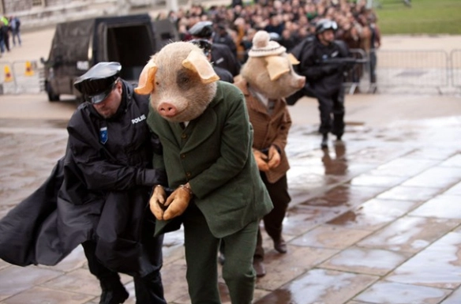
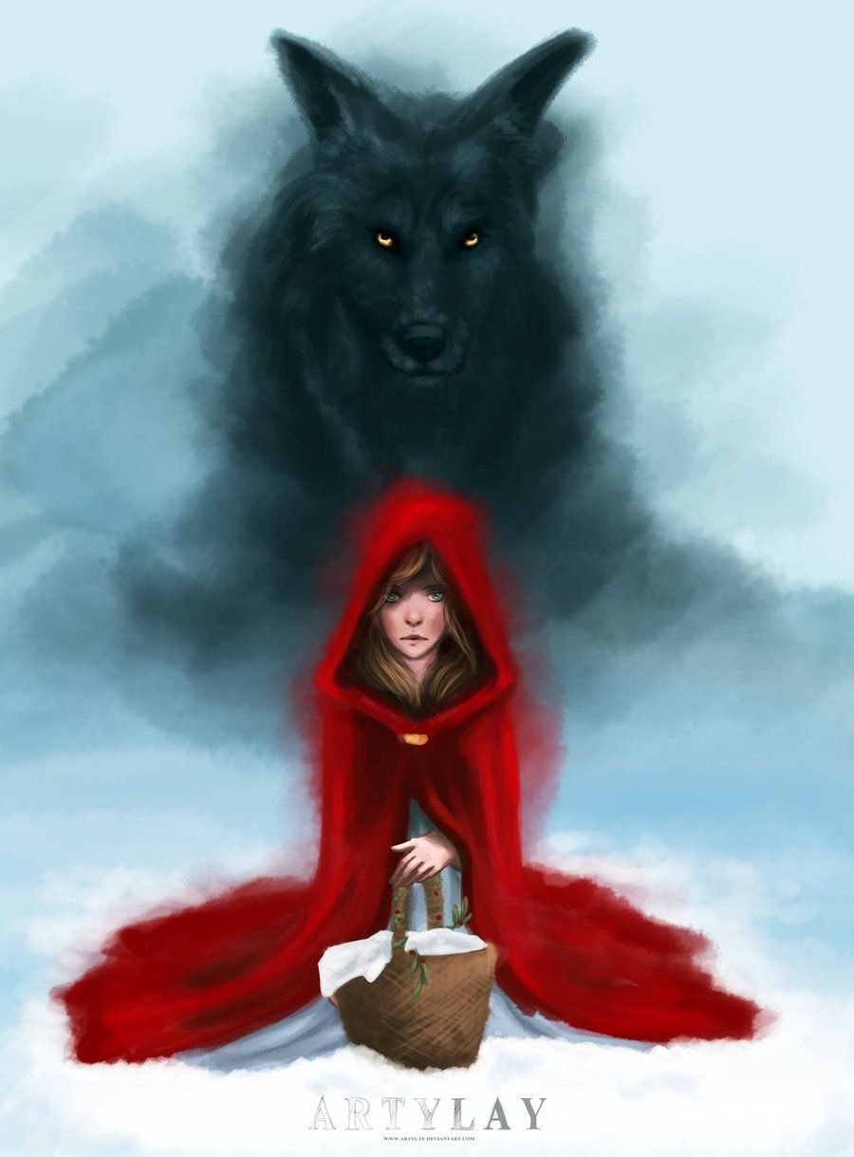

This week’s theme is
Wolves and Fairy Tales
Day 3 - 3.6.20

Slide 3
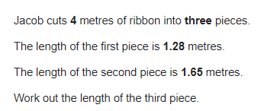

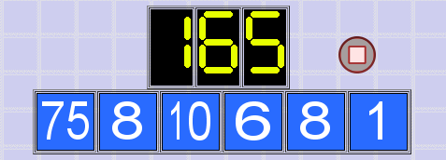
Morning Maths - Give yourself 15 - 20 minutes to complete these questions.
7. 1118 ÷ 43 =
8. Write these numbers in order, starting with the smallest.
0.78 0.607 5.6 0.098 4.003
9.
95 ÷ 5 =
876 x 3 =
3.005 + 6.12 =
1320 ÷ 12 =
60 - 42 ÷ 6 =
6.
10.

Slide 4
Now mark your work using these answers.
7. 1118 ÷ 43 = 26
8. Write these numbers in order, starting with the smallest.
0.098 0.607 0.78 4.003 5.6
9.
95 ÷ 5 = 19
876 x 3 = 2628
3.005 + 6.12 = 9.125
1320 ÷ 12 = 110
60 - 42 ÷ 6 = 53
6.
1.28 + 1.65 = 2.93m
4m = 400cm
400cm - 293cm = 107cm
1
4
Countdown Answer
8 + 1 = 9
10 x 9 = 90
90 + 75 = 165
10.

Slide 5

Daily Worship
Click the image to view today’s Newsround.

Slide 6

We may not be learning together in the classroom, but it is important to still remember our classroom beliefs.
WALT: develop problem solving and thinking skills.
In Maths today we will continue to work on our theme park project!
You will now need to think about how much your park will cost to run.

Slide 7
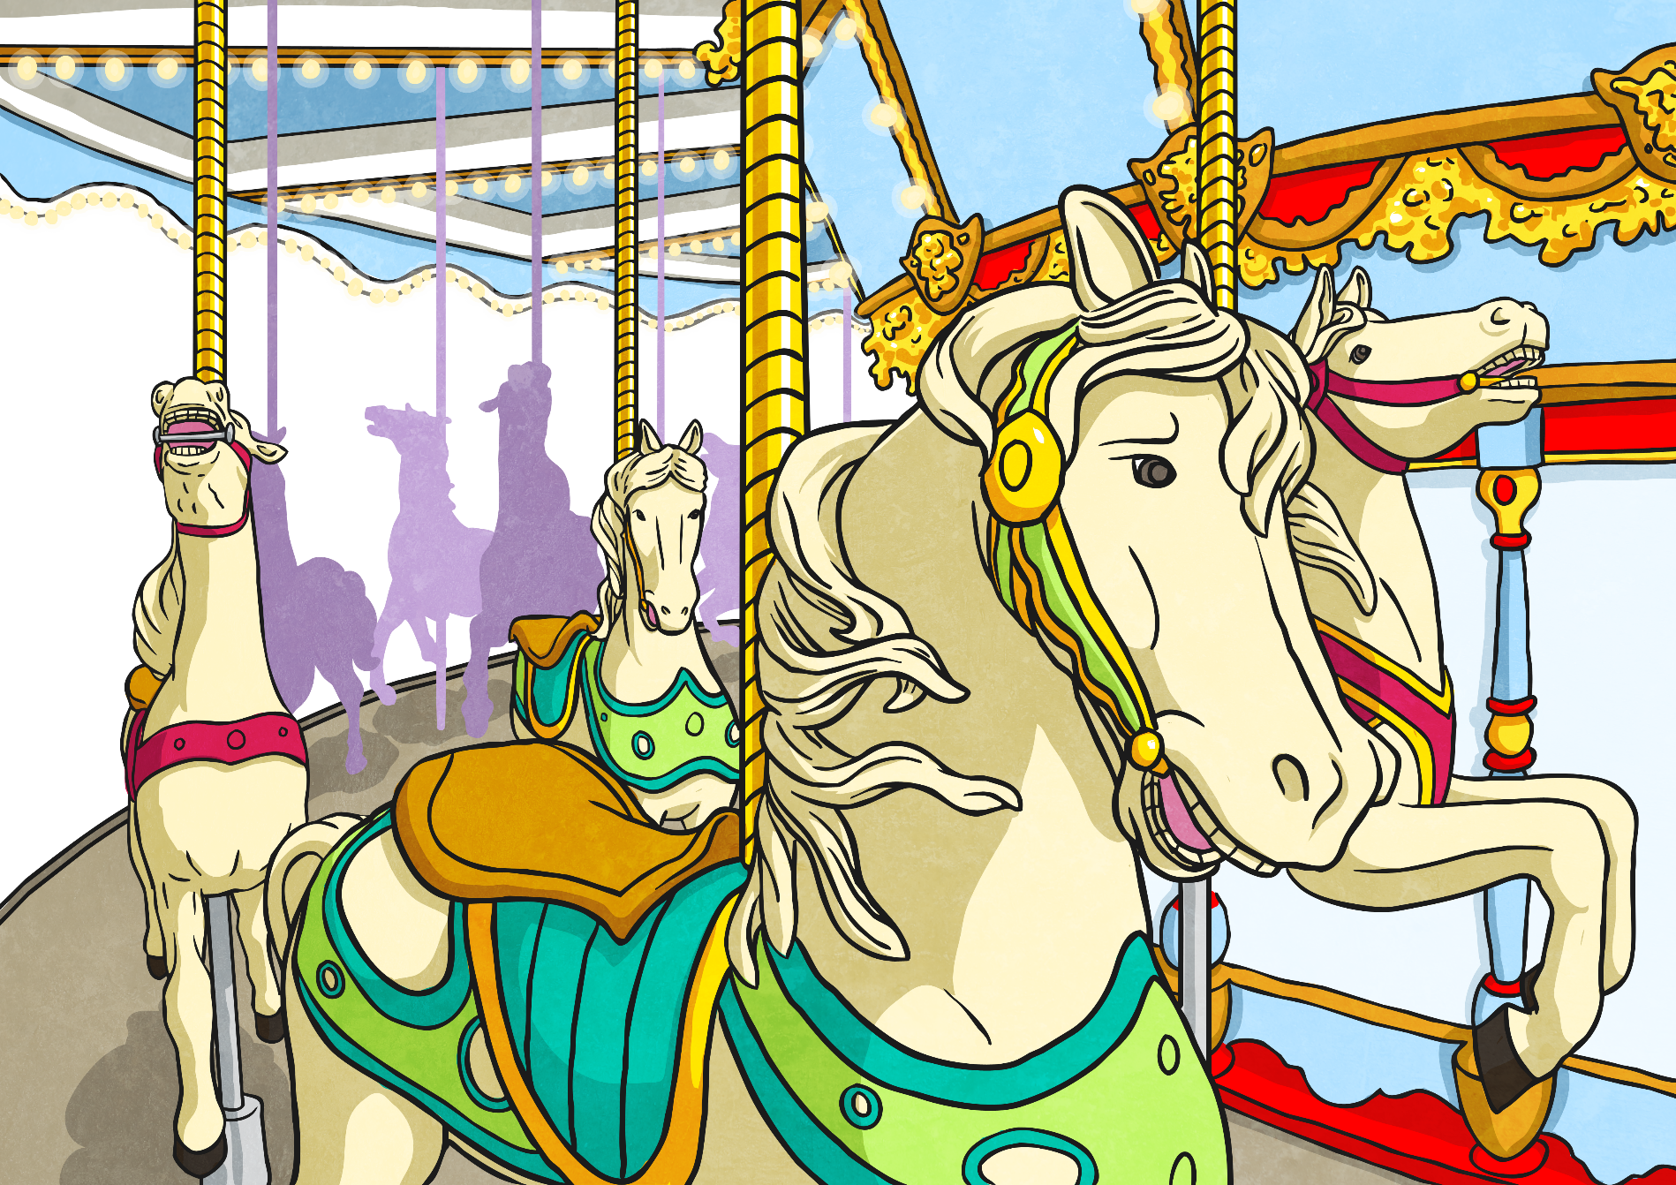
Lesson 3: Running Your Theme Park
Now that the building work on your theme park is well underway and your brochure is prepared, it’s time to make some business decisions about costs and prices.
How much will it actually cost for your theme park to operate?
It’s time to do some calculations…

Slide 8
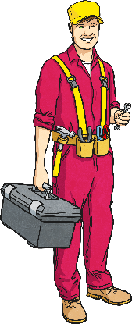



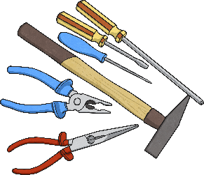
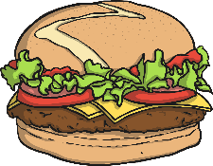
Estimating Running Costs
To open your theme park on a daily basis, you and your business partners will incur certain costs.
Can you think what these might be? What will you need to pay out for the business to operate?
Staffing
Paying people to work at the park. Who might this include?
Maintenance Costs
Paying to keep all the rides and attractions safe and functional.
Electricity
Paying to power your rides, attractions and amenities.
Stock for Food Outlets
Paying for the ingredients to make the food that you will sell.
Liability Insurance
Paying an insurance premium in case anyone gets hurt or injured while working or visiting the theme park.

Slide 9

Creating a Running Cost Estimate
You need to work out potential weekly running costs for the park and make sure you have enough money in your budget to cover at least two weeks of operating costs. Hopefully, after that time period, the business will start to make a profit and cover its own costs.
Different rides, attractions and amenities will all need to be covered by staff of different levels. The costs shown are per ride/amenity or attraction – you will need to work out how many of each you have in your theme park.
Maintenance and cleaning staff will need to be employed also to keep the theme park environment operational, clean and safe for your customers.
Other running costs will also be incurred on a daily basis. These costs are shown on your Running Costs Activity Sheet.

Slide 10
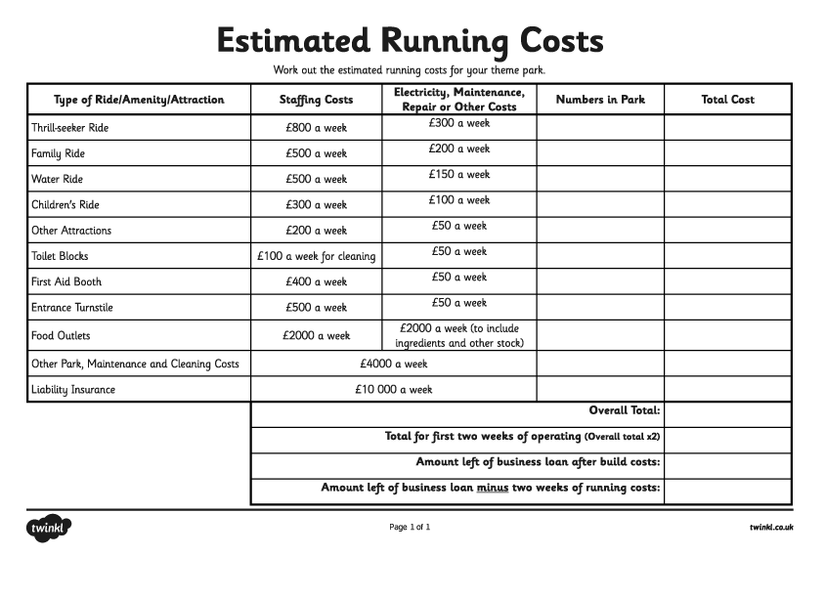
What Are Our Park Running Costs?
Look at the table on your Running Costs Activity Sheet in the separate word document - you will need to use your plan from yesterday and count up how many you have of each ride and use this to calculate the total cost.
Remember: you will still need funds to invest in marketing your park once the build costs and two weeks of running costs are taken out of the business loan.

Slide 11

Spellings
Reading = Eye of the Wolf
Writing = create a brochure

Slide 12
Wednesday - Spelling and handwriting practice.
license
licence
devise
device
environment
The advice is to stay indoors as the weather is forecast to be dangerous.
Copy out these words out twice in your best joined handwriting.

Slide 13
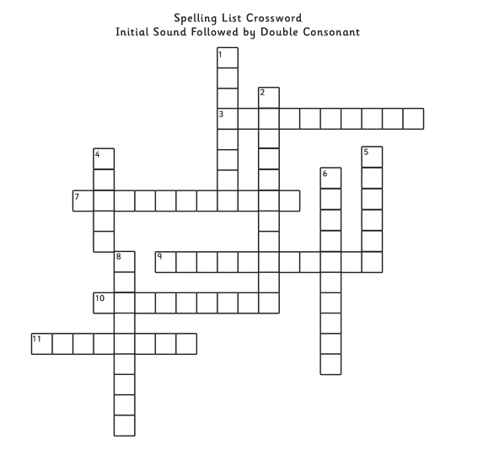
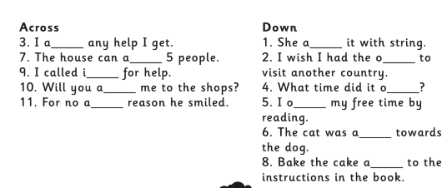
Wednesday - Spelling
Use the clues to complete the crossword

Slide 14
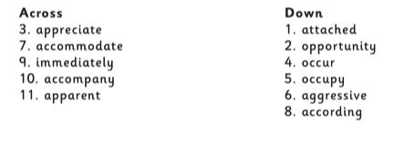
Wednesday - Spelling Answers

Slide 15
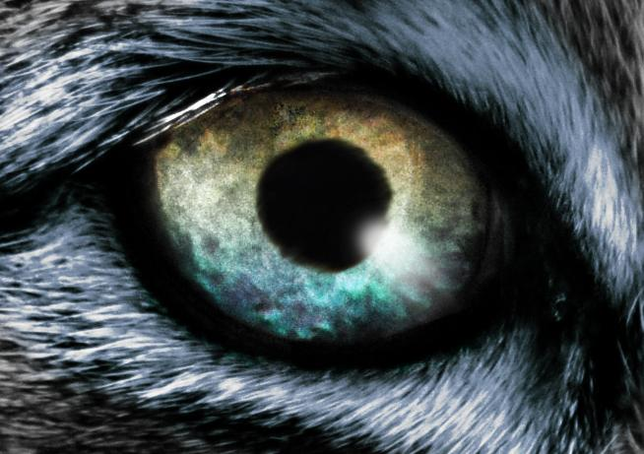

READING - Eye of The Wolf
WALT: Make inferences using evidence from the text.
Can you remember what happened in ‘the eye of the wolf’ extract from yesterday?

Slide 16
Reading Activity
Teacher Notes
The purpose of a close read activity is to gain an understanding of the text by reading it multiple times.
Close Read Instructions:
Look at the vocabulary. Do you know what the words mean? If you are unsure, note down the words and use a dictionary (this could be online) to find out their meaning.
Read the text to yourself and ask yourself the following questions:
What did I just read? What did it say? You can make notes or annotate the text.
Now read the text again (you could do this wit an adult) - this will help you gain a better understanding.
Read the questions and now reread the text again to find evidence that will support your answers.
Answer the questions in writing.
All close read texts are age appropriate.

Slide 17
READING - Eye of The Wolf
WALT: Make inferences using evidence from the text.
“The eye of the wolf” by Daniel Pennac
The wolf’s yellow eye is large and round, with a black pupil in the middle. And it never blinks. The boy could be watching a candle flame in the dark. All he can see is the eye: the trees, the zoo and the enclosure have disappeared. All that’s left is the eye of the wolf. It grows fatter and rounder, like a harvest moon in an empty sky. The pupil in the middle grows darker and he can make out small, coloured flecks in the yellow brown iris – a speck of blue here, like frozen water below the sky; a glimmer of gold there, shiny as straw.
But what really matters is the pupil. The black pupil. You wanted to stare at me, it seems to be saying, so go ahead, stare at me! It sparkles so brightly, it’s scary. Like a flame.
That’s what it is, thinks the boy, a black flame! Then he answers, “All right Black Flame, I’m staring at you and I’m not frightened.”

Slide 18
READING - Eye of The Wolf
WALT: Make inferences using evidence from the text.
“The eye of the wolf” by Daniel Pennac
The wolf’s yellow eye is large and round, with a black pupil in the middle. And it never blinks. The boy could be watching a candle flame in the dark. All he can see is the eye: the trees, the zoo and the enclosure have disappeared. All that’s left is the eye of the wolf. It grows fatter and rounder, like a harvest moon in an empty sky. The pupil in the middle grows darker and he can make out small, coloured flecks in the yellow brown iris – a speck of blue here, like frozen water below the sky; a glimmer of gold there, shiny as straw.
But what really matters is the pupil. The black pupil. You wanted to stare at me, it seems to be saying, so go ahead, stare at me! It sparkles so brightly, it’s scary. Like a flame.
That’s what it is, thinks the boy, a black flame! Then he answers, “All right Black Flame, I’m staring at you and I’m not frightened.”
Questions
1) What are the two things the writer compares the wolf’s eye to?
2) How do you think the boy is feeling about the wolf? Explain using evidence from the text.

Slide 19
READING - Eye of The Wolf - Answers
WALT: Make inferences using evidence from the text.
“The eye of the wolf” by Daniel Pennac The wolf’s yellow eye is large and round, with a black pupil in the middle. And it never blinks. The boy could be watching a candle flame in the dark. All he can see is the eye: the trees, the zoo and the enclosure have disappeared. All that’s left is the eye of the wolf. It grows fatter and rounder, like a harvest moon in an empty sky. The pupil in the middle grows darker and he can make out small, coloured flecks in the yellow brown iris – a speck of blue here, like frozen water below the sky; a glimmer of gold there, shiny as straw.
But what really matters is the pupil. The black pupil. You wanted to stare at me, it seems to be saying, so go ahead, stare at me! It sparkles so brightly, it’s scary. Like a flame.
That’s what it is, thinks the boy, a black flame! Then he answers, “All right Black Flame, I’m staring at you and I’m not frightened.”
Questions
1) What are the two things the writer compares the wolf’s eye to?
A harvest moon in an empty sky and a frozen water below the sky
2) How do you think the boy is feeling about the wolf? Explain using evidence from the text.
The boy is not intimidated or scared. He was challenging the wolf - I’m not frightened/go ahead stare.

Slide 20
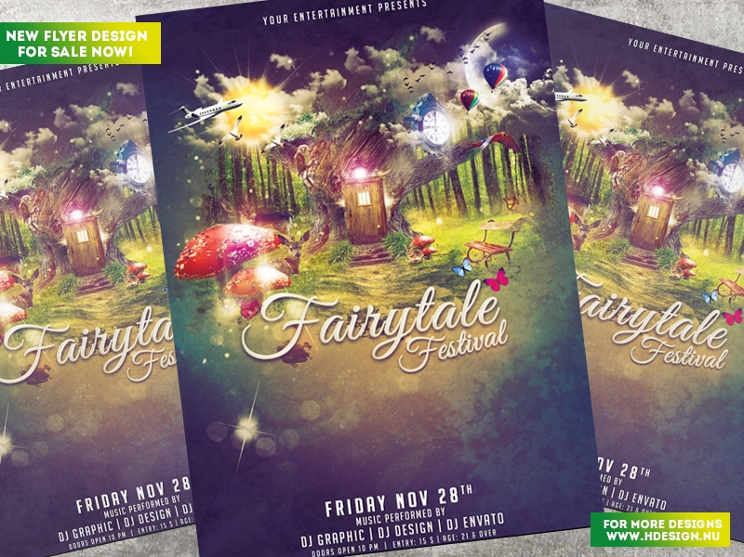
Create A Brochure
Continue with creating your brochure that you started yesterday.

