Slide 1
Good MoRning Year 6!
Welcome to Tuesday’s home learning!
Please follow the instructions on each page to help you - we look forward to hear about how you have got on!
Mrs Jones and Miss Nolan

Slide 2


This fortnight’s theme is
Transition
Day 2 - 7.7.20

Slide 3
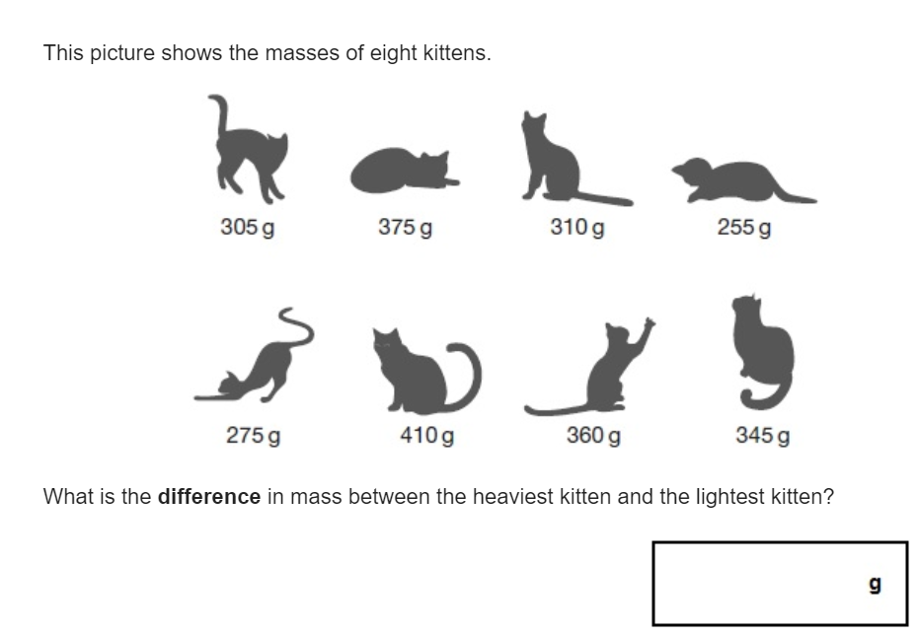
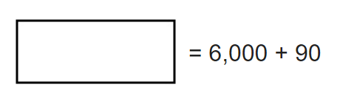
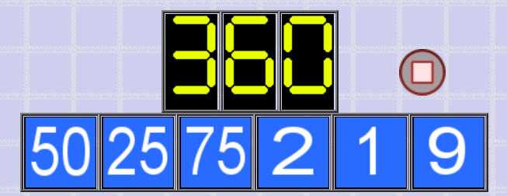
Morning Maths
8.
9. How many days are there in September, October and November altogether?
10.
180 ÷ 3 =
3³ =
35% of 320 =
⅚ x 540
8051 ÷ 83 =
6.
7. The temperature at the bottom of Mount Fiji is 2C. The top of the mountain is 21C colder than the bottom. What is the temperature at the top of Mount Fiji?
Notes:
Children complete in maths book.
They have 15 minutes to complete independently.
Spend 10 minutes at the end of the session going through the answers and the children self mark.

Slide 4
ANSWERS
8.
9. How many days are there in September, October and November altogether?
10.
180 ÷ 3 = 60
3³ = 27
35% of 320 = 112
⅚ x 540 = 450
8051 ÷ 83 = 97
6.
7. The temperature at the bottom of Mount Fiji is 2C. The top of the mountain is 21C colder than the bottom. What is the temperature at the top of Mount Fiji? -19C
410 - 255 = 155g
91 days
6090
50 + 9 + 1 = 60
75 / 25 = 3
60 x 3 x 2 = 360

Slide 5

Class Based Worship

Slide 6


Class Based Worship
Watch this newsround special on the protests and Black Lives Matter movement.
https://www.bbc.co.uk/newsround/52813673

Slide 7

St Catherine’s Classroom Beliefs
Mistakes are valuable.
Everyone can learn maths to the highest level.
Questions are really important.
Depth is more important than speed.
Maths is about making connections.

Slide 8

7.7.20
WALT: apply our mathematical knowledge to a variety of questions.
As part of the transition to high school, your new schools have sent some work for you to complete.
They will be having a look at this to see how you get on so remember to try your best!
Today’s task is a skills check...
Notes:
Notes: If the child is going to Wolverley, please ask them not to stick it in their book. Instead can they name the sheet and then put them in a pile please in case they want to collect them back. These may also be in the workbooks Wolverley dropped off for them.

Slide 9
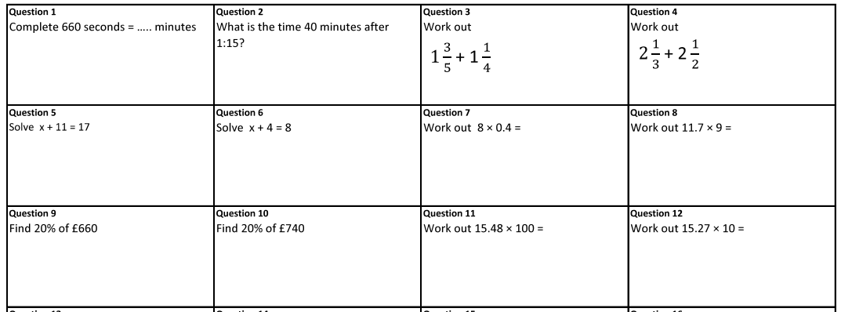
7.7.20
WALT: apply our mathematical knowledge to a variety of questions.
Notes:
Notes:

Slide 10
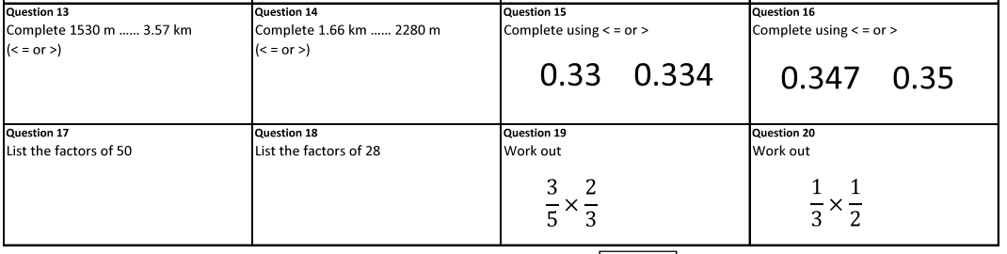
7.7.20
WALT: apply our mathematical knowledge to a variety of questions.
Notes:
Notes:

Slide 11
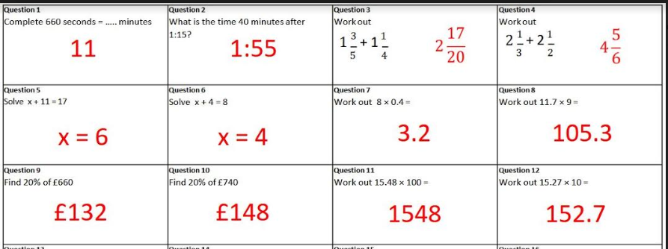
7.7.20
WALT: apply our mathematical knowledge to a variety of questions.
Answers
Notes:
Notes:

Slide 12
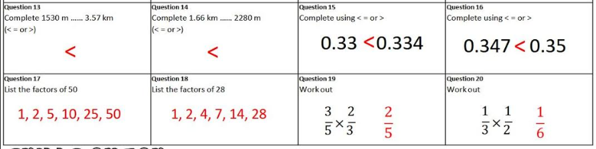
7.7.20
WALT: apply our mathematical knowledge to a variety of questions.
Answers
Notes:
Notes:

Slide 13

Grammar
Writing = Transition

Slide 14
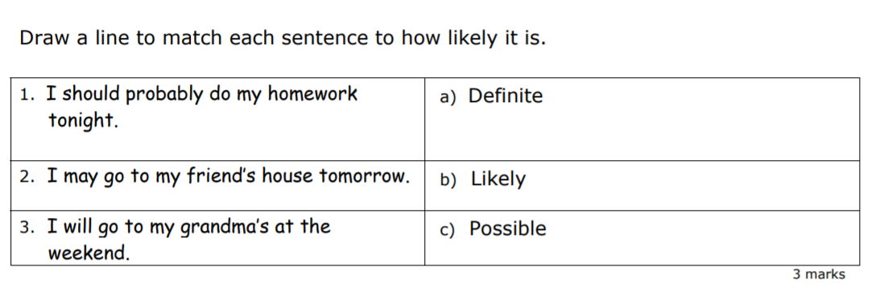
Tuesday Grammar

Slide 15
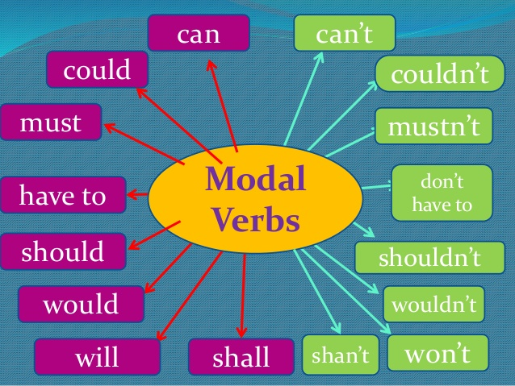
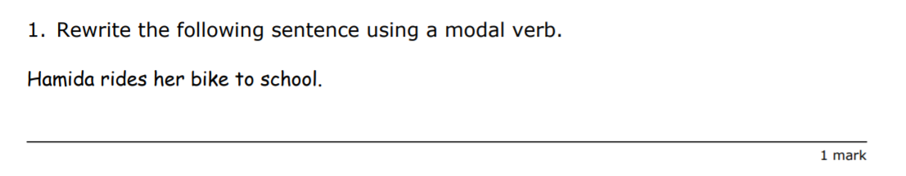
Grammar

Slide 16
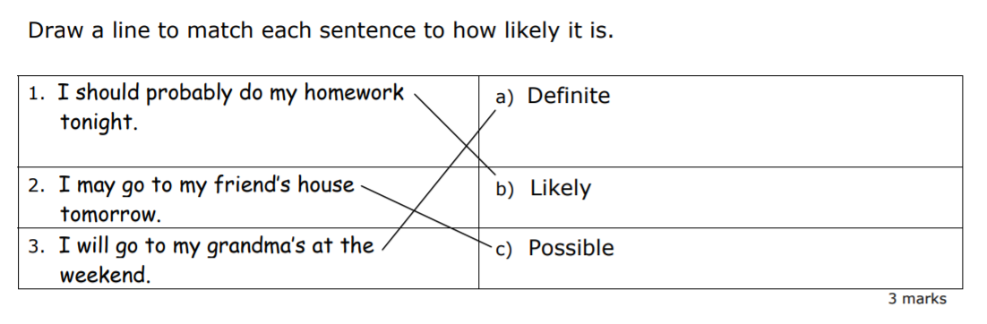
Grammar
Answers

Slide 17
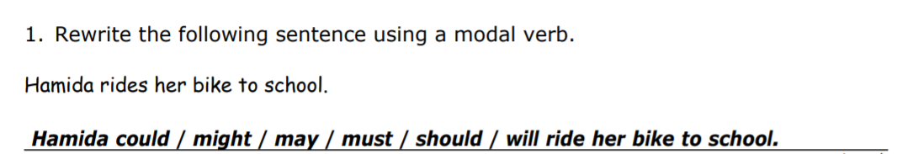
Grammar
Answers

Slide 18
Transition Writing Task
This English Task has been set by your secondary school. Please write up your task on named paper.
They will be having a look at this to see how you get on, so remember to try your best!

Slide 19
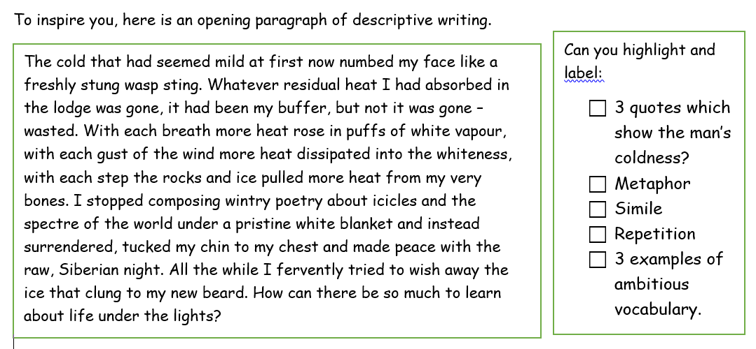
Transition Writing Task
Your task this week will be to create a first-person narrative piece of extended, descriptive creative writing. You will be imagining that you are there watching the Northern Lights in person.
Today you will be planning

Slide 20
Transition Writing Task
From the paragraph above, can you choose what you think is the most effective sentence to describe the cold. Justify your choice of quote in a clear Point, Evidence and Explain paragraph.

Slide 21
Transition Writing Task
The Planning
Before starting your writing, it is crucial you plan your work. It is up to you how you design your plan, usually a mind-map or list for each paragraph works best.
A good piece of writing usually starts by establishing the scene and the narrator.
Around your plan for paragraph one, make notes on what you can: See? Hear? Feel? Touch? Smell?
Challenge: How are you going to ‘Show not tell’ the reader about your emotions and reaction to the Northern Lights for the first time.
Expert: Can you create a simile, metaphor and a line of personification to describe any of the features of the picture

Slide 22
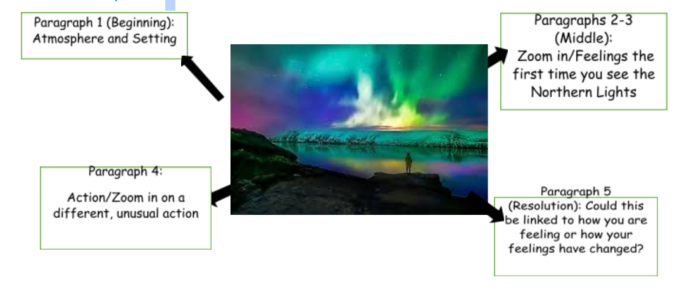
Transition Writing Task
The Planning

Slide 23

Good Afternoon Year 6!
Let’s start our afternoon with a quick burst of energy!
Get your PE kit at the ready because at the start of each afternoon session we will be joining Joe Wicks for our daily workout.
Do as much as you can and over the week you should find you are getting fitter and finding it easier.
Let’s go!
Click the youtube link below and select today’s date from the videos listed.
https://www.youtube.com/channel/UCAxW1XT0iEJo0TYlRfn6rYQ

Slide 24

Geography - Transition Work
Your high schools have sent over some Geography transition work they would like you to complete.
Have a go at the following activities....

Slide 25
Geography - Transition Work
What is geography?
What do you learn about in geography?
What topics are ‘geography’?

Slide 26
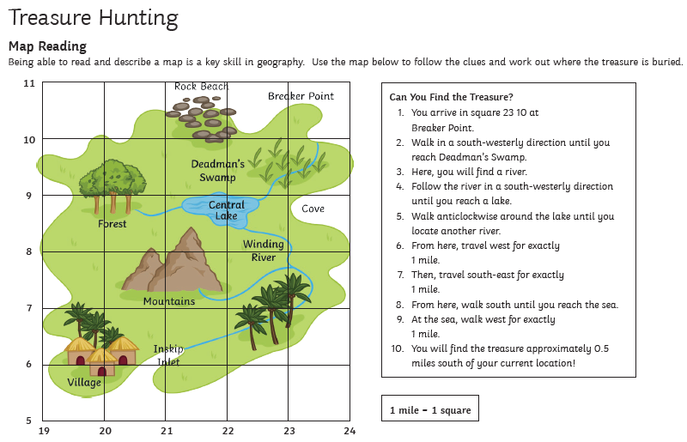

Slide 27
Geography - Transition Work
Why do we still use maps and need to have map reading skills?
You will study map skills in September so it is important to practise them now.

Slide 28
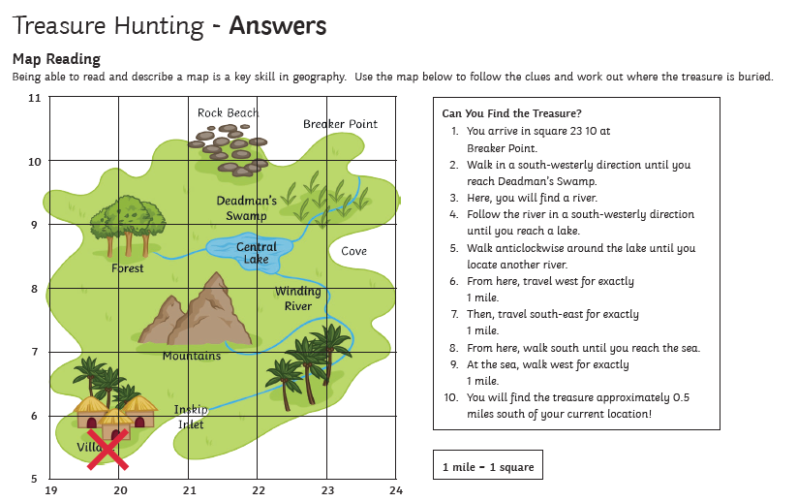
Geography - Transition Work - Answers

Slide 29

Well done on a great day!
Enjoy your evening and be ready for more learning tomorrow...

