Slide 1
Good MoRning Year 6!
It’s Wednesday!
You are all doing a great job! Keep up the good work!:)
We hope you are enjoying learning with us again today.
Once again, follow the instructions on each page to access today’s home learning sessions.
Mrs Jones and Miss Nolan

Slide 2
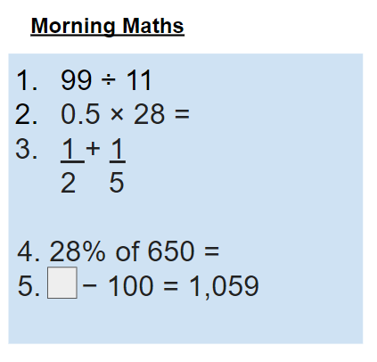
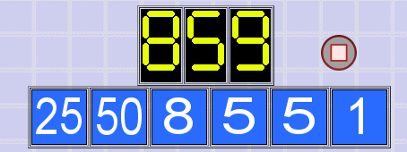
As always, our day will start with Morning Maths.
Give yourself 10 minutes to complete these questions and then try and tackle today’s countdown. If you finish within 10 minutes, check your work and see how many ways you can find to solve the countdown.
After 10 minutes, use a calculator to check your answers and the countdown solver (linked below) to see how to solve today’s problem.
Click the link below and type in the numbers and target to see how the countdown could be solved!
http://www.maths-resources.com/countdown/

Slide 3

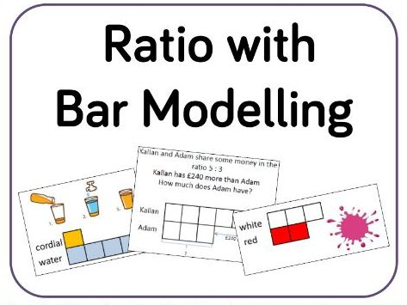
Maths today will focus on using bar models to solve ratio problems.
We may not be learning together in the classroom, but it is important to still remember our classroom beliefs.
WALT: use bar models to solve ratio problems.
Before we start, get your My Maths log in details ready. These were provided in your first work pack.

Slide 4
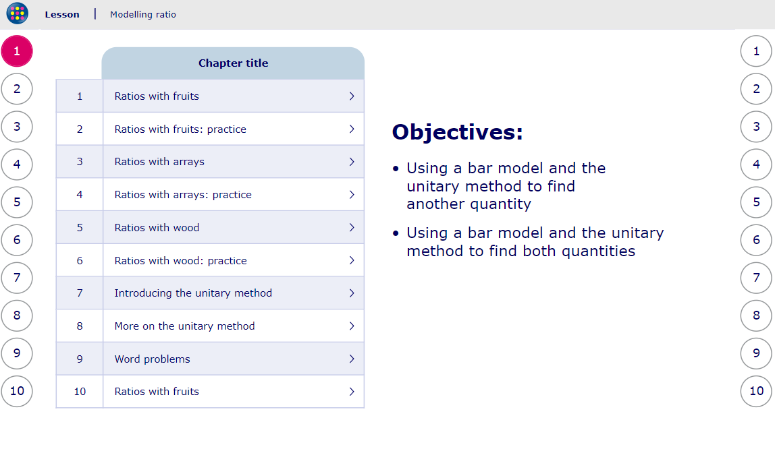
WALT: use bar models to solve ratio problems.
To start the lesson, click on the image on the left - this will take you to an interactive lesson. This lesson will show you how to use a bar model to solve ratio problems (Mrs Jones’ favourite thing - bar models!)
Click on the next buttons at the bottom of the page to move your learning on and take part in the mini-quizzes along the way to check your understanding.

Slide 5
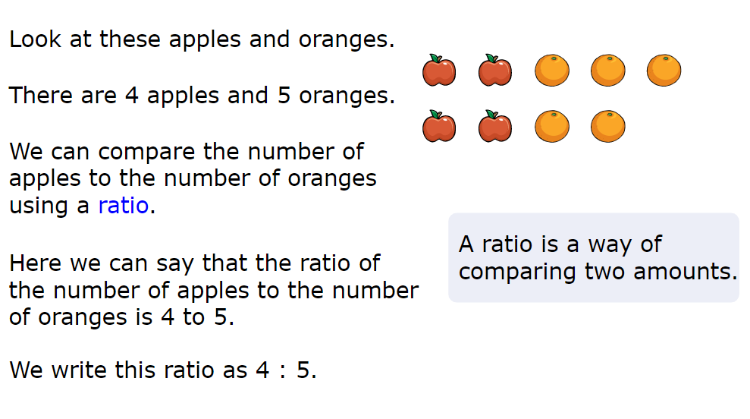
WALT: use bar models to solve ratio problems.
A quick recap...

Slide 6
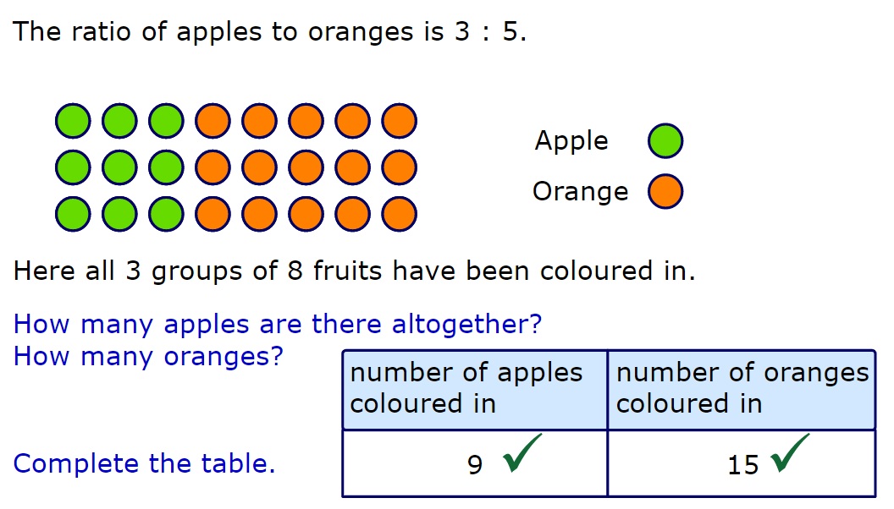
WALT: use bar models to solve ratio problems.
A quick recap...

Slide 7
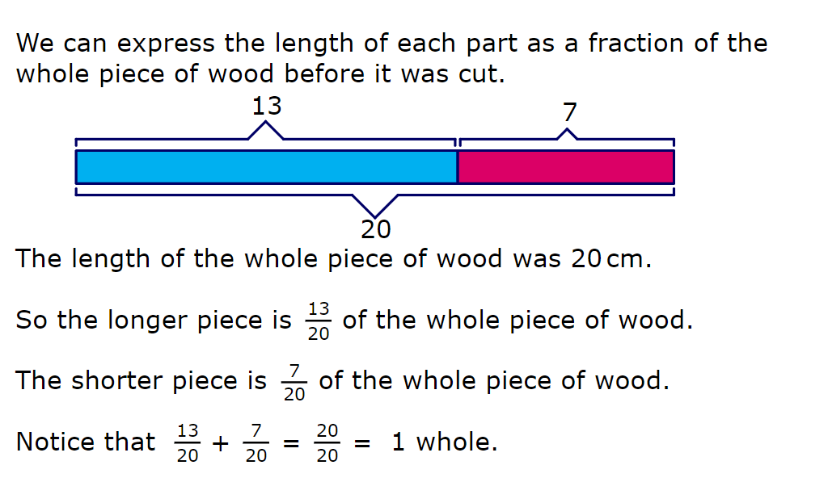
WALT: use bar models to solve ratio problems.
A quick recap...

Slide 8
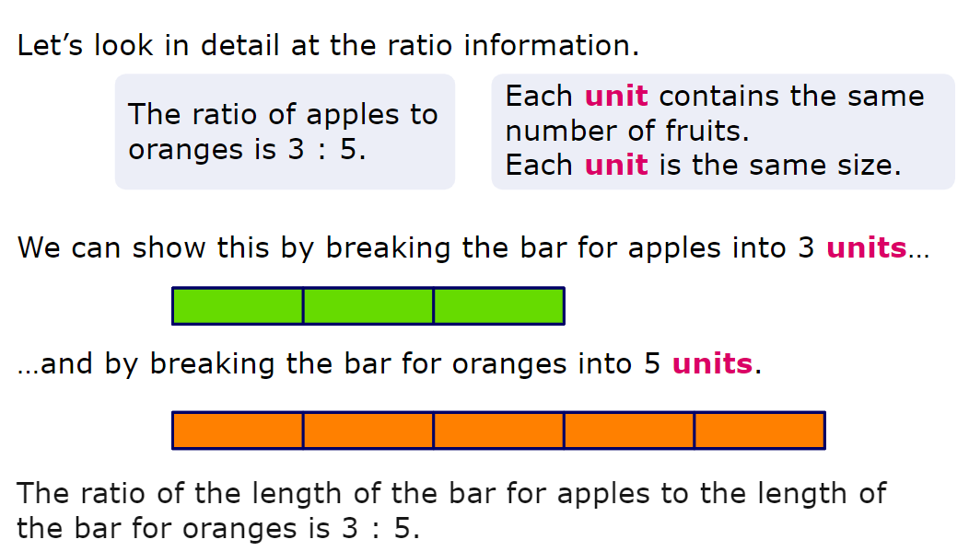
WALT: use bar models to solve ratio problems.
A quick recap...

Slide 9
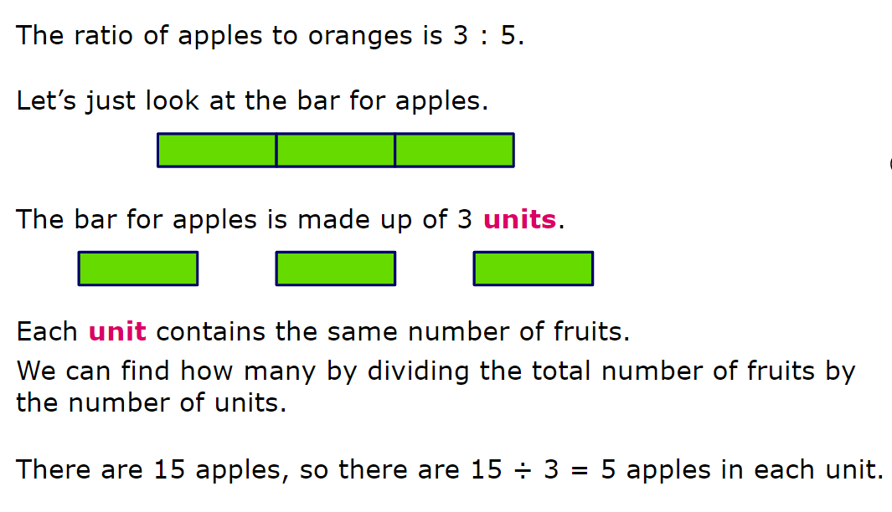
WALT: use bar models to solve ratio problems.
A quick recap...

Slide 10
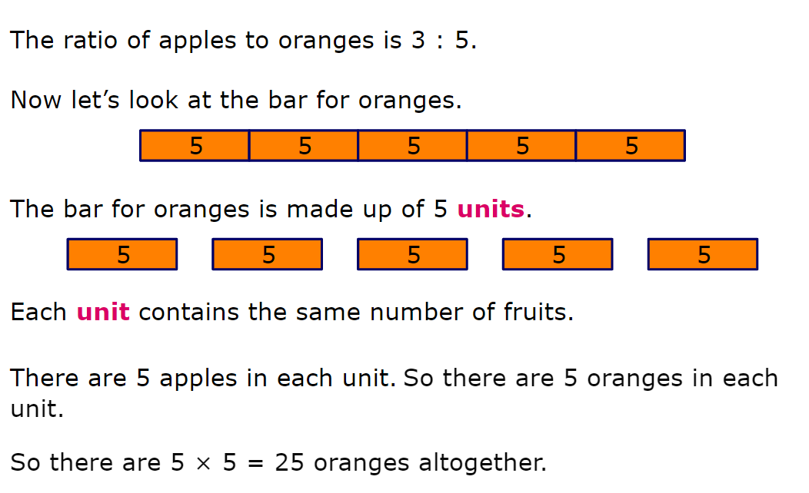
WALT: use bar models to solve ratio problems.
A quick recap...

Slide 11
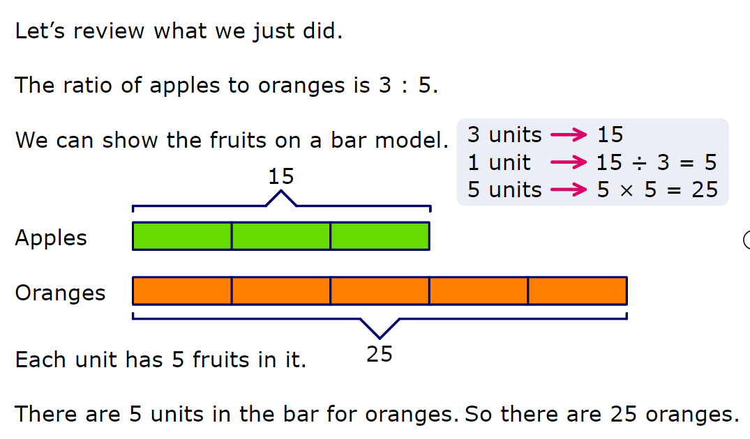
WALT: use bar models to solve ratio problems.
A quick recap...

Slide 12
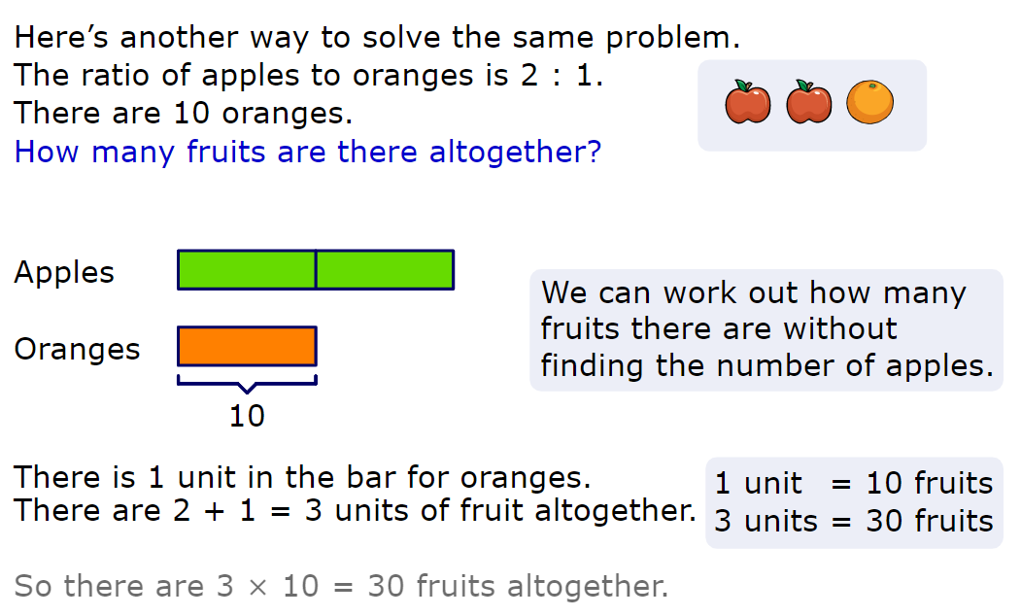
WALT: use bar models to solve ratio problems.
A quick recap...

Slide 13
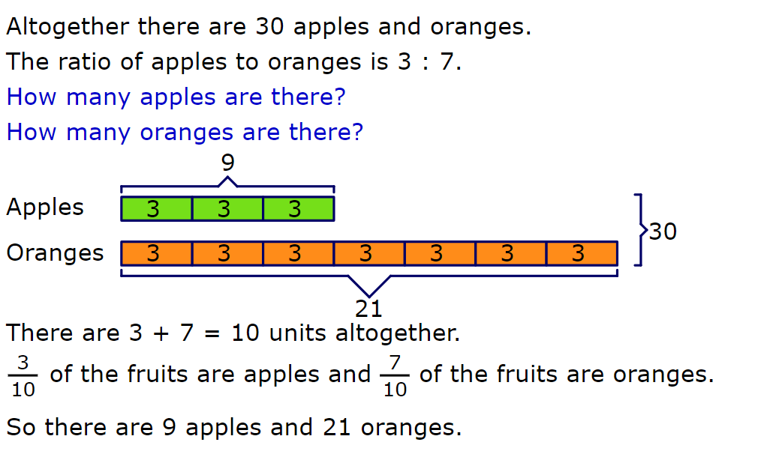
WALT: use bar models to solve ratio problems.
A quick recap...

Slide 14
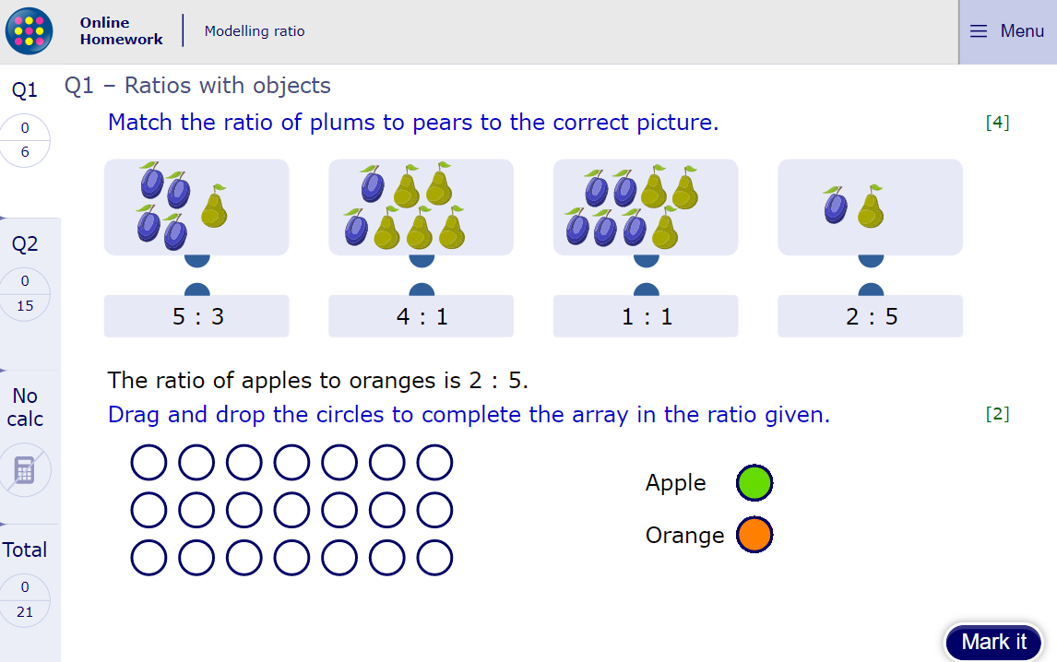
WALT: use bar models to solve ratio problems.
Now click the image on the left of the screen, this will take you to an online homework where you can test your understanding.
You might want to have a scrap piece of paper at the ready to support your bar modelling or calculations.
Have a go at the questions and then click ‘Mark it’ to see how you have go on.
Your login details for My Maths were sent home in your first work pack - make sure you log in so we can see how you are getting on.

Slide 15
Now you have completed the maths (and had a short break), it’s time for spellings.
Wednesday - Spelling and handwriting practice.
Copy out these words out twice in your best joined handwriting.
commercial
residential
influential
social
essential
The president is an influential figure.

Slide 16
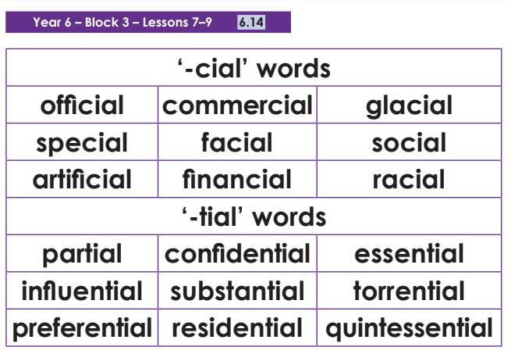
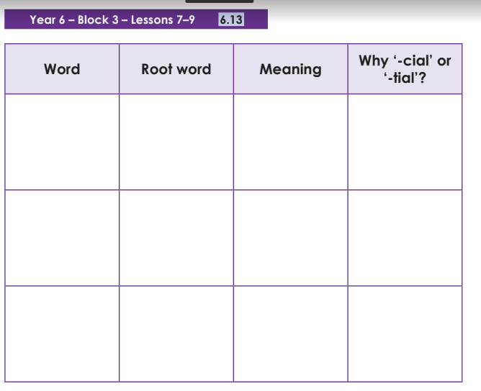
Spelling - Lesson 3
Teacher Notes
Choose some of these words and fill out the table. Remember to use the spelling rule from the previous spelling lesson.

Slide 17
Close Read
Today’s English Lesson will be a close read activity is taken from Harry Potter.
Teacher Notes
The purpose of a close read activity is to gain an understanding of the text by reading it multiple times.
Close Read Instructions:
Read the blurb about the text to gain an idea of the context. Share your thoughts with an adult or sibling.
Look at the vocabulary highlighted. Do you know what the words mean? If you are unsure, read the vocabulary slide to gain a better understanding.
Read the text to yourself and ask yourself the following questions:
What did I just read? What did it say? You can make notes or annotate the text.
Now read the text again with an adult - this will help you gain a better understanding.
Read the questions and now reread the text again to find evidence that will support your answers.
Answer the questions in writing.
All close read texts are age appropriate.

Slide 18
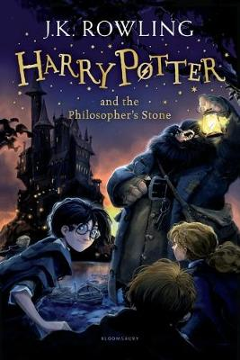
Close read - Harry Potter
WALT: make inferences and deductions using evidence from the text.
Blurb
When mysterious letters start arriving on his doorstep, Harry Potter has never heard of Hogwarts School of Witchcraft and Wizardry.
They are swiftly confiscated by his aunt and uncle.
Then, on Harry’s eleventh birthday, a strange man bursts in with some important news: Harry Potter is a wizard and has been awarded a place to study at Hogwarts.
And so the first of the Harry Potter adventures is set to begin.

Slide 19
Close read - Harry Potter - Text
WALT: make inferences and deductions using evidence from the text.
Chapter Four: The Keeper of the Keys
BOOM. They knocked again. Dudley jerked awake. ‘Where’s the cannon?’ he said stupidly. There was a crash behind them and Uncle Vernon came skidding into the room. He was holding a rifle in his hands – now they knew what had been in the long, thin package he had brought with them. ‘Who’s there?’ he shouted. ‘I warn you – I’m armed!’ There was a pause. Then – SMASH! The door was hit with such force that it swung clean off its hinges and with a deafening crash landed flat on the floor. A giant of a man was standing in the doorway. His face was almost completely hidden by a long, shaggy mane of hair and a wild, tangled beard, but you could make out his eyes, glinting like black beetles under all the hair. The giant squeezed his way into the hut, stooping so that his head just brushed the ceiling.
© Hamilton Trust

Slide 20
Close read - Harry Potter - Text
WALT: make inferences and deductions using evidence from the text.
He bent down, picked up the door and fitted it easily into its frame. The noise of the storm outside dropped a little. He turned to look at them all. ‘Couldn’t make us a cup’o’tea, could yeh? It’s not been an easy journey…’ He strode over to the sofa where Dudley sat frozen with fear. ‘Budge up, yeh great lump,’ said the stranger. Dudley squeaked and ran to hide behind his mother, who was crouching, terrified, behind Uncle Vernon. ‘An’ here’s Harry!’ said the giant.
Harry looked up into the fierce, wild, shadowy face and saw that the beetle eyes were crinkled in a smile. ‘Las’ time I saw you, you was only a baby,’ said the giant. ‘Yeh look a lot like yer dad, but yeh’ve got yer mum’s eyes.’ Uncle Vernon made a funny rasping noise. ‘I demand that you leave at once, sir!’ he said. ‘You are breaking and entering!’ ‘Ah, shut up, Dursely, yeh great prune,’ said the giant. He reached over the back of the sofa, jerked the gun out of Uncle Vernon’s hands, bent it into a knot as easily as if it had been made of rubber, and threw it into a corner of the room. Uncle Vernon made another funny noise, like a mouse being trodden on.
© Hamilton Trust

Slide 21
Close read - Harry Potter - Vocabulary
WALT: make inferences and deductions using evidence from the text.
Meaning of words:
Jerked - a quick, sharp, sudden movement.
Rasping - to make a rough unpleasant sound, especially while breathing or speaking

Slide 22
Close read - Harry Potter Questions
WALT: make inferences and deductions using evidence from the text.
1) The giant squeezed his way into the hut, stooping so that his head just brushed the ceiling.
Which word is closest in meaning to stooping? Tick one.
walking slouching strolling trailing
2) Uncle Vernon came skidding into the room.
What does the word skidding suggest about how Vernon is feeling?
3) Give one reason why Hagrid might seem frightening when he first appears?
© Hamilton Trust

Slide 23
Close read - Harry Potter Answers
WALT: make inferences and deductions using evidence from the text.
1) The giant squeezed his way into the hut, stooping so that his head just brushed the ceiling.
Which word is closest in meaning to stooping? Tick one.
walking slouching strolling trailing
2) Uncle Vernon came skidding into the room.
What does the word skidding suggest about how Vernon is feeling?
urgency, desperation to defend his beloved son, unexpected and uncontrollable feelings.
3) Give one reason why Hagrid might seem frightening when he first appears?
His face was almost completely hidden. He has a wild tangled beard. He hit the door with such force that it swung clean off its hinges. His eyes were like beetles under all his hair.

Slide 24

Good Afternoon Year 6!
Let’s start our afternoon with a quick burst of energy!
Get your PE kit at the ready because at the start of each afternoon session we will be joining Joe Wicks for our daily workout.
Do as much as you can and over the week you should find you are getting fitter and finding it easier.
Let’s go!
Click the youtube link below and select today’s date from the videos listed.
https://www.youtube.com/channel/UCAxW1XT0iEJo0TYlRfn6rYQ

Slide 25

History - World War Two
We hope you enjoyed a lunch break, had something delicious to eat and are feeling energised after your workout!
Now time for our afternoon session of History.
Over the past few weeks, we have been learning all about WW2 and we didn’t want to leave it there!
This week we will be continuing to study this period of history and complete the learning we started together in the classroom.

Slide 26
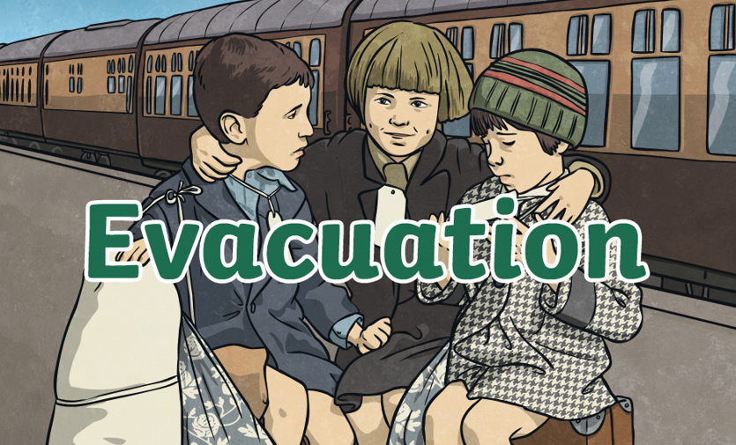
History - World War Two
This afternoon we are going to look further at what life was like for our young British evacuee during WW2.

Slide 27
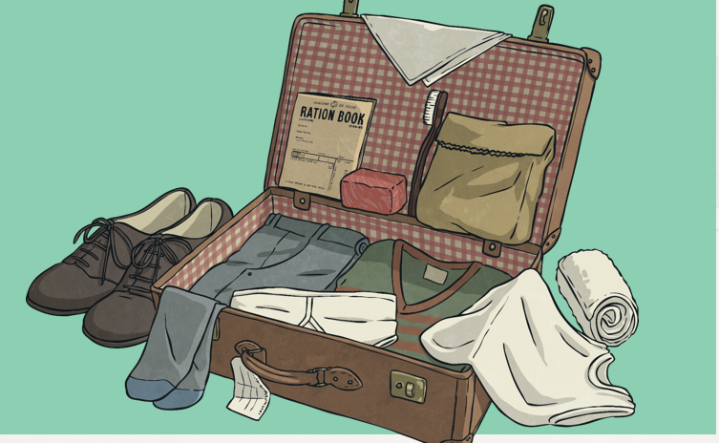
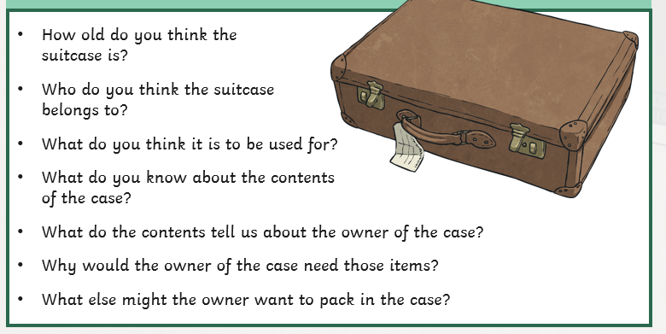
History - World War Two
Have a look at the suitcase. Think about what the answers to the questions might be below.

Slide 28
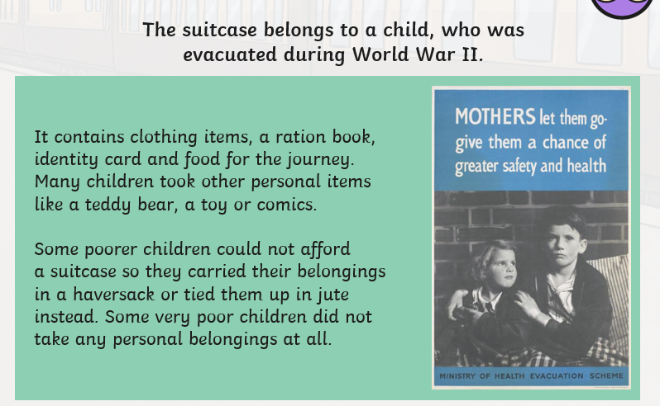
History - World War Two

Slide 29
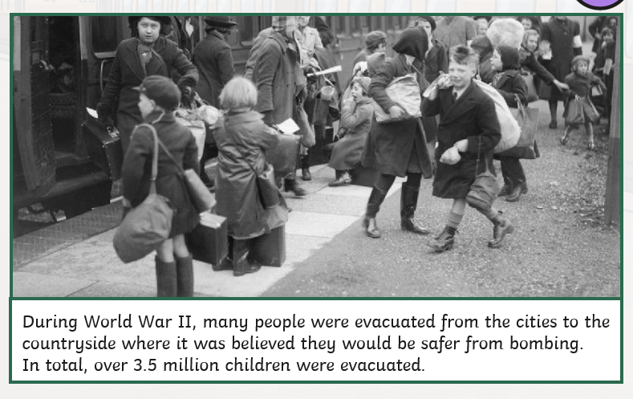
History - World War Two

Slide 30
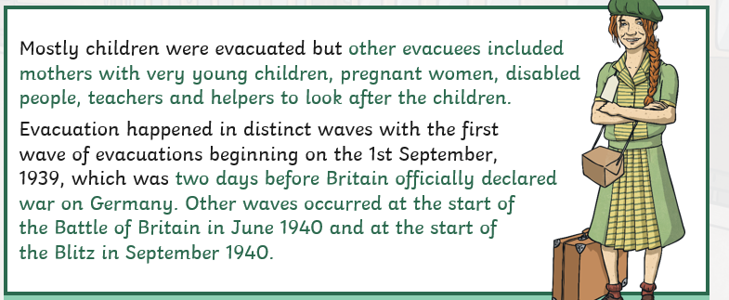
History - World War Two

Slide 31
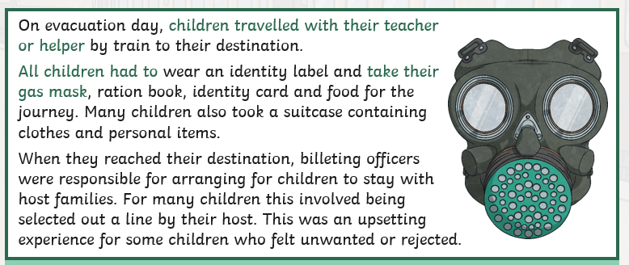
History - World War Two

Slide 32
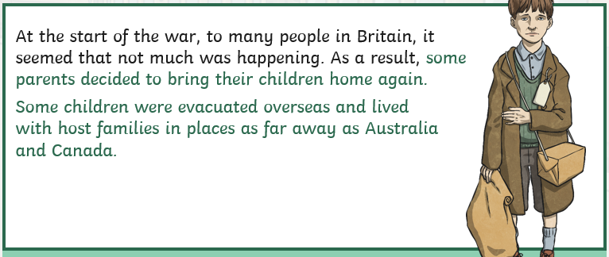
History - World War Two

Slide 33
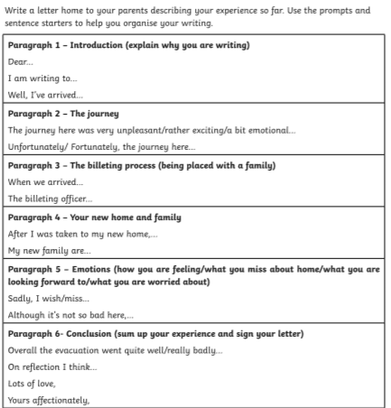
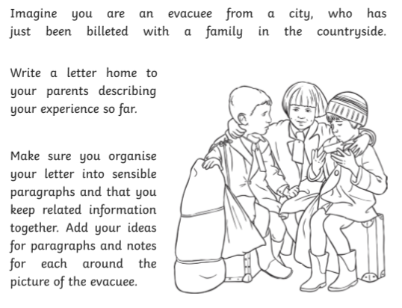
History - World War Two
Your Task

Slide 34
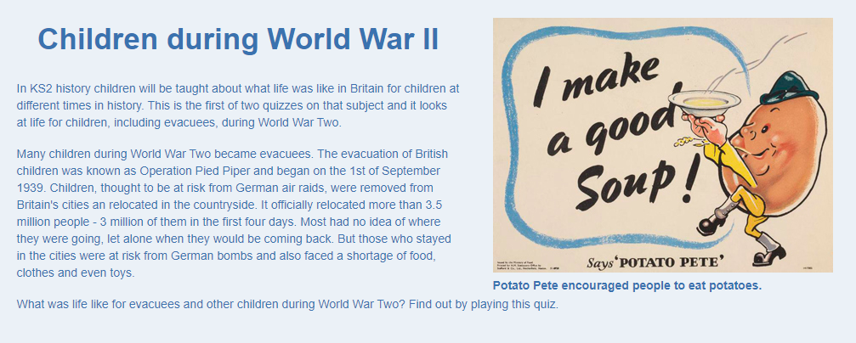
History - World War Two
Test your knowledge and understanding of evacuation in this short online quiz.
Just click the image below.

Slide 35

Wednesday complete!
Well done on a great day!
Enjoy your evening and be ready for more learning tomorrow...

