Slide 1
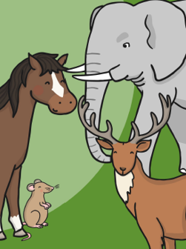
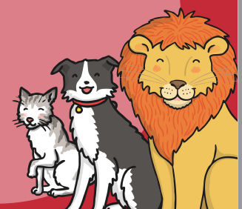
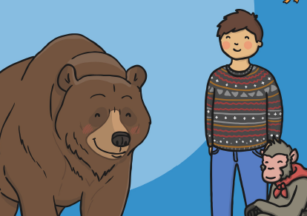
Y1 Science
Week 7 (W/c: 8.6.20)
Carnivores, Herbivores
& Omnivores

Slide 2
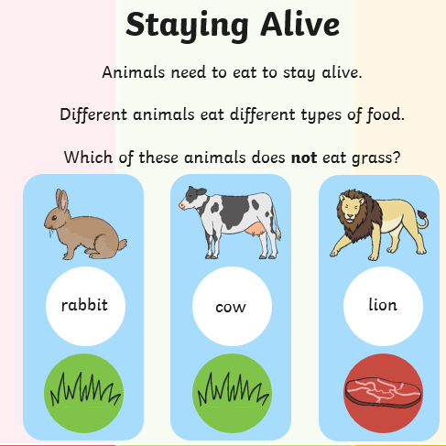
This week we are going to be learning about the three different foods that animals eat.
We have previously talked about Carnivores in school so you should be very familiar with this. ☺

Slide 3
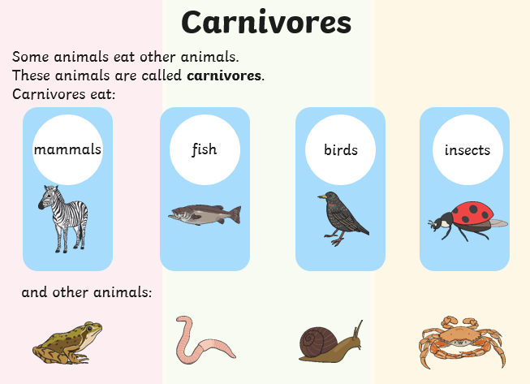

Slide 4
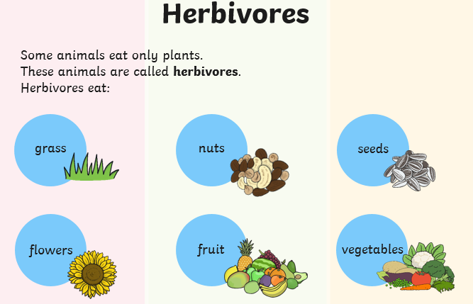

Slide 5
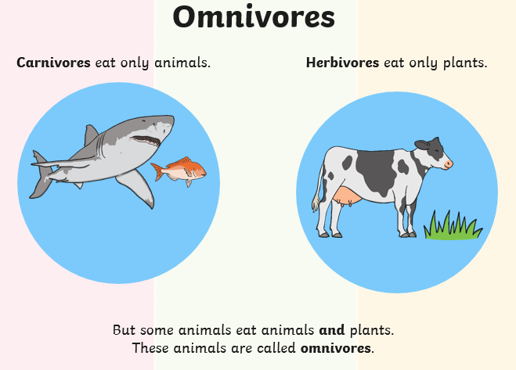

Slide 6
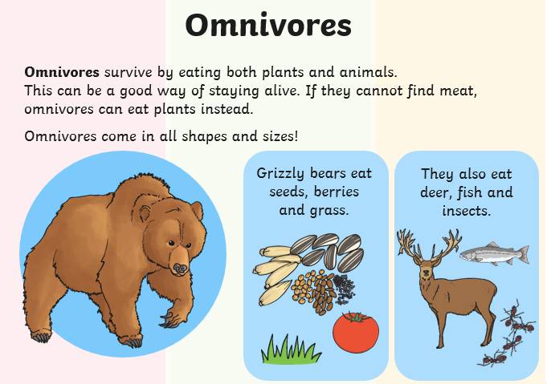

Slide 7
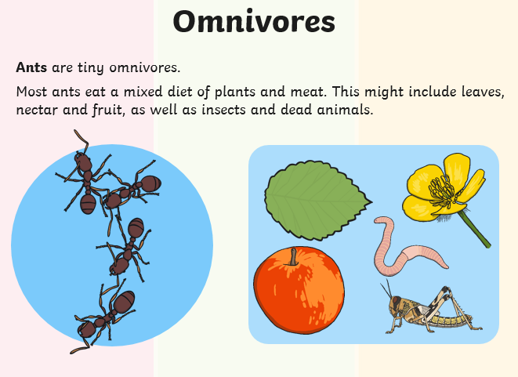

Slide 8
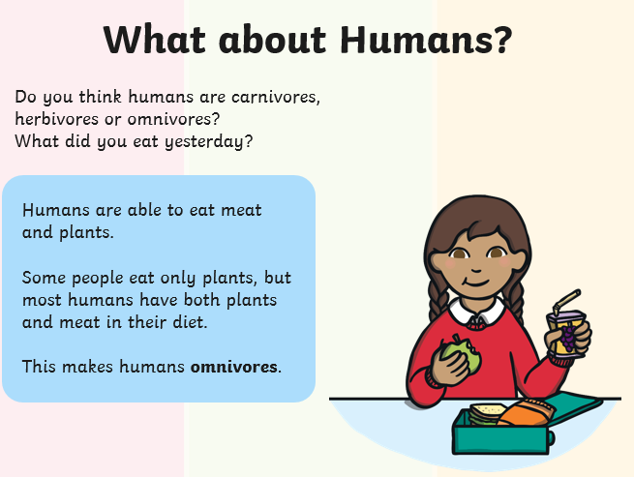

Slide 9
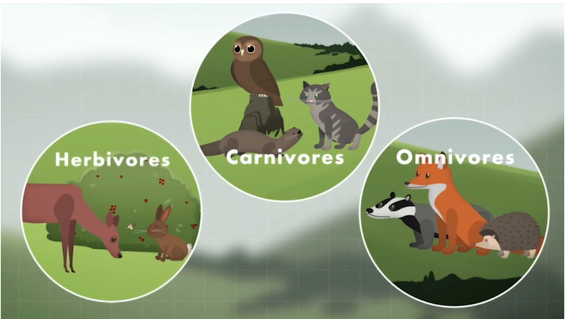
Monday’s lesson
Watch the BBC Bitesize clip below to see what the different animals eat.
* There is also a quiz you could try at the bottom of the website page *
https://www.bbc.co.uk/bitesize/topics/z6882hv/articles/z96vb9q

Slide 10
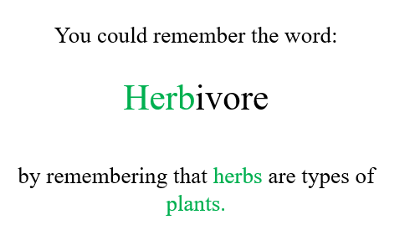
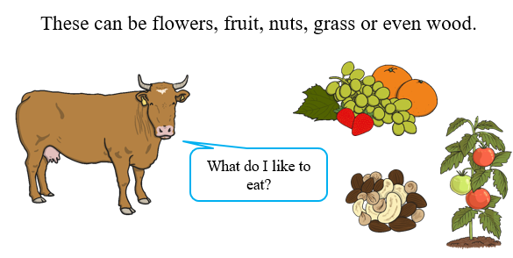
So to recap …
Some animals eat only plants. They are called Herbivores.

Slide 11
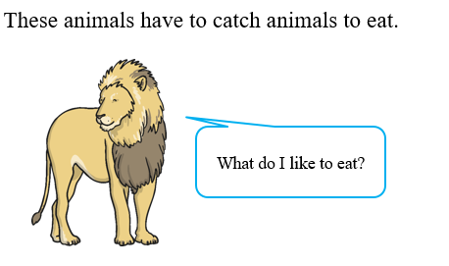
Some animals eat meat. They are called Carnivores.
So to recap …

Slide 12
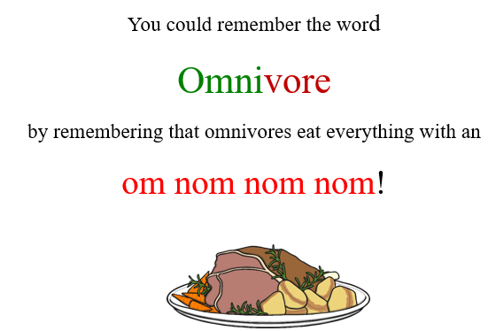
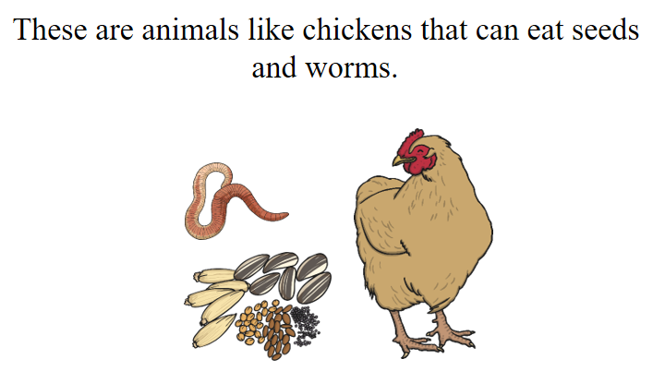
Some animals eat both meat and plants and they are called omnivores.
So to recap …

Slide 13
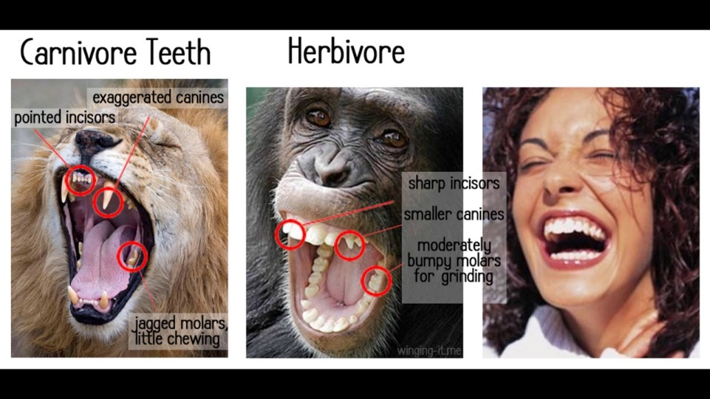
It is important to remember that we fit into a group too, as humans.
Humans are omnivores because lots of humans will eat meat and foods such as vegetables and nuts.
.
Some humans choose not to eat meat and they are called ‘vegetarians’.
However, all humans have teeth similar to other carnivores and herbivores to allow us to eat both types of food if we choose to.

Slide 14
Tuesday’s Lesson:
Let’s see if you can match the animal group to the correct definitions.
Animals that eat meat and plants.
Herbivores
Omnivores
Animals that eat plants.
Carnivores
Animals that eat meat.

Slide 15
Answers:
Animals that eat meat and plants.
Herbivores
Omnivores
Animals that eat plants.
Carnivores
Animals that eat meat.

Slide 16
Let’s see if you can match the animal to the correct group.
Tiger
Herbivores
Omnivores
Hedgehog
Carnivores
Rabbit

Slide 17
Answers:
Tiger
Herbivores
Omnivores
Hedgehog
Carnivores
Rabbit

Slide 18
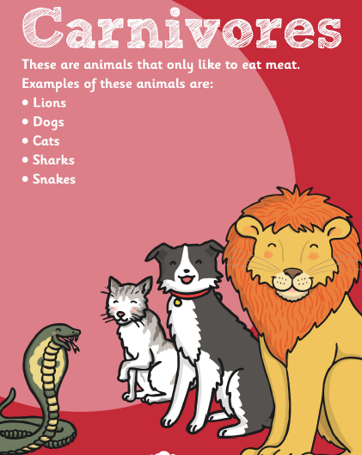
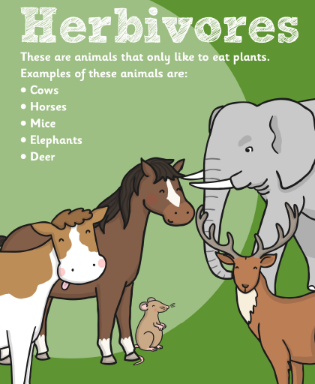
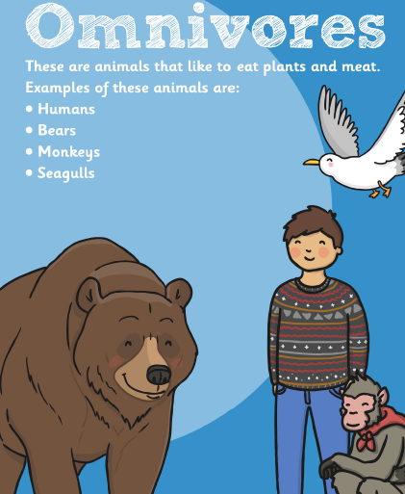

Wednesday’s lesson
True or False?

Slide 19

Wednesday’s lesson
Read the statement.
Decide if it is true or false?
A lion is a carnivore and only eats meat.

Slide 20
Wednesday’s lesson
Answers:
✓
A lion is a carnivore and only eats meat.

Slide 21
Wednesday’s lesson
Read the statement.
Decide if it is true or false?
A bird is a carnivore and only eats meat.

Slide 22
Wednesday’s lesson:
Answers:
x
A bird is a carnivore and only eats meat.
Birds are omnivores- they eat both meat and plants.

Slide 23
Wednesday’s lesson
Read the statement.
Decide if it is true or false?
A giraffe is a herbivore and only eats plants.

Slide 24
Wednesday’s lesson:
Answers:
A giraffe is a herbivore and only eats plants.
✓

Slide 25
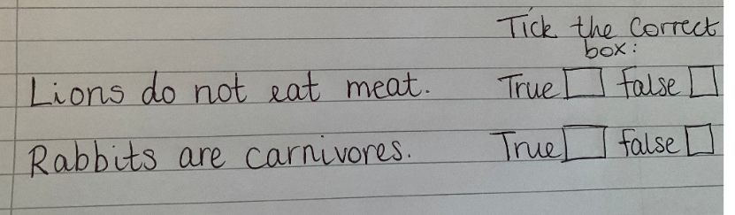
Wednesday’s lesson:
You could now have a go at making up your own statements and ask someone in your family to decide if they are true or false…

Slide 26
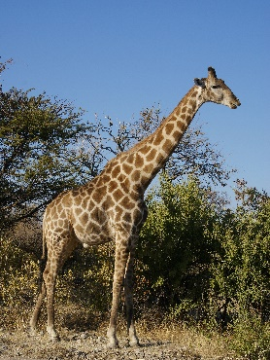
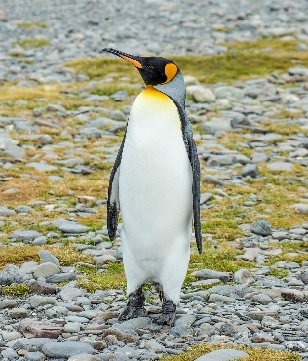
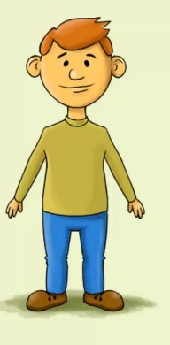
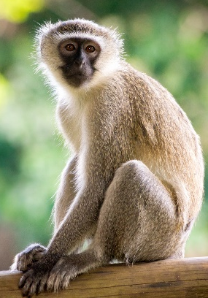
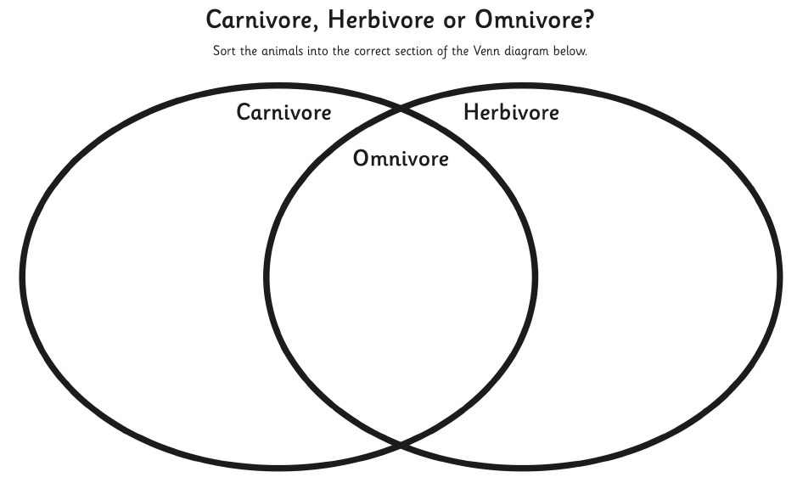
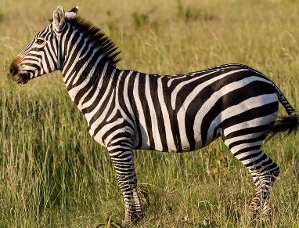
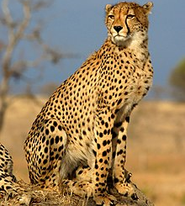
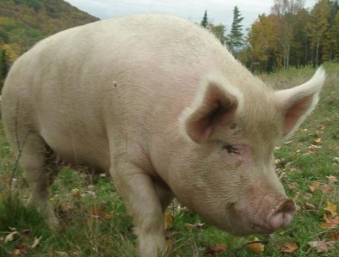
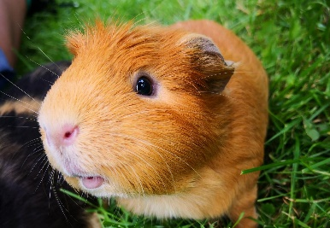
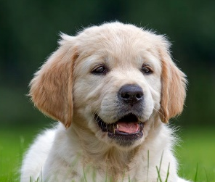
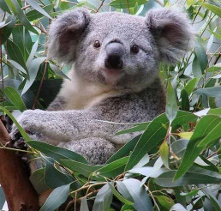
Thursday’s lesson-
Today we are going to have a go at sorting animals into the correct group. To do this, we are going to use a Venn Diagram.
You need to put any animals that eat meat into the ‘carnivore’ circle, any animals that eat plants into the ‘herbivore’ circle and then any animals that eat both meat and plants will go into the middle over lapping circle as they are ‘omnivores’.
* You can download this worksheet from the Y1 week 7 folder *

Slide 27


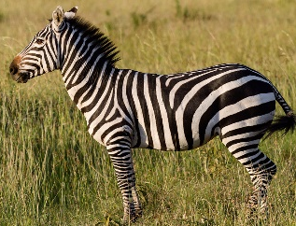
Thursday’s lesson-
Answers:

Slide 28
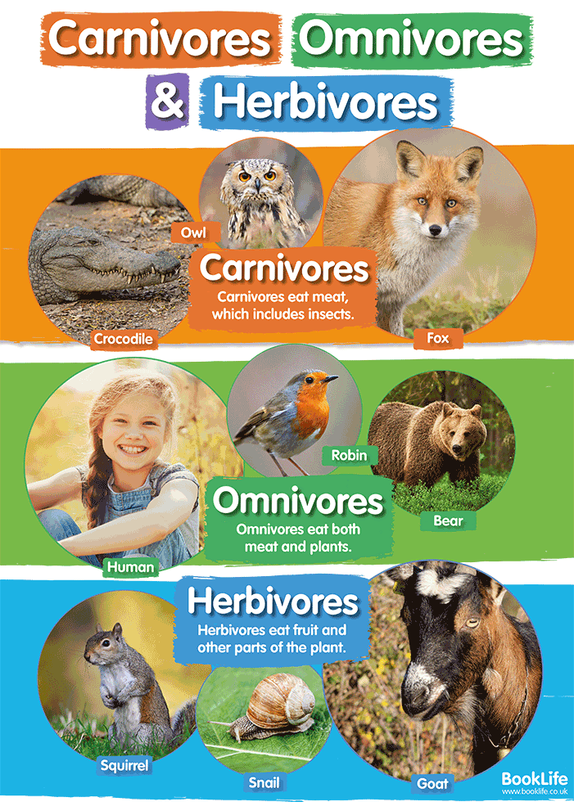
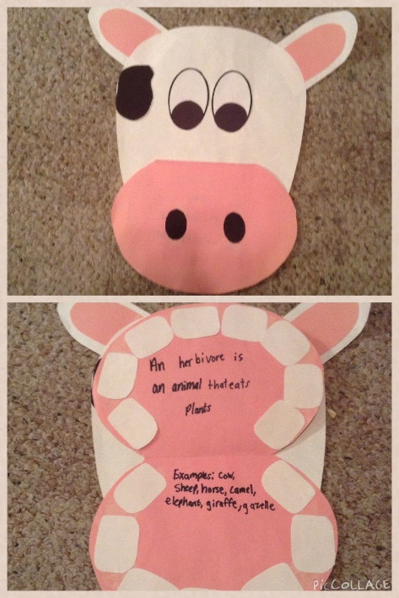
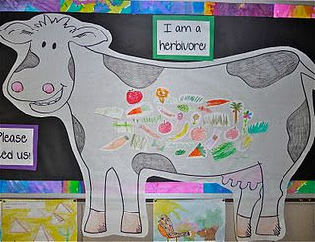
Friday’s lesson:
Today we would like you to pretend you are teaching someone else about Carnivores, Herbivores & omnivores. You will need to explain what the different groups are and put the correct animals into each group. You could do this in many different forms:
You may choose to create a poster to teach others
You may choose to simply write some sentences like the example below
You may want to make your animal out of a
piece of card/paper plate and make a flap
so that it’s mouth opens.
You can then write about
it inside the mouth
(like the image shown)…
A lion is a carnivore because it only eats meat.
You may choose to draw/paint a large animal of your choice and draw all the things that animal would eat inside it’s tummy.
You could do 1 carnivore, 1 herbivore and 1 omnivore.

