Slide 1
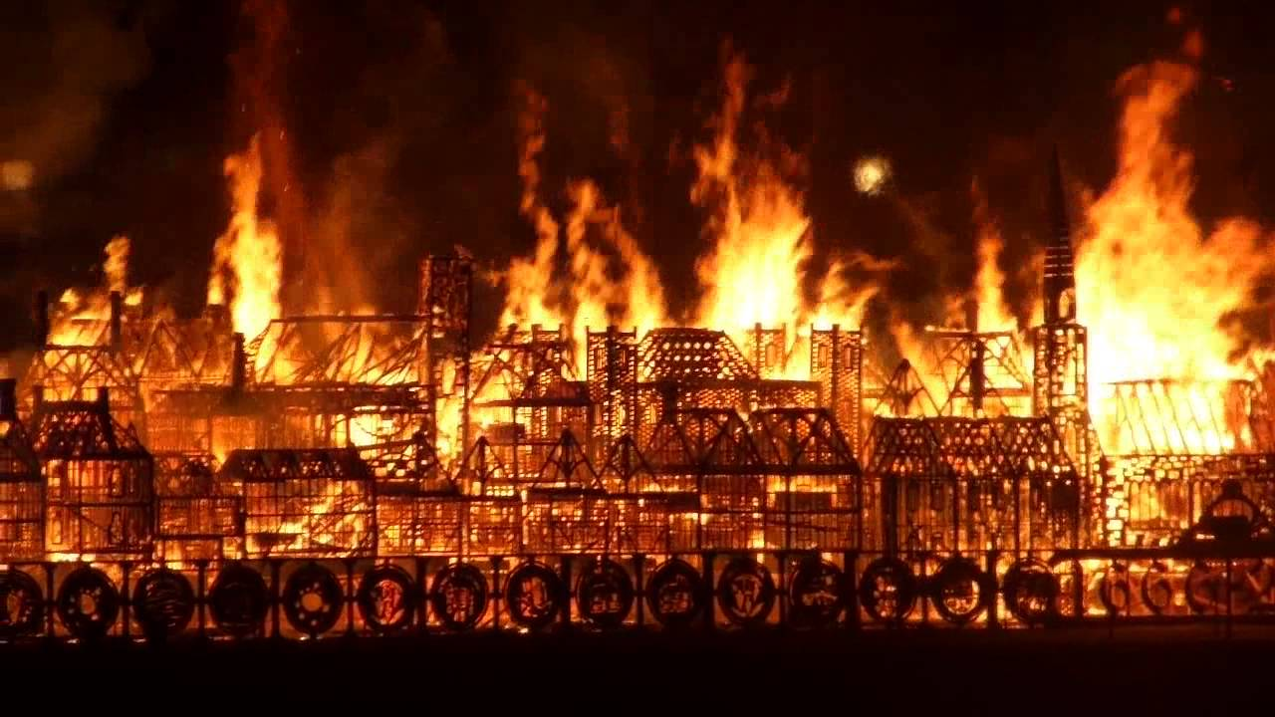
Y1 History
Week 12 (W/C: 13.7.20)

Slide 2
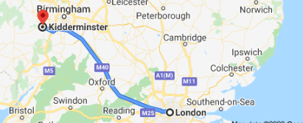
History: We will learn about events beyond living memory that are significant nationally or globally
The Great Fire of London
Q) Have you heard of this before?
Discuss with your grown up how far away London is to us…
This happened in 1666. We are now in the year 2020. That was a very long time ago!
Great Fire of London
The Queen was born
You were born
Now
1666
1926
2013/
2014
2020

Slide 3
History: We will learn about events beyond living memory that are significant nationally or globally
The Great Fire of London
What do you think might have happened? Think about the words in the title:
“The great fire of London”
Have you heard of any songs that talk about
‘London Burning’?

Slide 4

Monday:
Watch this clip to hear all about what happened …
https://www.youtube.com/watch?v=VarSSAwiimU&t=4s
Note for parents:
Pause the clip throughout to discuss anything your child wants to understand more about.
Encourage your child to ask questions for further clarity.

Slide 5
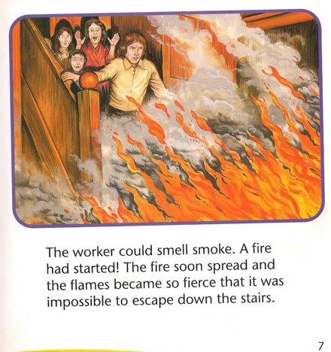
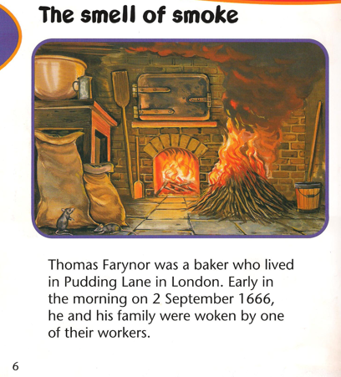
Tuesday:
Recap what happened using the following slides…
(PPT has been uploaded into the resources folder)

Slide 6
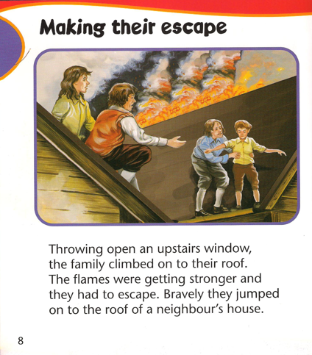
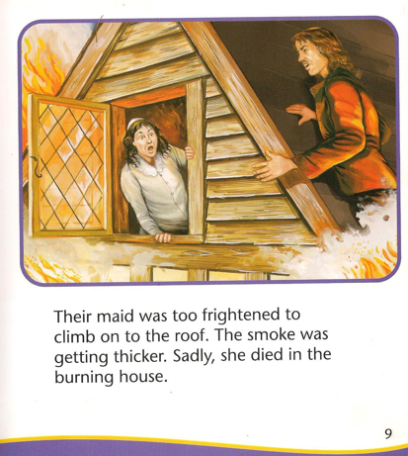
Tuesday:
Recap what happened using the following slides…
(PPT has been uploaded into the resources folder)

Slide 7
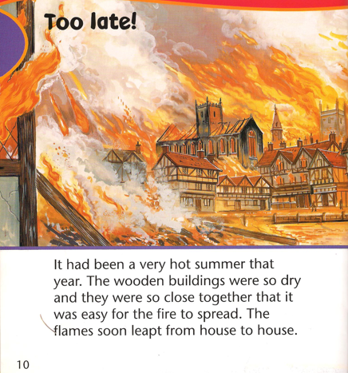
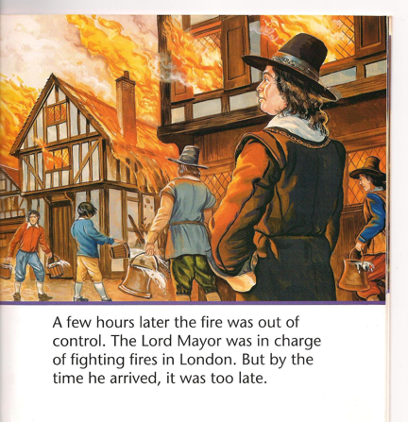
Tuesday:
Recap what happened using the following slides…
(PPT has been uploaded into the resources folder)

Slide 8
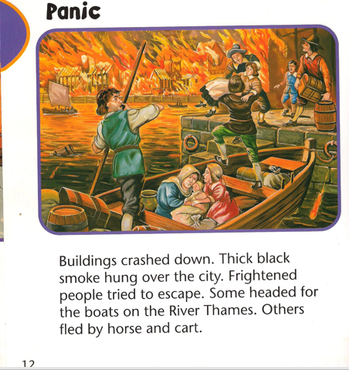
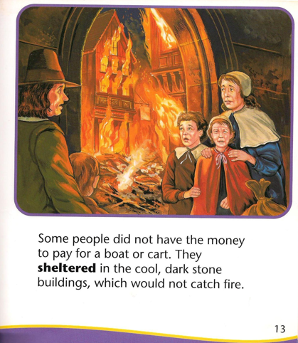
Tuesday:
Recap what happened using the following slides…
(PPT has been uploaded into the resources folder)

Slide 9
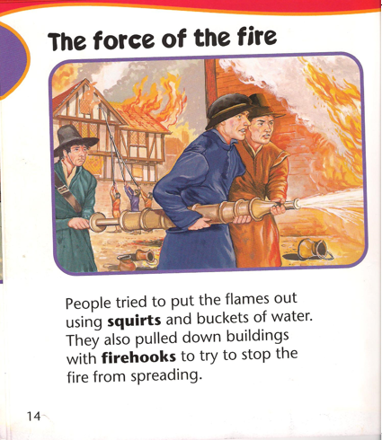
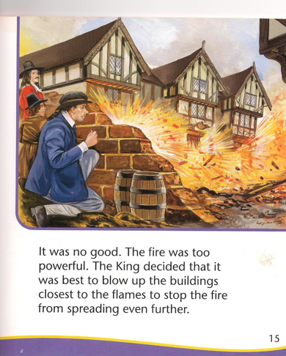
Tuesday:
Recap what happened using the following slides…
(PPT has been uploaded into the resources folder)

Slide 10
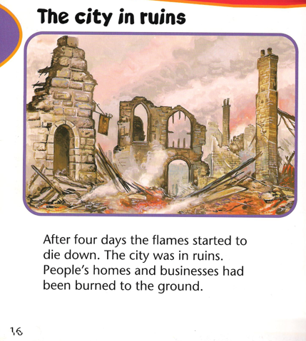
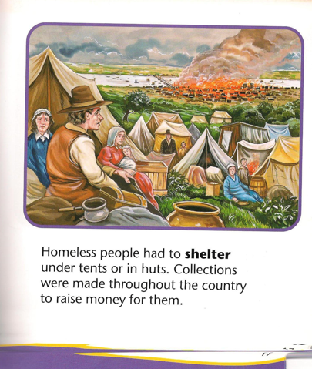
Tuesday:
Recap what happened using the following slides…
(PPT has been uploaded into the resources folder)

Slide 11
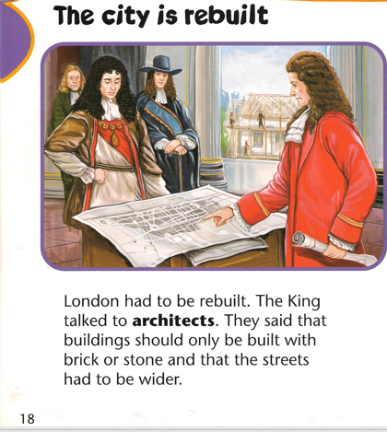
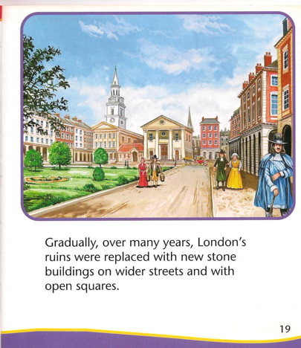
Tuesday:
Recap what happened using the following slides…
(PPT has been uploaded into the resources folder)

Slide 12

Tuesday:
True / False
See if you can sort these statements into those that are true and those that are false. The first one has been one for you ☺
The houses were close together.
True ☺
The houses were far apart.
False ☹
It happened in 2015.
The houses were made of metal.
The fire spread quickly.
The fire spread slowly.
It happened in 1666.
It had been a very hot summer.
The fire started in a bakery.
The houses were made of wood.

Slide 13
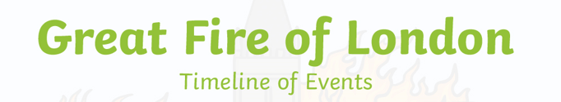
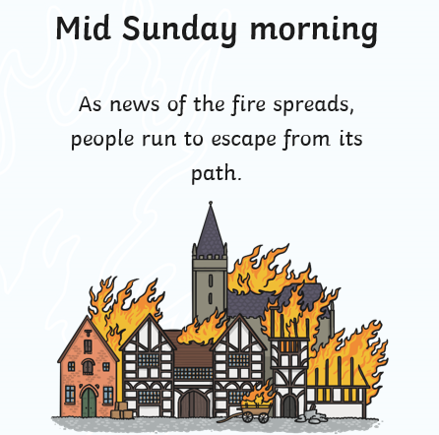
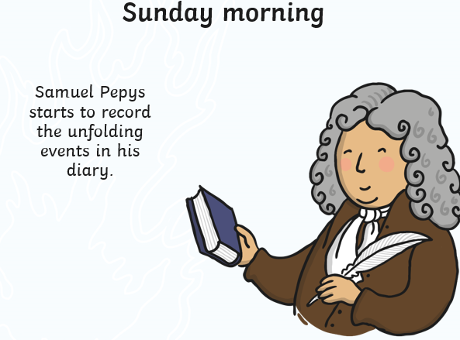
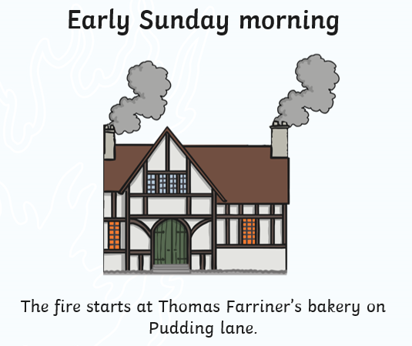
Wednesday:
Recap what happened using the timeline ppt…
(PPT has been uploaded into the resources folder)

Slide 14
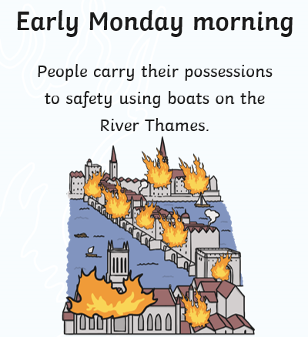
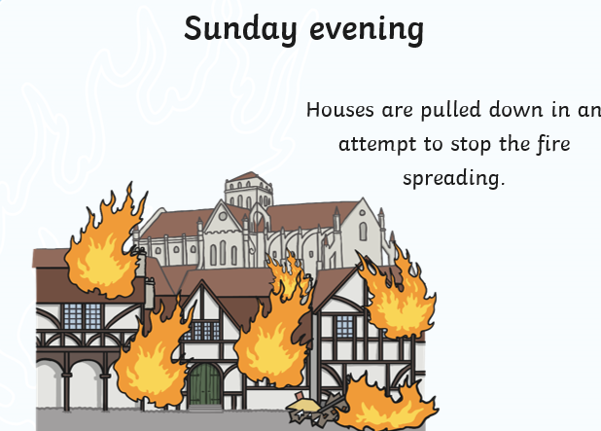
Wednesday:
Recap what happened using the timeline ppt…
(PPT has been uploaded into the resources folder)

Slide 15
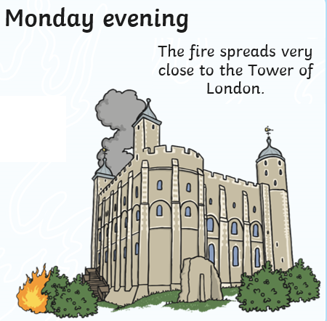
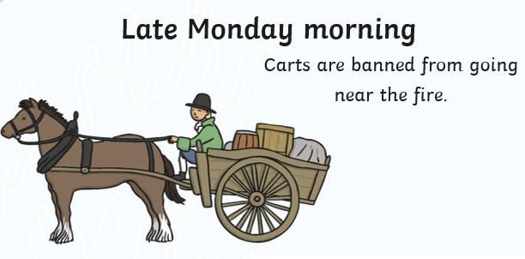
Wednesday:
Recap what happened using the timeline ppt…
(PPT has been uploaded into the resources folder)

Slide 16
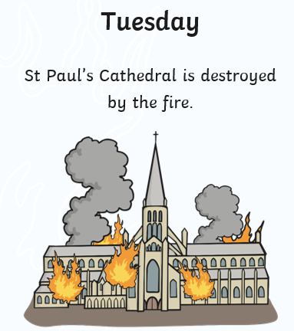
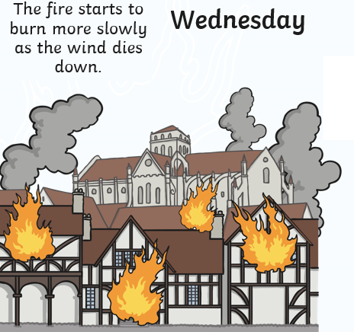
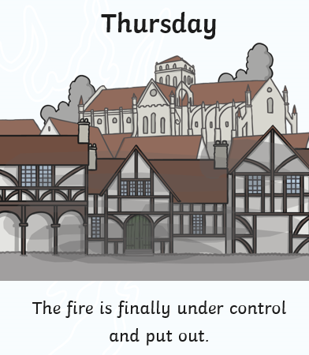
Wednesday:
Recap what happened using the timeline ppt…
(PPT has been uploaded into the resources folder)

Slide 17
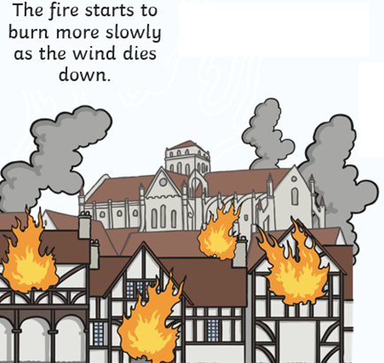
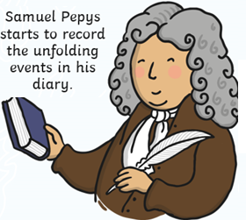
Wednesday:
Your turn to order the sequence of events
(PPT has been uploaded into the resources folder)
Early Sunday Morning
Mid Sunday Morning
Early Monday
Morning
Late Monday Morning
Sunday Morning
Sunday Evening
Monday Evening
Thursday
Tuesday
Wednesday

Slide 18





Thursday:
Senses:
If you were there during the Great Fire how would you have been feeling? What would you see? Smell? Hear? Touch?
Write as many things you can think of for each of the headings. An example has been done for you for each. You may want to watch the clip again to see how you would have felt.
See
Smell
Burning buildings
Choking smoke
Hear
Touch
Feel
Fire sizzling
Hot flames
Terrified

Slide 19
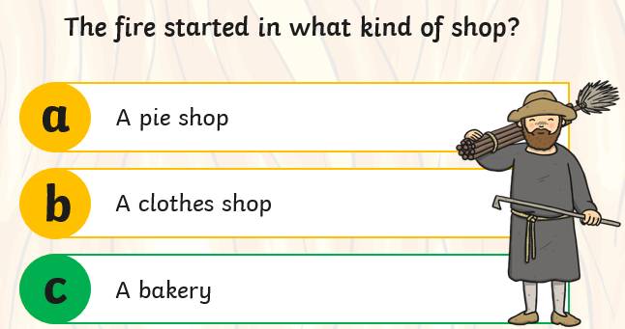
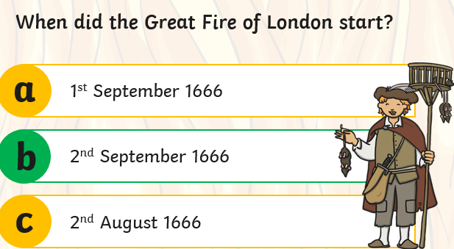
Friday:
QUIZ
Q2
Q1

Slide 20
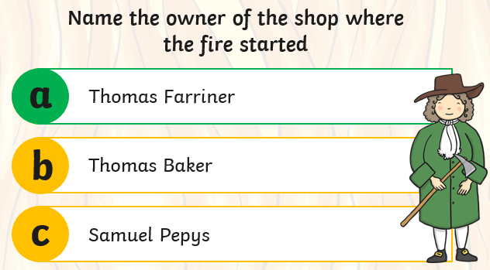
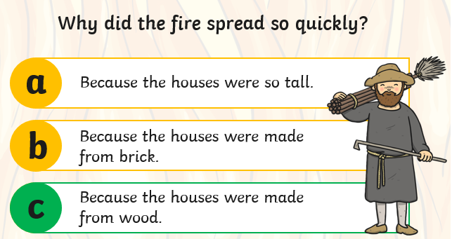
Friday:
QUIZ
Q3
Q4

Slide 21
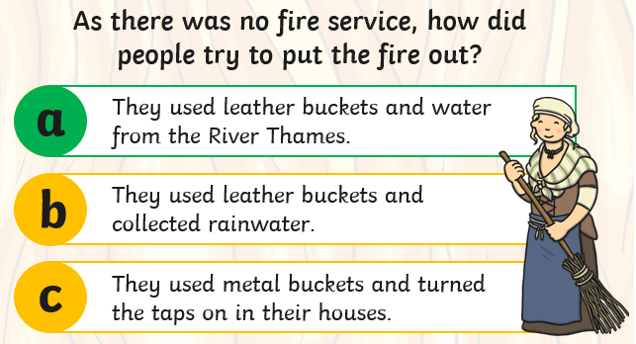
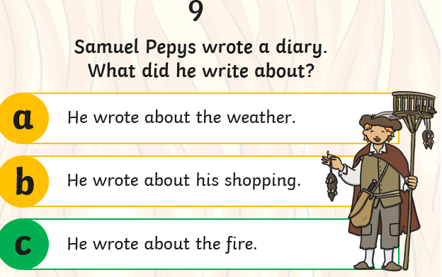
Friday:
QUIZ
Q5
Q6

Slide 22

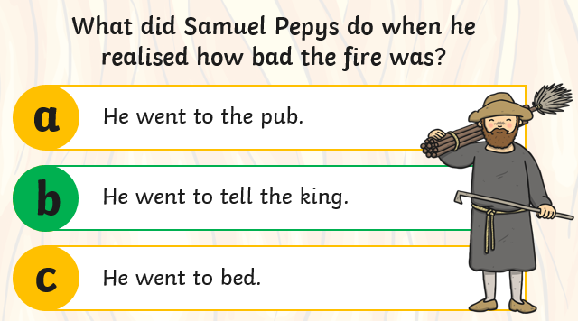
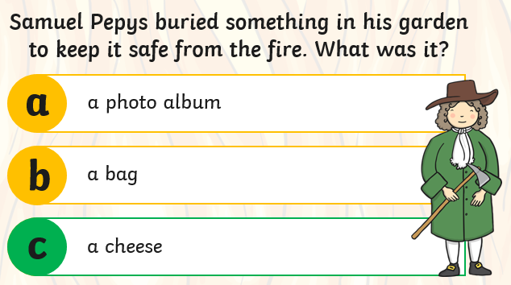
Friday:
QUIZ
Q7
Q8

Slide 23
Friday:
QUIZ answers
Q1) b
Q2) c
Q3) a
Q4) c
Q5) a
Q6) c
Q7) b
Q8) c

