Slide 1
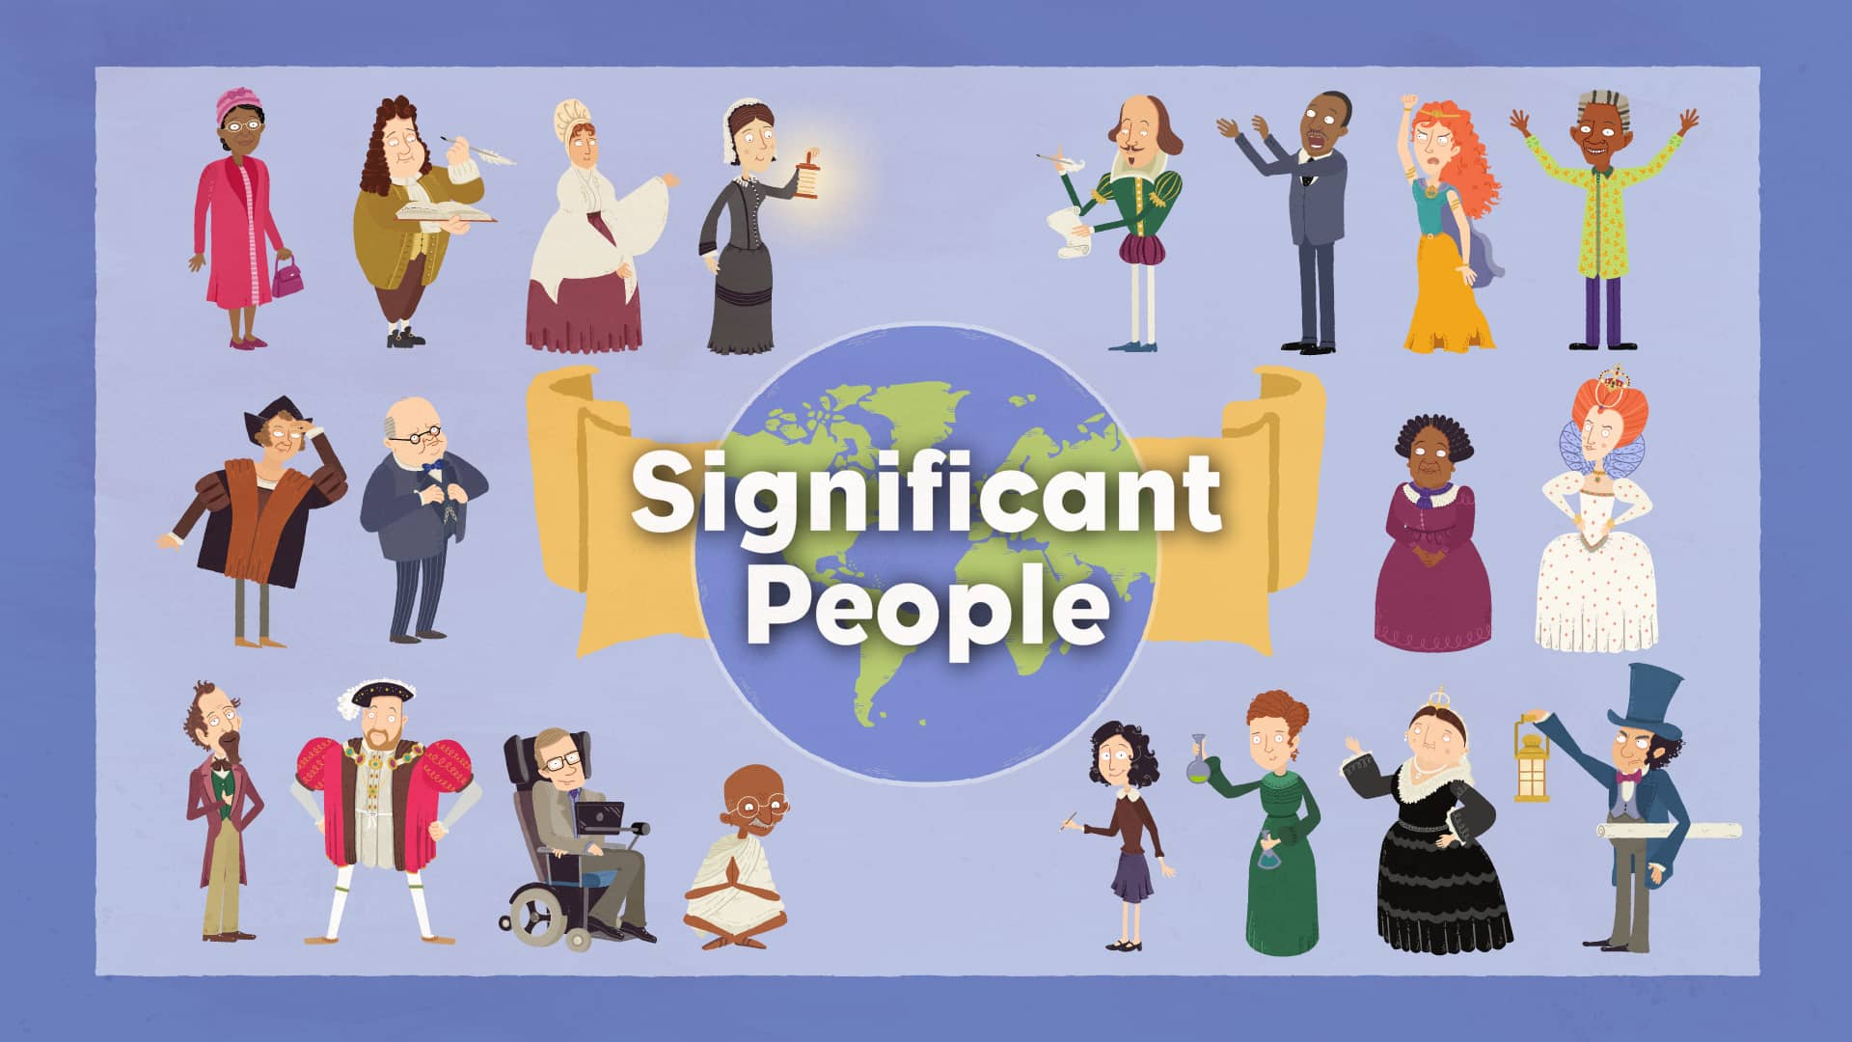
History
20.4.20 – 1.5.20
Significant People

Slide 2
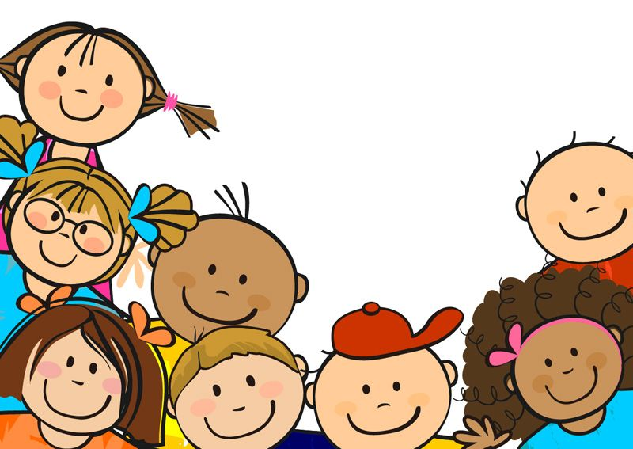
Dear Year 1 children,
We hope you are all keeping well and safe at home. We miss you all so very much!
We know how much you all enjoy and love learning, so we have made 10 history lessons for you to try at home.
We look forward to seeing you all very soon.
Mrs Ross, Miss Wheeler, Miss Townsend,
Mrs Shelley, Mrs Jones and Mrs Hulagu xxx

Slide 3
History lesson 1
Significant People

Slide 4
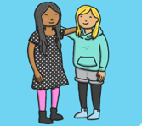
People who are significant to me
Think about the people who are important to you. Tell your family who they are and why they are important to you.

Slide 5
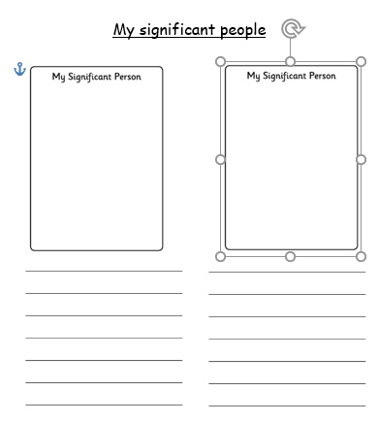
My significant people
Draw 2 people that are important to
you.
Explain why they are important to you.

Slide 6
History lesson 2
Significant People

Slide 7
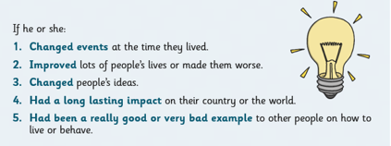
What makes people Significant?
There are many reasons that people can become significant.
There could be more than one reason.

Slide 8
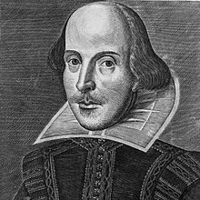
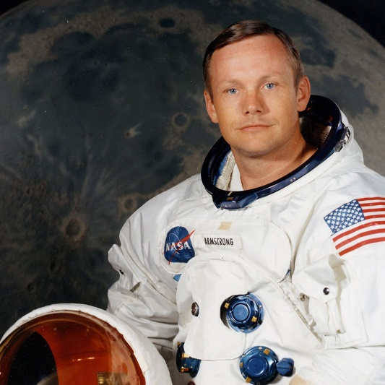
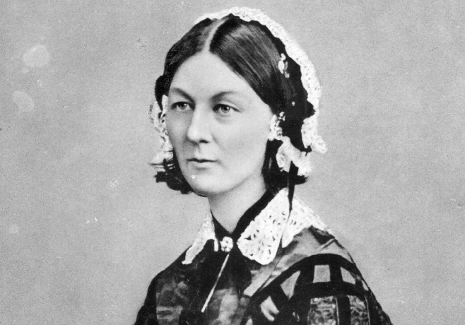
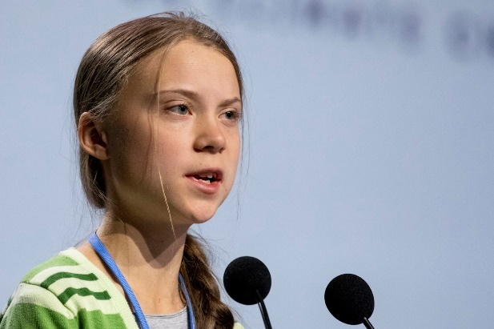
Do you recognise any of these significant people?
Talk to your family about who they are and why they are significant. Play a game of charades with the 4 people – can they guess who you are by your actions?

Slide 9
Answers
William Shakespeare
A famous playwright and poet.
Neil Armstrong
The first person to walk on the moon.
Florence Nightingale
A famous nurse who improved hospital conditions.
Greta Thunberg
A fighter against climate change.

Slide 10
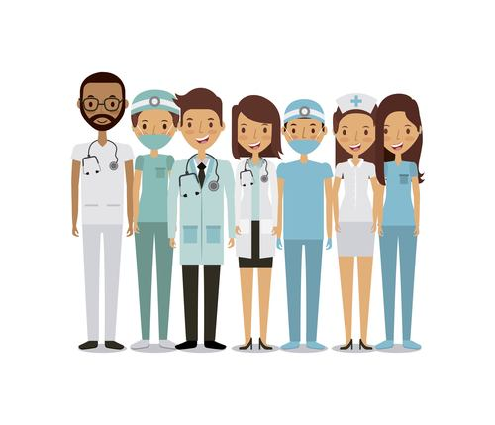
History lesson 3
Significant People
Nurses

Slide 11
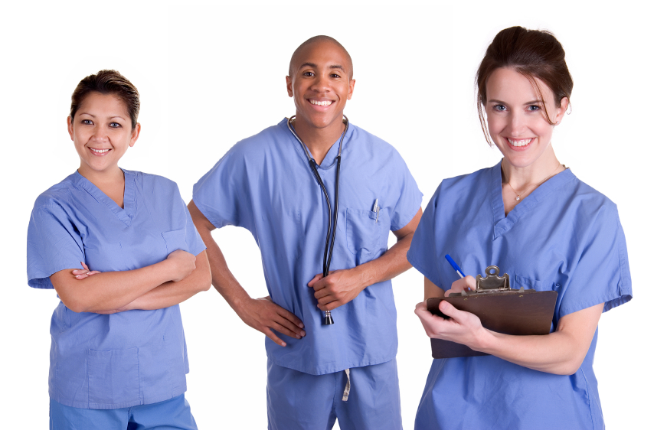
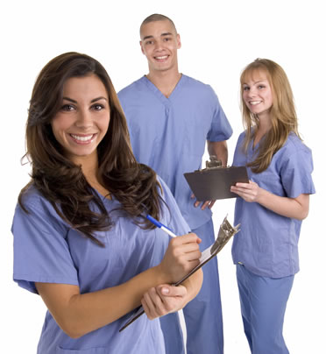
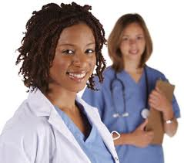
What job do these people do?
How do they help us?

Slide 12
Why are doctors and nurses especially important at the moment?
Imagine your teddy is not feeling very well and that you are a doctor or a nurse.
How will you make your teddy feel better?
What equipment will you need?
Where will your teddy need to be?
What kind of person does a nurse have to be?
Take a photo or write about how you helped nurse your teddy back to good health

Slide 13
History lesson 4
Significant People
Nurses

Slide 14
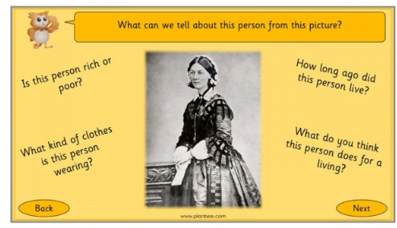

Slide 15

Why do you think she was a
significant person?
Write a list of the things you
would like to find out about her.

Slide 16
History lesson 5
Significant People
Nurses

Slide 17
Florence Nightingale
Watch the clips to find out about Florence Nightingale.
https://www.bbc.co.uk/bitesize/topics/zns9nrd/articles/znsct39
https://www.youtube.com/watch?v=QBoc60LsTy0

Slide 18
History lesson 6
Significant People
Nurses

Slide 19
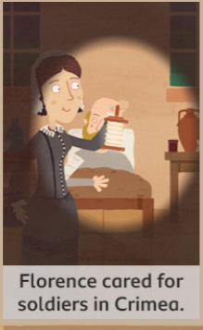
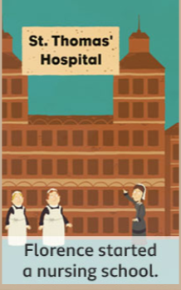
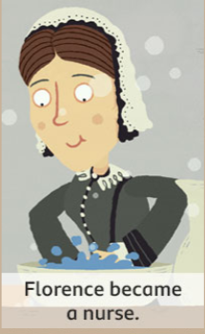
Tell your family about the story of Florence Nightingale. Put the pictures into the correct order

Slide 20
History lesson 7
Significant People
Nurses

Slide 21
What do modern
nurses wear?

Slide 22
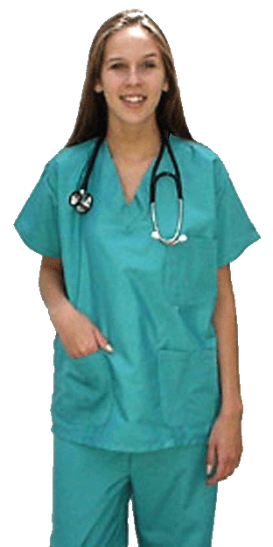
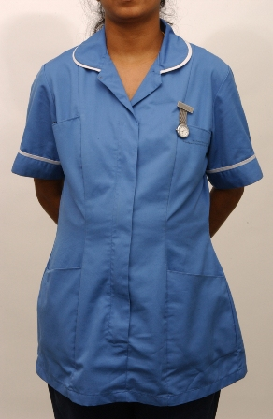
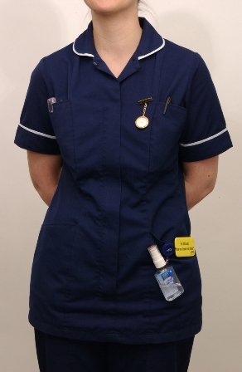
Have you ever seen a nurse wearing these uniforms?

Slide 23
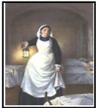
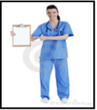
What are the similarities and differences between the nurses?
Why do you think there are differences?
Here is a picture of Florence Nightingale. A famous nurse from the 1800’s.
Here is a picture of a nurse today.

Slide 24
History lesson 8
Significant People
Nurses

Slide 25
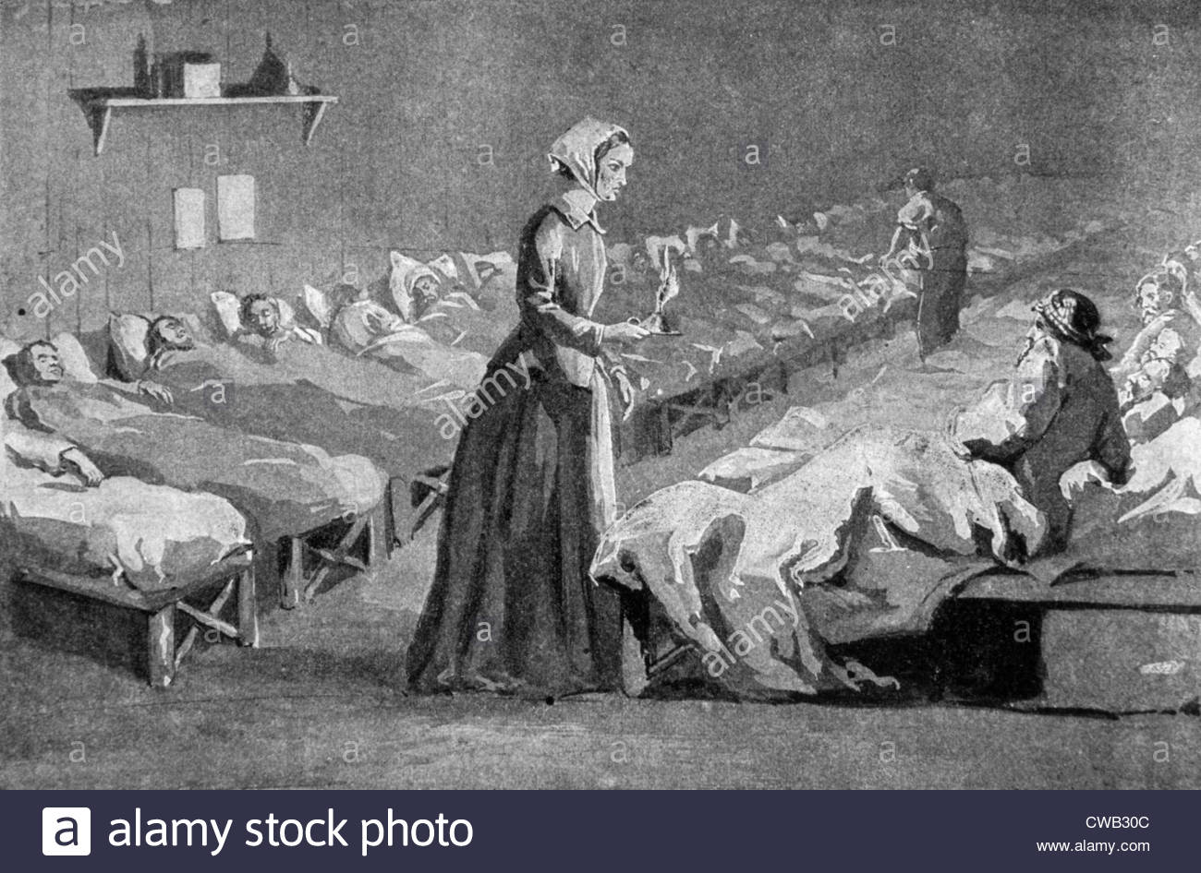
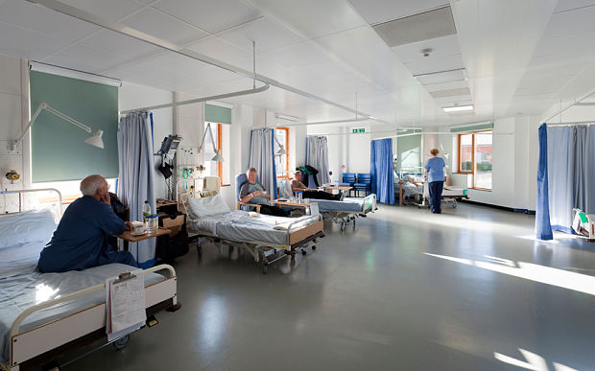
Hospitals now and then
What are the similarities and differences between hospitals now and hospitals when Florence Nightingale was alive?

Slide 26

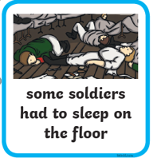


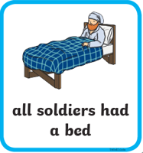


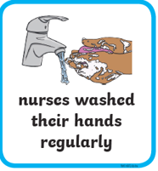
Sort the cards into the correct column
Hospitals now Hospitals in the 1800’s

Slide 27
History lesson 9
Significant People
Nurses

Slide 28
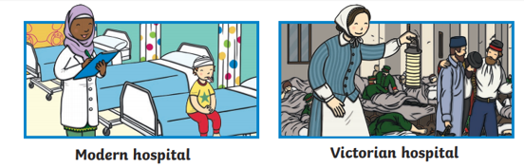
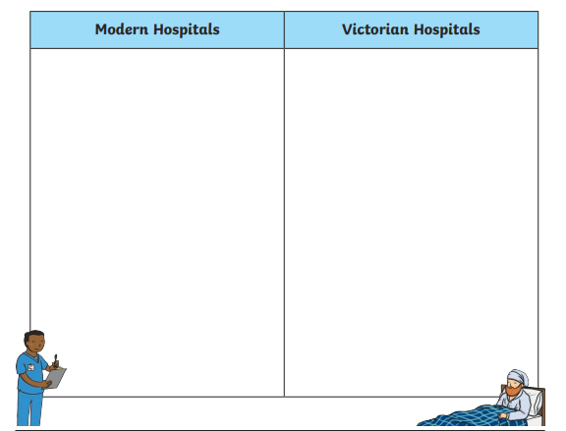



Sort the sentences into the table below

Slide 29
History lesson 10
Significant People
Nurses

Slide 30
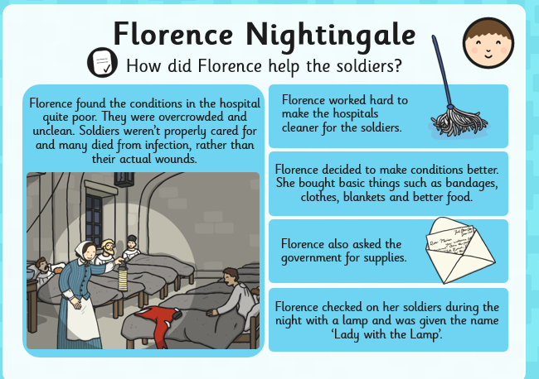
How did Florence help the soldiers?

Slide 31
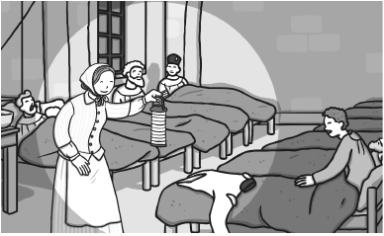
Look at the picture below. Explain what the problems were and how Florence Nightingale solved them.

