Slide 1
Year 1 Science
Week 3 and Week 4
4/5/20 – 7/5/20
Hello Year 1!
We hope you had fun learning about Florence Nightingale last week.
This PowerPoint includes nine science sessions for you to complete over the next two weeks.
Our learning is going to be based on finding out more about wild and garden plants.

Slide 2
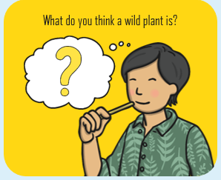
Lesson 1 - Identifying wild flowers

Slide 3

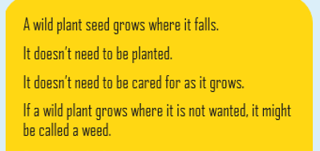
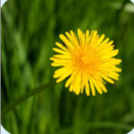
Lesson 1 - Naming wild flowers
Talk to your family. Can you think of any wild flowers?

Slide 4
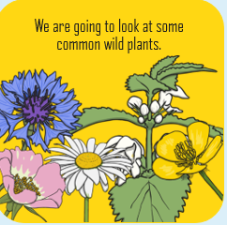

Slide 5
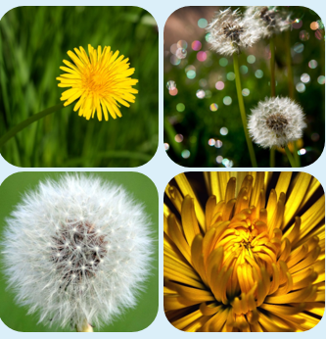
Can you name the wild flower?

Slide 6
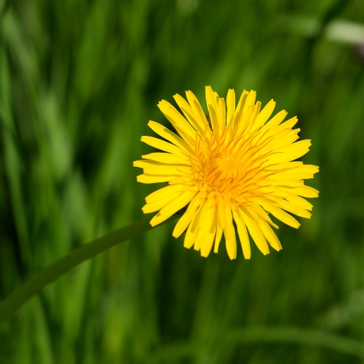
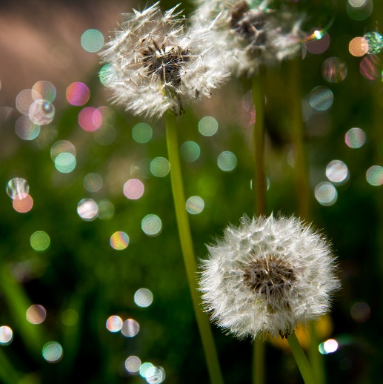
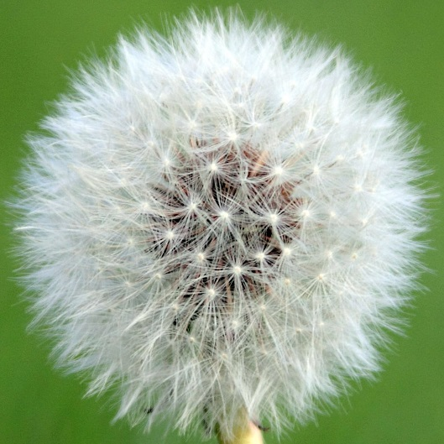
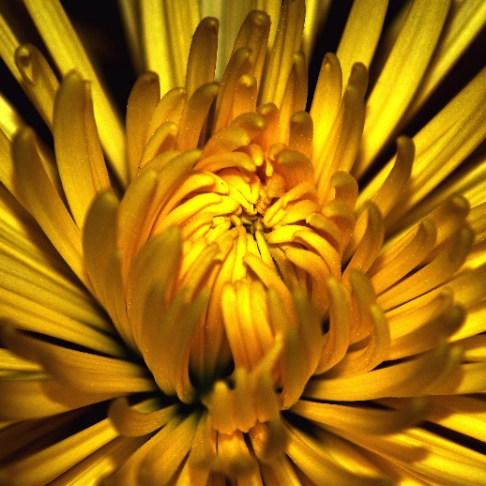
Dandelions
These are dandelions.
They have bright
yellow flowers.
They have fluffy white
seed heads.
Some people like to blow the seeds and make a wish!

Slide 7
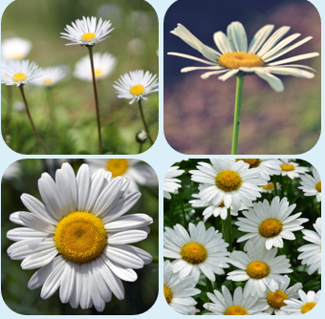
Can you name the wild flower?

Slide 8
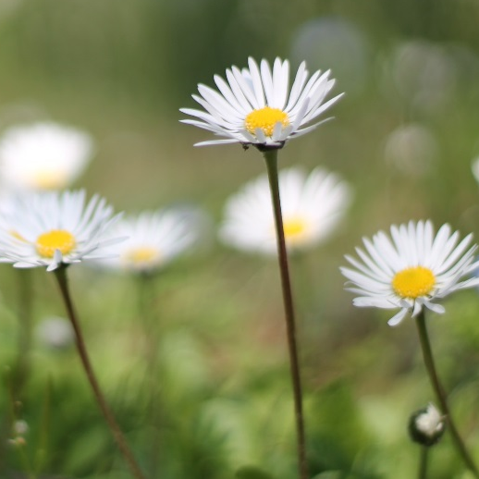
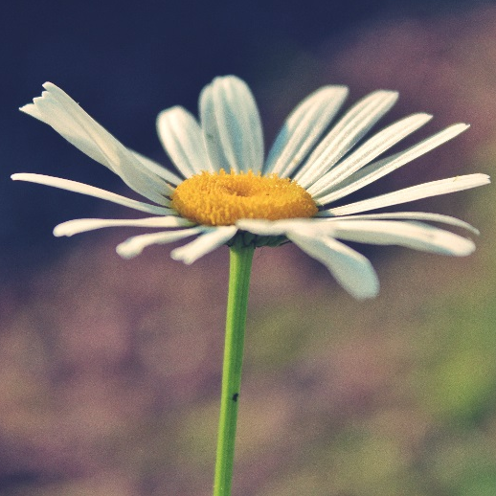
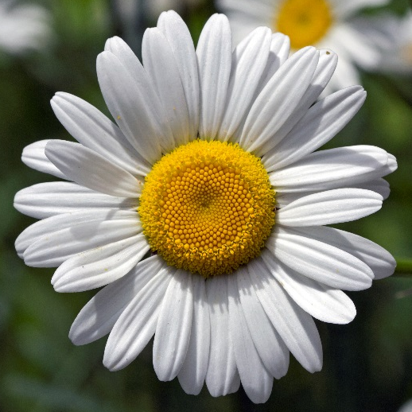
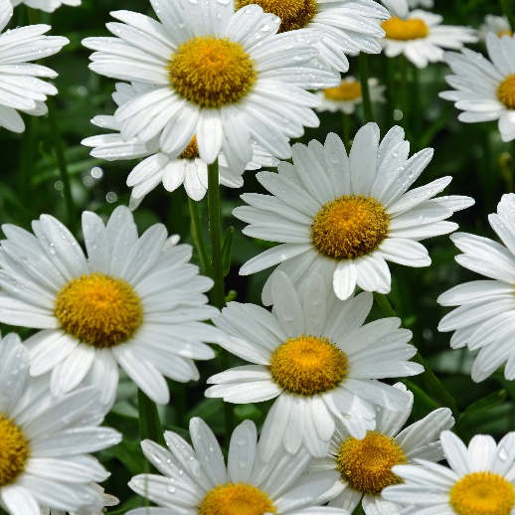
Daises
These are daisies.
They have white petals with bright yellow centres.
They grow in the grass.
Sometimes, people use them to make daisy chains.

Slide 9
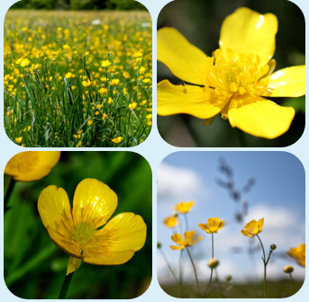
Can you name the wild flower?

Slide 10
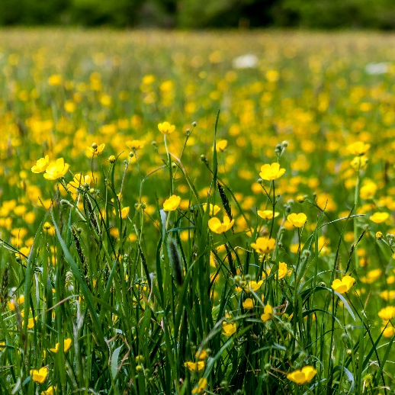
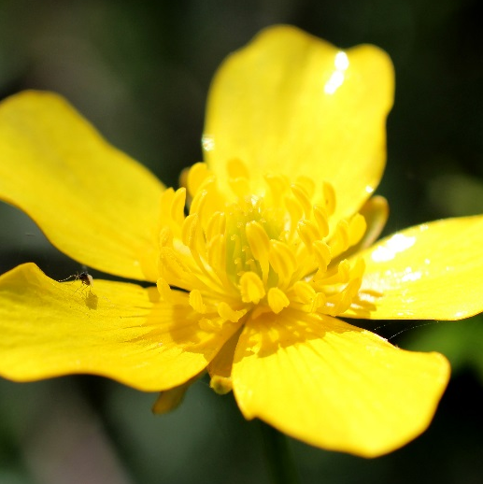
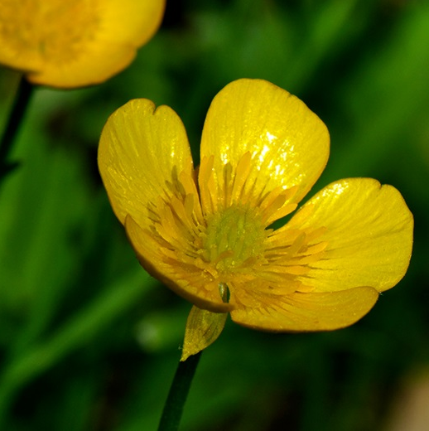
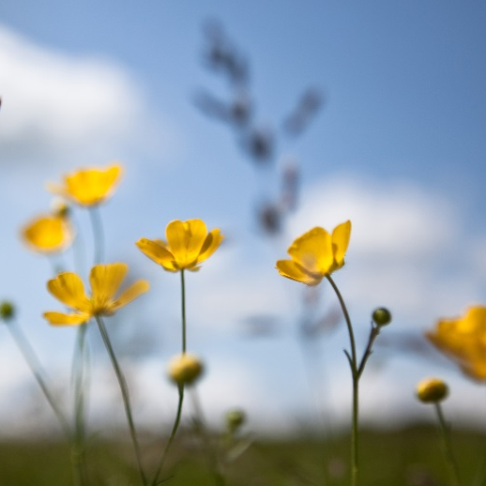
Buttercups
These are buttercups.
They have shiny
yellow petals.
They have feathery leaves.
You might have played a game where you hold one under someone’s chin to see if it shines yellow!

Slide 11
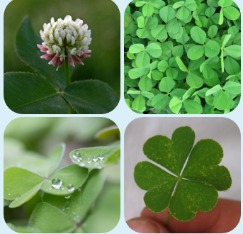
Can you name the wild flower?

Slide 12
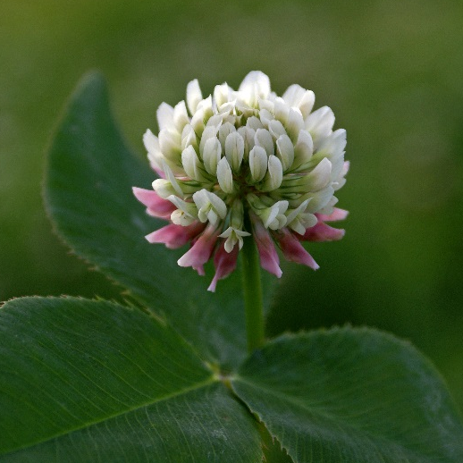
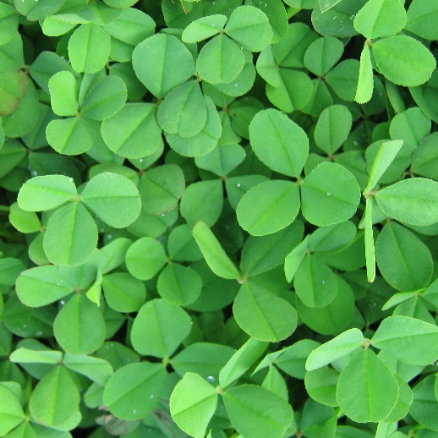
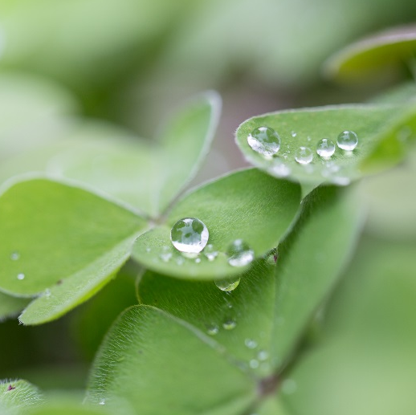
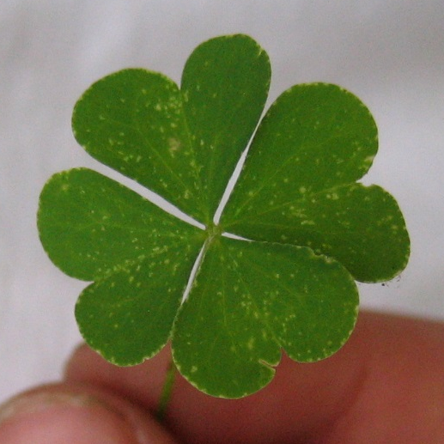
Clover
This is clover.
Clover has white or pink flower heads.
It has leaves in groups
of three.
Some people think it is very lucky to find a four leaf clover!

Slide 13
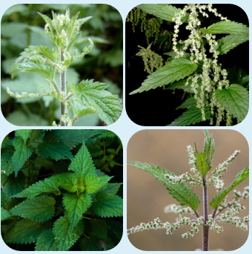
Can you name the wild plant?

Slide 14
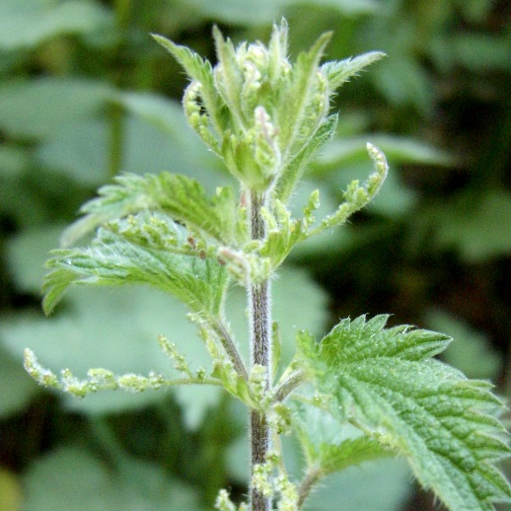
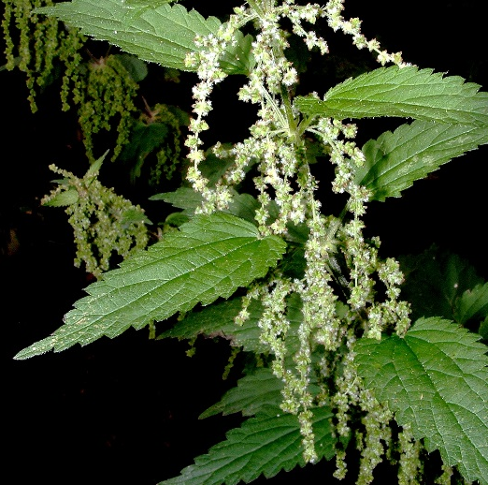
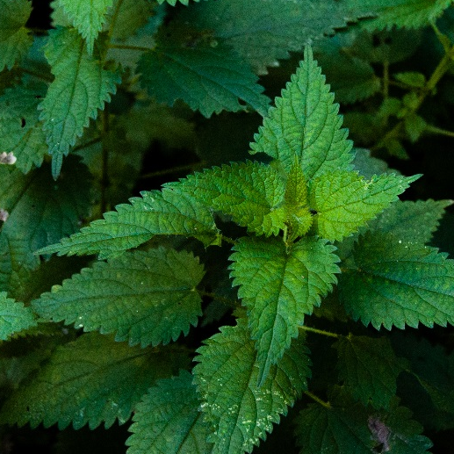
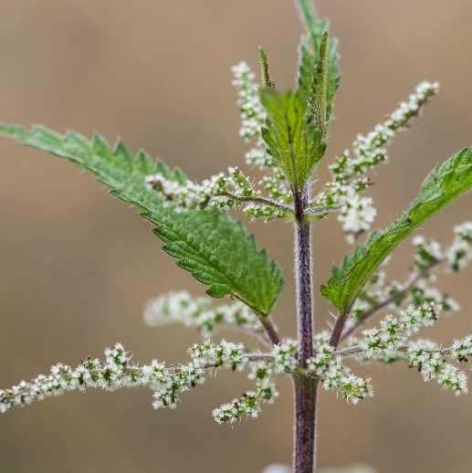
Nettles
These are nettles.
They have jagged,
prickly leaves.
They have tiny
green-white flowers.
Be very careful not to touch them, they will give you a nasty sting!

Slide 15
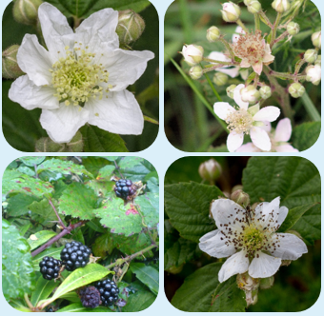
Can you name the wild plant?

Slide 16
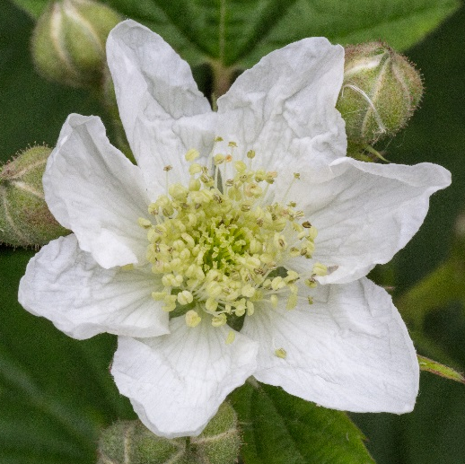
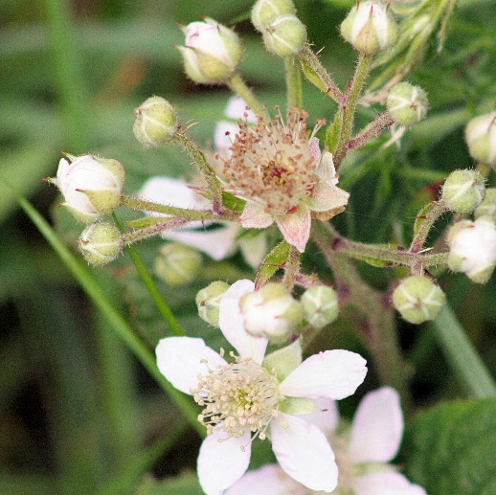
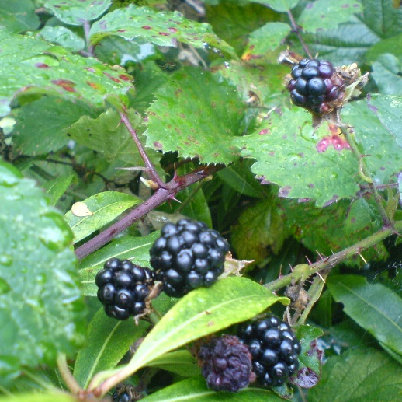
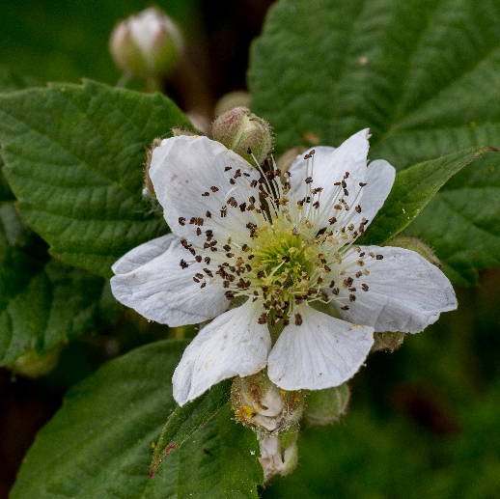
Brambles
These are brambles.
They have very
prickly stems.
They have white flowers.
They can grow very big.
In the autumn, brambles grow blackberries!

Slide 17
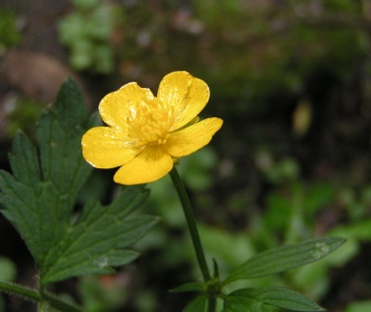



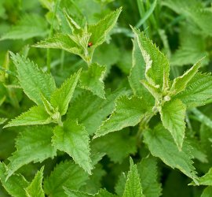
Comparing and contrasting wild plants
Draw a picture of your favourite wild plant. Write some sentences to describe it. How is it similar/different to the other wild plants that we have seen?

Slide 18
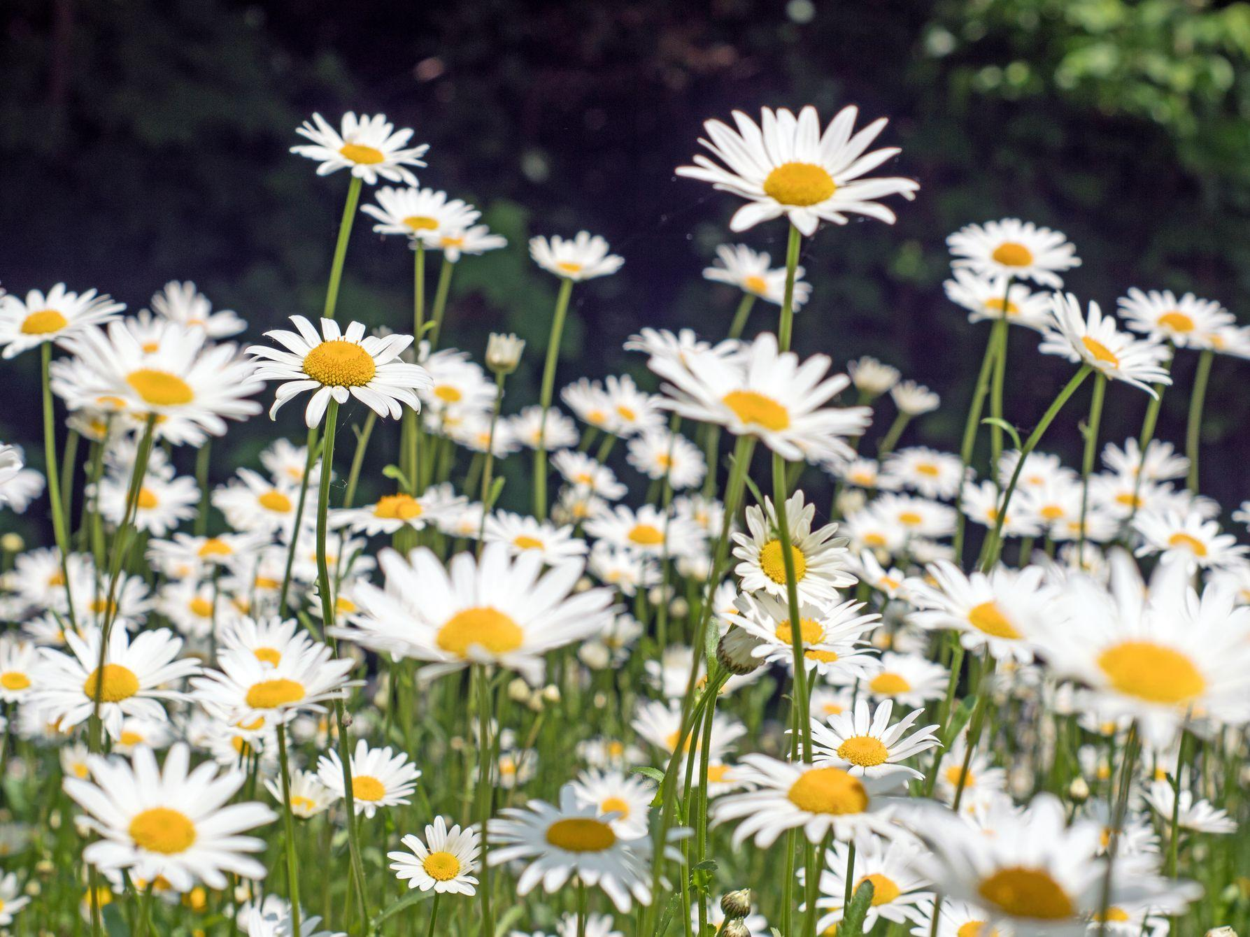
We’re going on a daisy hunt
Lesson 2 - finding wild flowers

Slide 19

Daises
Tell your family 3 things that you would like to find out about daises.
Go for a walk in your garden/ local area. Collect as many daisies as you can find.
Observe your daises carefully.
What do you notice?
Can you find the answers to your questions?

Slide 20

Making Daisy Chains
We are going to use our daises to make a daisy chain.
Who will you make your daisy chain for?

Slide 21
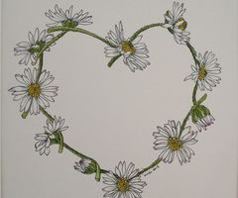
Making Daisy Chains
You will need:
Lots of daises with their stalks
Step by step guide
Go somewhere where there are lots of daises.
Pick some daises with long stalks.
Use your thumbnail to split the stalk about halfway down its length
Thread the stalk of another daisy through the hole, then make a hole in this daisies stalk with your thumbnail and thread another daisy through it.
Keep going until you have made a daisy chain.

Slide 22
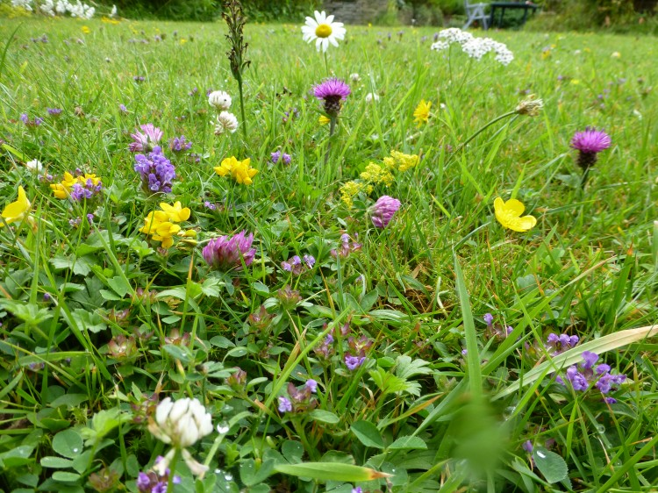
Lesson 3 -Interpreting data
Miss Wheeler went on a wild plant hunt. She wanted to find the most common wild plant in Worcester. She went for a walk to investigate.

Slide 23
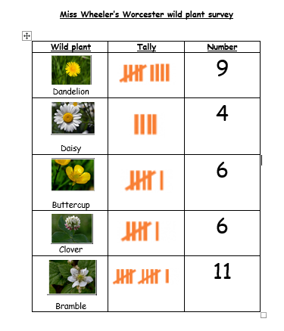
Miss Wheeler’s results
What was the most common wild plant that Miss Wheeler found?
What was the least common wild plant that Miss Wheeler found?
How many buttercups and daisies did Miss Wheeler find altogether?
How many yellow wild plants did Miss Wheeler find?

Slide 24
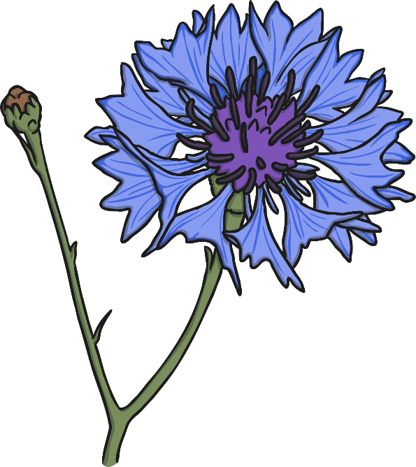
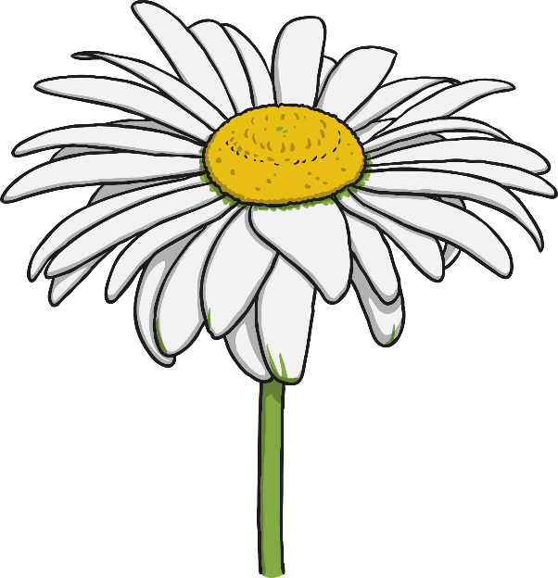
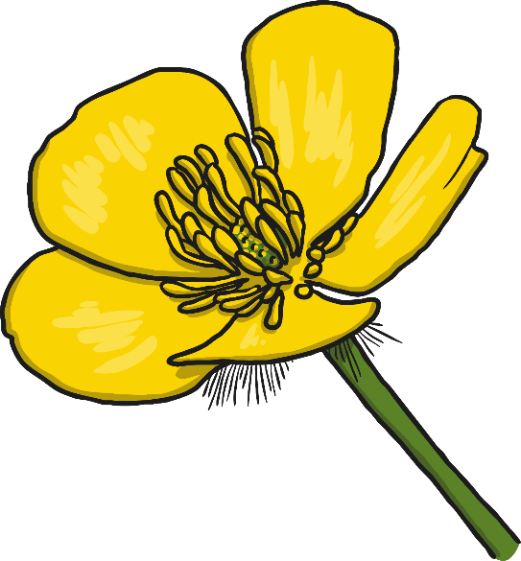
Lesson 4 Gathering data and recording results

Slide 25
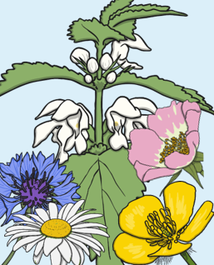

Finding wild flowers
I really enjoyed my wild plant hunt
in Worcester. What is the most common wild plant in your garden/area? How can you find out?

Slide 26
Gathering data
Go for a walk in your garden/local area
How many wild plants can you spot? What is the most common wild plant? How will you record your results?
Where was the best place to find wild plants?
Why?

Slide 27
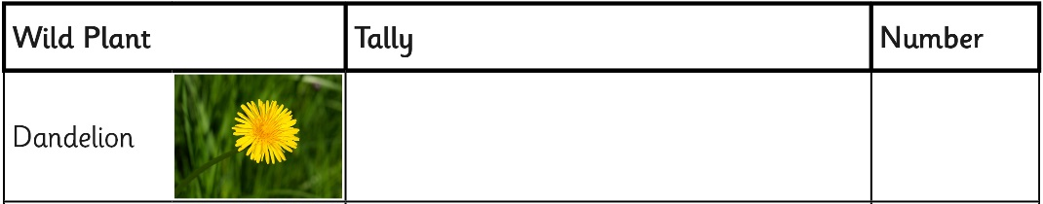

Results – what did you find out?
Count up the marks of on your tally chart and write the total number in the box at the end.
Let’s find out which plant you saw the most times.
Which was the most common wild plant?

Slide 28
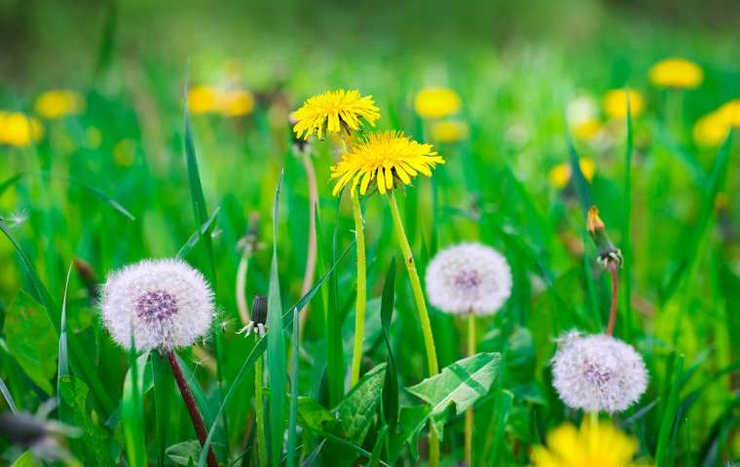
Lesson 5
Observing changes over time

Slide 29
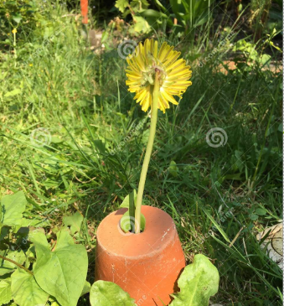
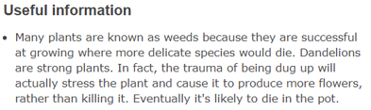
Keeping a pet dandelion
How long will it take?
About 20-30 minutes to plant the dandelion, then several weeks of watching and observing
What you will need
*A plant pot
*Soil or compost
*A dandelion growing somewhere you can dig it out without
damaging its long root.

Slide 30
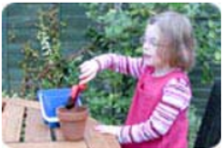
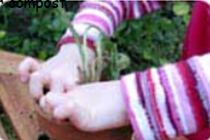

Keeping a pet dandelion
Step-by-step guide
Half-fill the pot with soil or compost
2. Dig up a dandelion (you must get most of the long root up with it or it will quickly die)
3. Plant it in the pot, and firm it in with more soil or compost
4. Water it well, then put it on a windowsill
5. Look at it regularly. You should see it grow buds, then the flowers will open, then they’ll die, and finally the seed clock will form.
6. Keep a diary of how your pet dandelion changes over time.
You dandelion should grow quite a few flowers. Count how many it grows, then see if you can guess how many seeds it has produced.

Slide 31

Keeping a pet dandelion
Keep a diary to record what happened to your pet dandelion.
What did you notice? What changed/stayed the same?
Take some photos or draw some pictures to help you to remember.

Slide 32

Lesson 6
Identifying garden plants
Today we will be thinking about plants found in gardens.

Slide 33


Naming garden plants
Gardens are places where people grow plants.
Some people grow plants because they are nice to look at.
Some people use their gardens for growing things to eat.
You might have a garden where you live.
A public park is a kind of garden for lots of people to enjoy.

Slide 34



Did you know that the most popular garden plant is grass?
Grass is a special kind of plant that looks good and is comfortable to walk on and sit on.
You can have a picnic on the grass.
You can play games on the grass.
You can go for
a walk on the grass.

Slide 35

Think of a garden that you like
to spend time in.
It could be your own garden, a garden that you like to visit, or it could be a public garden or park.
Which garden is a happy
place for you?

Slide 36

My favourite garden
Take photos of your favourite garden.
What can you see/hear/touch/smell?
What plant is your favourite plant in your garden. Why?
Find your favourite plant and draw it.
Do you know the name of your
favourite plant? Can you describe it? How is
it similar/different to the other plants?

Slide 37

Lesson 7
Identifying features ogarden plants

Slide 38






Common Garden Plants
buddleia
heather
clematis
lavender
lily
fuschia

Slide 39






Common Garden Plants
poppy
sunflower
sweetpea
rose
pansy
wisteria

Slide 40

Garden plants game 1

Slide 41
Lesson 8
Identifying features of garden plants
Names of common garden plants

Slide 42






Garden plants game
Nature detectives
Choose a plant from your garden. Find out as much as you can about the plant. Share what you have learnt with your family

Slide 43

Garden treasure hunt
Find and name the garden plant:
*A plant that is the same colour as your top
*A smelly plant
*A green plant
*A beautiful plant
*A plant that begins with the letter t
*A tall plant
*A small plant
To help you to get better at naming plants in your garden. We have designed a treasure hunt for you. We hope that you enjoy it!

Slide 44

Lesson 9
Sorting plants

Slide 45






Can you name and sort the plants below? Tell your family how you sorted them and why.

