Slide 1
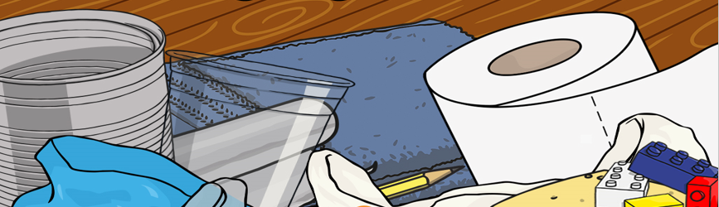
Science
15.6.20
Everyday Materials

Slide 2
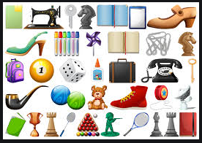
Lesson 1
Materials
What are they?

Slide 3
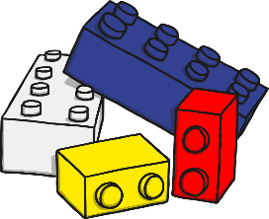
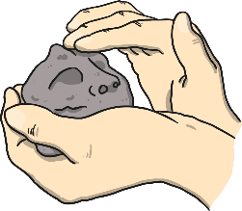
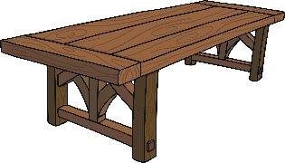
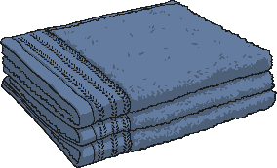


What Does Material Mean?
Everything around us is made from a material.
Objects might be made from…
wood | fabric | glass | plastic | clay
Look around you. Find three objects and see if you know which material they are made from.

Slide 4
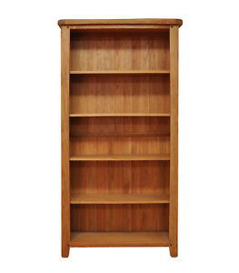
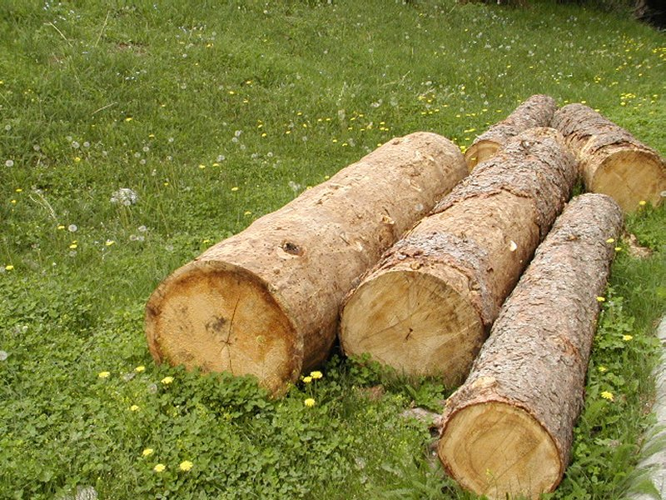
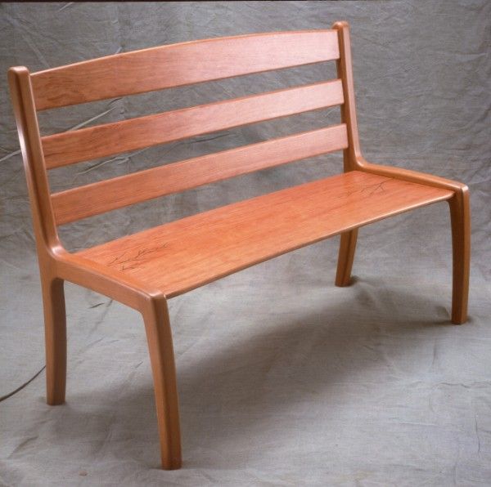
What are these made of?

Slide 5
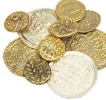
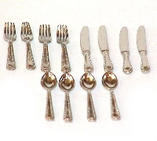
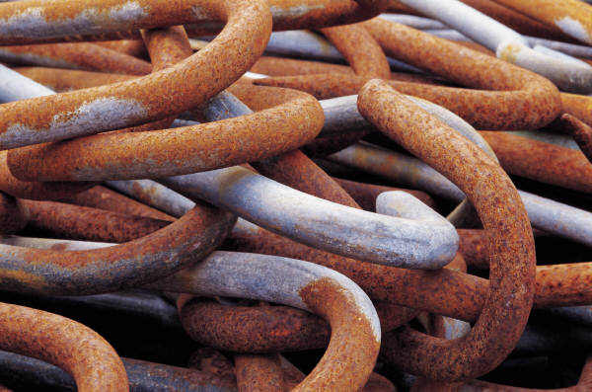
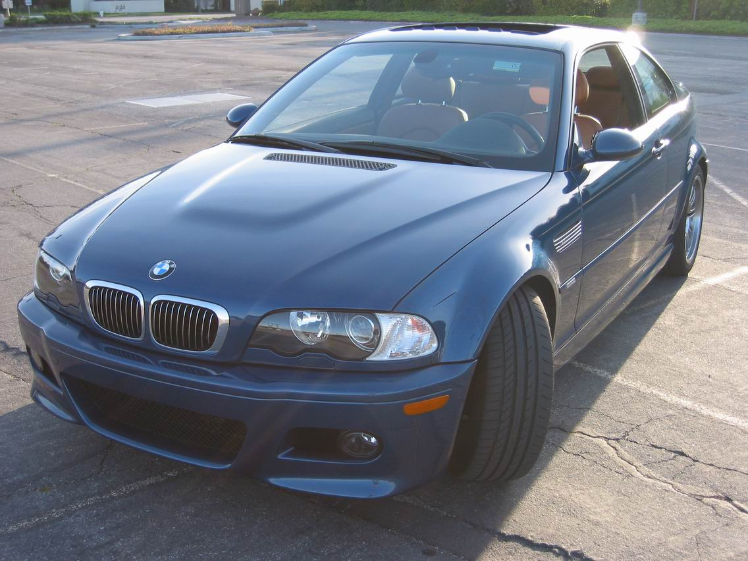
What are these made of?

Slide 6
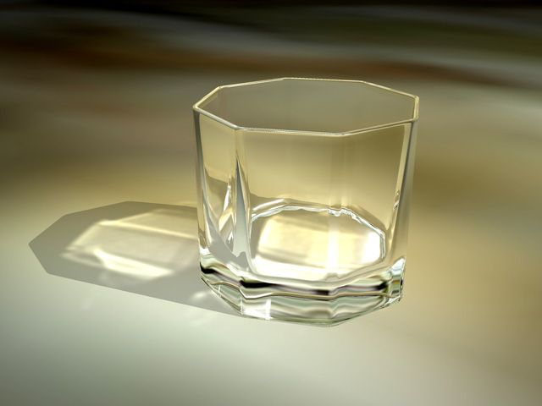
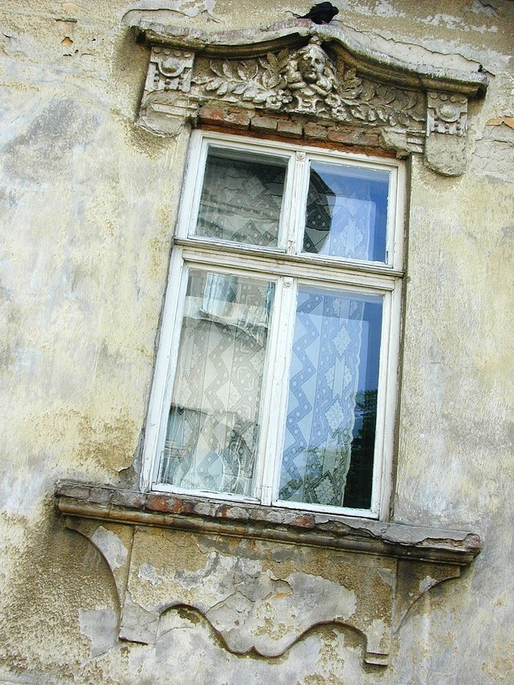
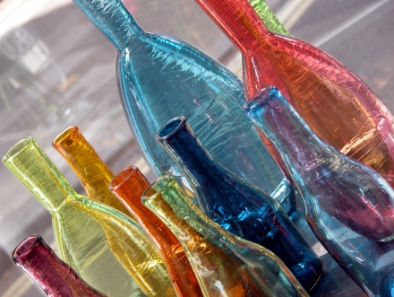
What are these made of?

Slide 7

Let’s go on a material hunt!
Let’s go on a walk and see if we can find things that are made out of wood, metal, plastic or glass

Slide 8
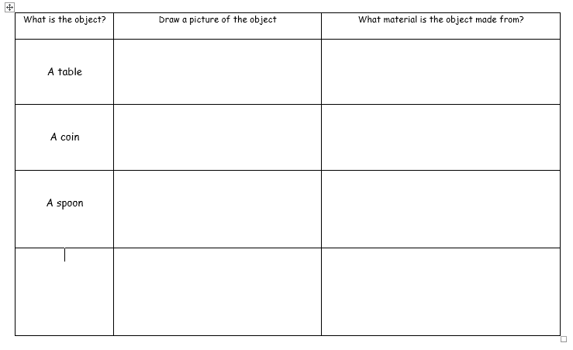
Choose something from your house or from the list below. What materials are used to make a:
A plant pot
A ladder
A bottle
A table
A spoon
A coin
A glass
A nail
A car

Slide 9
Lesson 2
Describing materials

Slide 10
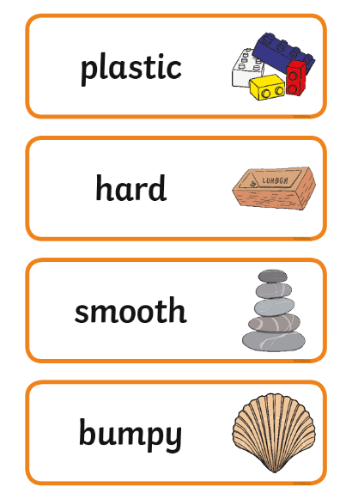
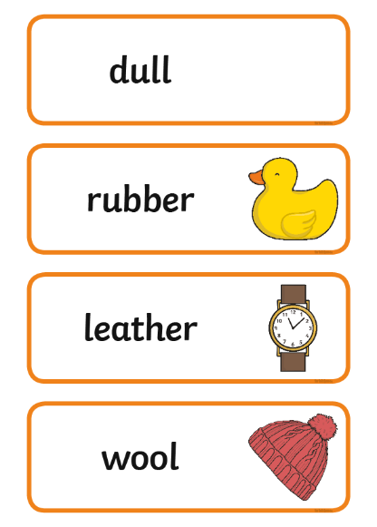
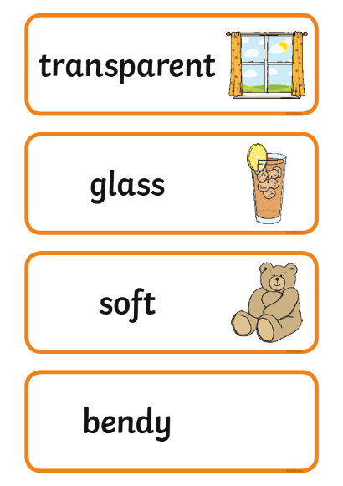
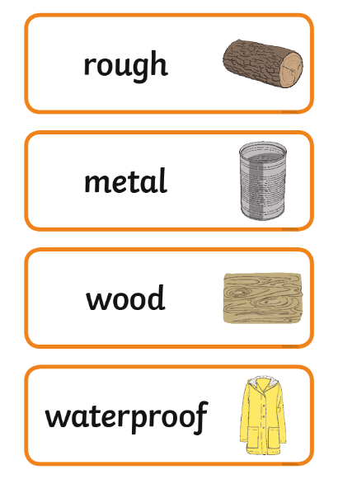
Activity Time
Let’s have a go at describing different objects!
Look at the word cards on the next slides. Talk to your family about what the words mean.

Slide 11
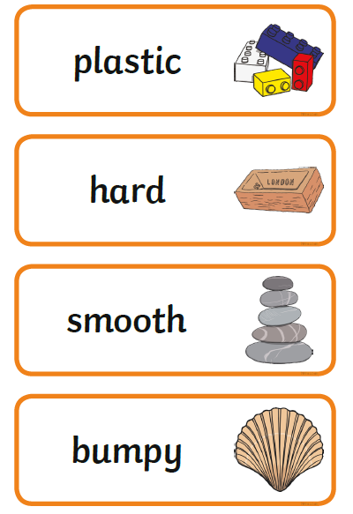
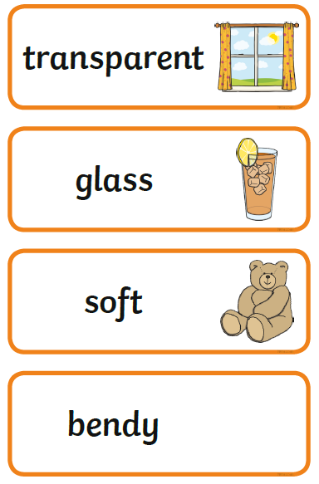
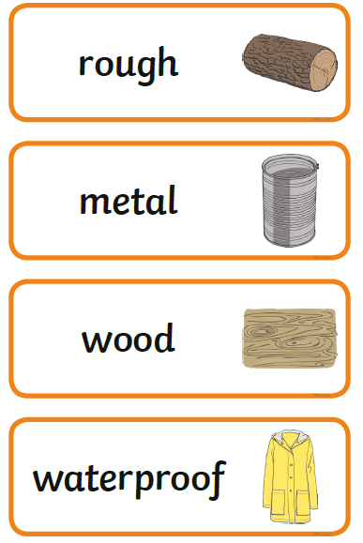

Slide 12
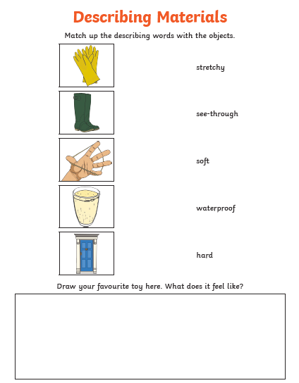
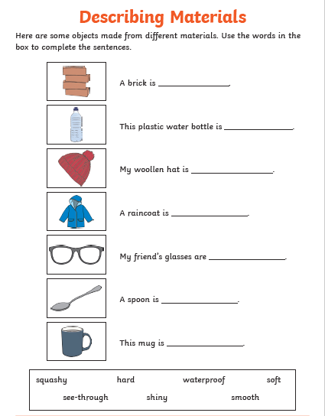
Use the vocabulary on the word cards to help you to describe the materials below

Slide 13
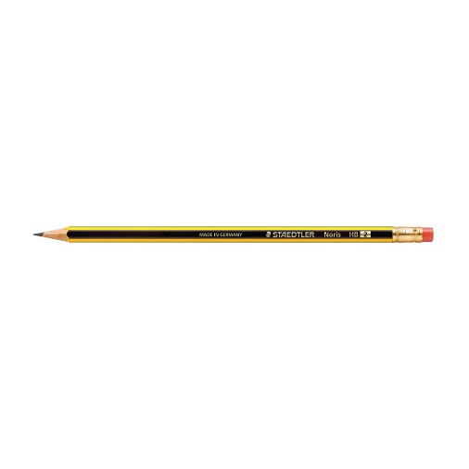
Describing Materials
Look at the objects on your table. Write a sentence describing the objects.
For example, my pencil is hard and smooth

Slide 14
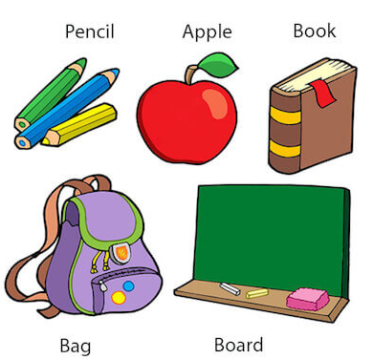
Lesson 3
Grouping Materials

Slide 15
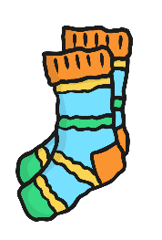






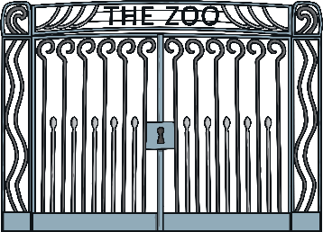
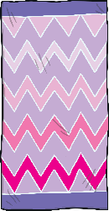

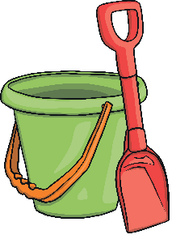

Grouping Materials
Have a look at these objects...
How would you group them together?
Why would you group them that way?
Talk to the person next to you about which objects you would group together and why.

Slide 16
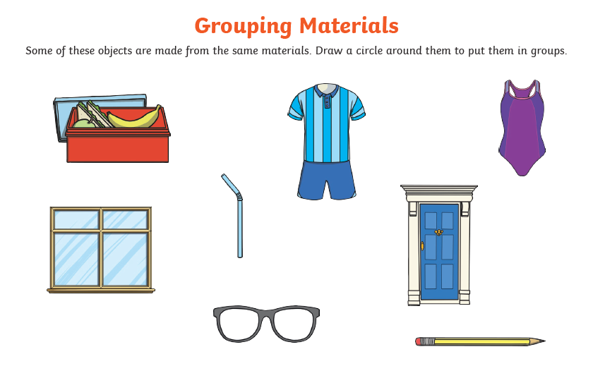
Identify what each object is made from, draw a circle around them and put them into groups

Slide 17
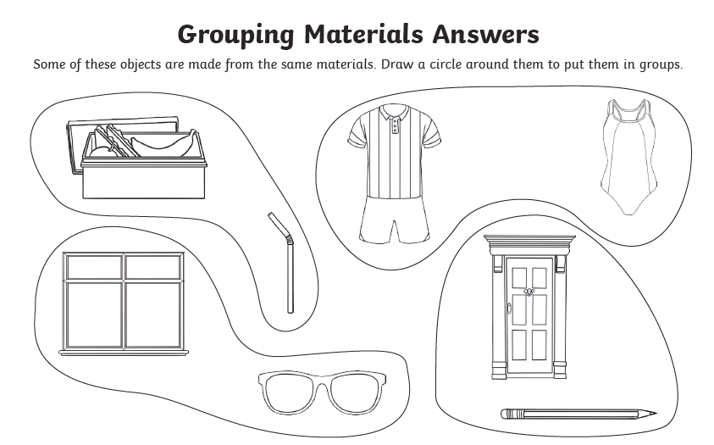

Slide 18
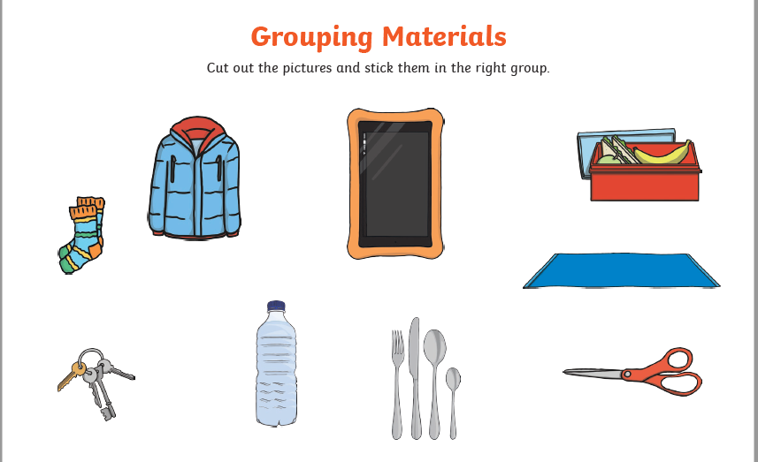
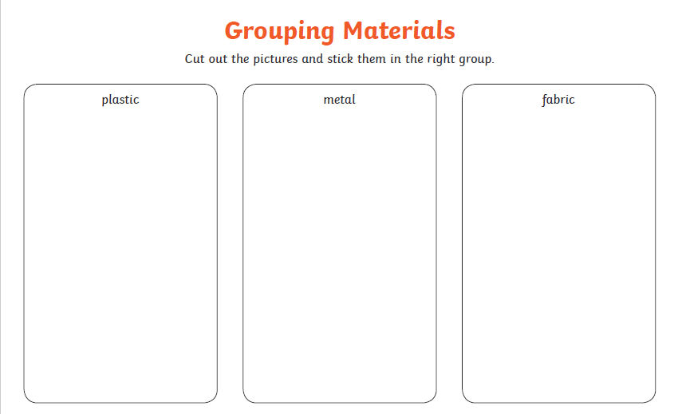
Identify what each object is made from, draw a circle around them and put them into the correct group

Slide 19
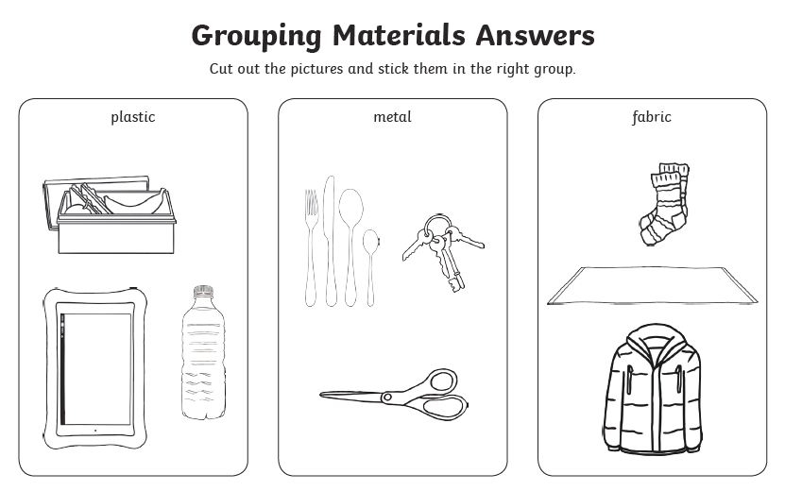

Slide 20
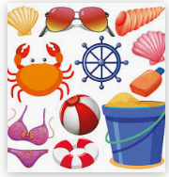
Lesson 4
Grouping Materials

Slide 21
Vocabulary
Look at the following slide and remind yourself of the vocabulary for everyday materials

Slide 23
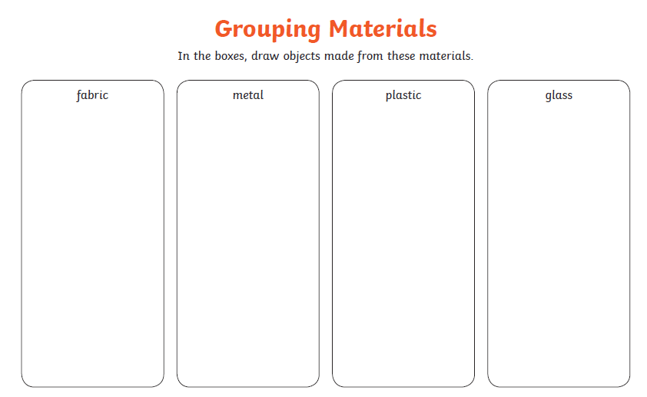
Find at least 10 items. What are they made of? Sort them into the correct box

Slide 24

Lesson 5
Why is it made from that?

Slide 25

Why Is It Made from That?
Objects are made from different materials because of the different things they can do. Think about what the following items are made from...
pencil
Click to reveal the answer
wood
Most pencils need to be sharpened. Sharpeners cut the wood away so that you can still use the pencil and keep it sharp.

Slide 26

Why Is It Made from That?
Objects are made from different materials because of the different things they can do. Think about what the following items are made from…
window
glass
You can see through glass. That means glass is transparent.
Windows need to let the light in but keep the rain out,
so they are made from glass.
Click to reveal the answer

Slide 27
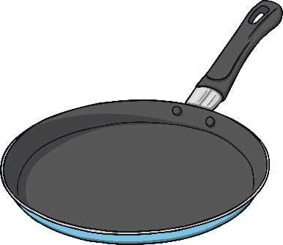
Why Is It Made from That?
Objects are made from different materials because of the different things they can do. Think about what the following items are made from...
frying pan
metal
Frying pans need to get very hot to cook the food inside. Metal can get very hot and lasts a very long time. It is also easy to keep clean.
Click to reveal the answer

Slide 28
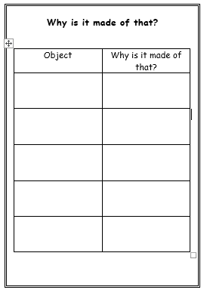
Choose 5 items. Tell your family why they have been made from that material.
Why Is It Made from That?

Slide 29

Well done! Now you are able to identify, sort and describe everyday materials.

