Slide 1
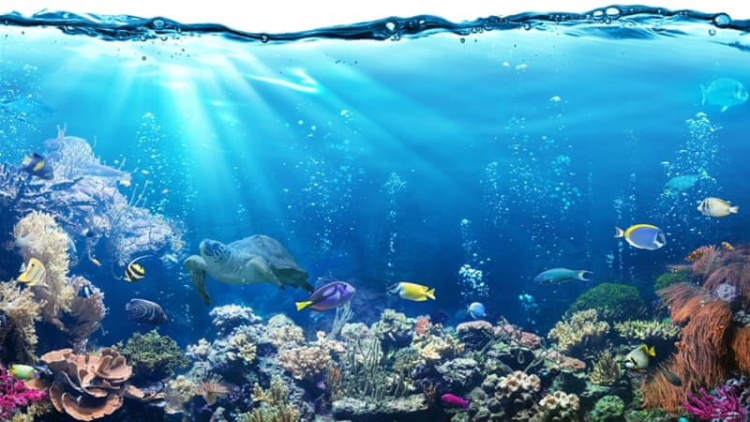
Geography
22.6.20
The 7 continents and the 5 Oceans of the world

Slide 2
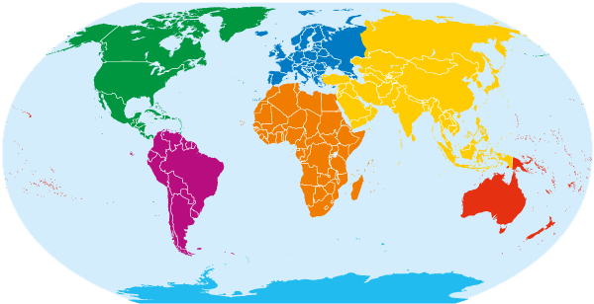
Lesson 1
The 7 Continents of the World

Slide 3

How can we find out about different countries around the world?

Slide 4
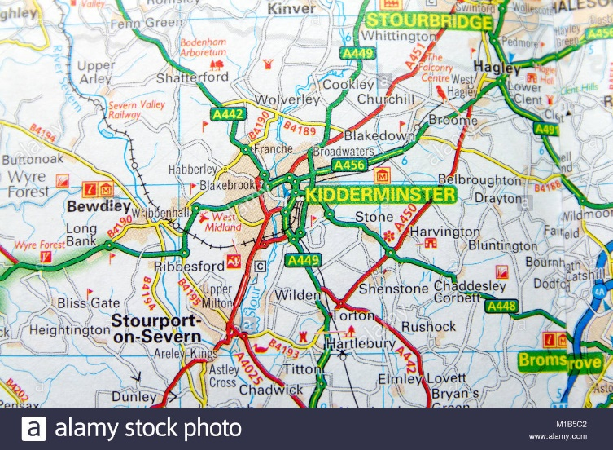
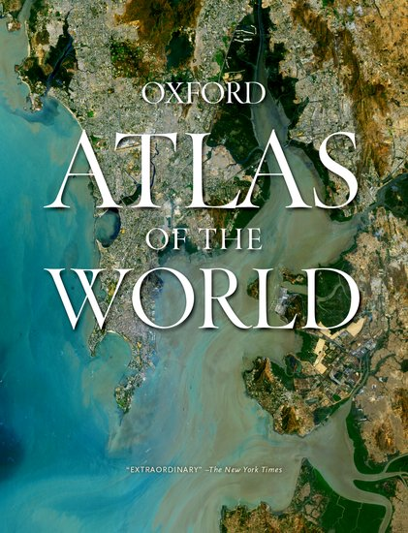
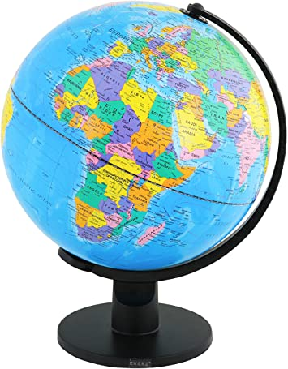
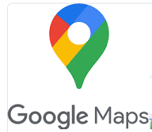
Answers
Globe
Atlas
Map
Google maps

Slide 5
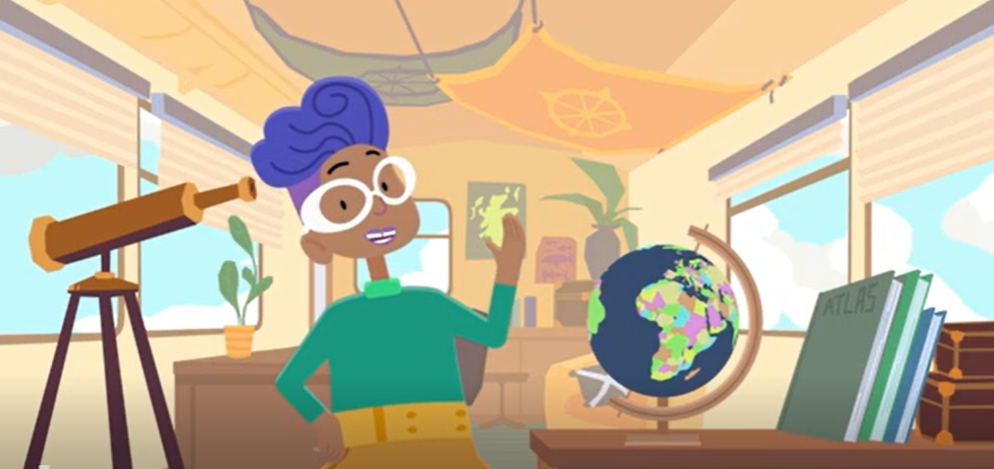
Video Clip
https://www.bbc.co.uk/bitesize/topics/zvsfr82/articles/znm7vk7

Slide 6
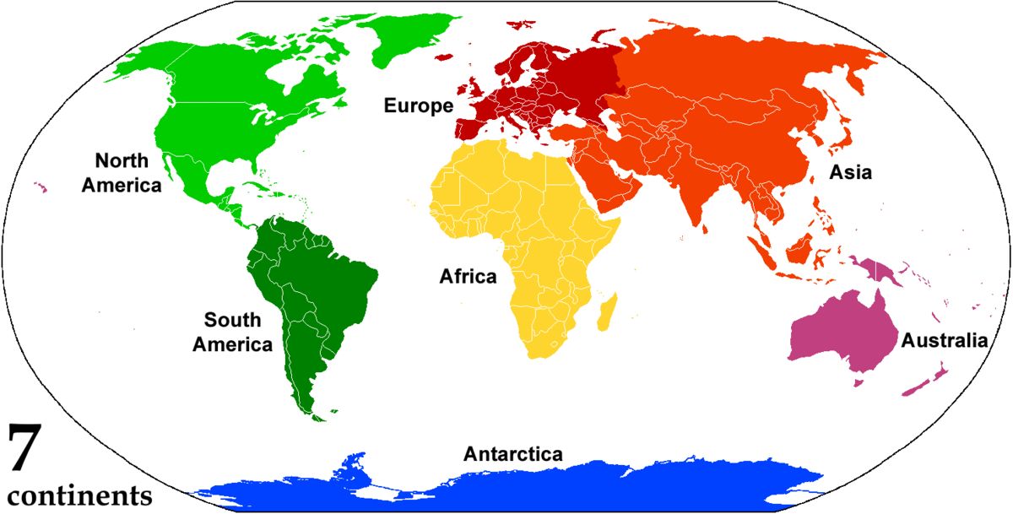
We have previously talked about the 7 continents of the world.
Can you remember any of them?
You can sing a song to help you remember the continents and it goes like this …
https://www.youtube.com/watch?v=K6DSMZ8b3LE

Slide 7
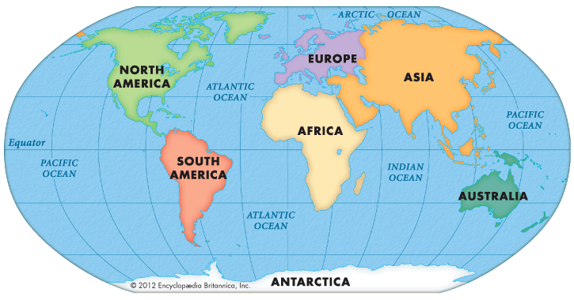
What do you notice?
What is the same? What is different?

Slide 8
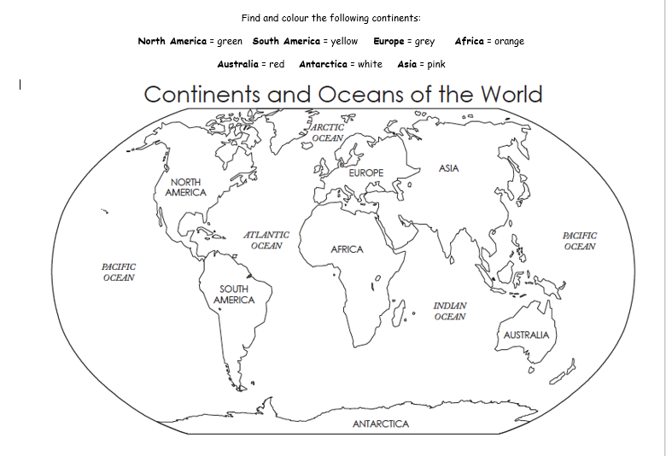
Choose 1 of the following activities:
1) Find and colour the continents
2) Use a map, globe or atlas to locate the 7 continents.

Slide 9
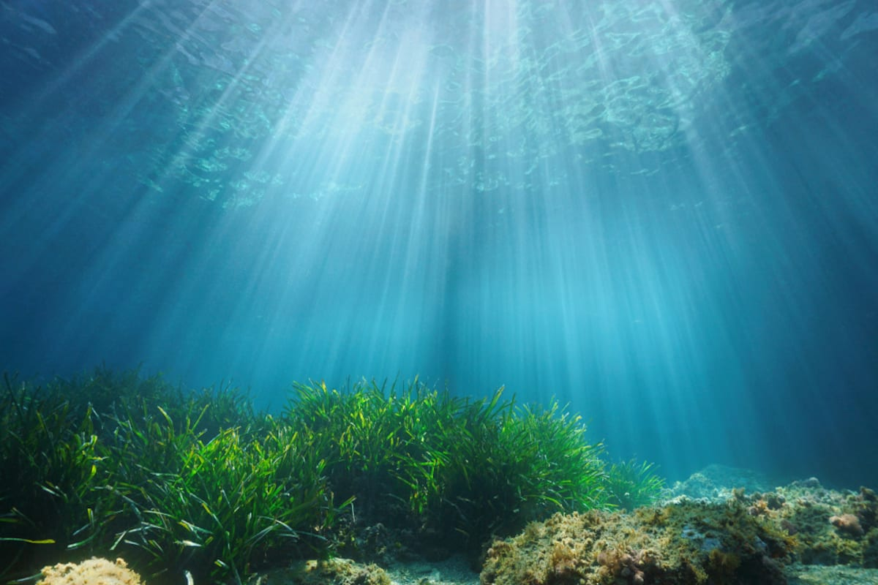
Lesson 2
The 5 Oceans

Slide 10
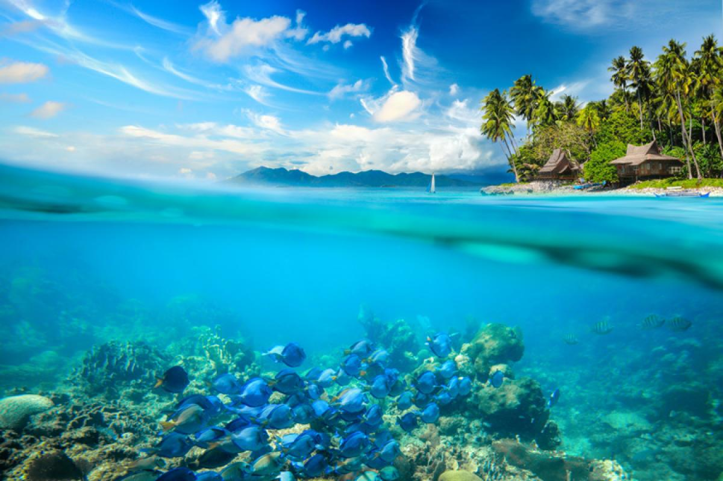
Can you name any of the 5 oceans?
Watch this clip to find out more
https://www.youtube.com/watch?v=X6BE4VcYngQ

Slide 11
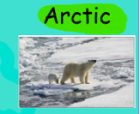
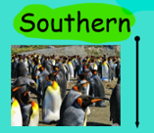
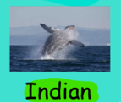
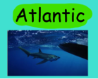
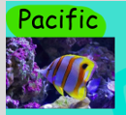
Some of the oceans are bigger than others!
The five oceans from smallest to largest are:
Arctic ocean
Southern ocean
Indian ocean
Atlantic ocean
Pacific ocean

Slide 12
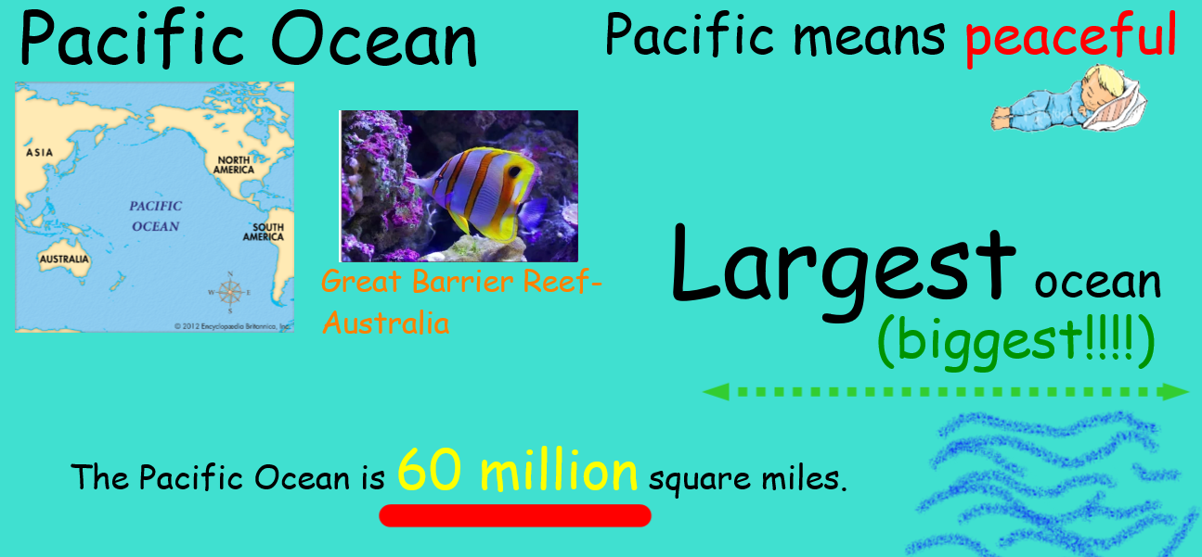
The Pacific Ocean

Slide 13
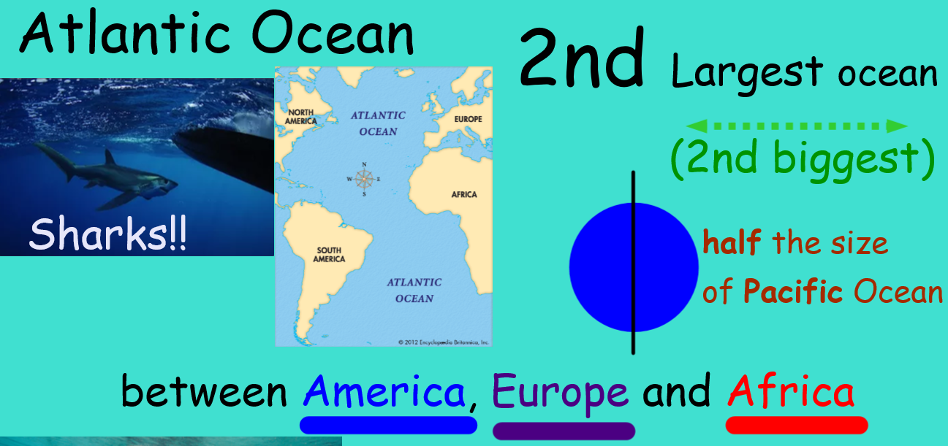
The Atlantic Ocean

Slide 14
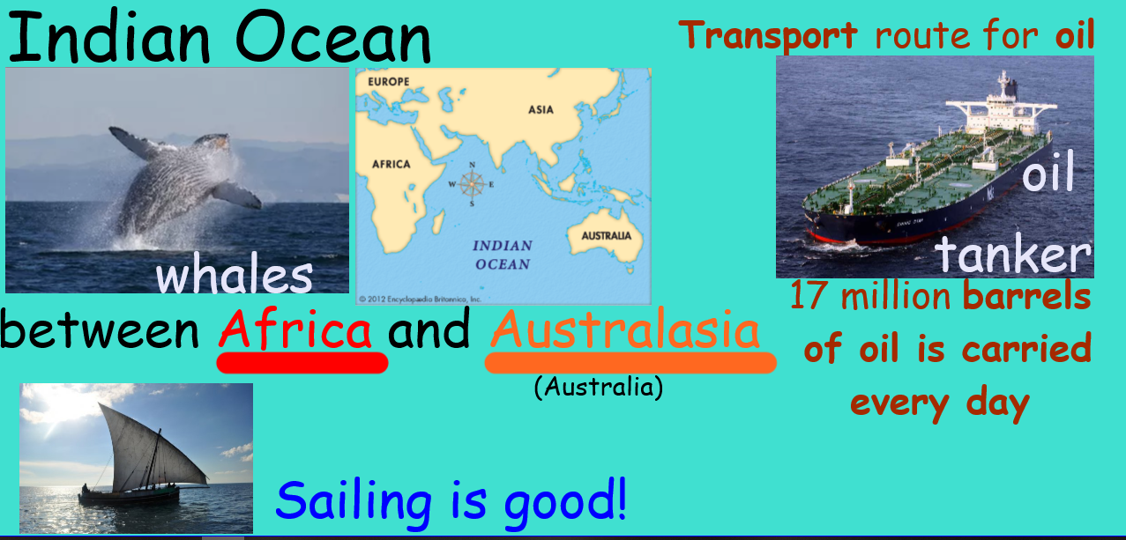
The Indian Ocean

Slide 15
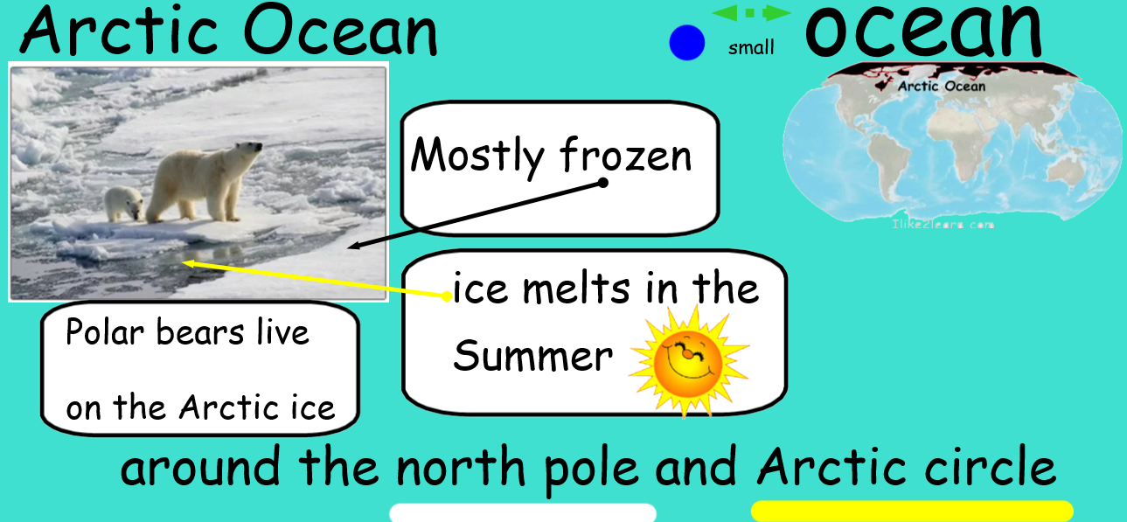
The Artic Ocean

Slide 16
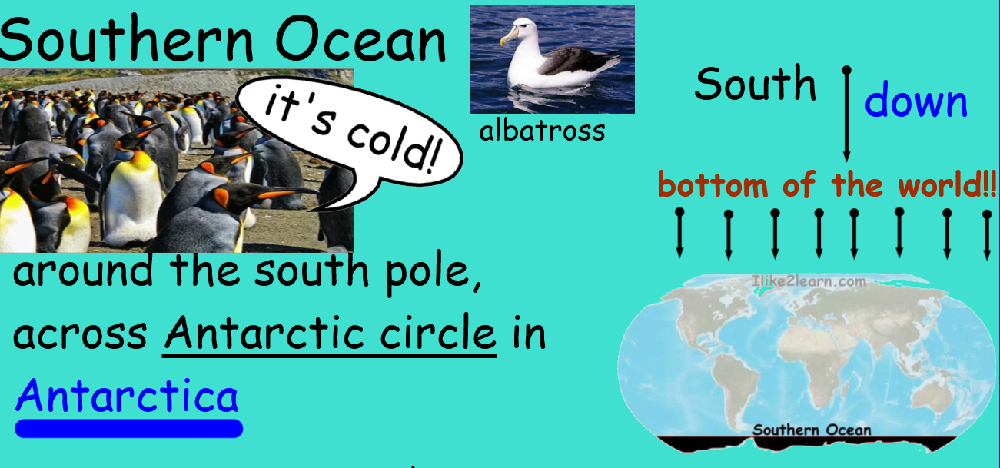
The Southern Ocean

Slide 17
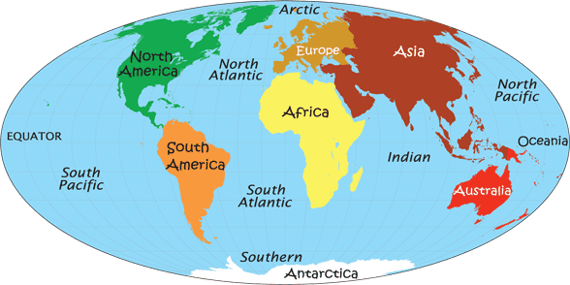
Look at the map. What do you notice?

Slide 18
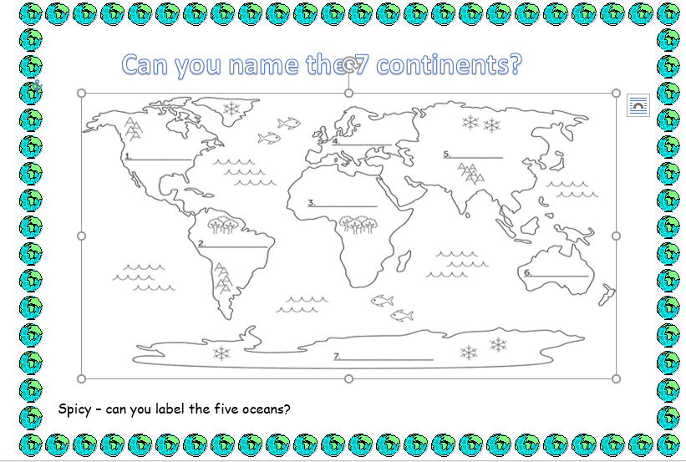
Choose 1 of the following activities:
1) Add the seven continents and five oceans onto this world map
2) To find out more about the 5 oceans of the world we can also use Google Maps. Go to https://www.google.com/maps/@52.3929246,-2.2642688,14z
Click on the satellite box
Type in an ocean you want to look at eg Pacific ocean
Click on the plus sign to get a more detailed look at an area
What did you find out?

Slide 19
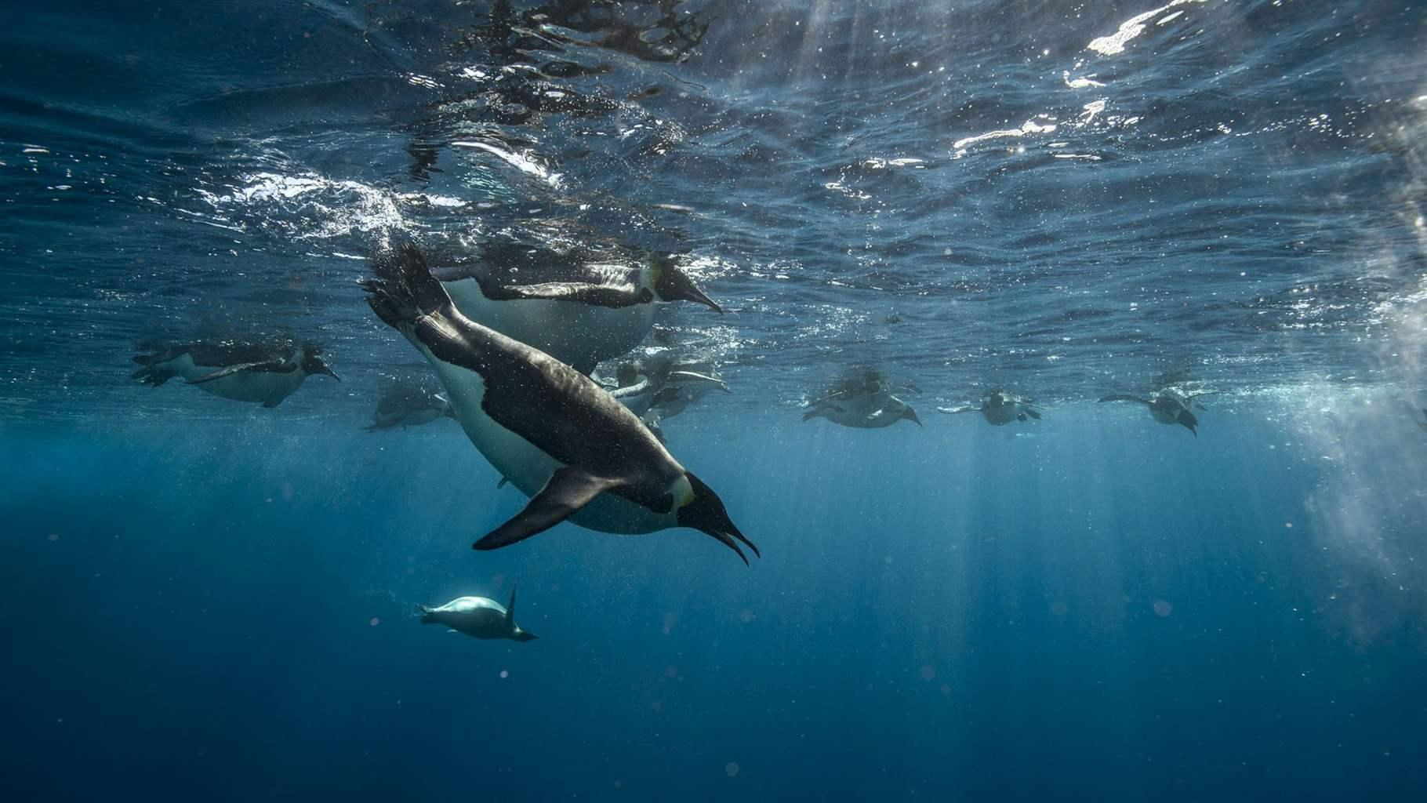
Lesson 3 and 4
The 5 Oceans

Slide 20
Can you name the 5 oceans?
Watch this clip
https://www.youtube.com/watch?v=X6BE4VcYngQ

Slide 21

Tell your family everything that you can remember about the 5 oceans.
Look at yesterday’s slides to remind you.

Slide 22
The Pacific Ocean

Slide 23
The Atlantic Ocean

Slide 24
The Indian Ocean

Slide 25
The Artic Ocean

Slide 26
The Southern Ocean

Slide 27

Make an Ocean Book
Staple 5 pieces of paper together to make a book

Slide 28

Make an Ocean Book
In your ocean book write facts about each one of the 5 oceans.
The Pacific Ocean
The Atlantic Ocean
The Southern Ocean
The Indian Ocean
The Artic Ocean

Slide 29
The Pacific Ocean

Slide 30
The Atlantic Ocean

Slide 31
The Indian Ocean

Slide 32
The Artic Ocean

Slide 33
The Southern Ocean

Slide 34
Lesson 5
The 5 Oceans

Slide 35
Ocean Quiz
(Use your printed slides to help you)
1) This ocean is the biggest ocean in the world!
2) Sharks are found in this ocean.
3) The second biggest ocean.
4) The name of this ocean means ‘peaceful’.
5) This ocean is the home of penguins and albatrosses.
6)This ocean is the most important transport route for oil.
7) Polar bears live around this ocean.
8) This ocean is located around the South Pole across the Antarctic circle in the Southern Hemisphere off Antarctica.
9) There are lots of humpback whales in this ocean!
10) The ocean is mainly frozen

Slide 36
Ocean Quiz answers
The Pacific ocean
The Atlantic ocean
The Atlantic
The Pacific ocean
The Southern Ocean
The Indian ocean
The Artic ocean
The Southern ocean
The Indian ocean
The Artic ocean

Slide 37

Well done! You now know all about the world’s seven continents and five oceans!
Have a great weekend!

