Slide 1
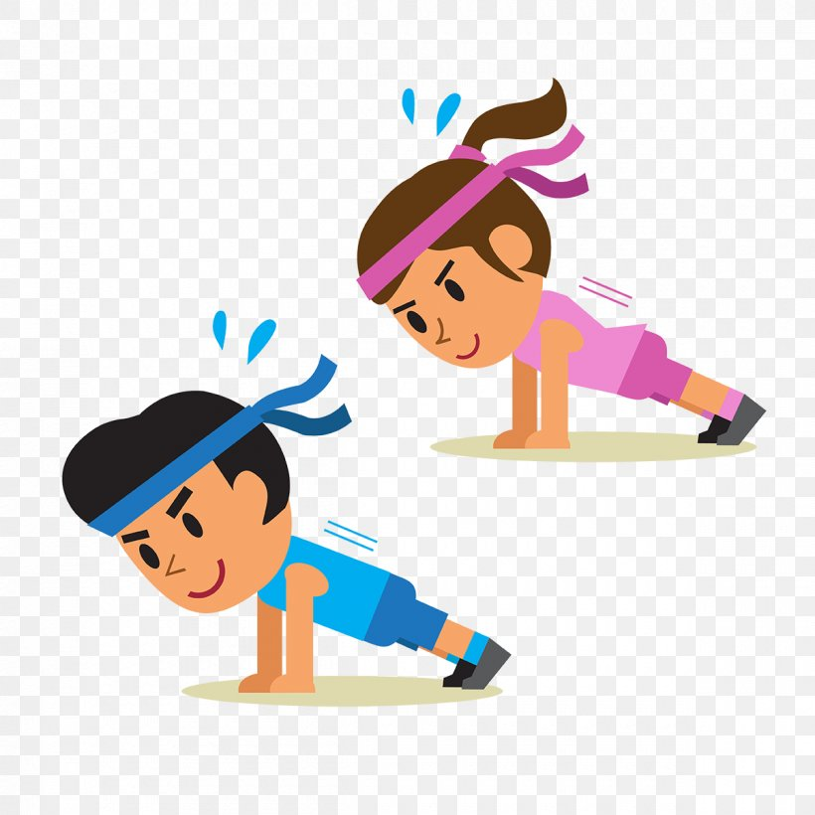
Exercise 1
Monday
Let’s begin by doing some exercise ...
https://app.gonoodle.com/activities/boom-chicka-boom?s=Channel&t=Moose%20Tube&sid=18&cs=moose-tube

Slide 2
Lesson 1
Germs, germs, germs!
We have always educated the children about the need for personal hygiene and ensuring we prevent the spread of germs where possible.
Now is more important than ever to teach our children about germs and how they are spread.
Watch the youtube clip below and discuss this with your child at home.
https://www.youtube.com/watch?v=Bqozl-9WYgM

Slide 3
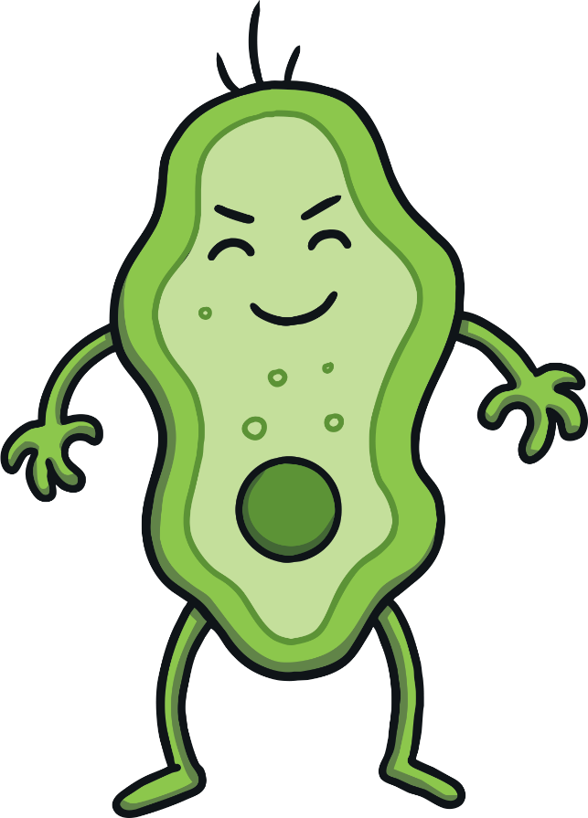
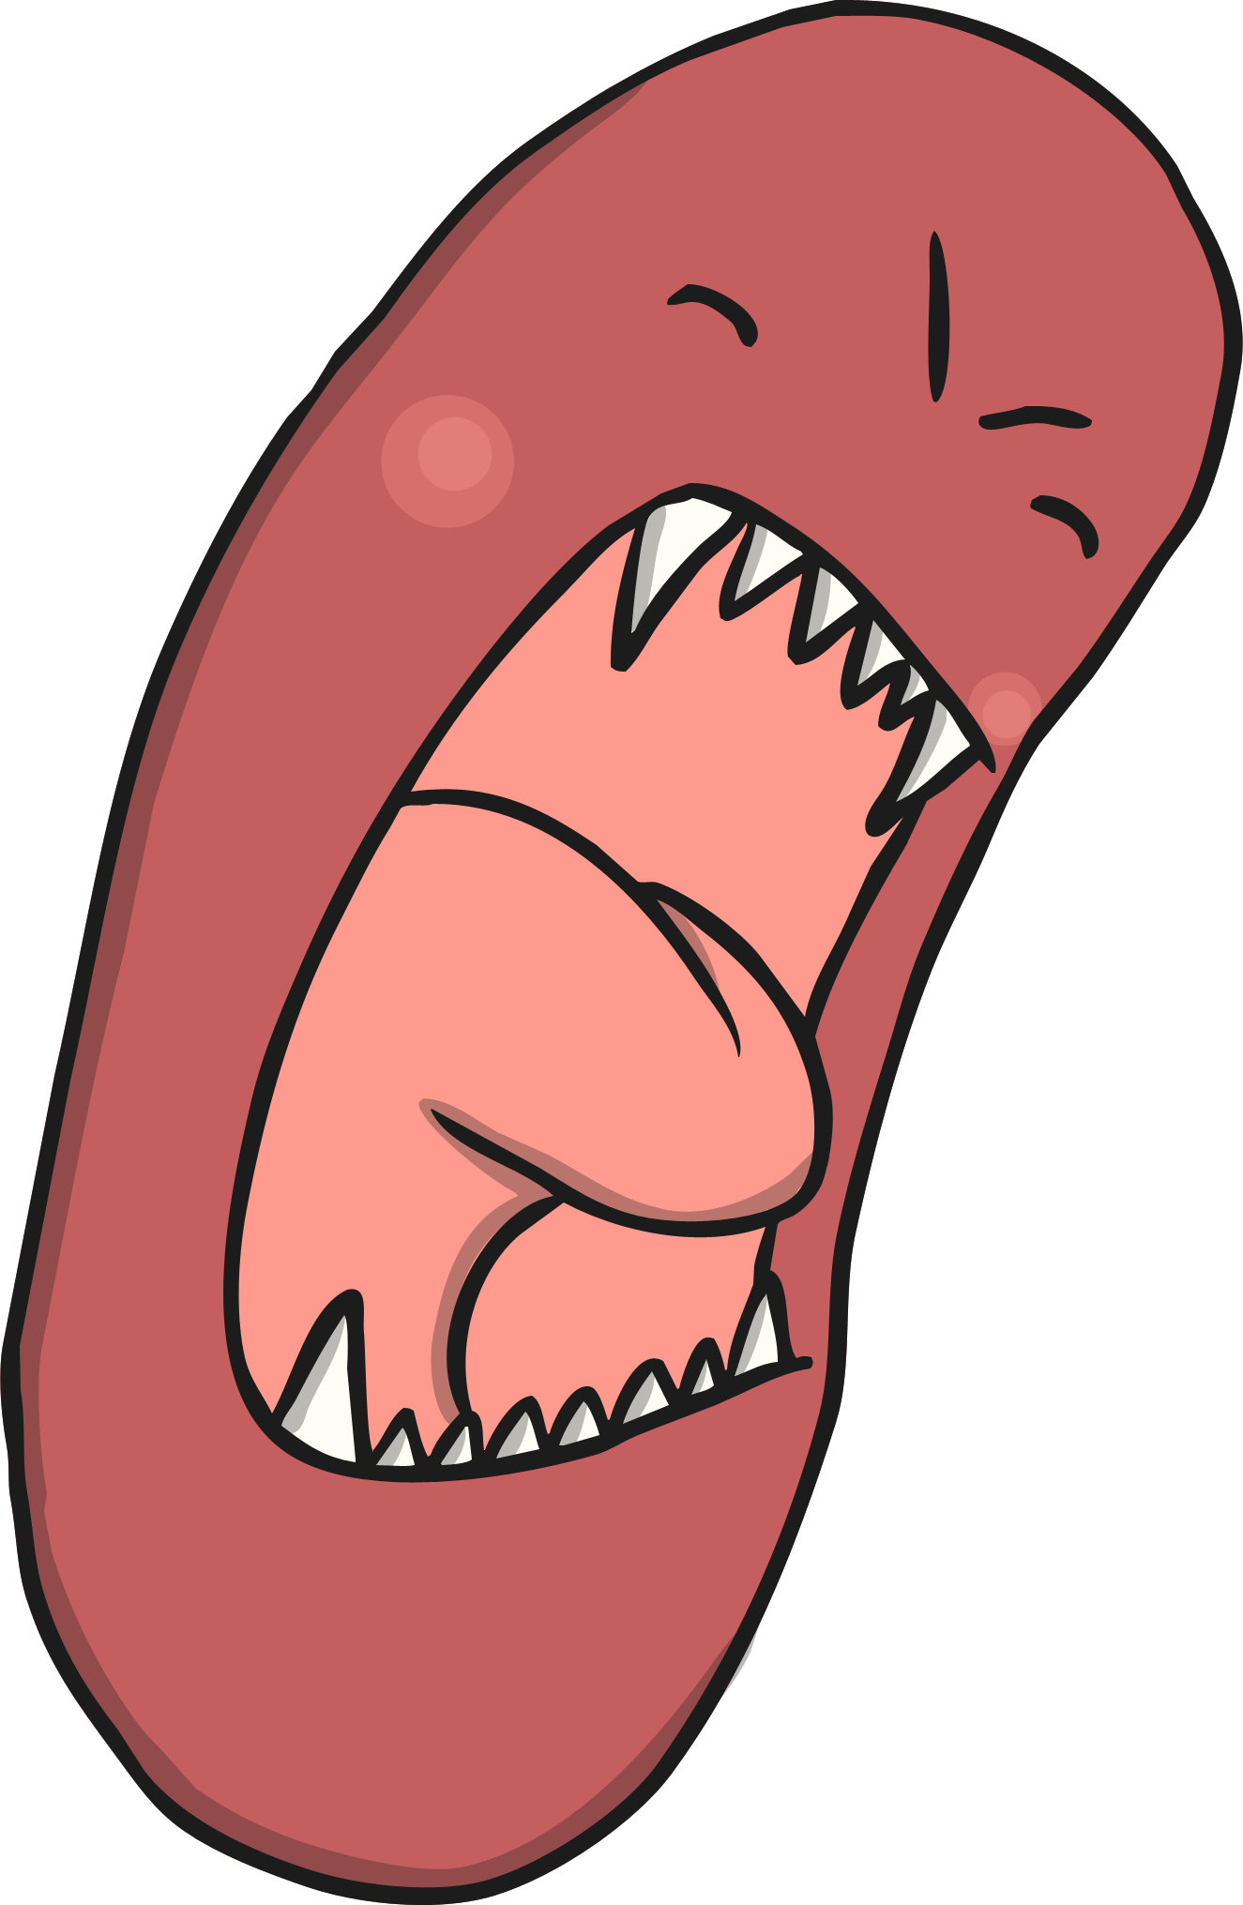

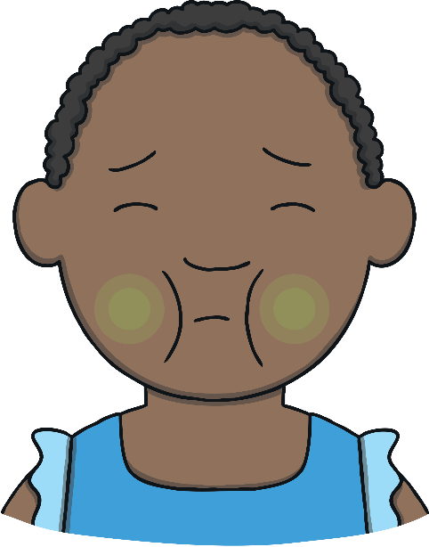
What Are Germs?
Washing your hands helps to remove germs. Germs are very, very tiny – they are so small we cannot see them.
Some germs can make us poorly. Washing our hands stops the germs from spreading or getting inside our bodies and making us feel ill.

Slide 4
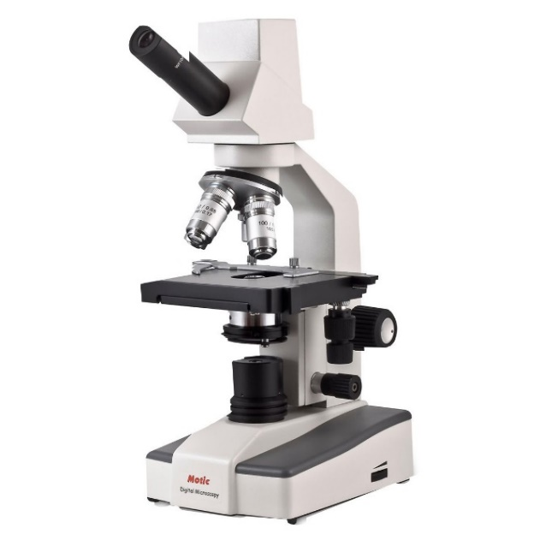
Look at your hands. Can you see any germs?
Why/Why not?

Slide 5
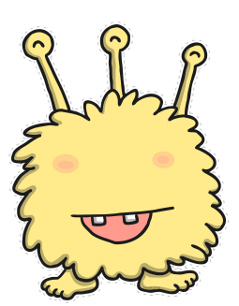


What do you think germs look like?
Draw around your hand. Draw germs on your hand.

Slide 6
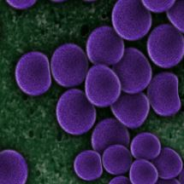
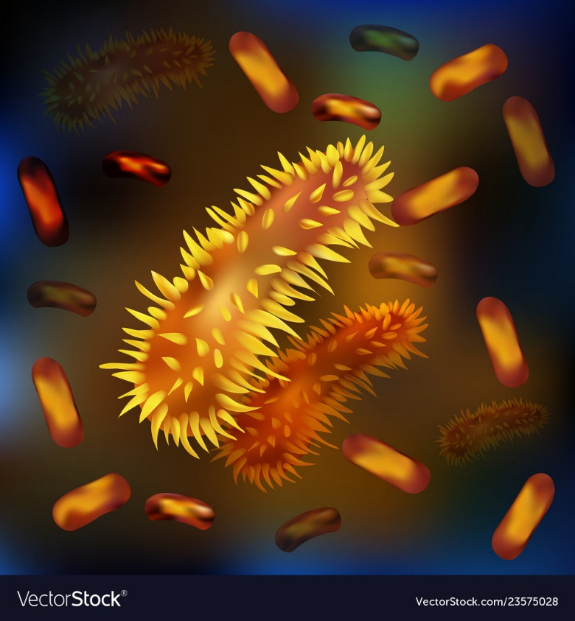
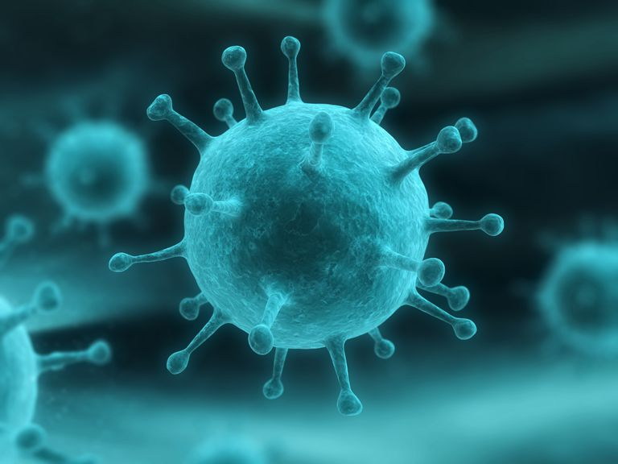
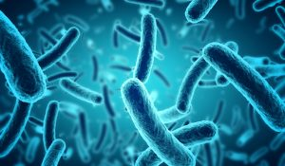
Germs under a microscope

Slide 7
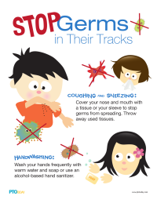
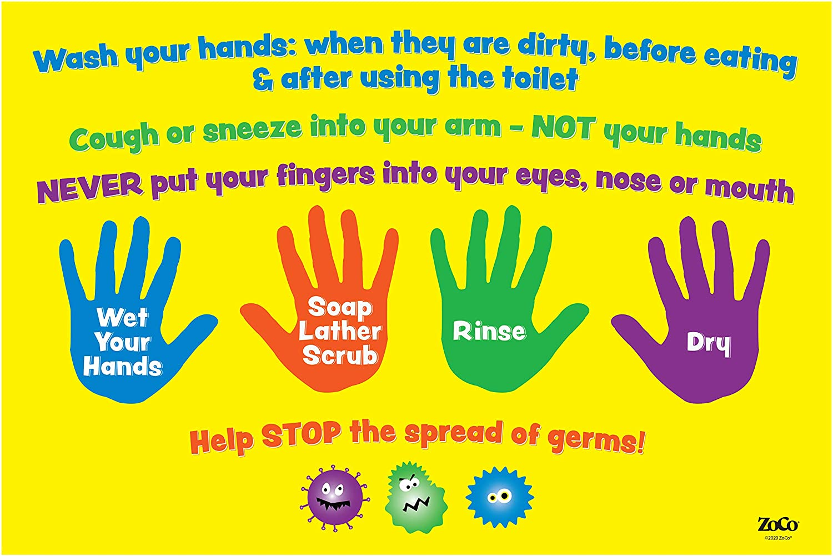
How do we stop germs spreading?
Watch the youtube clip below and think about what your family can do at home to prevent the spread of germs …
Maybe you could make a poster to remind everyone what they must remember to do!
https://www.youtube.com/watch?v=ghLkwSlWSXw

Slide 8
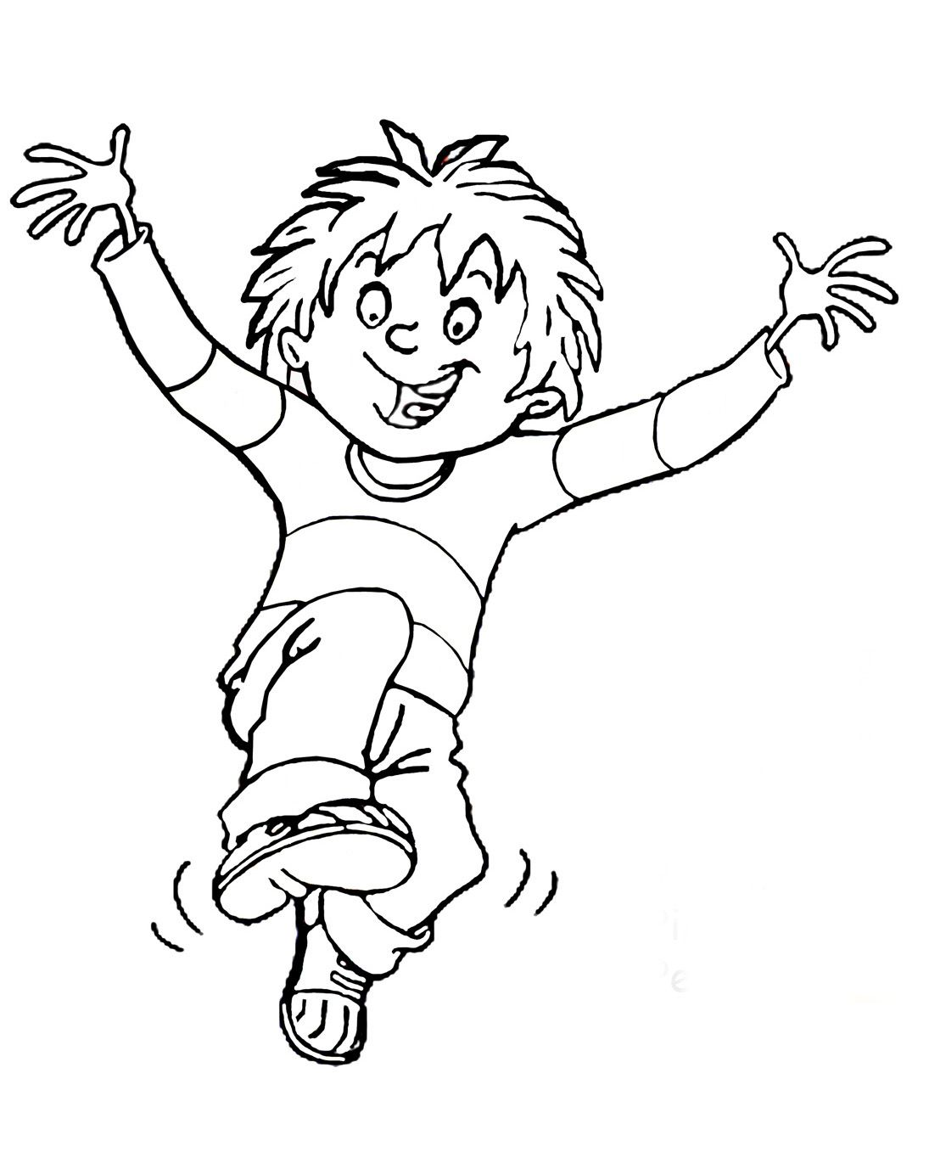
Colour in Horrid Henry and make his hands look dirty!
(Colouring sheet uploaded in the Week 6 topic folder)
Oh no! Henry has dirty hands with lots of germs because he has not washed his hands with soap and water!

Slide 9
Exercise 2
Tuesday
https://app.gonoodle.com/activities/what-makes-you-beautiful?s=Channel&t=Zumba%20Kids&sid=2&cs=zumba-kids

Slide 10
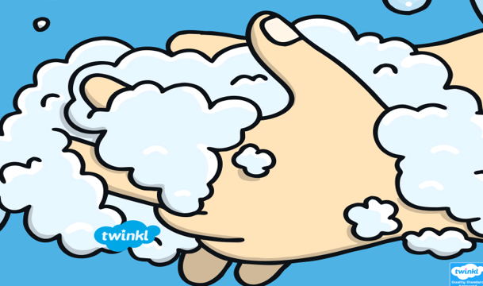
Lesson 2 – Washing your hands

Slide 11
Washing your hands
https://www.youtube.com/watch?v=S9VjeIWLnEg
Watch the youtube clip above and practise washing your hands at home. It is important not to just give them a ‘quick swill’.

Slide 12
What Are Germs?
Washing your hands helps to remove germs. Germs are very, very tiny – they are so small we cannot see them.
Some germs can make us poorly. Washing our hands stops the germs from spreading or getting inside our bodies and making us feel ill.

Slide 13
When Should You Wash Your Hands?

Slide 14

When Should You Wash Your Hands?
It is important to wash your hands…
before eating
before touching food (e.g. cooking activities)
after going to the toilet
after blowing your nose, sneezing or coughing
after touching your pets or other animals
after playing outside
after playing with messy toys (e.g. playdough)

Slide 15
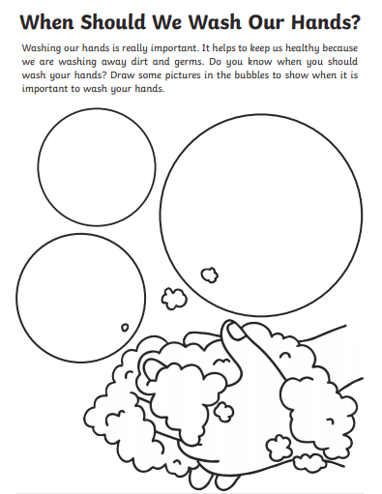

Slide 16
How to wash your hands
https://www.google.com/search?q=howto+wash+your+hands+kids&rlz=1C1GCEU_en-GBGB821GB821&oq=howto+wash+your+hands+kids&aqs=chrome..69i57j0.8211j0j7&sourceid=chrome&ie=UTF-8#kpvalbx=_UKnDXvGpLc76gAbql4OADA100

Slide 17
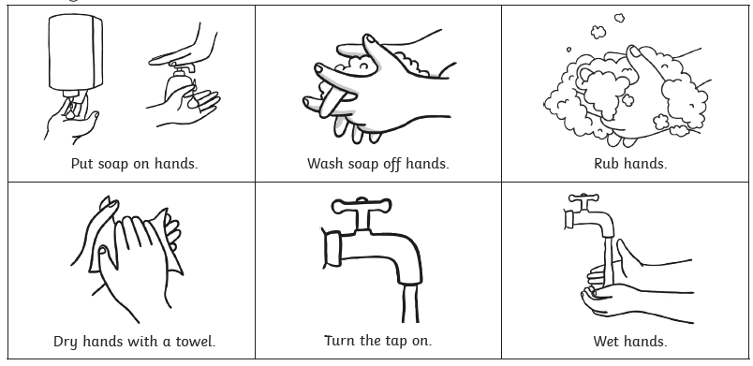
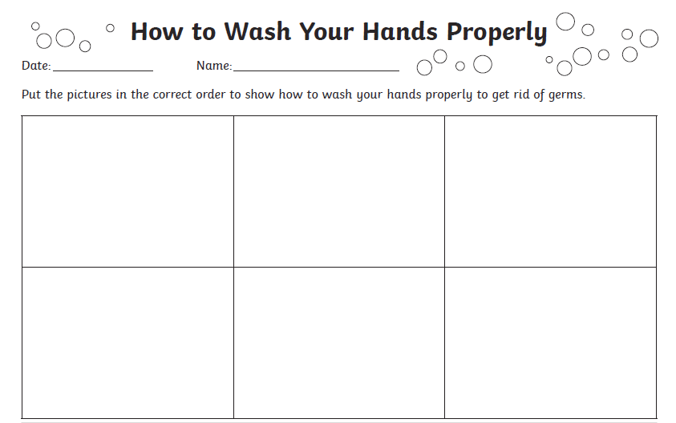
Cut out the squares and put them in the correct order
These sheets have been uploaded into the Week 6 topic folder for you to try at home. If you can’t print this out, i’m sure you could have a go at drawing your own pictures to sort into the correct order!

Slide 18
Exercise 3
Wednesday
https://app.gonoodle.com/activities/happy?s=Channel&t=Zumba%20Kids&sid=2&cs=zumba-kids

Slide 19
Lesson 3
How can we stop germs spreading?

Slide 20
How can we stop germs spreading?
https://www.youtube.com/watch?v=YBGsoimPXZg

Slide 21
Spreading Germs
Germs spread.
It’s a fact and we can’t stop it, but we can try to minimise their spread.
How can we stop germs from spreading?
covering our mouths when we sneeze or cough;
not sharing water bottles, etc;
not coming to school if you have a tummy bug and have been sick;
try not to touch our eyes, noses and mouths too much.

Slide 22
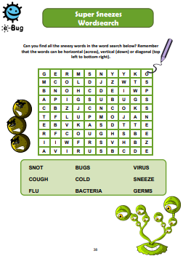

Slide 23
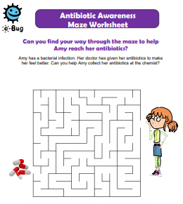

Slide 24
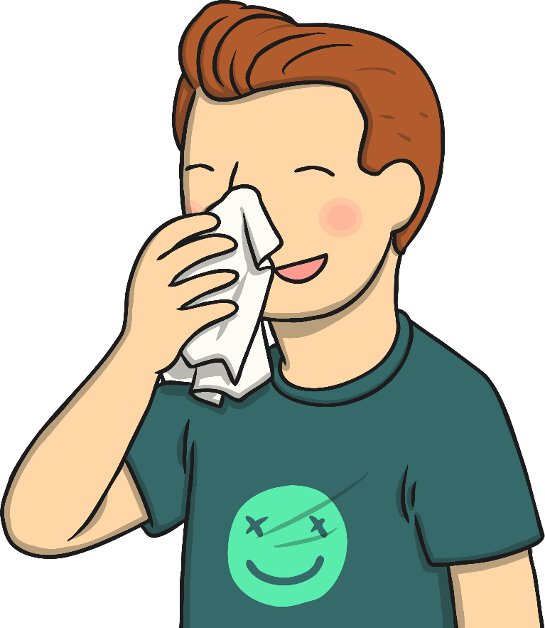
Keeping Our Noses Clean
Have you ever had a really runny nose? Or has it been really blocked and you feel like you can’t breathe through it?
It’s a horrible feeling, but we have all been there!
The only acceptable way of dealing with this is a tissue.
Sniffing, picking, wiping with sleeves… YUCK!

Slide 25
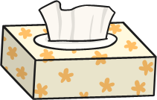
Using a Tissue
Dirty tissues must be binned or flushed down a toilet straightaway!
Don’t share used tissues with others.
Wash your hands after using a tissue.

Slide 26
Exercise 4
Thursday
https://app.gonoodle.com/activities/beat-go-pop?s=Channel&t=Zumba%20Kids&sid=2&cs=zumba-kids

Slide 27
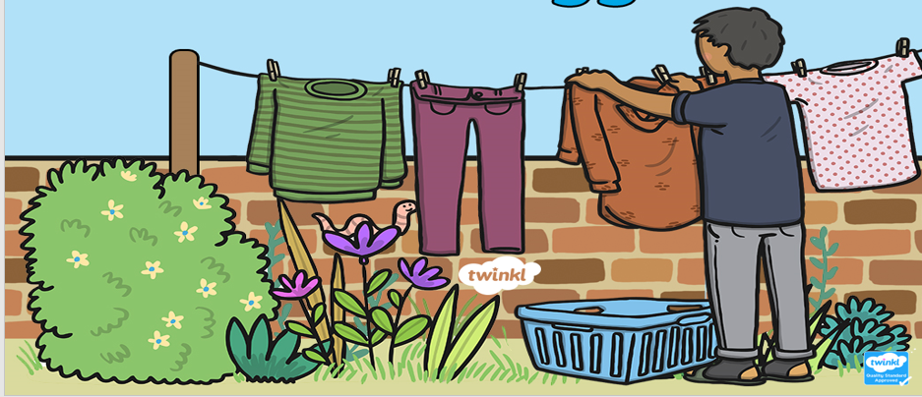
Lesson 4 personal hygiene

Slide 28

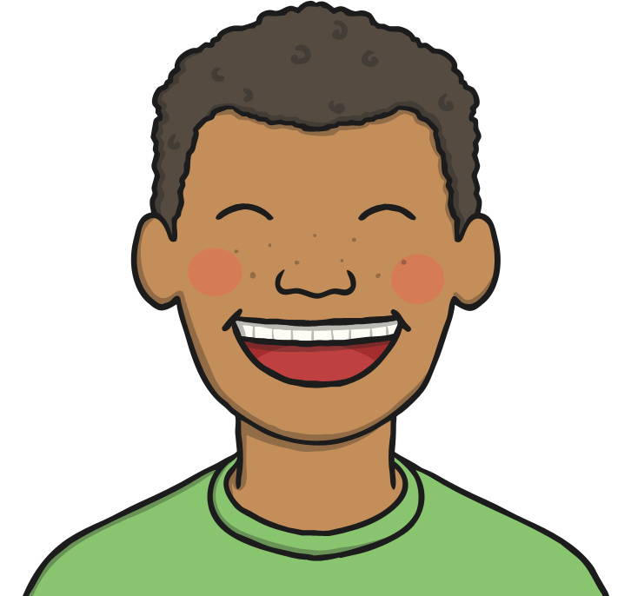
What Is Personal Hygiene?
Personal hygiene is how we look after our bodies. Keeping ourselves clean and tidy makes us feel better about ourselves and also keeps us, and those around us, healthier!

Slide 29
What Does It Include?
Brushing our teeth;
Washing our hands;
Showering or bathing regularly;
Keeping our noses clean;
Stop the spread of germs where we can!

Slide 30
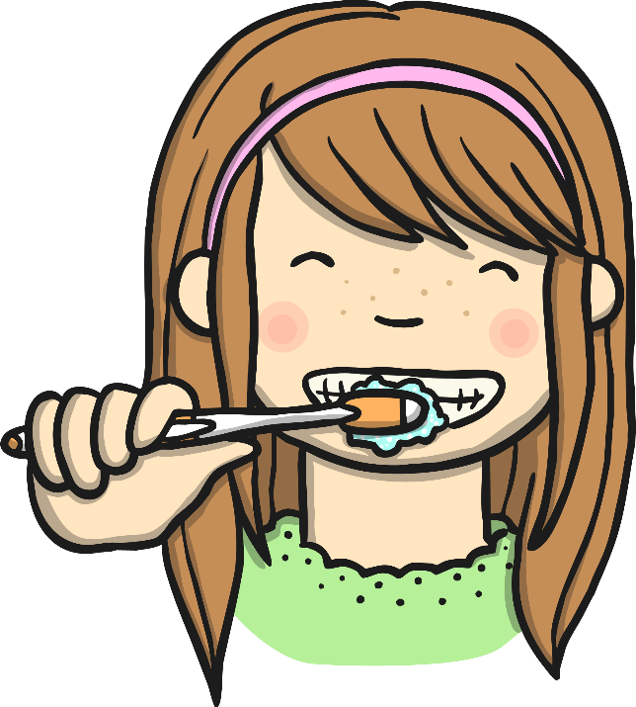
Brushing Our Teeth
It is recommended that we brush our teeth twice a day, for around
2 minutes.
We should visit the dentist every 6 months for a check up.
Brushing properly removes plaque. Plaque can cause cavities, toothache, gum disease and even our teeth to fall out!
It also gives us lovely fresh breath!

Slide 31
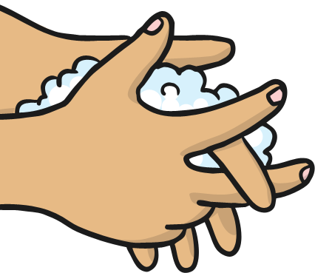
Washing Our Hands
Washing our hands is one of the simplest ways we can keep ourselves and those around us healthy.
Think about everything your hands touch in a day…
Computers screens and keyboards
Door handles and stair banisters
Toilet flushes
How many other people have touched these things too!

Slide 32

Don’t Forget About Your Nails
When washing our hands, it is important to keep our nails clean. Underneath our fingernails is a great place for germs to hide!
It’s best to keep your nails neatly trimmed and clean!
And try not to bite them…….

Slide 33
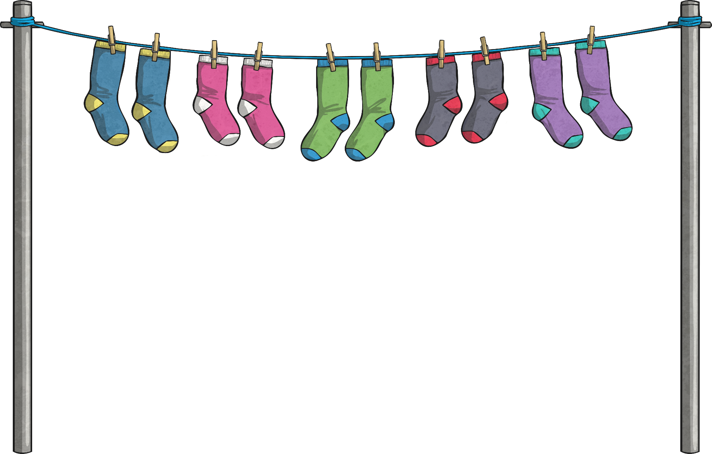
Don’t Forget Your Underwear!
Underwear covers our personal parts, which can get the most sweaty.
This includes socks!! Our feet are covered in sweat glands and can get sweaty and smelly as we’re on our feet a lot!
Remember to change your socks and underwear every day!
Don’t leave them on your bedroom floor! YUCK!

Slide 34
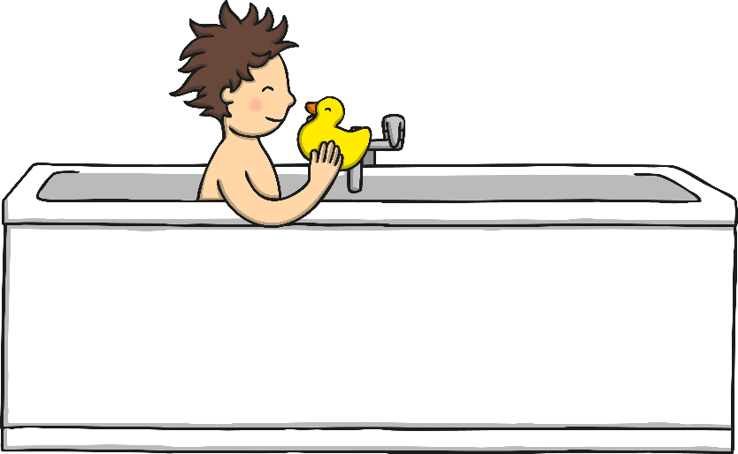
Showering or Bathing Regularly
When bathing or showering, remember to clean yourself properly
Remember to clean all over your body including our arms, between our legs and those feet with all the sweat glands!
To keep your hair clean, use shampoo.

Slide 35
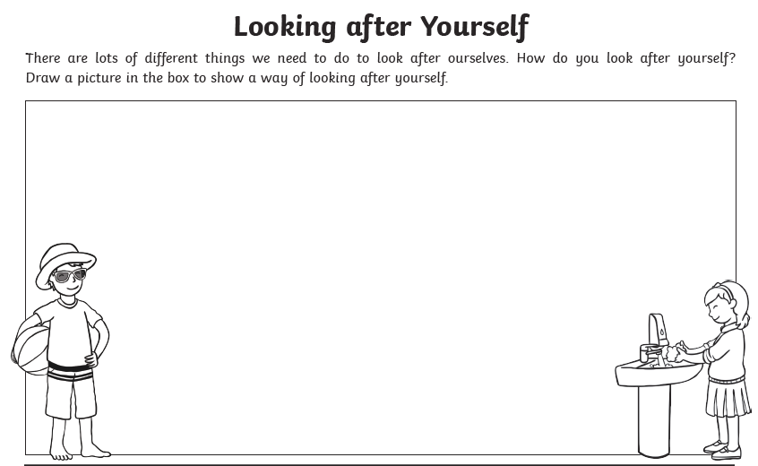
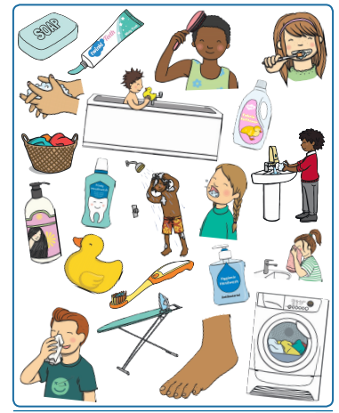
These worksheets can be downloaded from the week 6 topic folder.

Slide 36
Exercise 5
Friday
https://app.gonoodle.com/activities/good-energy-flow?s=Discover&t=Wo5/18/20-FP-4A-Featured%20on%20GoNoodle%20TUESDAY&sid=1774&x=4&y=1&mft=simple%20row

Slide 37

Lesson 5 - No worries
https://www.youtube.com/watch?v=nbY_aP-alkw

Slide 38
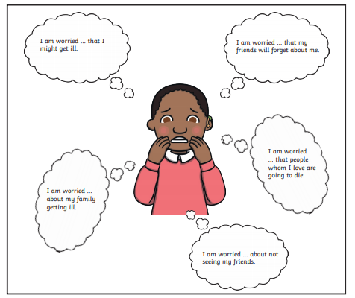
This is Jack. How do you think Jack is feeling?

Slide 39
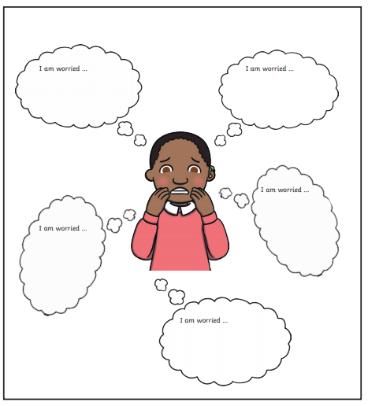
How are you feeling?

Slide 40
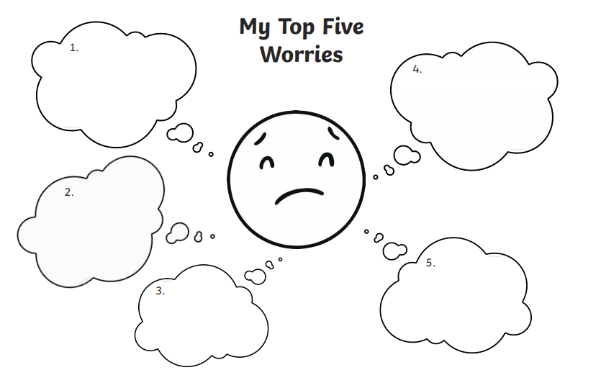
Have a think about any worries you may have. Remember not to keep your worries to yourself. It is always good to talk to someone as they are likely to be able to help you!

Slide 41
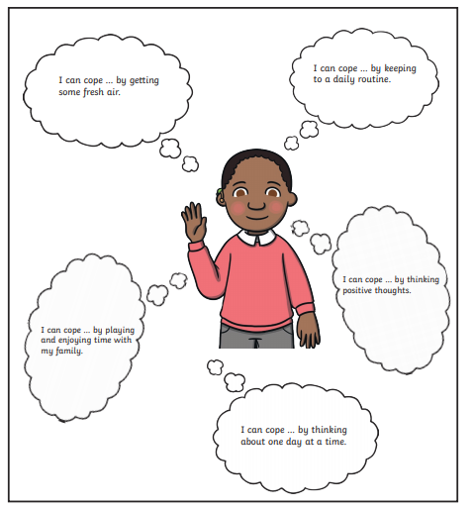
Jack thinks of ways to help himself feel better

Slide 42
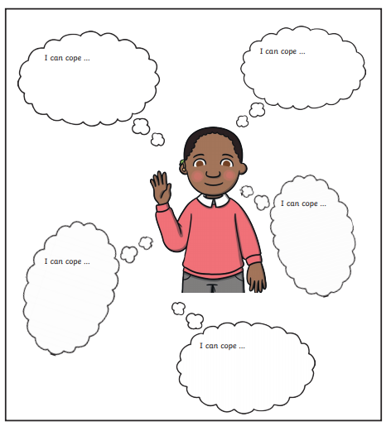
Ways I can help myself feel better

Slide 43


