Slide 1
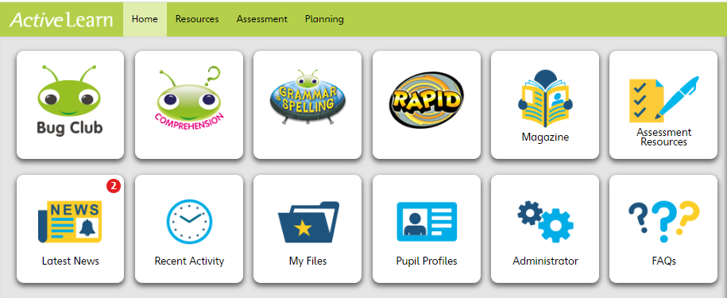
Active Learn
Bug Club – Online reading resource

Slide 2
Guide for parents
How to use Bug Club
For the remaining weeks of home learning we would like you to encourage your child to read using Bug Club.
Your child has been allocated a set amount of books to read by their class teacher at the relevant book band level.
We would also really encourage you to continue using this resource over the summer holidays to continue their reading. ☺

Slide 3
Login details
You will have received a letter telling you what your child’s individual login details are. Here is an example:
Child’s name: Joe Bloggs
Username: 18JoeB (Capital letters for first initial of first and last name)
Password: 1Rabc (If your child is in Class 1T it would be 1Tabc)
To access the site you will need to follow the link below:
https://www.activelearnprimary.com.au/login?e=-1&c=0

Slide 4
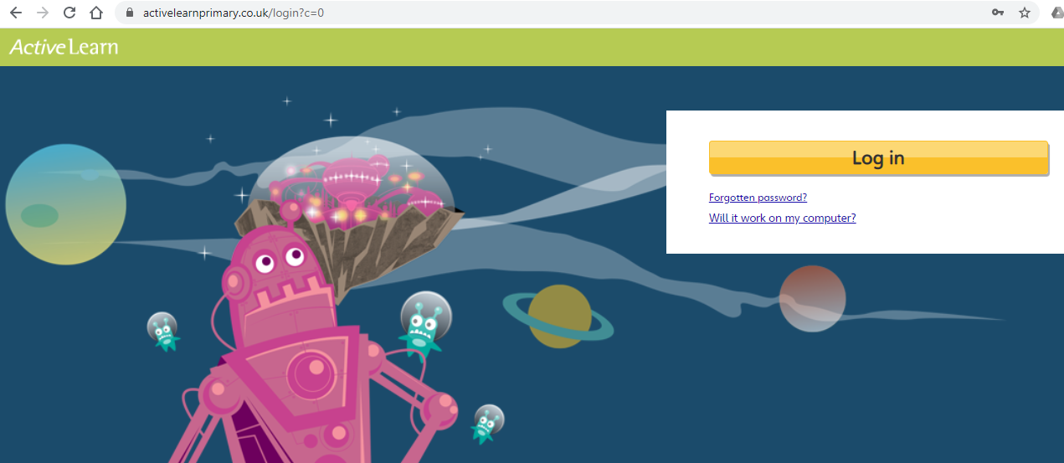
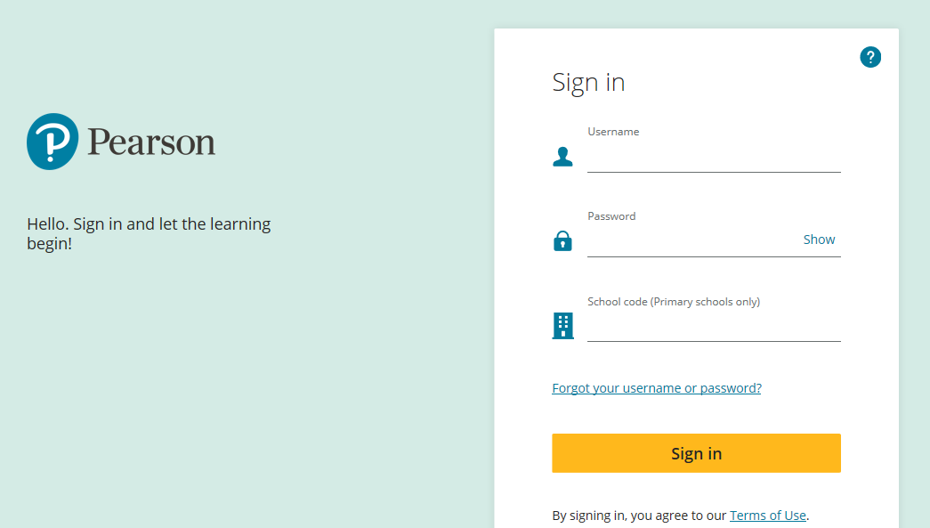
Using Active Learn
https://www.activelearnprimary.com.au/login?e=-1&c=0
When following the link, you will appear on the home page.
Click ‘Log in’
Username: 18JoeB
(Your child’s individual username)
Password: 1Tabc (if your child is in Class 1T)
1Rabc (if your child is in Class 1R)
St. Catherine’s school code: mwtj

Slide 5
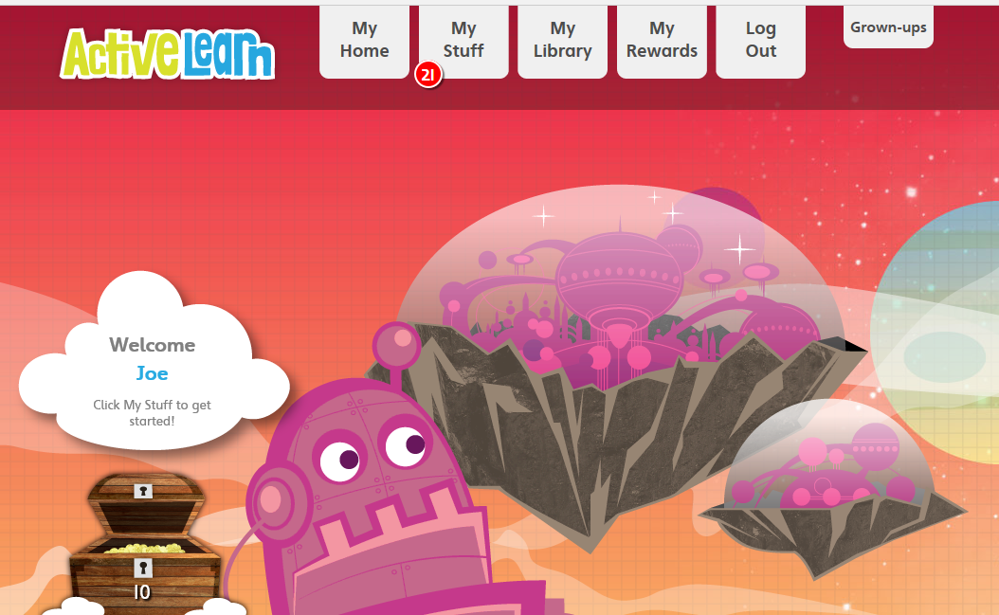
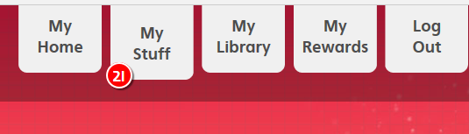
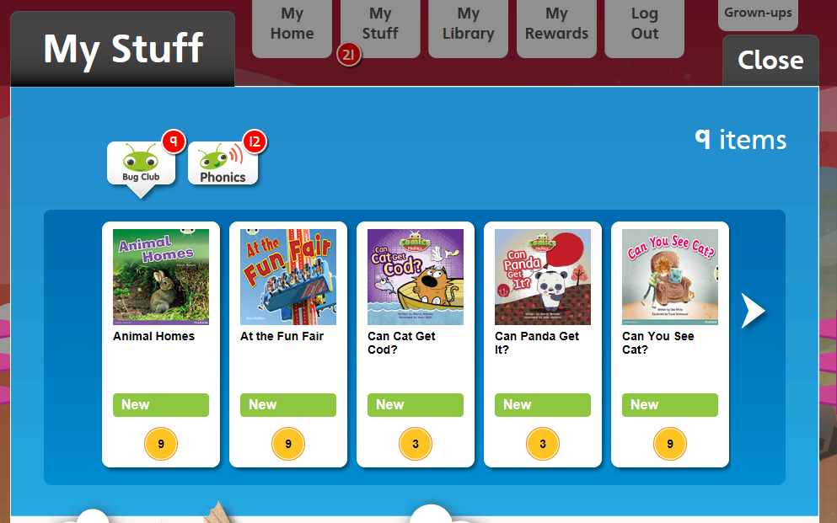
Using Active Learn
When you have logged on successfully, you will be redirected to this page.
You will notice that there is a ‘number’ under the section ‘My Stuff’. This is the amount of books that have been allocated by your child’s class teacher to read over a period of time.
** Your child can change their home screen by hovering over the ‘My Home’ tab. They can choose their own bug, race or future world. **
** Please note: Your child’s class teacher will allocate appropriate books to each child depending on their current ability. **
Allow your child to have a look through the allocated books and choose which one they would like to read each time.

Slide 6
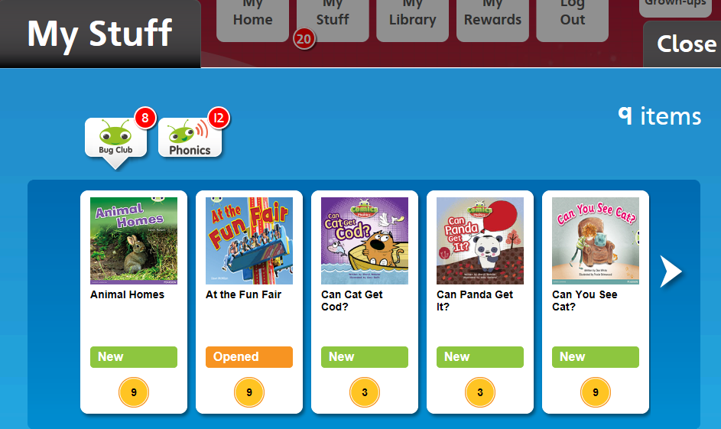
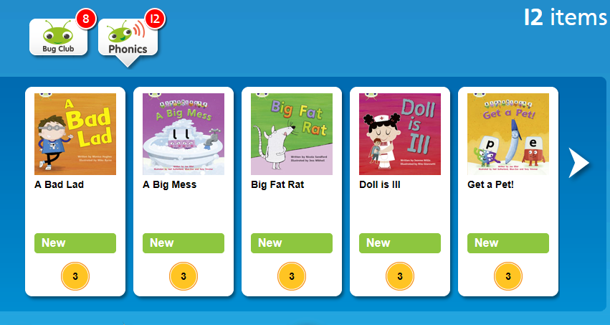
Bug Club & Phonics tab.
When you click on the Phonics tab it will give you the books that focus on the words that your child can read by using their phonics knowledge. These are phonetically plausible words. The children will be familiar with reading these books in school.

Slide 7
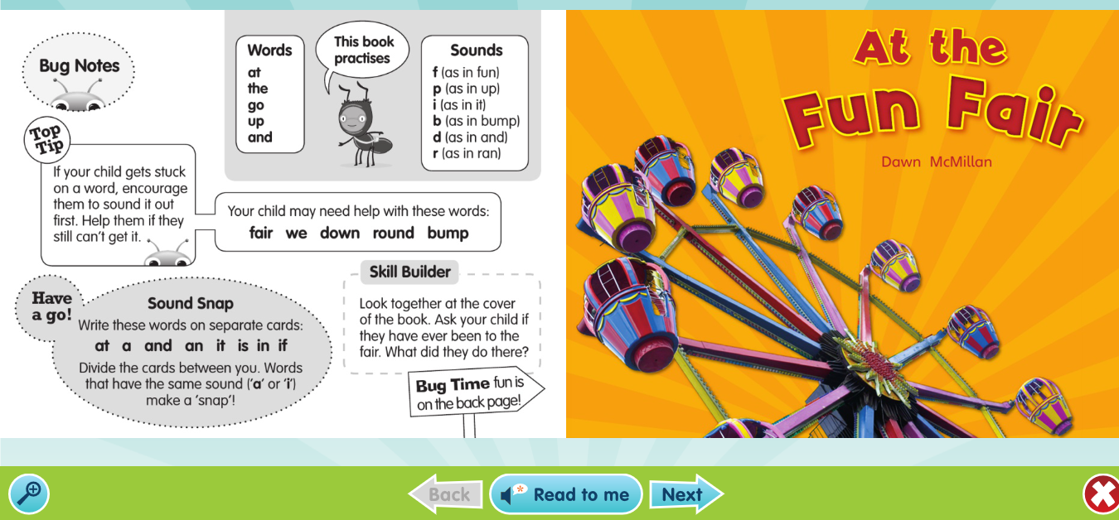
It is important to read the ‘bug notes’ page as it gives parents some guidance as to what you will find in the book and how to support your child’s reading. You will often have activities to try at the end of each book too. ☺
Simply use the navigation arrows to turn the pages.
You also have the option to hear the book being read by clicking on ‘Read to me’.

Slide 8
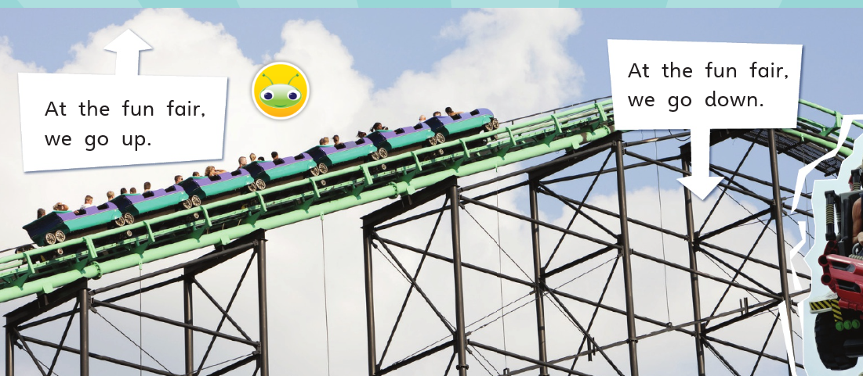
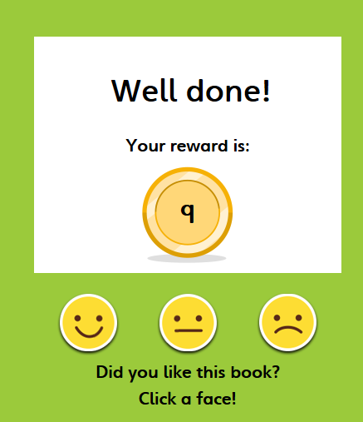
Throughout the book are ‘bugs’ to click on and answer some questions to earn active points. When the ‘bug’ is answered, return to the book to continue reading.
Some ‘bugs’ will require a written response which your child’s teacher will be able to see.
At the end of the book you will be able to see if all of the ‘bugs’ have been answered and your child can give it a ‘smiley face’ if they have enjoyed the book. Remember to have a discussion about why they liked it.
What was their favourite part? How did it make them feel?

Slide 9
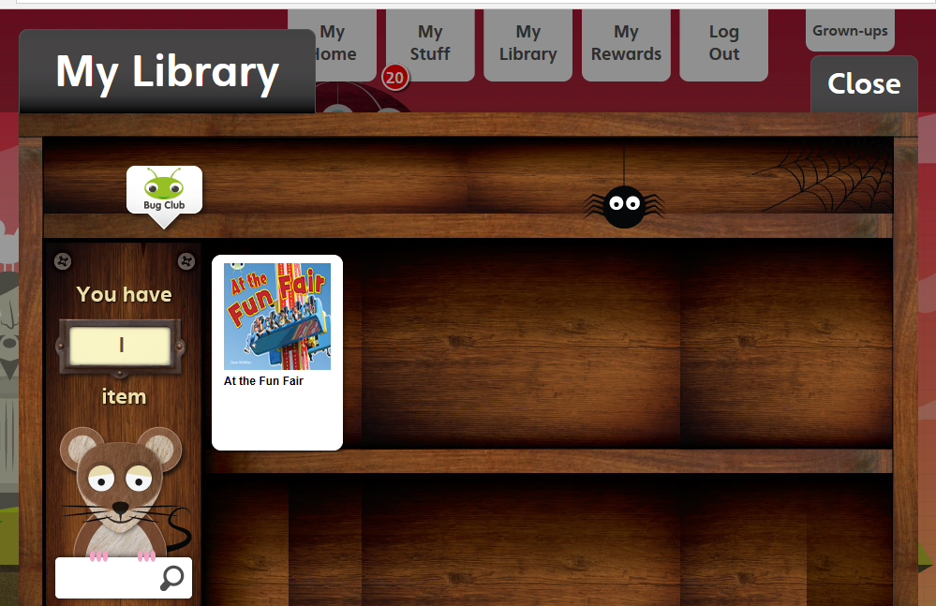
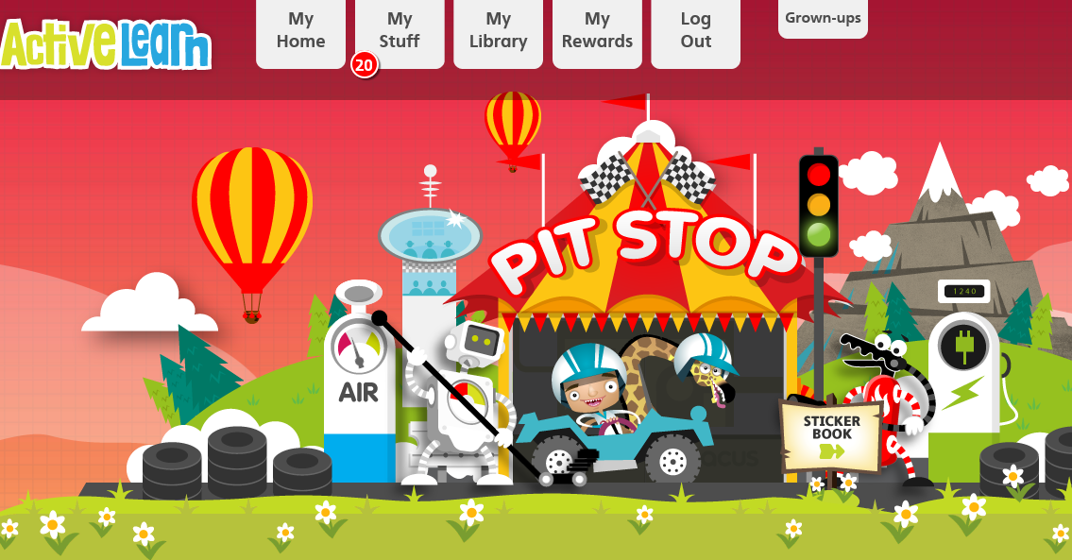

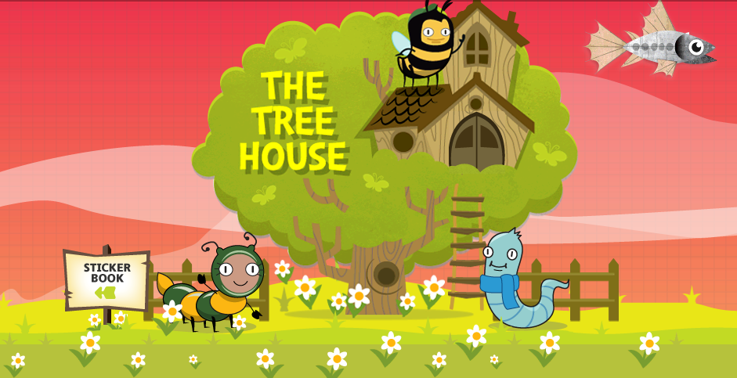
In the ‘My Library’ tab, you will find the books that your child has read. You can choose to re-read these books at any time.
(Remember we strongly recommend that your child re-reads each book to improve pace, fluency, confidence and comprehension.
You can click on ‘My rewards’ for your child to choose how they are going to spend their ‘active points’ and play games as a reward for reading so well.
This is a great way to encourage children to persevere throughout the week as they will then get to play a game at the end.
They can do races in the pit stop, collect stickers in the sticker factory or add items to a tree house. ☺

