Slide 1

Year 1 Maths
Week 10 & 11
29/6/20 and 6/7/20

Slide 2
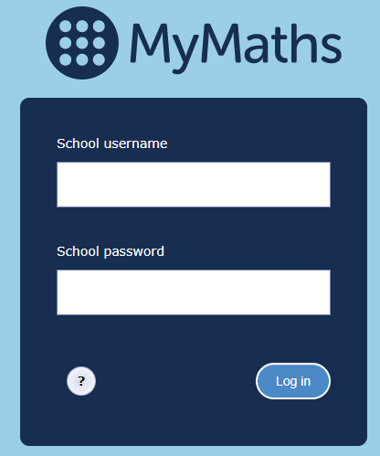
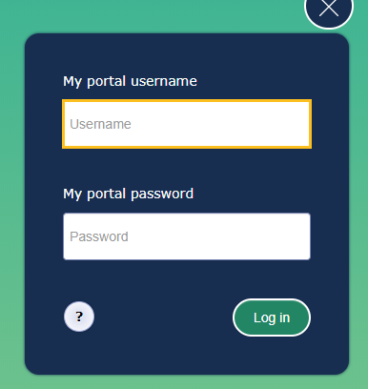
For the next 2 weeks we are going to continue learning about time.
Each day go to the MyMaths website https://login.mymaths.co.uk/login and log in with the school’s username and password.
You then need to login with your own personal details which were sent to you in the first home learning pack. If you have lost yours, please contact the school office.

Slide 3
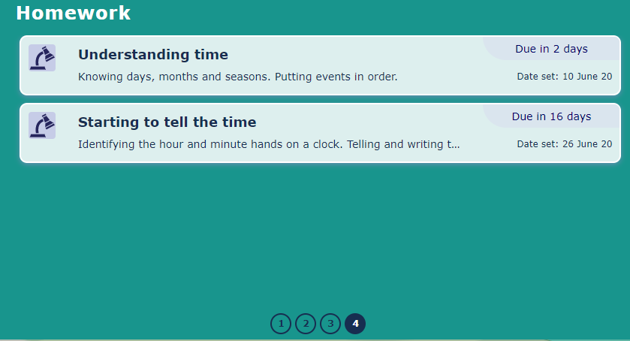
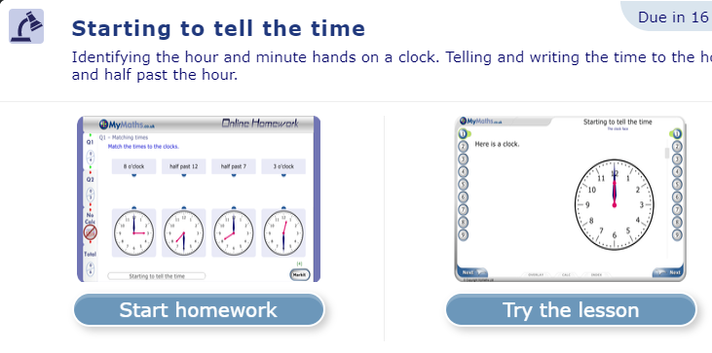
Week 1
Once you have logged in click on ‘Starting to tell the time’.
Please note you will find this lesson on the last page.
Last page
Then click on ‘Try the lesson’.
Please follow the instructions on this Powerpoint presentation to see which parts of the lesson you need to complete each day ☺

Slide 4
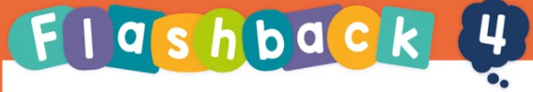
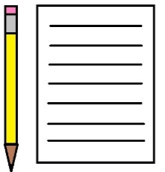
Each day we have set four flashback questions for you to complete. These four questions are based on what we have already learnt.
Complete the flashback questions before starting your MyMaths lesson.
You will need a piece of paper to jot down your answers.
The answers to each set of questions are on the following slide.

Slide 5
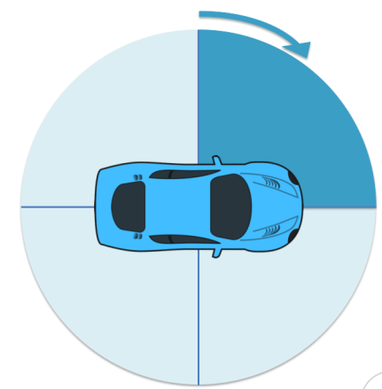
Monday
Here are 4 questions based on what we have already learnt.
Write numbers 1 – 4 on a piece of paper and have a go at working out the answers.
1. What is 16 + 2 ?
2. Has the car turned clockwise
or anti-clockwise?
3. What is 20 - 6?
4. If today is Monday, what day was it yesterday?

Slide 6
Monday
Answers. Mark your own work ☺
1. What is 16 + 2 ? 18
2. Has the car turned clockwise
or anti-clockwise?
clockwise
3. What is 20 - 6? 14
4. If today is Monday, what day was it yesterday?
Sunday

Slide 7
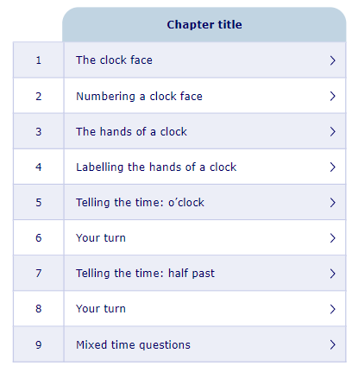
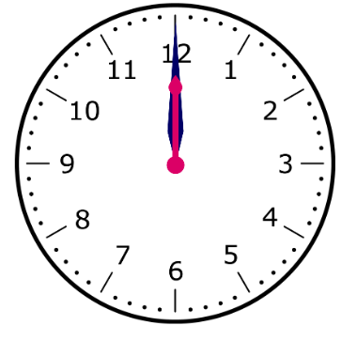

Monday
Today we are going to complete sections 1 and 2:
The clock face.
Numbering a clock.
Look on the next slide for an extra activity.

Slide 8
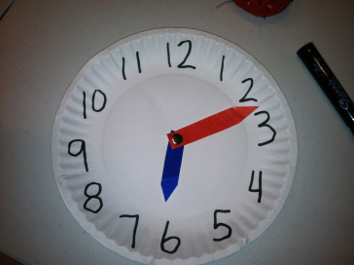
Monday
The clock face.
Have a go at making your own clock face. You will need:
A piece of paper and something circular to draw around (or a paper plate)
A pencil
Scissors
A split pin (ask an adult for help)

Slide 9
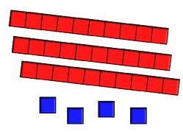
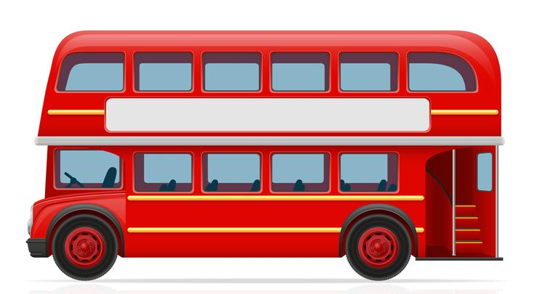
Tuesday
Here are 4 questions based on what we have already learnt.
Write numbers 1 – 4 on a piece of paper and have a go at working out the answers.
What number is being represented by
the dienes?
2. How many months are there in the year?
3. What is double 8?
4. 5 people were on the bus. 4 more got on.
How many people are on the bus now?

Slide 10
Tuesday
Answers. Mark your own work ☺
What number is being represented by
the dienes? 34
2. How many months are there in the year? 12
3. What is double 8? 8 + 8 = 16
4. 5 people were on the bus. 4 more got on.
How many people are on the bus now?
5 + 4 = 9

Slide 11
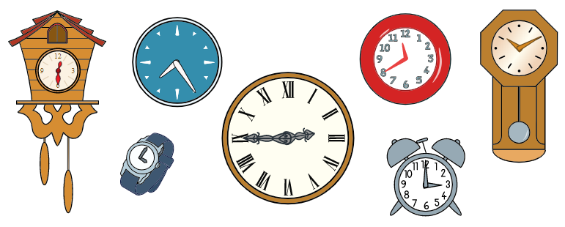
Tuesday
Today we are going to complete sections 3 and 4:
The hands of a clock.
Labelling the hands of a clock.
Look on the next slide for an extra activity.

Slide 12

Tuesday
Explore your house. How many clocks can you find? What is the same about them? What is different?

Slide 13
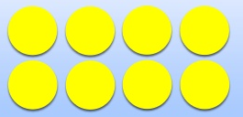
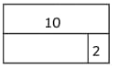
Wednesday
Here are 4 questions based on what we have already learnt.
Write numbers 1 – 4 on a piece of paper and have a go at working out the answers.
Which number sentence is correct?
10 + 3 = 13 10 – 3 = 13
2. Here are 8 counters.
How many groups of 2 could you make?
3. What number comes next?
40, 50, 60, 70, ____
4. What is the missing number in the bar
model?
?

Slide 14
Wednesday
Answers. Mark your own work ☺
Which number sentence is correct?
10 + 3 = 13 10 – 3 = 13
2. Here are 8 counters.
How many groups of 2 could you make?
3. What number comes next?
40, 50, 60, 70, 80
4. What is the missing number in the bar
model?
8

Slide 15
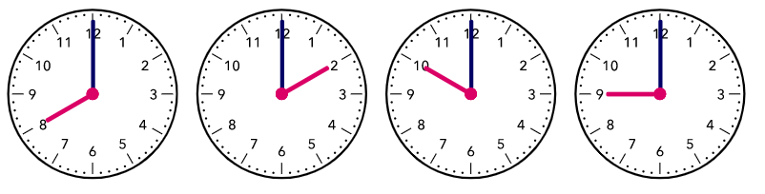
Wednesday
Today we are going to complete sections 5 and 6:
Telling the time: o’clock.
Your turn.
Look on the next slide for an extra activity.

Slide 16
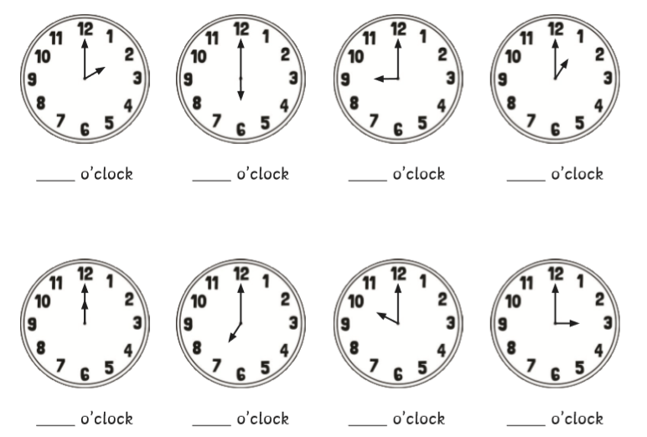
Wednesday
Can you write the times shown on a piece of paper?

Slide 17
Wednesday
Here are the answers.
2
6
9
1
12
7
10
3

Slide 18
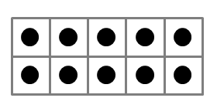
Thursday
Here are 4 questions based on what we have already learnt.
Write numbers 1 – 4 on a piece of paper and have a go at working out the answers.
Which month comes after July?
2. Which number is being represented
by the ten frames?
3. What is 3 less than 20?
4. Write down all the numbers between 18 and 25.

Slide 19
Thursday
Answers. Mark your own work ☺
Which month comes after July? August.
2. Which number is being represented
by the ten frames? 30
3. What is 3 less than 20? 17
4. Write down all the numbers between 18 and 25.
18 19 20 21 22 23 24 25

Slide 20
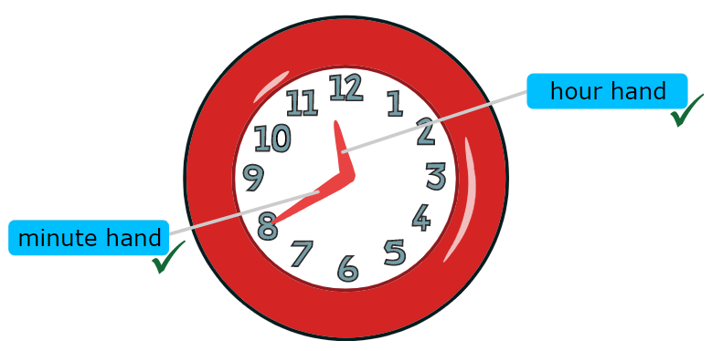
Thursday
Today we are going to practice telling the time.
Look on the next slide for your activity.

Slide 21
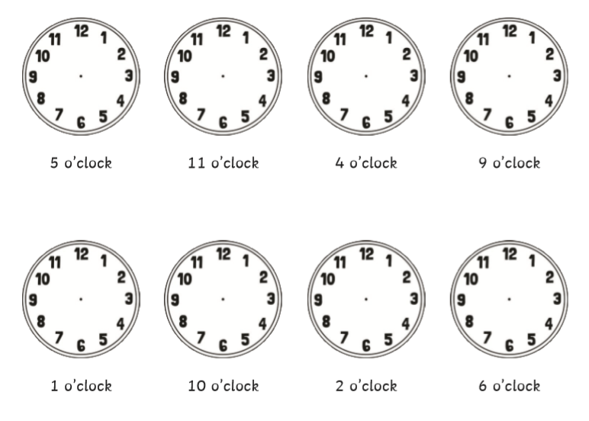
Thursday
Below are some o’clock times. You could print this slide or have a go at drawing your own little clocks (try and find something circular to draw around). Can you draw the hands on the clock to show the time?

Slide 22
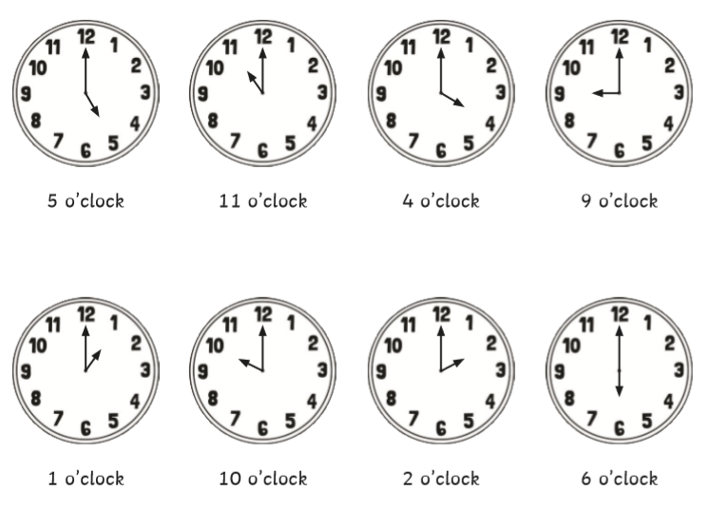
Thursday
Here are the answers.

Slide 23
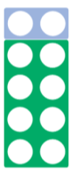
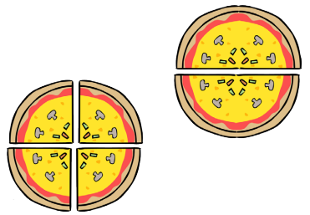
Friday
Here are 4 questions based on what we have already learnt.
Write numbers 1 – 4 on a piece of paper and have a go at working out the answers.
1. Which number bond to 10 is being represented?
2. What is 16 plus 4?
3. What is 16 – 4?
4. Which pizza has been cut
into quarters?
b
a

Slide 24
Friday
Answers. Mark your own work ☺
1. Which number bond to 10 is being represented?
8 + 2 = 10 or 2 + 8 = 10
2. What is 16 plus 4? 20
3. What is 16 – 4? 12
4. Which pizza has been cut
into quarters? A
B
A

Slide 25
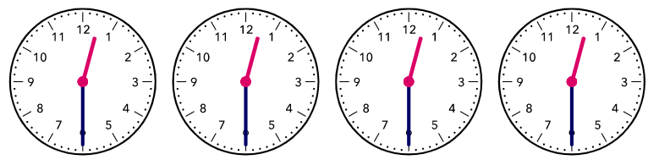
Friday
Today we are going to complete sections 7 and 8:
Telling the time: half past.
Your turn.
Look on the next slide for an extra activity.

Slide 26
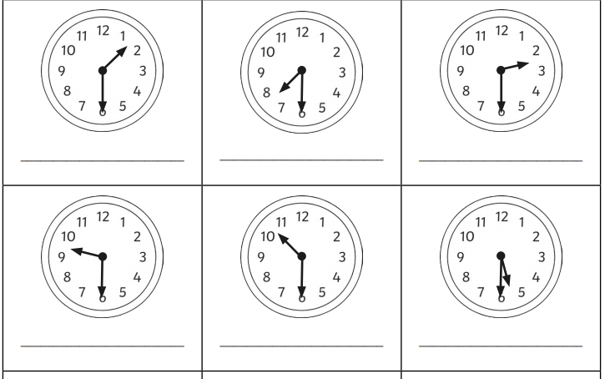
Friday
Can you write the times shown on a piece of paper?

Slide 27
Friday
Here are the answers.
half past 1
half past 7
half past 2
half past 9
half past 10
half past 5

Slide 28
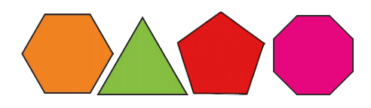
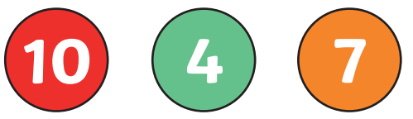
Week 2
Monday
Here are 4 questions based on what we have already learnt.
Write numbers 1 – 4 on a piece of paper and have a go at working out the answers.
Which shape is a triangle?
2. Which number comes next?
45, 40, 35, 30, 25, ____
3. Find the total of 6 and 3.
4. Which 2 numbers make 14?
A
B
C
D

Slide 29
Monday
Answers. Mark your own work ☺
Which shape is a triangle? B
2. Which number comes next?
45, 40, 35, 30, 25, 20
3. Find the total of 6 and 3. 6 + 3 = 9
4. Which 2 numbers make 14?
A
B
C
D
10 + 4 = 14

Slide 30
Week 2
Monday
Today we are going to practice telling the time.
Look on the next slide for your activity.

Slide 31
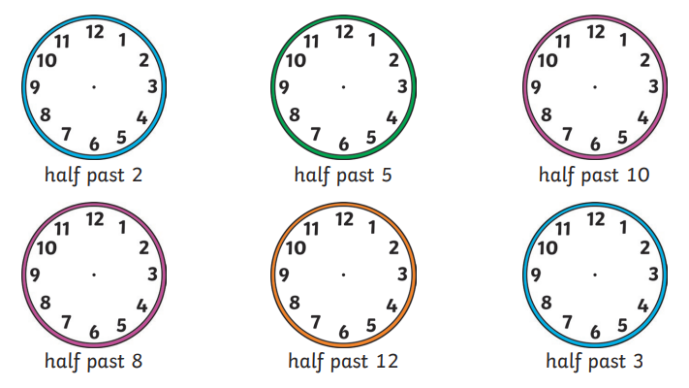
Monday
Below are some half past times. You could print this slide or have a go at drawing your own little clocks (try and find something circular to draw around). Can you draw the hands on the clock to show the time?

Slide 32
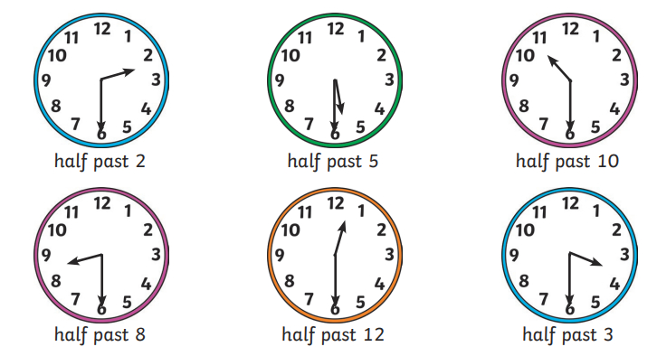
Monday
Here are the answers.

Slide 33
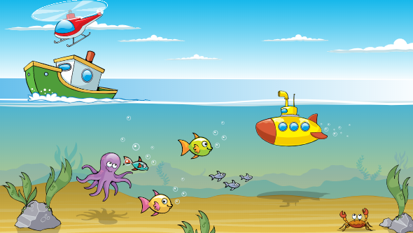
Tuesday
Here are 4 questions based on what we have already learnt.
Write numbers 1 – 4 on a piece of paper and have a go at working out the answers.
The submarine is ________ the
water.
2. What is 10 – 0?
3. What is 2 + 2 + 2 + 2?
4. Which number sentence is correct?
10 + 9 = 19 10 + 9 = 18

Slide 34
Tuesday
Answers. Mark your own work ☺
The submarine is under the
water.
2. What is 10 – 0? 10
3. What is 2 + 2 + 2 + 2? 8
4. Which number sentence is correct?
10 + 9 = 19 10 + 9 = 18

Slide 35
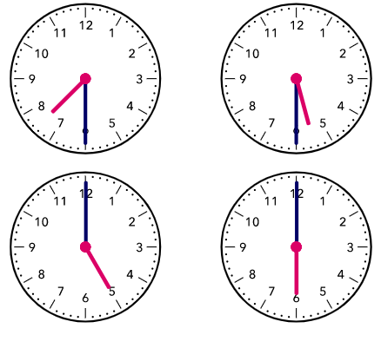
Tuesday
Today we are going to complete the questions in section 9:
Mixed time questions
Look on the next slide for an extra activity.

Slide 36
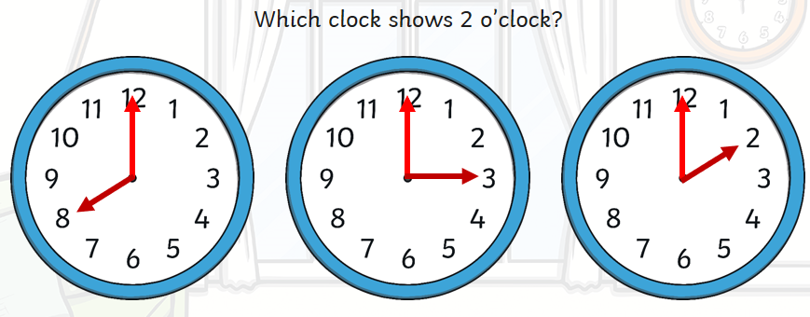
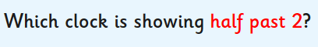
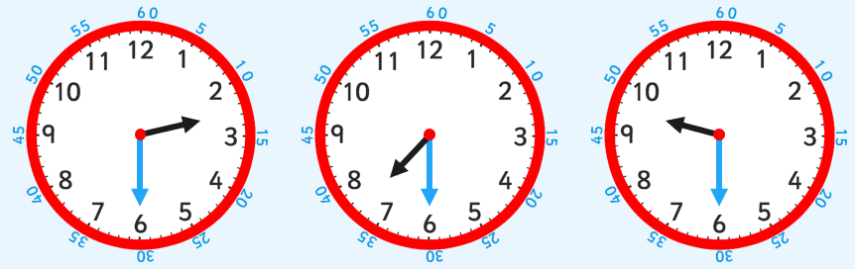
Tuesday

Slide 37
Tuesday
Here are the answers.

Slide 38
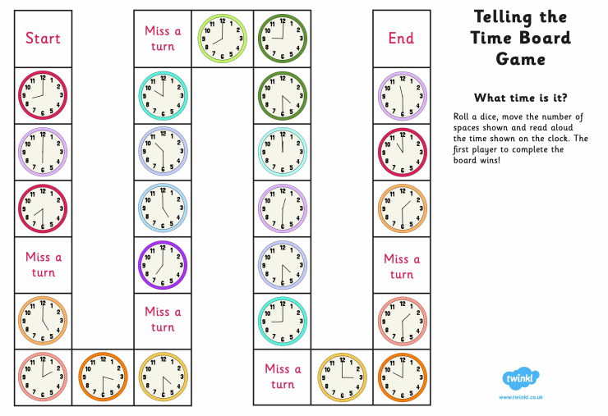
Tuesday
Here is a telling the time board game you might like to play with your family.

Slide 39
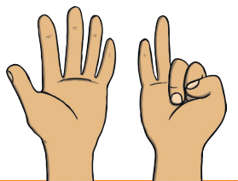
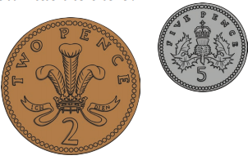
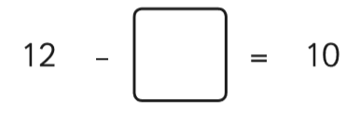
Wednesday
Here are 4 questions based on what we have already learnt.
Write numbers 1 – 4 on a piece of paper and have a go at working out the answers.
How do you write this number
as a word?
2. What is 15 - 5 ?
3. Can you add these coins together?
4. What is the missing number?

Slide 40
Wednesday
Answers. Mark your own work ☺
How do you write this number
as a word? seven
2. What is 15 - 5 ? 10
3. Can you add these coins together?
5p + 2p = 7p
4. What is the missing number?
2

Slide 41

Wednesday
Today we are going to complete the homework, which will recap on the learning from the past week on ‘Starting to tell the time’ .
Once you’ve logged in click on ‘Start homework’.

Slide 42
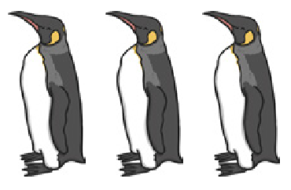
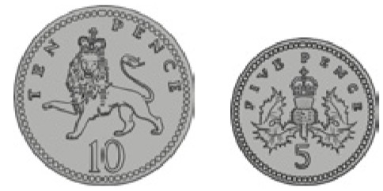
Thursday
Here are 4 questions based on what we have already learnt.
Write numbers 1 – 4 on a piece of paper and have a go at working out the answers.
1. How many feet are there on 3 penguins?
2. How many tens are there in 14?
3. What is the total of the coins?
4. What is 1 less than 20?

Slide 43
Thursday
Answers. Mark your own work ☺
1. How many feet are there on 3 penguins?
2 + 2 + 2 = 6
2. How many tens are there in 14? 1 ten
3. What is the total of the coins?
10p + 5p = 15p
4. What is 1 less than 20? 19

Slide 44

Thursday
Today we are going to think about measuring time. We can measure how long something takes.
Talk to your adult about 1 minute.
1 minute is the same as 60 seconds.
Using a clock face or stopwatch, sit still
and quiet for 1 minute (60 seconds)
Do you think 1 minute is a long time or a short time?
The lesson continues on the next page

Slide 45
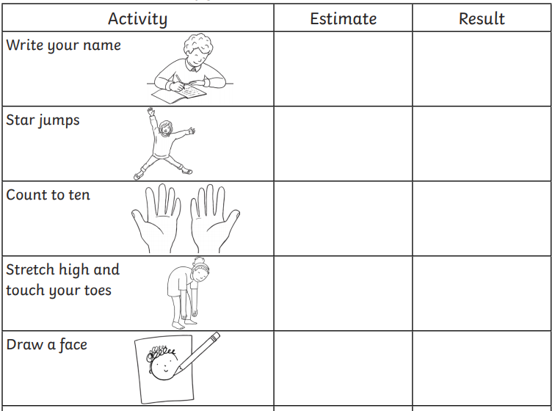
Thursday
What can you do in 1 minute?
Choose an activity. Estimate how many times you think you can do it in 1 minute.
Use a clock face or stopwatch to time yourself and see if you are correct.

Slide 46
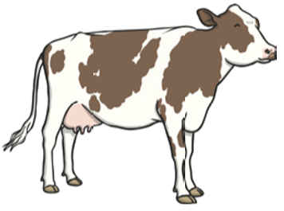
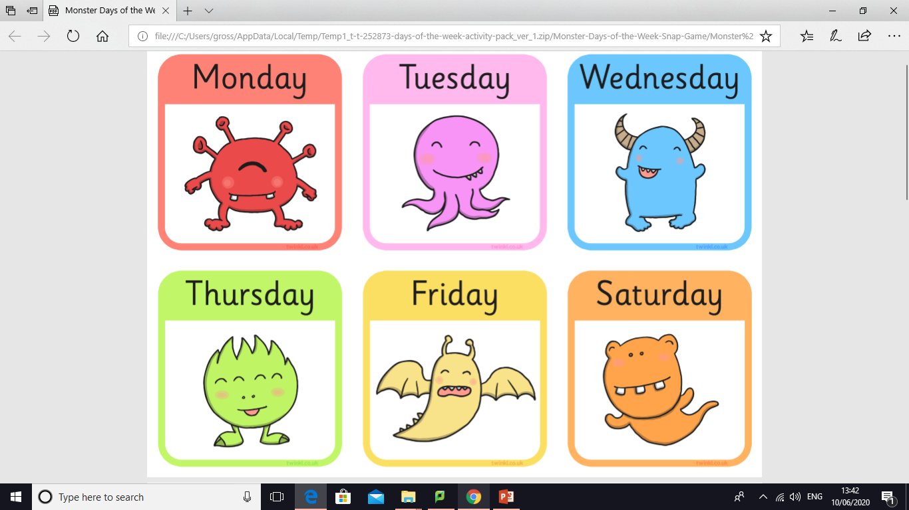
Friday
Here are 4 questions based on what we have already learnt.
Write numbers 1 – 4 on a piece of paper and have a go at working out the answers.
1. 5 is more than 15. True or false?
2. What is 6 + 4?
3. 10 cows are in the field. 7 of them leave.
How many are there now?
4. Which day of the week is next?

Slide 47
Friday
Answers. Mark your own work ☺
1. 5 is more than 15. True or false? False.
5 is less than 15
2. What is 6 + 4? 10
3. 10 cows are in the field. 7 of them leave.
How many are there now? 10 – 7 = 3
4. Which day of the week is next?

Slide 48
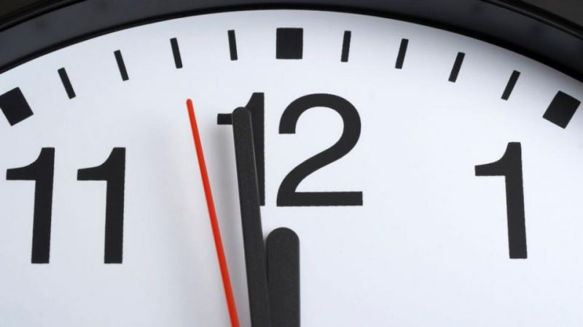
Friday
1 minute and 1 second.
We know how long 1 minute is. Look at a clock face with your adult. How long is one second?
1 second is very quick!
There are 60 seconds in 1 minute.
The lesson continues on the next page

Slide 49
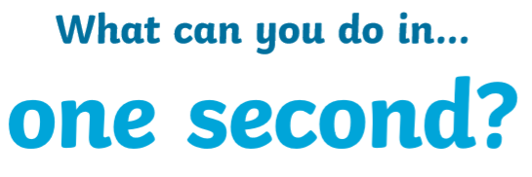
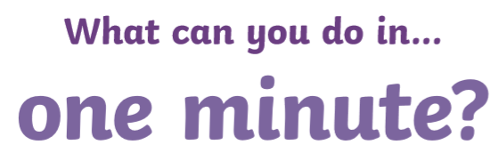
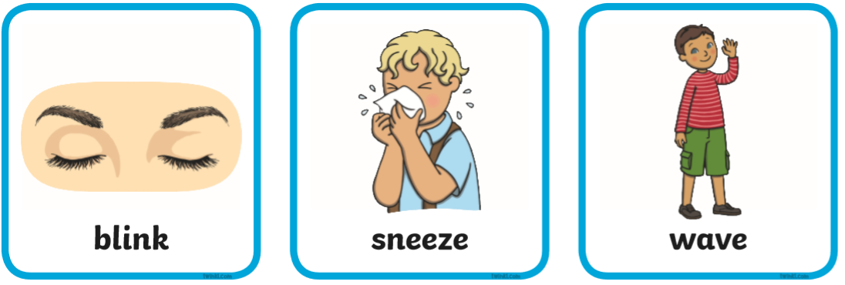
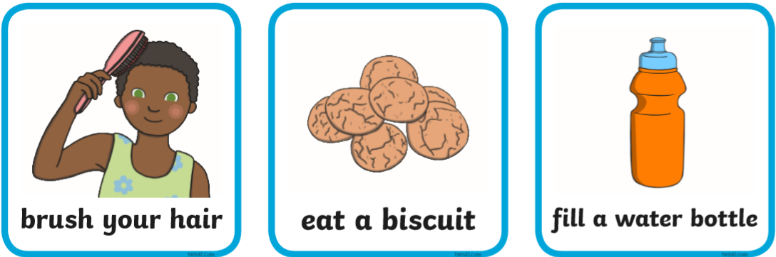
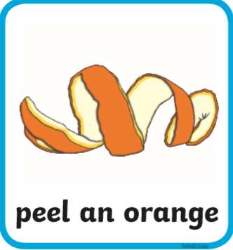
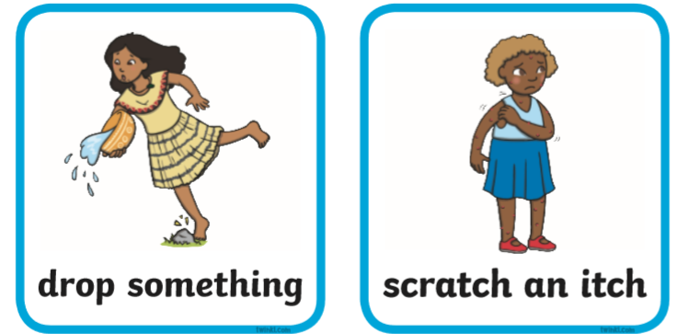
Friday
What can you do in 1 second? What can you do in 1 minute?
Look at the pictures and sort them into 1 second or 1 minute.
Talk about your choices with your adult.

Slide 50
Friday
Here are the answers ☺

Slide 51
If you have had a go at some or all of the tasks…
Well done!
We are really proud of you.

